Slide 1
Hadronic Rescattering
Without Hadron Rescattering
With Hadron Rescattering
UrQMD hadron cascade simulator is included in the simulation
(included in VISHNU by Chun-shen)
Hadron rescattering effect is tiny

Slide 2
Elliptic flow coefficient
Correction: take modulus of v_{n}
We now get reasonable elliptic flow coefficients

Slide 3
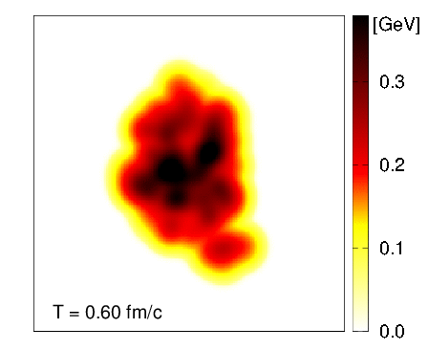
Parton splitting in QGP medium
QGP evolution is
extracted from the
VISHNU simulator
Working on
numerical
calculation of
parton splitting
function in the
medium based on
Ivan’s analytic calculation (q➔qg, g➔gg, g➔qq)
PLB 706 (2012) 371–378, JHEP 1703 (2017) 146

