Slide 1
Perturbative QCD

Slide 2
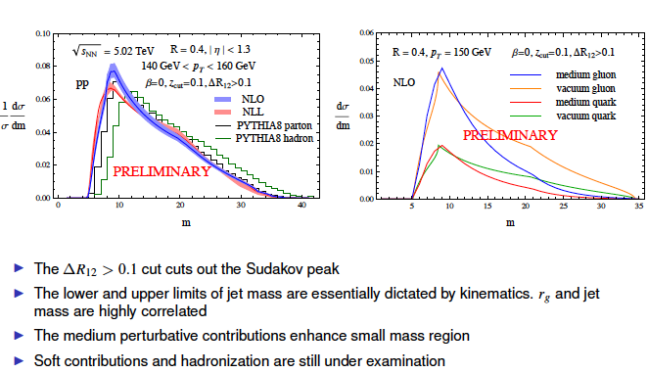
New observables in jets
Mass distribution modification in jets
Look at possible sensitivity to the soft sector of the theory

Slide 3

SCET_{G} to any number of correlated scatterings
Fully solved for elastic scattering
Progress made on inelastic

Slide 4
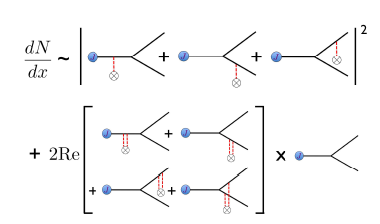
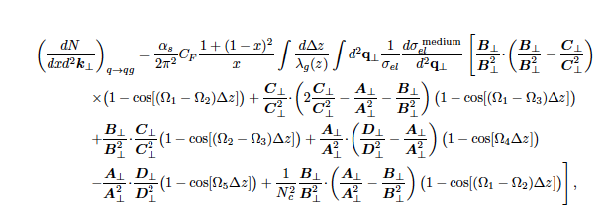
Splitting functions in a hydro background
Evaluate the current theory in new grids

Slide 5
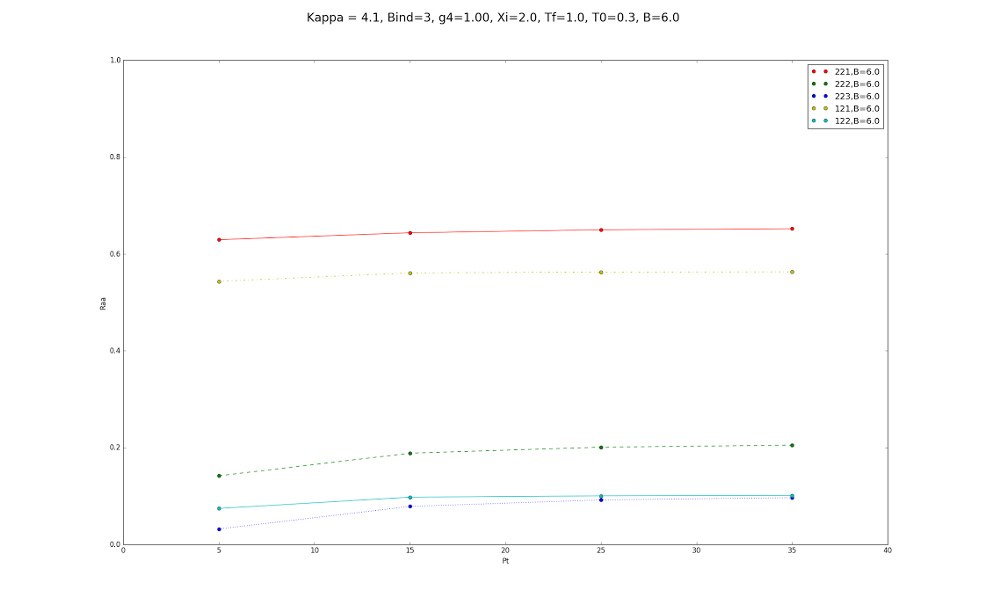
Quarkonia in the medium are being studied
Implementation in hydrodynamic grids
Dissociation of quarkonium states

