Slide 1
LDRD – MVTX Key Tasks/Milestones
7/17
10/17
10/18
10/19
Today
RUv1.0/FELIX1.5 Integration
40MHz, 7/17-12/17
More detailed task schedules
on MS Project
cosmic telescope
LDRD
RUv1.x/FELIX2.0, 10MHz,
10/17 – 6/18
MVTX Design Review 7/2018
System test, cosmic & source
6/18 - 1/19
Test Beam, tracking performance
analysis, physics sim, NIM paper etc.
1/19 – 9/19
MVTX: 2018 – 2021
Stave Production, procure FPGA, GBT etc.
8/18-4/19
BNL Director Review
7/10-11, 2017
Electronics Production
1/19-6/19

Slide 2
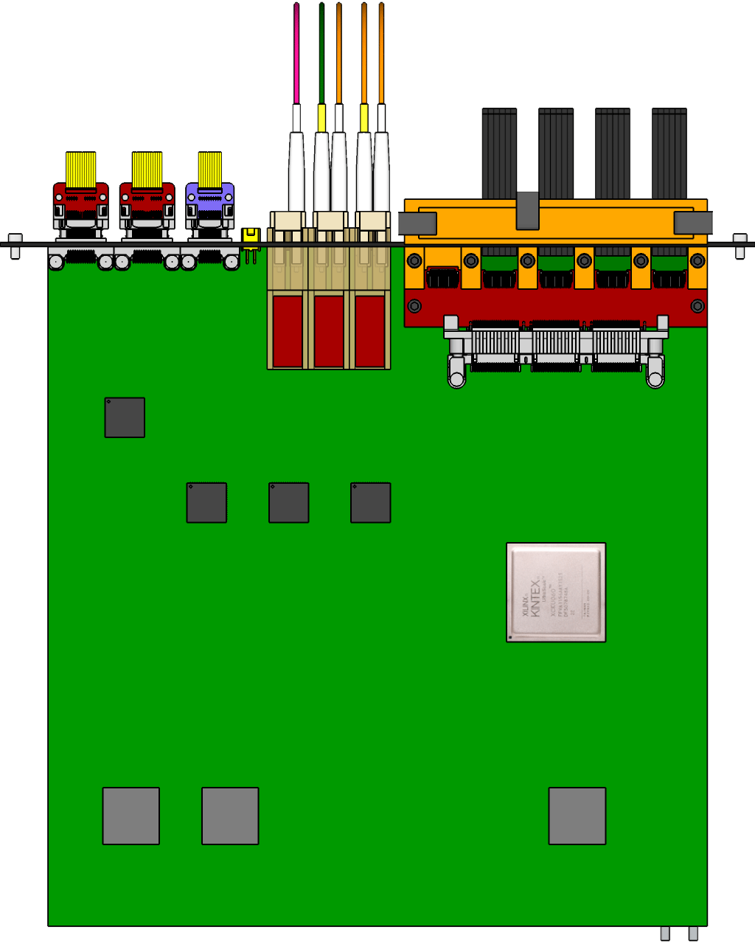

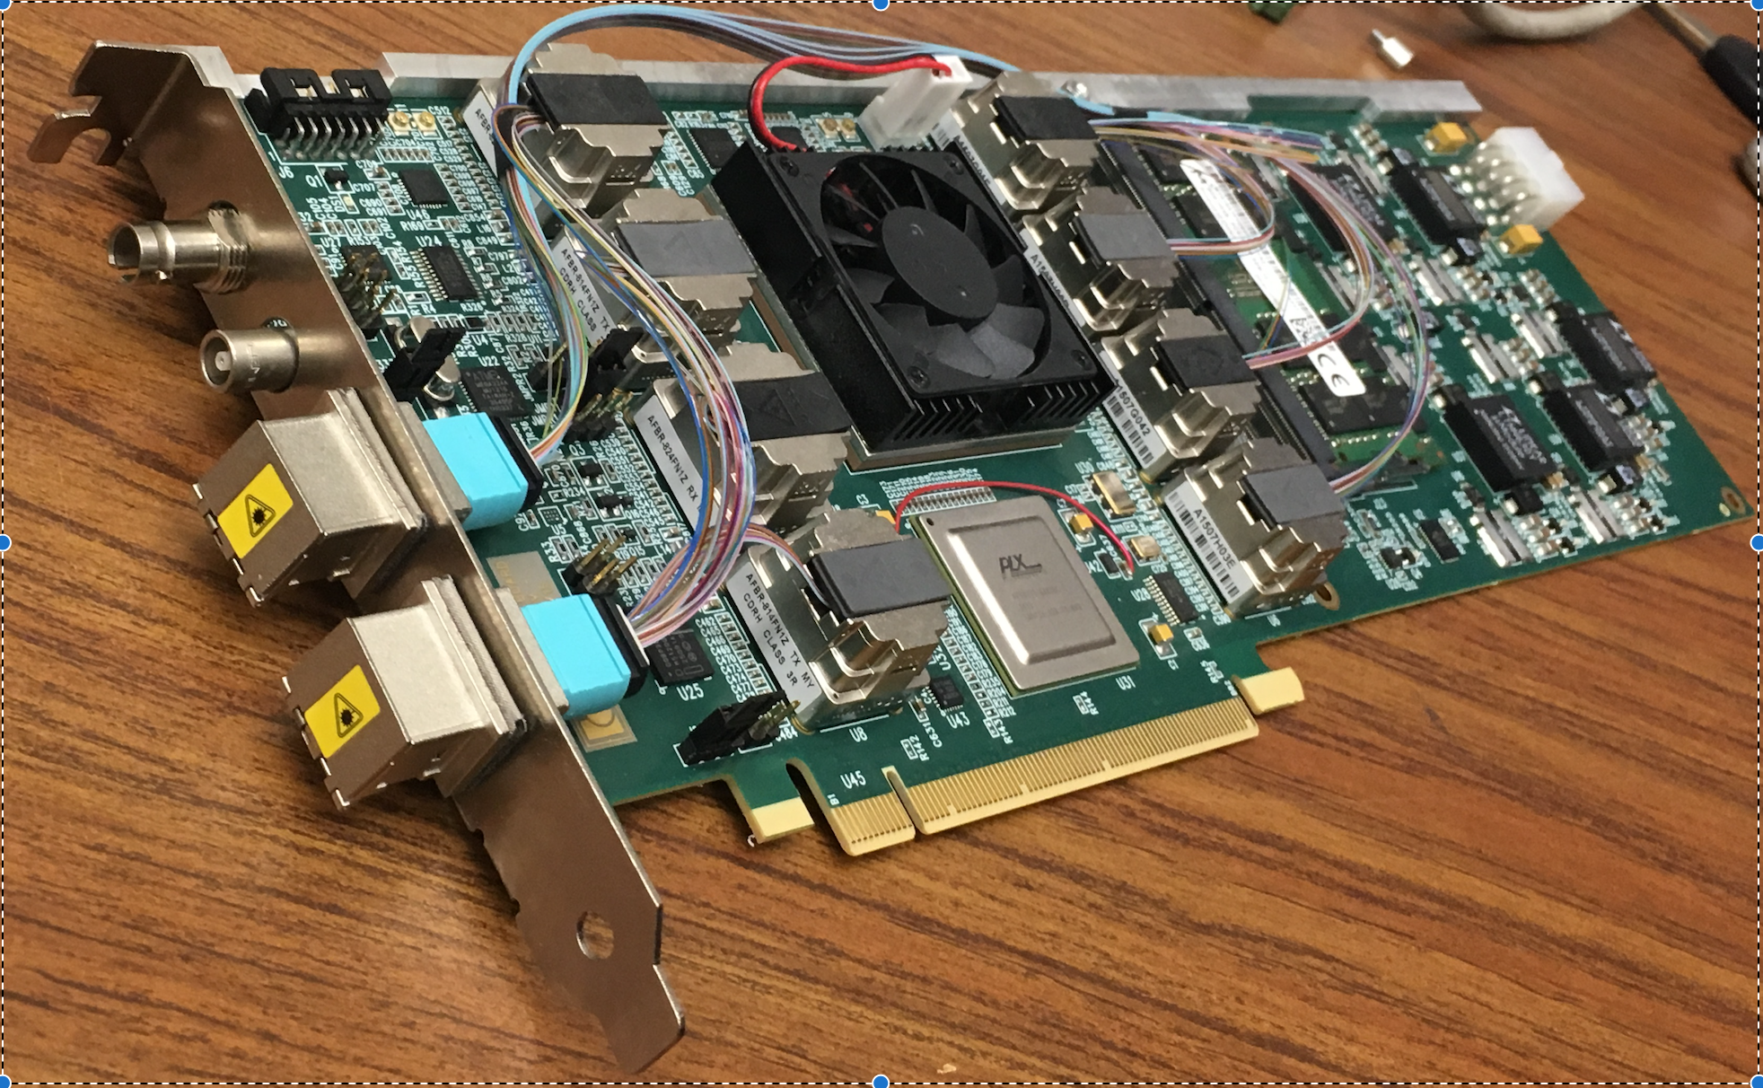
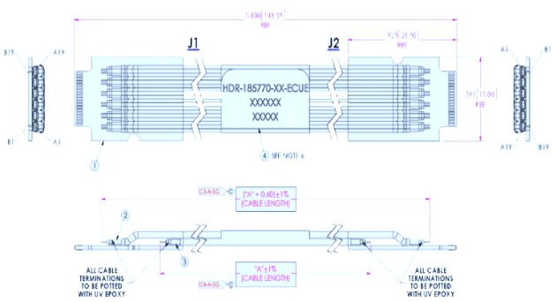

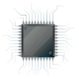
MVTX Readout Electronics
sPHENIX GL-1 & GTM
RUv1.0: ~9/2017
Stave: 06/2017
CAN bus
DCS
5-10 m
Trigger & Clock
Front End Electronics
GBT Optical Links
9-sensor Stave
9 Data (1.2Gbps)
1 Clock, 1 Control/Trigger
Control
Data (9.6 Gb/s max)
Trigger
Samtec Twinax “FireFly”
Back End Electronics
FPC
Power
Alpide Sensors
Power
FELIXv1.5:
6/2017
Filtering Capacitors
regulators
Power supplies
Cold Plate
Regulated Power
Power Board
Interaction Region
Experimental Hall
Counting House
PS: ~08/2017
CAEN PS: 07/2017

Slide 3
Priority List: 8/10/2017
MVTX technical note
  V1 by 8/16
Readout chain
  FELIX operation & integration
    RCDAQ (Kun, Sho)
    TTC (40MHz, data format etc) (Sho, Mark)
    Firmware (Alex T., Sho)
  KC705/RU (Alex T, Sho)
    readout a MAPS/HIC (RUv1 ~ early Sept. 2017)
    KC705/RU - FELIX communication
  ALIPDE operation w/ MOSAIC (Xuan)
    optimization,
    cable test, eye diagram
  Setup a Laser test bench (Sho, Alex W.)
  Samtec cable test (Pat, Mark, Xuan, Sanghoon)
    Long cables, 5m vs 7, 10m
    Short extension cables/PCB
  Power board integration w/ HIC, through MOSAIC
    a water-cooling chiller needed (an old one exists), Chris, Hubert
    Slow control – Sanghhoon, Darren
Stave assembly and test @CERN
  LANL’s contribution, 6+ months
Telescope
  GEANT geometry and simulation
  Negative pressure cooling
  Mechanical structure (UT-Austin machine shop)
MVTX proposal update – by the end of 2017
  Cost, Schedule and Risk
  Management plan
  Mechanical integration – MVTX/INTT
  Review report & follow up,
    bi-weekly MVTX discussions,
    ALD/DOE discussion ~Oct/Nov.
    Proposal ready for submission 12/2017
  Physics inputs
    HF-Jet workfest @BNL ~8/14
  Physics simulations
    Multi-collision & pile-up effect (Sanghoon)

Slide 4
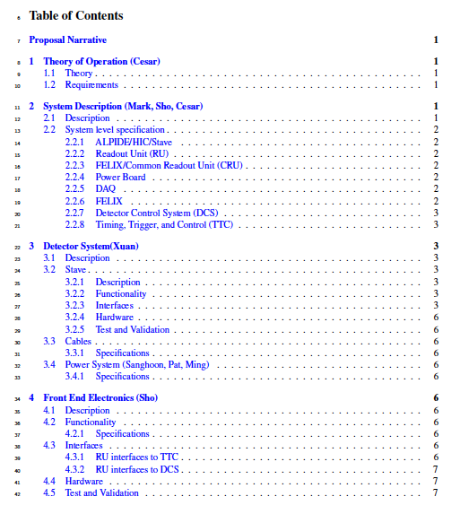
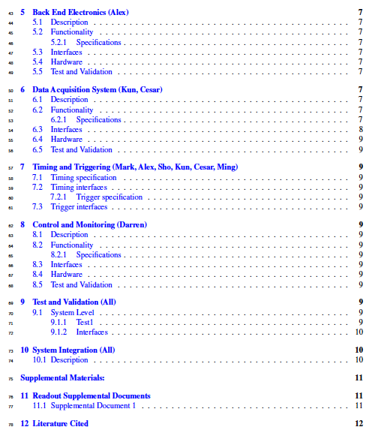
MVTX Technical Note https://www.overleaf.com/10473895mfzvyxhxxgst#/39038249/

Slide 5
sPHENIX Timing, Trigger & Controls and Raw data
sPHENIX follows more or less the similar approach we have used in the previous PHENIX experiment
  Uniform Timing, Trigger & Controls
  Uniform raw data format
  Limited information available at,
  https://wiki.bnl.gov/sPHENIX/index.php/Electronics
Timing System
  Distribute RHIC Clock to frontend electronics(FEMS)
  Send accepted Lvl-1 trigger to the FEMs
  Manage multi-event buffers (5-event deep buffer)
One level trigger system - Lvel-1
  trigger latency ~4uS (~37 RHIC Clocks in PHENIX)
  Handle subsystem busy
  Control minimal trigger interval (“dead for 4” in PHENIX)

Slide 6
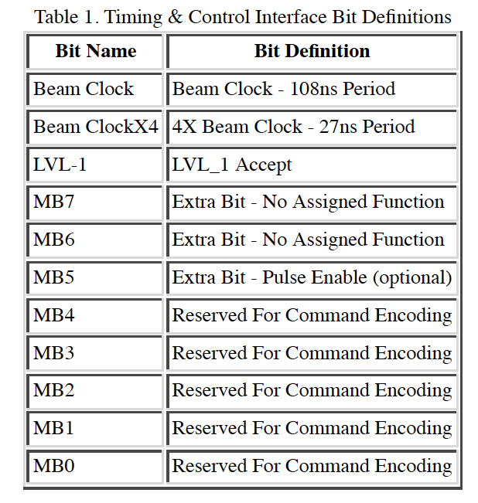
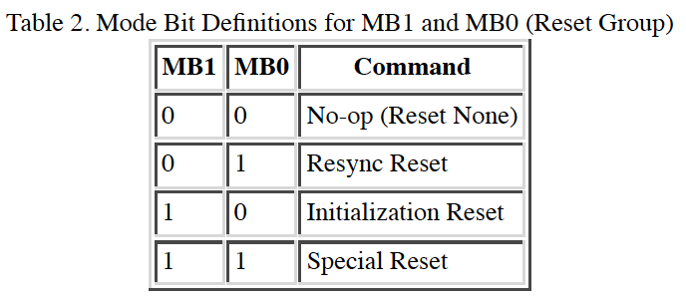
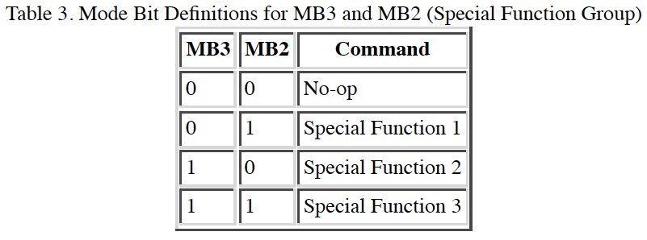
(s)PHENIX DAQ & GTM
PHENIX Timing and Control – Mode bits: 11-bit
  very similar system to be used for sPHENIX
  http://www.phenix.bnl.gov/phenix/project_info/electronics/mode_bits/mode_v2.html

Slide 7
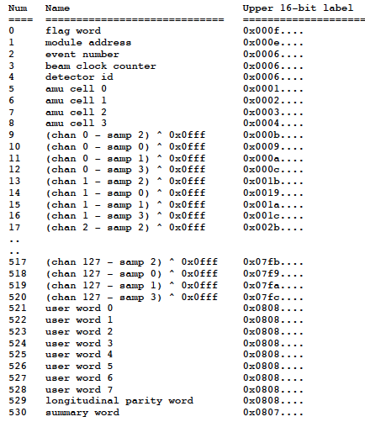
(s)PHENIX Raw Data Format - PRDF https://www.phenix.bnl.gov/phenix/project_info/electronics/dcm/DCM_formats/PHENIX_Formats/
PRDF (PHENIX Raw Data Format)
Header words
Data words
Trailer words
Muon Tracker System data format
Un-zero suppressed
Zero suppressed
FVTX data format
  Zero suppressed
The length of the package is detector specific:
- Header words
- Trailer words
For MVTX: for a 9-chip stave, raw data could be:
Header: RU ID, Event #, Clocks ….
Trailer: RU error, Parity ….
Data: Hit #, Chip ID, Region ID, pixel address …
Muon Tracker Data Format
FVTX data format
Packet 25124 24 0 (Unformatted)
425 (IDFVTX_DCM0)
Number of hits 9
Event number: 54347
Det id 64512
Error Code 0
module address 27
Flag word 0x5555
beam clock counter 37264
FEM Error word 0
Parity b5a0
Parity Ok Yes
hit # | FemId Chip Chan ADC
0 | 1 52 104 0
1 | 1 17 120 2
2 | 1 52 105 7
3 | 1 52 106 0
4 | 1 17 121 2
5 | 1 17 122 1
6 | 1 17 123 1
7 | 2 42 54 3
8 | 2 42 55 4

Slide 8
ALICE RU-CRU Data Format V0, still in flux, 08/9/2017
https://www.phenix.bnl.gov/WWW/publish/mxliu/sPHENIX/Readout/CRU/CRU_Specification_v0.7.pdf

Slide 9
MVTX Power Unit & Controls, 08/2017
CAEN PS system for MVTX (copy of ALICE ITS)
  One CAEN EASY3000 crate
  One A1676A EASY Branch Controller
  Two A2518 LV 8V 10A (50W) modules
    For the full system, we may need
    2 power boards for 64 channels (only 48 used)
    One module per power board
  One CAEN Power supply (TBD, SY8800?, A3484/5/6)
  One slow control computer (can be part of the slow control system)

Slide 10
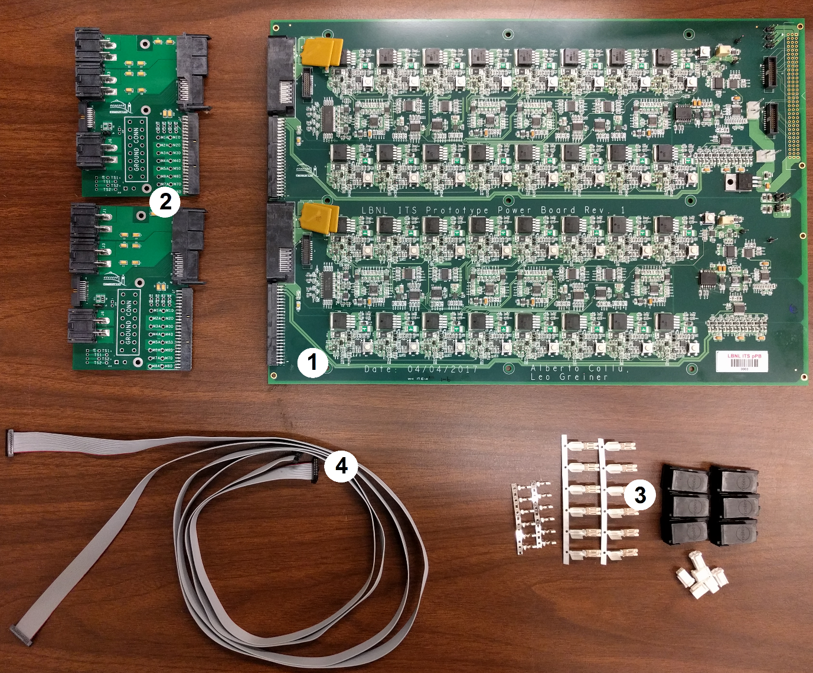
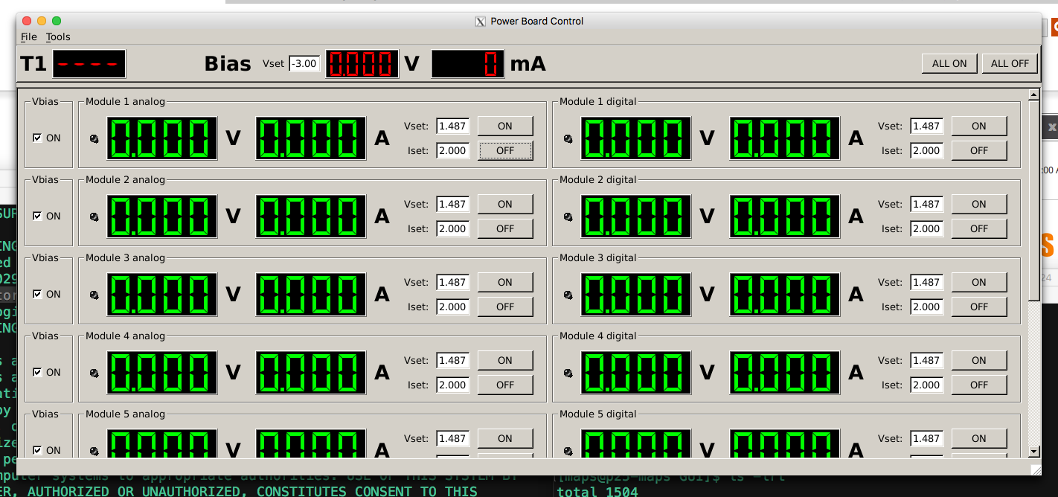
32-Channel Power Board
PS control GUI – MOSAIC/RU
Updated for 32-ch version by Xuan

Slide 11
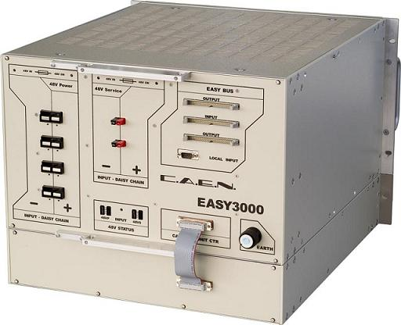

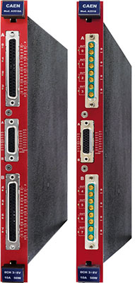
CAEN Power System: EASY3000

Slide 12
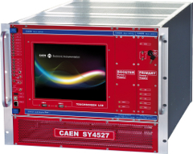
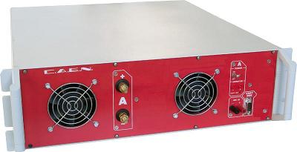
CAEN Mainframe: SY4527
A3484 PS

Slide 13
backup

Slide 14
Experimental Tasks and Assignments
07/27/2017
Interface to sPHENIX – Sho, Cesar, Ming
  Data format, trigger etc.
  Online monitoring and analysis
Readout and control firmware - Mark, Alex T., Sho
  RU and FELIX firmware development & test – Alex, Mark, Sho, Kun
  FELIX and sPHENIX DAQ, offline code - Sho, Alex T., Ming
  Evaluation test boards – Andi, Kun, Mark
Detector Control System (DCS) – Sho, Sanghoon, Xuan, Cesar, Pat
  Slow control and monitoring of sensor status
  PS control and monitor, offline code
Single chip/stave evaluation w/ MOSAIC – Xuan, Alex W. Elena, Andi
  Chip performance, noise, threshold, gain, timing etc
  Stave performance
  Data analysis
  Cosmic telescope
FireFly cable test w/ MOSAIC - Xuan, Sho, Ming
  Extension cable test
Mechanical system: Chris, Walt, Hubert, a visiting student?
  Telescope frame
  Cooling
  sPHENIX integration conceptual design – Walt, Chris, Ming
Physics simulation : Sanghoon, Darren, Xuan, Alex W.
  Vertex finding
  B-reconstruction
  Full physics simulations
Stave production and test – Cesar, new hire? Collaborators
  Stave production & QA
  Staves & DAQ operation , Training
More detailed task schedules
on MS Project.
Lead person from each subtask
develop and defines the details,
goals, schedules, resource needs etc.,
with Ming and other experts

Slide 15
Current Status (1)
MAPS sensors
  5 ALPIDE-3 w/ high-speed readout cards
  1 ALPIDE-3 w/ low-speed USB readout
  one 9-chip HIC(”stave w/o Carbon frame”)
SamTec Cables
  1m, 3x5m, 3x7m and 3x10m
  One cable per MAPS sensor or stave
  BNL safety rule
MOSAIC test bench
  1 MOSAIC in operation;
    Old version w/ AC coupling
    Readout single MAPS chip and also 9-chip HIC.
    Analyze data from MOSAIC readout
    Sensor temperature read back
    Slow control and monitoring and interface
  2 MOSAIC just arrived, being installed
    New version w/DC coupling
    Interface to Power Unit (distribution)
    Full stave QA
  MAPS to RU e-link interface (ALICE, no change for sPHENIX)
  Preliminary data format
  e-link communication protocol defined
  Tested by ALICE on “stave + RUv0”
CAEN Power Supplies
  Arrived @LANL
  1 Crate and 1 Controller
  2 PS modules
Draft sPHENIX/MVTX technical document on readout and control available
  ALPIDE operation & data format
  RU interface
  FELIX interface
  Power unit interface
  Work in progress
To do w/ MOSAIC test bench: ~ by 12/2017
Long FireFly cable test
Short FireFly cable extension test
Bit error check with Eye diagram
Optimize ALPIDE operation configuration
To do: by ~10/2017
- Setup and operate power system
- Remote control GUI

Slide 16
Current Status (2)
One FELIX board and a Linux Server
  FELIX installed and tested
  Passed GBT loop test
  Installed sPHENIX RCDAQ
    integration w/ sPHENIX RCDAQ in progress
  48 optical fibers and patch panel
RUv1.0
  First 5 test boards arrive @ CERN, ~next Monday
  Production of the rest ~late August
    Ordered 5 RUs for LANL R&D
Power Units
  Distribution boards v1 being tested at CERN,
  One available ~late August

Slide 17
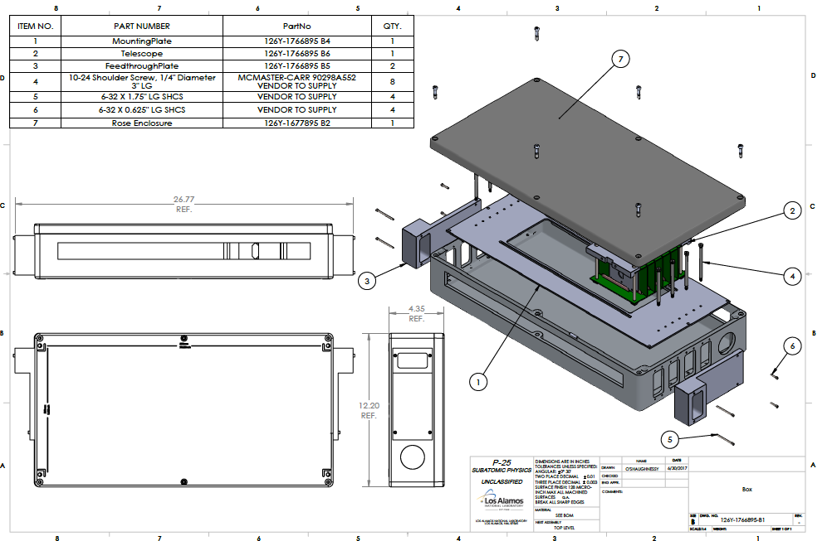
Current Status (3)
Telescope Mechanical box designed
  Design sent to UT-Austin for quote
  4 MAPS sensors
  4 staves

Slide 18
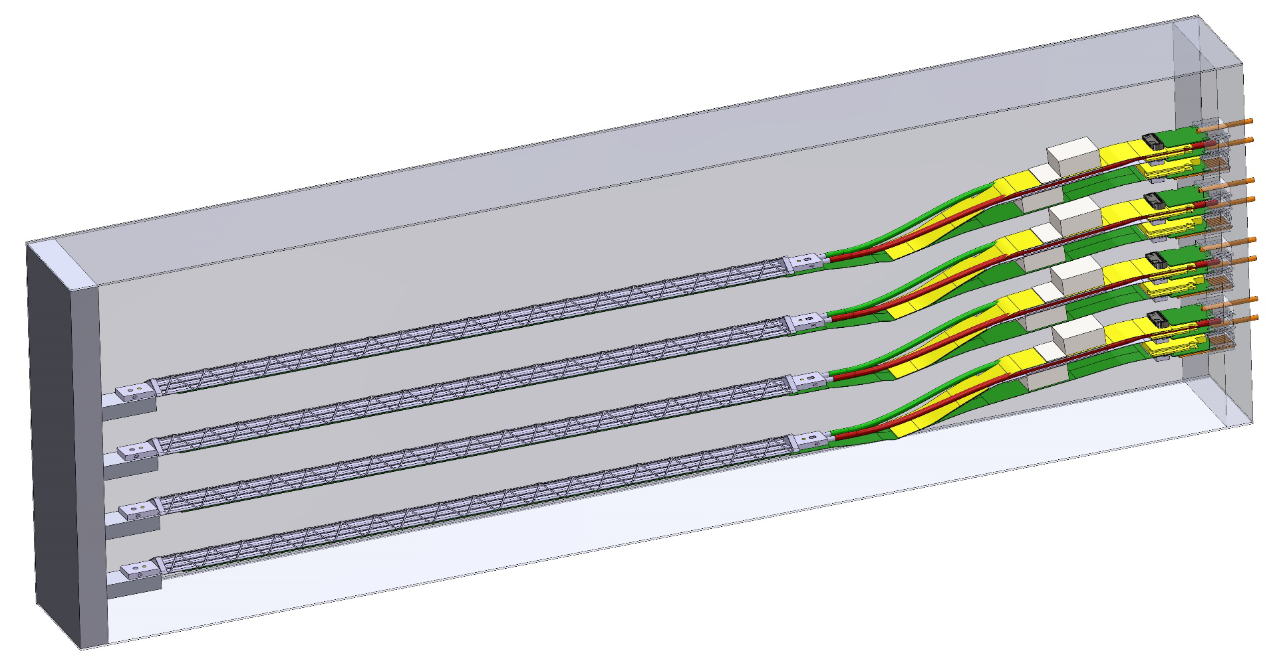
Cosmic Test: 1/2018-6/2018
A telescope consists of 4 MAPS layers (a combination of chips/staves) to allow cosmic ray tracking study
  Full readout chain, 4 Chips + 4RUs + 1 FELIX + RCDAQ. @40MHz clock
  Track position resolution study with cosmic rays, ~30um resolution, <P>
Tasks and schedule
  Readout electronics chain
    MAPS chip/stave operation, configuration, w/ MOSAIC - Xuan, Sho,
      Shaping time <~10uS, noise rate < 10-6;
      Threshold scan and noise rate;
    MAPS readout and control with RUv1.0
      Alex T., Mark, Sho
    RUv1.0 and FELIXv1.5 GBT communication
      Alex T., Mark, Sho
    FELIX and sPHENIX RCDAQ integration
      Sho, Alex T.,
  Mechanical support
    Telescope box design and assembly: 8/17 – 10/17
  Analysis software
    GEANT – Darren, Hubert
    Alignment and offline analysis – Darren, Xuan et al

Slide 19
Toward DOE Proposal
BNL Directors Review report & future plan
  Available this Friday, 7/28/2017
  Start a Bi-weekly MVTX group meeting
    Expect ~2 months to address findings
    Develop future plan
  Discuss with BNL ALD and DOE for next step: funding & schedule
Cost, Schedule and Risks
  Weekly project managers’ meeting to address general concerns and issues
  Draft risk management plan document
  Update cost on modifying mechanical support to integrate MVTX w/ INTT/TPC:
    Walt/Chris + MIT + BNL Engineers (TBD ~3-4 weeks)
    sPHENIX Tracking Integration Task Force
  Address other recommendations from BNL Directors Review
Update Physics “Money Plots”
  B-hadron and b-jet tagging through simulations
    Au+Au
  Get more inputs from theory groups
    LANL, Duke, Jet-scape, TAMU, Sacley …
New external collaborators
  NCU Twaiwan, QA and test @CERN & offline simulations
Work w/ BNL ALD, DOE/NP and MVTX group
  Project documents
  Reviews
  Funding

Slide 21
sPHENIX/MVTX LDRD Status & Plan
7/20/2017
—specifications for all items in the readout chain
—purpose, goals for any beam tests
—engineering estimates for mechanical and electrical development work that needs to be done
—more detailed specifications of milestones that will be guiding the work over the next 2+ years
—Priority lists of what needs to be completed before the full DOE MAPS review
—Spend-plan for the remainder of this year and the following year.
More directions for people involved in both LDRD and MAPS project?

Slide 22
Goals of Test Beams and Cosmic Tests
Evaluate tracking performance with test beam @Fermilab
  Resolution vs momentum, P= (1, 2, 5) 10, 20, 40 … GeV
  Efficiency vs momentum, adjusting “bending angle”
  Rate dependence, shaping time, high rate ~1MHz (?), pile-up, latch-up etc. (radiation test done at CERN)
    Test beam rate ~ 100kHz, 5x10^5 per spill
  Stress test of “event multiplicity”, put a converter
  Test trigger latency, rate dependence
  Test alignment algorithms
  MVTX + (INTT, TPC) + (EMCal + Hcal +), be part of sPHENIX test beam (~ Jan/Feb 2019)
Test sPHENIX DAQ integration @Fermilab
  MVTX + EMCal + Hcal + (TPC)
  MVTX data format and suppression
  Slow controls and monitoring, I, V, T … (already packed in RU)
Cosmic Ray Test, ~Jan 2018
  Check GEANT MC detector response simulation, cluster size
  Test stave mechanical stability, cooling
  Continuous operation, stability
  Stave spacing = same as MVTX, ~1cm

Slide 23
MVTX Readout Electronics
sPHENIX GL-1 & GTM
RUv1.0: ~08/2017
Stave: 06/2017
CAN bus
DCS
5-10 m
Trigger & Clock
Front End Electronics
GBT Optical Links
9-sensor Stave
9 Data (1.2Gbps)
1 Clock, 1 Control/Trigger
Control
Data (9.6 Gb/s max)
Trigger
Samtec Twinax “FireFly”
Back End Electronics
FPC
Power
Alpide Sensors
Power
FELIXv1.5:
6/2017
Filtering Capacitors
regulators
Power supplies
Cold Plate
Regulated Power
Power Board
Interaction Region
Experimental Hall
Counting House
PS: ~08/2017
CAEN PS: 07/2017

Slide 24
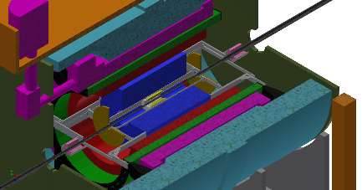
MVTX Data Flow
FEE
BEE
EBDC
10+ Gigabit
Crossbar
Switch
Buffer Box
DCM
DCM
/
8
DCM
FEE
Buffer Box
DCM
BEE
EBDC
DCM
/
8
DCM
FEE
Buffer Box
DCM
BEE
EBDC
DCM
/
8
DCM
FEE
Buffer Box
To RCF/
HPSS
DCM
EBDC
DCM
/
8
BEE
DCM
MVTX
FEE
Buffer Box
DCM
DCM
BEE
EBDC
DCM
/
8
FEE
Buffer Box
DCM
DCM
BEE
EBDC
DCM
/
8
Buffer Box
Data Concentration
FEE x 48
Buffer Box
BEE: Back End Electronics (FELIX)
EBDC: Event Buffering Data Compressor
FEE: Front End Electronics (RU)
FELIX+ sPHENIX Server Integration:
~ 8-10, 2019, sPHENIX/DAQ, RCDAQ

Slide 25
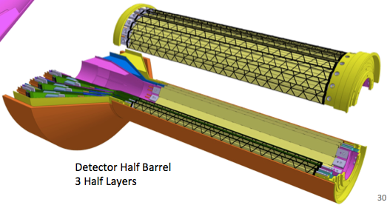
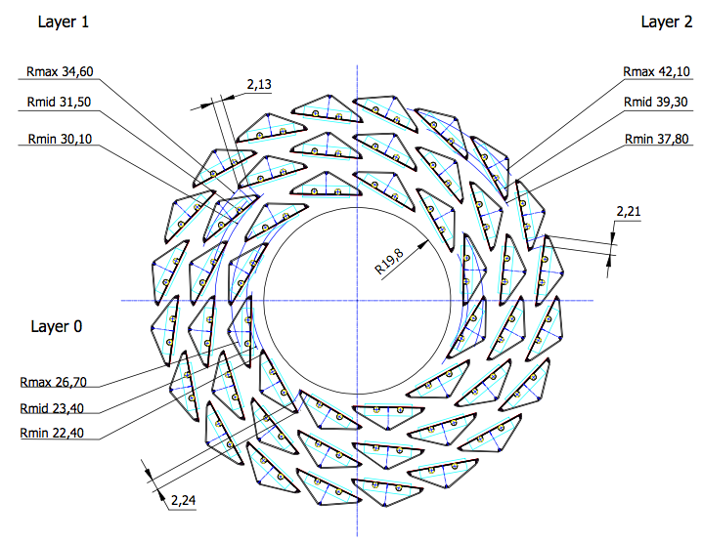
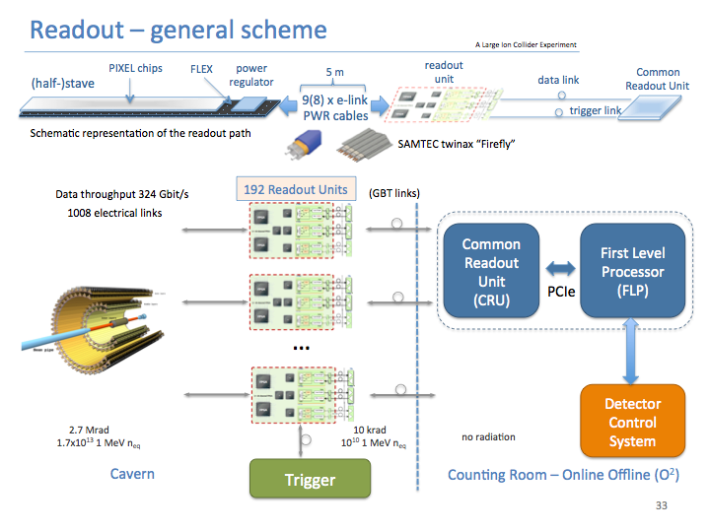
Technical Goals
LDRD GOAL
DOE MAPS PROJECT GOAL
4-staves prototype
Readout firmware

Slide 26
Engineering Estimate
Readout Electronics – 1.2 FTE Engineer 1 year
  RU integration, w/ UT-Austin, ALICE
  FELIX integration, w/ BNL/ATLAS, sPHENIX DAQ
  PS control integration, w/ LBNL, ALICE
  Based on inputs from experts (Alex, Mark, Martin et al)
Mechanical work – 0.2 FTE
  Telescope mechanical structure: 0.2FTE, 1 year
    A Box with air cooling for the 4-satve telescope
    Cooling system test
  Conceptual design of mechanical system: 0.2 FTE, 1 year
  Based on inputs from Chris and Walt
More detailed task schedules
on MS Project

Slide 27
LDRD Priority List
Readout integration
  1 stave + RU + FELIXv1.5 @40MHz, by 12/2017
  1 stave + RU + FELIXv2.0 @10MHz, by 6/2018
Readout chain validation
  Test system using evaluation boards, FELIX /GBT
MVTX Conical extension
  Test 20cm FirFly extension cable/ALICE flexible cable, by 12/2017
  MVTX/INTT integration, conceptual design
B-tagging in AuAu
  B-hadron
  B-jet
  Theory inputs
More detailed task schedules
on MS Project

Slide 28
LDRD Budget for Major Items
FY-17,
  Scope, $38K
  4 staves, $11.5 x 4 = $46K
  5 RUv1.0, $7K x 5 =$35K
  Cooling system and design, $30K
  2 MOSAIC test stands, $8K
  Telescope mechanical box, $10K
  Electronics Engineer, $50K
FY18
  Electronics Engineering, $150K
  CERN Housing etc, $20K
  FELIX v2.0 cards, $12K x 2 = $24K
  FELIX final cards, $12K x 2 = $24K
  RU final, $7K x 5 = $35K
  PS final, $10K
  Cables, fibers and patch panels, $10K
  2 High Performance Linux Servers hosting 2 FELIX boards, $12K x 2 = $24K

Slide 29
Scope of the MVTX Project
MAPS Staves & Electronics
  Produce 68 ITS inner Barrel Staves
    No modification
  Readout Electronics R&D (LANL LDRD)
    Frontend: ALICE/ITS, RU
    Backend: ATLAS FELIX
    Modify/reprogram RU & FELIX for sPHENIX
  Production:
    Extend ALICE/ITS MAPS stave production
      WBS 1.5.3.1, LANL
      sPHENIX personnel help at CERN
    Reproduce additional ALICE/RU & ATLAS/FELIX
      WBS 1.5.2.1, UT-Austin
      WBS 1.5.2.2 , LANL
    Final assembly and test in US
      WBS 1.5.3, LBNL
  Ancillary systems, “adopt” ALICE system
    Power distribution, cables, crates, racks etc.,
      WBS 1.5.2.3, LBNL
    Slow control, safety and monitoring
Mechanics & Cooling
  Some changes to ALICE/ITS inner tracker mechanical structures, WBS 1.5.3
    End Wheels
    Cylindrical structure shells
    Detector half barrels
    Detector and Service half barrels
  Mechanical Integration, WBS 1.5.4
    Conceptual design by LANL LDRD
    Prototype by sPHENIX R&D, MIT/LANL
    Design integration frames
    Carbon frames etc., LBNL
    Installation tooling etc.
  Adopt ALICE cooling plant design
    Minor modification to fit sPHENIX
    Smaller heat load than ALICE ITS
  Metrology and Survey

Slide 30
Status, Plans and Issues
LANL- ALICE MoU
  Associate member of ALICE ITS Upgrade project
  Obtained ALICE readout test stand, MAPS sensors, staves and electronics for early R&D
  Obtained design files, electronics and mechanics
  Training sPHENIX personnel
High Level Agreement with ALICE – on going discussions
  Produce 68 staves for sPHENIX using ALICE/CERN facilities
Potential schedule/funding gap of stave production
  ITS/IB production: 7/2017 - 6/2018
  If funding significantly delayed, concerns over the availability of CERN facilities
  Risk Mitigation:
    Early training through LDRD effort, maintain activity at low level
    External foreign funding, CCNU Pixel Lab etc.
    Possible “mortgage” for sPHENIX production from ALICE/CERN with “Agreement”
sPHENIX readout and mechanical integration R&D
  Schedule risks due to unavailability of key R&D elements like staves and readout electronics
  MVTX/INTT integration
  Risk mitigation:
    Early joint R&D with ALICE as associate members
    Early R&D with prototype staves, RU and FELIX
    Early mechanical system integration R&D

Slide 31
Schedule
MAPS sensors by mid 2018
  2 test stands by August 2018
    4 fully assembled staves for system test, by the end of 2018
Preliminary mechanical design by Nov 2018

Slide 32
Costs
WBS | Task | T&E | M&S | RISK | Lead Person
3.1 | MOU btw LANL and ALICE | 19K |  | Low | Ming
3.2 | Obtain design from ALICE | 83K |  | Low | Ming
3.3 | Setup Alice Readout Test Stand | 10K | 100K | Low | Sho
3.4 | Procure ALICE staves | 260K | 290K | Low | Cesar
3.5 | Procure ALICE electronics & cables | 110K | 180K | Medium | Ming
3.6 | Electronic Final design Review | 15 K | 10K | Low | Mark
3.7 | Mechanical Support and Cooling | 130K | 110K | Low | Walt, Chris
3.8 | Mechanical Conceptual Design Review | 24K | 10K | Low | Walt, Chris
3.9 | Prototype assembly and test | 55K | 55K | Low | Cesar
3.10 | Software (FPGA, online, controls) | 350K |  | Low | Mark and new staff or post-doc
3.11 | Detector optimization and physics simulations | 850K | 50K | Low | Sanghoon, Xuan, Darren
3.12 | Test beam operations | 50K | 80K | Low | M. Durham
 | TOTAL | 1.8M | 885K
20% contingencies applied. Except electronics with 40% contingency.
Estimates based on ALICE ITS procurements and recent FVTX experience.

Slide 33
Initial Assignments, 10/2016
sPHENIX readout and trigger requirements (DCM2, JSEB etc) – Mike and Ming
MAPS CRU readout - Mark, Ming, Pat
  Physical parameters (PCIex4)
  Data format
  Electrical signal, lack of busy etc
  sPHENIX trigger/busy inputs and clock
Detailed specs/understanding of MAPS/ALIPED-3(4 ~ final) test card – Pat, Cesar and Andi
BNL specifies cabling/material electrical and fire safety etc – Walt, Hubert, Eric…
Radiation enviroenment, damage, occupancy, SEU; Configuration and Operation, programing and initializatio etc – Mark, Xuan
Power needs:
  (LANL LDRD) Hubert and Ming;
  (BNL sPHENIX) Hubert, Eric
  Staves, readout control etc. (A, V)
Mechanics – Walt, Hubert, Jin
  Structure, cooling, alignment, assembly and integration
Integration into sPHENIX – Walt, Eric
Test stands setup and operation
  Single chip readout – Mike, Pat
  Staves and cosmic ray - Xuan Cesar
  Mockup, electrical, readout, power – Sanghoon, Hubert, Walt
FPGA firmware – Andy, Mark, Cesar, Ming and Pat
  VHDL, Verilog
Software – Sanghoon and Andy
  Slow controls, electronics
  Test software, root-based
Beam test – Ming and team
  LANL, FNAL, rad damage at LANSCE
Web page – Hubert, Pat
  R+W access
  Tree structure
  https://p25ext.lanl.gov/maps/

Slide 34
MVTX BNL Director’s Review
July 10-11, 2017
Review went well
Received constructive comments; overall encouraging
Our understanding is that we will be able to forward report to the collaboration once we received it (~in a few weeks)
Discussed further process with ALD. ALD planning to discuss with DOE regarding proposal submission/update, once satisfatory answers to report received from MVTX group

