Slide 1
Findings – 5/16/2019
Steve J Chappa
During the ORC review of the T1441.02 installation today at 13:00, we found:
1) The power strip AC cords and an extension cord was under the electronics crate cart roller. Require that the cords be moved away from this pinch point and the cart rollers locked down. Done during the review. --OK.
2) The AC power cordage, plug-ins, loading looked --OK.
3) The DC power supplies are using the internal presets, entered into non-volatile​ memory, to set the DC power voltage limits and current limits. Require that the presents be indicated on the power supplies with a label to indicate their respective presets, the effective dates, and person/persons using these presets.
Done, see attached photo-1.
4) The DC power distribution's fuse protection, wire sizes, etc. are sufficient for the DC power involved. --OK.
5) Recommend to place a tape over the power supply banana jack connections to prevent any DC shorting through these jacks. Done during the review. --OK. Also see photo-1
6) No HV (over 50 VDC) used in this installation. Tables and crate are grounded. --OK.
7) Require to fasten the 12 VDC cooling fan to the crate top rails to prevent the fan from moving when turned on. Done during the review. --OK.
8) When the detector's cooling tubes are connected and tested for leaks, the table travel and planar rotation needs to be checked for proper cable and tubing slack and restraint.
Done. 1) connected and tested for leaks, 2) cable slack and restrains see photo-2,3,4,5;
9) The cables to the readout crate need to be grouped and restrained properly for the table travel. Once done, this travel needs to be rechecked. Done, see photo 2,3,4,5; readout cables are also taped to the table
10) Recommend to tape up the exposed PC board terminals/pads, on the LVDS connector PC board, to prevent shorts to any grounded structure or component. Done, see photo-6.
When the corrective actions in item 3 and the table travel is rechecked for proper cooling tube and cable restraint/dress, an email with a picture of the power supply labeling and a statement indicating the table travel has been checked, I can then recommend the ORC issuance for this installation.
Regards,
Steve
---
Thanks for your review and recommendations, this will make our experiment safe.
Ming for the sPHENIX MVTX team

Slide 2
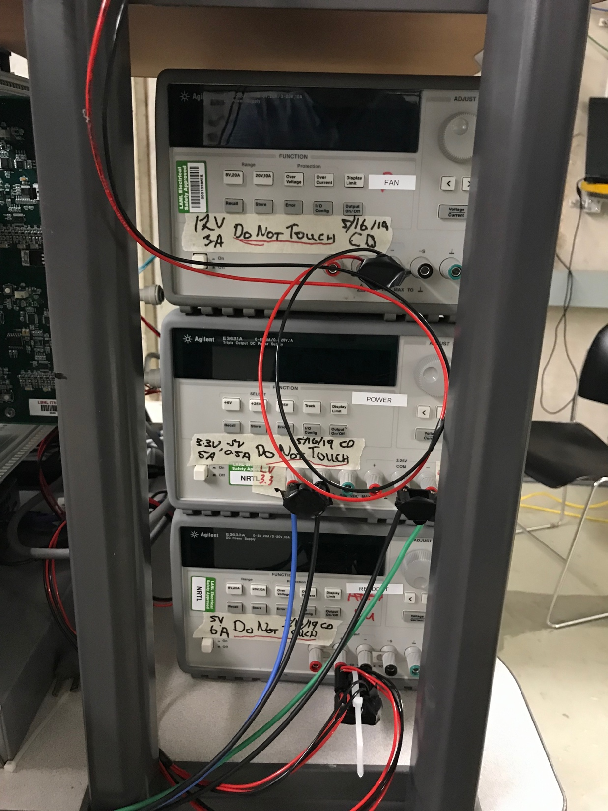
PS voltage and current limits are labeled: User Cameron Dean, 5/16/2019; see photo-1
Top: Fan PS
12 V
3A
Middle: staves
3.3V, 5A
Bias: -5V, 0.5A
Bottom: RU power
5V, 6A

Slide 3
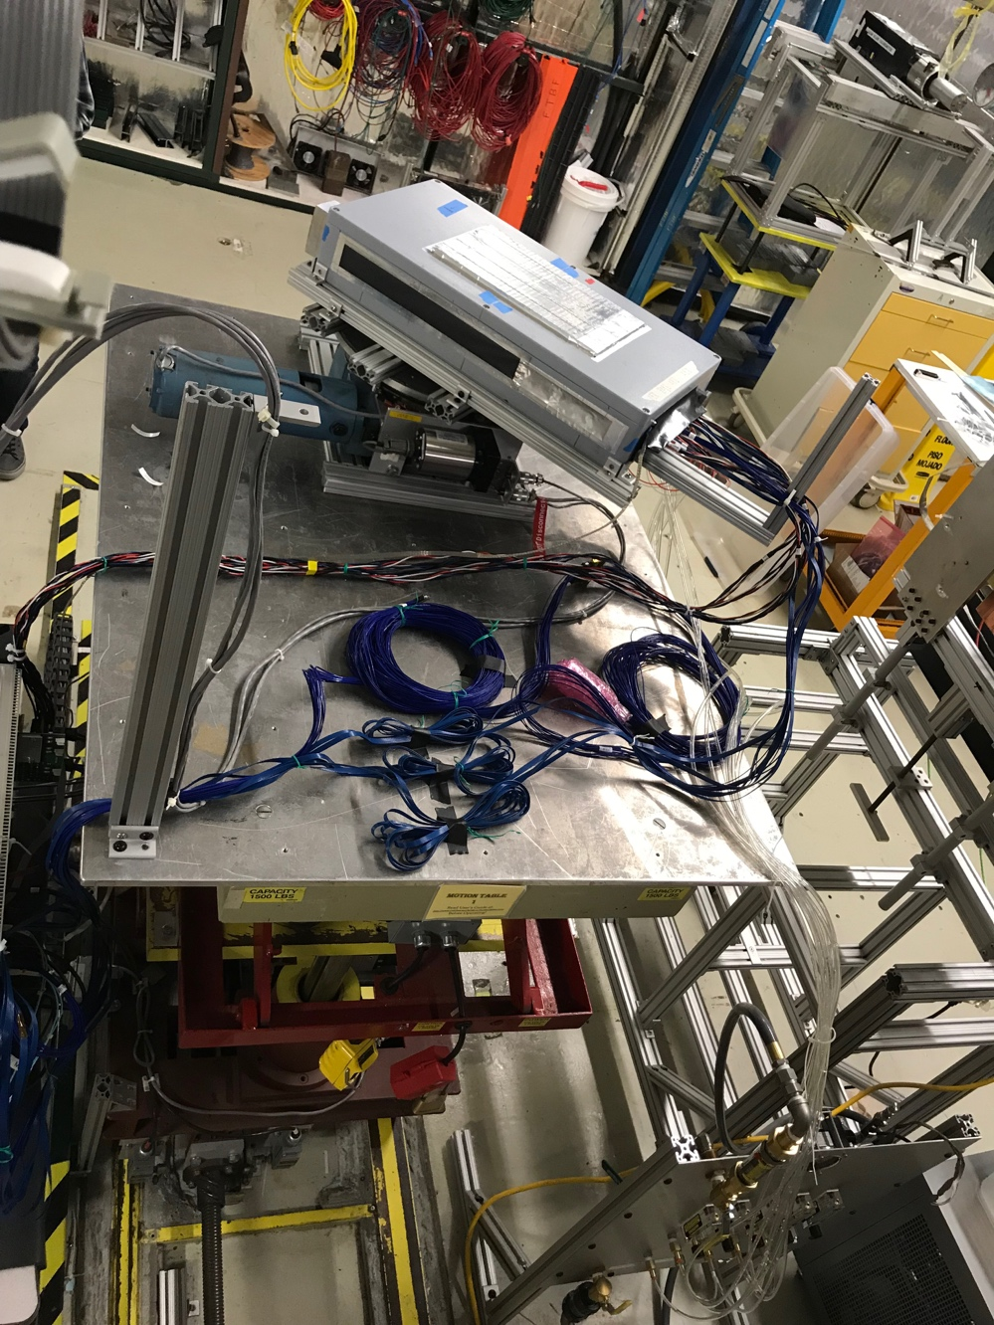
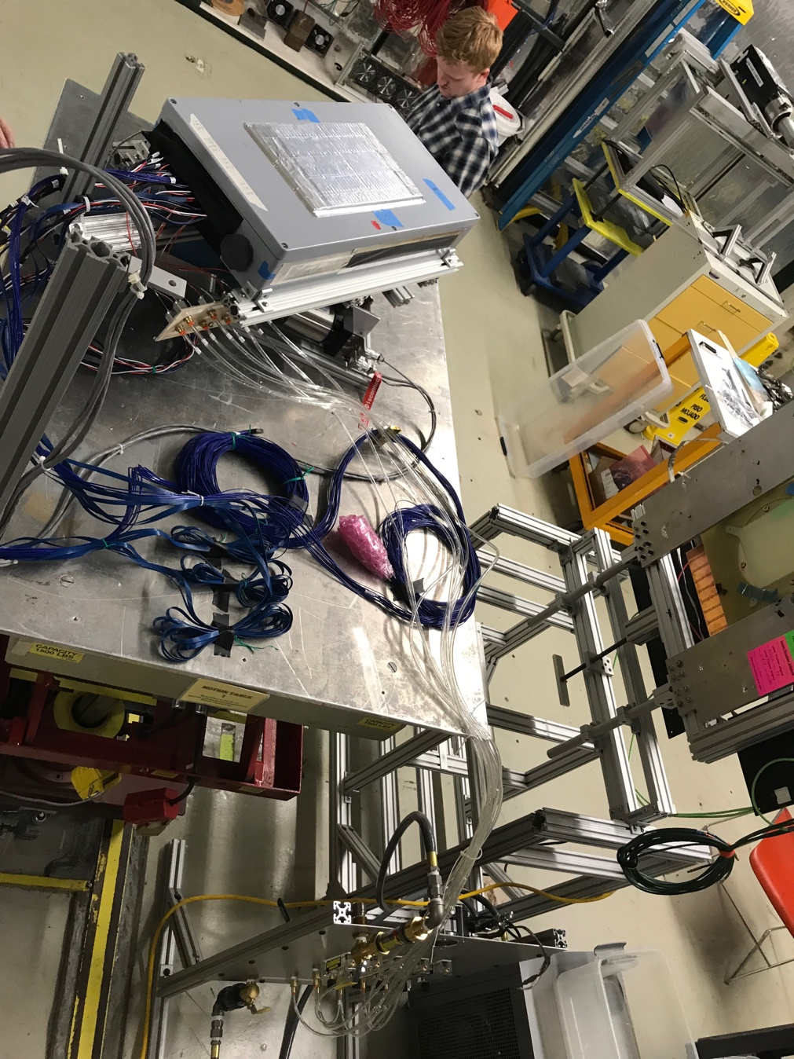
Detector with cooling tubes connected Far-end location, photo-2,3

Slide 4
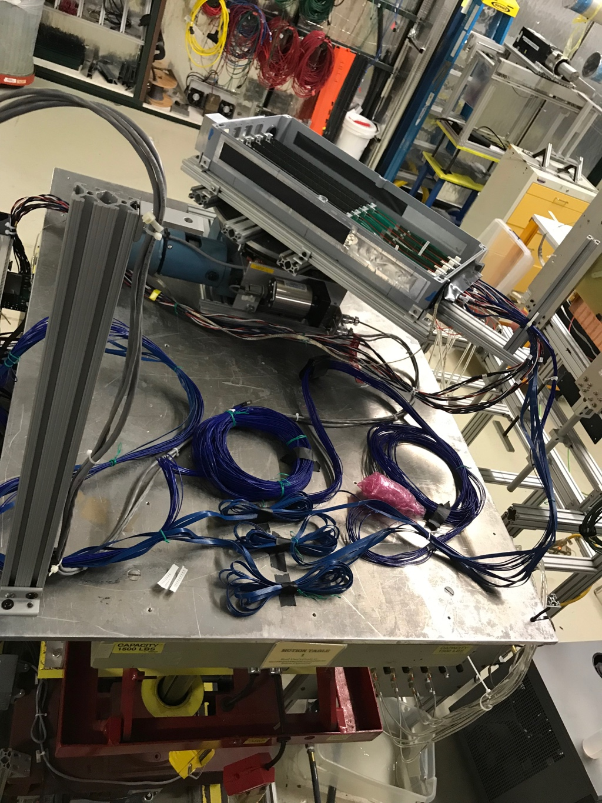
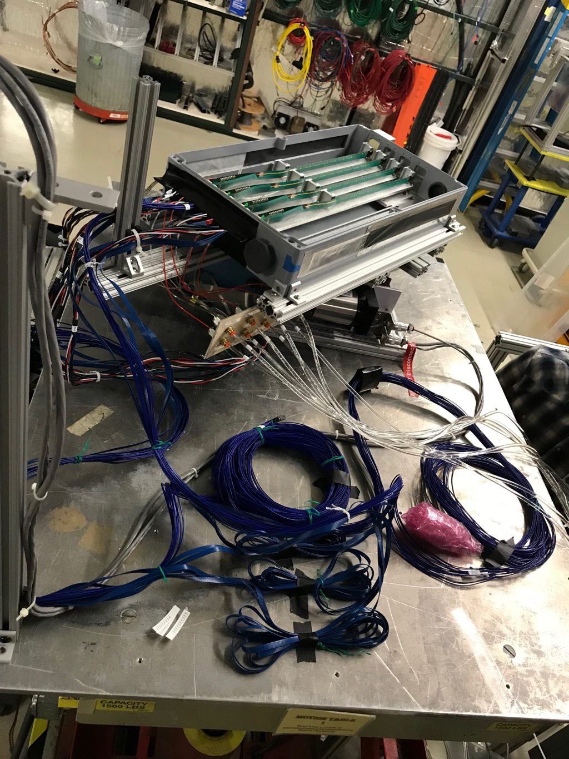
Detector with cooling tubes Near-end location, photo-4,5

Slide 5
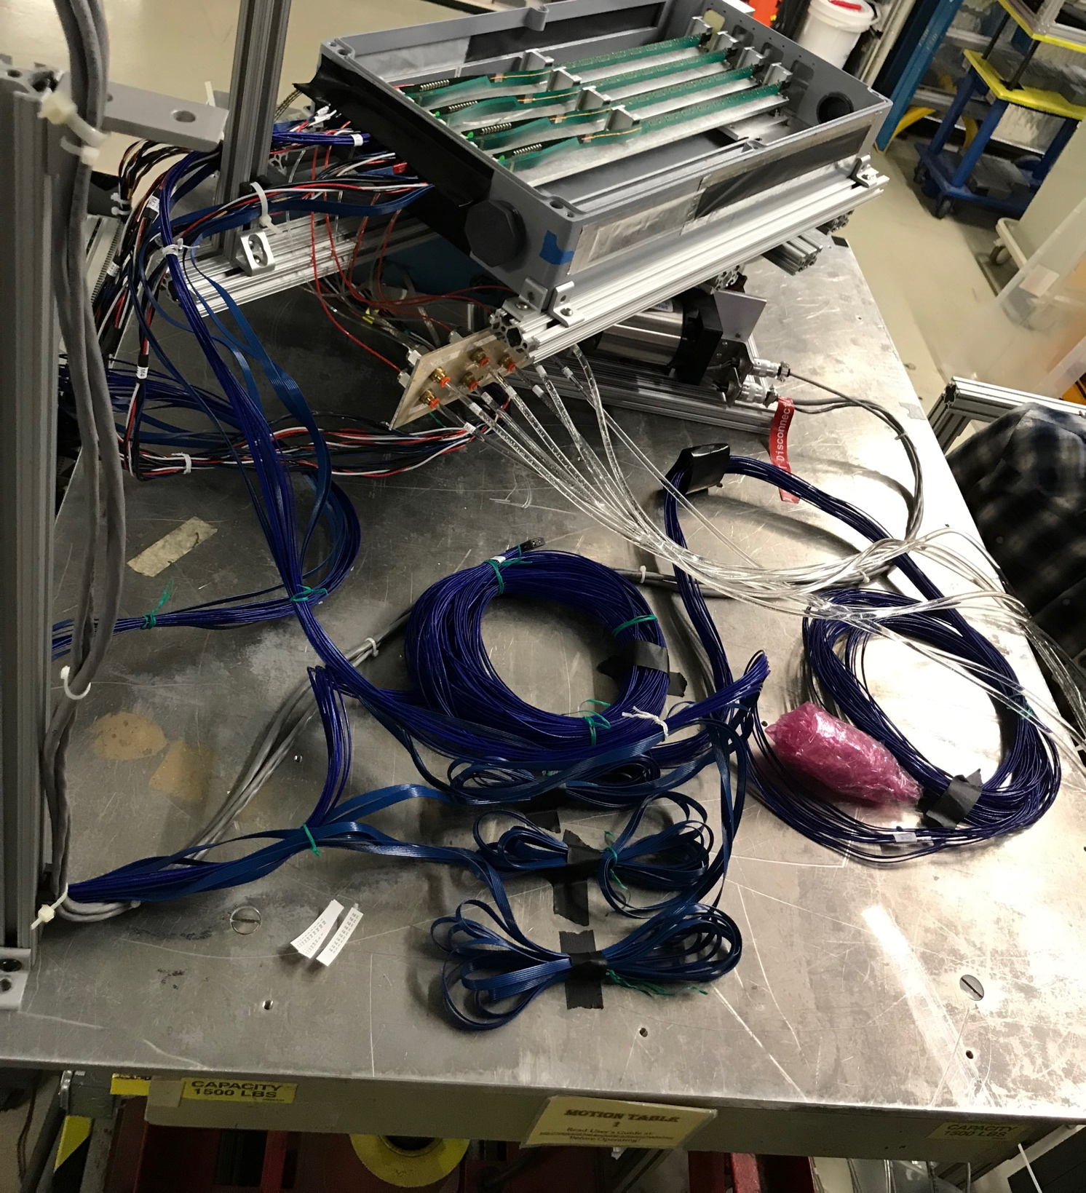
PC boards and connector are all taped up to prevent shorts to ground photo-6

