Slide 1
sPHENIX LDRD Work
Sho, Ming
01/24/2019
Updated 2/5/2019 after discussions with Jo @CERN;
and Huber, Walt and Abel at LANL 2/6/19

Slide 2
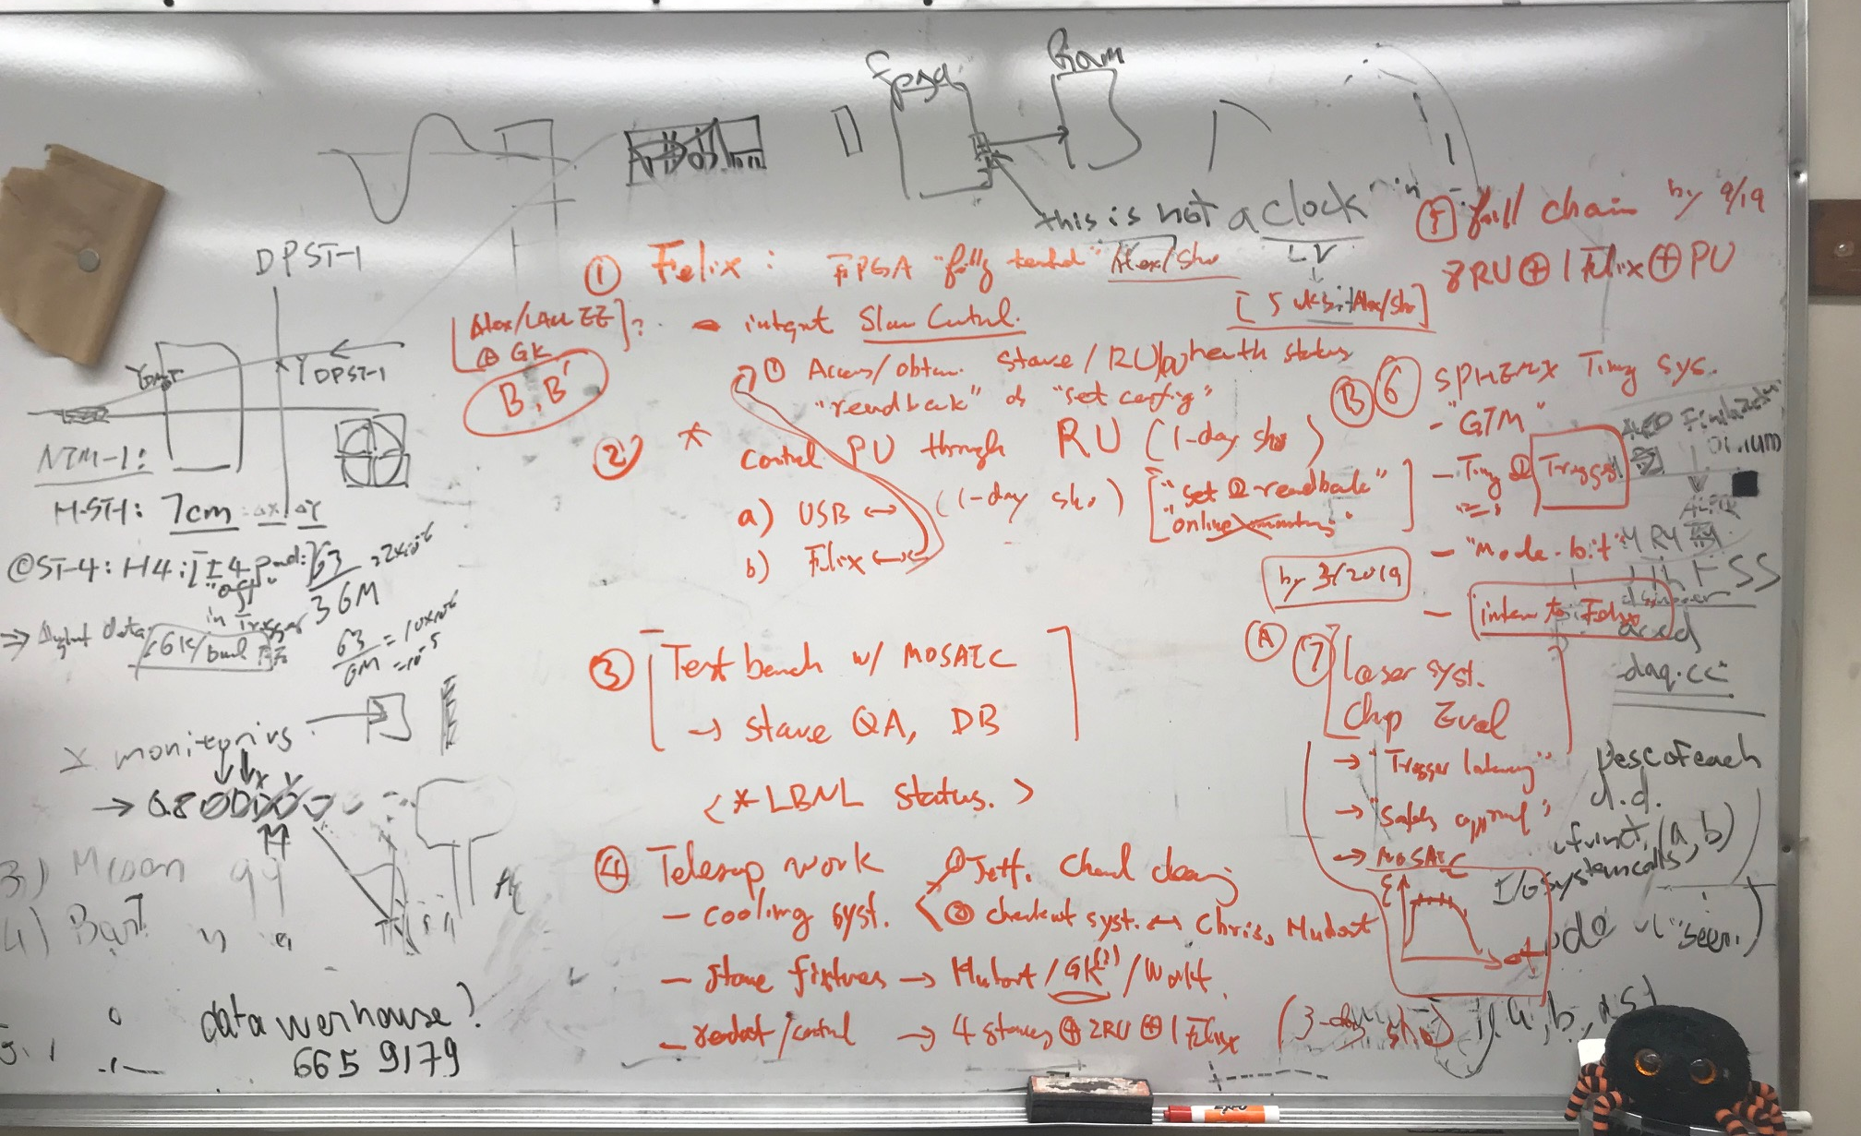
Discussions with Sho, 1/16/2019

Slide 3
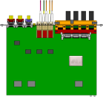
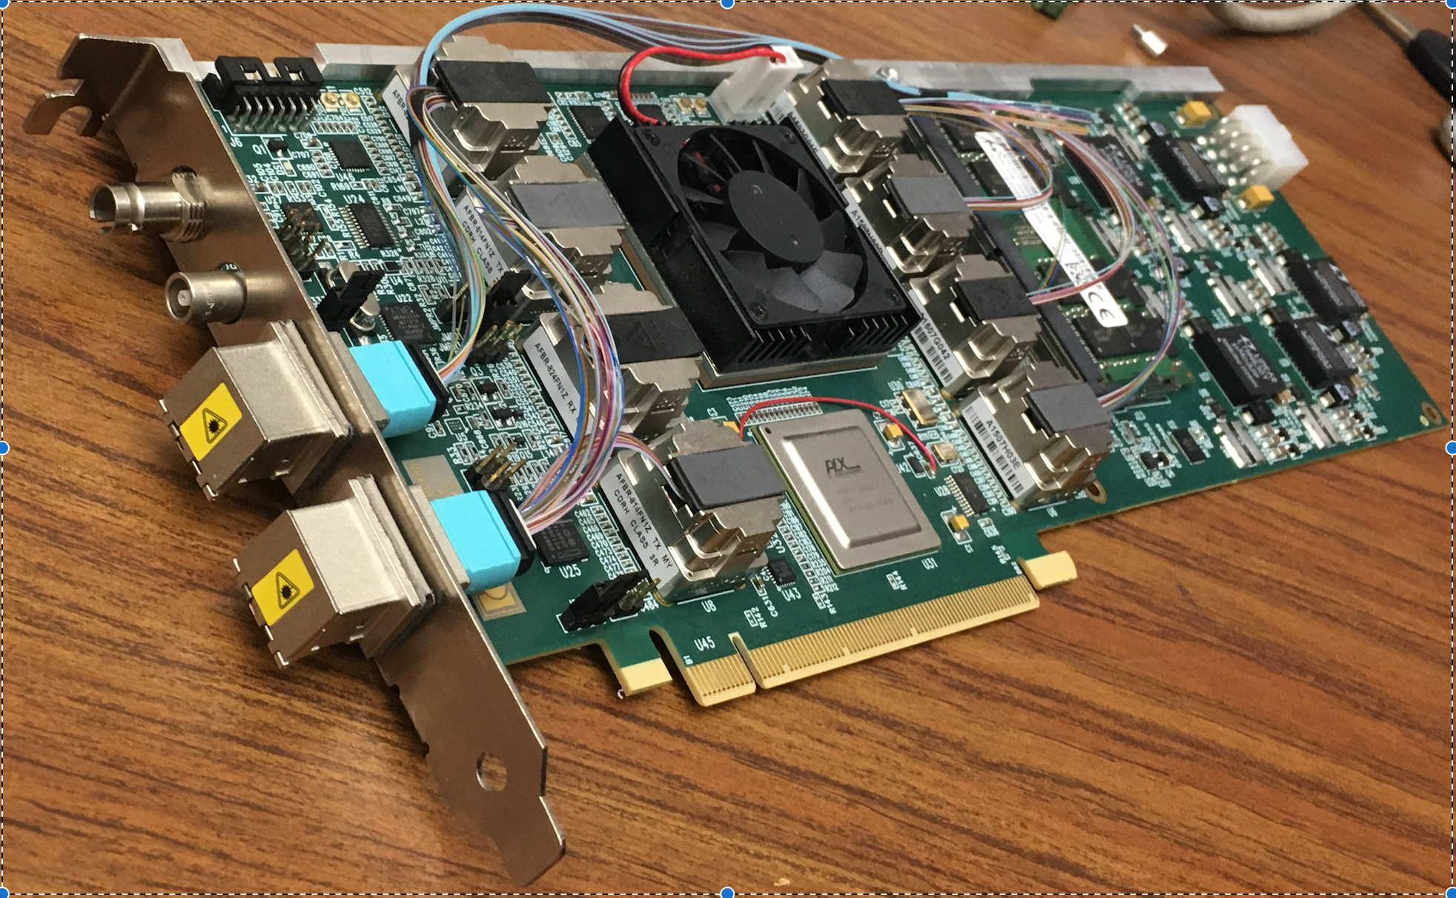
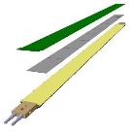
MVTX Electronics, Power and Controls
CAN bus
DCS
~10 m
Trigger & Clock
Readout Unit
Front End
GBT Optical Links
9-sensor Stave
9 Data (1.2Gbps)
1 Clock, 1 Control/Trigger
Control
Data (9.6 Gb/s max)
Trigger
Samtec Twinax “FireFly”
FELIX
Back End
FPC
Power
Alpide Sensors
Filtering Capacitors
Power
regulators
Power supplies
Cold Plate
Regulated Power
Power Board
Interaction Region
Experimental Hall
Counting House
Sensor-Stave (9 ALPIDE chips) | Front End-Readout Unit | Back End-FELIX
(------- ALICE/ITS Hardware --------)
(-- ATLAS Hardware --)

Slide 4
To do list - Priority
4-stave telescope integration --- Feb – April, test beam in May @FNAL. (all)
---- possibility to joint early test beam w/ sPHENIX/EIC EMCal; April 3-23 (4/15-23 for MVTX), @MT6.2b
Get 5 staves from ALICE, test/QA at LANL, ~ Feb. 2019
Cooling system operation and testing –- in Feb-Mar
Asked Jeff B. to get the chemical to clean up the system , IWD? (Sho)
Run and checkout the system (Hubert, Chris, AlexW, Ming)
Stave holding fixtures design and fab (Hubert, Walt et al) – in Feb-March
Setup and test Readout and controls of {4-stave + 2-RU + 1-Felixv2.0 + 1PU + RCDAC (~ 3days, Sho)}, be ready in ~Mar? (Sho, Cameron, Ming et al)
Control and readback PU through RU --- get it ready for Test beam?
USB (~ 1 day, Sho), get it ready for the beam test in May? (followed by AlexW, MIng et al..), through FELIX later (requires completion of #2)
Data analysis (Yasser, Cameron, Sho et al )
Integrate slow control over FELIX for staves, RU and PU --- by this summer, also working with Jo @UTA
Upload initial configuration, dead/hot mask; readback V, I, T etc
FPGA interface work (~5 weeks, Alex/Sho), (Mark/student, Cameron, Ming et al)
Evaluate ~10m SamTec cables, AWG 30/32 vs 36
Eye diagram with MOSAIC, or RU?, help from Jo
Direct check on the scope
Stave testbench setup with MOSAIC *
Run the full ALICE QA, output final results to DB(ALICE)
Need to check the Status at LBNL, maybe already done there? (Sho/AlexW, Ming )
Setup sPHENIX GTM system at LANL --- check with BNL for the GTM availability [Gerd]
Timing and Trigger through “Mode-Bit”, to be defined (Gerd, Sho, Ming)
Evaluate chip performance with laser system + MOSAIC., external “injection” [Gerd] – Feb – April, preliminary results before May test beam at FNAL (Gerd, AlexW, Ming, Cameron, Yasser, Sho)
Study sensor efficiency vs trigger latency
Operate MOSAIC with external triggered mode with pulsed laser; may need to modify the MOSAIC code for this.
Obtain laser system safety approval for operation
Full chain test of a complete unit [ 8 staves/sensors + 8RU + 1 FELIX + PU + “sPHENIX GTM”] – later summer, complete by Sep 2019
Obtain 10 RU, 1 FELIX+GTM by summer (Sho, Cameron, AlexW, Ming et al)

Slide 5
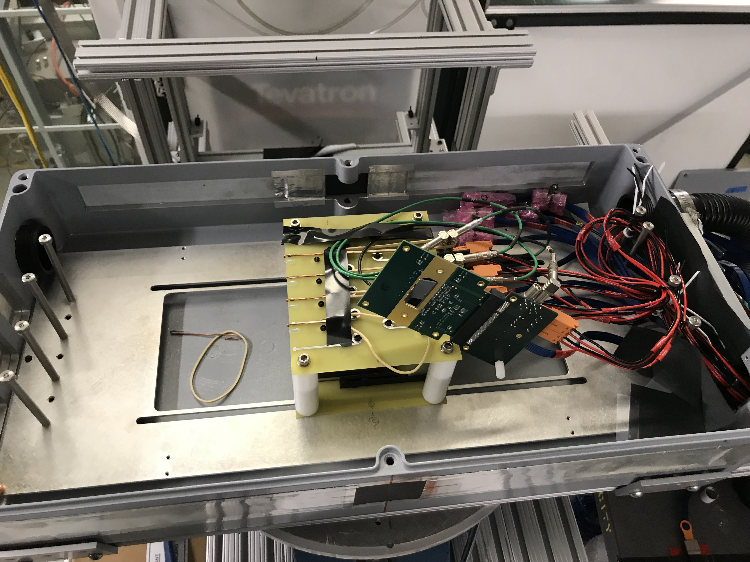
Telescope work
Hardware
4 staves available
One more coming later
2 RU v1.1
Samtec cables
5m, 8m, 10m
1 FELIX v2.0
Also one Felix v1.5 (used last time)
FELIX server and RCDAQ
2-stave → 1 RU
2 RU → 1 FELIX
Telescope box
Fixtures for staves
Cooling (air OK), T-monitoring?
Software
4-stave readout
FPGA
RCDAQ and decoder
PU control via RU/USB
4 DVDD, 4 AVDD, 4 BV
V, I, T monitoring
Online monitoring
Event information, hit distribution n
Sensor V, I, T monitoring
Offline analysis

Slide 6
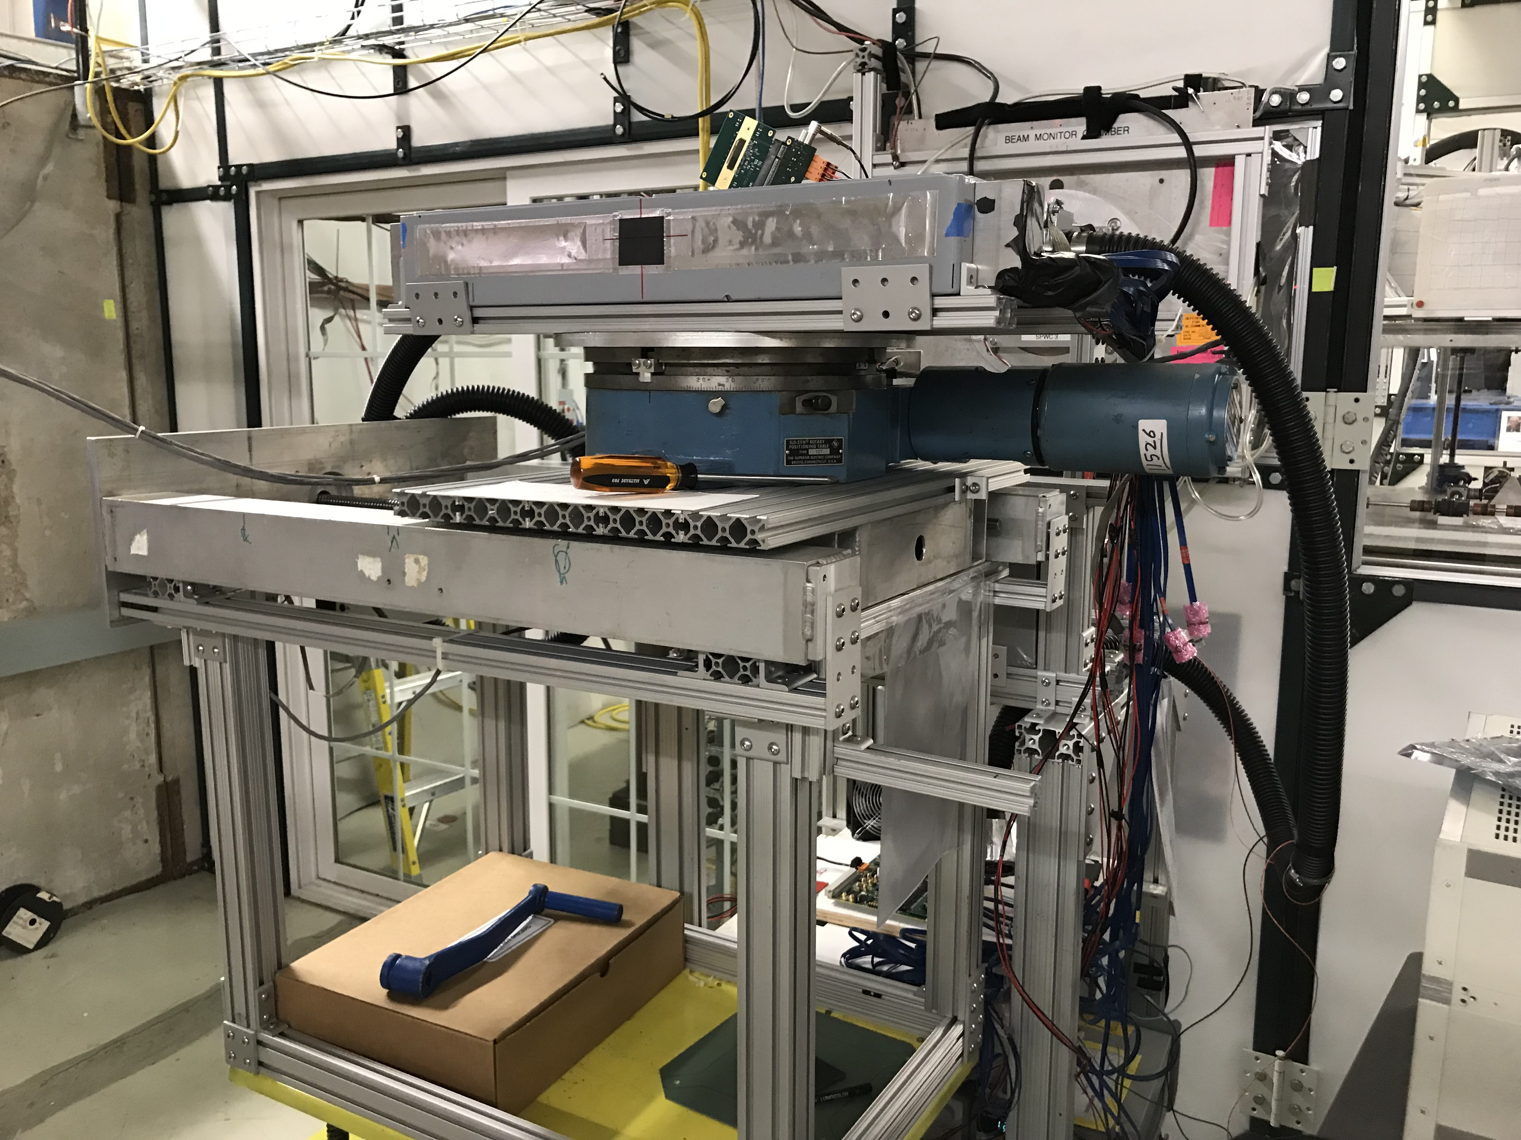
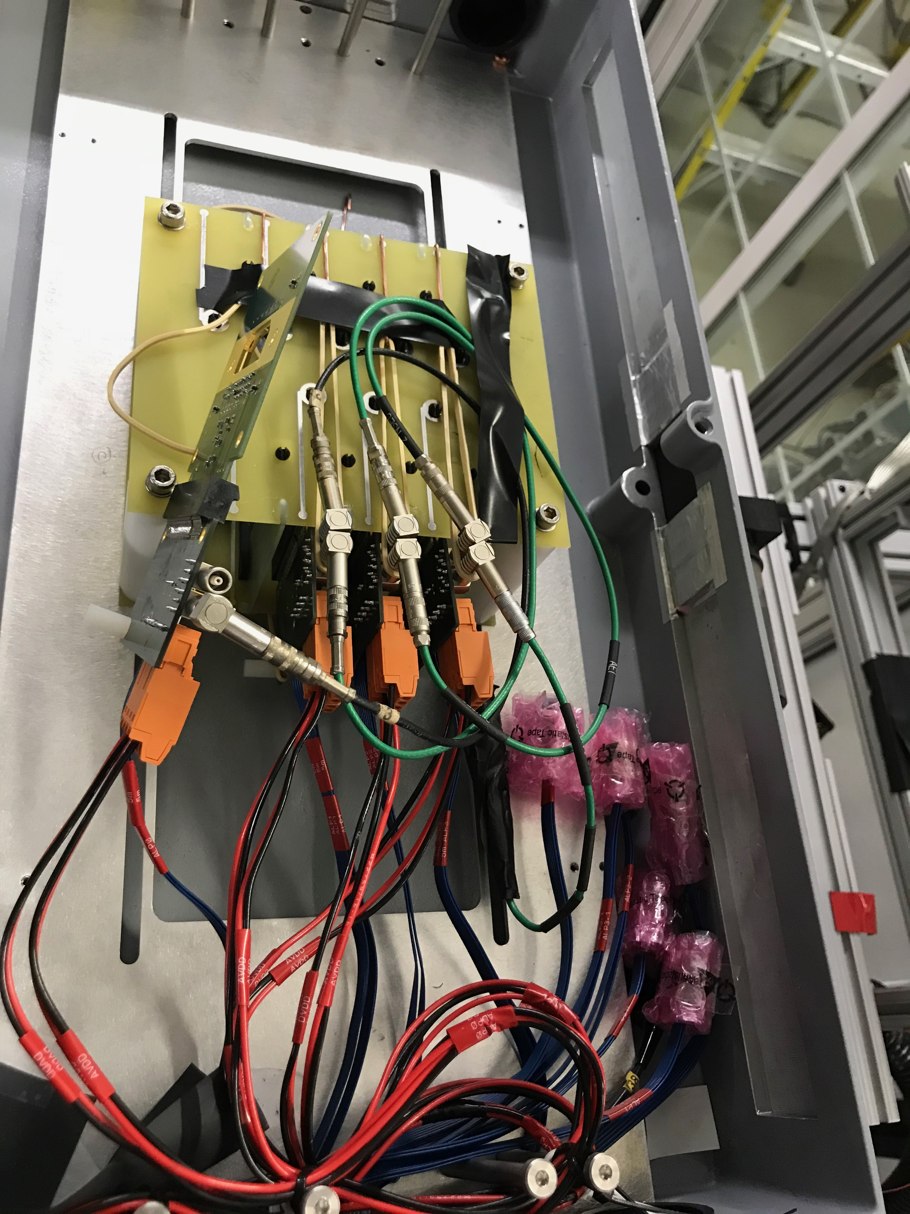
2018 Fermilab Setup

Slide 7
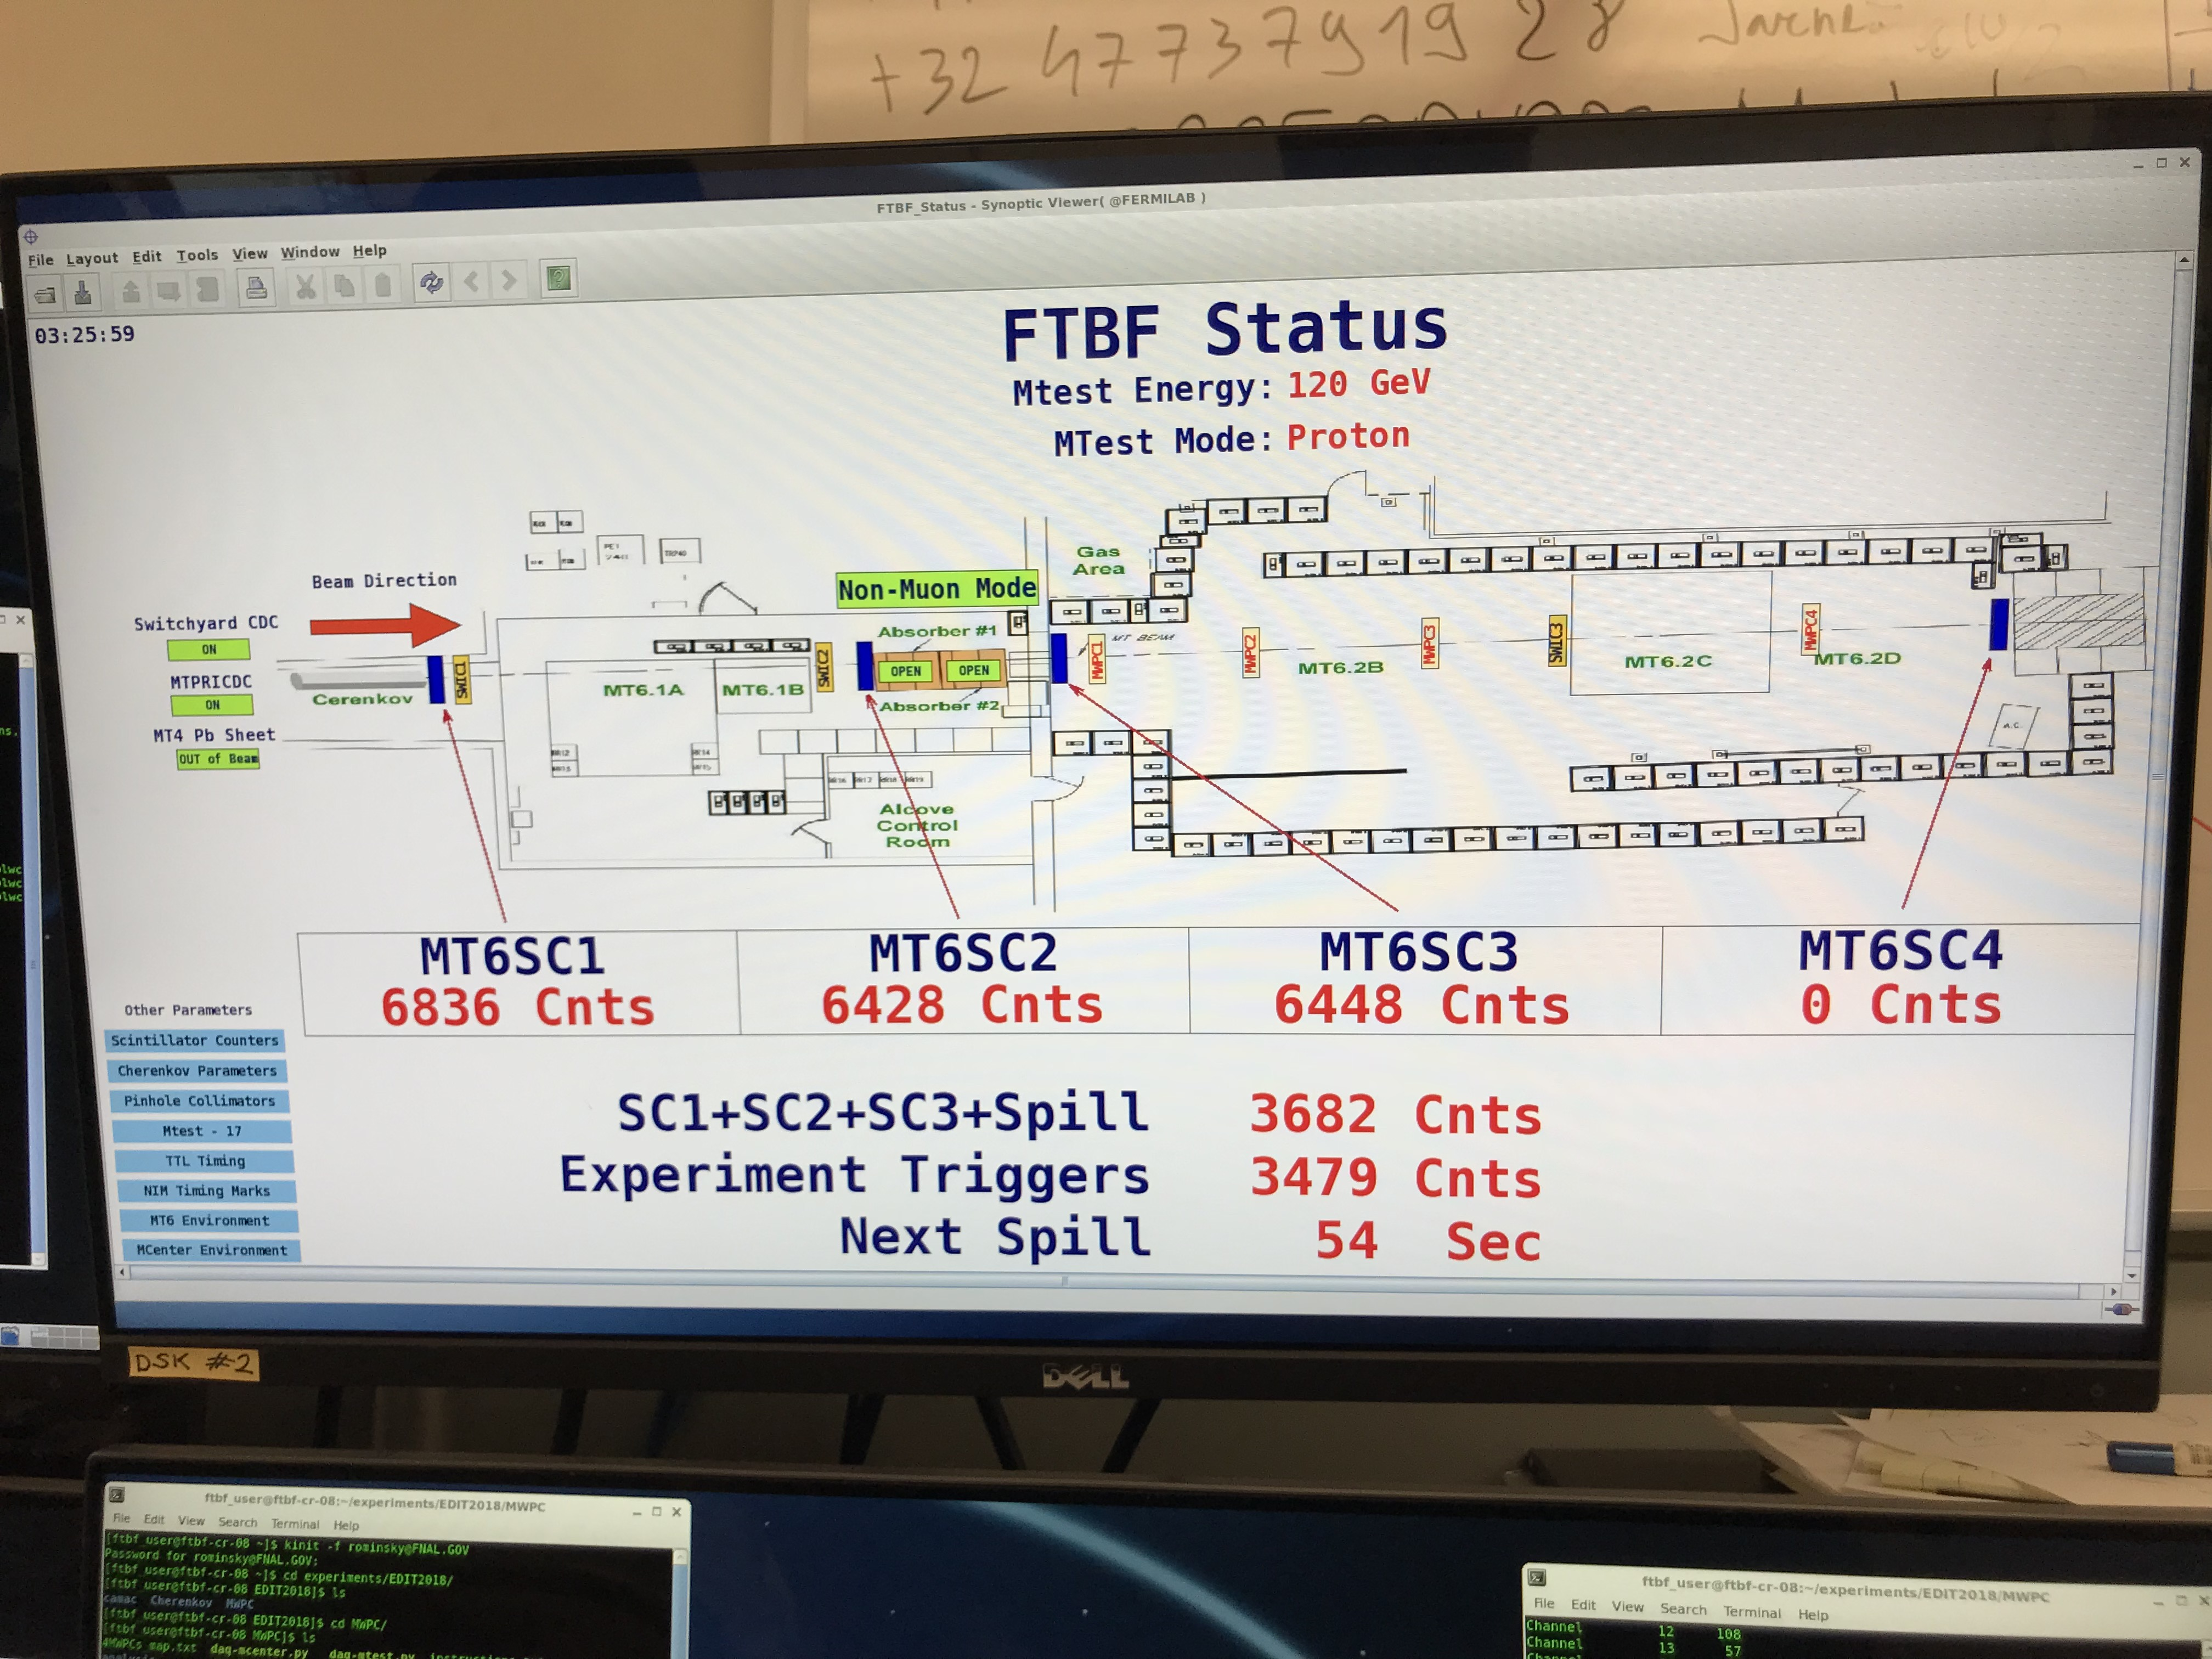
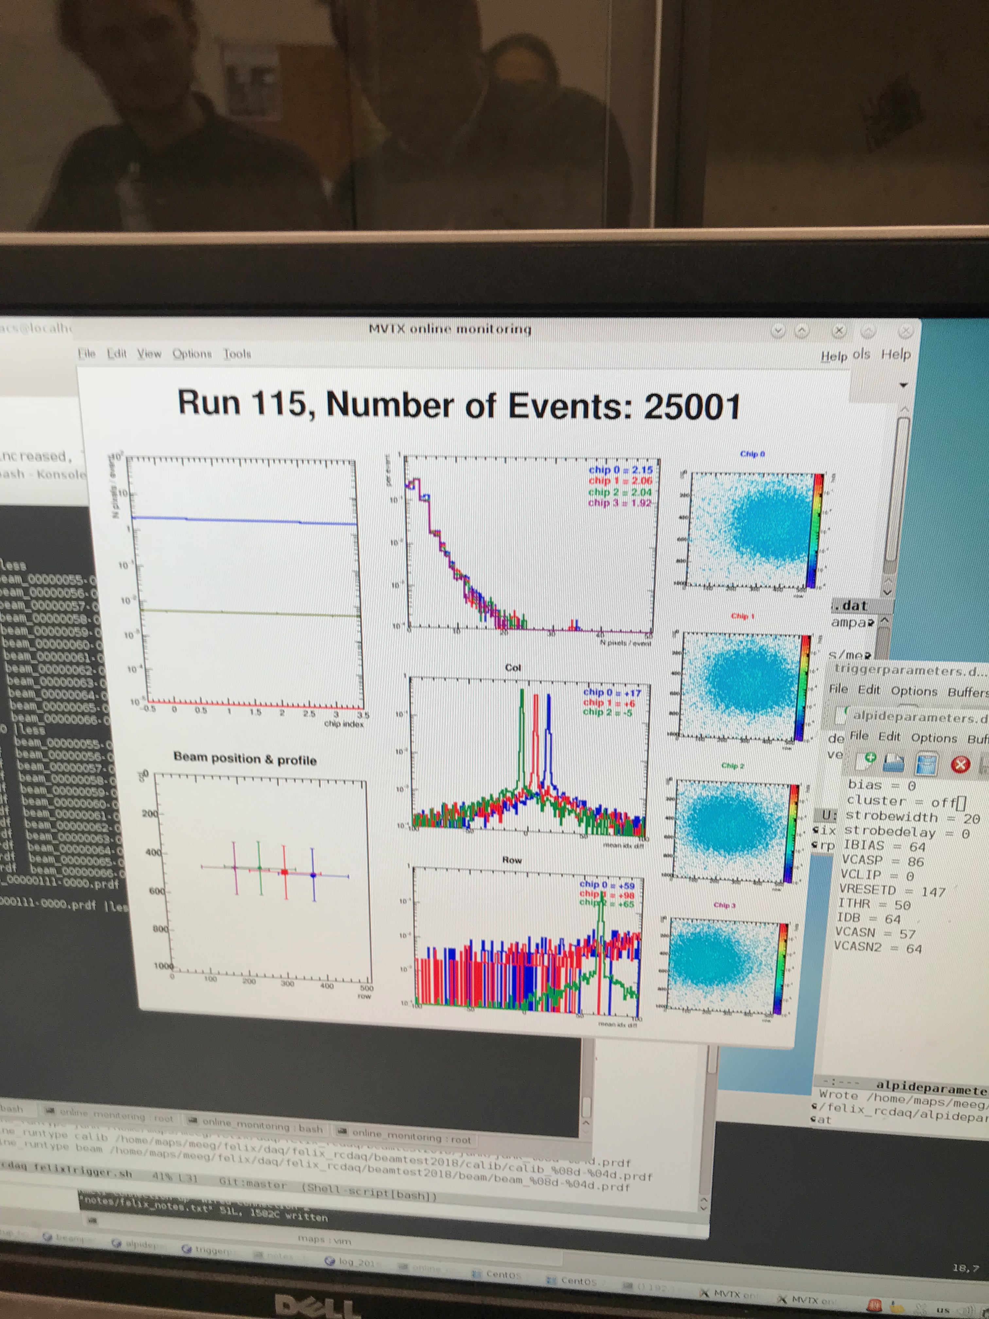
Test beam at FNAL
March, 2018
MVTX Telescope 03/2018
Online Monitoring @FNAL

Slide 8
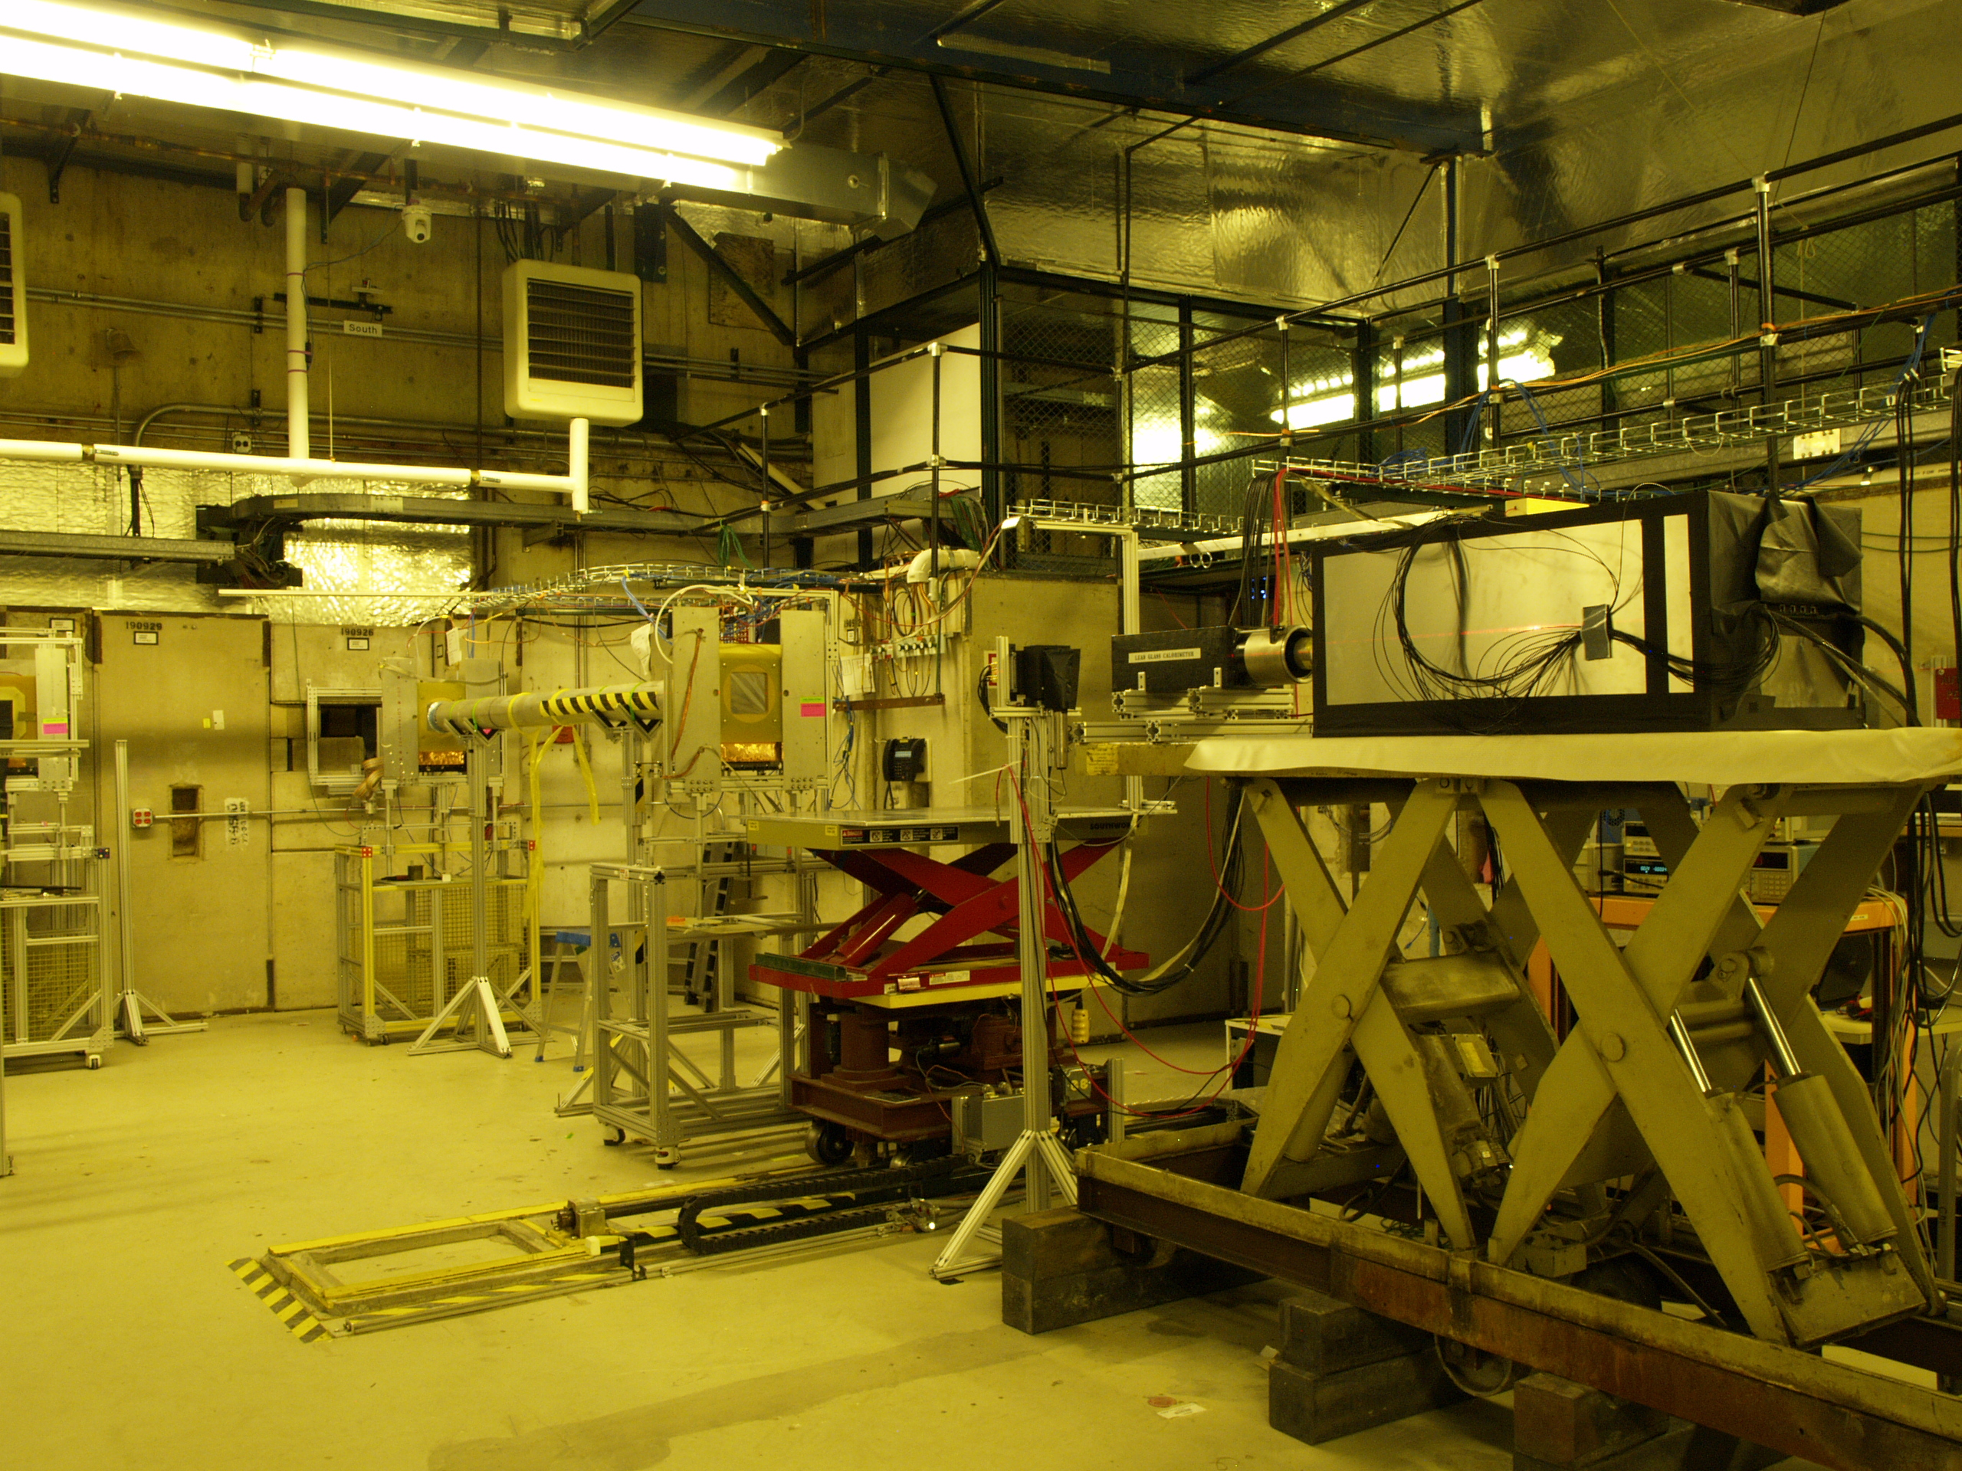
UCLA EMCal TB in 2014, Possible joint TB
We could use the table upstream of
UCLA Emcal for MVTX TB;
The same table was used for INTT
last time with MVTX located down stream
https://www.phenix.bnl.gov/WWW/publish/mxliu/sPHENIX/LDRD/FermilabTestBeam-032018/IMG_0673_sPHENIX_Overview.jpg
MVTX
UCLA EMCal

Slide 9
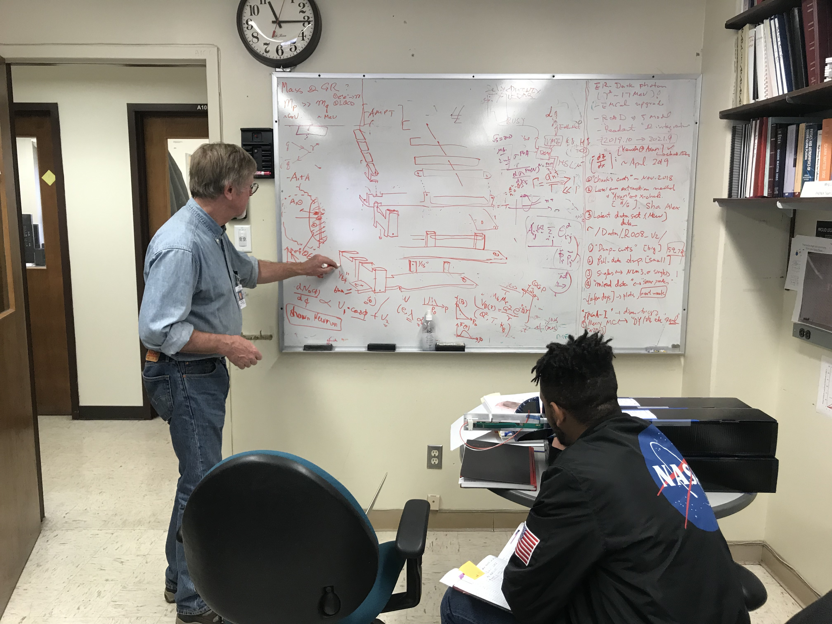
Preliminary mechanical support for 4-stave
Abel works with Hubert to fabricate stave
Support frames;

Slide 10
Early Test Beam with EIC/sPHENIX EMCal? April 3 -23, 2019
Possible MVTX telescope beam test:
- 4/14-23 @ Fermilab
*BNL sPHENIX Director’s review:
4/8-13 @BNL
MVTX and INTT will be reviewed

Slide 12
Readout Development Work
Sho’s summary page:
https://p25ext.lanl.gov/maps/readout.html
MVTX technical document: https://www.overleaf.com/18152646jkqtztvgnrtp

