Slide 1
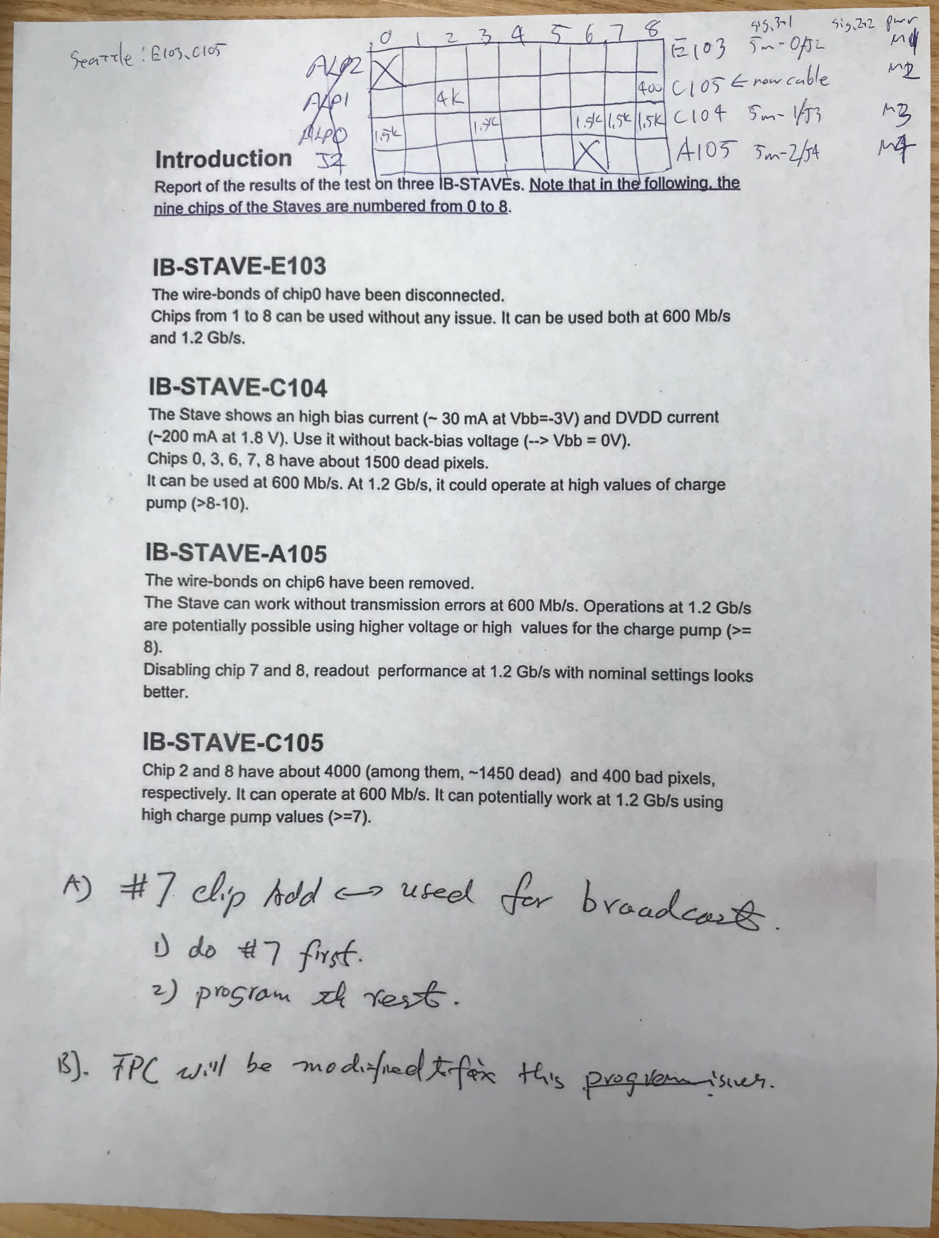
MVTX 4-stave Telescope Setup Photos
4 staves
GTM
RU
PU
SamTec Cables, 5m & 8m
USB control
LAN
Cooling system

Slide 2
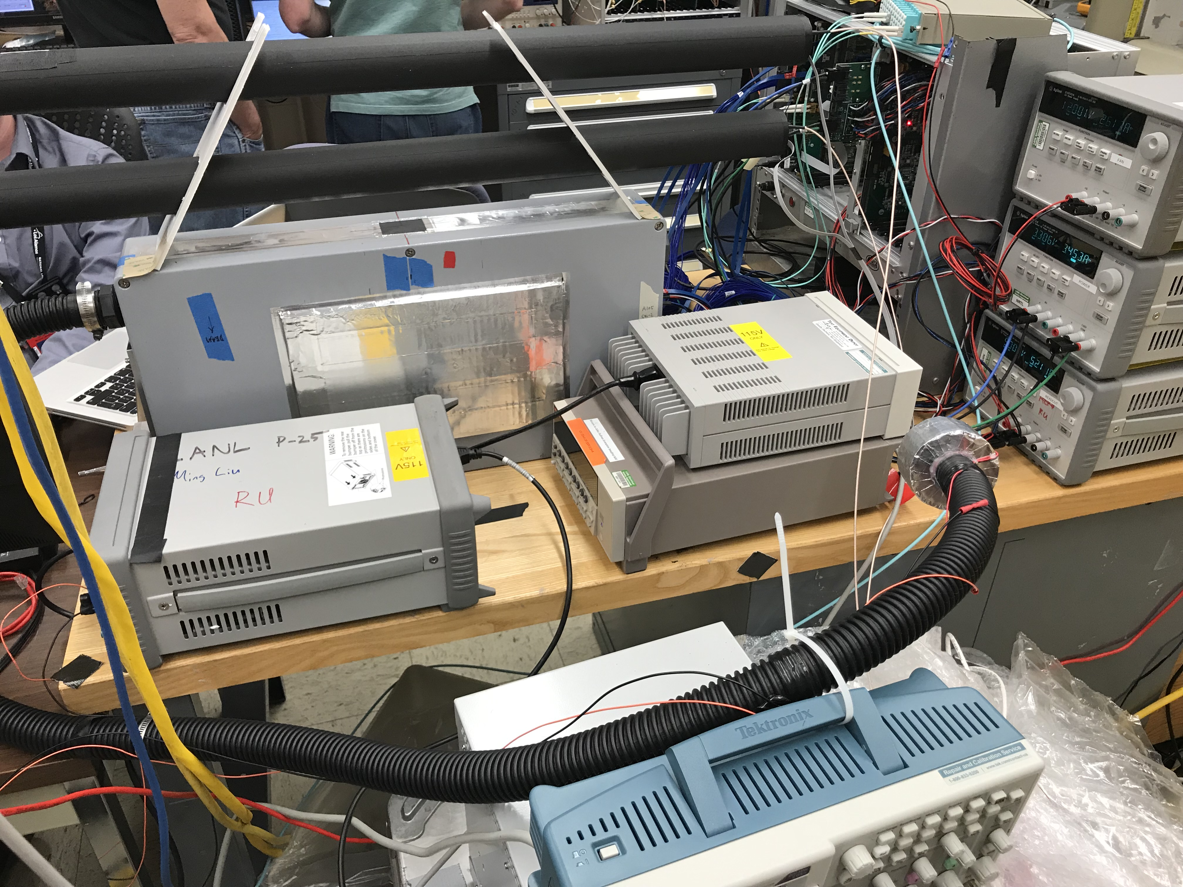

Slide 3
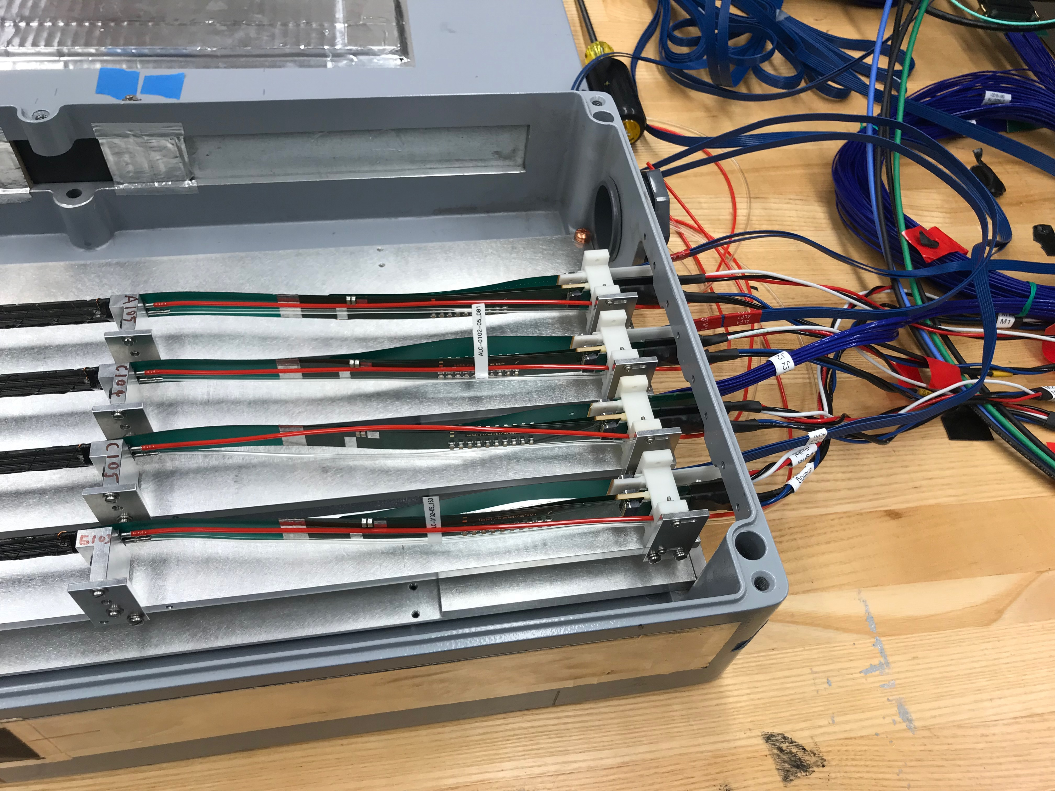
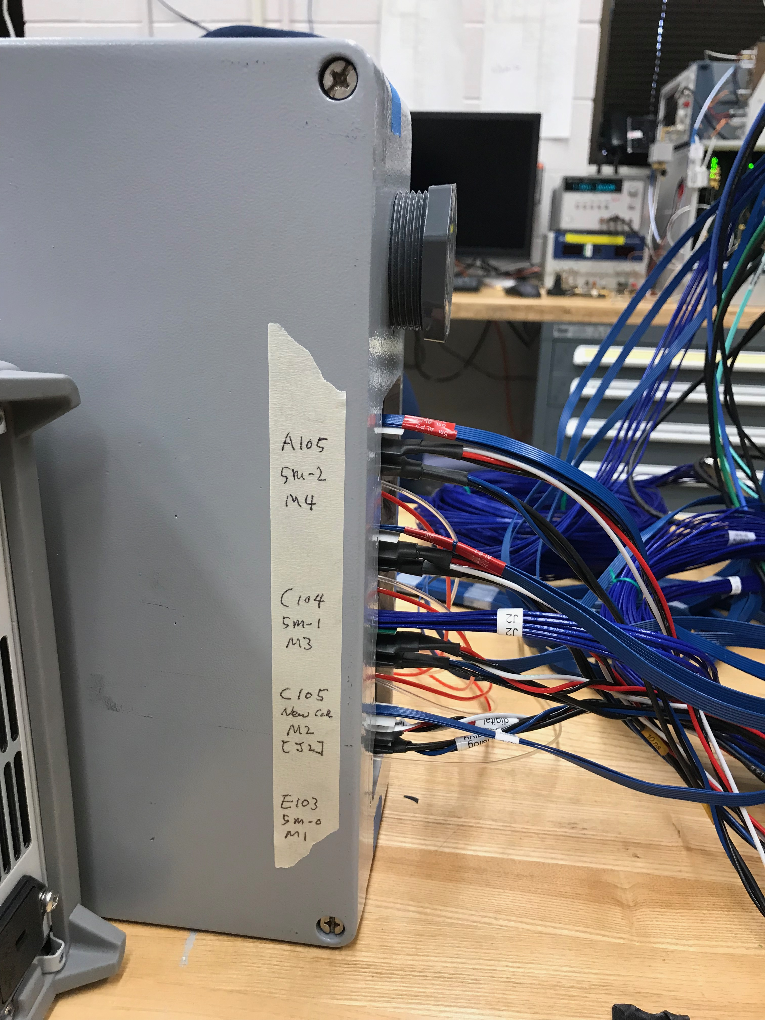
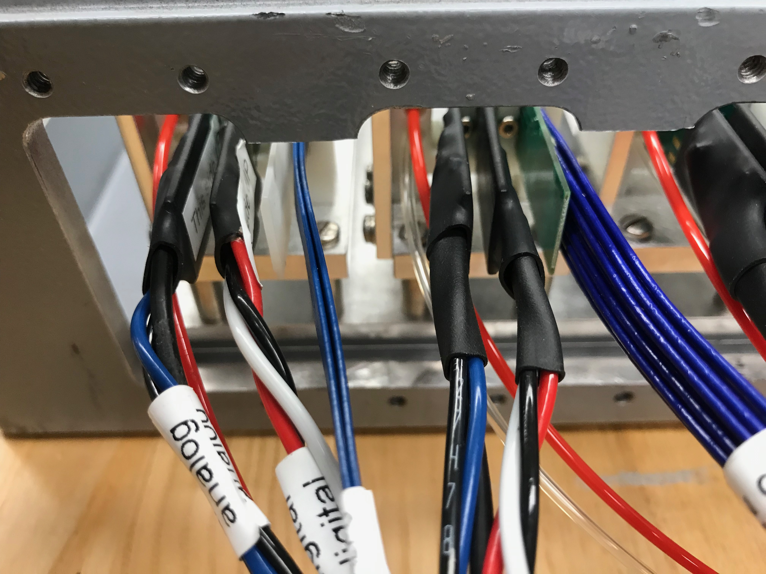

Slide 4
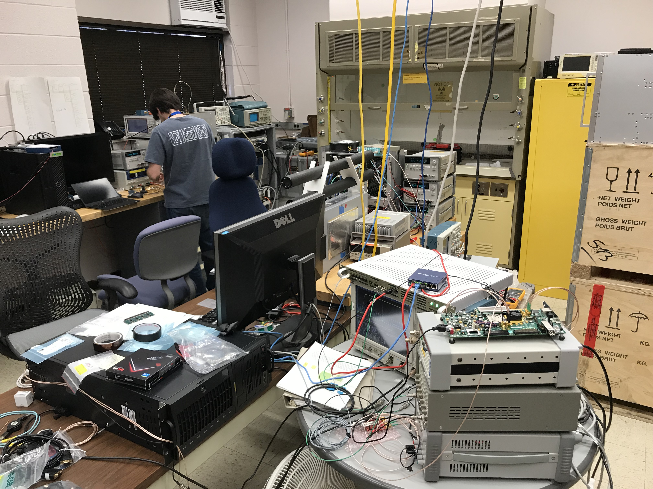

Slide 5
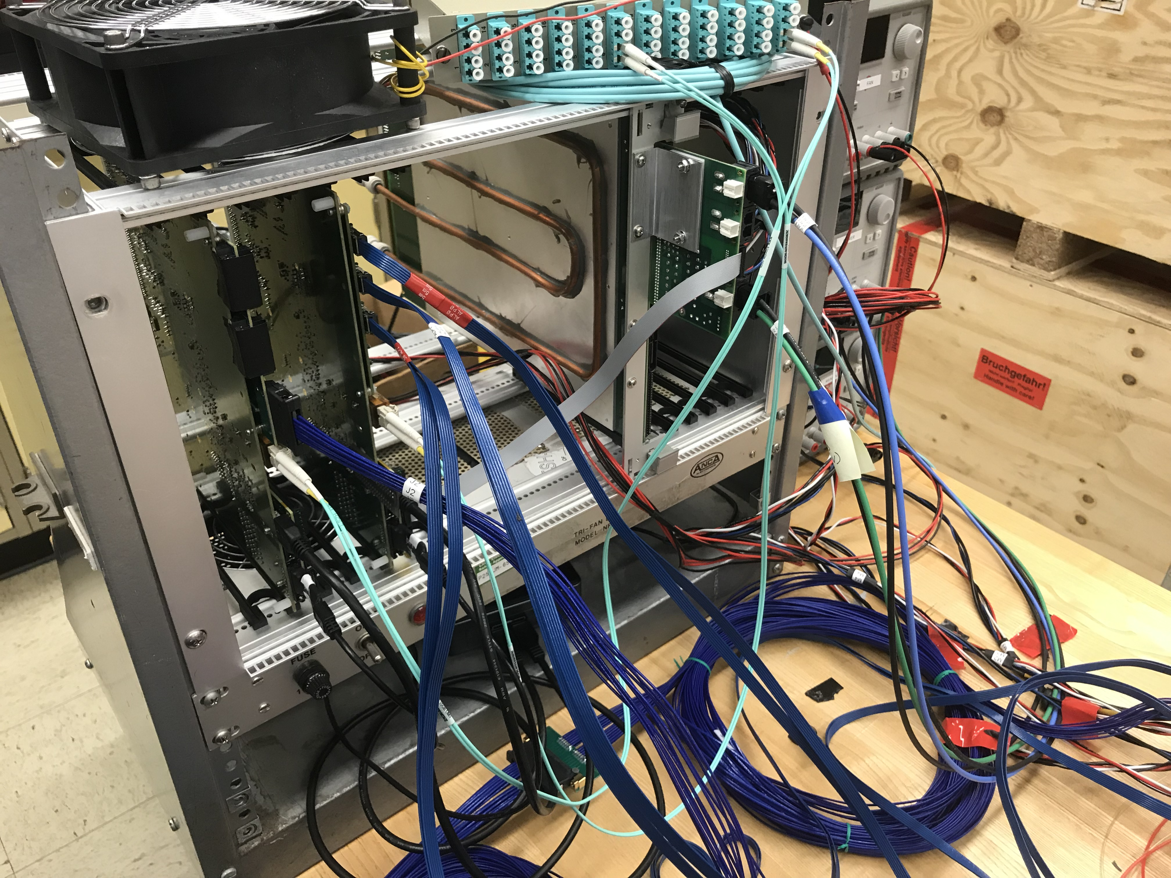
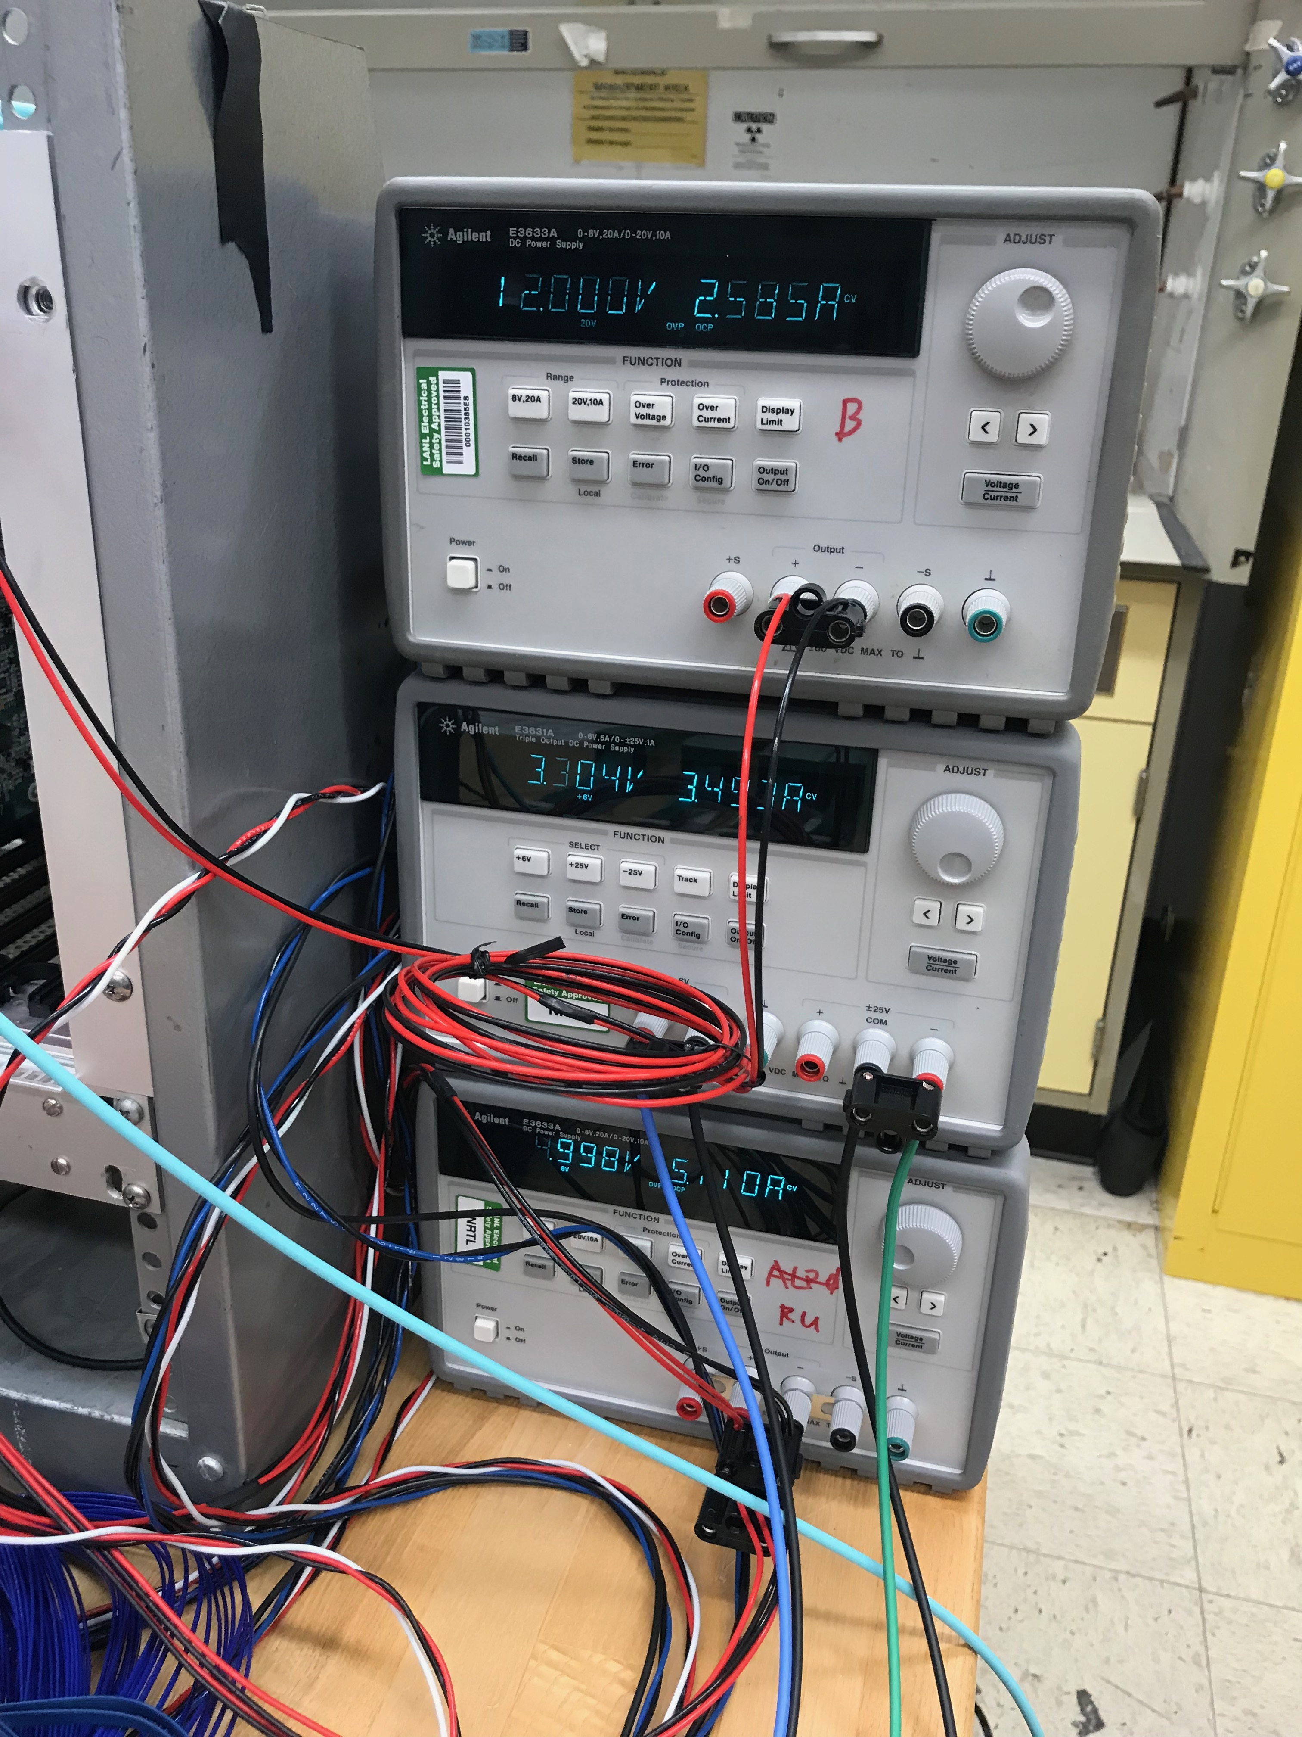

Slide 6
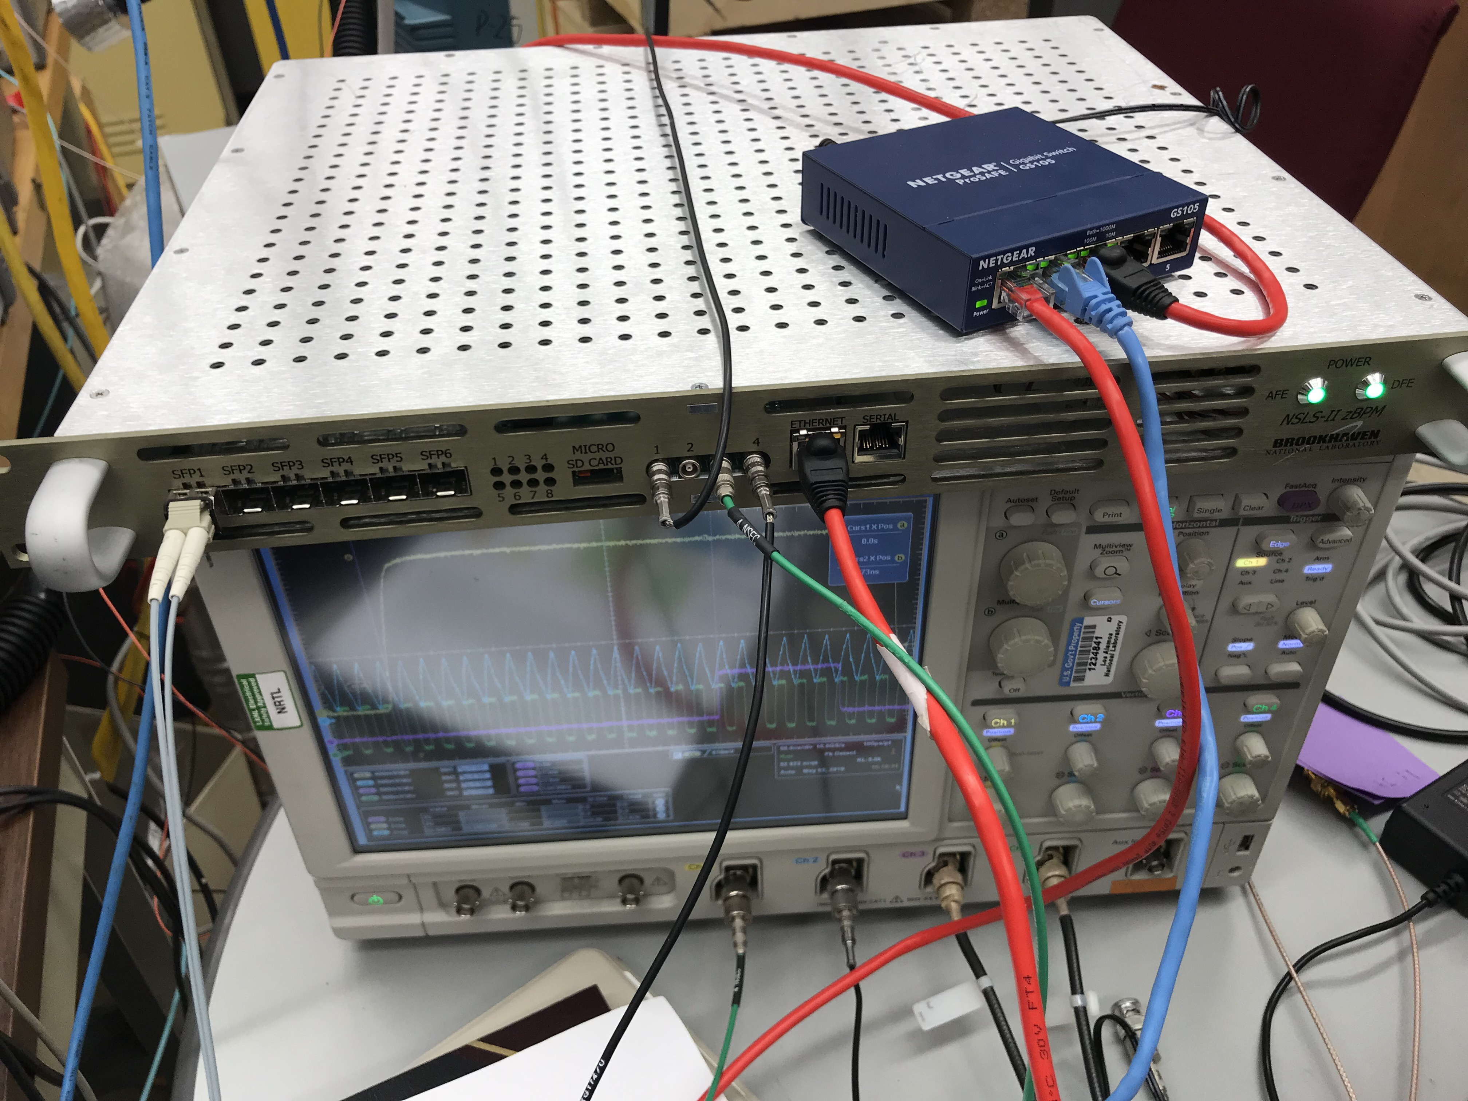
LAN
To NUC
From GTM
External
Trigger
To LAN-box
Trig. Out
Fiber to
FELIX
6x RHIC CLK
OUT
To FELIX server

Slide 7
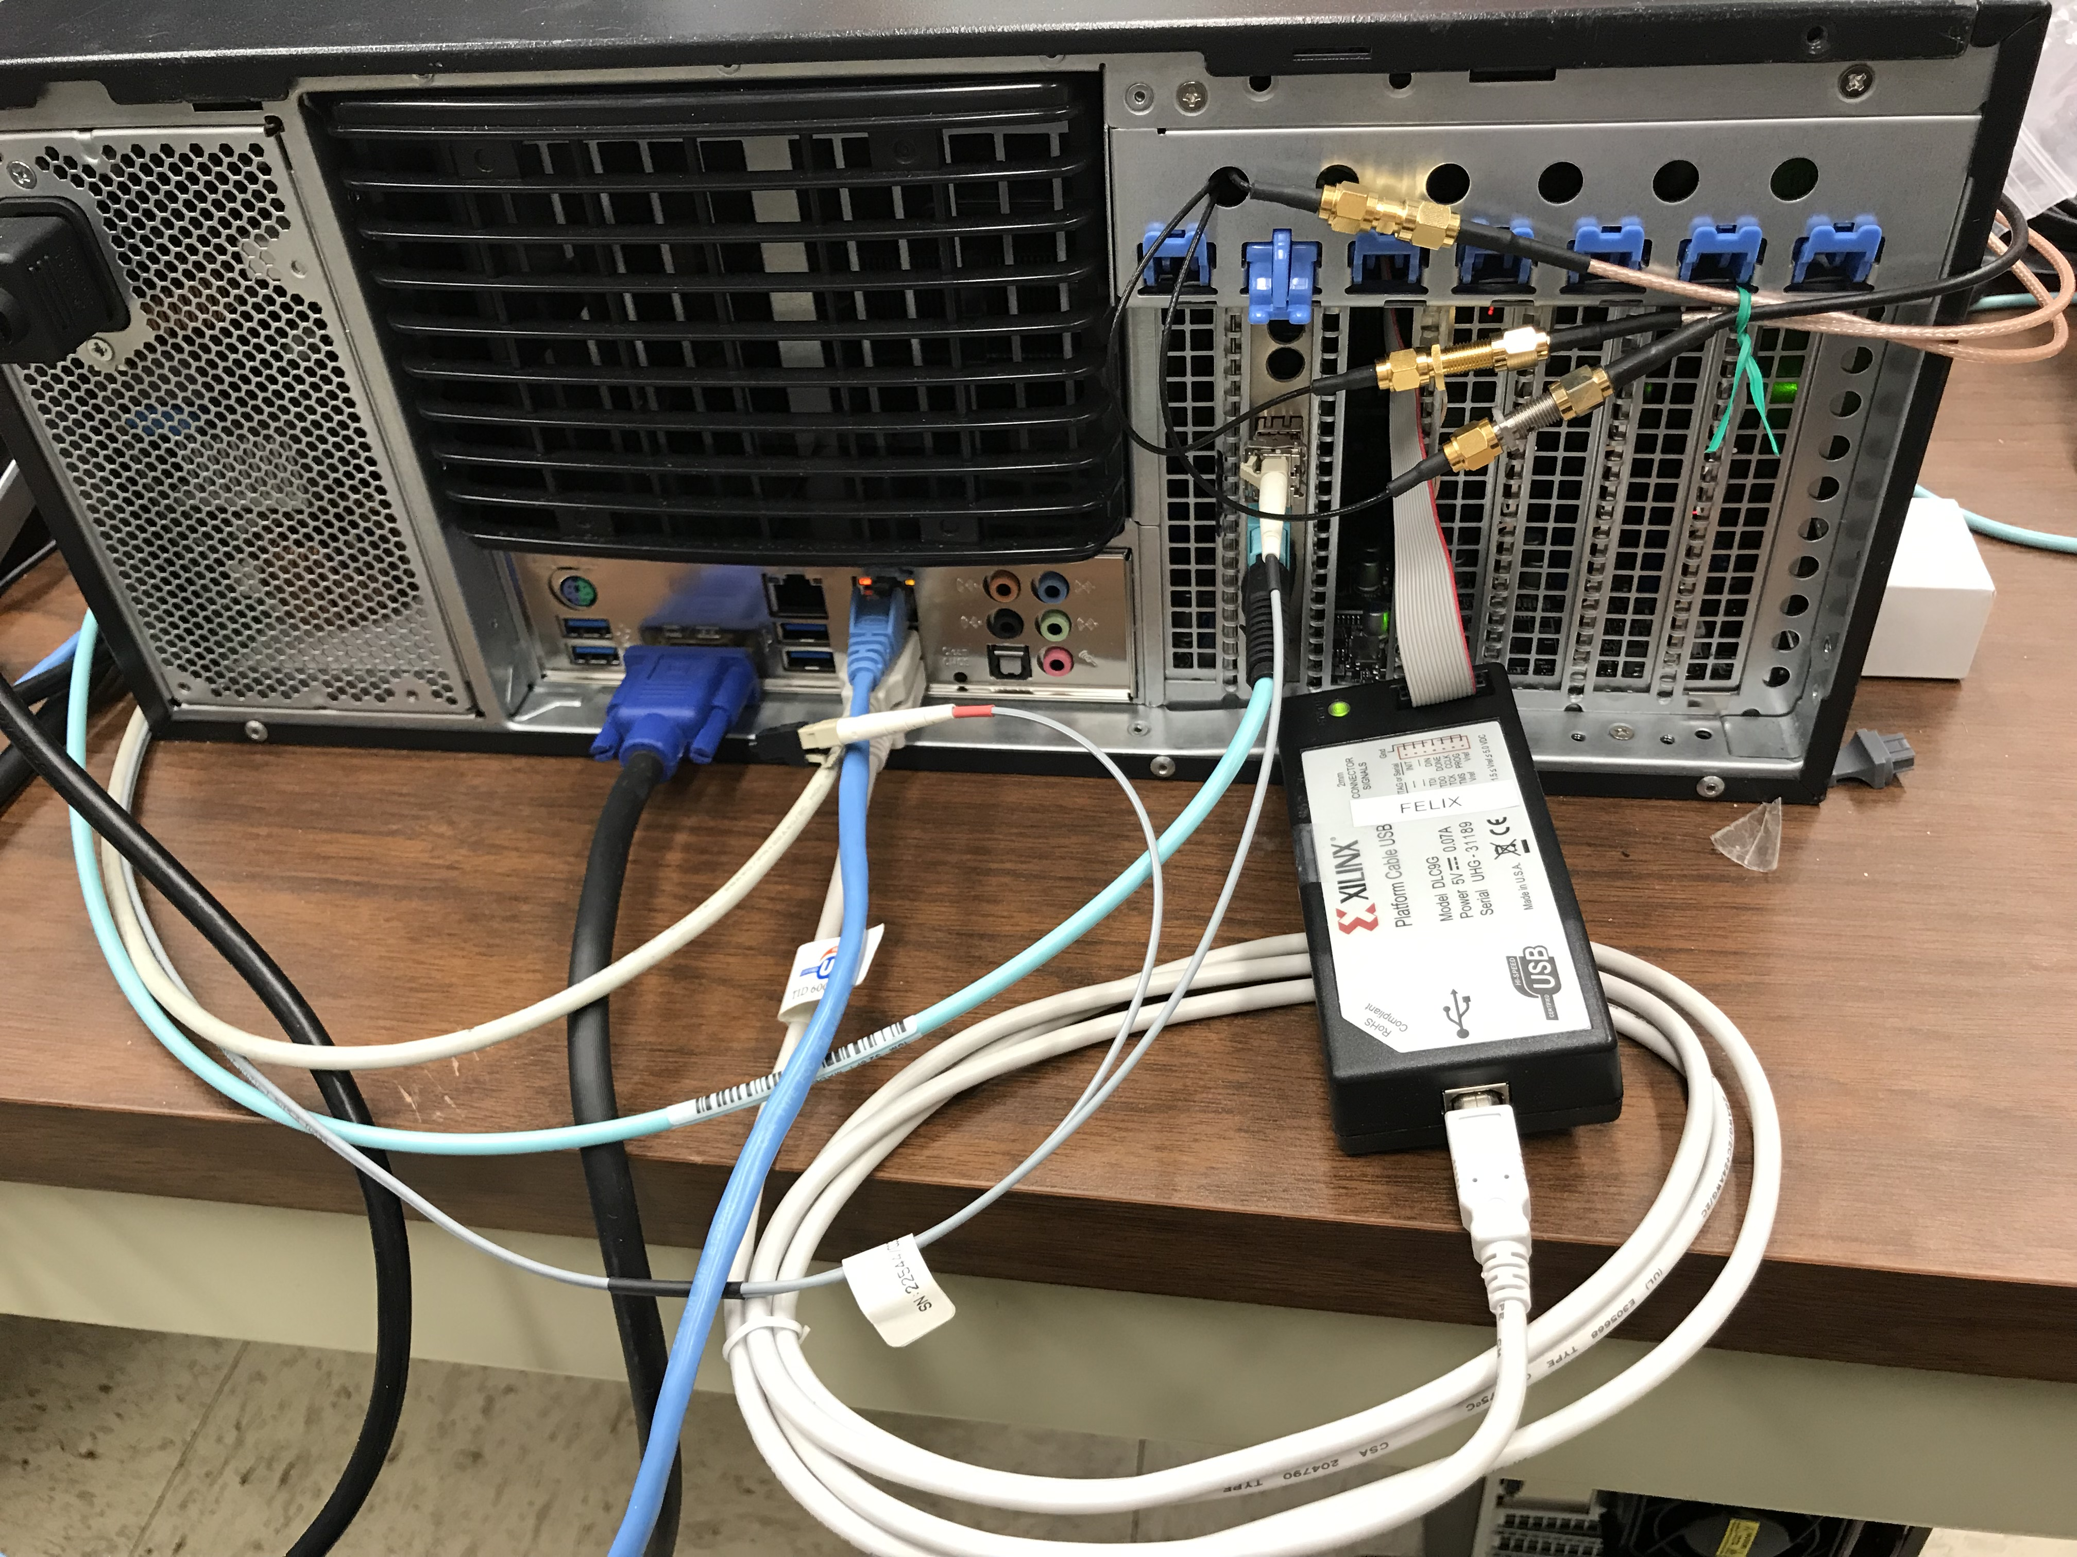
Synced FELIX
CLK & trigger
To key board/mouse
RU-FELIX
fibers
GTM fiber

Slide 8
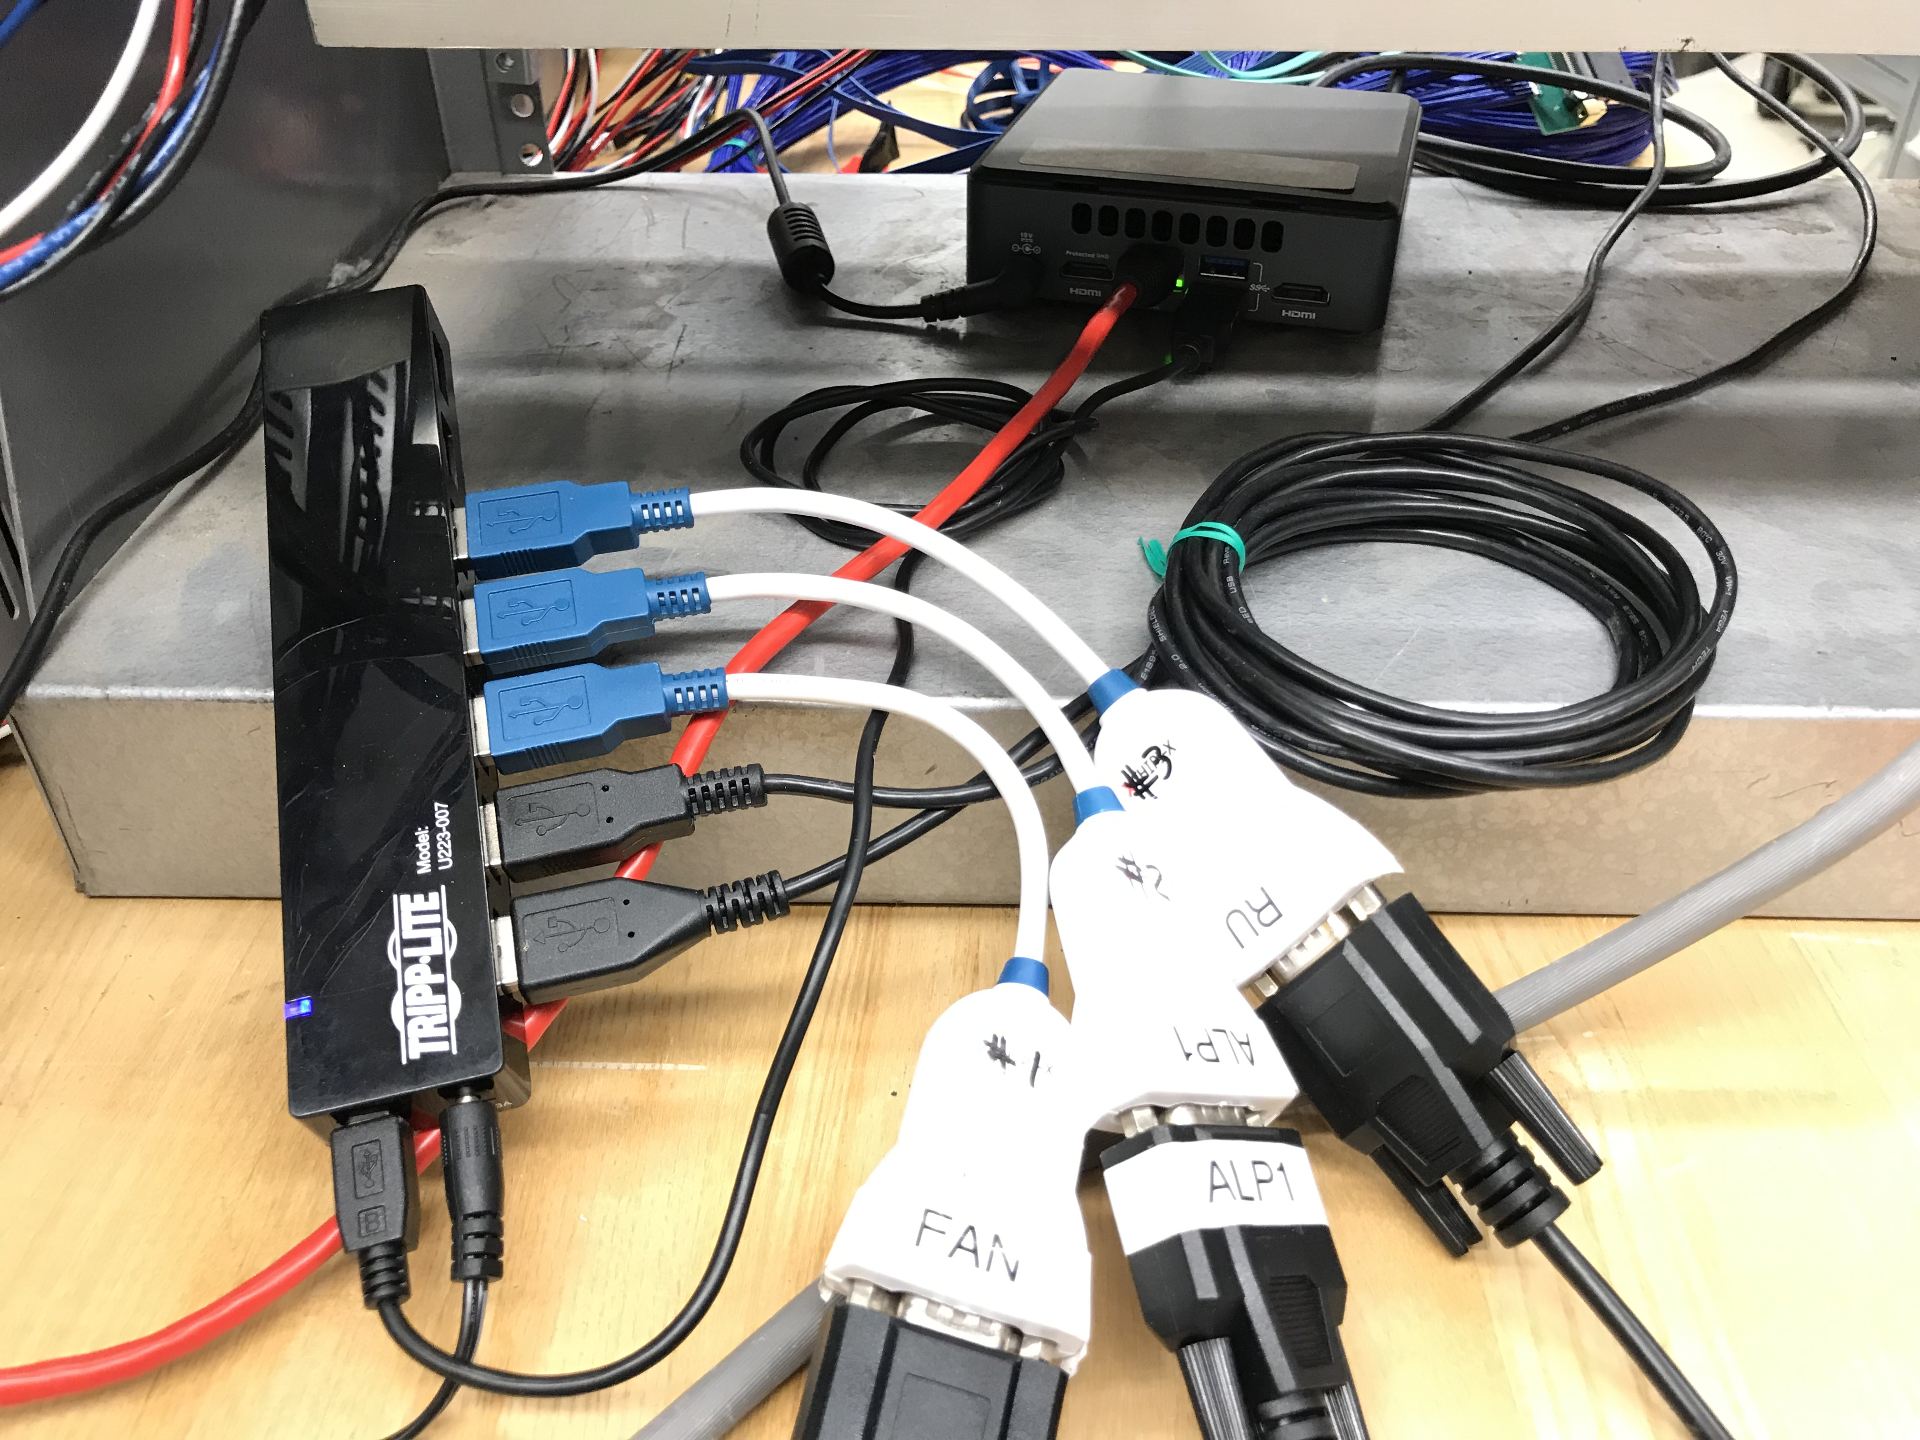
NUC
to USB hub
2 USB-JTag
NUC-LAN
PS controls

Slide 9
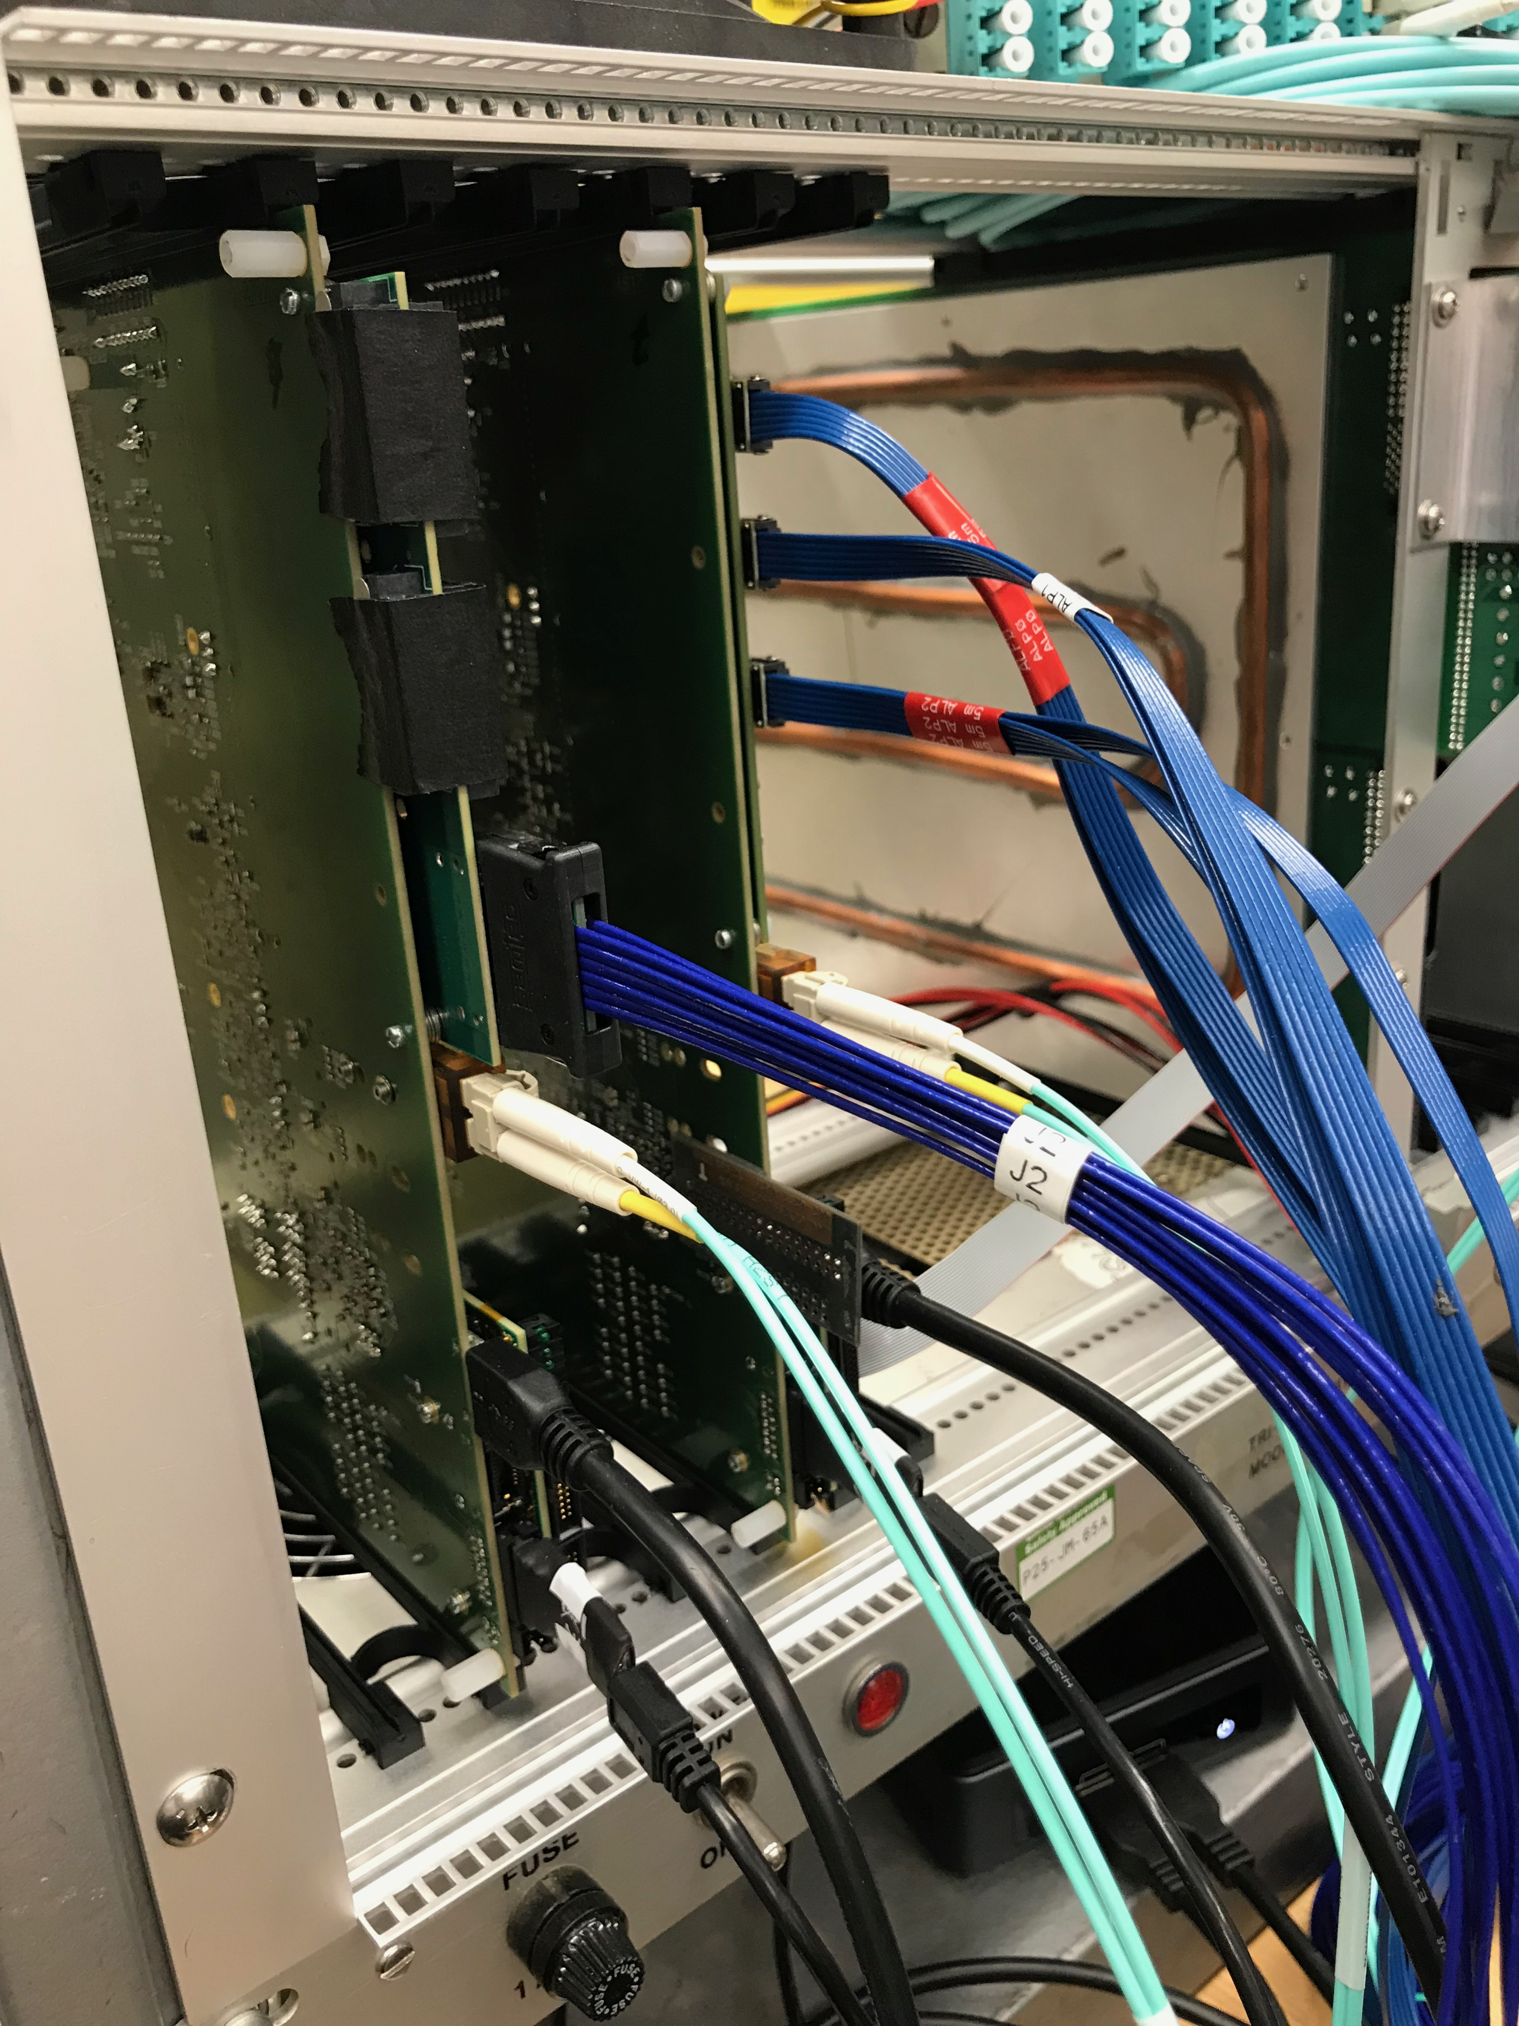
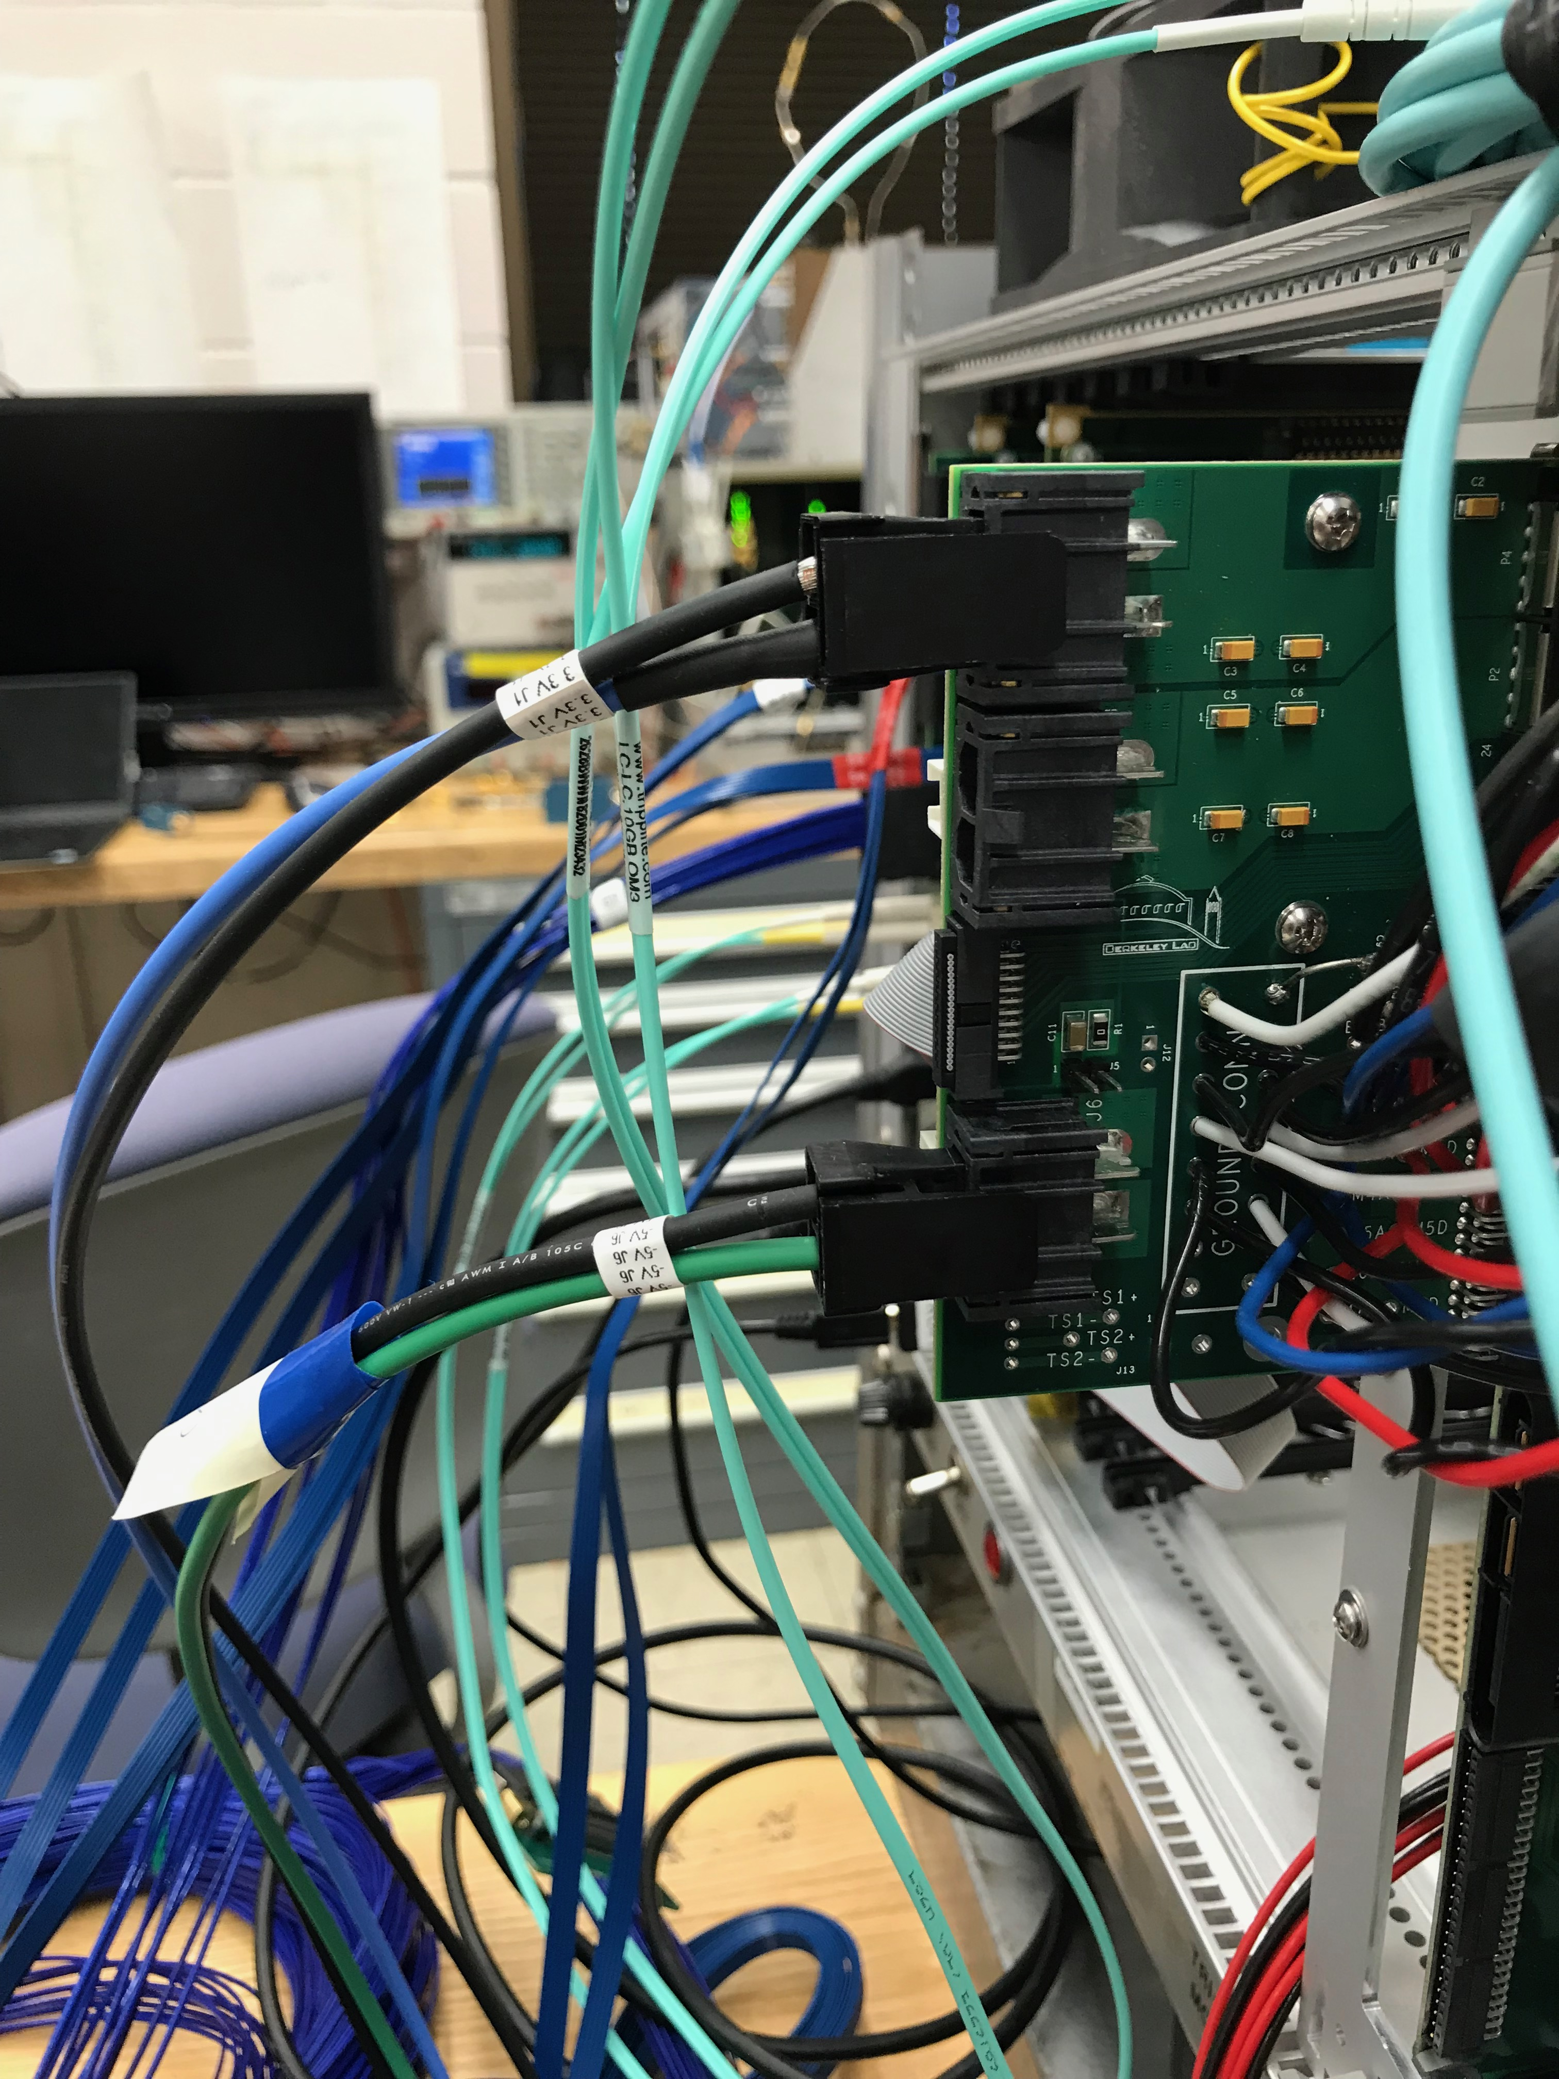
RU-1
Stave LV:
3.3V
RU-2
RU-PU
cable
Data/control
fiber
Bias HV:
-5.0V
USB
Jtag-USB;
from USB hub
USB - RU
From NUC

Slide 10
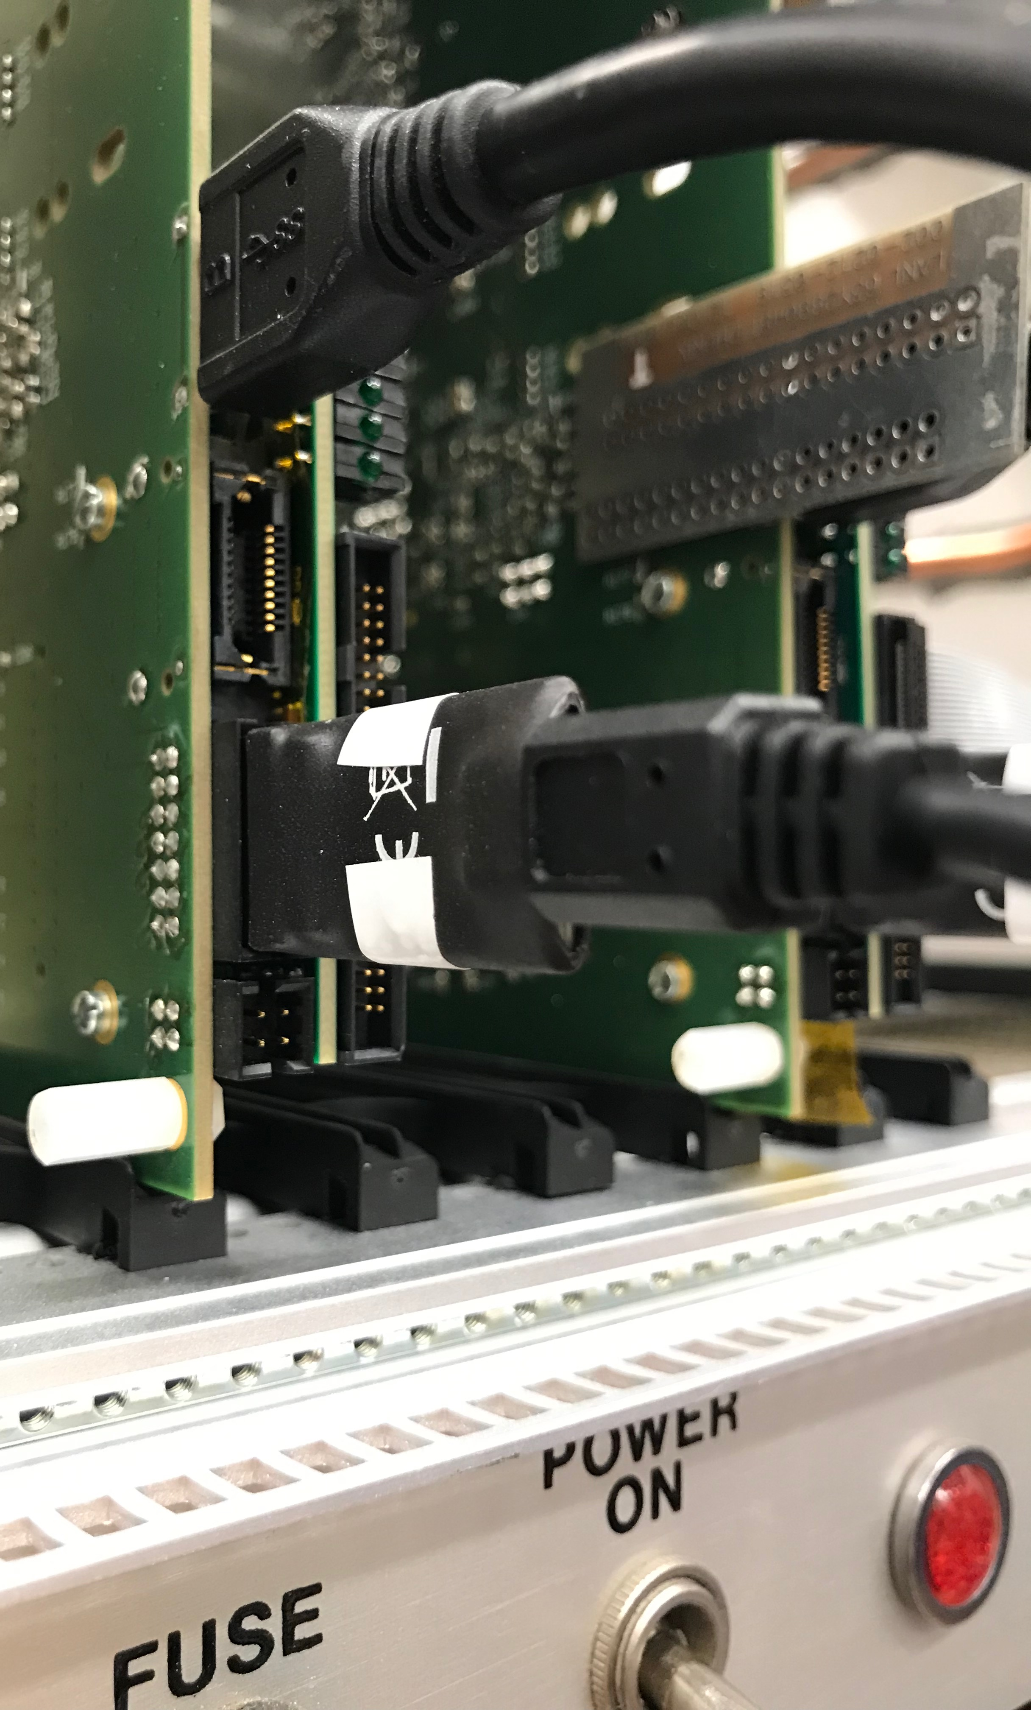
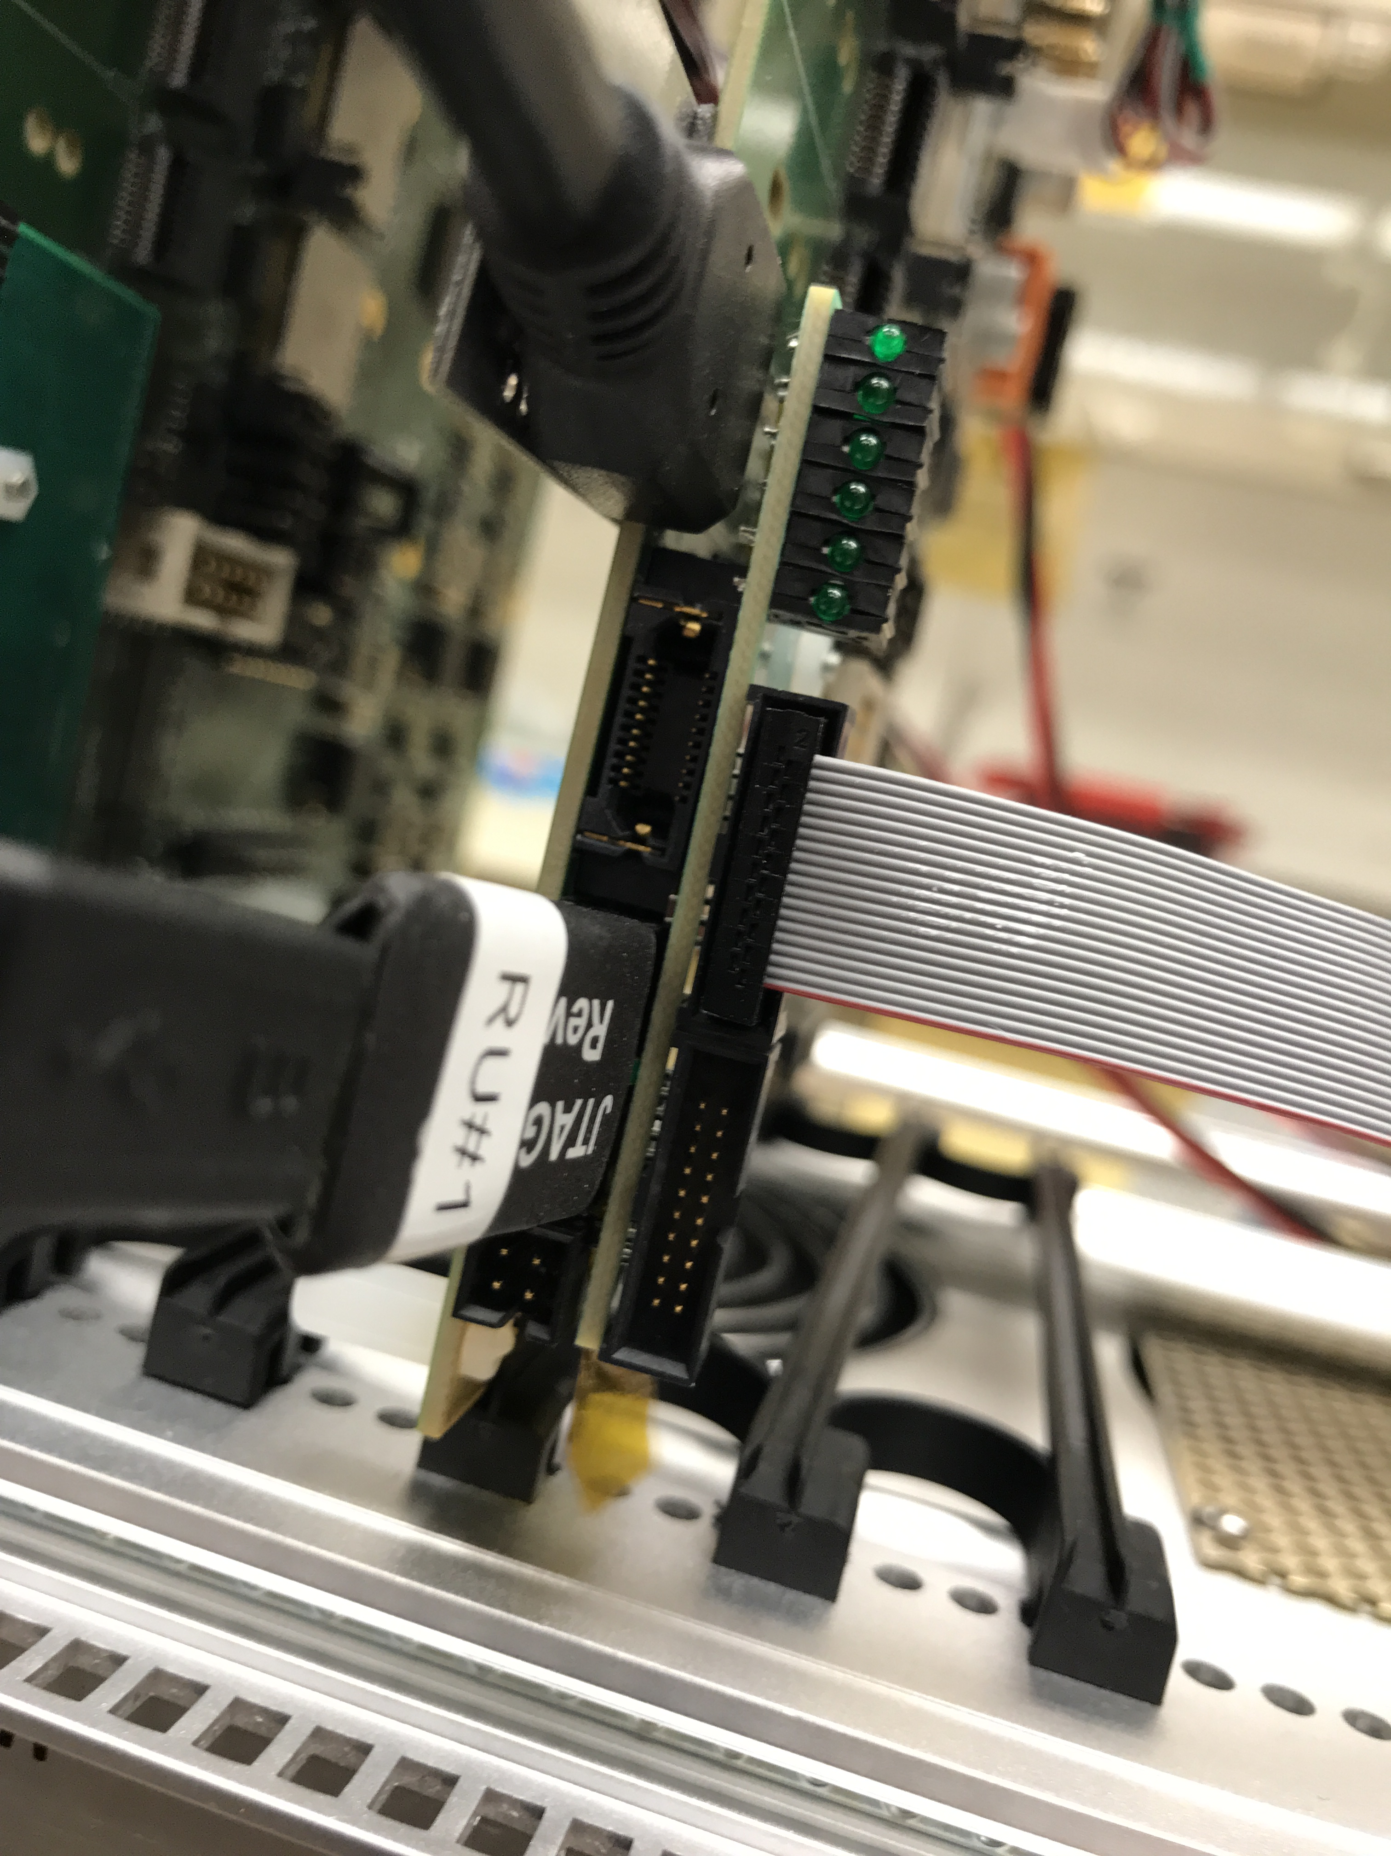
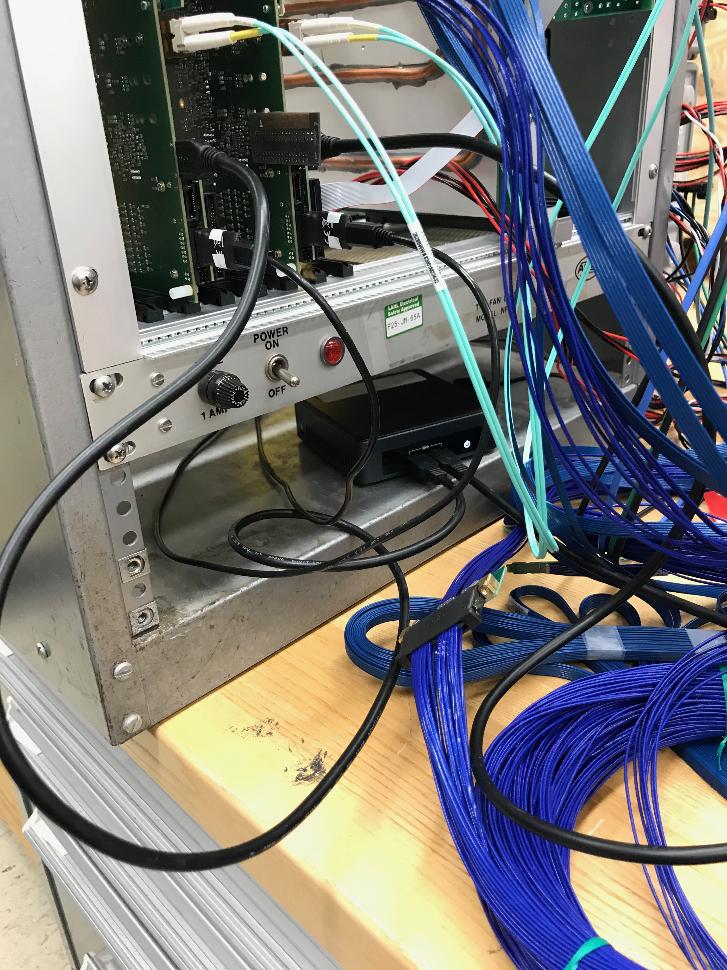
USB from NUC
RU – USB Connections
USB from NUC
RU-to PU
Jtag-USB#2 from NUC
2 USB to
RU
Jtag-USB #1
from NUC

Slide 11
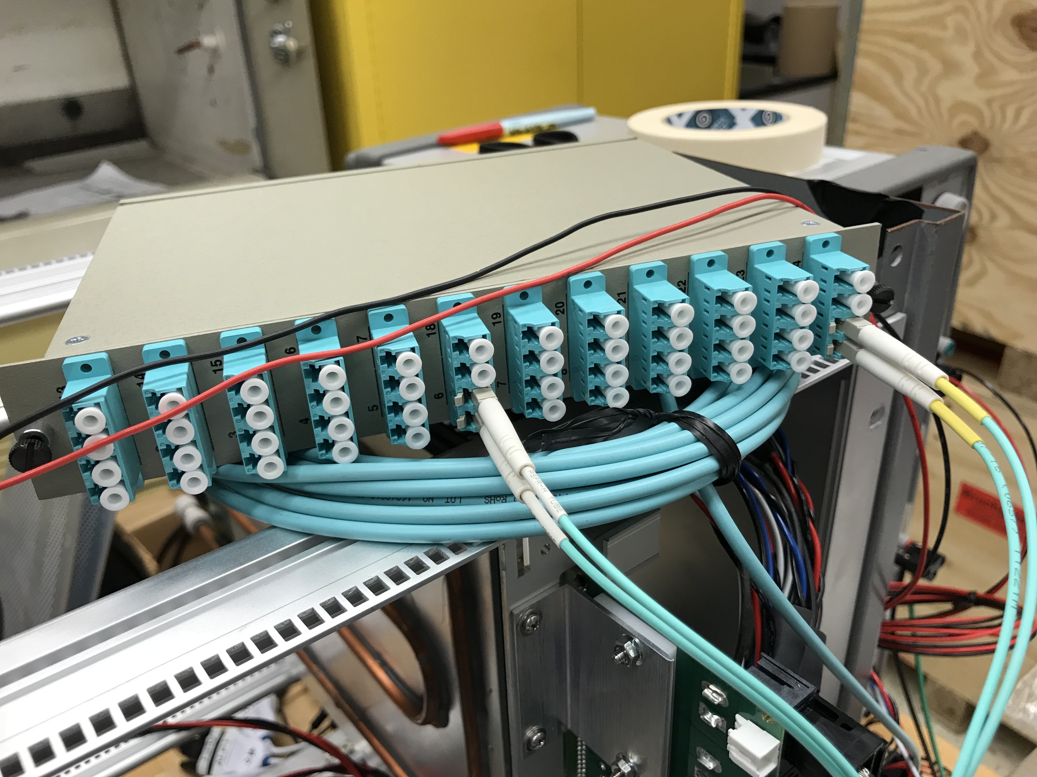
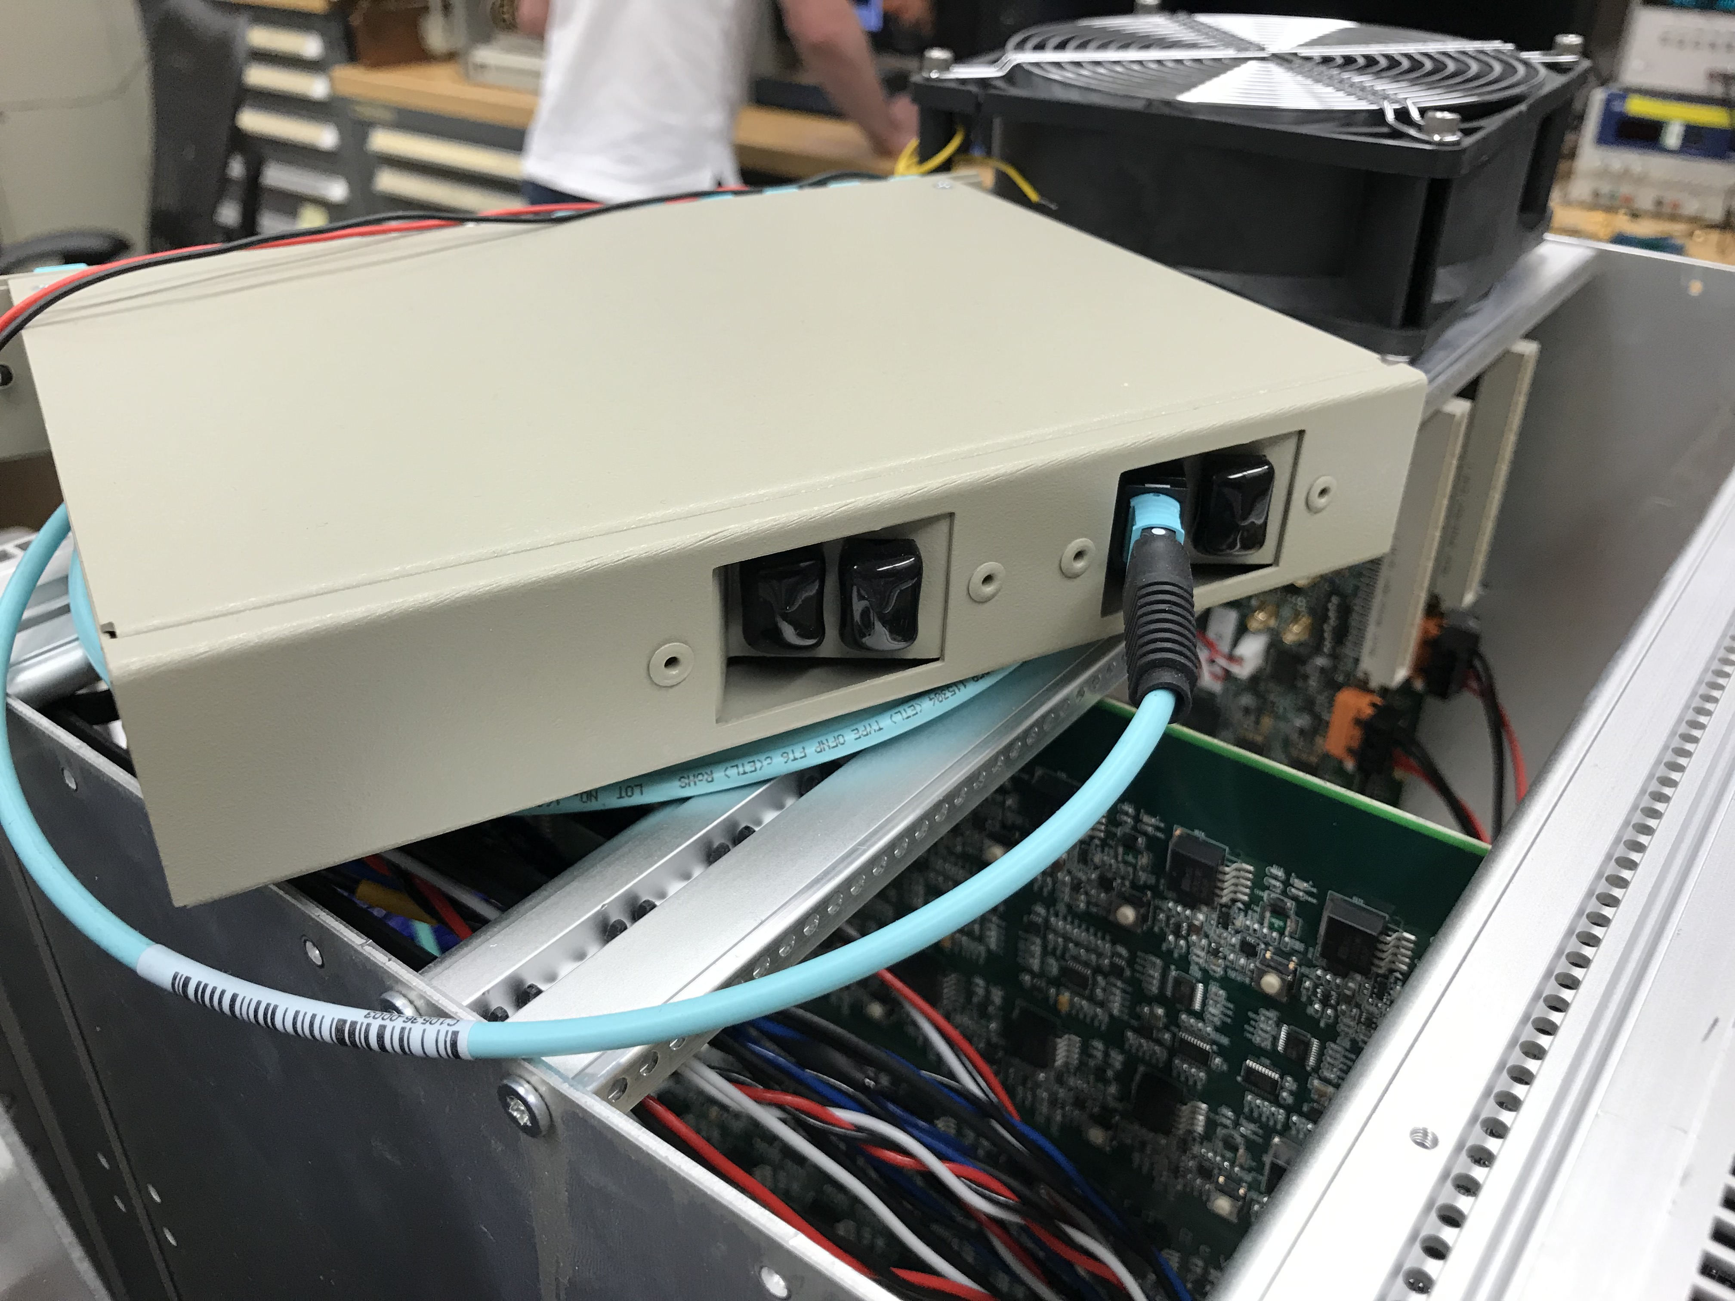
RU-FELIX Fibers

Slide 12
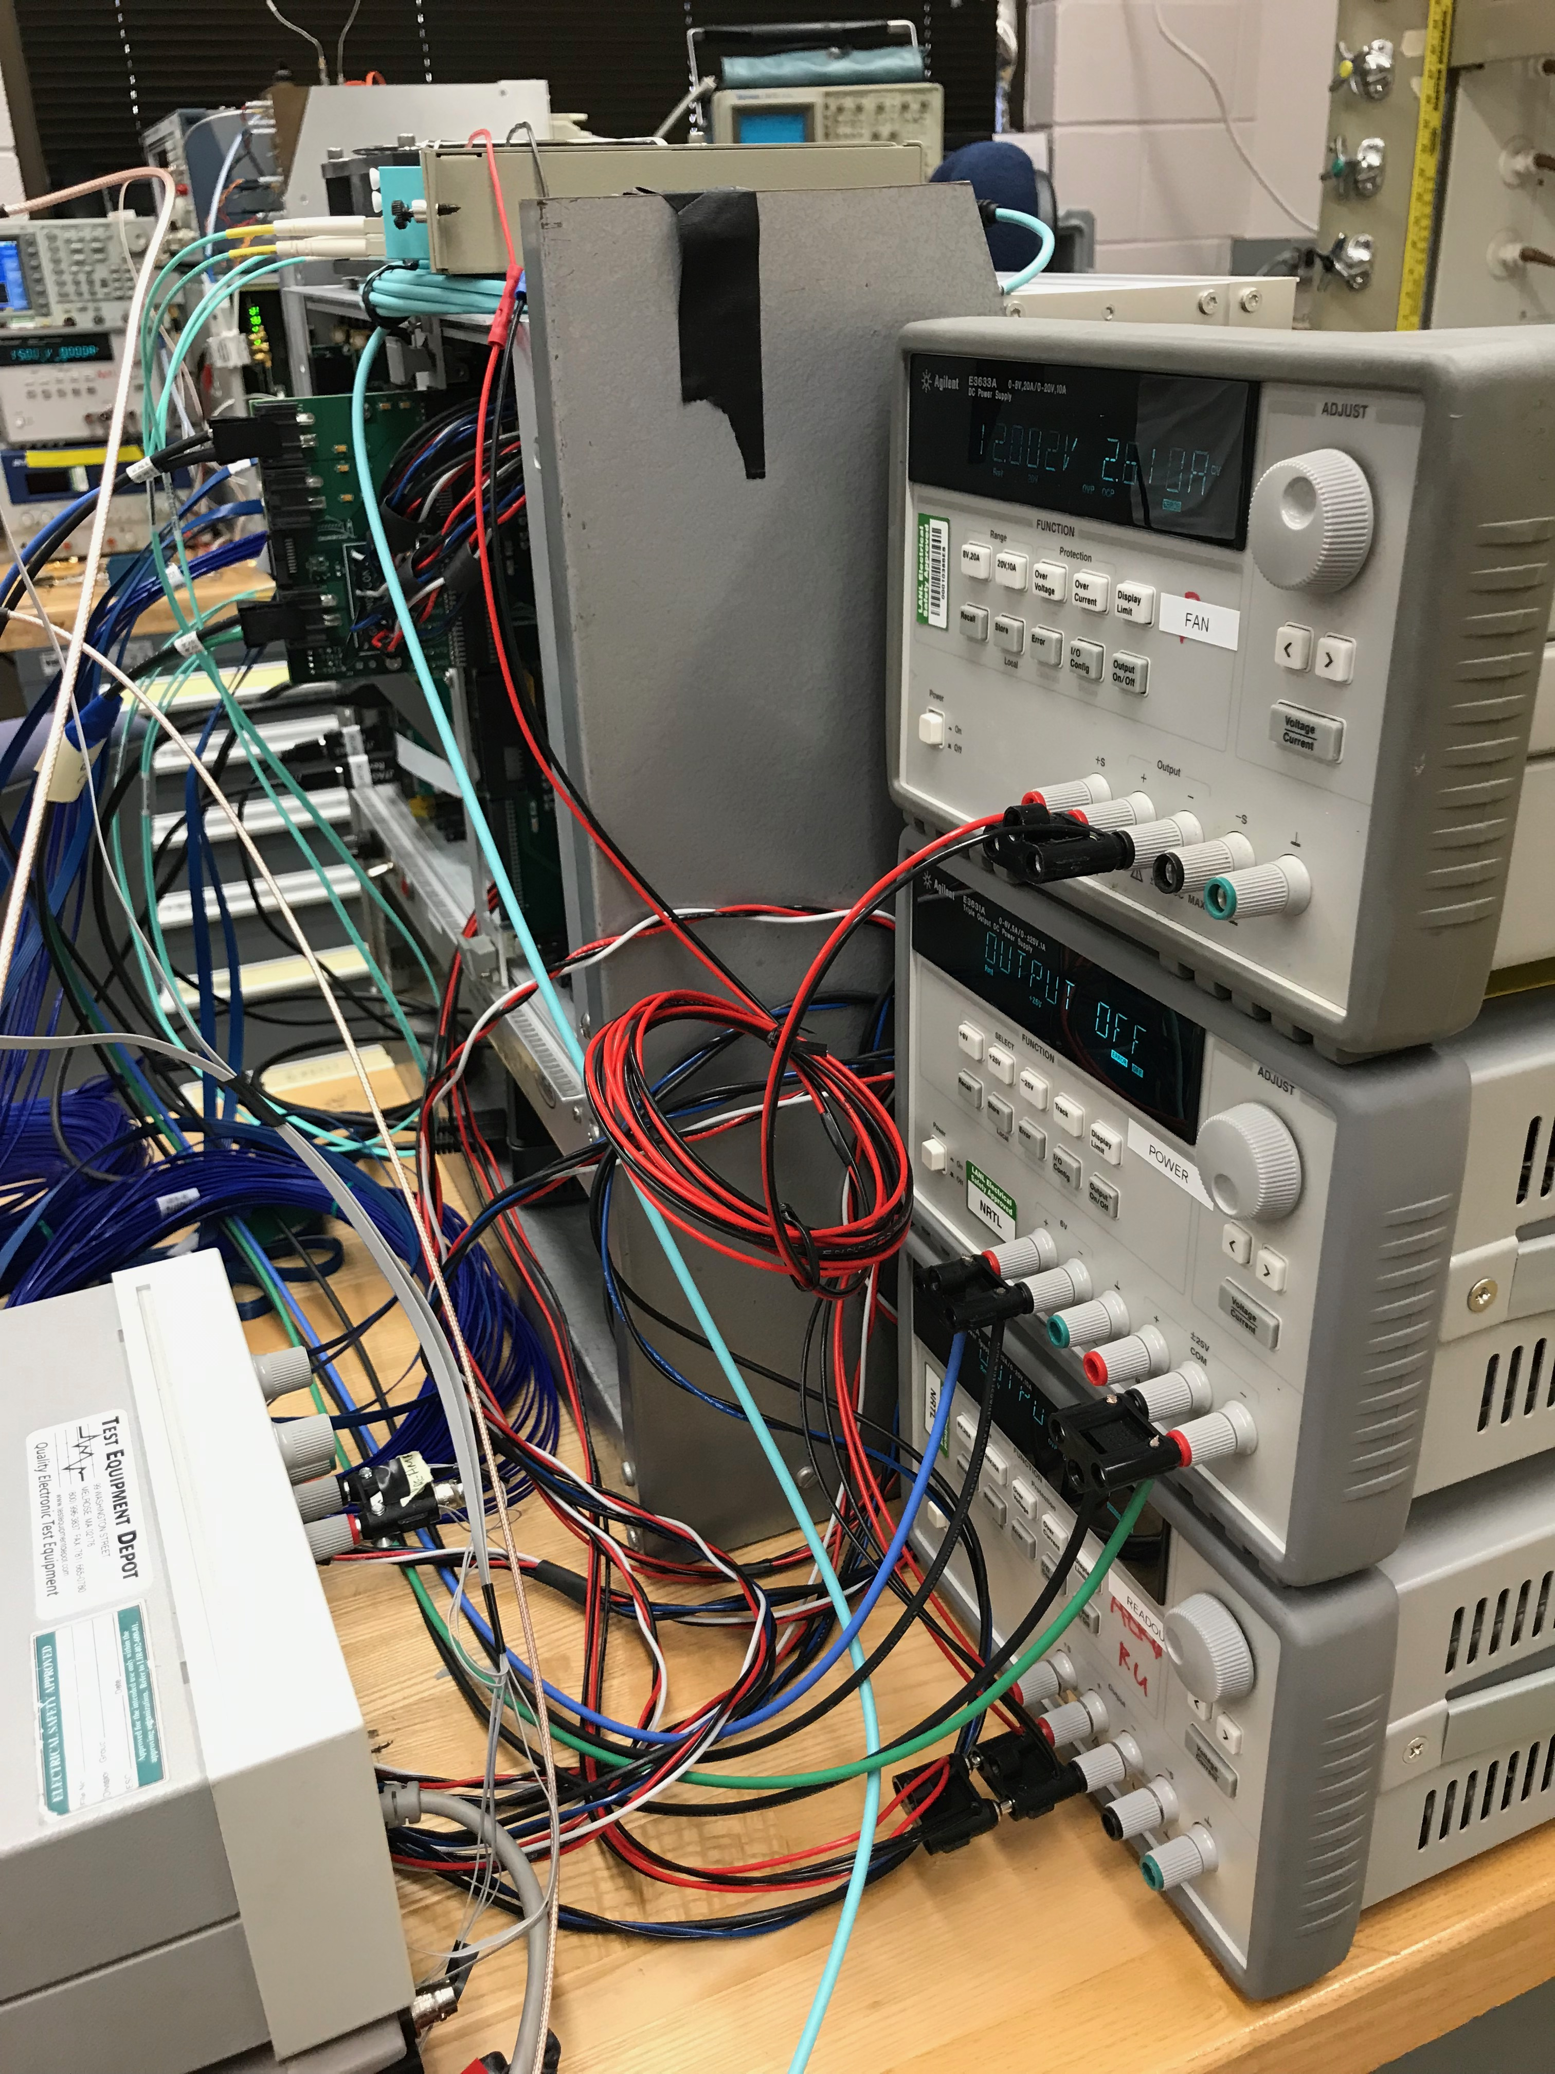
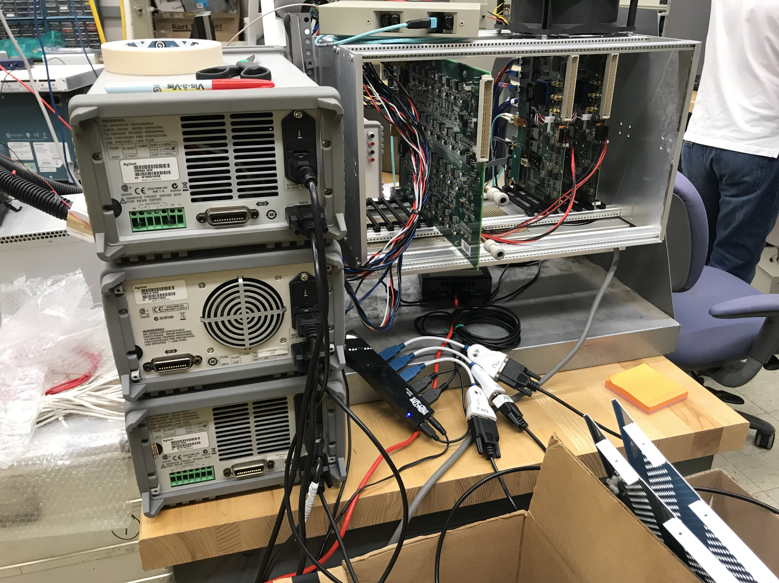
Power Supplies
USB hubs
FAN: 12V
FAN: 12V
Stave:
LV: 3.3V
Bias: -5.0V
RU: 5V
RU: 5V

Slide 13
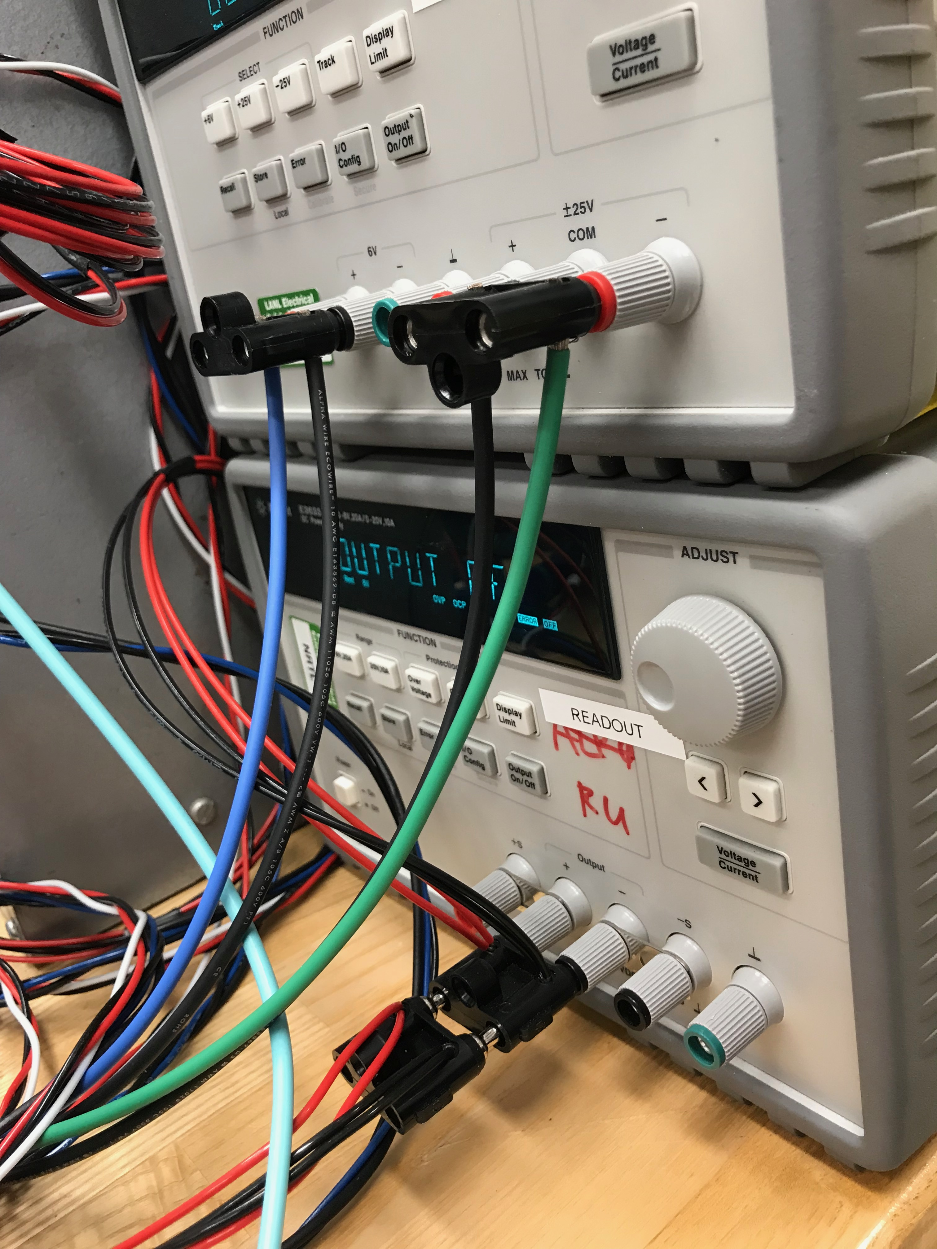
NUC, PS etc
2 USB-Jtag
to 2 RU

Slide 14
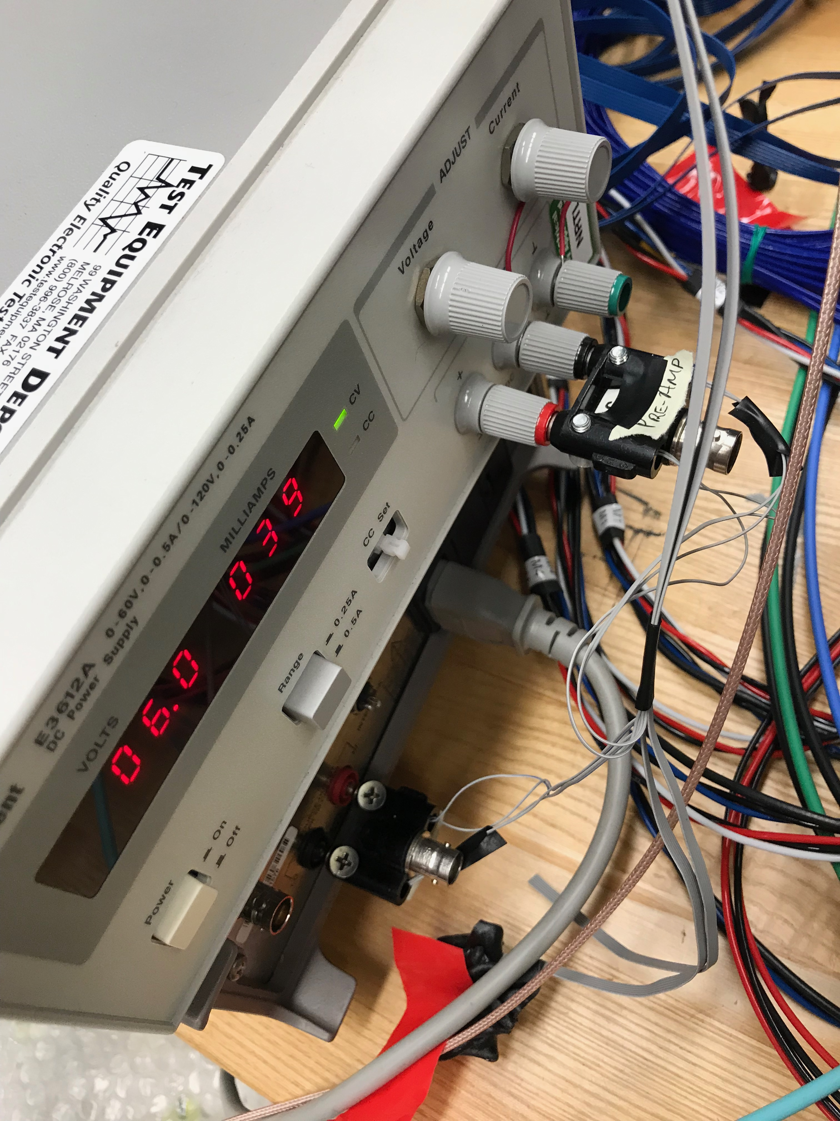
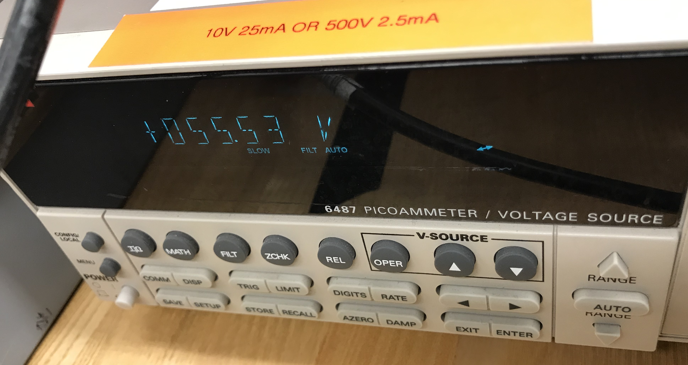
Cosmic Telescope PS
SiPM PreAmp: 6V
Cosmic Telescope PS
SiPM: 55.53V
Cosmic Telescope PS
SiPM: 55.53V

Slide 15
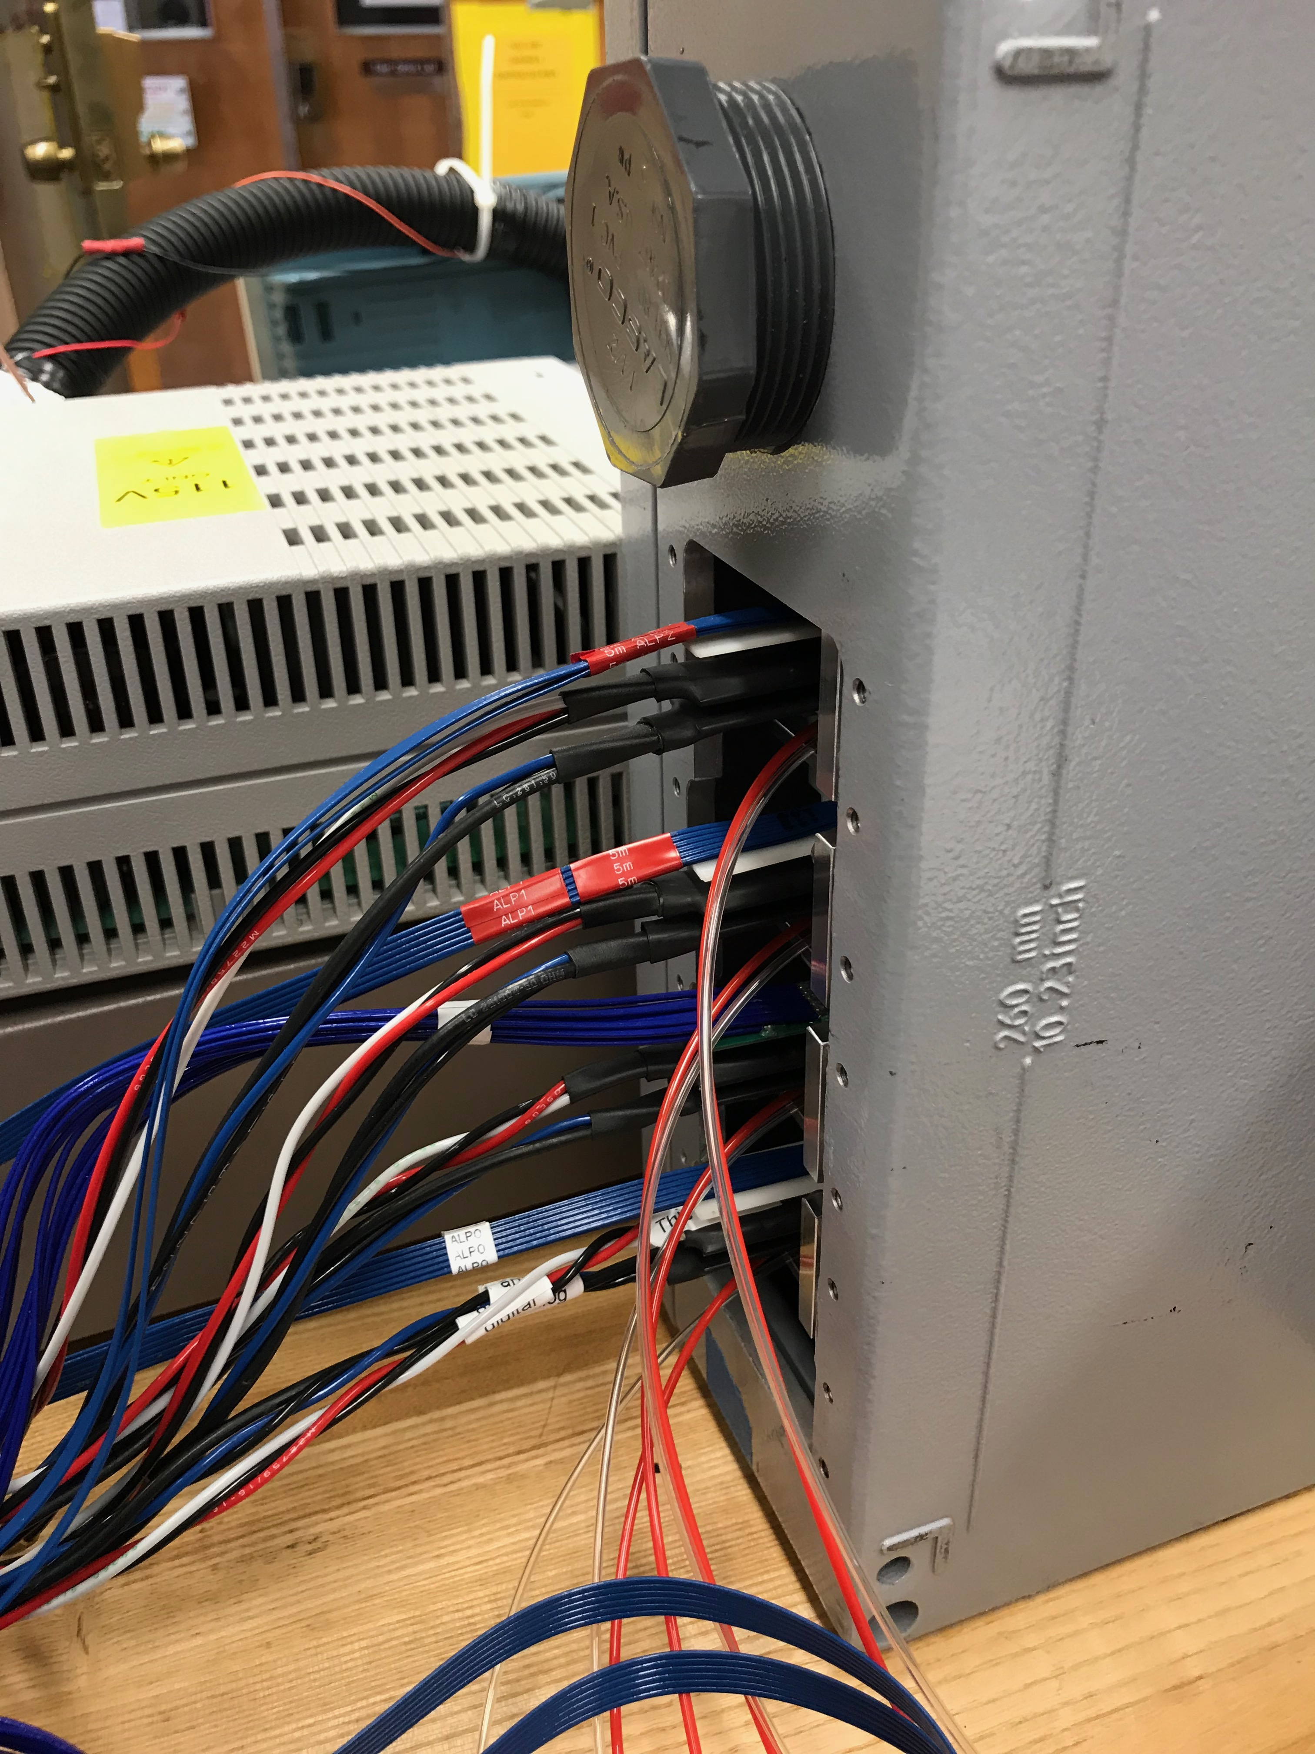
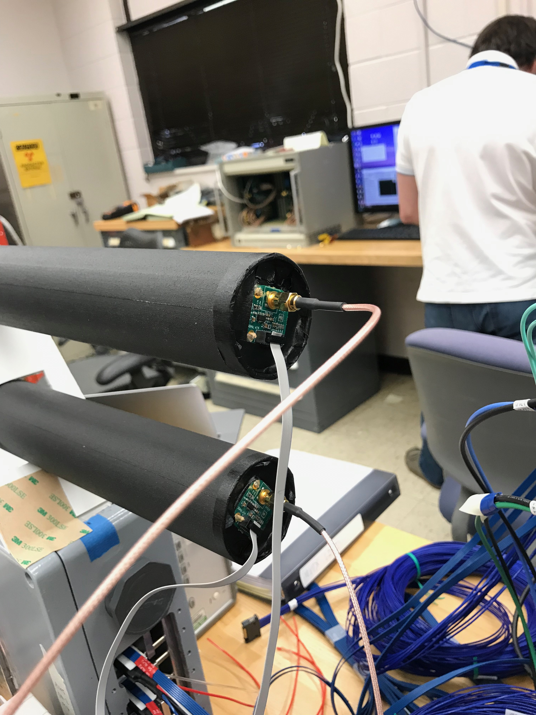
Cosmic Telescope tubes

Slide 16
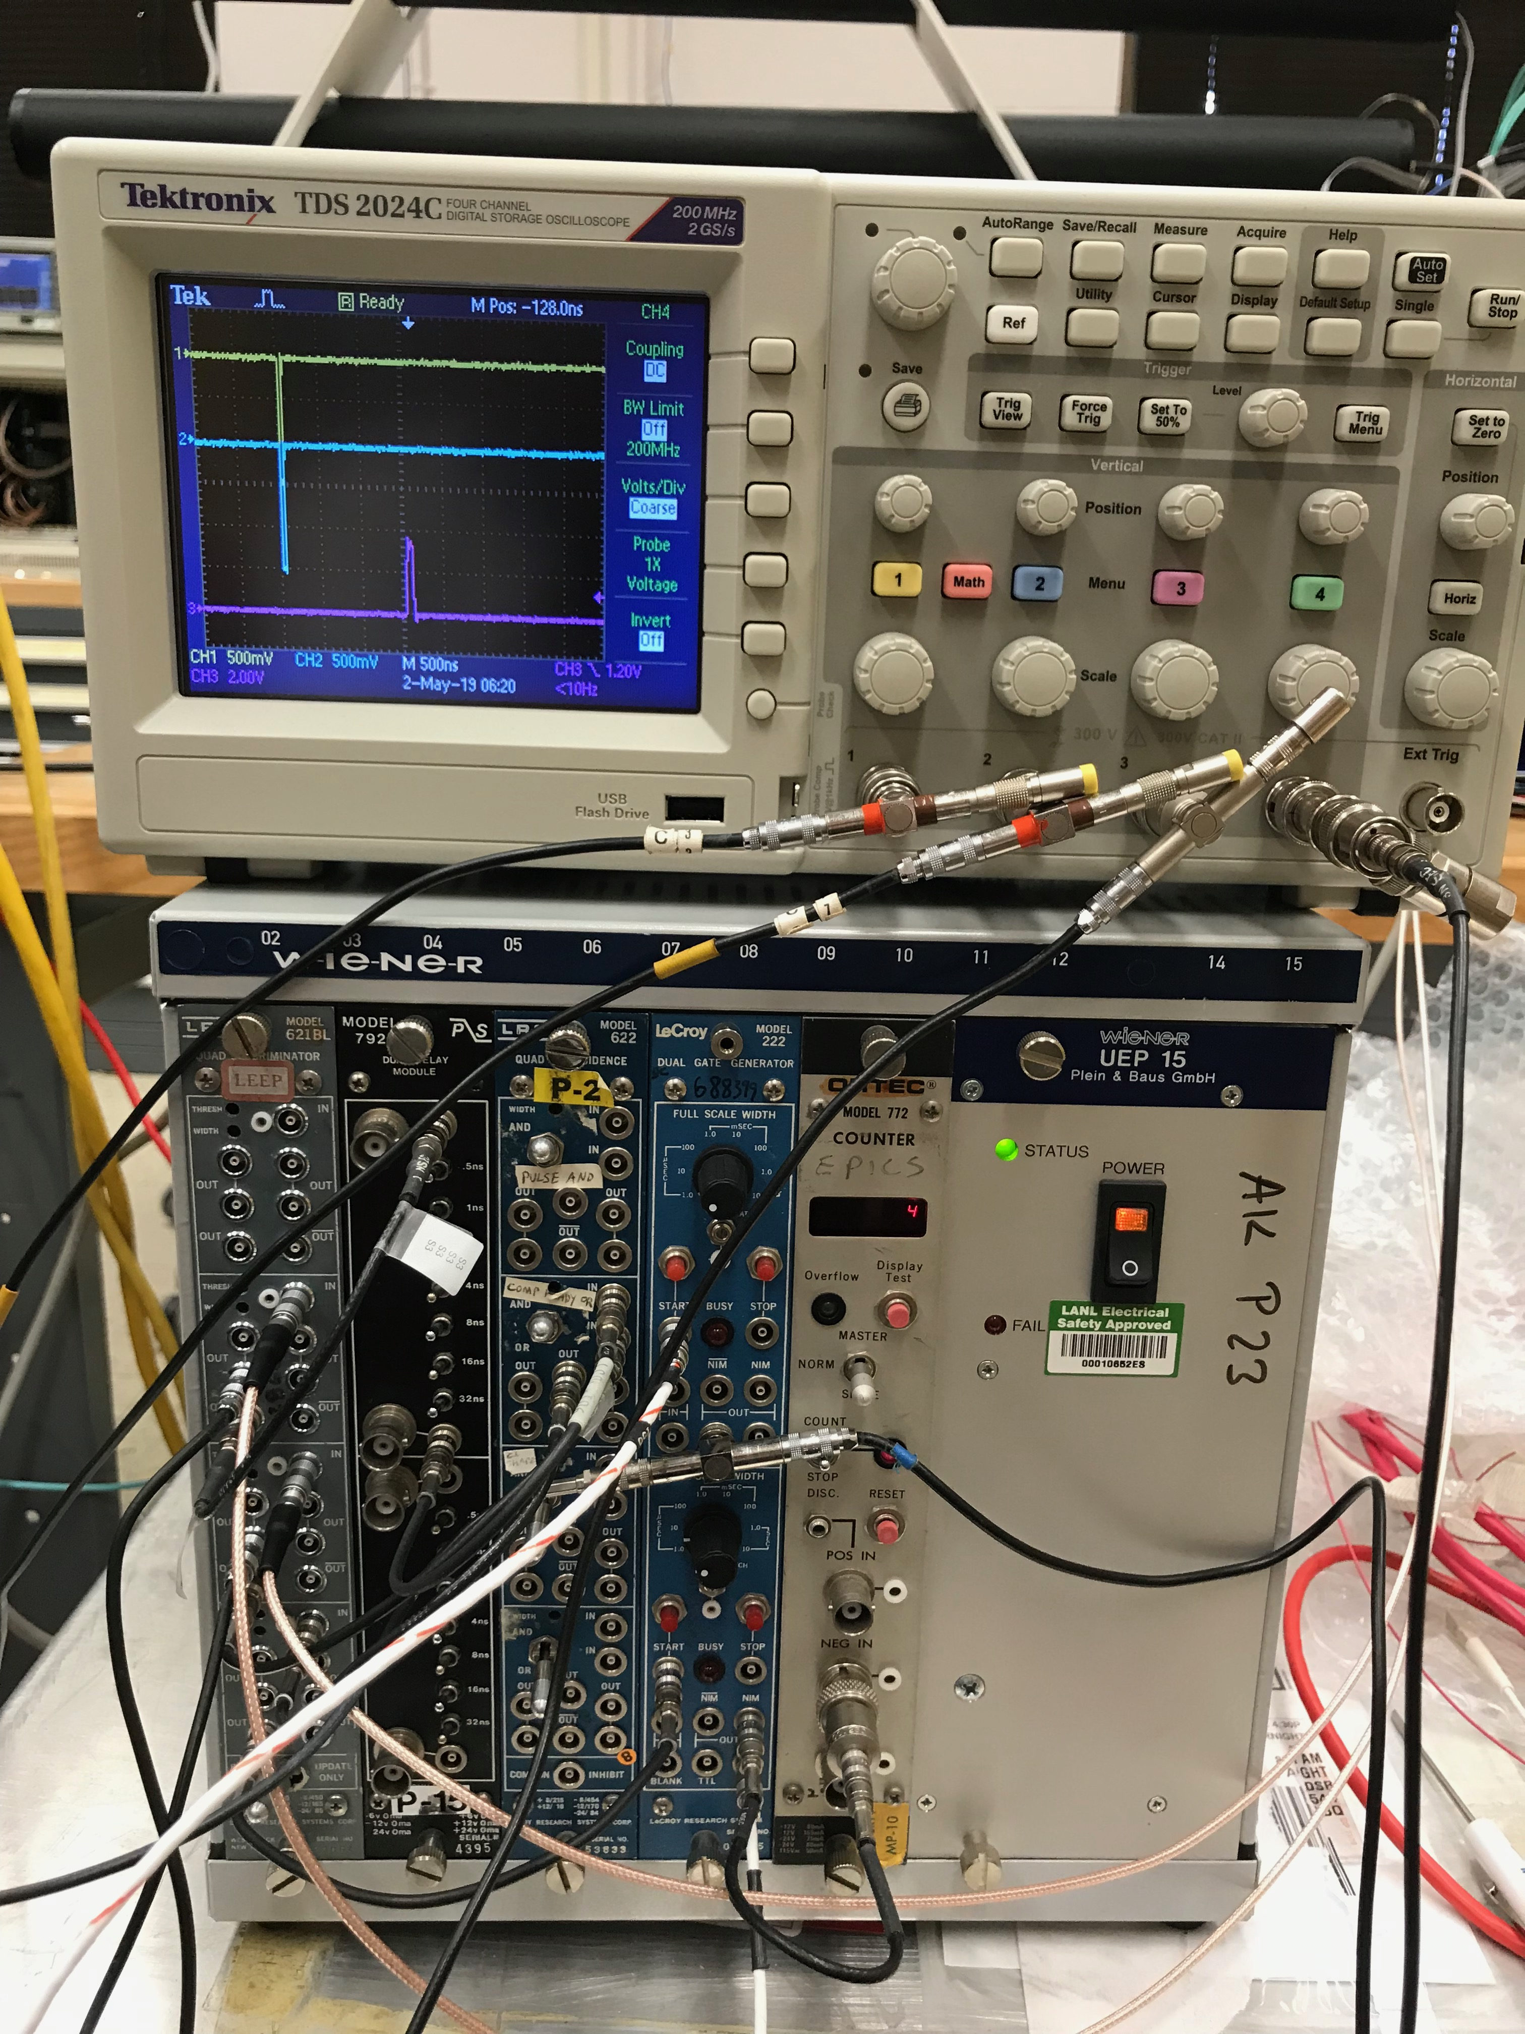
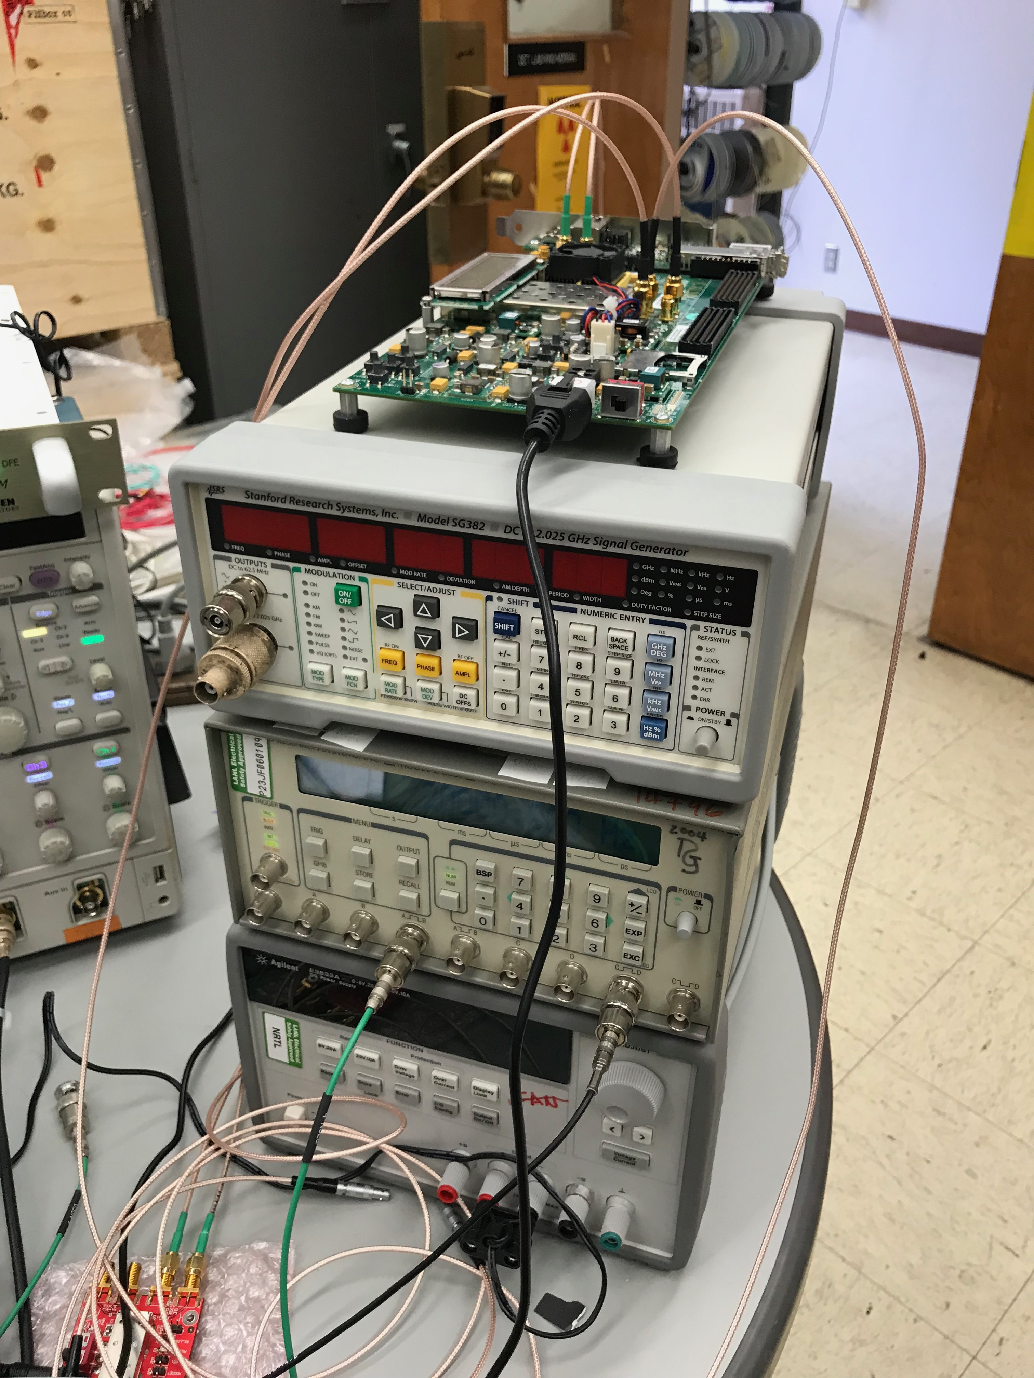
COSMIC Trigger
Logics
External trigger
20kHz. TTL into GTM

Slide 17
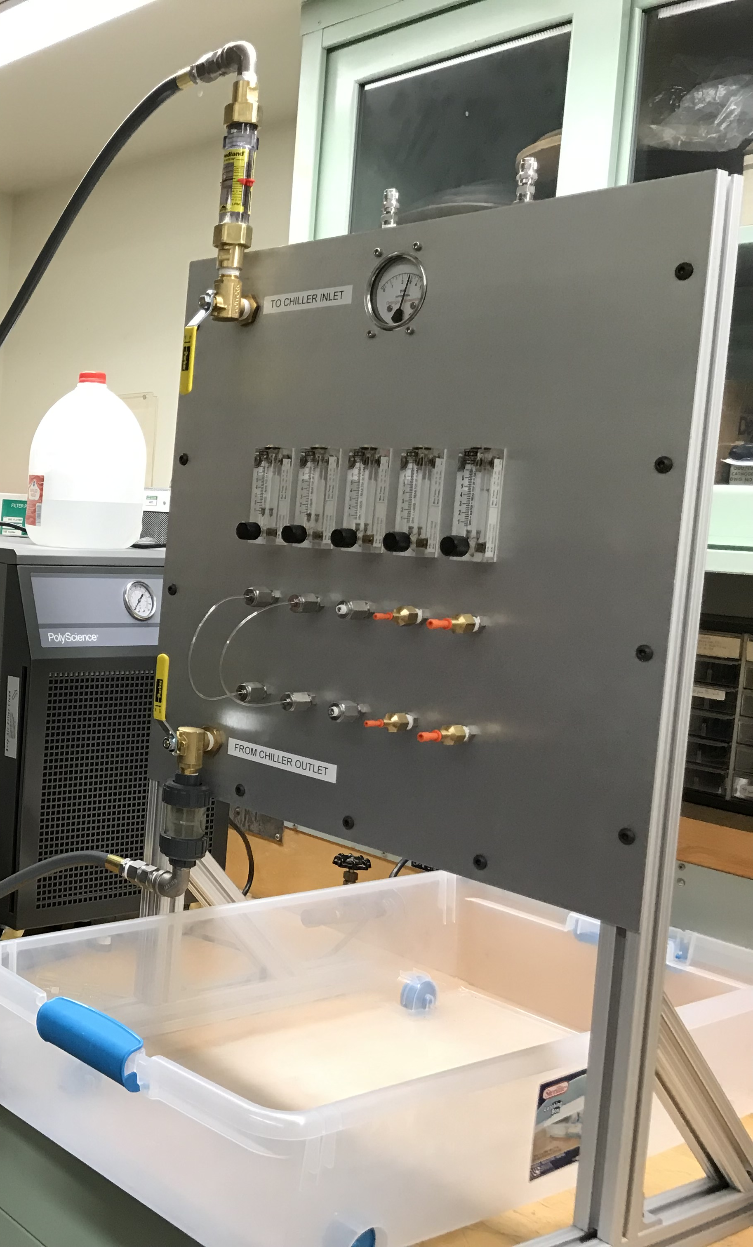
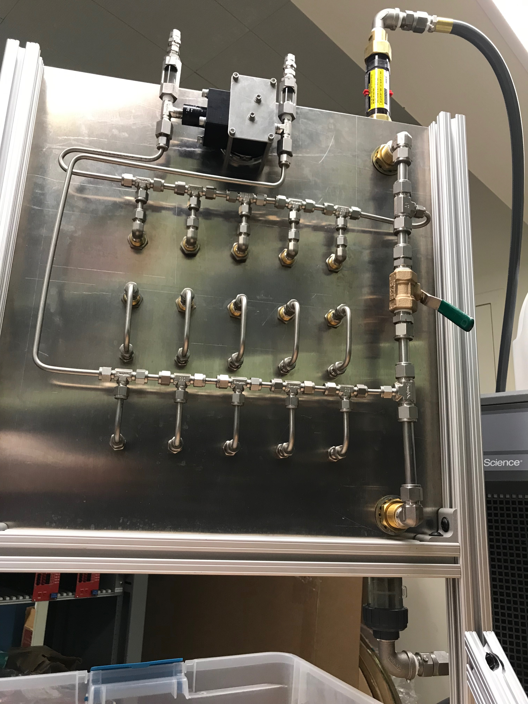
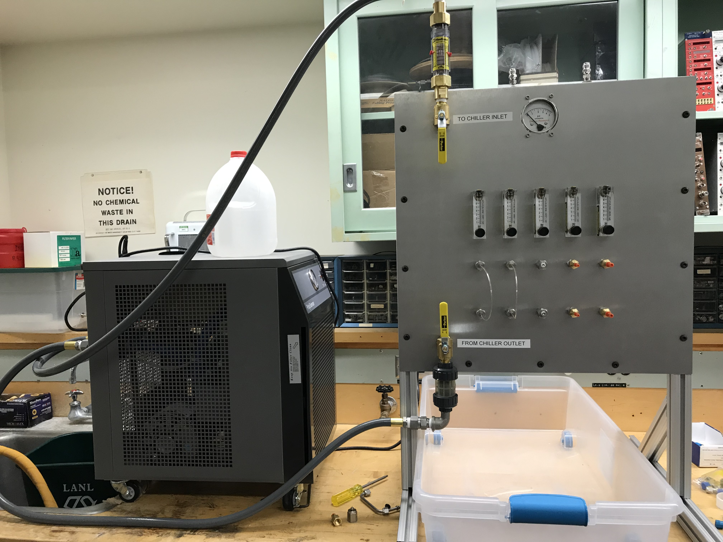
-3PSI;
-20%;
-1GPH
Negative pressure
cooling system

