Slide 1
MVTX TB @Fermilab May 22 – 29, 2019
Essential goals for LDRD:
  Demonstrate full readout chain with new hardware at high rate (~15kHz)
    4 staves + 2 RUs + 1 PU + 1 FELIX + RCDAQ
  New “final” hardware
    Production staves, RU(1.1), FELIX(2.0), PU, readout cables, stave cooling
  Reproduce last TB results on tracking efficiency and spatial resolution
    Offline simulation and analysis
Stretch goals for sPHENIX:
  sPHENIX GTM (v0) integration (LANL+BNL/DAQ)
  Online monitoring and slow control (via CAN Bus?, MIT/GSU et al)
  Scan stave material budget (requires low E beam, sPHENIX, ALICE/ITS, later at LBNL?)
  Exercise “Continue Readout” mode and offline data decoding (sPHENIX/DAQ)
Timeline
  Ship telescope to Ferimlab, 5/10(Friday). It will take 1 week to get them there
  Travel to Fermilab. 5/19 (Sunday)
  Preinstallation test and setup, training, ORC review etc. 5/20-21(Mon-Tue)
  Installation at TB facility beam line 5/22 (Wed, day time)
  Operation and data taking 5/22 – 5/28 (all evenings)
  Online monitoring & offline data analysis 5/22-28
  Disassemble setup 5/29(Wed), and ship the detectors to LANL
  Possible extension for another week if needed

Slide 2
Manpower & Schedule
Activities
  Ship telescope setup to Fermilab, latest 5/10(Fri),
    Hand-carry 4 staves and electronics boards (RU, FELIX etc)
    Travel to Fermilab on 5/19 (Sunday) or ealier
  Preinstallation test and setup 5/20-21(Mon-Tue) – mostly LANL folks
    Full time: Yasser, Hubert, new PD/Cameron, Walt, Ming, Xu(GSU), Gerd …
    Part time: Xuan, Kun, Matt
  Installation at TB facility beam line 5/22 (Wed): LANL folks + sPHENIX helpers
    plus other LANL PDs?
  Operation and data taking 5/22 – 5/28 (all evening): LANL + sPHENIX helper
    Full time: Yasser, Hubert, new PD/Cameron, Ming, Walt, Xu (GSU), Gerd
    Part time: Xuan, Kun, Matt, Cesar, other LANL PDs
    sPHENIX helpers
  Online monitoring & offline data analysis 5/22-28: LANL + sPHENIX helpers
    Full time: Yasser, Hubert, new PD/Cameron, Xu (GSU), Ming …
    Part time: Xuan, Kun, Matt, Other LANL PDs
    sPHENIX helpers
  Disassemble setup 5/29(Wed), and ship the detectors to LANL: - mostly LANL folks
    Yasser, Hubert, new PD/Cameron, Ming, Kun et al
“Remote” helpers:
  Alex T., Sho, Jo et al
  sPHENIX offline/online analysis
Preparation work & training at LANL
  Build 4-stave telescope in Feb/Mar
  Test cooling system, evaluate the need of
  Operate telescope with cosmic rays in Mar/April
  Offline data analysis
  Detector online monitoring, V, I, T etc.
  Lab training for operation and analysis, RU/FELIX, RCDAQ etc

Slide 3
More information

Slide 4
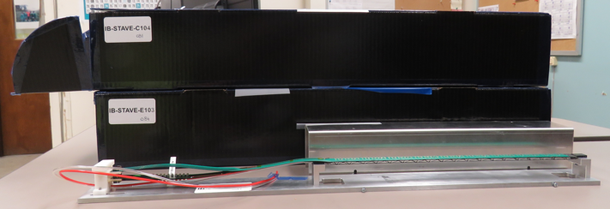
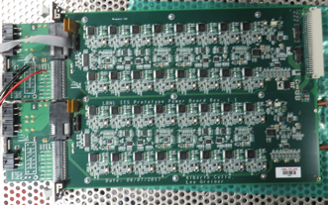
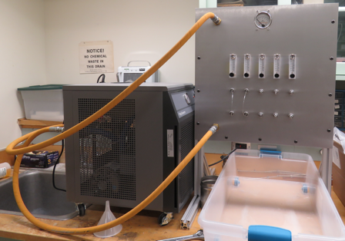
2019 test beam: 4-stave telescope
Sho’s talk
Scheduled for May 22-29, at Fermilab
Additions compared to the 2018 test beam:
  Staves (from single chips)
  Full-length MVTX signal cables (from 5 m off-the-shelf cables)
  FELIX v2.0 (from v1.5)
  Cooling system
  Power board
  sPHENIX GTM
Full test of all components of the MVTX detector - LDRD “stretch goal”

Slide 5
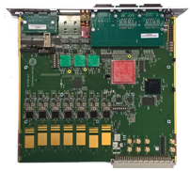
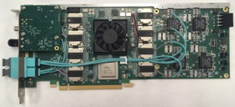
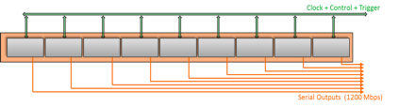

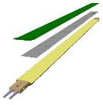
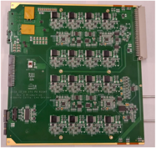
System overview
Readout Unit
Front End
FELIX
Back End
5-10 m twinax
GBT Optical Links
9-sensor stave
Control
Data (9x1.2Gbps), Clock, Control/Trigger
Data (3x3.2 Gbps)
Trigger
PCIe
FPC
Clock/Trigger
ALPIDE Sensors
Power supplies
Regulated power
Power
Cold Plate
DAQ and Slow Control
sPHENIX GTM
Power Board
Interaction Region
Experimental Hall
Counting House

Slide 6
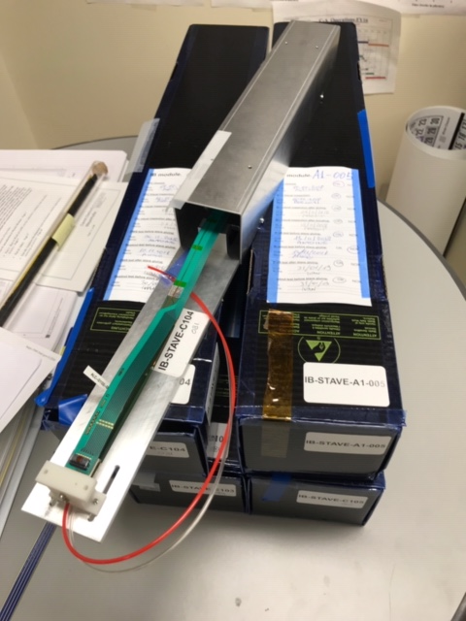
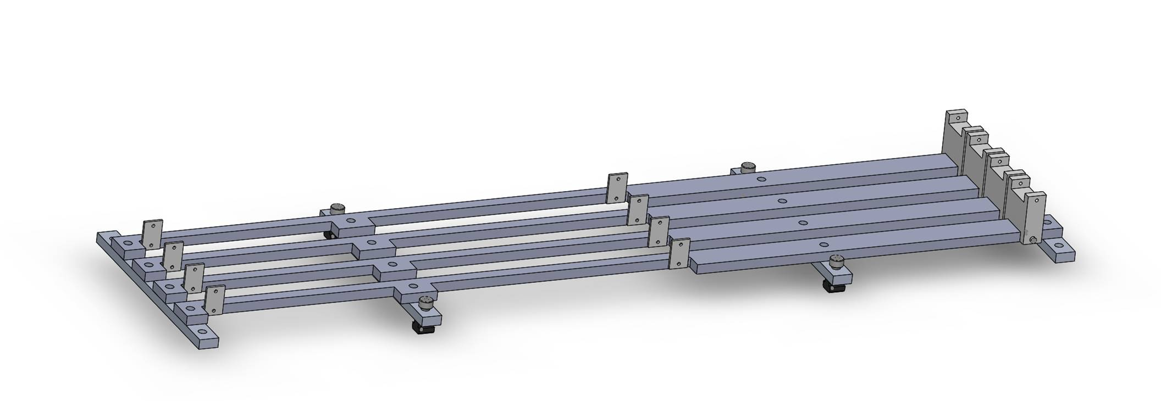
Mechanical design
Telescope box design completed, sent for fabrication
  One stave can be offset by (0.5,0.5)cm for material scanning

Slide 7
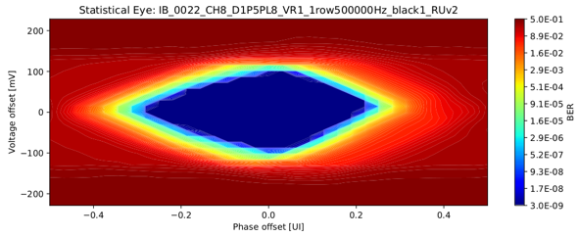
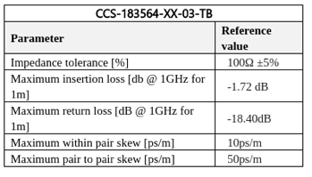
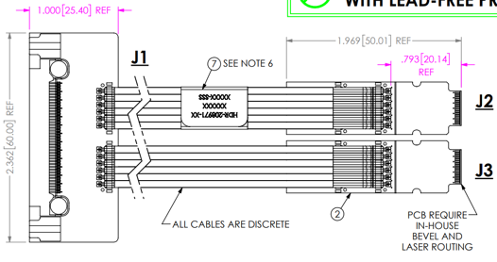
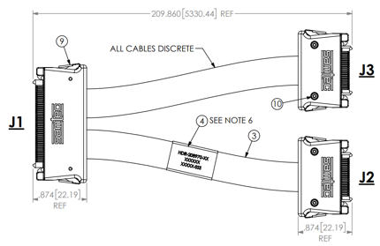
ALICE/ITS Signal cable design
The Samtec twinax cables carry clock (40 MHz), control (40 Mbps bidirectional), data (9x1.2 Gbps)
ALICE is using halogen-free cables (32 AWG, LDPE dielectric) due to CERN LSZH requirement; 2.65 + 5.3 m cables have been tested and are now in production
RU
RU
Stave
Stave

Slide 8
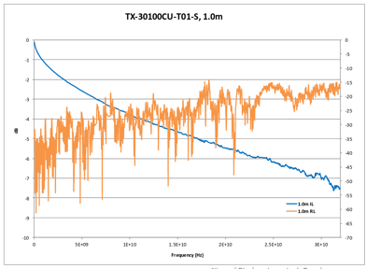
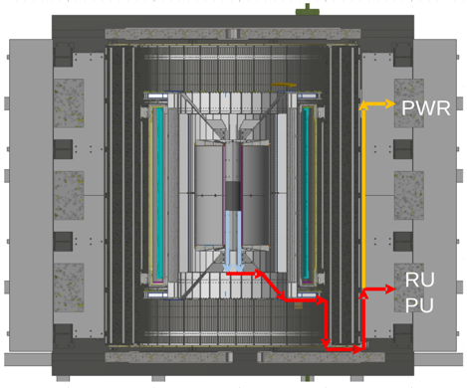
sPHENIX MVTX Cable testing
BNL has approved non-halogen-free cables (30 AWG, FEP dielectric); improved signal integrity
sPHENIX cable run estimates are converging: 1.4 + 6.5 m
We have Samtec quotes for 1.2/2.65 + 5.3/8.8 m (total length 6.5 - 11.45 m), will order soon
We will qualify these cables using stave and RU (bit error rates, statistical eye), and scope/network analyzer
We will test full-length MVTX cables in the next months

