Slide 1
MVTX Telescope Update – 4/15/2019
4-stave readout is ready
AlexT, Sho, Gerd, Cameron, Ming worked through the weekend and confirmed the 4-stave telescope setup is working properly
Hardware
2 RU v1.1
1 Felix v.2.0
sPHENIX GTM v0
1 8-m (2.6 + 5.3m) new cable (sPHENIX config.), (1.2+8.8m cables will come later)
3 5-m SamTec blue cable
Updated firmware and software
Raw PRDF files available for software development and test
Sho and Sanghoon are uploading the data files and the updated decoder to RCF
Online decoder is ready (Sho)
Telescope box mechanical parts arrived – to do’s
assembly work started
Test cooling with dummy staves
Telescope assembly
Alternative TB plan later at LBNL – in August
50MeV proton beam
Asked for about 24 hrs beam time

Slide 2
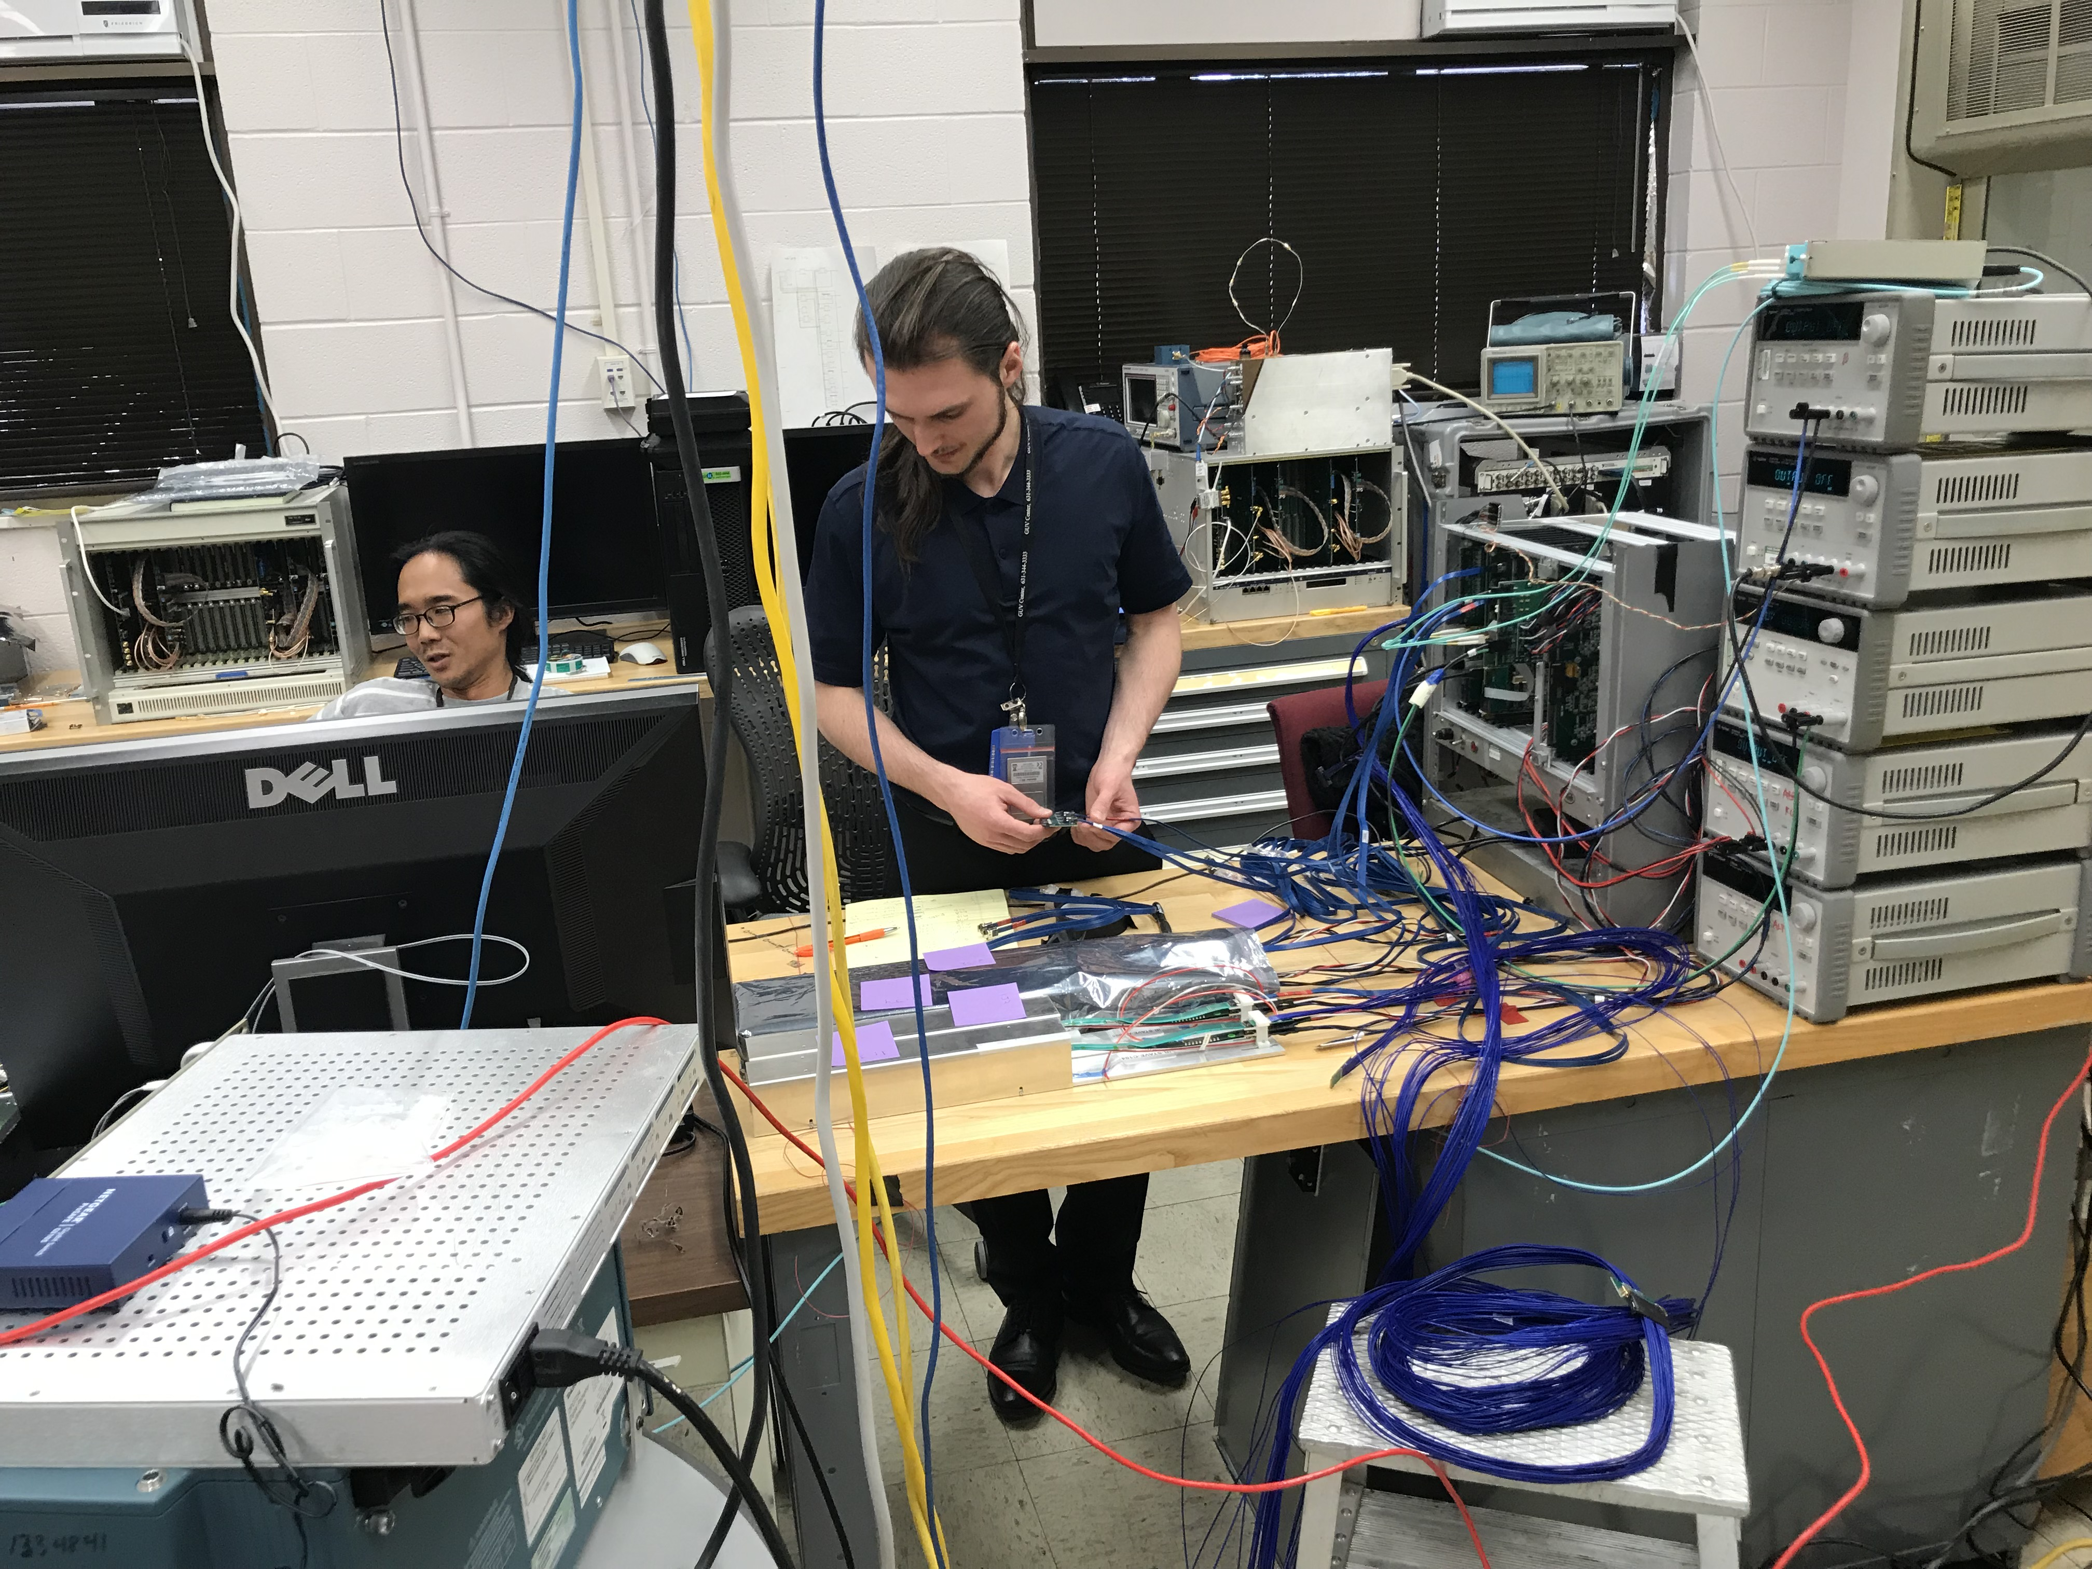
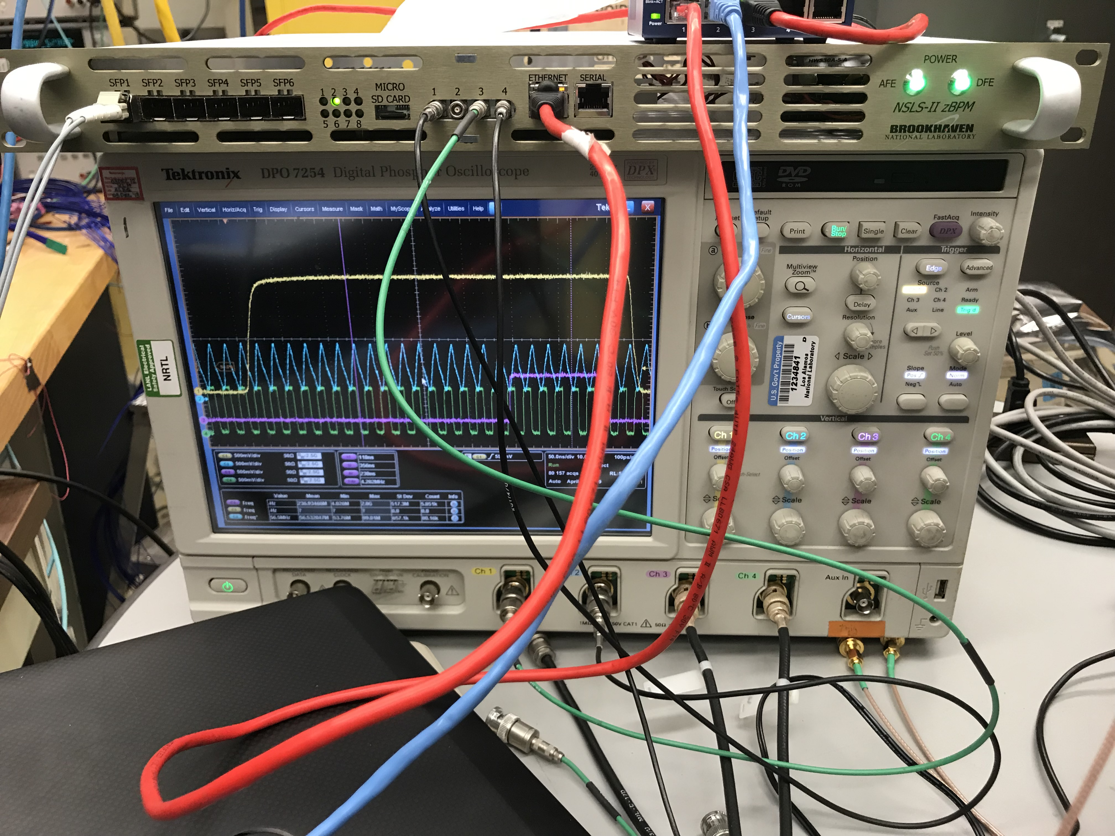
sPHENIX GTM,
integrated into FELIX
sPHENIX GTM v0.1
8-m sPHENIX Readout Cable: AWG30

Slide 3
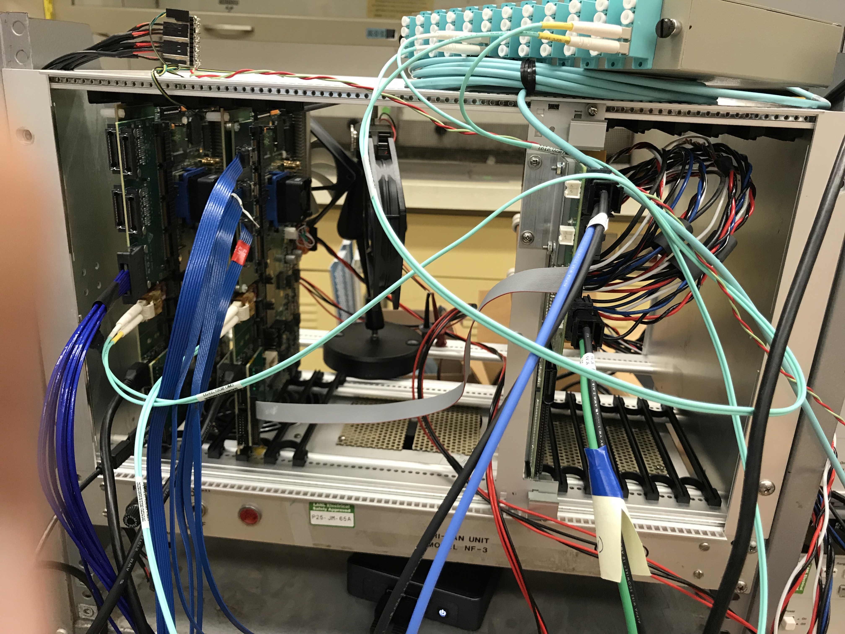
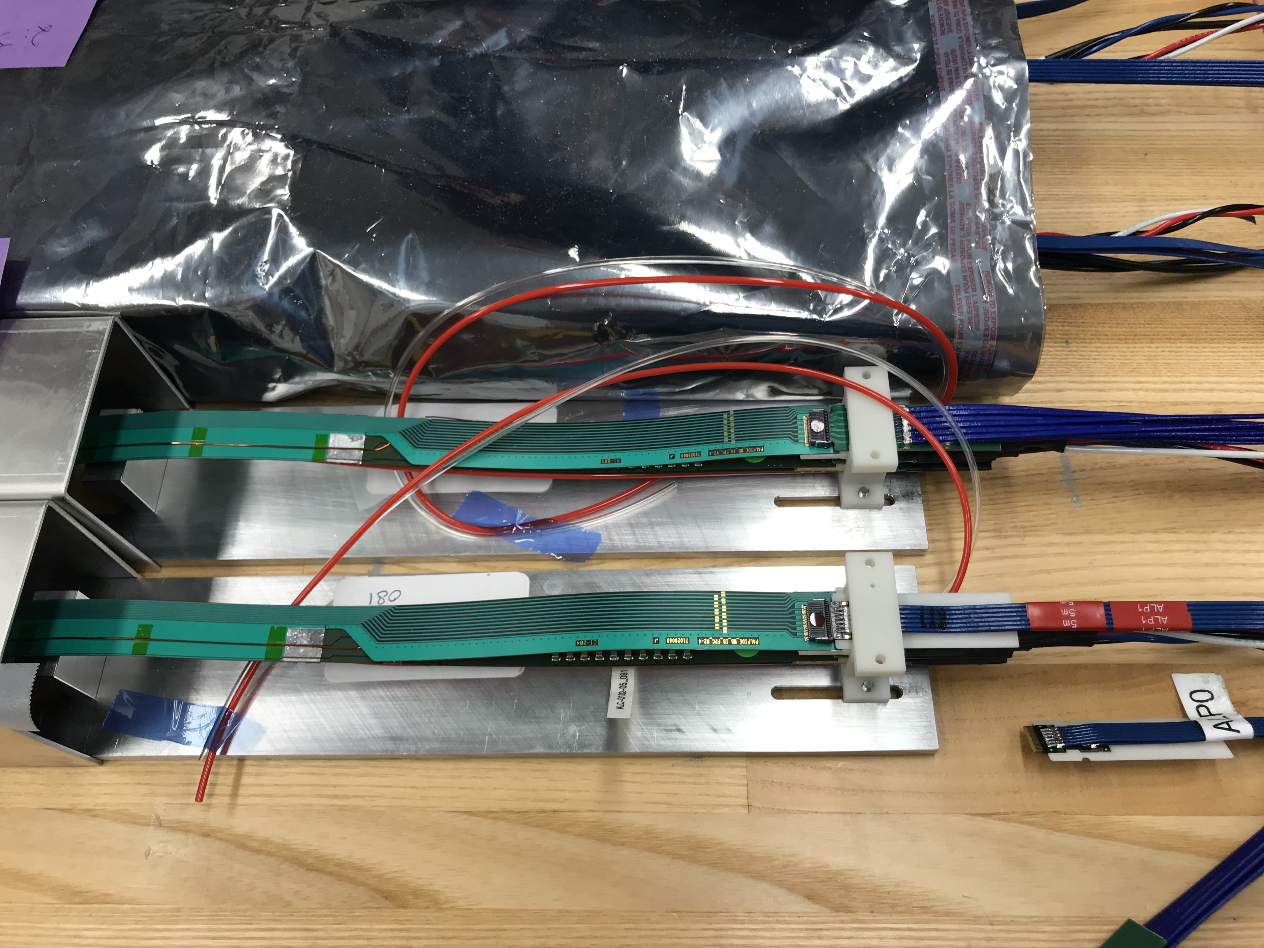
4 staves:
one 8-m sPHENIX cable
Three 5m SamTec default
2 RUs
4 staves
PU
1st RU: connected to 8-m sPHENIX cable
2nd RU: connected to 3 5-m cables
10m sPHENIX cables will be tested when available

Slide 4
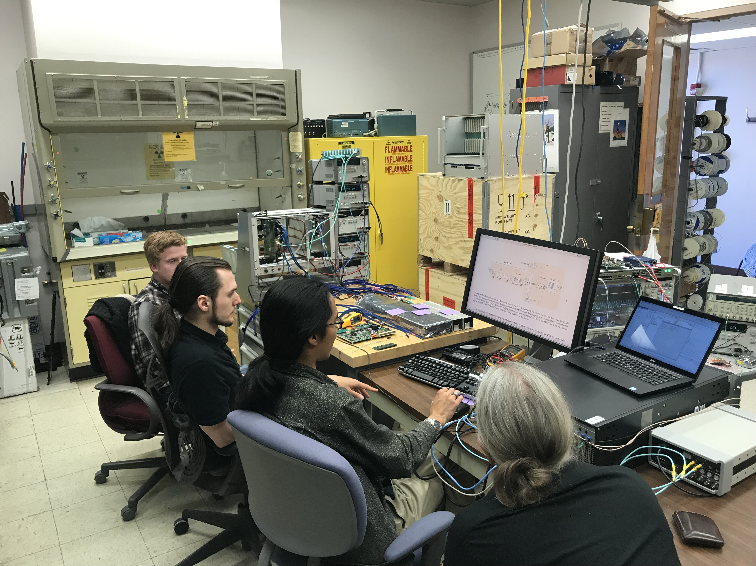
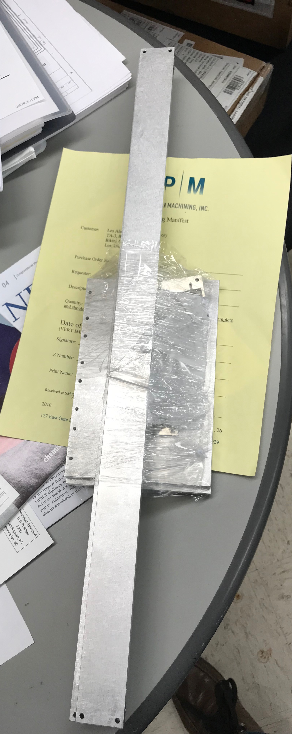
System demo
Telescope parts
arrived at LANL

Slide 5
BNL sPHENIX Review Summary
Here is a brief summary of my discussion with Ed this afternoon. Also, Flemming kindly sent me a copy of iTPC PMP doc as an example for MVTX, attached.
1. prepare for a MVTX cost & schedule review (sPHENIX internal or at a higher level) in ~mid June after the PD2/3 review (5/29-31), update the P6 with the latest C&S developed after the MVTX/HF workshop at LBNL in March.
2. update project management plan (PMP), risk registry, WBS dictionary and BoE documents. sPHENIX project team will help to enter them into P-6
3. submit funding breakout to sPHENIX/BNL management for FY19, for LANL, MIT, LBNL, UT-A et al, including design and test/QA efforts etc. Ed will work with BNL management to get fund transferred as soon as possible for FY19.
4. wire bonds – why ALICE has decided not encapsulating the wire bonds? I know the intrinsic vibration is NOT an issue for ALICE and sPHENIX.
5. MVTX C&S review~ Mid/late of June
BoE:
https://docs.google.com/document/d/1l-xytelgTuUtmABSQHs9fd1e5e8LQ-vFhSFk0qhM2Z4/edit?usp=sharing
Risk Registry:
https://docs.google.com/spreadsheets/d/1UzIOnXfAwbjxUcnrQVnFLN20niq43x2v2J2epF10bjg/edit?usp=sharing

Slide 6
MVTX TB @Fermilab May 22 – 29, 2019 03/19/2019
Essential goals for LDRD:
Demonstrate full readout chain with new “final” hardware at high rate (~15kHz)
4 staves + 2 RUs + 1 PU + 1 FELIX + RCDAQ
New “final” hardware
Production staves, RU(1.1), FELIX(2.0), PU, readout cables, stave cooling
Reproduce last TB results on tracking efficiency and spatial resolution
Offline simulation and analysis
Stretch goals for sPHENIX:
sPHENIX GTM (v0) integration (LANL+BNL/DAQ)
Online monitoring and slow control (via USB, MIT/GSU et al)
Scan stave material budget (requires low E beam, sPHENIX, ALICE/ITS, later at LBNL?)
Exercise “Continue Readout” mode and offline data decoding (sPHENIX/DAQ)
Summary of timeline
Ship telescope to Ferimlab, by 5/10(Friday). It will take 1 week to get them there
Travel to Fermilab. 5/19 (Sunday)
Preinstallation test and setup, training, ORC review etc. 5/20-21(Mon-Tue)
Installation at TB facility beam line 5/22 (Wed, day time)
Operation and data taking 5/22 – 5/28 (all evenings)
Online monitoring & offline data analysis 5/22-28
Disassemble setup 5/29(Wed), and ship the detectors to LANL
Possible extension for more data taking with TPC/INTT if needed, June 12 - July 8
2 shifts per evening
- 6PM - midnight
- Midnight - 6AM
~3 people per shift

Slide 7
Preparation for Test Beam in May
Firmware & software update:
2x (2-stave + 1 RU) -> 1 FELIX - AlexT, Sho, in progress, to finish by ~ 4/7/2017;
PU integration, controls and monitoring via USB - Sho, Cameron, Ming, GSU/Xu et al
GTM integration - Sho, Alex, Gerd + BNL, done!
8m SamTec cables & transition boards – Gerd, Cameron, Sho, Ming … ; plan-B ready (5m cables)
VME cage hosting 2RU + 1 PU, almost done!, Sho
Telescope box & cooling -
Box design and fabrication - Abel, Hubert, Matt; Chris sent request for quote (3/19)
4 stave installation - Hubert, Abel, Ming
Cooling test & evaluation - Matt, Sho, Abel, Ming
System integration & test at LANL in April/May. -- training for operation, debugging etc.
Setup cosmic trigger – Matt, Xuan et al
System test – Cameron, Yasser, Sho, Gerd, Ming… all
Offline analysis -- can use more help from sPHENIX
4-stave telescope geometry & simulation – Yasser, Ming, (Sanghoon, Darren)
Offline analysis – Yasser, Cameron, Sanghoon et al
Use old TB data for analysis – training for all
4-stave decoder is ready (Sho)
2018 TB data analysis:
https://wiki.bnl.gov/sPHENIX/index.php/Test_beam_in_2018_at_FNAL
Online monitoring & slow control
GSU & MIT, Sho/Ming, Jo’s - help
(V,I,T) of staves and PU/RU via USB
ORC docs --- Sho
Shipping, training, schedule, travel, installation --- Ming et al

Slide 8
Manpower & Schedule
Activities
Ship telescope setup to Fermilab, latest 5/10(Fri),
Hand-carry 4 staves and electronics boards (RU, FELIX etc)
Travel to Fermilab on 5/19 (Sunday) or earlier
Preinstallation test and setup 5/20-21(Mon-Tue) – mostly LANL folks
Full time: Yasser, Hubert, Cameron, Walt, Ming, Xu(GSU), Gerd …
Part time: Xuan, Kun, Matt
Installation at TB facility beam line 5/22 (Wed):
LANL folks + sPHENIX helpers
Operation and data taking 5/22 – 5/28 (all evening): LANL + sPHENIX helper
Full time: Yasser, Hubert, new PD/Cameron, Ming, Walt, Xu (GSU), Gerd
Part time: Xuan, Kun, Matt, Cesar, Darren(TBD), Sanghoon, other sPHENIX folks?
Online monitoring & offline data analysis 5/22-28: LANL + sPHENIX helpers
Full time: Yasser, Hubert, Cameron, Xu (GSU), Ming …
Part time: Xuan, Kun, Matt, Other sPHENIX helpers
Disassemble setup 5/29(Wed), and ship the detectors to LANL: - mostly LANL folks
Yasser, Hubert, Cameron, Ming, Kun et al
“Remote” helpers:
Alex T., Sho, Jo et al
sPHENIX offline/online analysis
Preparation work & training at LANL
Build 4-stave telescope in Feb/Mar
Test cooling system, evaluate
Operate telescope with cosmic rays in April
Offline data analysis
Detector online monitoring, V, I, T etc.
Lab training for operation and analysis, RU/FELIX, RCDAQ etc

Slide 9
TM6.2 Room Layout
MVTX Telescope setup on the motion table:
MVTX telescope
MVTX crate (2-RU + 1 PU)
3.3V HP PS
One Linux server/RCDAQ in CH

Slide 10
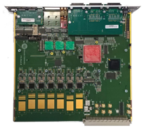
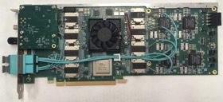
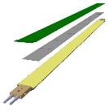
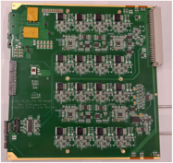
System overview
Readout Unit
Front End
FELIX
Back End
~8m twinax
GBT Optical Links
9-sensor stave
Control
Data (9x1.2Gbps), Clock, Control/Trigger
Data (3x3.2 Gbps)
Trigger
PCIe
FPC
USB
Clock/Trigger
ALPIDE Sensors
Power supplies
Regulated power
Power
Cold Plate
DAQ and Slow Control
sPHENIX GTM
Power Board
Interaction Region
Experimental Hall
Counting House

Slide 11
More information

Slide 12
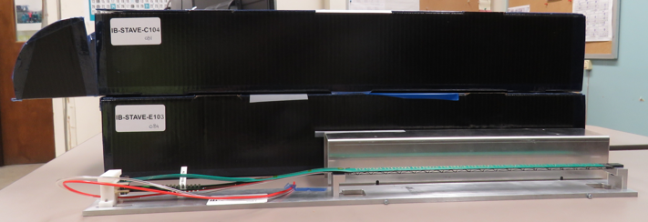
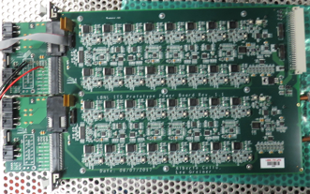
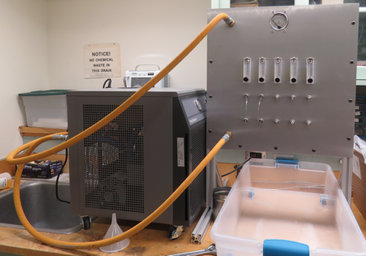
2019 test beam: 4-stave telescope
Sho’s talk
Scheduled for May 22-29, at Fermilab
Additions compared to the 2018 test beam:
Staves (from single chips)
Full-length MVTX signal cables (from 5 m off-the-shelf cables)
FELIX v2.0 (from v1.5)
Cooling system
Power board
sPHENIX GTM
Full test of all components of the MVTX detector - LDRD “stretch goal”

Slide 13
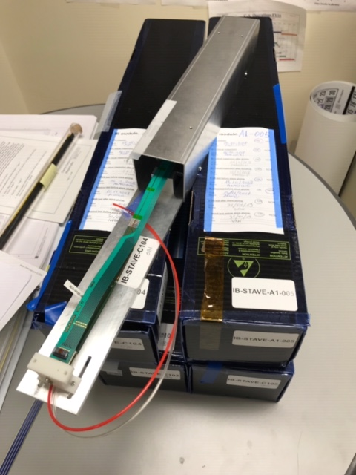
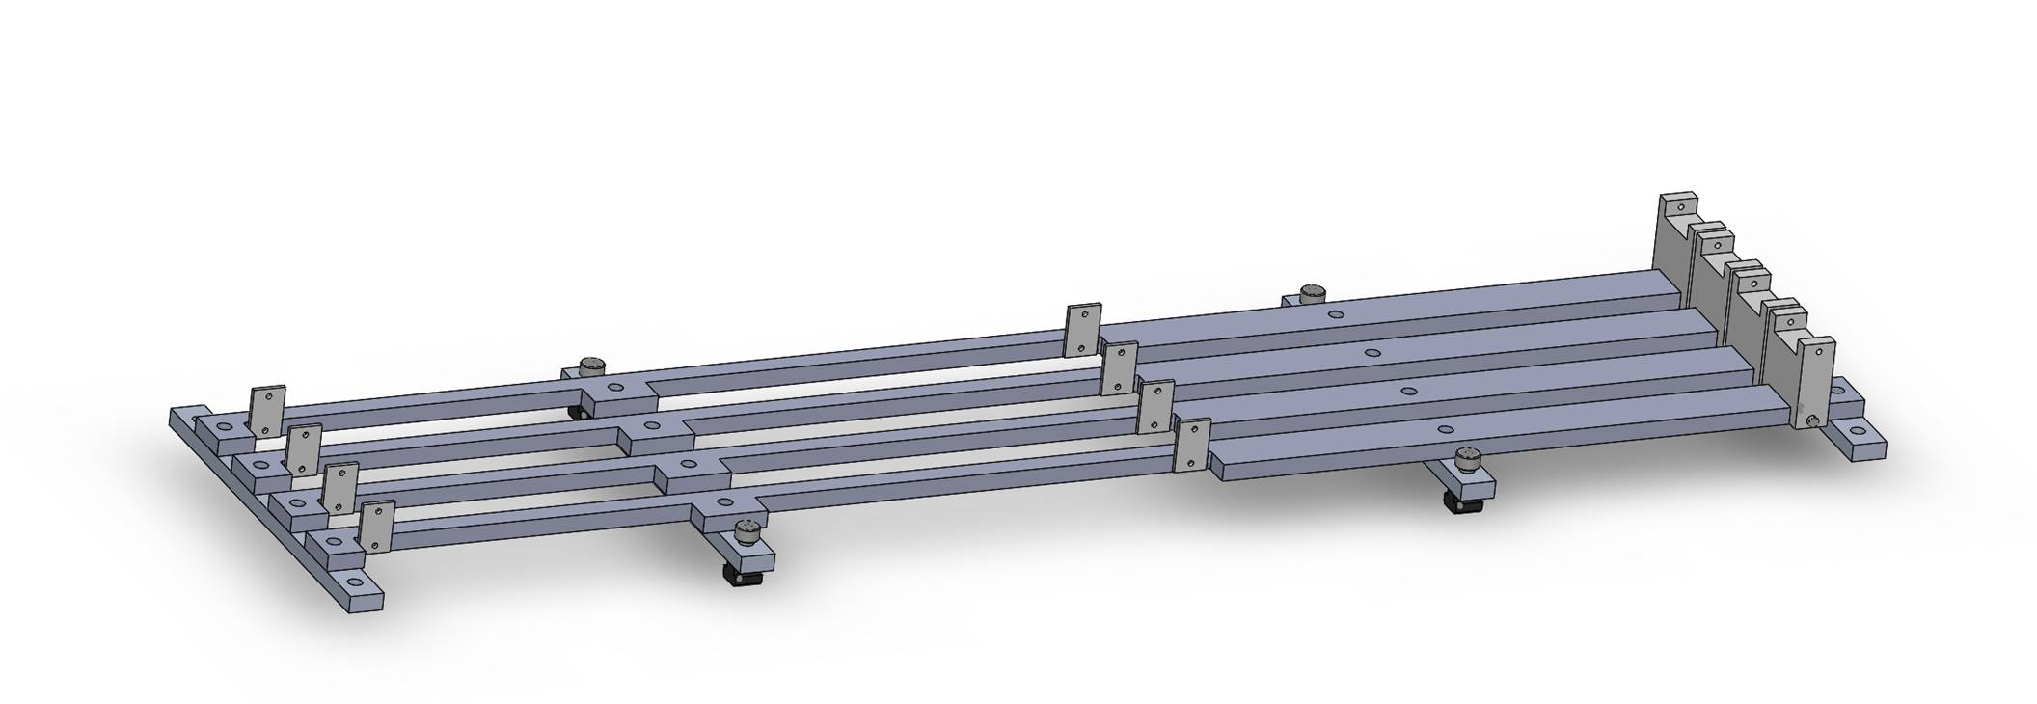
Mechanical design
Telescope box design completed, sent for fabrication
One stave can be offset by (0.5,0.5)cm for material scanning

Slide 14
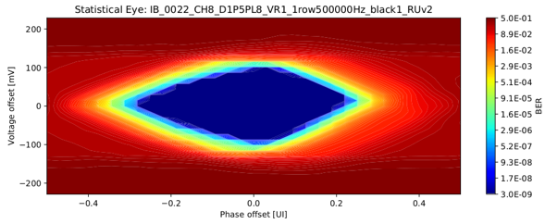
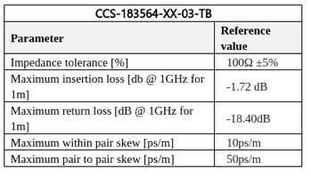
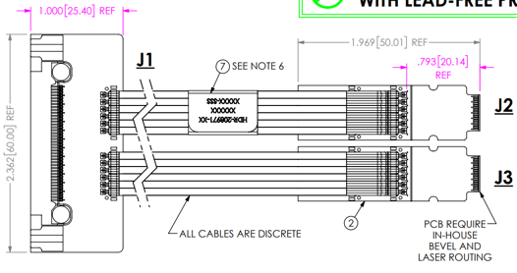
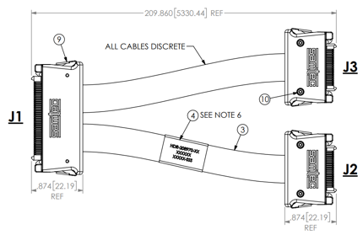
ALICE/ITS Signal cable design
The Samtec twinax cables carry clock (40 MHz), control (40 Mbps bidirectional), data (9x1.2 Gbps)
ALICE is using halogen-free cables (32 AWG, LDPE dielectric) due to CERN LSZH requirement; 2.65 + 5.3 m cables have been tested and are now in production
RU
RU
Stave
Stave

Slide 15
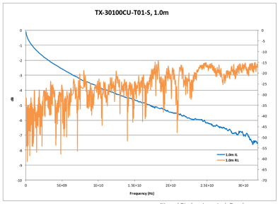
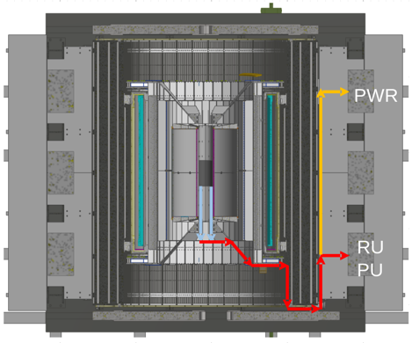
sPHENIX MVTX Cable testing
BNL has approved non-halogen-free cables (30 AWG, FEP dielectric); improved signal integrity
sPHENIX cable run estimates are converging: 1.4 + 6.5 m
We have Samtec quotes for 1.2/2.65 + 5.3/8.8 m (total length 6.5 - 11.45 m), will order soon
We will qualify these cables using stave and RU (bit error rates, statistical eye), and scope/network analyzer
We will test full-length MVTX cables in the next months

