Slide 1
MVTX TB @Fermilab May 22 – 29, 2019 03/19/2019
Essential goals for LDRD:
Demonstrate full readout chain with new “final” hardware at high rate (~15kHz)
4 staves + 2 RUs + 1 PU + 1 FELIX + RCDAQ
New “final” hardware
Production staves, RU(1.1), FELIX(2.0), PU, readout cables, stave cooling
Reproduce last TB results on tracking efficiency and spatial resolution
Offline simulation and analysis
Stretch goals for sPHENIX:
sPHENIX GTM (v0) integration (LANL+BNL/DAQ)
Online monitoring and slow control (via USB, MIT/GSU et al)
Scan stave material budget (requires low E beam, sPHENIX, ALICE/ITS, later at LBNL?)
Exercise “Continue Readout” mode and offline data decoding (sPHENIX/DAQ)
Summary of timeline
Ship telescope to Ferimlab, by 5/10(Friday). It will take 1 week to get them there
Travel to Fermilab. 5/19 (Sunday)
Preinstallation test and setup, training, ORC review etc. 5/20-21(Mon-Tue)
Installation at TB facility beam line 5/22 (Wed, day time)
Operation and data taking 5/22 – 5/28 (all evenings)
Online monitoring & offline data analysis 5/22-28
Disassemble setup 5/29(Wed), and ship the detectors to LANL
Possible extension for more data taking with TPC/INTT if needed, June 12 - July 8
2 shifts per evening
- 6PM - midnight
- Midnight - 6AM
~3 people per shift

Slide 2
Preparation for Test Beam in May
Firmware & software update:
2x (2-stave + 1 RU) -> 1 FELIX - AlexT, Sho, in progress, to finish by ~ 4/7/2017;
PU integration, controls and monitoring via USB - Sho, Cameron, Ming, GSU/Xu et al
GTM integration - Sho, Alex, Gerd + BNL, done!
8m SamTec cables & transition boards – Gerd, Cameron, Sho, Ming … ; plan-B ready (5m cables)
VME cage hosting 2RU + 1 PU, done!
Telescope box & cooling -
Box design and fabrication - Abel, Hubert, Matt; Chris sent request for quote (3/19)
4 stave installation - Hubert, Abel, Ming
Cooling test & evaluation - Matt, Abel, Ming
System integration & test at LANL in April/May. -- training for operation, debugging etc.
Setup cosmic trigger – Matt, Xuan et al
System test – Cameron, Yasser, Sho, Gerd, Ming… all
Offline analysis -- can use more help from sPHENIX
4-stave telescope geometry & simulation – Yasser, Ming, (Sanghoon, Darren)
Offline analysis – Yasser, Cameron, Sanghoon et al
Use old TB data for analysis – training for all
4-stave decoder is ready (Sho)
2018 TB data analysis:
https://wiki.bnl.gov/sPHENIX/index.php/Test_beam_in_2018_at_FNAL
Online monitoring & slow control
GSU & MIT, Sho/Ming, Jo’s - help
(V,I,T) of staves and PU/RU via USB
ORC docs --- Sho
Shipping, training, schedule, travel, installation --- Ming et al

Slide 3
Manpower & Schedule
Activities
Ship telescope setup to Fermilab, latest 5/10(Fri),
Hand-carry 4 staves and electronics boards (RU, FELIX etc)
Travel to Fermilab on 5/19 (Sunday) or earlier
Preinstallation test and setup 5/20-21(Mon-Tue) – mostly LANL folks
Full time: Yasser, Hubert, Cameron, Walt, Ming, Xu(GSU), Gerd …
Part time: Xuan, Kun, Matt
Installation at TB facility beam line 5/22 (Wed):
LANL folks + sPHENIX helpers
Operation and data taking 5/22 – 5/28 (all evening): LANL + sPHENIX helper
Full time: Yasser, Hubert, new PD/Cameron, Ming, Walt, Xu (GSU), Gerd
Part time: Xuan, Kun, Matt, Cesar, Darren(TBD), Sanghoon, other sPHENIX folks?
Online monitoring & offline data analysis 5/22-28: LANL + sPHENIX helpers
Full time: Yasser, Hubert, Cameron, Xu (GSU), Ming …
Part time: Xuan, Kun, Matt, Other sPHENIX helpers
Disassemble setup 5/29(Wed), and ship the detectors to LANL: - mostly LANL folks
Yasser, Hubert, Cameron, Ming, Kun et al
“Remote” helpers:
Alex T., Sho, Jo et al
sPHENIX offline/online analysis
Preparation work & training at LANL
Build 4-stave telescope in Feb/Mar
Test cooling system, evaluate
Operate telescope with cosmic rays in April
Offline data analysis
Detector online monitoring, V, I, T etc.
Lab training for operation and analysis, RU/FELIX, RCDAQ etc

Slide 4
TM6.2 Room Layout
MVTX Telescope setup on the motion table:
MVTX telescope
MVTX crate (2-RU + 1 PU)
3.3V HP PS
One Linux server/RCDAQ in CH

Slide 5
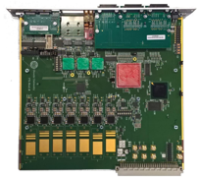
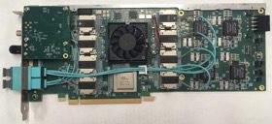
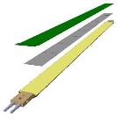
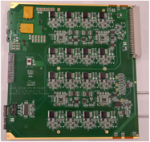
System overview
Readout Unit
Front End
FELIX
Back End
~8m twinax
GBT Optical Links
9-sensor stave
Control
Data (9x1.2Gbps), Clock, Control/Trigger
Data (3x3.2 Gbps)
Trigger
PCIe
FPC
USB
Clock/Trigger
ALPIDE Sensors
Power supplies
Regulated power
Power
Cold Plate
DAQ and Slow Control
sPHENIX GTM
Power Board
Interaction Region
Experimental Hall
Counting House

Slide 6
More information

Slide 7
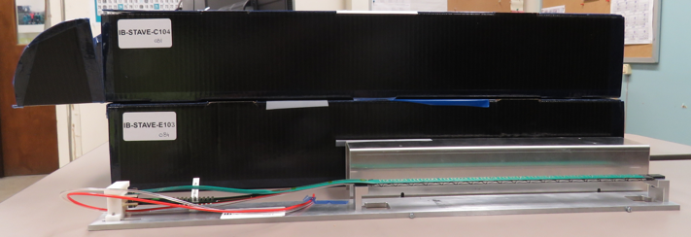
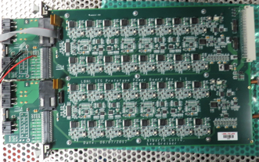
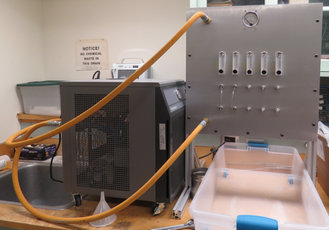
2019 test beam: 4-stave telescope
Sho’s talk
Scheduled for May 22-29, at Fermilab
Additions compared to the 2018 test beam:
Staves (from single chips)
Full-length MVTX signal cables (from 5 m off-the-shelf cables)
FELIX v2.0 (from v1.5)
Cooling system
Power board
sPHENIX GTM
Full test of all components of the MVTX detector - LDRD “stretch goal”

Slide 8
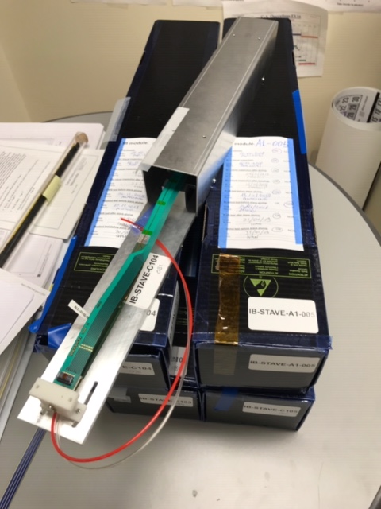
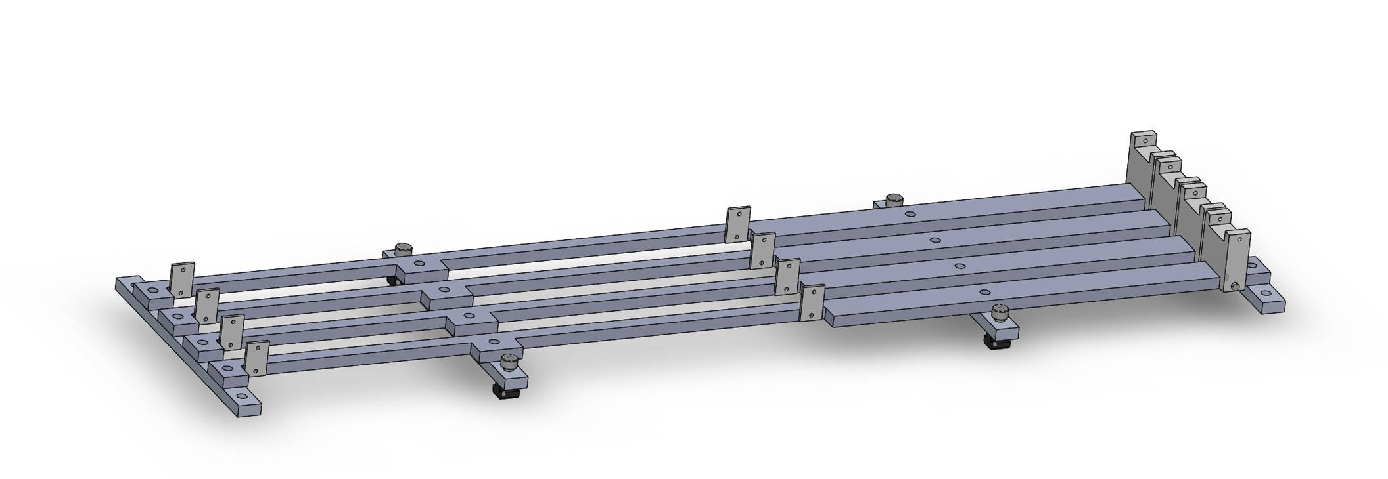
Mechanical design
Telescope box design completed, sent for fabrication
One stave can be offset by (0.5,0.5)cm for material scanning

Slide 9
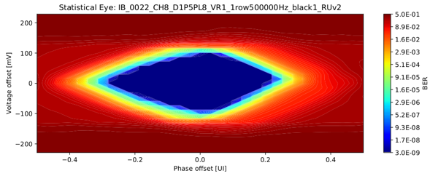
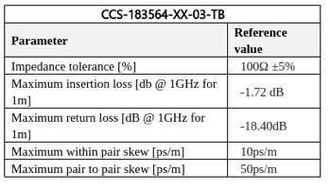
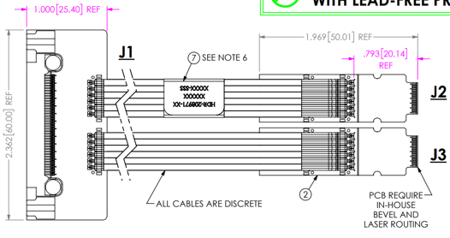
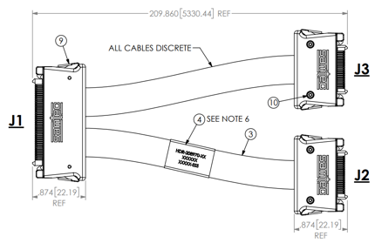
ALICE/ITS Signal cable design
The Samtec twinax cables carry clock (40 MHz), control (40 Mbps bidirectional), data (9x1.2 Gbps)
ALICE is using halogen-free cables (32 AWG, LDPE dielectric) due to CERN LSZH requirement; 2.65 + 5.3 m cables have been tested and are now in production
RU
RU
Stave
Stave

Slide 10
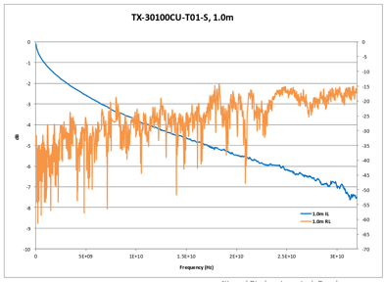
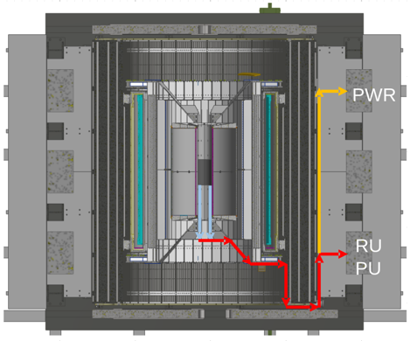
sPHENIX MVTX Cable testing
BNL has approved non-halogen-free cables (30 AWG, FEP dielectric); improved signal integrity
sPHENIX cable run estimates are converging: 1.4 + 6.5 m
We have Samtec quotes for 1.2/2.65 + 5.3/8.8 m (total length 6.5 - 11.45 m), will order soon
We will qualify these cables using stave and RU (bit error rates, statistical eye), and scope/network analyzer
We will test full-length MVTX cables in the next months

