Slide 1
sPHENIX MVTX Telescope
TB Plan
Sho, Ming et al
01/24/2019
Updated 2/5/2019 after discussions with Jo @CERN;
and Huber, Walt and Abel at LANL 2/6/19

Slide 2
Early Test Beam with EIC/sPHENIX EMCal?
April 3 -23, 2019
Possible early MVTX telescope beam test:
- 4/14-23 @ Fermilab
*BNL sPHENIX Director’s review:
4/8-13 @BNL
MVTX and INTT will be reviewed
Other plan (current default):
A joint MVTX + INTT test beam
May 20-30, 2019

Slide 3
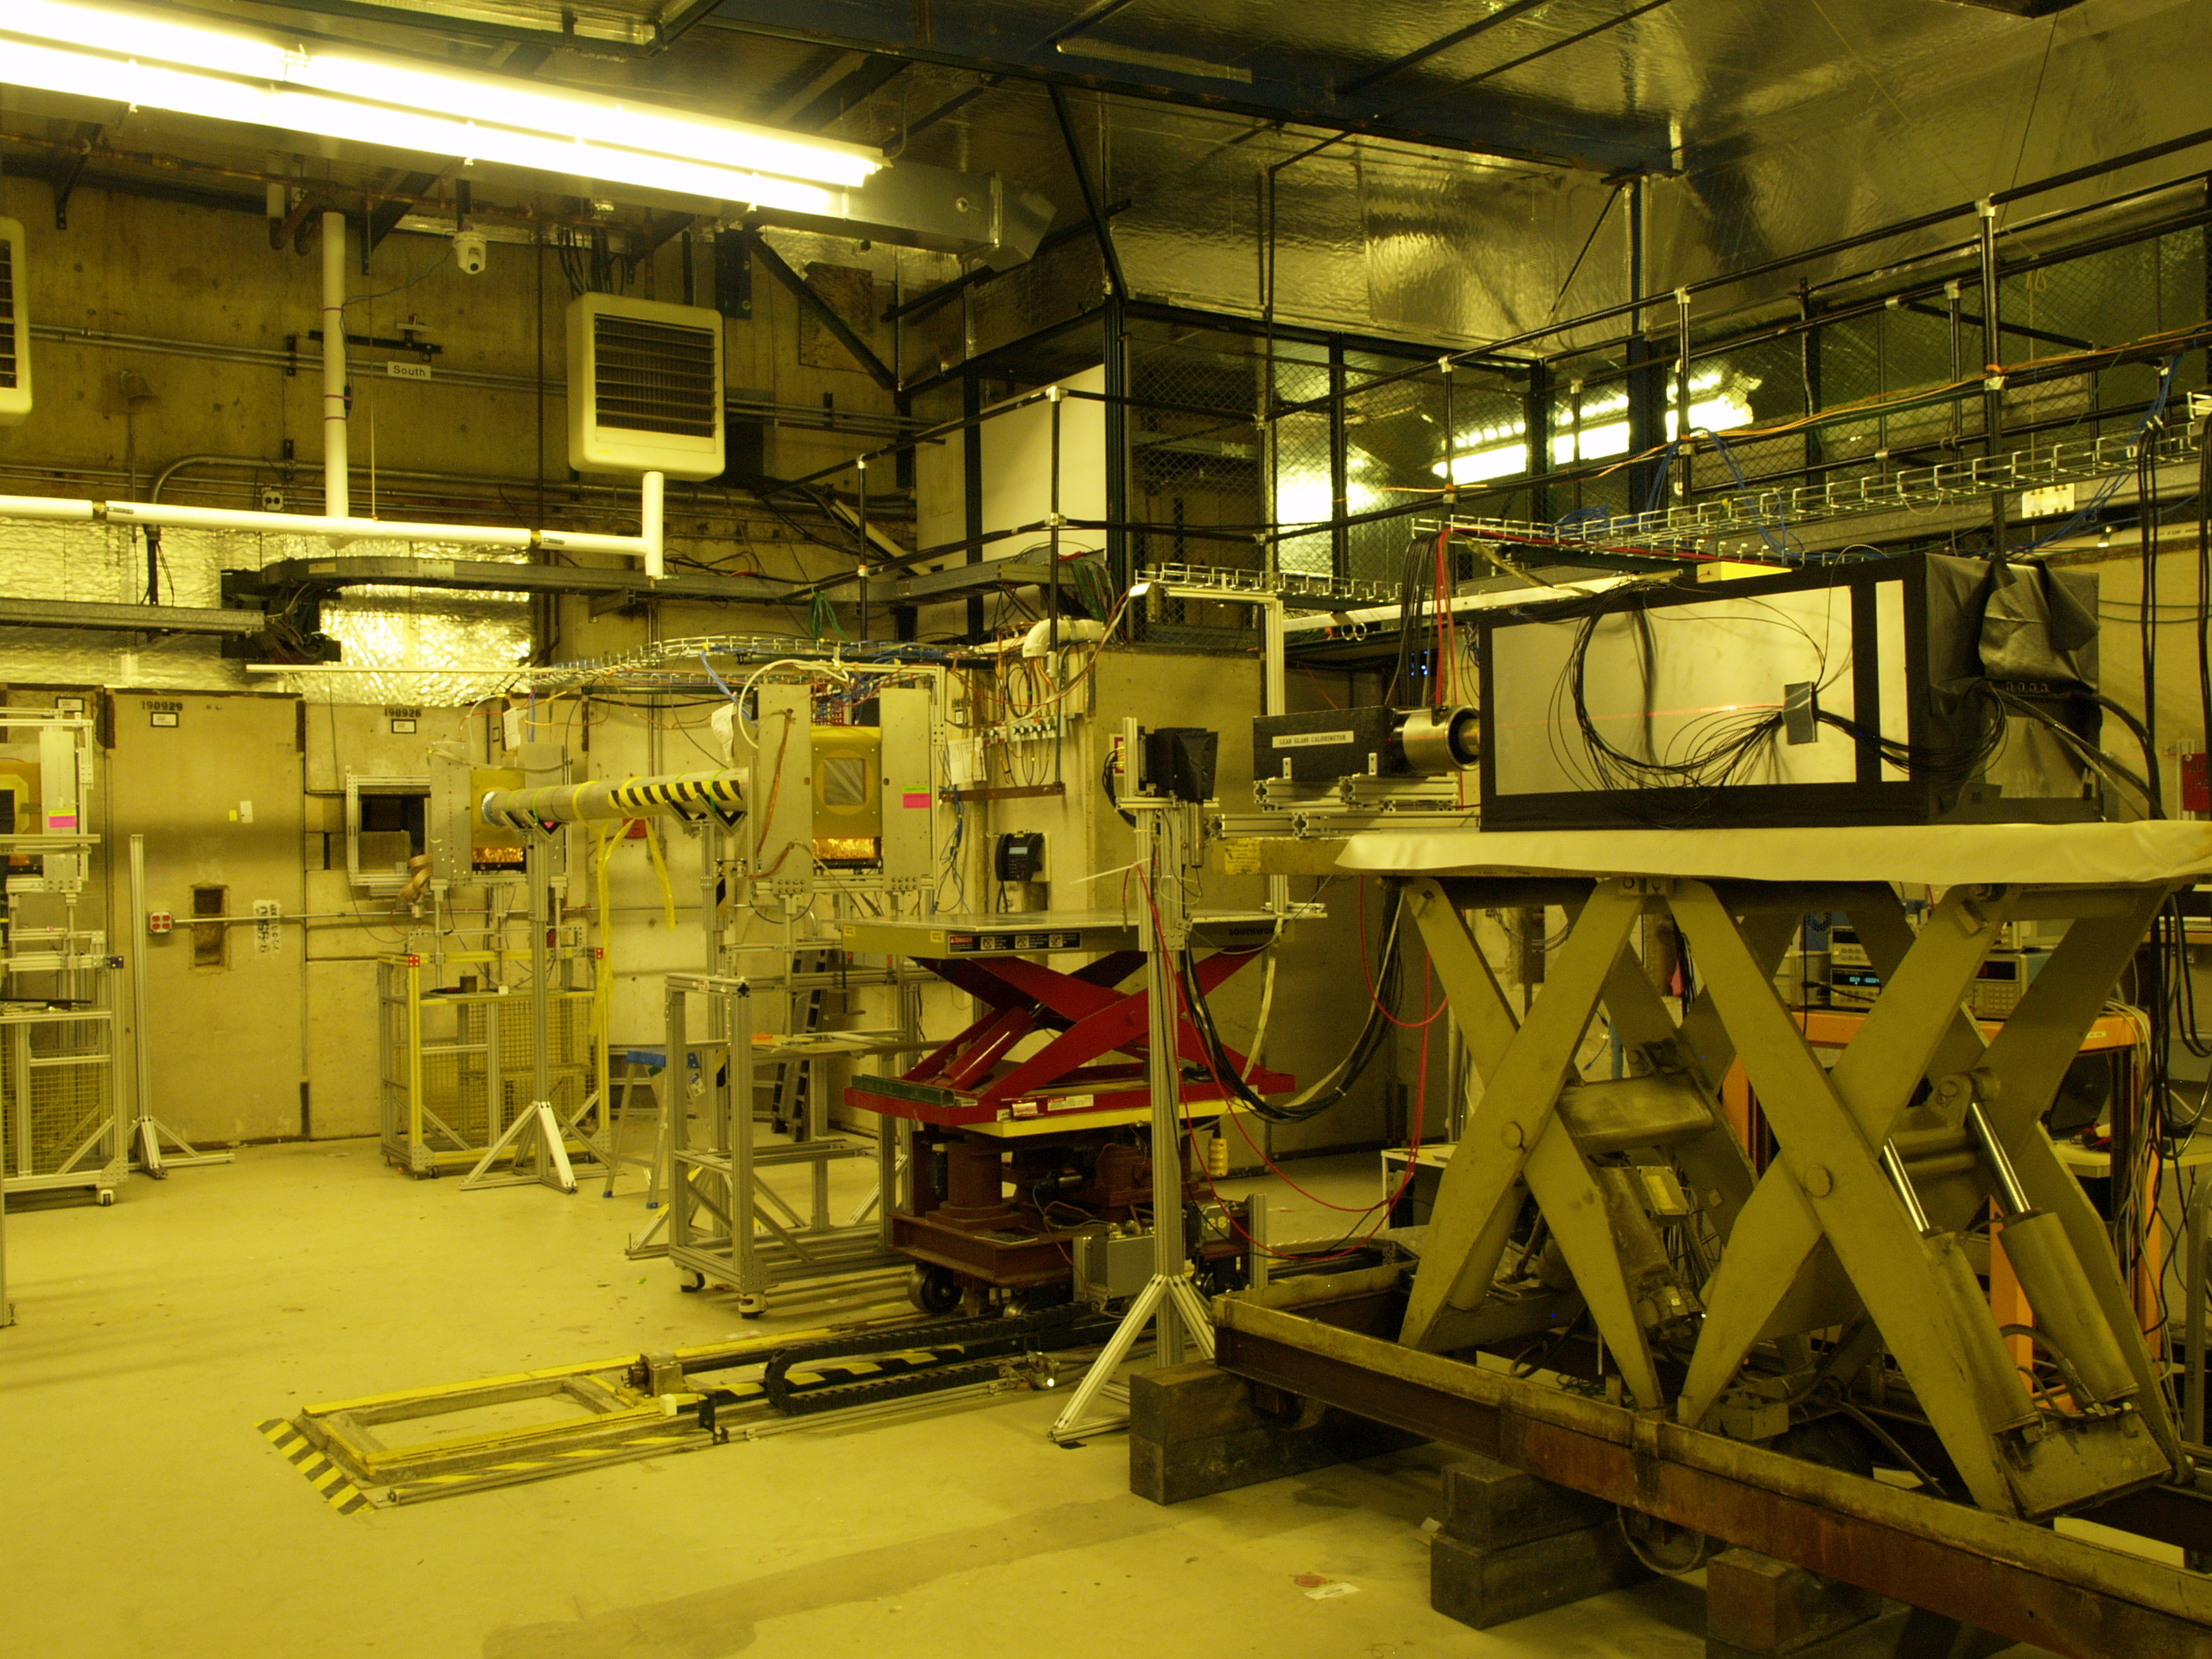
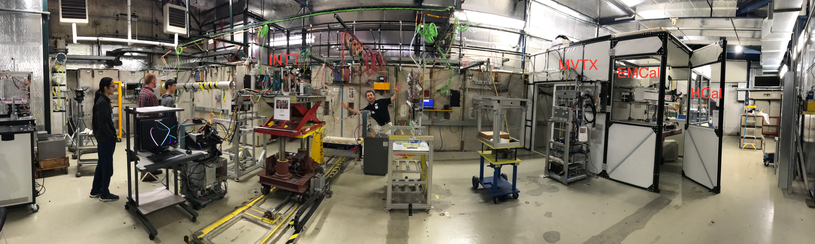
UCLA EMCal TB in 2014 (~ for 2019)
Possible joint TB
MT6.2B, 4/2019
We could use the table upstream of
UCLA Emcal for MVTX TB;
The same table was used for INTT
last time(3/2018) with MVTX located down stream
https://www.phenix.bnl.gov/WWW/publish/mxliu/sPHENIX/LDRD/FermilabTestBeam-032018/IMG_0673_sPHENIX_Overview.jpg
MVTX
UCLA EMCal
MT6.2B, 3/2018

Slide 4
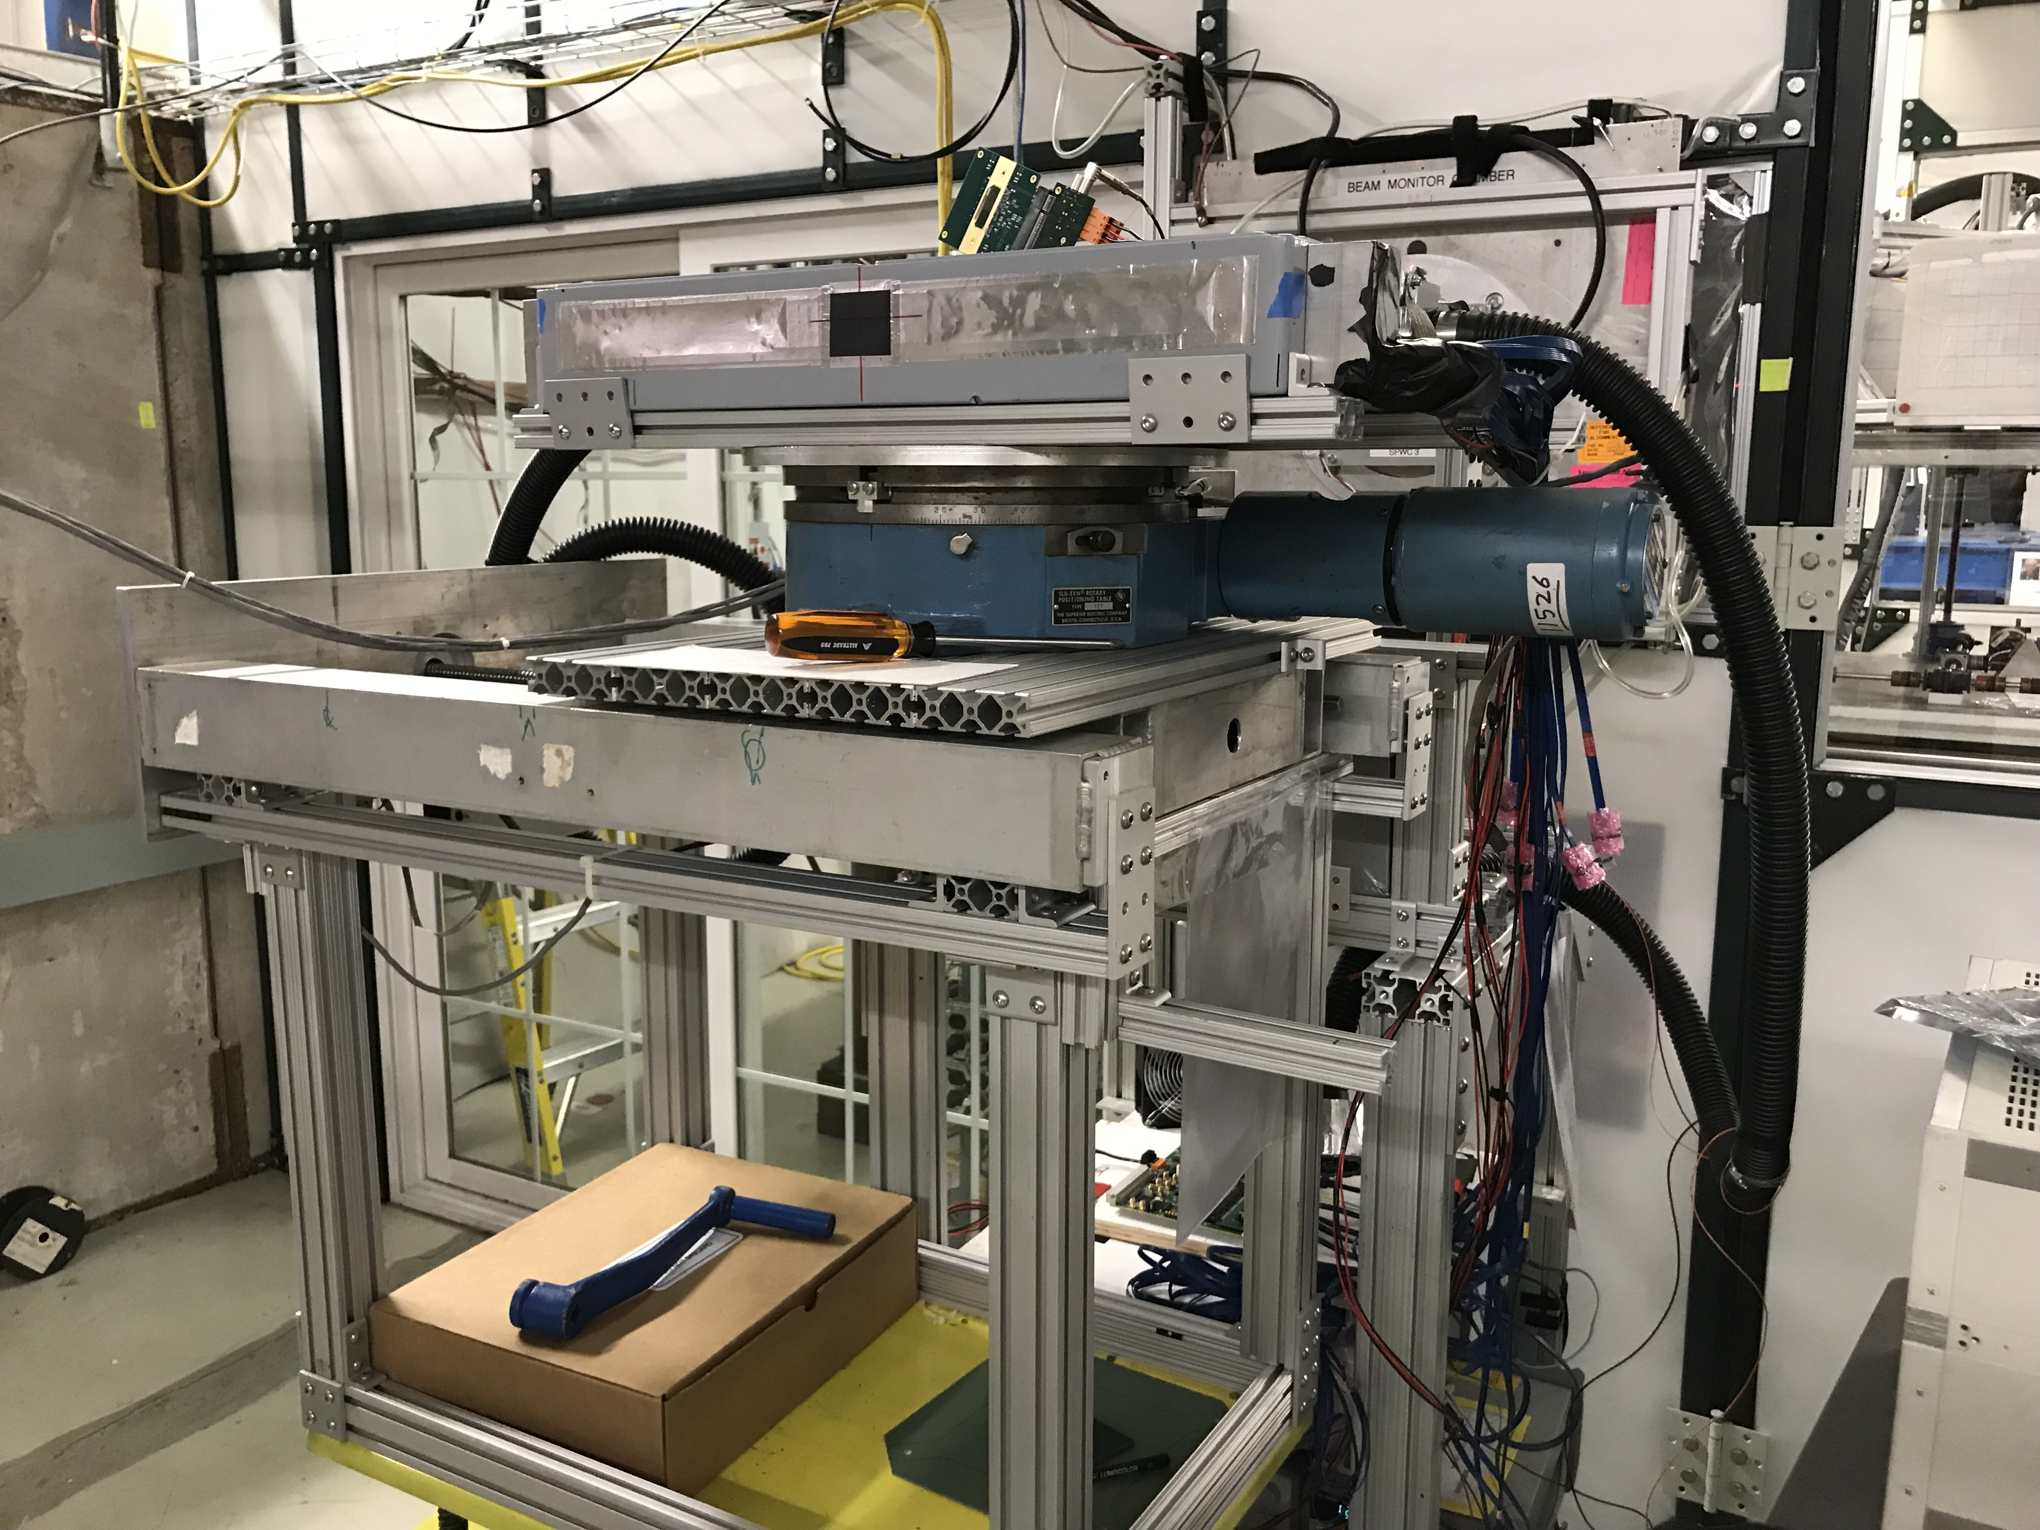
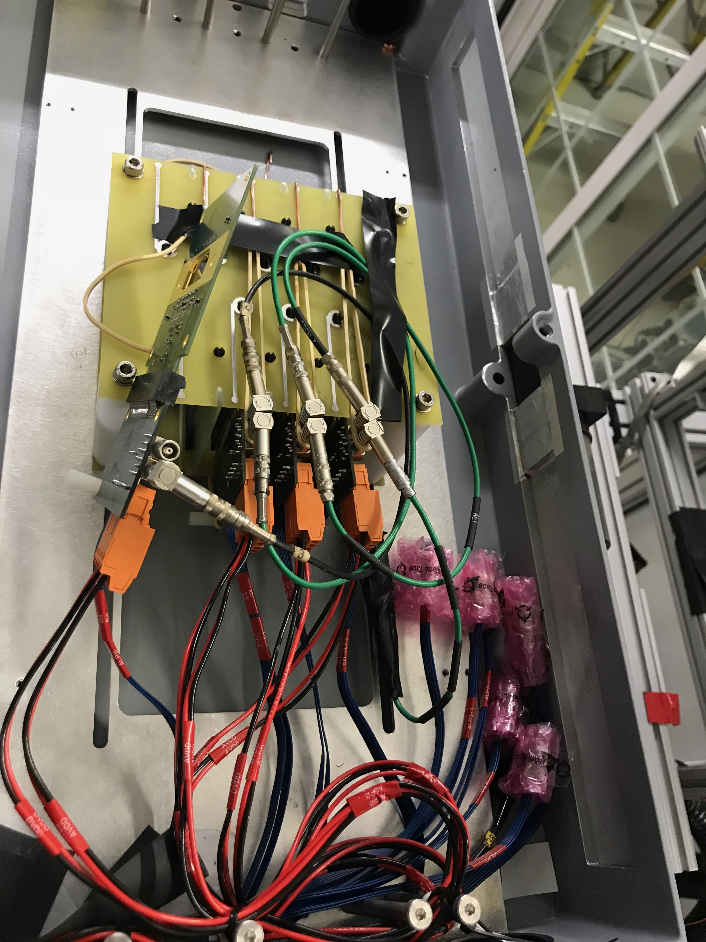
2018 Fermilab Setup

Slide 5
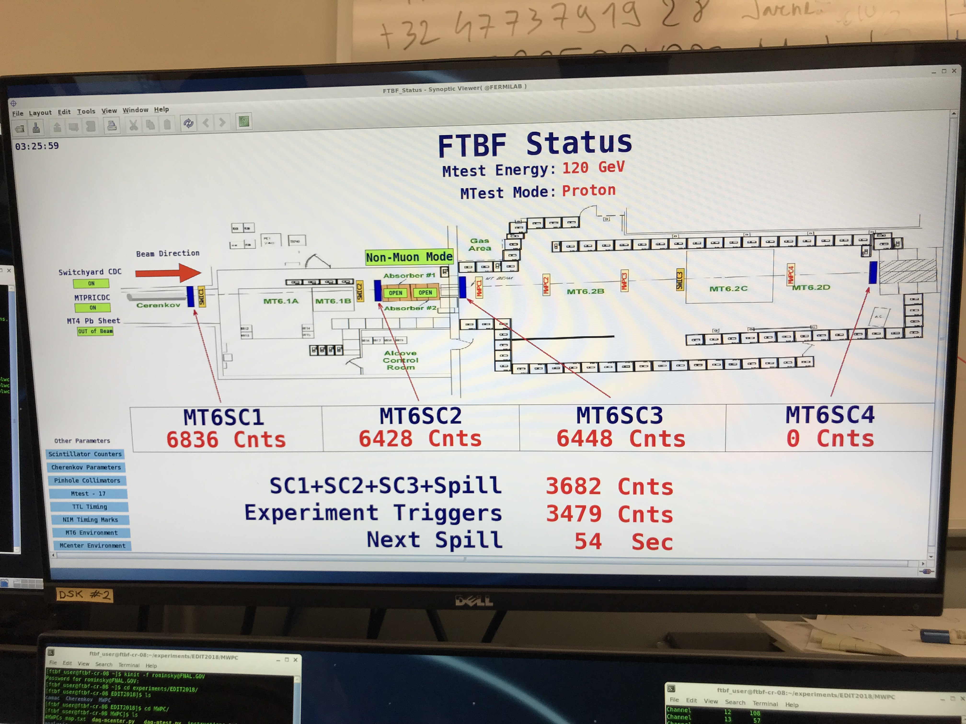
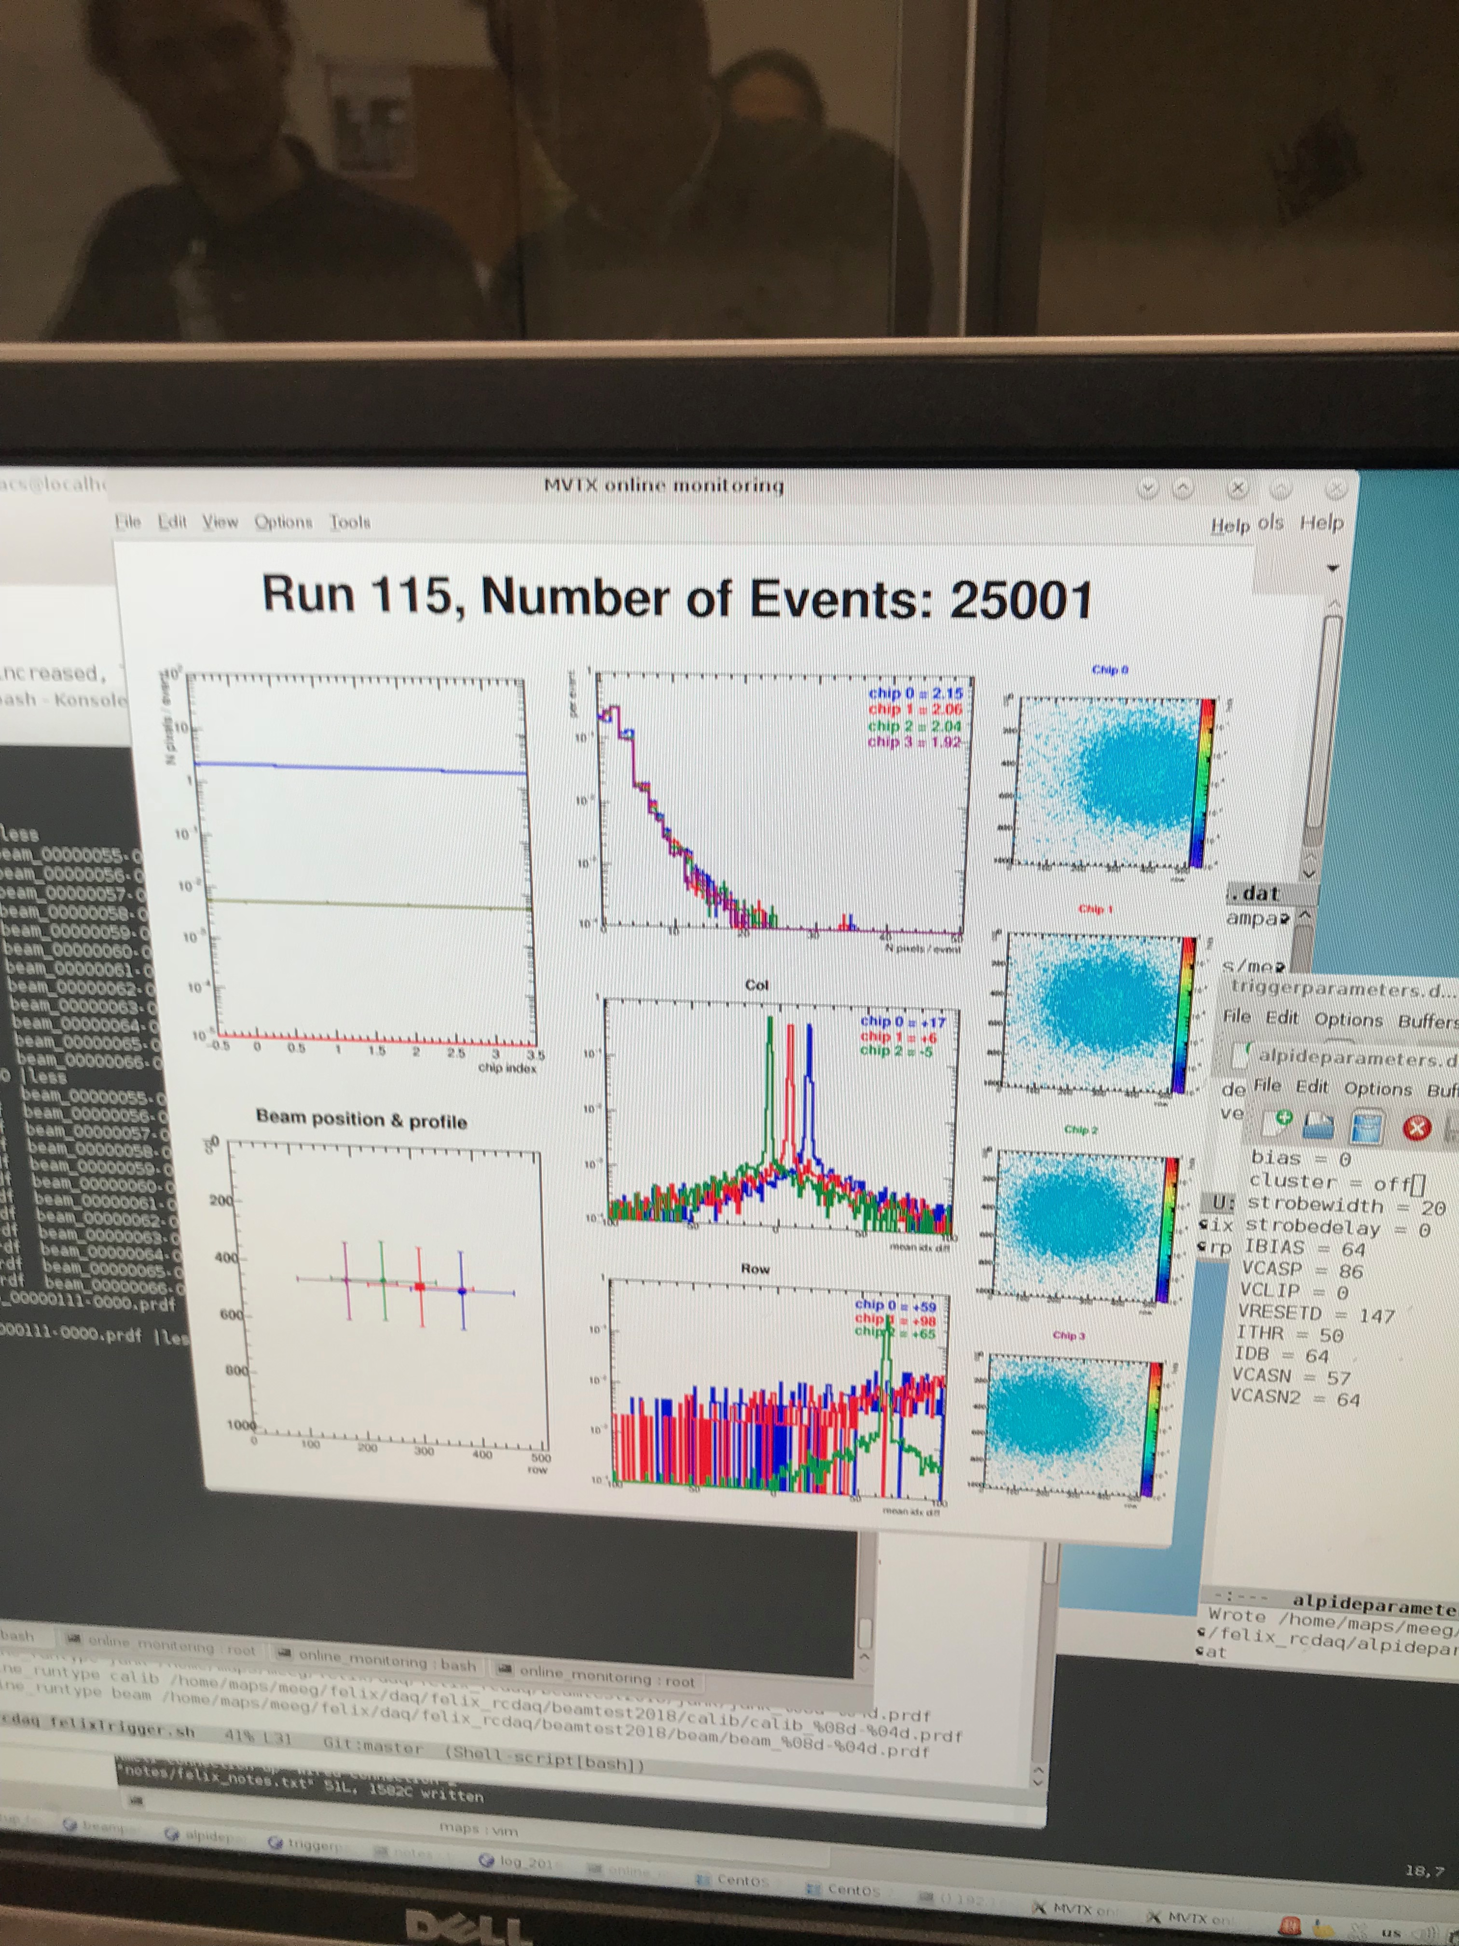
Test beam at FNAL
March, 2018
MVTX Telescope 03/2018
Online Monitoring @FNAL

Slide 6

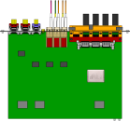
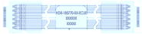
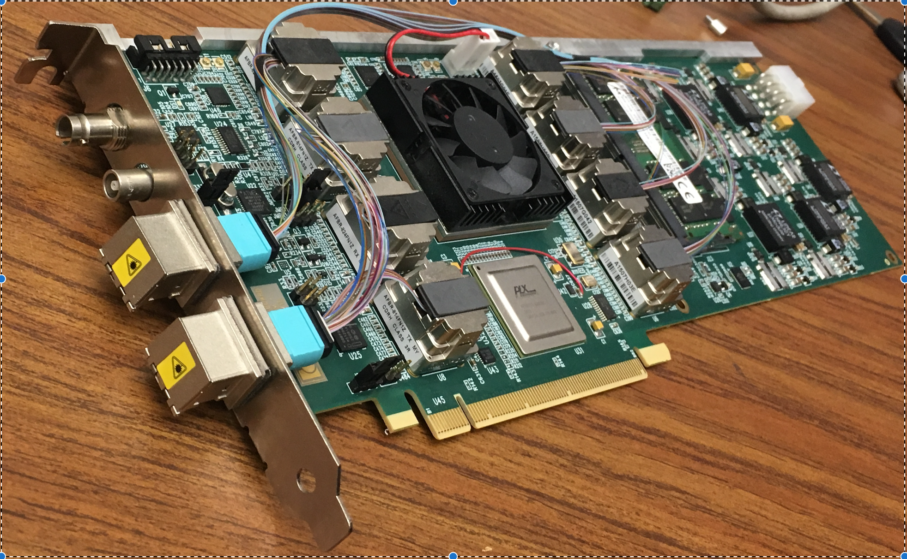

4-Stave Telescope Configuration
Online monitoring and control
Data, CLK, CTRL
PU
FELIX
DVDD, AVDD, Bias

Slide 7
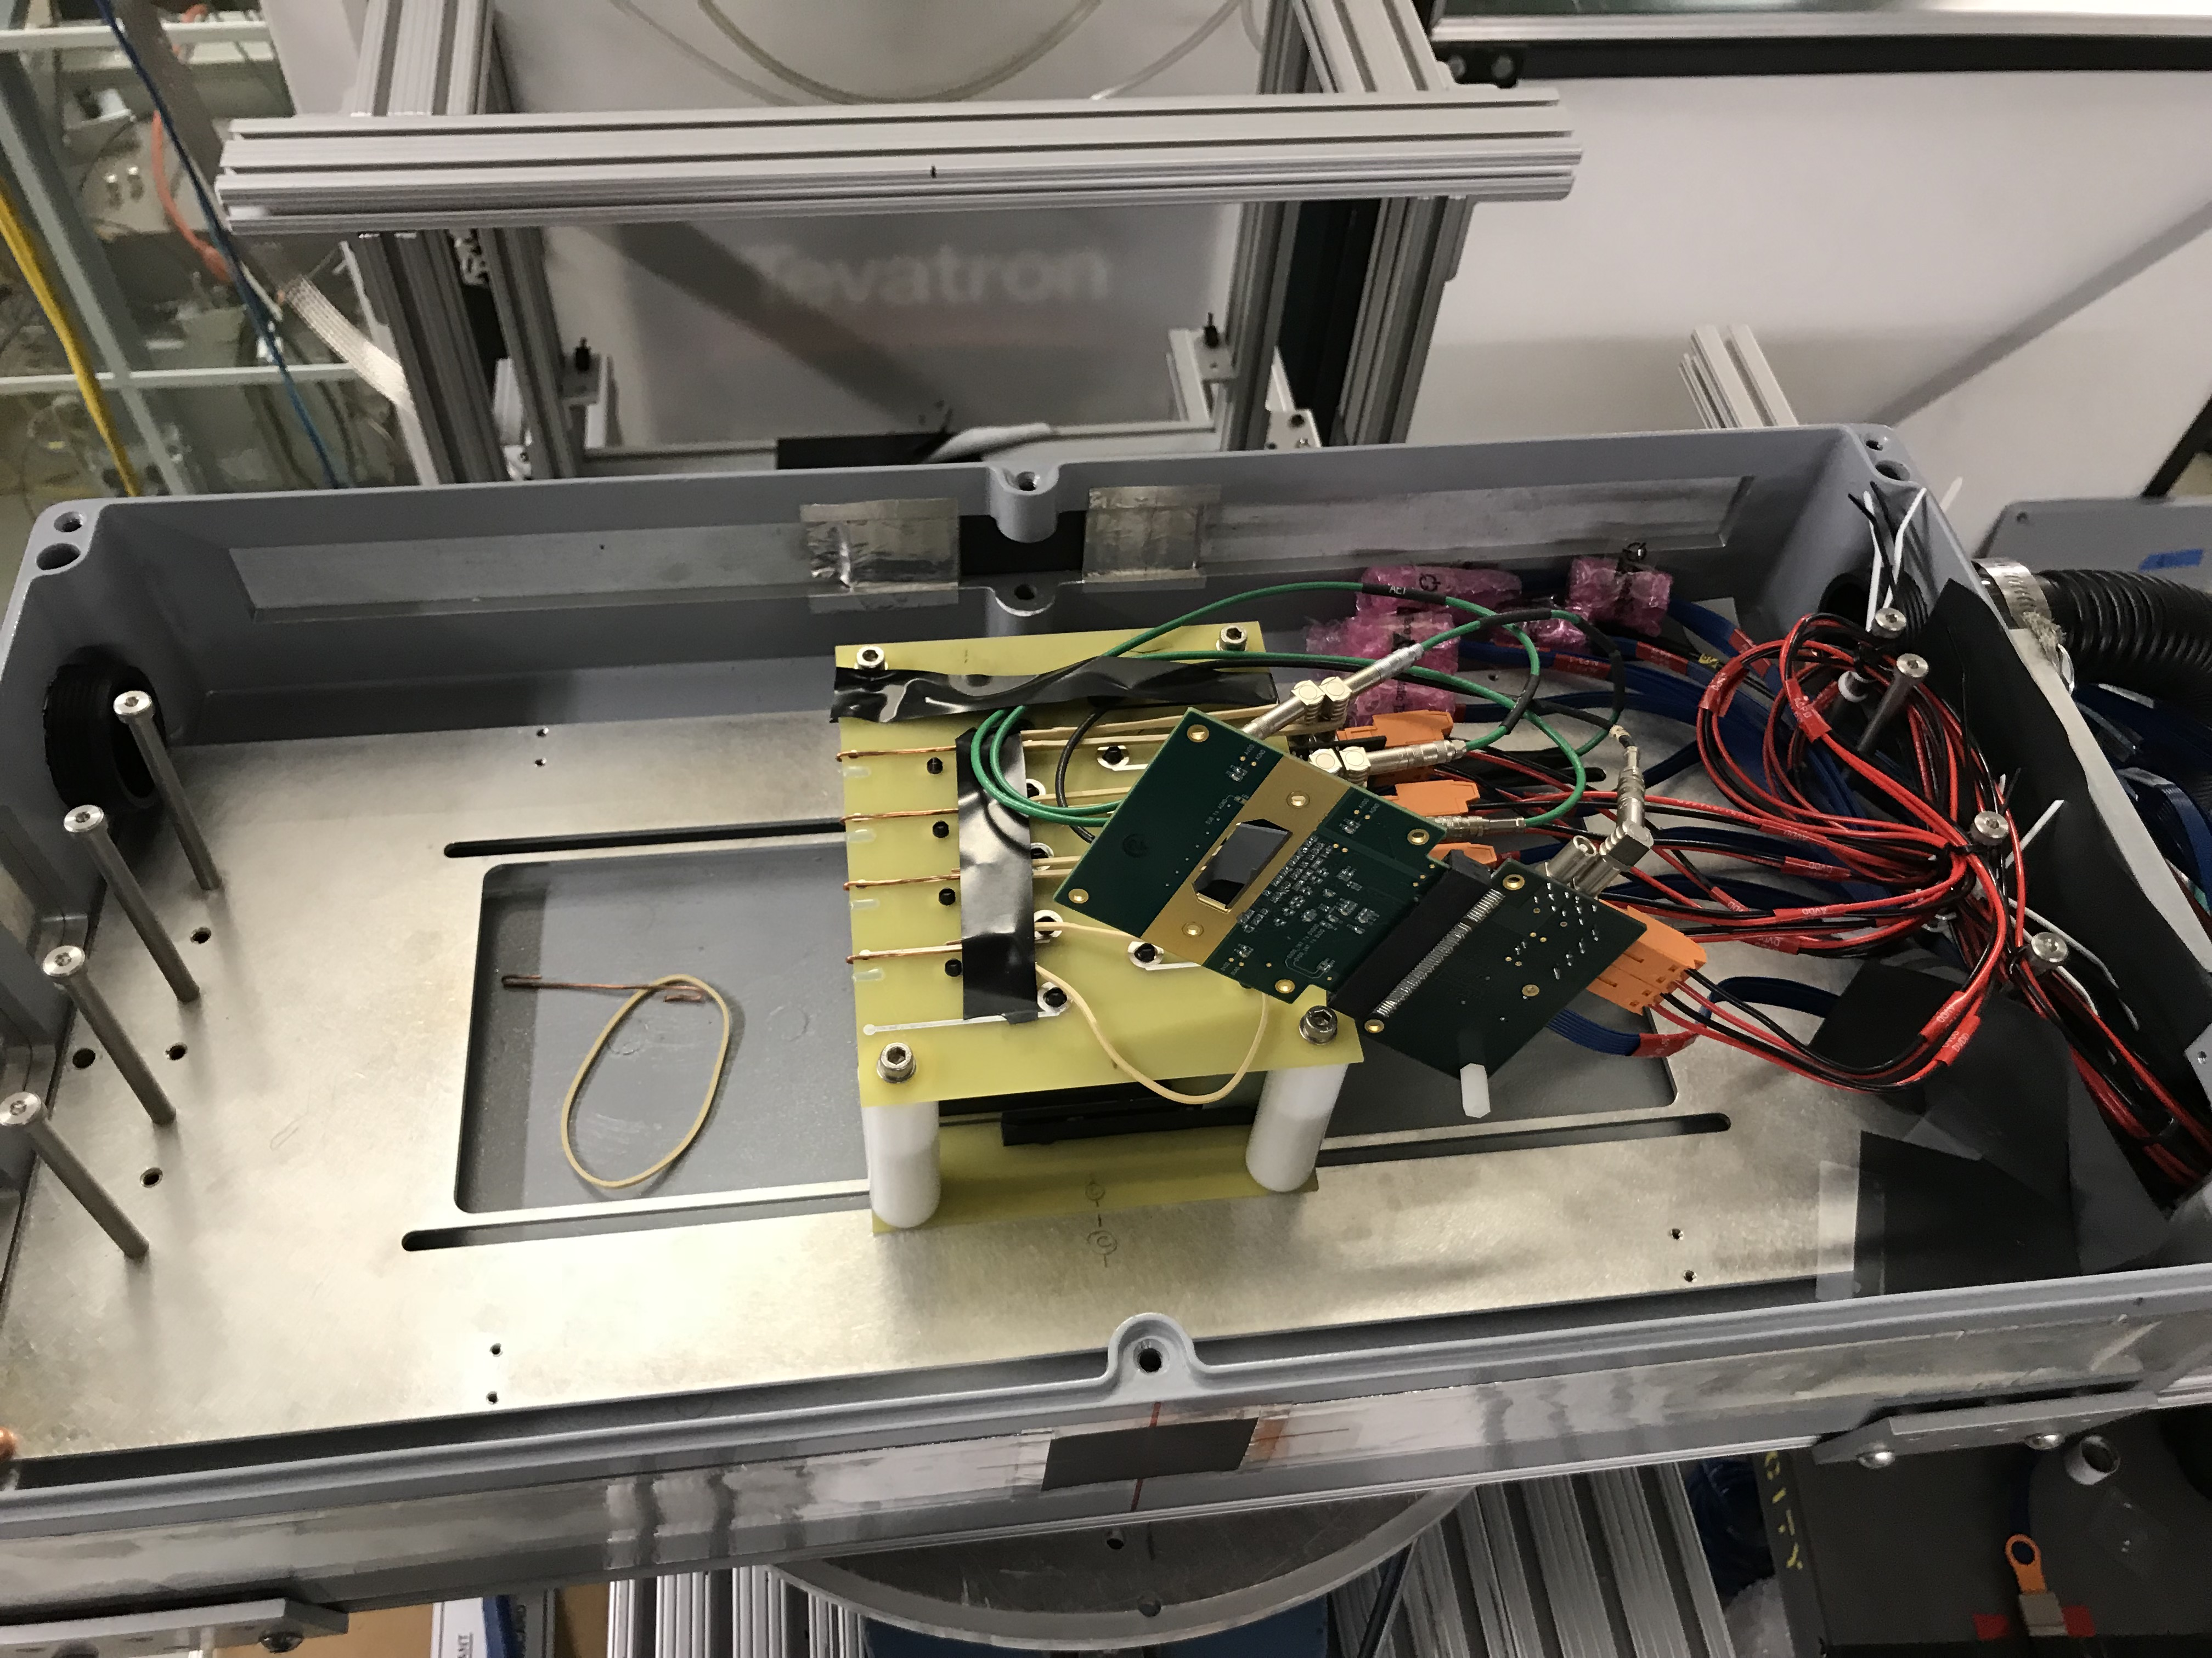
Telescope work
Hardware
  4 staves available
    One more coming later
  2 RU v2.0
  Samtec cables
    5m, 8m, 10m
    New transition boards
    Plan-B , 5m w/ existing transition baords
  1 FELIX v2.0
    Also one Felix v1.5 (used last time)
  FELIX server and RCDAQ
    2-stave → 1 RU
    2 RU → 1 FELIX
  Telescope box
    Fixtures for staves
    Cooling (air OK), T-monitoring?
Software
  4-stave readout
    FPGA
    RCDAQ and decoder
  PU control via RU/USB
    4 DVDD, 4 AVDD, 4 BV
    V, I, T monitoring
  Online monitoring
    Event information, hit distribution n
    Sensor V, I, T monitoring
  Offline analysis

Slide 8
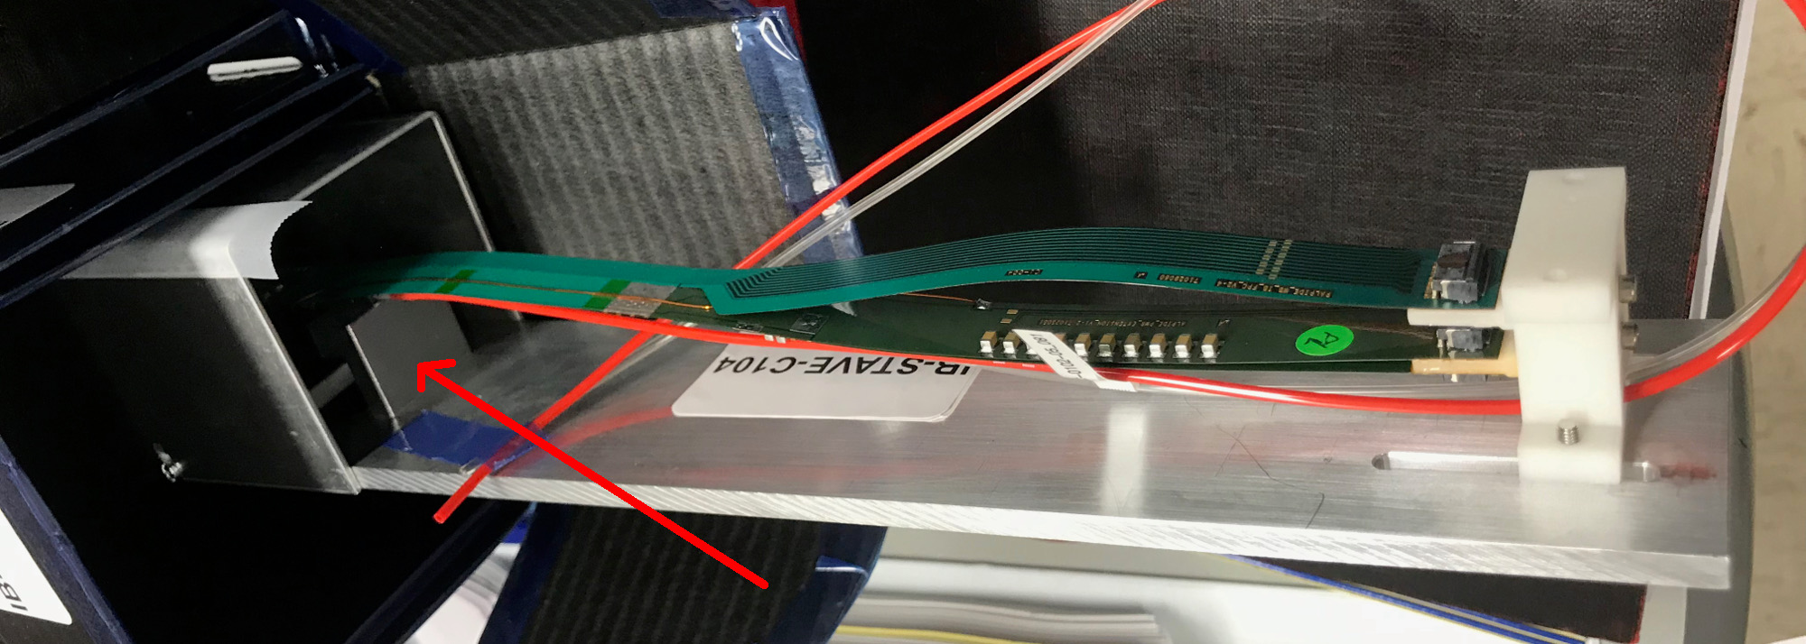
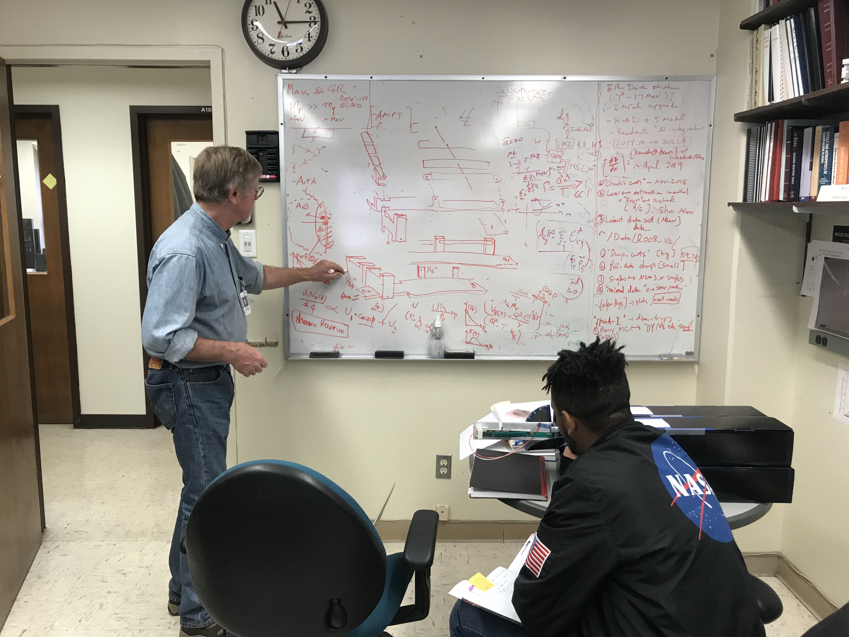
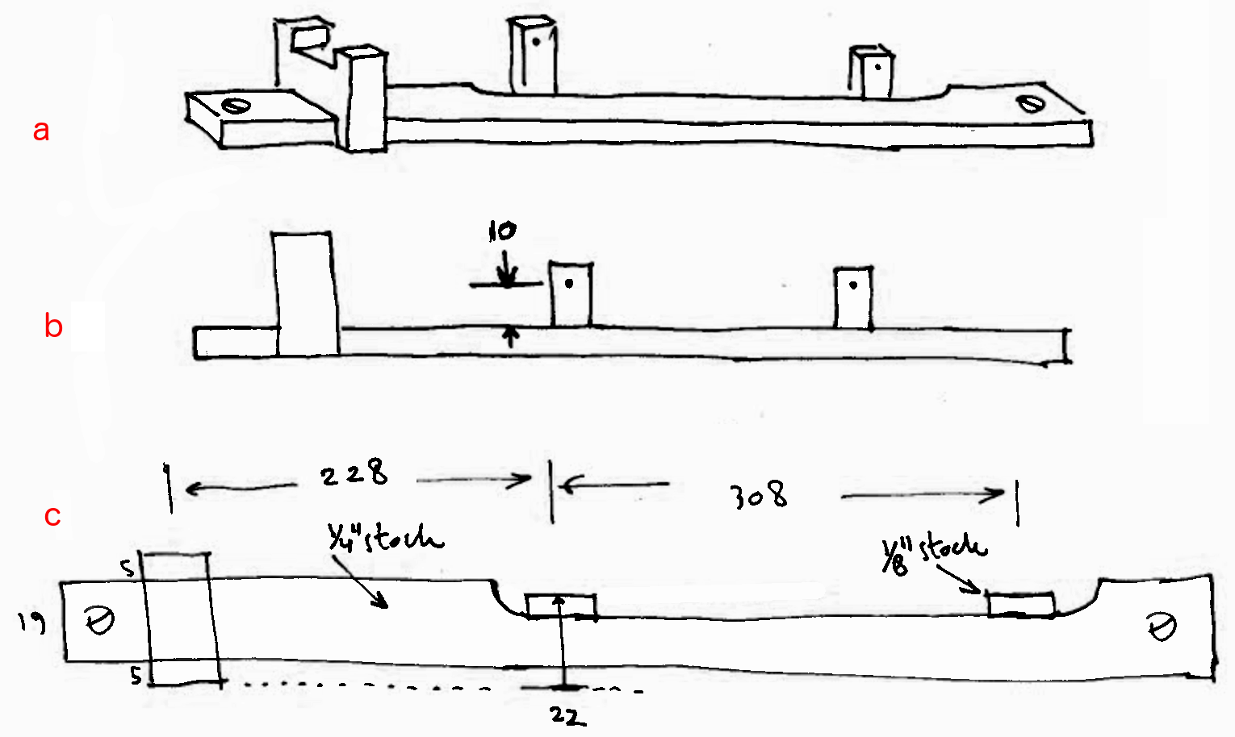
Preliminary mechanical support for 4-stave
Abel works with Hubert and Walt to
fabricate stave support frames;
https://p25ext.lanl.gov/maps/hardware/stave_box.html

Slide 9
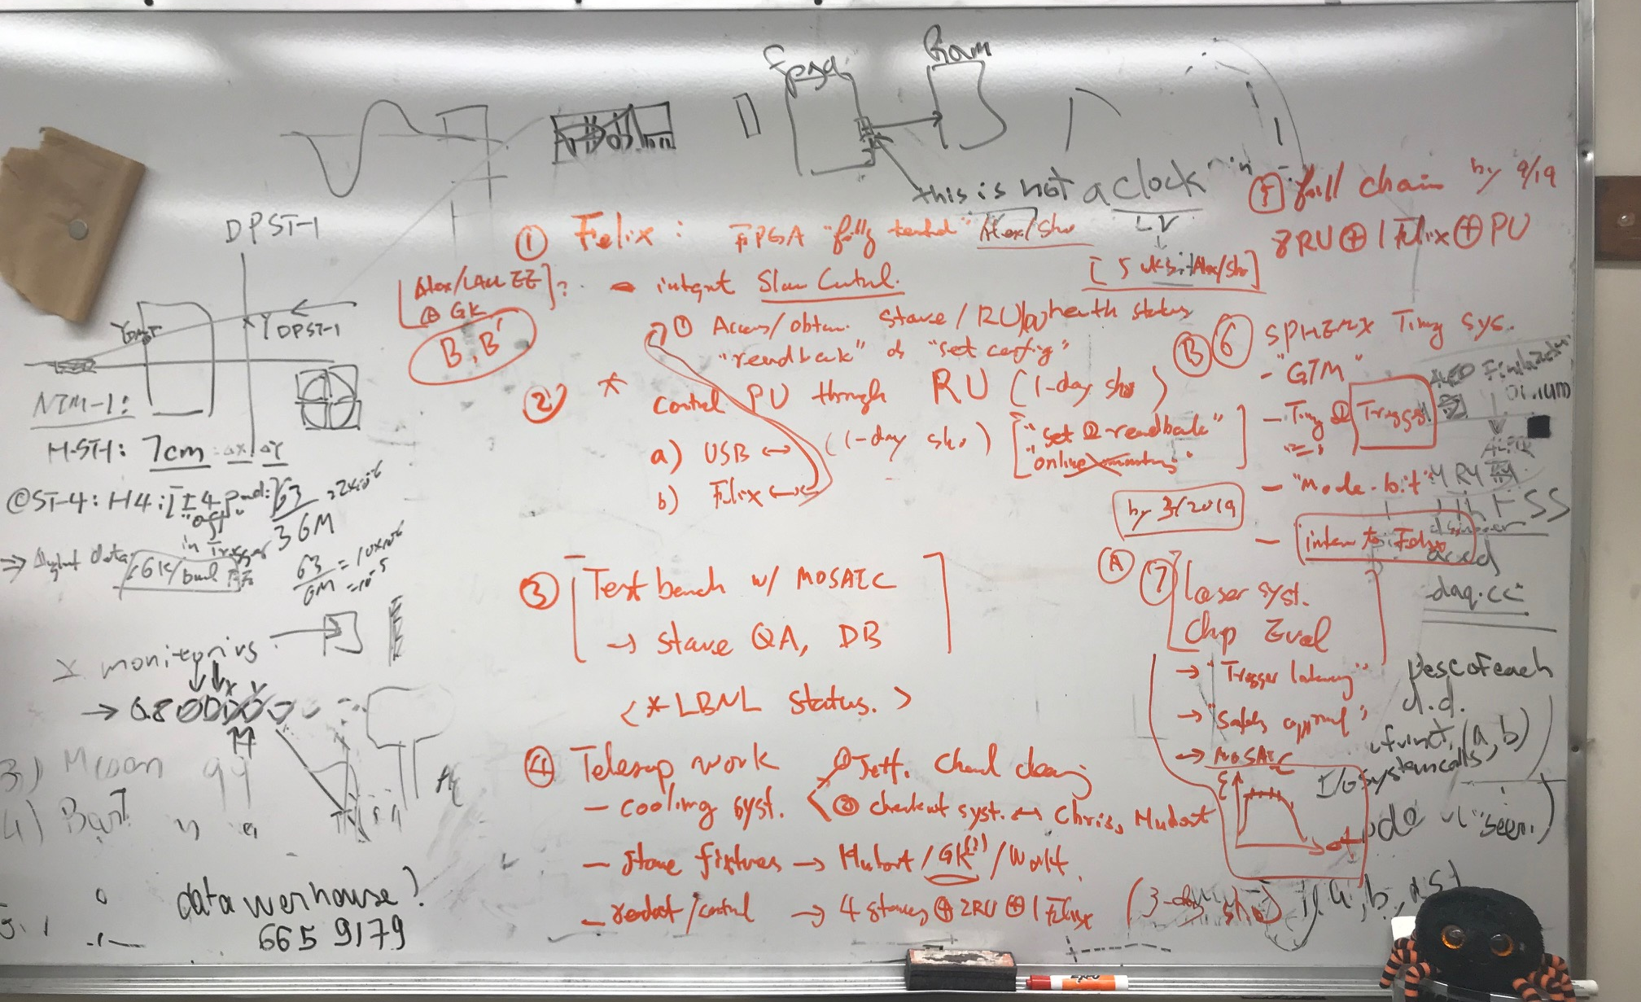
Discussions with Sho, 1/16/2019

Slide 10
Manpower
LANL
  Ming, Sho, Kun, Cesar, Yasser, Cameron*, Gerd, Xuan, …
  Darren?
sPHENIX collaborators
  Jin (remote), Sanghoon?

Slide 11
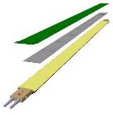
MVTX Electronics, Power and Controls
CAN bus
DCS
~10 m
Trigger & Clock
Readout Unit
Front End
GBT Optical Links
9-sensor Stave
9 Data (1.2Gbps)
1 Clock, 1 Control/Trigger
Control
Data (9.6 Gb/s max)
Trigger
Samtec Twinax “FireFly”
FELIX
Back End
FPC
Power
Alpide Sensors
Filtering Capacitors
Power
regulators
Power supplies
Cold Plate
Regulated Power
Power Board
Interaction Region
Experimental Hall
Counting House
Sensor-Stave (9 ALPIDE chips) | Front End-Readout Unit | Back End-FELIX
(------- ALICE/ITS Hardware --------)
(-- ATLAS Hardware --)

Slide 13
Readout Development Work
Sho’s summary page:
https://p25ext.lanl.gov/maps/readout.html
MVTX technical document: https://www.overleaf.com/18152646jkqtztvgnrtp

