Slide 1
Plan for Today
Overview – 20+5’ Ming Liu 1:00-1:25
  Project Org, scope and plan, collaborations
Theory Status – 10+0’ Ivan Vitev 1:25-1:35
Experimental technical aspects
  Simulation progress - 10+5’ Sanghoon Lim 1:35-1:50
  Electronics readout – 15+5’ Pat McGaughey 1:50-2:10
  Mechanical R&D – 10+5’ Walt Sondheim 2:10-2:25
Experimental Cost, Schedule, Risk
and Procurements (II) – 25+10’ Cesar da Silva 2:25-3:00
Summary - 5’ Ming Liu 3:00-3:05
Committee discussion – 20’ 3:05-3:25
Closeout 3:25 – 3:35

Slide 2
LDRD Project Overview
Ming Liu, P-25, for the LDRD Team
December 5th, 2016
LDRD Goals
  Develop a new QGP physics program with heavy flavor b-jet measurements in sPHENIX at RHIC
  Carry out key detector R&D and develop a new MIE proposal to DOE to build a state-of-the-art MAPS-based high precision vertex detector to support the b-jet physics program in sPHENIX
Project Scope, Plan and Milestones
  Experimental tasks
  Theoretical tasks
Cost, Schedule, Procurement and Risk Management
Organization

Slide 3
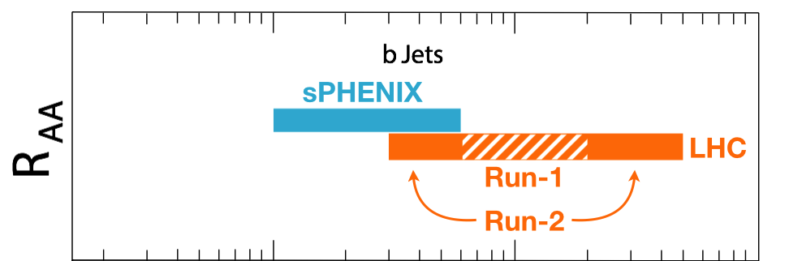

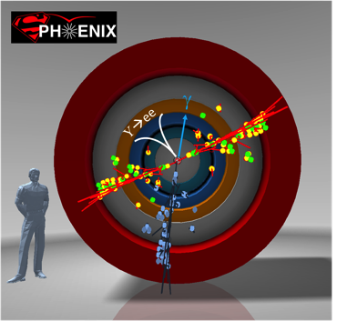
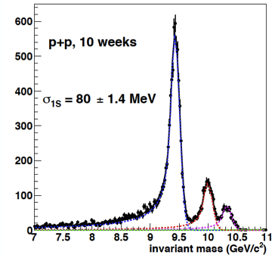
Goal: Big Science to LANL
sPHENIX is the next US NP flagship project in heavy ion physics, to study the properties of Quark-Gluon-Plasma (QGP); recently granted CD-0 (9/2016)
This LDRD will allow LANL to take a leadership role in sPHENIX
  Proposed innovation : develop a new b-jet physics program as a Major Pillar of the sPHENIX Program; novel Monolithic-Active-Pixel-Sensor (MAPS) based precision tracking; b-jet identification and theory
  Bring new state of the art technical capability (MAPS) to LANL applied program, also future EIC program
Cannot be done at the LHC for lack of low pT reach and huge backgrounds
sPHENIX Three Physics Pillars
Jets
Upsilons
B-Jets ← this LDRD

Slide 4
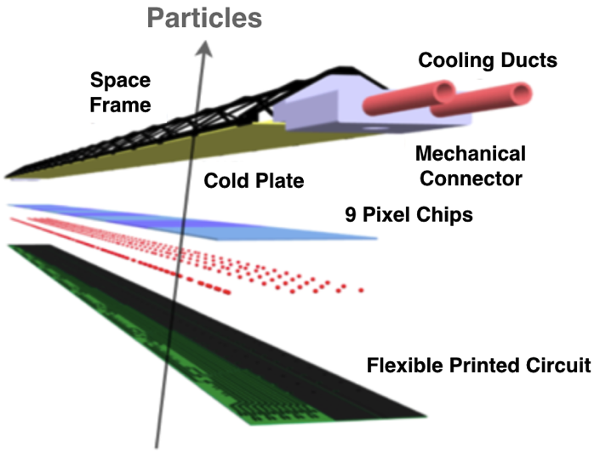

MAPS: a State of the Art Tracker
Advantages of MAPS:
  Very fine pitch (28x28 μm)
  High efficiency (>99%) and low noise (<10⁻⁶)
  High speed, 2~4 μS
  Ultra-thin/low mass, 50μm (~0.3% X₀)
  On-pixel digitization, low power dissipation
  15+ years of R&D at CERN for ALICE upgrade
An ideal detector for QGP b-jet physics!
A 9-chip MAPS stave
50 μm
28 μm

Slide 5


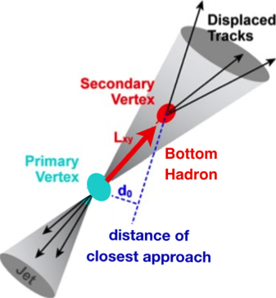
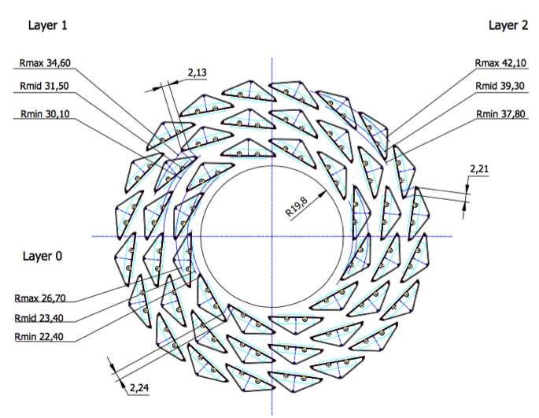
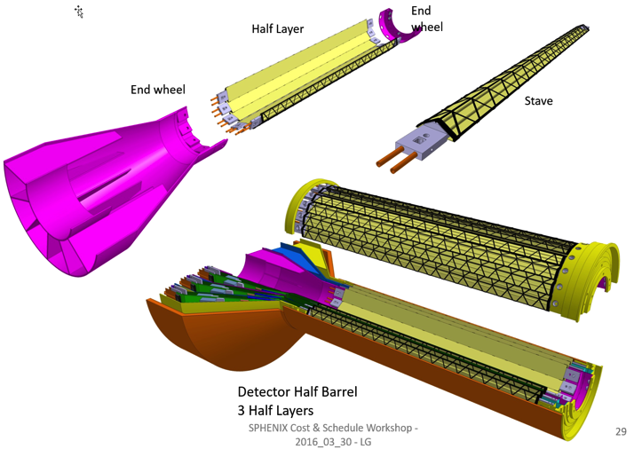
LANL Proposed sPHENIX MAPS Inner Tracker
2022+
ALICE ITS Upgrade (2021+);
Inner Tracker System
Key integration issues:
- Readout
- Mechanics
sPHENIX Inner Tracking
“Adopt” ALICE/ITS
Mini. risk,
Max. physics

Slide 6
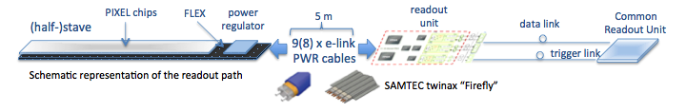
Goal: MAPS-sPHENIX Electronics Integration
Plan A:
reprogram
ALICE readout path
Plan B: sPHENIX readout path (held as contingency)
MAPS FEM
DCM2
EvB
existing ALICE design
trigger in
modified design,
starting with ALICE boards
busy out
existing design
existing sPHENIX design
Pat’s talk

Slide 7
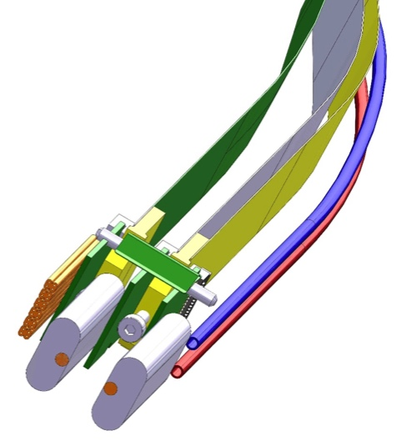
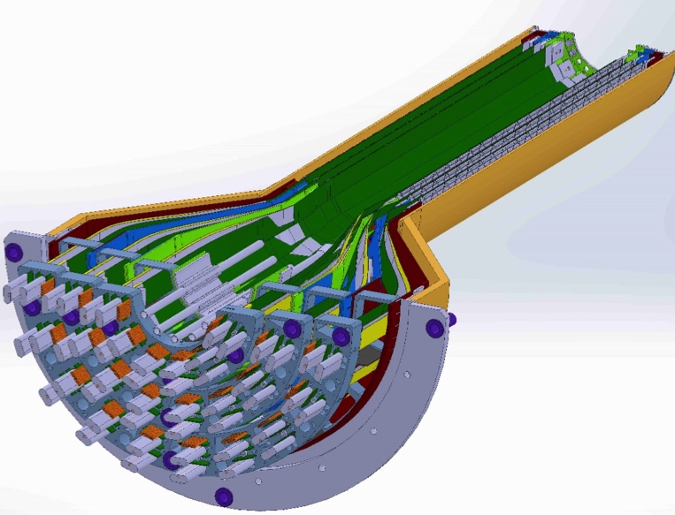
Goal: MAPS-sPHENIX Mechanical Integration
Service End Wheel
Possible modifications
High speed signal
Analogy power
Digital power
Cooling
Walt’s talk

Slide 8
LDRD Project Scope and Plan
Minimal scope
  Develop a MAPS telescope with 2-4 early prototype staves with ALICE readout, sPHENIX DAQ integration
  Complete R&D on Mechanics conceptual design, sPHENIX mechanical system integration
  Develop b-jet tagging algorithms
  DOE MIE proposal submitted to fund the full detector construction
Desired scope
  Develop a full 4-production-staves MAPS telescope, test beam run with integrated sPHENIX DAQ
  DOE MIE proposal approved for the full detector construction

Slide 9
LDRD Experimental Key Tasks and Schedules
Closely tied to ALICE R&D and Production Schedule
Cesar’s talk

Slide 10
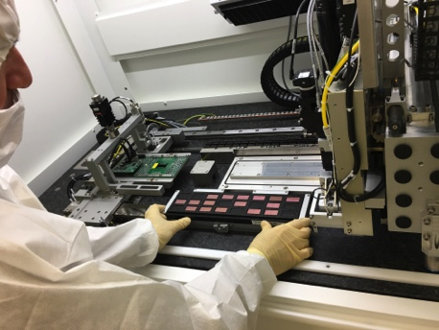
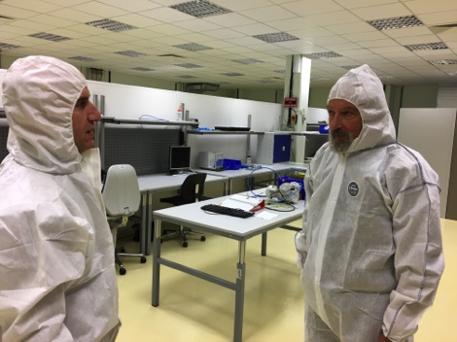
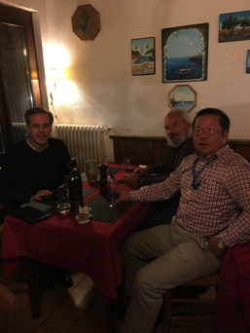
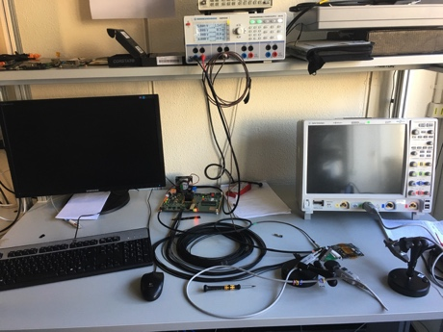

1st Milestone: MoU with ALICE/ITS
CERN Visit to discuss MoU: November 10-15, 2016
  Visited MAPS R&D and construction labs
  Agreement on MoU achieved!
MoU with ALICE/ITS
  Associate member on the ALICE/ITS project at CERN
    Access all technical design files and documents
    Access other technical resources, including Engineering and Computing support, joint R&D on LDRD project
    Train LANL personnel on the job
  Procurement of critical items from CERN
    5 single-chip MAPS readout evaluation boards
    1-2 high-speed readout out test boards (MOSAIC test bench)
    4+ Readout-Unit and 2+ Common-Readout-Unit prototypes and associated electronics components, including CERN GBT optical links
    Mechanical support frame prototypes
LDRD milestones developed to match:
  ALICE R&D and production schedule
  sPHENIX proposed installation and run schedule
Automated chip
mounting
High speed readout test

Slide 11
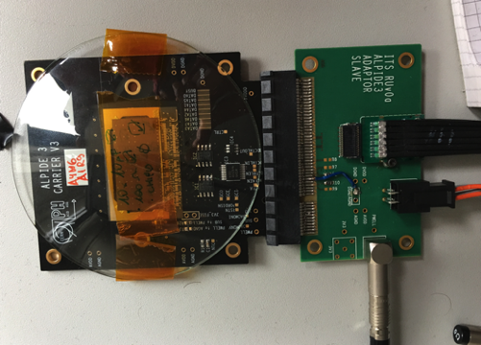
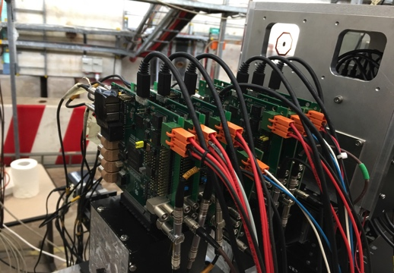
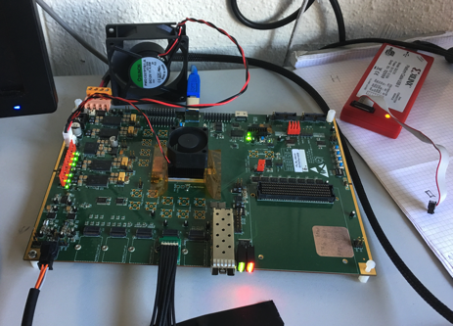
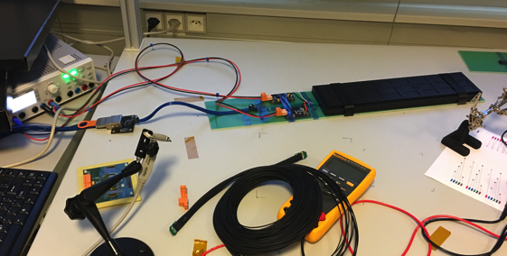
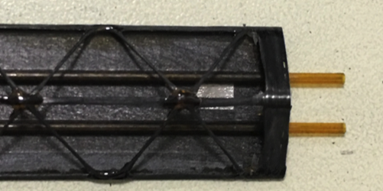
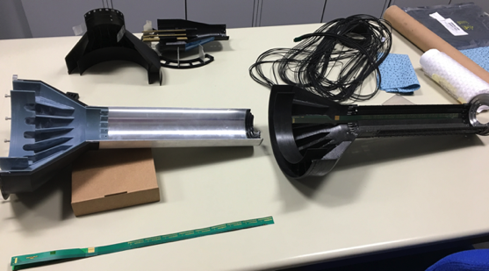
Status of MAPS R&D at ALICE/CERN
MAPS chip readout with test board
  Also tested at LANL
  Telescope
Multichip MAPS high speed readout
  with the first prototype Readout Cards (RUv0)
  MiniDAQ (MOSAIC board) test bench
RU fiber optics communication established with a prototype Common Readout Unit (CRU)
Stave space frame being produced
Service End Wheel being prototyped
Procurement for LANL LDRD R&D items
  Key test electronics and mechanic prototypes being produced for LANL LDRD
A 7-single-chip telescope
Single MAPS Chip
RUv0
MOSAIC Test Bench
stave
Service wheel

Slide 12
Major Item Cost, Schedule and Risks
No high risk items!
- Low Risk for most items
- Medium risk on stave and readout electronics production schedule
Risk mitigation:
Use early prototype staves to build LANL telescope for key integration and performance studies
Early R&D on readout, also explore alternative approaches
  CRU firmware integration at EvB level (Plan-A)
  DCM-II readout via custom adaptor boards (Plan-B)
Joint R&D with other sPHENIX subsystems for MAPS DAQ and mechanical system integration
Cesar’s talk

Slide 13
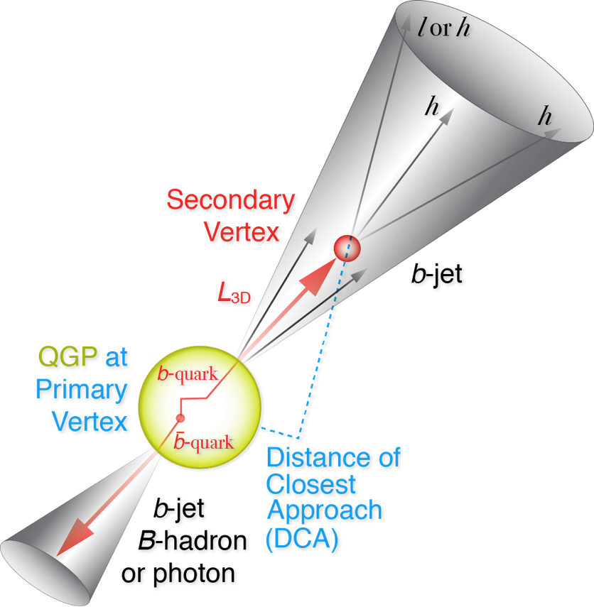
Experimental R&D Deliverables: Physics
LDRD Goal: much improved B-jet Identification in Heavy Ion Collisions
Secondary Vertexing Possible!
Sanghoon’s talk
A new b-jet identification with high efficiency and high purity is possible
Figure of merit is efficiency x purity. Greatly enhancing the b-jet physics program, x4 improvement in FOM (compared to alternatives)

Slide 14
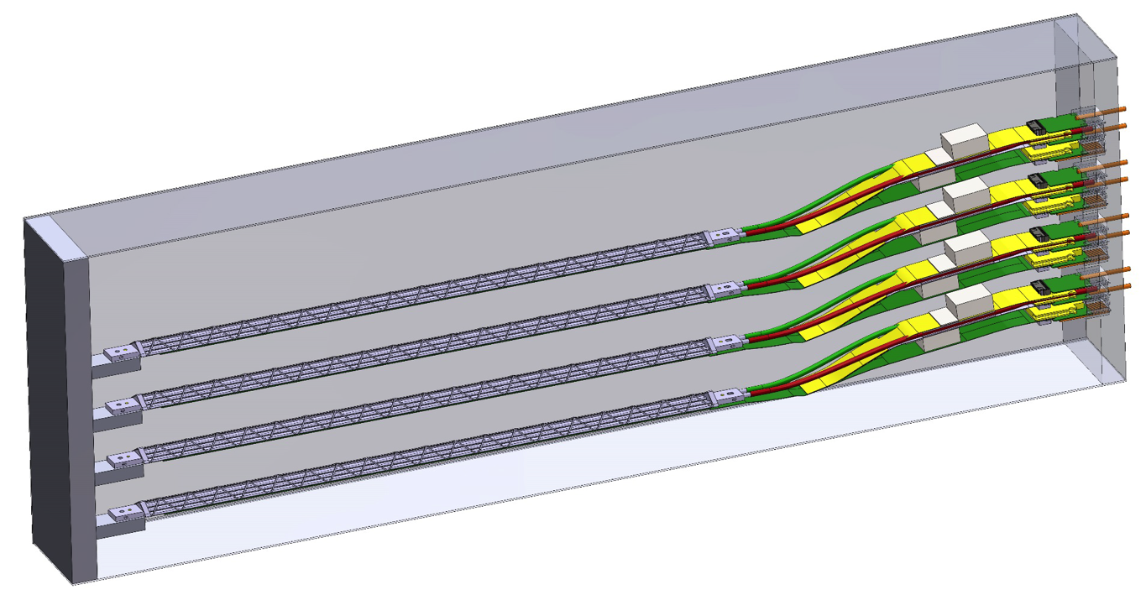

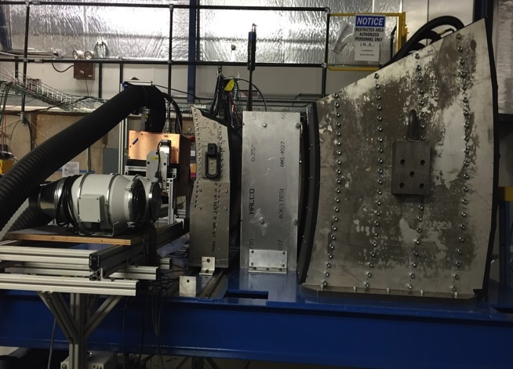
Experimental R&D Deliverables a 4-Stave Telescope
A 5-single-chip telescope
Performance of prototype tracker
  High speed readout of staves
  Spatial resolution
  Electrical and mechanical stability
  Cooling etc.
NIM paper
Cosmic ray
Beam test at Fermilab
sPHENIX
Data Format
Pat and Walt’s talks

Slide 15


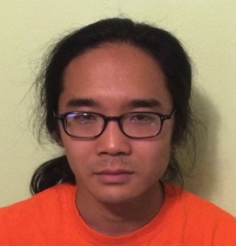





Experimental Project Organization
LALN internal
  Simulations
  Electronics
  Mechanics
External collaboration
  CERN/ITS group
  ALICE US groups
Lead people identified for key tasks
  Team of experts
Job AD out for a new staff
  Several outstanding candidates
Mark
Prokop
(AOT)
A new
staff
Cesar’s talk

Slide 16
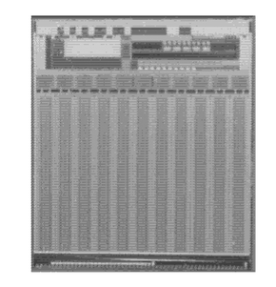
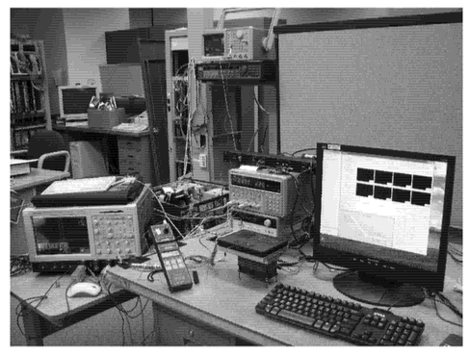
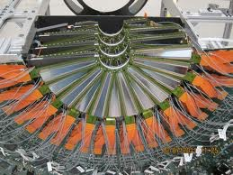
Impact and Transition Plan
Extend LANL’s position as an international leader at the next generation QGP physics frontier, major discovery potential
Develop a new long term (10Y) major DOE funded program ($3M/year) at LANL in line with the national priority, DOE funded QCD theory (~$1M/year)
New in-house capabilities in low-mass high resolution tracking/imaging technology. Benefit other future programs, such as the EIC and applied missions at LANL
Expect high Return On Investment, above 6:1
Previous successful path followed by LANL’s FVTX silicon tracker
prototyping under LDRD DR:
final tracker supported by DOE:
  FVTX prototype
  sensor & readout

Slide 17
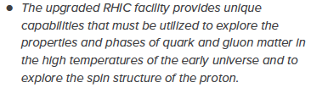


A Road Map
Excellent strategic Alignment
NSAC Long Range Plan
At the heart of the recently released LANL NP strategy, by Rej, Wilburn, Carlson, 2016
Our projects are pipelines for talent to applied LANL missions
Recommendation #1 (RHIC):
Recommendation #3 (EIC):
The highest priority in this 2015 Plan is to capitalize on the investments made.
LDRD
sPHENIX
EIC
2015
2020
2025
2030

Slide 18
Project Status
MoU with ALICE/ITS achieved (in advance)
Initial cost, schedule and risk management plan developed
Key R&D item procurement in progress
Physics and detector simulation work underway
MIE pre-proposal writing in progress
Low Risk on theory
Project is on schedule!

Slide 19
backups

Slide 20
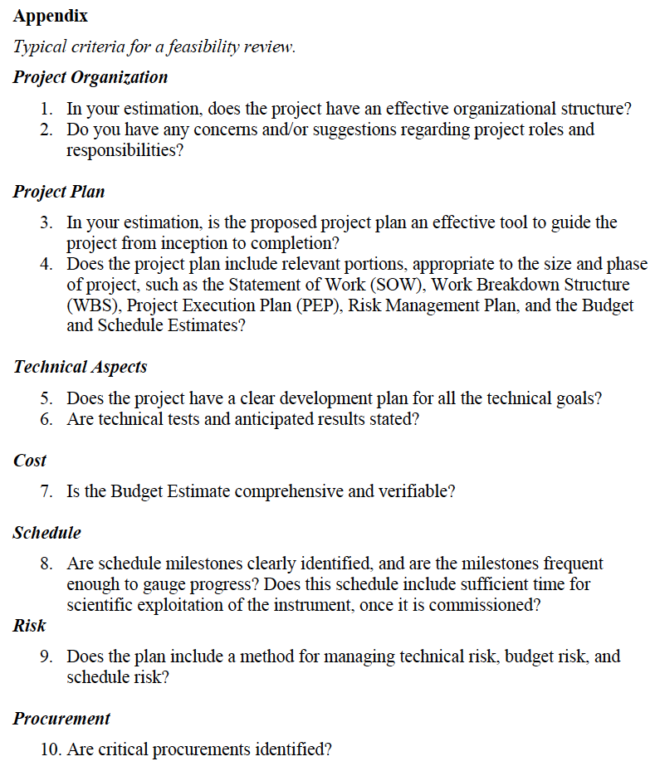
Experimental group
  Lead persons on major tasks
Theory group
Experimental MS Project:
Tasks & resources, WBS etc.
Milestones
Theory:
- Milestones
- Milestones
MoU with CERN, by mid Decemebr
Local R&D
MS Project:
Tasks & resources, WBS etc.
Milestones
Risk mitigation:
Technical, early R&D
Budget, MoU, early R&D
Schedule, collaboration with
ALICE/ITS R&D,

Slide 21
LDRD MS Project(I)
Closely Tied to ALICE/ITS Upgrade Schedule

Slide 22
LDRD MS Project(II)
Closely Tied to ALICE/ITS Upgrade Schedule

