Slide 1
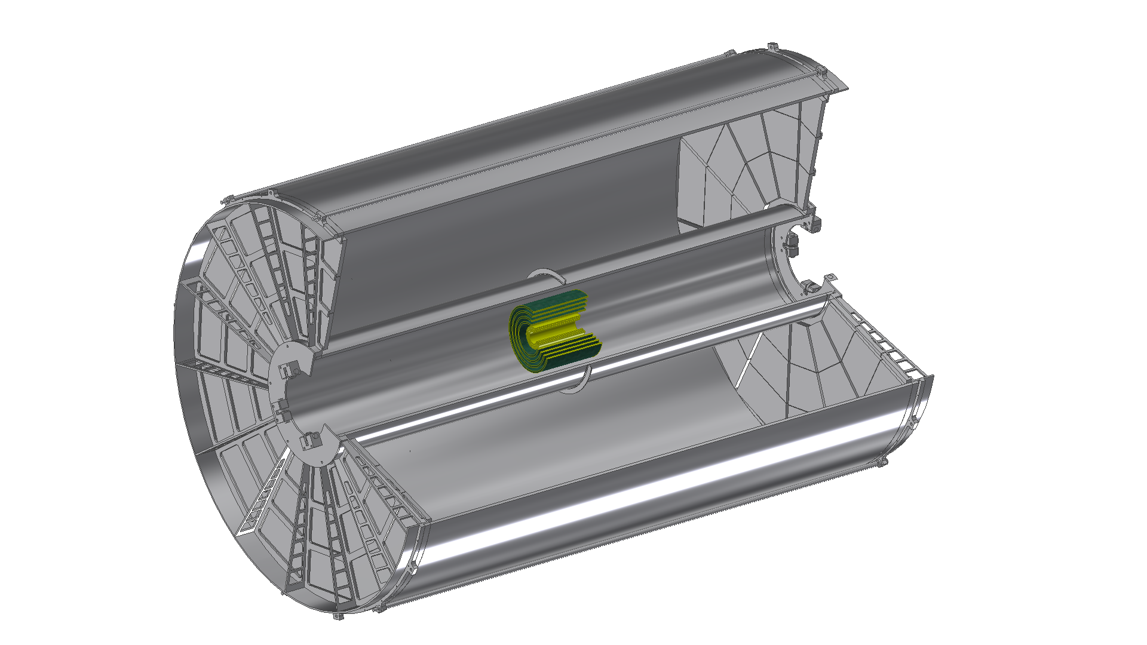
Advantage of b-jet measurement with MAPS LDRD/DR feasibility review Dec. 5, 2016 Sanghoon Lim / Mike McCumber
Notes:
Advantage of b-jet tagging with MAPS

Slide 2
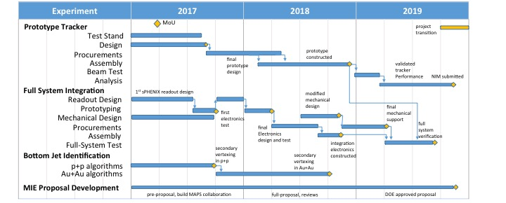
Goal and Schedule
Simulation study of b-jet measurement with MAPS
Develop b-jet tagging methods and evaluate performance in two years
MIE proposal development
Using sPHENIX simulation framework to evaluate MAPS performance
People working on simulation
Mike McCumber, Sanghoon Lim, Xuan Li, Sho Uemura, Darren McGlinchey, and a new staff member
Notes:
Using sPHENIX simulation framework to evaluate MAPS performance
Add Sho and Darren (New staff member)

Slide 3
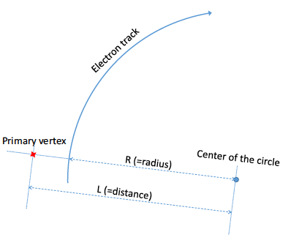
LANL proposed sPHENIX tracker configuration with MAPS
Specification for physics program
Heavy-flavor jet measurement
→DCA resolution <100 um
Upsilon (3 states) measurement →Mass resolution <100 MeV
Tracking efficiency & purity are also important
3-layer MAPS vertex tracker
R = 2.3, 3.2, 3.9 cm
Thickness: 50 um (0.3% X₀) in each layer
Cell dimension: 20 um x 20 um
4-layer silicon strip intermediate tracker (INTT)
R = 6, 8, 10, 12 cm
Thickness: 120 um (1% X₀) in each layer
Cell dimension: 80 um x 1.2 cm
60-layer TPC
R = 30-80 cm
Thickness: 60 cm (2.2% X₀)
Cell dimension: 1.5 mm x 1.7 mm
Notes:
detector configuration/
tracking code update/
heavy-flavor ID (described for proposal)
detailed on methods (working on together for algorithm and tracking things).

Slide 4
Simulation framework
Use sPHENIX simulation framework to evaluate MAPS performance uniform cylindrical tracking layers of sensitive material + uniform cylindrical layers of inactive support material →Realistic detector geometry will be implemented
Silicon tracker Layers of sensitive Si of pixel (MAPS) or strips (INTT) Layers of Cu for supporting materials
TPC 60 layers of active gas (1.5 mm x 1.7 mm cell) Layers of inactive material for inner and outer field cage Layers of inactive gas at 20-30 cm radius
Tracking procedure
Evaluation with truth information
Digitization of G4 hits
Clustering with threshold
Hough transform in helix parameter space
Kalman filter to fit tracks
Notes:
Using sPHENIX simulation framework to evaluate MAPS performance

Slide 5
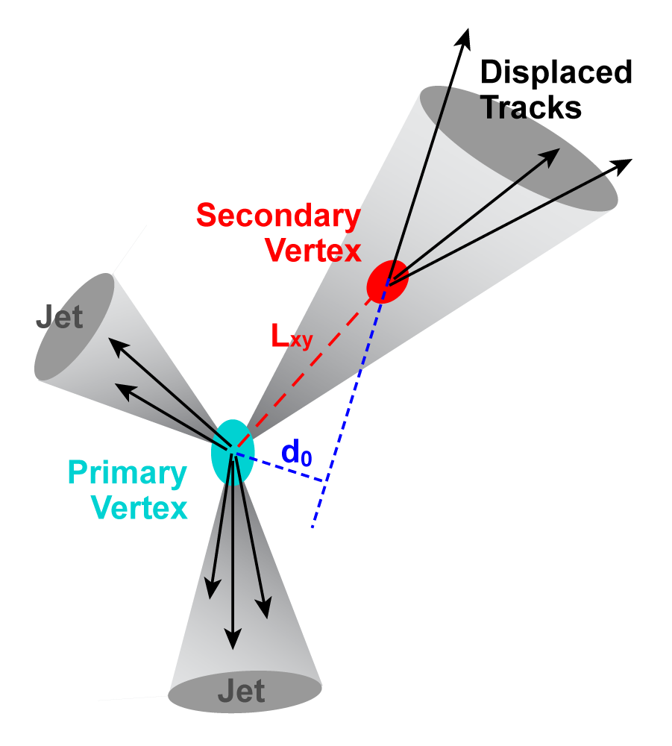
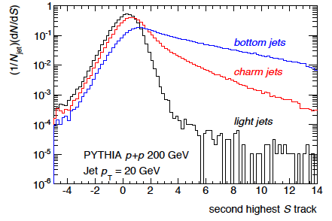
b-jet tagging algorithm I
Track counting method
Count the number tracks with large DCA (d₀)
Optimization of cuts and evaluation of b-jet tagging purity vs. efficiency in p+p collisions (w/ PYTHIA) are underway
Performance study in Heavy-ion collisions will be following
L_{xyz}
b-jet
(DCA)

Slide 6
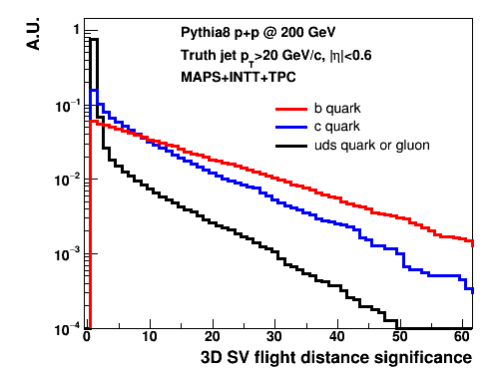
b-jet tagging algorithm II
Secondary vertex method
Reconstruct secondary vertex with in a heavy-flavor jet
Deviation from the primary vertex (L_{xyz}) of b-jets are expected to be larger than others
<30 μm of primary vertex resolution in x/y/z with MAPS
L_{xyz}
b-jet
(DCA)

Slide 7
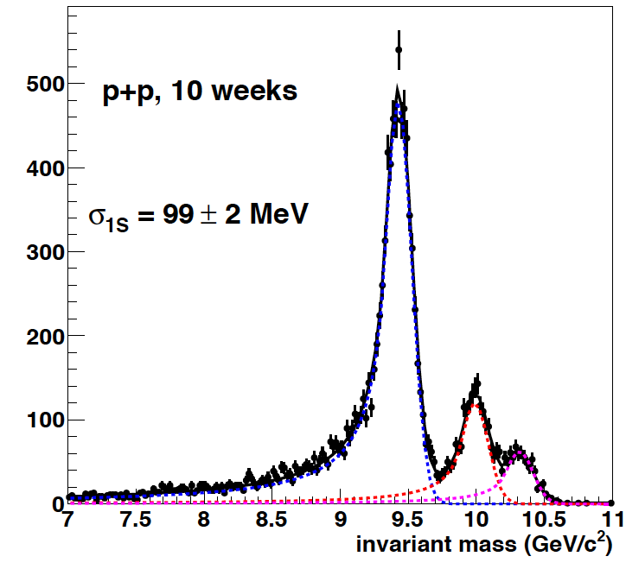
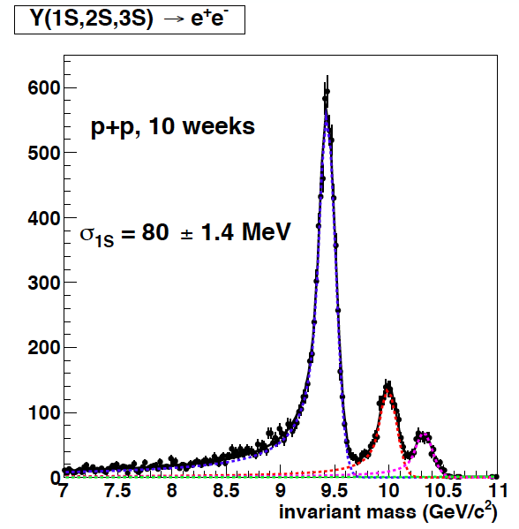
Upsilon mass distribution
Reuse PHENIX VTX(2)+STRIP(5)
MAPS(3)+INTT(4)+TPC(60)
80 MeV Upsilon mass resolution in simulation (<100 MeV of sPHENIX specification) Higher efficiency and less material budget than the alternative option

Slide 8
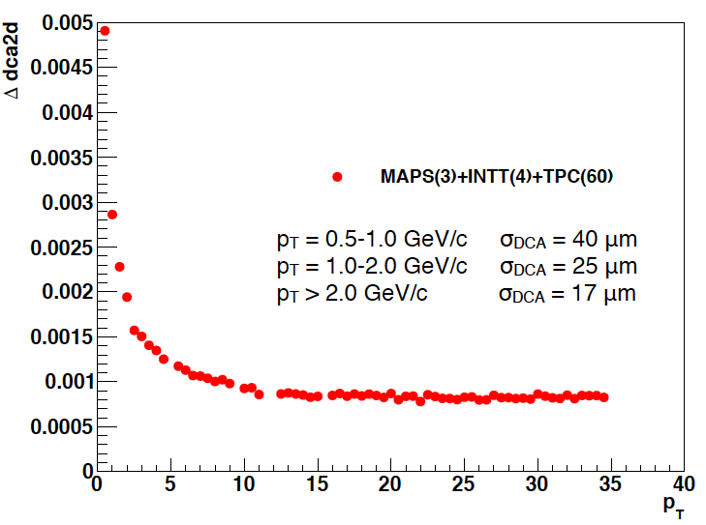
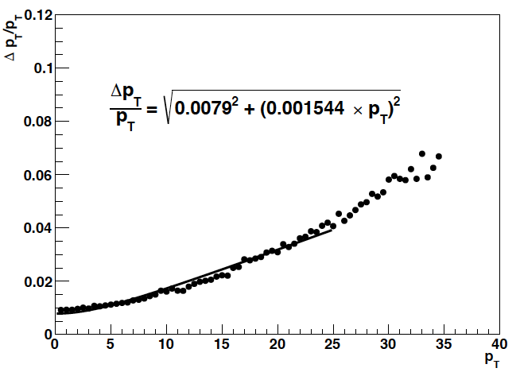
DCA and momentum resolution
Embedded simulation 100 pions embedded into central HIJING events (0-4 fm Au+Au collision)
DCA resolution in simulation is satisfied with the sPHENIX specification (< 100 μm)
dca2d (cm)
p_{T} (GeV/c)
p_{T} (GeV/c)
DCA resolution
momentum resolution

Slide 9
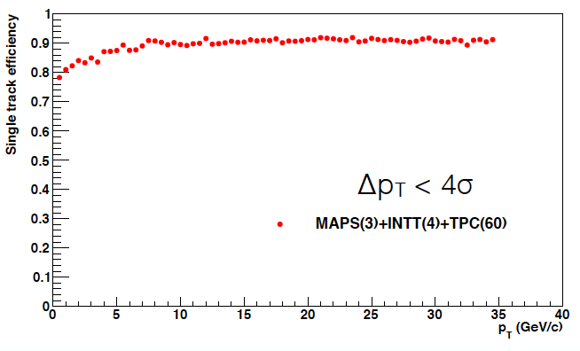
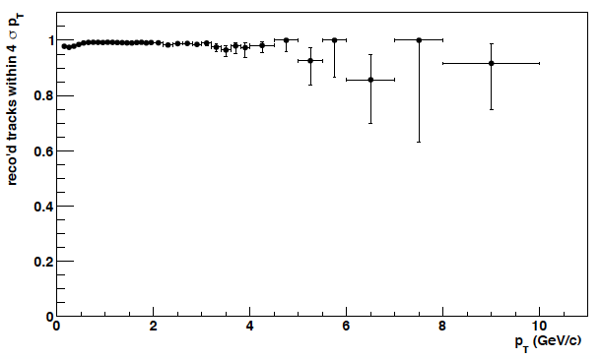
Single track efficiency and purity
Embedded pions in central Au+Au events from HIJING
Loop over truth tracks and try to find matching reconstructed track
Quality cut of reconstructed p_{T}<4σ from true p_{T}
Purity in central Au+Au events from HIJING
Loop over reconstructed track and check reconstructed p_{T} is within 4σ of true p_{T}
Fake tracks at high p_{T} are from low p_{T} tracks of incorrectly reconstructed momentum
single track efficiency
track purity

Slide 10
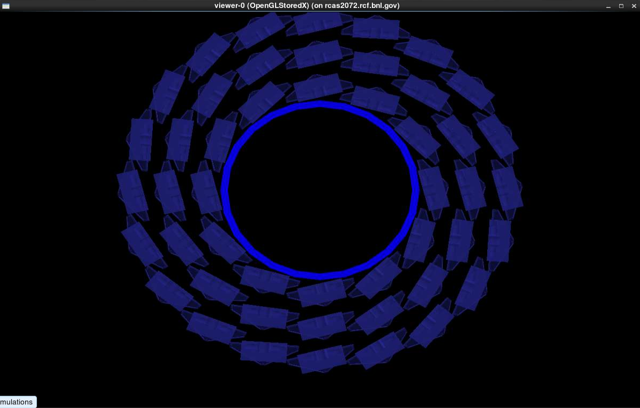
Implementation of MAPS ladder geometry
Import ALICE ITS stave geometry
Notes:
important one to have MIE proposal (realistic performance)

Slide 11
Event pile-up
Estimation of event pile-up
Peak luminosity p+p: 2 MHz → 0.21 chance of an interaction per beam crossing Au+Au: 100 kHz → 0.011 chance of an interaction per beam crossing
MAPS (~2 μs integration time → 37 beam crossings) p+p: 8 events of pile-up → Multi-vertex tagging with MAPS Au+Au: 0.4 events of pile-up
TPC (~18 μs integration time → 340 beam crossings) p+p: 72 events of pile-up Au+Au: 3.6 events of pile-up → Precise tracking with MAPS
A framework to simulate event pile-up has been developed and implemented
Not much degradation of tracking performance in Au+Au collisions (momentum & DCA resolution, tracking efficiency)
Further study for physics measurement will be done
Notes:
How maps emphasize

Slide 12
Summary and Outlook
Study of MAPS performance by using sPHENIX simulation framework has been initiated
Two b-jet tagging methods are studied in p+p collisions
~80 μm of Upsilon mass resolution
DCA resolution of <30 μm for p_{T}>1 GeV/c in central Au+Au events
Single track efficiency of ~90% in central Au+Au events
Future plans
Realistic geometry will be used for further performance evaluation
New tracking and vertex finding (GenFit + RAVE packages) will be implemented
The performance of physics measurements in p+p and Au+Au collisions will be evaluated →effect of background hits →pile-up effect
Notes:
using sPHENIX framework

Slide 13
BACK up

Slide 14
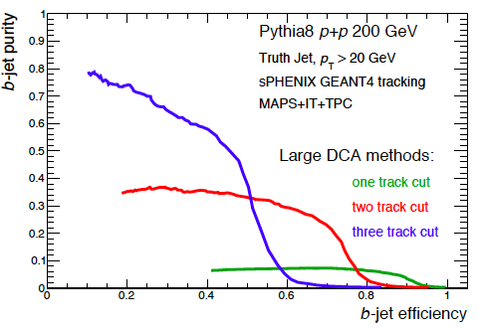
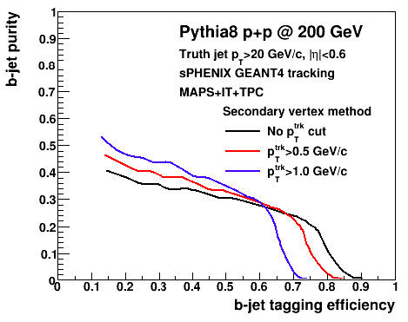
b-jet tagging performance
b-jet tagging performance in p+p collisions with PYTHIA8 Use truth information to evaluate purity vs. efficiency
Two methods are approached
Large DCA track counting method (30% efficiency @ 70% b-jet purity)
Secondary vertex finding method (comparable with two track cut of tracking counting method)
large DCA track counting method
secondary vertex finding method

Slide 15
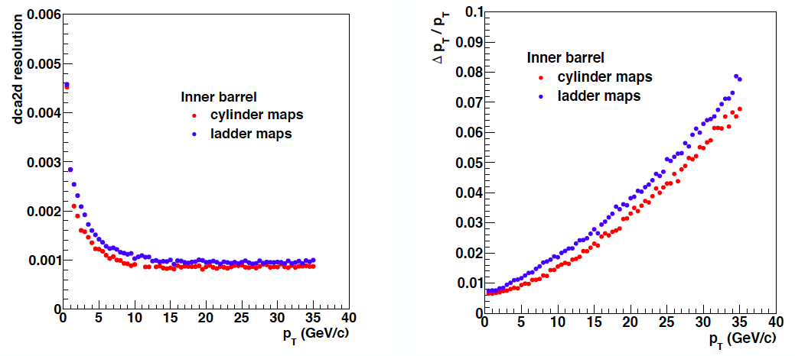
Implementation of MAPS ladder geometry
Import ALICE ITS stave geometry
Similar DCA & momentum resolutions from the initial look
Precise study of tracking with the realistic geometry is on going
DCA resolution
momentum resolution

Slide 16
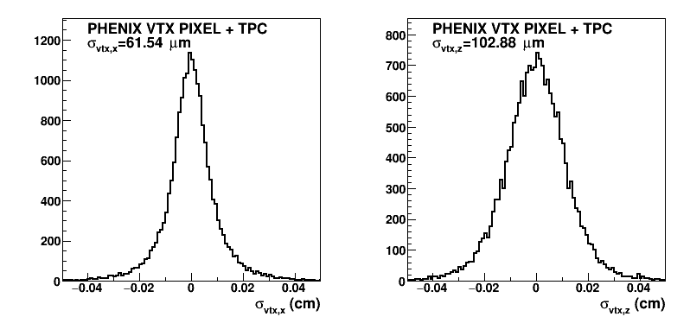
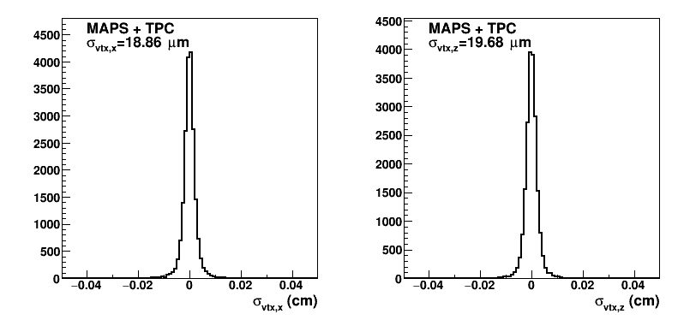
Benefit of MAPS
Resolution of primary vertex (p+p collisions from PYTHIA8)
Comparison with the re-configured PHENIX VTX (including realistic inefficiency)
Clearly improved primary vertex resolution with MAPS
vtx-x
vtx-z
PHENIX VTX PIXEL
50 um x 425 um
MAPS
20 um x 20 um
vtx-x
vtx-z

