Slide 1
Simulations
- Calculation of Splitting Functions
(Ivan Vitev & Boram Yoon)
- Effect of strong coupling on the stopping
power of dense plasmas (Jerome Daligault)

Slide 2
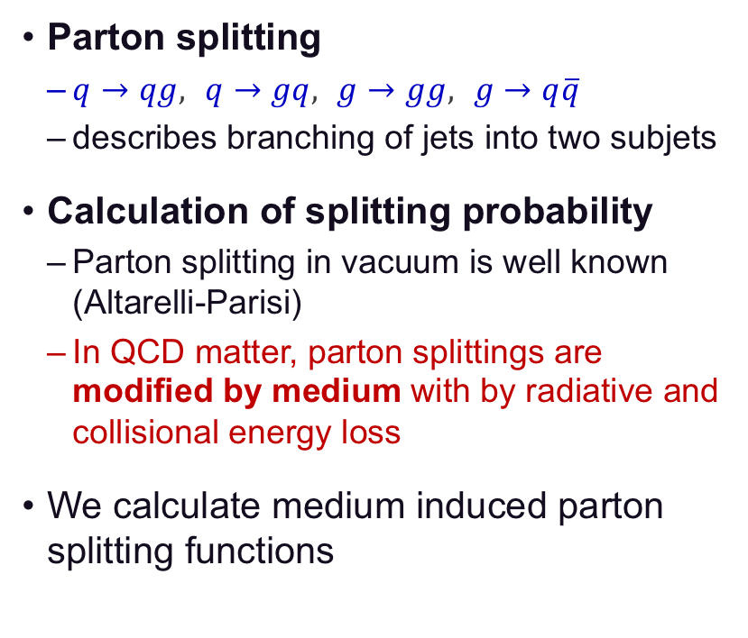
Parton Splitting Functions
Parton splitting
  $q→qg,$ $q→gq,$ $g→gg,$ $g→q\overline{q}$
  describes branching of jets into two subjets
Calculation of splitting probability
  Parton splitting in vacuum is well known (Altarelli-Parisi)
  In QCD matter, parton splittings are modified by medium with by radiative and collisional energy loss
We calculate medium induced parton splitting functions

Slide 3
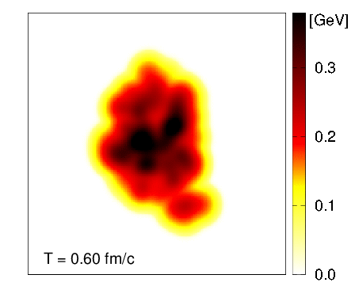
QGP Medium from Hydrodynamic Simulation
Evolution of medium temperature
in Au+Au collision
QGP medium from Hydrodynamic simulation
  Simulation performed using iEBE-VISHNU
  Relativistic viscous hydrodynamics describes
  soft particle production in RHIC & LHC
  State-of-the-art hydrodynamics including
  viscosity and density fluctuations
Equation of state (EOS)
  We adopt EOS calculated by
  HotQCD collaboration (LQCD)
  20% difference found in spectra
  and flow coefficients when compared to
  older s95p-v1 (2010) parameterization

Slide 4
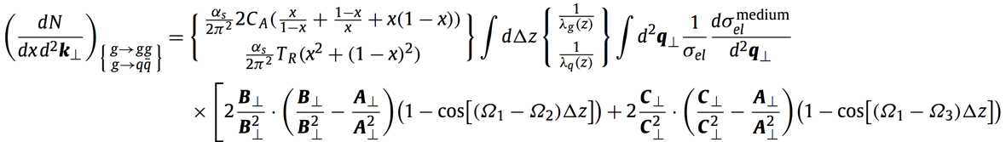
Leading Order Splitting Function Calculation
Medium-induced parton splitting functions at LO in opacity
Numerical Evaluation
  At multiple kinematic parameters
  Code optimization
    Code restructing for better function calls
    Improved arithmetic calculations
    Effective QGP medium access
    Efficient on-node parallelization
    Overall improvement: 18 days → 1 hour
G. Ovanesyan and I. Vitev,
Phys. Lett. B (2012)
+ …
Scaling Comparison

Slide 5


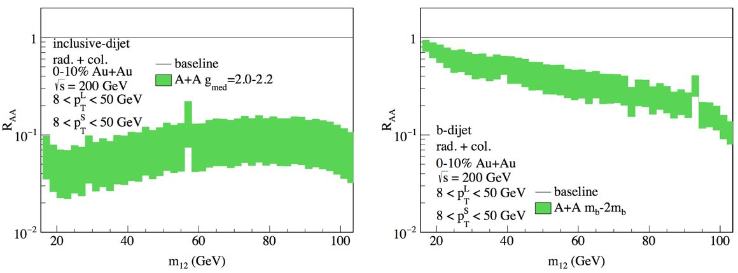
Dijet Production & Mass Modification in Heavy Ion Collisions
Dijet invariant mass modification as a novel probe of QGP
  Differential in one-dimensional observable → Better statistics
  Dijet mass distribution adds medium modification of two jets
  → Enhanced medium modification, more sensitive to the medium properties
Z. Kang, J. Reiten, I. Vitev and B. Yoon, Phys. Rev. D, in press

Slide 6
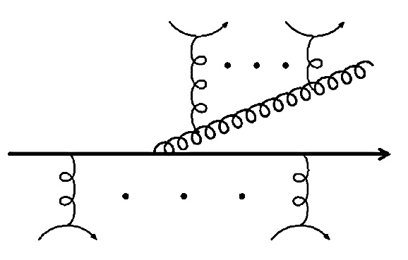
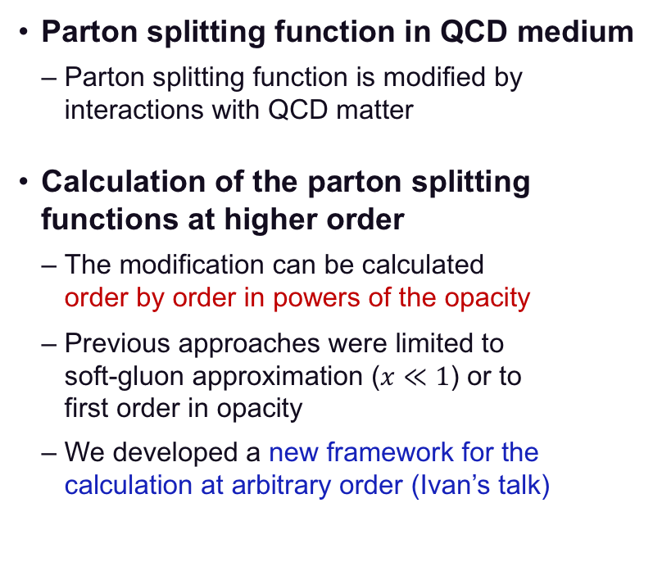
Parton Splitting in QCD Matter at Higher Order
Parton splitting function in QCD medium
  Parton splitting function is modified by interactions with QCD matter
Calculation of the parton splitting functions at higher order
  The modification can be calculated
  order by order in powers of the opacity
  Previous approaches were limited to
  soft-gluon approximation ($x≪1$) or to
  first order in opacity
  We developed a new framework for the calculation at arbitrary order (Ivan’s talk)
QGP
Parton splitting in the QGP
M. Sievert and I. Vitev, Phys. Rev. D (2018)
M. Sievert, I. Vitev and B. Yoon, (Paper in preparation)

Slide 7

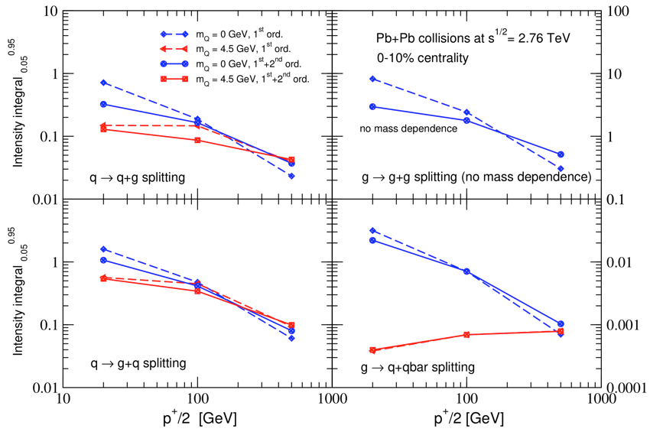
Parton Splitting Functions at NLO
Numerical challenges
  Increased integration dimension
  Complicated equation (10 pages)
  (100-1000)x more expensive
  than LO
Calculation is in progress
  Further code optimization
  Cluster computers
  Preliminary study shows up to
  50% NLO correction

Slide 8
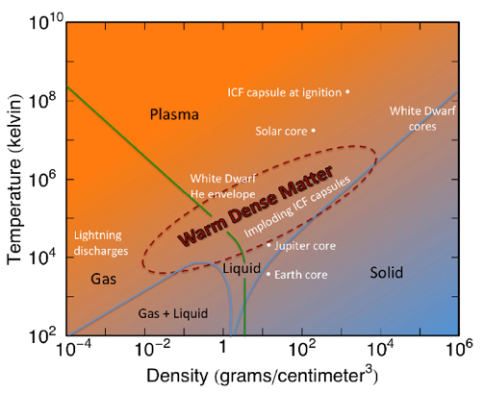

Effect of strong coupling on stopping power: insights from warm dense matter
Warm Dense Matter conditions occur for temperatures between a few thousand and a few million kelvins and densities a fraction to several tens of times solid density
In WDM, ions are strongly coupled
Coulomb coupling strength
QGP
breakdown of
traditional plasma theory
minimum of viscosity
onset of liquid-like behavior
1st order
liquid-solid transition
Gas-like
Liquid-like
Crystal
How does strong coupling affect the stopping power of plasmas ?
$$S=−\frac{dE(V)}{dx}$$
Los Alamos National Laboratory
2/13/19 | 8

Slide 9




We used Molecular Dynamics to study the effect of strong coupling on the stopping power of dense plasmas
$$(1≤i≤N)$$
M/m$=1000$
+
PBC
Q/q$=1$
We performed an extensive parameter study of dE/dx, varying projectile mass, speed, and background coupling strength and screening
$$tω_{p}$$

Slide 10

We identified the effects of strong coupling on dE/dx
Existing theories do not account for these effects
As coupling increases,
- the speed at which the peak stopping power occurs (Bragg peak) increases.
- the curve broadens over a larger range of speeds.
- standard definition of dE/dx is challenged for light projectiles due to strong deflections
These observations can be understood with the collision cross section (in progress)
David Bernstein is doing a PhD on the topic
We are currently working on what these findings tell us about QGP’s
D. Bernstein and J. Daligault, Phys. Rev. E in press

Slide 11
Summary
Calculation of Splitting Functions (Ivan Vitev & Boram Yoon)
  Incorporated modern LQCD EoS in the hydro code
  LO in opacity is calculated with hydrodynamic medium
  NLO calculation is in progress
Effect of strong coupling on the stopping power
of dense plasmas (Jerome Daligault)
  Molecular dynamics simulations are performed to study
  the effect of strong coupling on the stopping power of dense plasma
  for extensive parameters
  Connecting dense plasma simulation results to QGP medium is in progress

