Slide 1
MVTX mechanical conceptual design
Walter Sondheim, P-25
Los Alamos National Laboratory

Slide 2
MVTX mechanical conceptual design updated:
Personnel involved:
Walter Sondheim, P-25, engineer
Christopher O’Shaughnessy, P-25, engineer
New team from MIT:*
Dr. Ross Corliss, research scientist
James Kelsey, engineer, Assoc. Director Bates Lab.
Jason Bessuille, engineer, Bates Laboratory
Joseph Dodge, designer, Bates Laboratory
Dr. Mickey Chiu, BNL, sPHENIX integration task force leader
Corrado Gargiulo, CERN, lead engineer ALICE ITS upgrade
LBNL team:*
Dr. Grazyna Odyniec
Eric Anderssen
Joseph Silber
Dr. Yuan Mei
**See summary slide

Slide 3
Technical Goals (as stated in the proposal)
Develop a conceptual design for a MAPS silicon technology based vertex detector, based on a current design being implemented as a part of the inner tracker system (ITS) upgrade for the ALICE detector at CERN. This new design should be compatible with the proposed upgrade to the PHENIX experiment at BNL, this new detector is called sPHENIX.
The tracking portion of the sPHENIX detector consists of three independent systems:
1, A large TPC (time proportional chamber) detector
2, A two layer silicon strip detector, called the INTT
3, A three layer MAPS based vertex detector, called the MVTX
These three detectors will be located in reverse around the sPHEINX beam-pipe, with the MVTX being the closest.

Slide 4
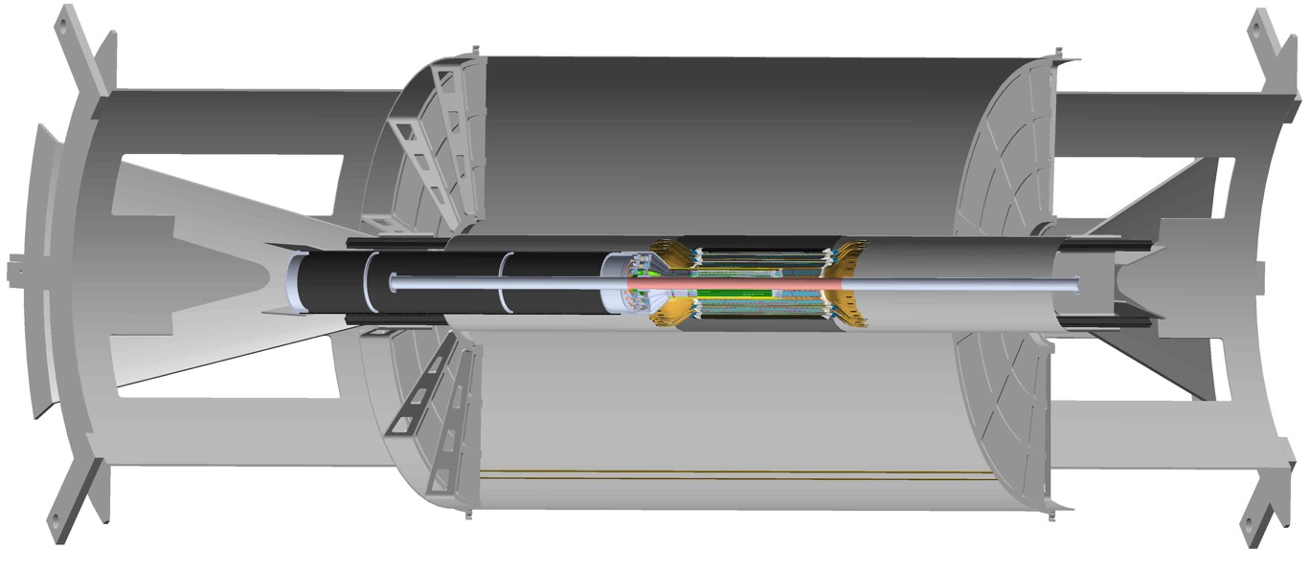
MVTX detector as a part of the sPHENIX tracking system:
MVTX detector with service cylinder
Support brackets for TPC and INTT
TPC volume, length 2,160.0mm
TPC inner bore 400.mm
INTT detector, 2 layers

Slide 5
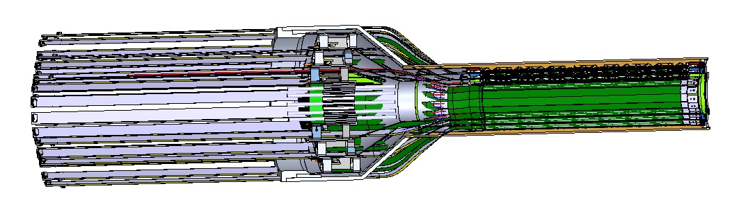
Mechanical components that make up the MVTX:
Composite outer shell structure
A “conical” region with “pig-tail” ribbon cabling to “patch-panels”
MAPS type silicon detector ladders called staves, 3 layers in this assembly
Extension signal and power ribbon cabling

Slide 6
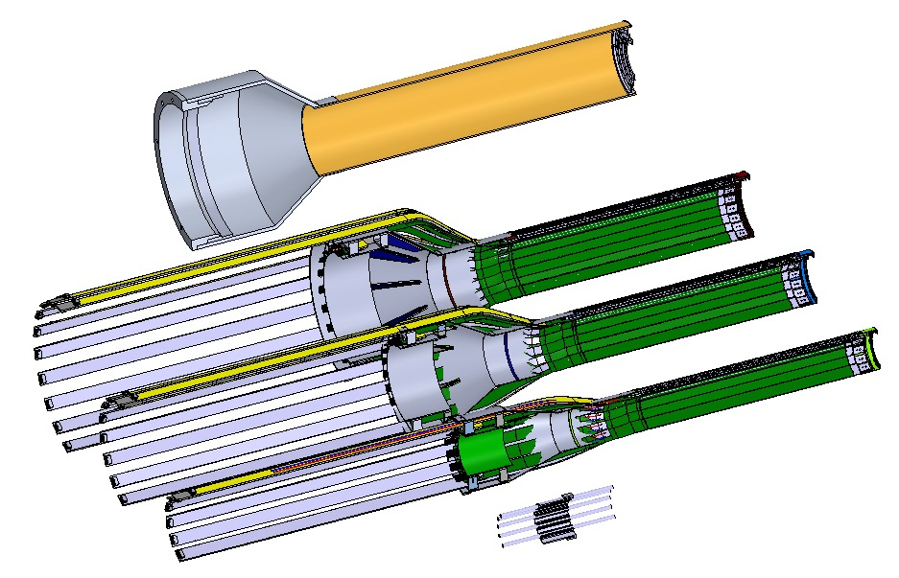
Mechanical components that make up the MVTX:
Exploded view of three layer MVTX detector with outer shell. The detector is designed to be in two halves for installation around the installed beam-pipe
Estimated total mass for half assembly 1.2 kgms,
Total power 80. watts

Slide 7
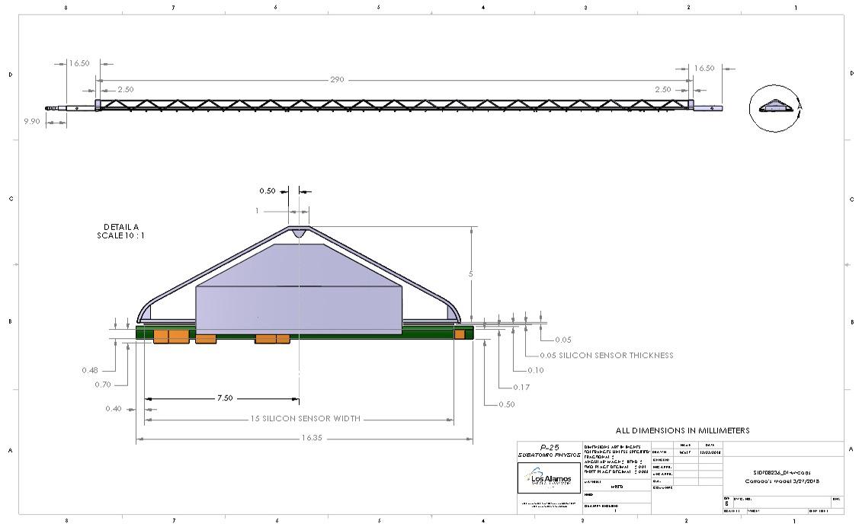
Detail drawing of stave assembly:
290.0 mm
9 silicon MAPS sensors, each 50 microns thick
Mass of stave without the FPC 1.7 grams
5.0 mm
16.35 mm
FPC

Slide 8
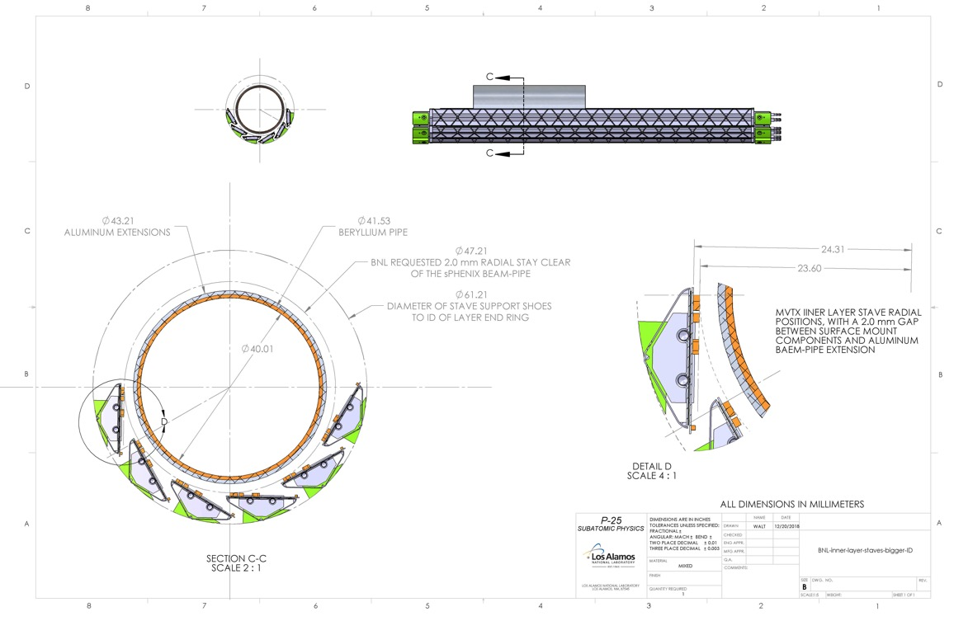
Reconfiguration of MVTX staves around sPHENIX beam-pipe allowing for 2.0 mm clearance, inner layer:
The sPHENIX beam-pipe diameter has a bigger diameter then the similar beam-pipe in the ALICE detector at CERN. This means that all of the silicon stave ladders need to be reconfigured to a larger radius (minimum of 2.0 mm) from the diameter of the sPHENIX aluminum extensions to this beam-pipe:
43.21 mm
Aluminum extension
41.53 mm beryllium
24.31 mm 23.60 mm
47.21 mm
61.21 mm
40.01 mm

Slide 9
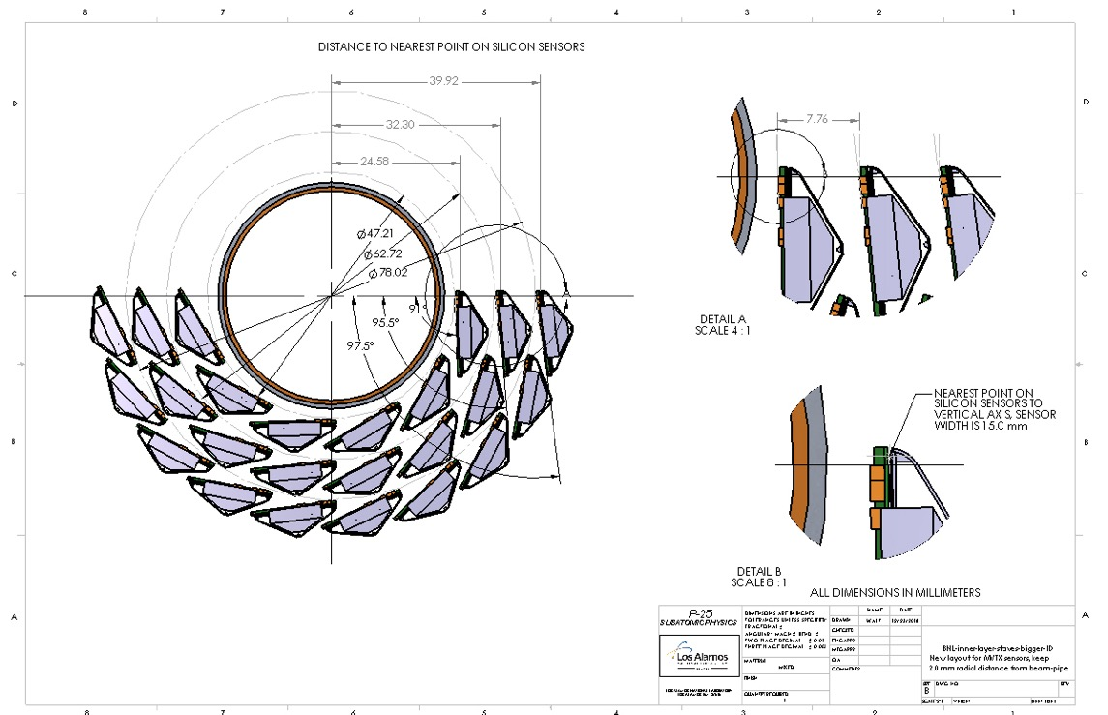
New configuration of MVTX staves in sPHENIX:
39.92
32.30
7.76
24.58
New stave configuration will be hermetic!

Slide 10
Modification to stave assembly with 40.cm power cable
Location for patch panel for power cables in service cylinder
Location for patch panel from previous slide -
With the tested extended length of the power cables from the stave we now have a path forward to reduce the diameter of the patch panels in the conical region of the MVTX detector

Slide 11
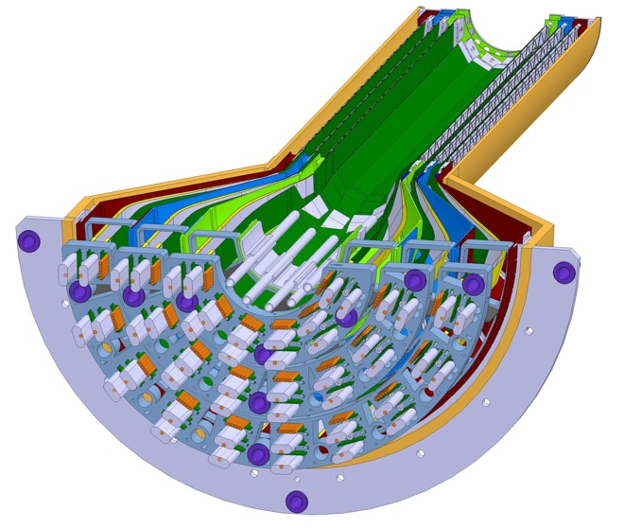
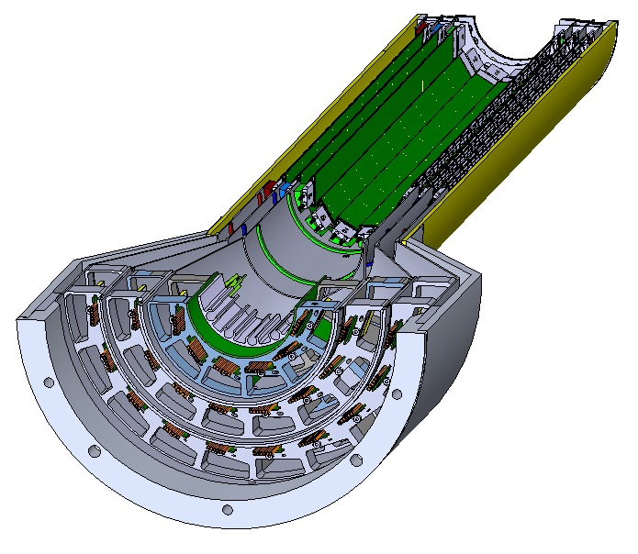
Conical sections of MVTX needs to have smaller diameter:
Integration with INTT detector prohibited by original larger diameter of conical region:
ALICE inner tracker
MVTX tracker
R=128.6mm
Pass-through ports for power cables
R=140.0mm
R=107.5mm

Slide 12
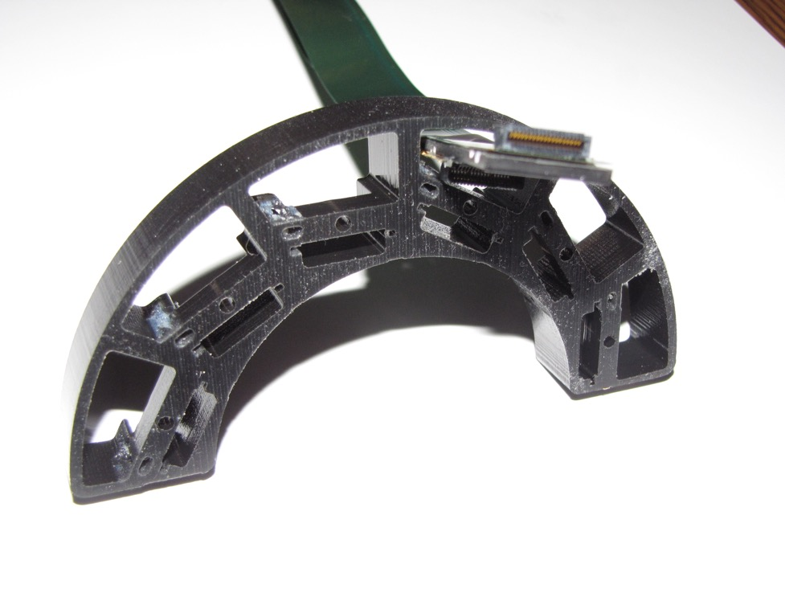
3D printing – MVTX inner layer patch panel
3D printed MVTX inner layer patch panel that demonstrates the idea of “passing through” the power cables from the stave to a second patch panel in the service cylinder, this allowed for the reduction in radius of the conical sections for each layer.

Slide 13
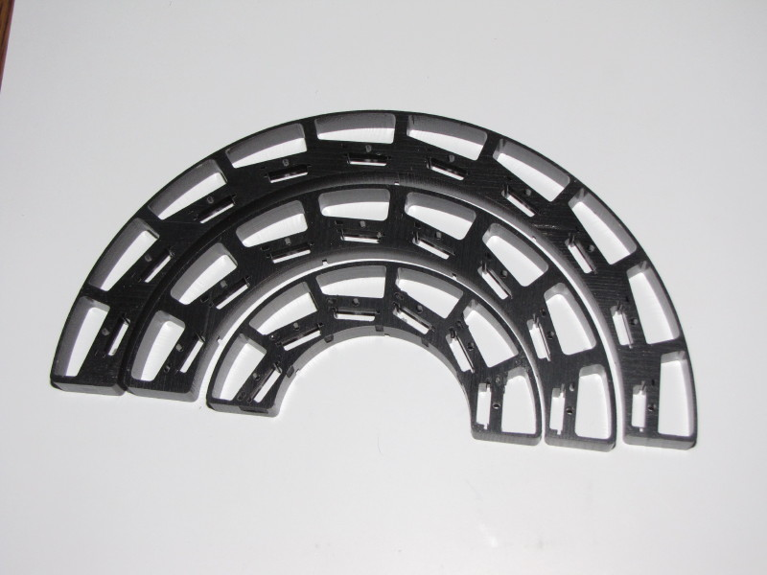
3D printing – MVTX signal cable patch panels;
3D printing of all three signal cable patch panels, used to verify that the power cables will pass through to a second patch panel in the service cylinder -

Slide 14
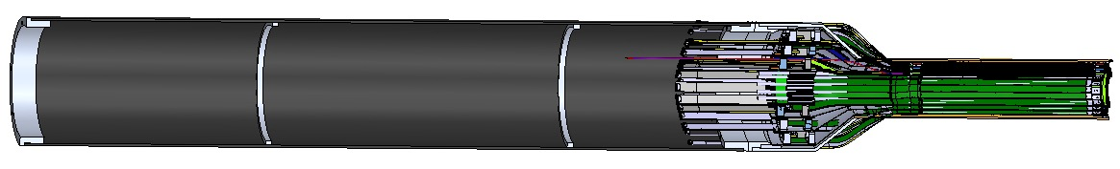
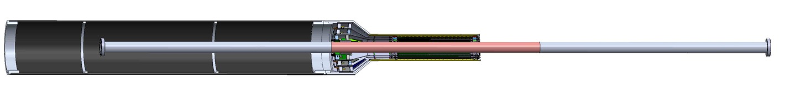
MVTX detector with service cylinder added:
Service barrel length 1,200.0 mm, carbon composite with aluminum flanges, this will support signal, power, bias cables along with water and air cooling lines
Beryllium section
MVTX detector shown with sPHENIX beam-pipe

Slide 15
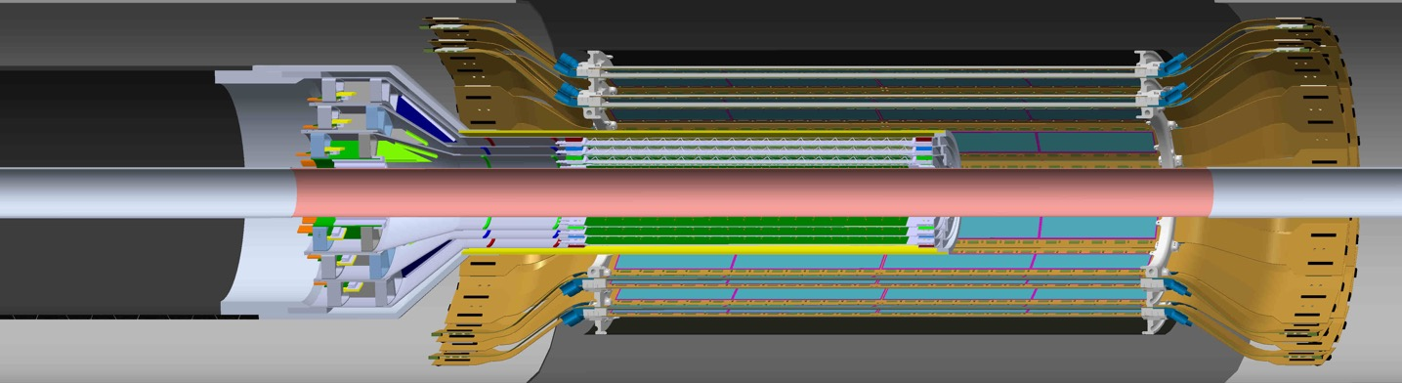
Detail view of INTT and MVTX detectors inside bore of TPC
Two layer silicon strip INTT detector,,
Extension cables go out each end
Three layer MVTX detector
Extension cables only in service cylinder

Slide 16
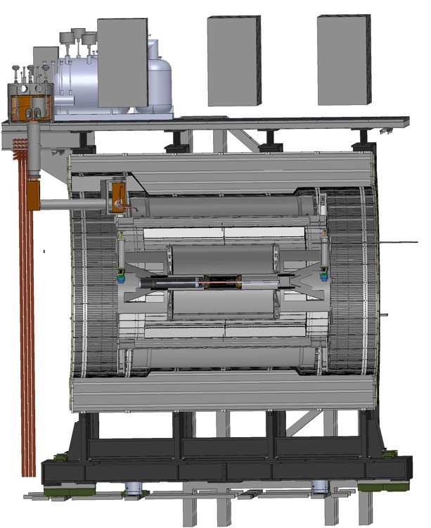
Section view of sPHENIX detector with tracking detectors
Superconducting solenoid coil
sPHENIX tracking system detectors supported off inner hcal end ring
Inner hcal
Outer hcal
7,600.mm

Slide 17
Summary, work projected for 2019:
Conceptual design for MVTX is complete!!
  Technical design work will begin at MIT*
  Work with LBNL team on composite material pieces*
Prototype cooling system developed at LANL
  Power dissipation MVTX assembly:
    120. watts, power cables an additional 34 watts
    Water cooling 31 liters/hour @ .22 bar (negative pressure)
    Dry air cooling (moisture control) 5 cubic-meters/hour
Develop installation scenario, MIT and LANL engineers*
FEA study of service barrel and support – MIT*
*These activities will be funded by the added sPHENIX operations funds from the DOE

Slide 18
Backup:

Slide 19
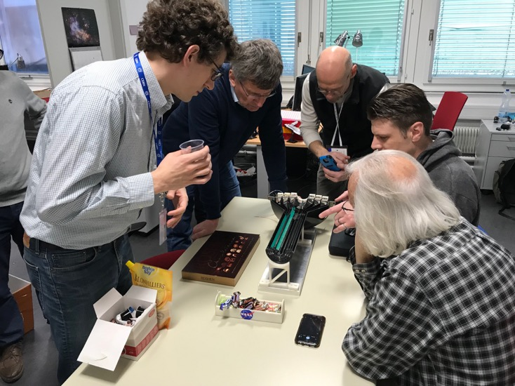
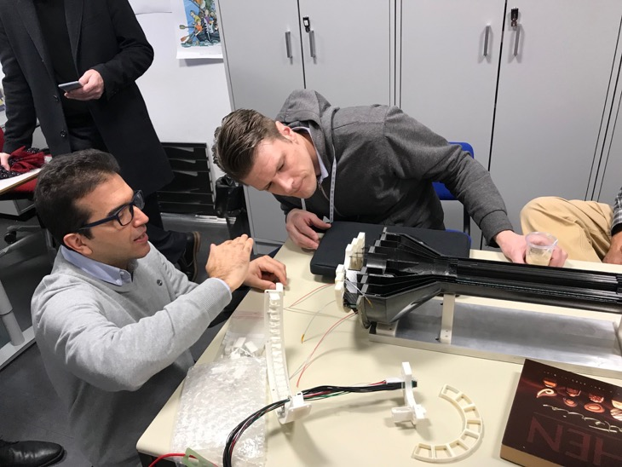
MIT, LANL engineers study prototype detector at CERN

Slide 20
MVTX stave assembly:

Slide 21
Radiation budget for stave assembly:
Water cooling

