Slide 1
Probing Quark-Gluon Plasma with Bottom Quark Jets at sPHENIX
THEORY ACCOMPLISHMENTS
20170073DR
Ivan Vitev (co-PI)
2/14/2019
LDRD

Slide 2

Theory Agenda
Introduction, scope and effort
Key theory concepts, technical goals, and mid-term review status
2nd year committee recommendations and outcome
R&D and project highlights in perturbative QCD and SCET *
Theory accomplishments and leadership
Broader impact of theory
* Highlights on Hydro with LQCD EoS, splitting functions computation, and MD simulations in Boram Yoon’s talk

Slide 3
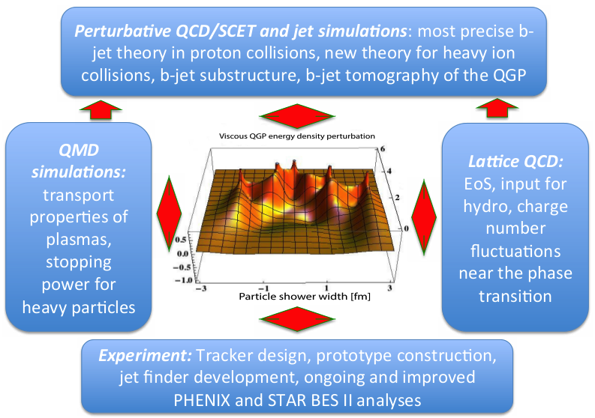
Introduction
  pQCD: b-jets and heavy flavor, energy loss and b-jet substructure in the QGP
  SCET: b-jets in p+p, energy correlators, resummation
  MD: Transport properties of SCPs. Stopping power for heavy fermions
  LQCD: EOS in fluctuating hydro, simulations of jet propagation
Theory deliverable: package of theoretical tools for precision b-jet tomography at sPHENIX and predictions for experiment

Slide 4












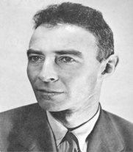
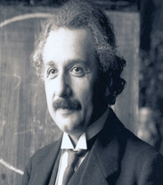
Scope of the Theory Effort
  Integrated theoretical effort in close connection to experiment: T-2, T-5, CCS-7
Staff: J. Daligault, R. Gupta, C. Lee, I. Vitev, B. Yoon
PD: H. Li, F. Ringer, M. Sievert, V. Vaidya
Students: S. Aronson, D. Bernstein, B. Odegard, J. Reiten, P. Shrivastava
Affiliates: Z. Kang, Y. Makris, D. Neill, A. Sadofyev, H. Xing, S. Yoshida

Slide 5
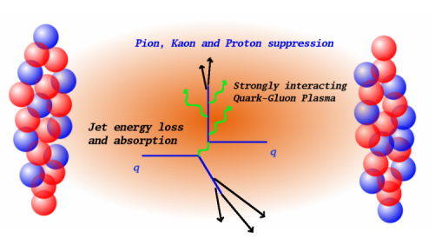

Key Theoretical Concepts
Jets: Collimated showers of subatomic particles produced in high energy collisions
Fundamental to the theory of strong interactions (QCD)
Jets allow us to construct novel observables, look at their correlations and substructure
R_{AA} = $\frac{Observable in A+A }{Norm ∗ Observablein p+p}$
R
Jets in the quark gluon plasma (QGP): modified in the medium and ideal diagnostics of the QGP properties
Heavy flavor jet (containing charm or especially bottom quarks) are particularly interesting. They introduce a new known mass scale relative to wich we can gauge such properties
Jets and heavy flavor are also ideal probes of different types of nuclear matter (cold), strong gluon fields (beyond the scope of this DR)
5

Slide 6
Technical Goals
Calculate novel observables for b-jets in p+p collisions using SCET, to high accuracy
Perform energy loss calculations of b-jets for experiment, MVTX performance
Develop an effective theory of b-jets in A+A collisions, constrain heavy flavor production
Include LQCD EoS in hydro simulations, develop the code for jet propagation in the quark-gluon plasma, evaluate fundamental QCD processes in the medium
Perform MD simulations of stopping power of strongly coupled plasmas for heavy particles
Last review

Slide 7

Recommendations from Second Year Review
Recommendation 2: The project had reached many milestones ahead of schedule and is proposing several enhanced goals. We advise the group to prioritize these to maximize the impact on the field (particular for theory).
Recommendation 4: It would be interesting to incorporate dynamical screening effects into these calculations, in addition to Debye screening effects.
New opportunities as presented at second year review: di b-jet correlations, c-jets, soft-Glauber interactions
1. Di b-jet correlations most impactful. Resulted in a new observable with enhanced sensitivity to the transport properties of the QGP, quark mass effects mass. Phys. Rev. D paper in press, just did the proofs
2. C-jets and SCET_{G} Developed a modern semi-inclusive jet function approach to heavy flavor jets in HI collisions. Paper submitted to JHEP and in revisions
3. Soft-Glauber interactions deferred
The Debye screening enters the scattering potential
1. Dynamical screening generates mass to the propagating partons. It is now included in the numerical evaluation
$$\frac{1}{k^{2}+iε}→\frac{1}{k^{2}+m_{g}^{2}+iε}$$

Slide 8
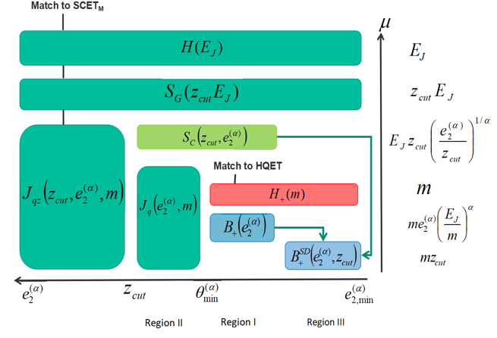

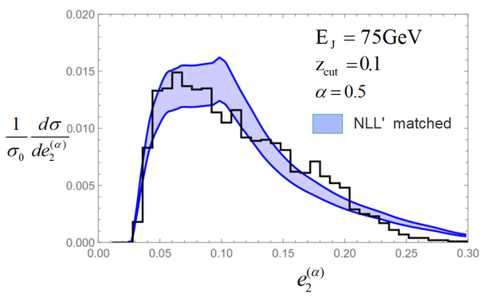

Effective Field Theory Framework for b jet Substructure
We identified necessary degrees of freedom and constructed a new Effective Field Theory framework applicable to heavy quark jet substructure
C. Lee, P. Shrivastava, V. Vaidya, arXiv:1901.09095
hard
$$e_{2}^{(α)}=$$
soft, collinear-soft
Energy energy correlators
mass
Ultracollinear
Hierarchy of EFT modes and scales
We see features in the energy energy correlators related to the mass (dead-cone effect) and soft drop grooming
Analytic resummed + fixed-order matched predictions vs. Pythia Monte Carlo predictions:

Slide 9
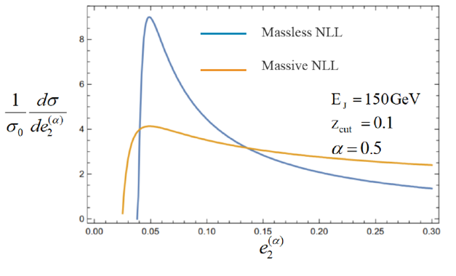
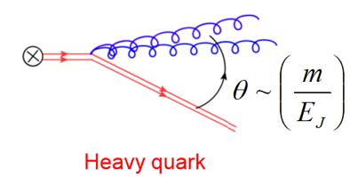



Impact of Quark Mass and TMD Advances
Close connections to heavy ion physics – new observable that can also help differentiate light and heavy flavor jets
Y. Makris, V. Vaidya, JHEP 1810, 019
Resummation of B hadron transverse momenta in soft drop groomed jets
$$z=E_{g}/E_{J}$$
$$x_{3}$$
Important new developments are related to Transverse Momentum Distributions (TMDs)
$$x_{1}$$
Y. Makris, D. Neill, V. Vaidya, JHEP 1807, 167
Heavy quark dead cone effect
Hadrons inside jets can constrain non-perturbative TMD evolution

Slide 10

Energy Loss Calculations for B-Jets
Connections between theory and experiment
Stretch goal: di-bjet correlations and di-bjet mass
Z. Kang, J. Reiten, I. Vitev, B. Yoon, Phys. Rev. D in press
Inclusive b-jets can have significant prompt gluon contribution at LHC. Di-bjets ensure 80% prompt b-quark purity
Inclusive b-jet suppression
Provided results to sPHENIX for the full DOE proposal. Constraints on the coupling “g” between the jet and the medium better than 10%, transport coefficients ~ 30%
* How one evaluates jet energy loss in the hydrodynamic QGP background, effects of strong coupling on the stopping power in and MD simulations - - see Boram Yoon’s talk
10

Slide 11

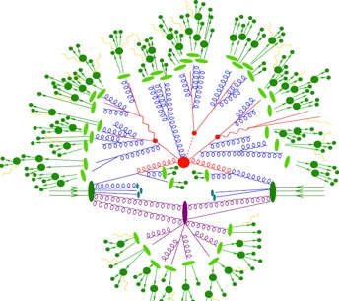


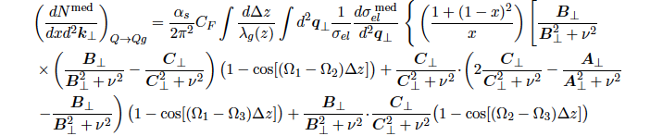

Effective Theory for Heavy Quark Propagation in The QGP
Formulated a new effective theory SCET_{M,G} – for massive quarks & Glauber gluon interactions
Performed the First NLO heavy flavor calculation in HIC
Z. Kang, F. Ringer, I. Vitev, JHEP 1703 (2017) 146
Splitting functions for higher order calculations and resummation
$$Q→Qg, Q→gQ, g→QQ, g→gg$$
+…
Gives an improved description of open heavy flavor suppression from radiative processed down to lower p_{T}
M. Sievert, I. Vitev, Phys. Rev D98 (2018) 094010

Slide 12
Global Analysis of Open Heavy Flavor Production
Milestones met: achievements beyond the original research scope
Fit at NLO in Mellin space
Excellent χ²/DOF ~ 1
Obtained much improved description of D* in jets. Even better description of heavy flavor in the medium
D. Anderle, T. Kauffman, M. Stratmann, F. Ringer I. Vitev, Phys. Rev D97 (2017) 034028

Slide 13


Light and Heavy Jet Substructure in the Medium
They are calculable from first principles and directly related to the splitting functions
T. Chien, I. Vitev, Phys. Rev. Lett 119 (2017) 112301
p_{T2}
r_{g} = ΔR₁₂
p_{T1}
z_{g =}
RHIC has an advantage
Special role of b-jets / heavy quark mass
Discovered a new way to constrain mass effects in parton showers
At RHIC jet energies, we predict a unique reversal of the mass hierarchy effects on jet splitting
The cornerstone of experimental NSF proposal
H. Li, I. Vitev, submitted to Phys. Rev. Lett

Slide 14
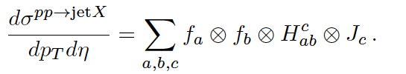
New Framework to Calculate Light and Heavy Flavor Jets in the QGP
A new theoretical approach based on semi-inclusive jet functions
Extend this framework to heavy flavor jets – b-jets and c-jets
Identified the contributions from the QGP
Typical diagrams
Made predictions for c-jets (stretch goal). Extended the physics scope of sPHENIX
Z. Kang, F. Ringer I. Vitev, Phys. Lett. B769 (2017) 242-248
H. Li, I. Vitev, submitted to JHEP

Slide 15


Summary of Theory Progress
= for theory
Today
Theory goals and milestones achieved, many ahead of time
Small remaining tasks well on track – finalize the b-jet tomography paper, complete charged hadron fluctuation simulation
Opportunity perhaps for one more stretch goal – energy-energy correlators in the QGP

Slide 16



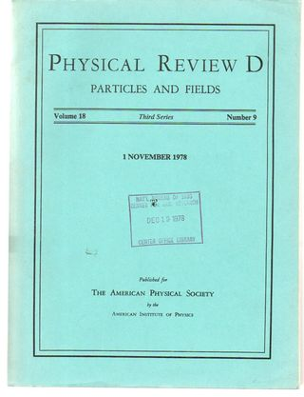


Theory Accomplishments (Fame)
Publications – 16 refereed publications in the leading journals in the field (including 3 letters), 2 more in preparation, 6 refereed conference proceedings
- Y. Chien, I. Vitev, Physical Review Letters
119: 112301 (2017)
- C. Lee, P. Srivastava, V. Vaidya, submitted
to Journal of High Energy Physics
- D. Bernstein, J. Daligault, and Physical
Review E in press
- D. Anderle, T. Kaufmann, M. Strattman,
F. Ringer, I. Vitev, Physical Review D 96 034028 (2017) …
Talks – given 31 talks and seminars, mostly invited, including several plenary
- I. Vitev, “Jets in SCET”, Precision spectroscopy of the QGP with jets and heavy flavor,
INT, Seattle, WA, 2017
- J. Daligault, “Particle slowing in the classical one-component plasma”, 60th annual APS
Division of Plasma Physics, Portland, OR, 2018
- V. Vaidya, “An effective field theory for b-jet substructure”, Santa Fe Jets and Heavy
Flavor, Los Angeles, CA 2019 …

Slide 17


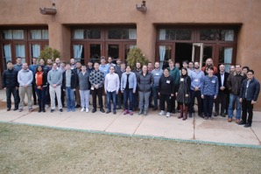

Broader Impact of Theory (Fortune and People)
Follow-on projects, grants & recognition: C. Lee DOE Early Career $500K/y; Z. Kang NSF 3-year award $60K/y, “Perturbative QCD Study for Jet and Heavy Flavor Production”; Jared Reiten $60K/y, UC Graduate Research in Residence Fellowship, PhD with us; D. Bernestein, PhD on strongly coupled plasmas; ER “Using Quarkonia to probe Matter form the Early Universe”; Haitao Li, Director’s fellowship; Duff Neill Feynman fellowship, Andrey Sadofyev Oppenheimer fellowship; Matt Sievert, RHIC & AGS executive committee award
Conferences: Co-organized many conferences related to jet and heavy flavor physics– Santa Fe Jets and Heavy Flavor workshop, 2017, 2018, 2019. UCLA jet physics workshop 2017. SCET 2019 in San Diego, Selected to host 2019 ISMD in Santa Fe, NM (in competition with Scotland); Hard Probes 2020 in Austin
Personnel: Z. Kang staff to professor UCLA; V. Vaidya to MIT, Y. Makris INFN fellowship Pavia; F. Ringer to LBNL, H. Xing & S. Yoshida professors at Southern China Normal U.; D. Kang professor at Fudan U., M. Sievert to Rutgers U, finalist at Regis U; D. Neill, Feynman to staff. Postdocs and affiliates on faculty shortlists; Many staff promotions in that period D. Bernestein, PhD

Slide 18
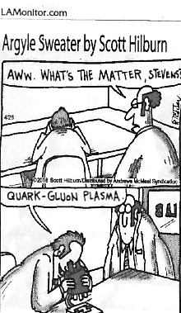
Thank you for your support !

