Slide 1
Probing Quark-Gluon Plasma with Bottom Quark Jets at sPHENIX
SUMMARY AND TRANSITION PLAN
20170073DR
Cesar Luiz da Silva P-25
Feb-14-2019

Slide 2
Two Main Physics Topics added by MVTX to sPHENIX Program
Low p_{T} B-Meson
High p_{T} b-jets
Probe QGP coupling, HF diffusion with B-hadrons.
Probe the QGP microscopic structure with b-quarks.

Slide 3
The Proposed MVTX Detector
216M pixels in 48 staves.

Slide 4
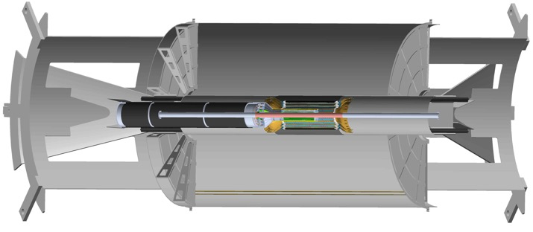
Integration with sPHENIX tracking
Mechanical conceptual design stage.
Regular discussion with MIT and BNL on the integration with sPHENIX baseline tracking system: INTT and TPC.
INTT
TPC
MVTX

Slide 5
2018 Beam Test Validation at Fermilab
120 GeV proton
beam
4-hit track
4-MAPS telescope
Fully functioning readout chain.
Position resolution: 5 microns
Tracking efficiency: >99.5%
Passed stress tests with a target between beam and telescope.
2019 beam test: 4 staves telescope (18M pixels, 36 ALPIDE sensors)

Slide 6
PUBLICATIONS/TECHNICAL REPORTS
Wrote a full proposal released in January 2018, including
Detail cost, schedule, contingencies
More detailed detector concept
Expected performance
Simulations
Expansion of the physics program
Technical Documentation, including
ALPIDE sensor operation, characterization
Frontend and backend technical design/operation
16 THEORETICAL PAPERS

Slide 7
The MVTX PROJECT
22 institutions
35% contingency

Slide 8
sPHENIX Status and Plan
MVTX funded
by DOE

Slide 9
MVTX Schedules and Milestones (11/2018)
Dave’s talk
sPHENIX: CD1/3a PD2/3
Installation
1st collisions
CY-2018 | 2019 | 2020 | 2021 | 2022 | 2023
MVTX
Stave & RU
production
FELIX
production
Detector mechanics design & production, global interface to sPHENIX
End Wheels
CYSS
Global integration
/interface design?
Service barrel
design & production
Ready for beam;
sPHENIX day-1 run
Barrel Assembly & Testing @LBNL
Install half barrels
@sPHENIX IR
Half barrel #1
Power system
production
Half barrel #2
Half barrels
arrive @BNL
design & procure
interface to
sPHENIX rails
Design & procure
sPHENIX rails
MVTX installation & commissioning @BNL
RU, FELIX, PS, cables etc.

Slide 10
sPHENIX MVTX Group: Institution Roles
Major institutions lead key tasks
(New) Lehigh University: Simulations and electronics/cable test

Slide 11
Stave Production at CERN
Stave production at CERN already scheduled for MVTX: Spring 2019 – Spring 2020
We have Yasser Morales (LANL postdoc) in the stave assembly facilities in Turin and at CERN to participate on the assembly process
Staff members will also participate on the process to obtain experience on this novel technology
ALICE spent years developing the assembly procedure, we are leveraging this experience

Slide 12
Conclusions
Major LDRD goals with single ALPIDE sensors accomplished
Additional tests with newly available 4-staves and operation improvements expected for the remaining of this project
MVTX is now funded and officially part of the sPHENIX detector. Another item for the list of highly successful QCD projects funded by the LDRD office
Activities already going on on the MVTX final design and construction in collaboration with MIT, LBNL, BNL and other 19 institutions
MVTX activities are supported by our science program with DOE/OS and BNL/RHIC operation funding
Combined experimental and theoretical efforts must be capitalized, including the increasing of the workforce for the major work ahead

Slide 13
EXTRAS

Slide 14
The MVTX PROJECT
22 institutions
Stave production at CERN starting immediately after the end of the ALICE production.
35% contingency

Slide 15
Funding Sources
BNL/RHIC operation funding : US$5M
  carbon fiber structure
  Mechanical engineering
  Safety system
DOE/OS through the ALICE account in the University of Tennessee : U$1.4M
  Staves
  Readout Unities

