Slide 1
Probing Quark-Gluon Plasma with Bottom Quark Jets at sPHENIX
20170073DR
Ming Liu (P-25)
for the
sPHENIX LDRD Team
02/14/2019
LDRD

Slide 2
Agenda for Today
Introduction 8:00-8:10AM LDRD office
Project overview and achievements 8:10 – 8:30AM Ming Liu (P-25)
Experimental highlights and plan 8:30 – 9:00AM
  Sensor and readout (10+5’) Sho Uemura (P-25)
  Mechanical system (10+5’) Walt Sondheim (P-25)
Theoretical highlights and plan 9:00 – 9:30AM
  Overview of theory (15+5’) Ivan Vitev (T-2)
  Simulations highlights (7+3’) Boram Yoon (CCS-7)
Transition plan 9:30-9:50AM Cesar da Silva (P-25)
Committee meeting 9:50 – 10:30AM

Slide 3
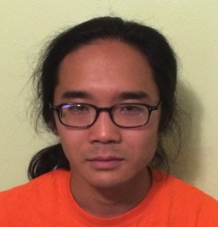
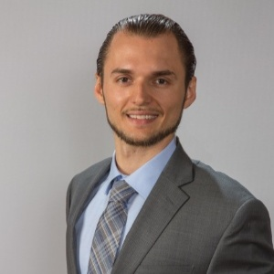

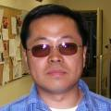
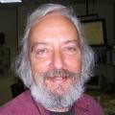
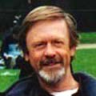



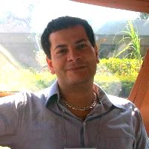
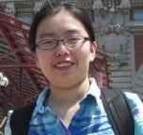
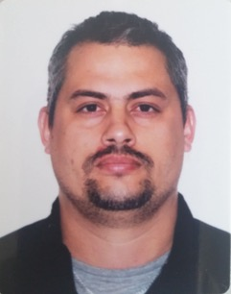

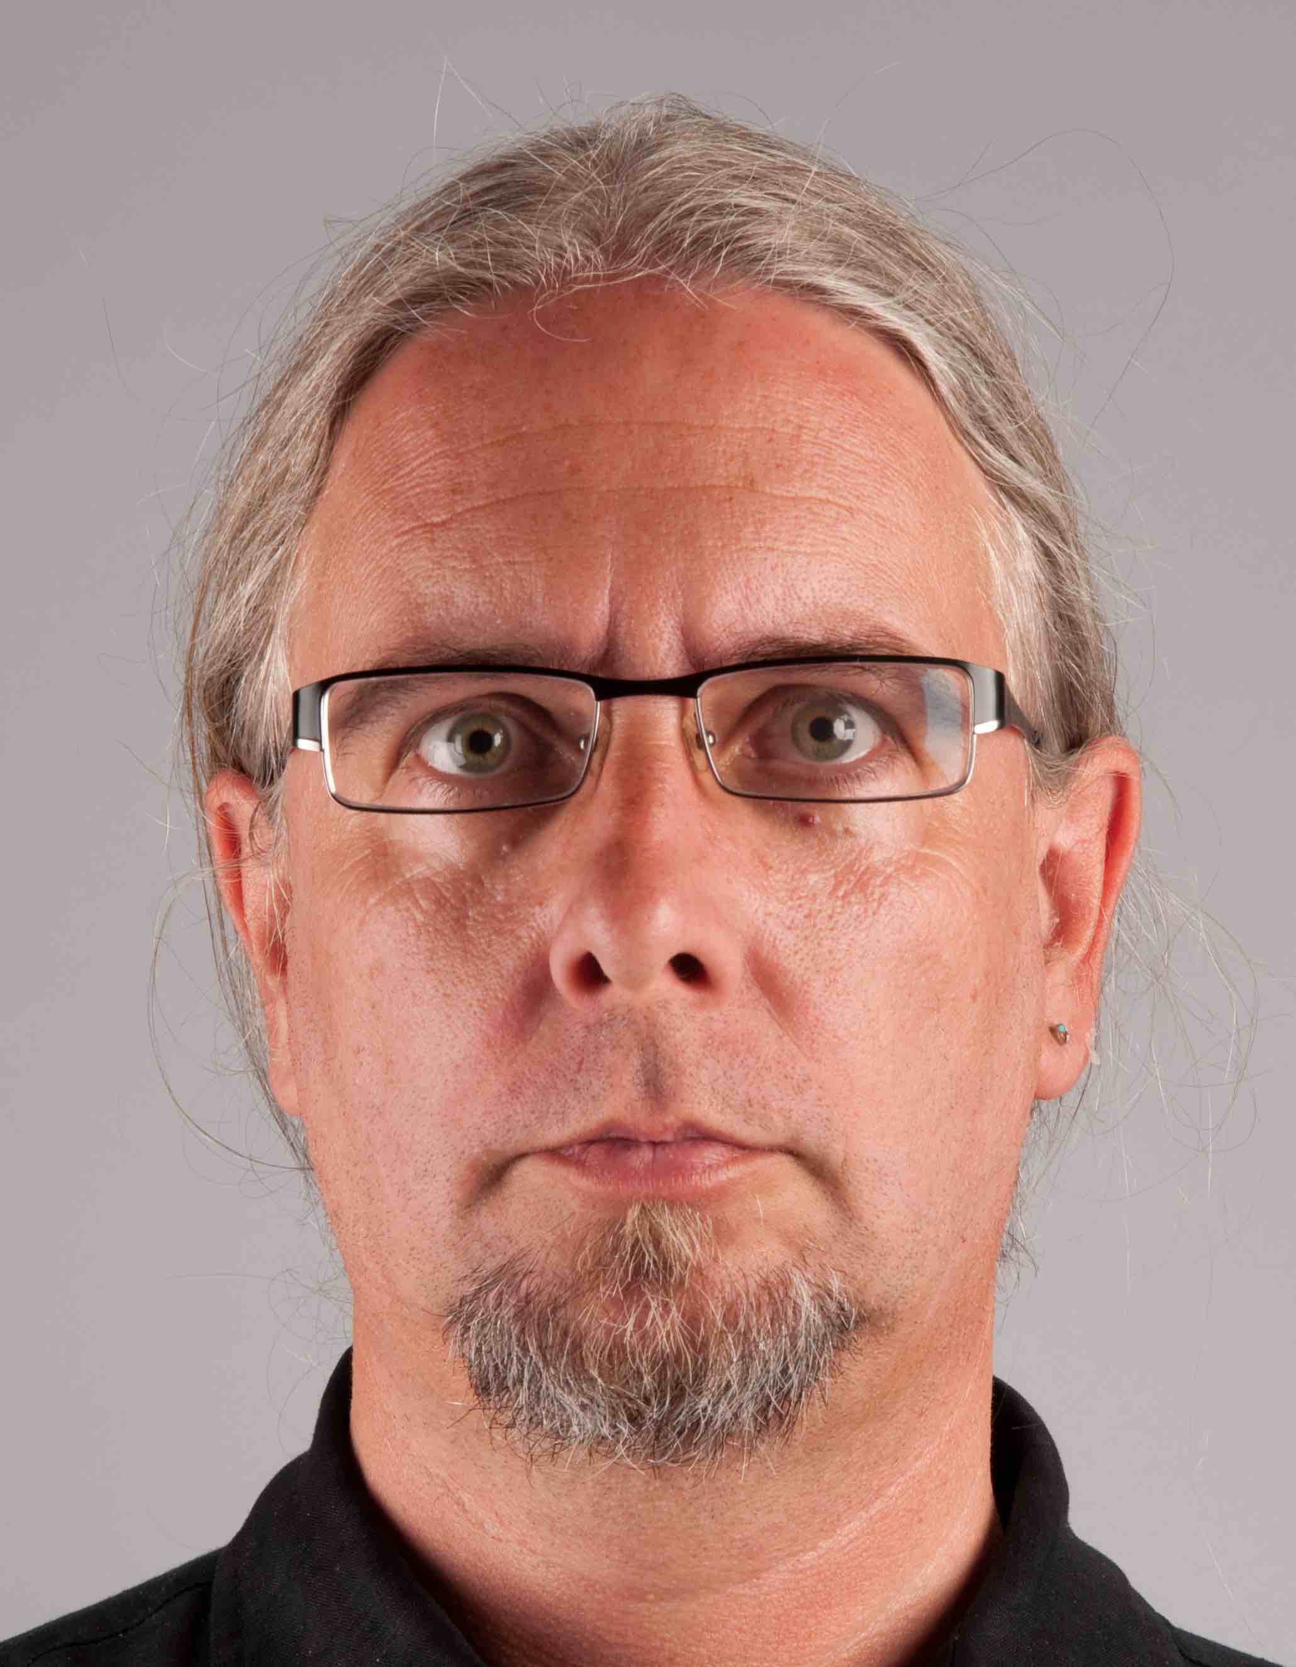
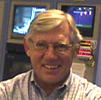
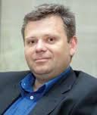
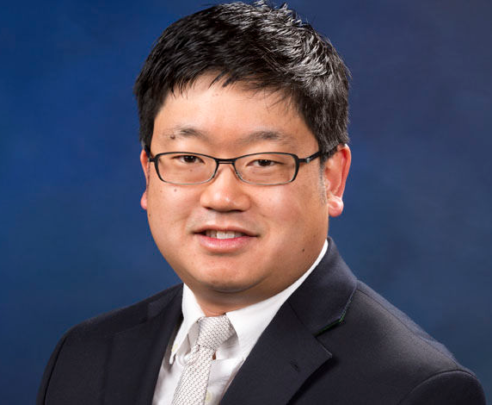
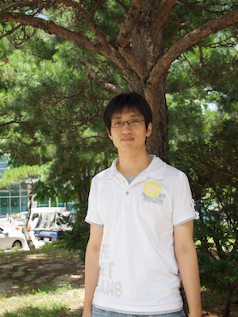
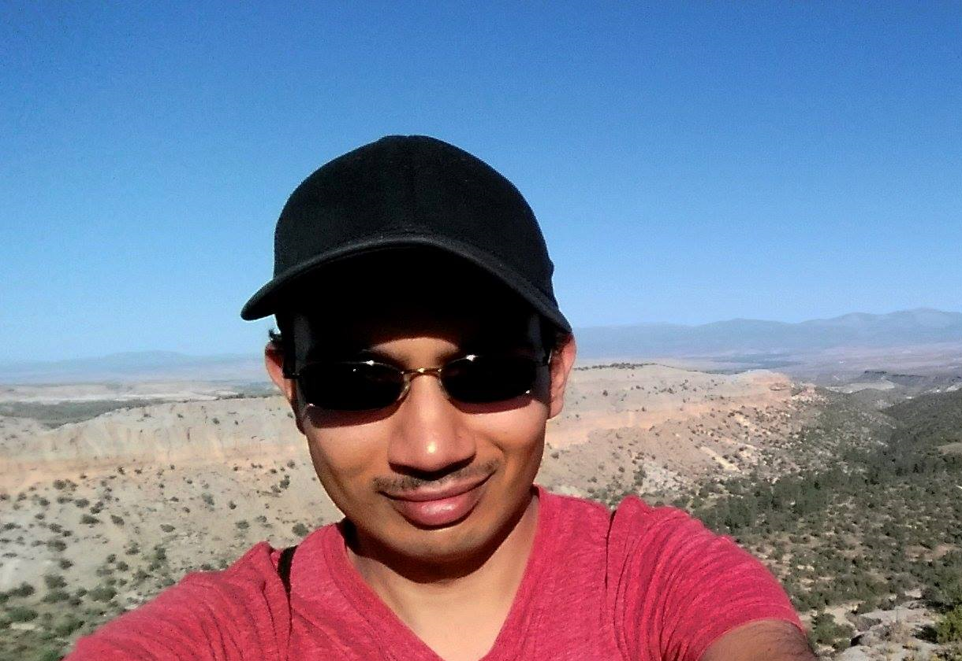
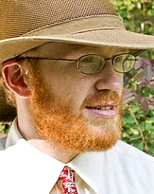
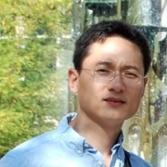
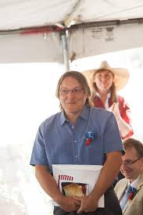
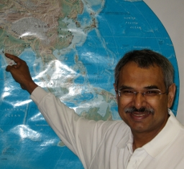
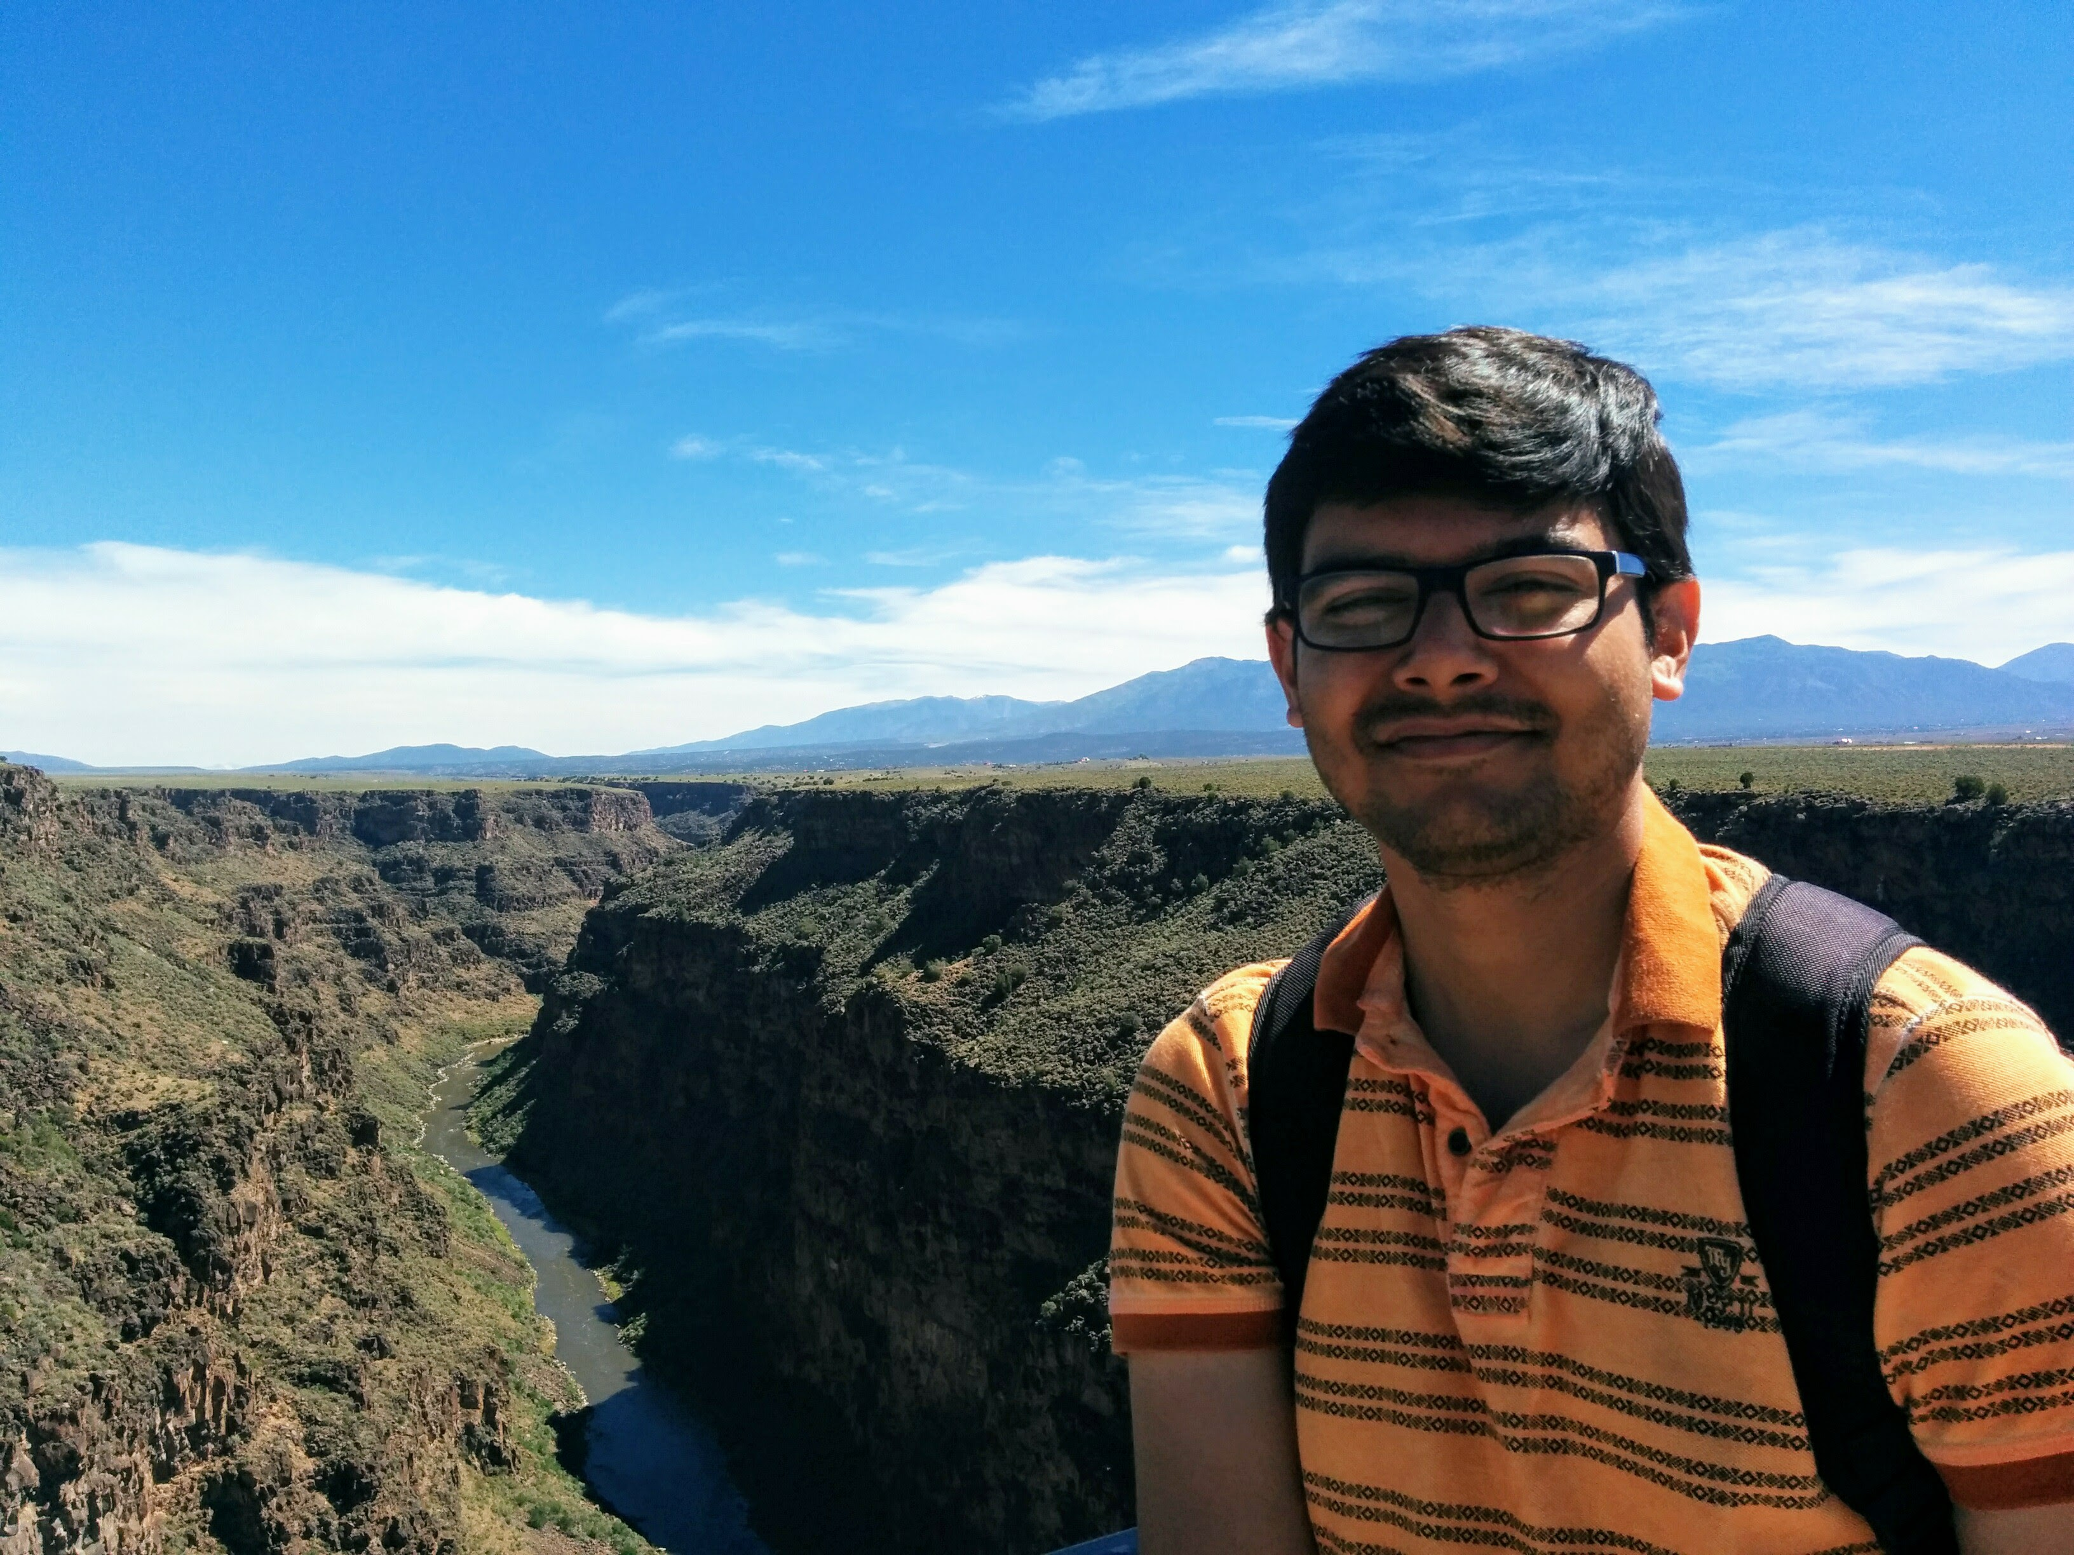
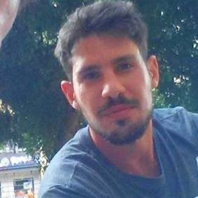
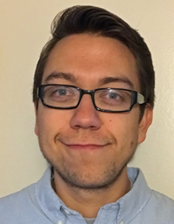
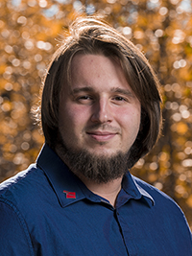
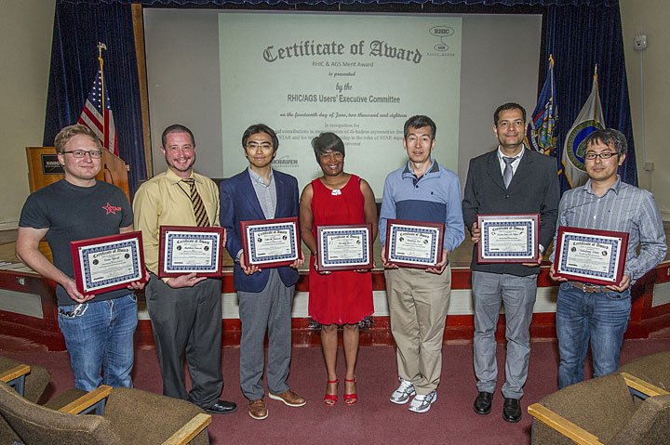
Introduction – The LDRD Team and Effort
Experimental group
  P-25, AOT
  Detector readout and mechanical support R&D
  Detector modeling and simulations
  Physics simulations
Theoretical group
  T-2, T-5, CCS-7
  Physics modeling & simulations
Budget: 1.6M/Year, FY17-19
  1/3 on experimental T&E
  1/3 on theoretical T&E
  1/3 on Hardware & M&S

Slide 4
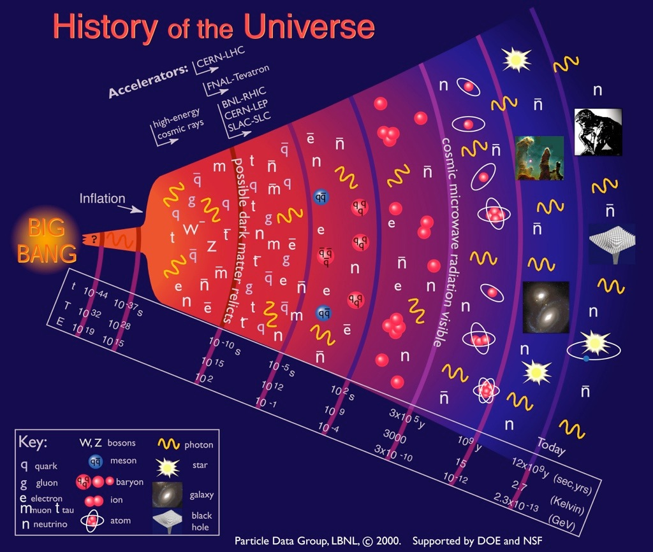
Quark-Gluon
Plasma (QGP)
Earliest stage of the universe that can be explored in detail in the laboratory

Slide 5

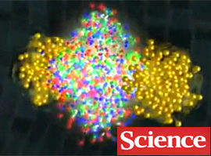
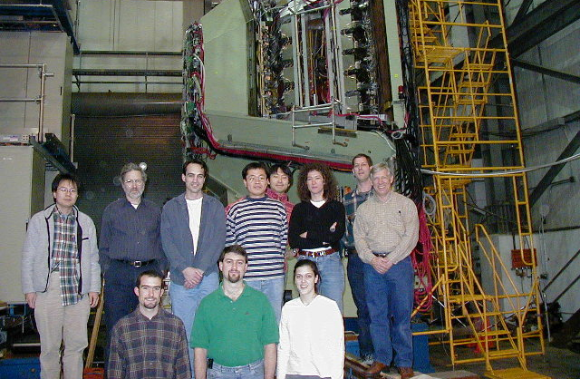
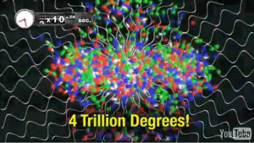
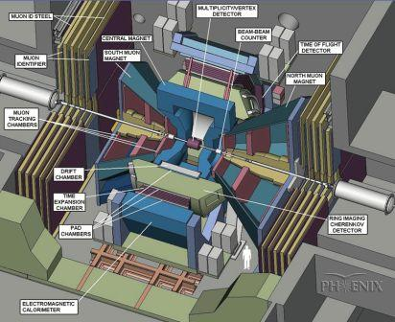
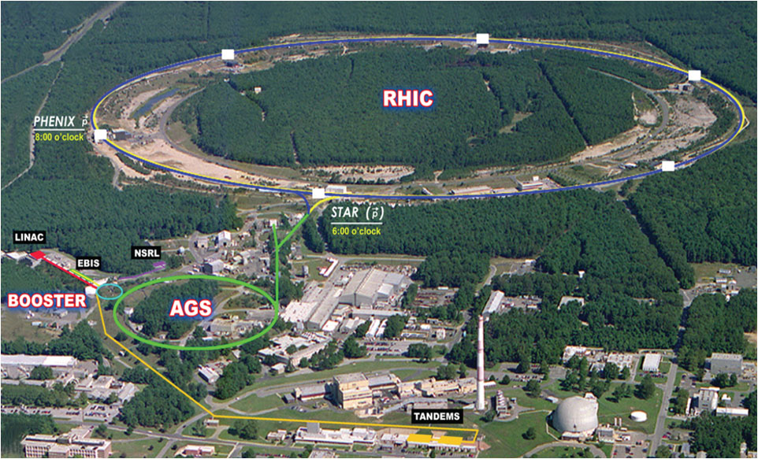
Discovery of QGP at the Relativistic Heavy Ion Collider
QGP created in Au+Au collisions @RHIC
Strongly coupled near perfect liquid!
LANL’s major roles @PHENIX experiment
  Muon Spectrometers (1990’s - 2016)
  Multiplicity vertex detector (1990s - 2004)
  Forward vertex detector upgrade (2007 - 2016)
QGP discovery announced in 2004 by 4 RHIC experiments, PHENIX, STAR, BRAHMS, PHOBOS
Confirmed later at LHC
PHENIX:
Mission completed in 2016
Upgrade path – sPHENIX @RHIC
FVTX
Circa 2001
LANL led
muon tracker
PHOBOS
BRAHMS

Slide 6
Bring Big Science to LANL – sPHENIX at RHIC
sPHENIX – the next US NP flagship heavy ion physics program, to study “the inner workings of QGP” (DOE/NP LRP2015)
  Granted CD0 9/2016; CD1/3a 8/2018; PD2/3b scheduled 5/2019
  Construction 2018 – 2022; Physics runs: 5+ years
This LDRD allows LANL to take a leadership role in sPHENIX and be a key player in the Heavy Ion physics frontier
  Innovation: develop a new open heavy flavor physics program, identified as the 3rd Science Pillar of the sPHENIX experiment
  Bring new state of the art technical capability to LANL applied program, also future EIC program
LANL’s NP program:
PHENIX: 1990s – 2016
sPHENIX: 2016 – 2027+
Electron Ion Collider: Next frontier
Complement & extend current and future
RHIC and LHC QGP programs

Slide 7
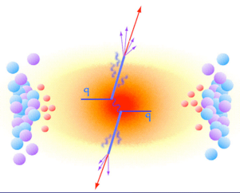
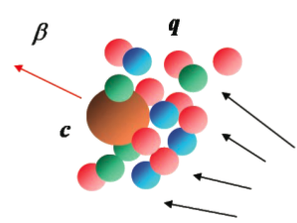
MVTX Physics Highlights
Ivan & Boram’s talks
“B meson and b-jet modification”
Heavy quarks – new scales, m_{c}, m_{b}
  Study mass dependence
    Jet quenching & energy loss
    Flow – interaction with medium
  Access QGP properties
    Density, coupling, transport coefficients etc.
“B meson and b-jet flow”
m_{u} m_{d}
m_{s}
Λ_{QCD}
m_{c}
m_{b}
MeV
1
10
10²
T_{c}
T_{QGP}
10³
10⁴

Slide 8
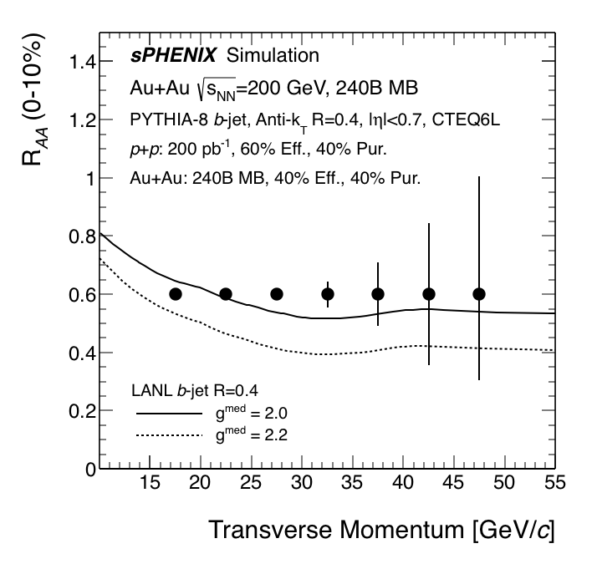
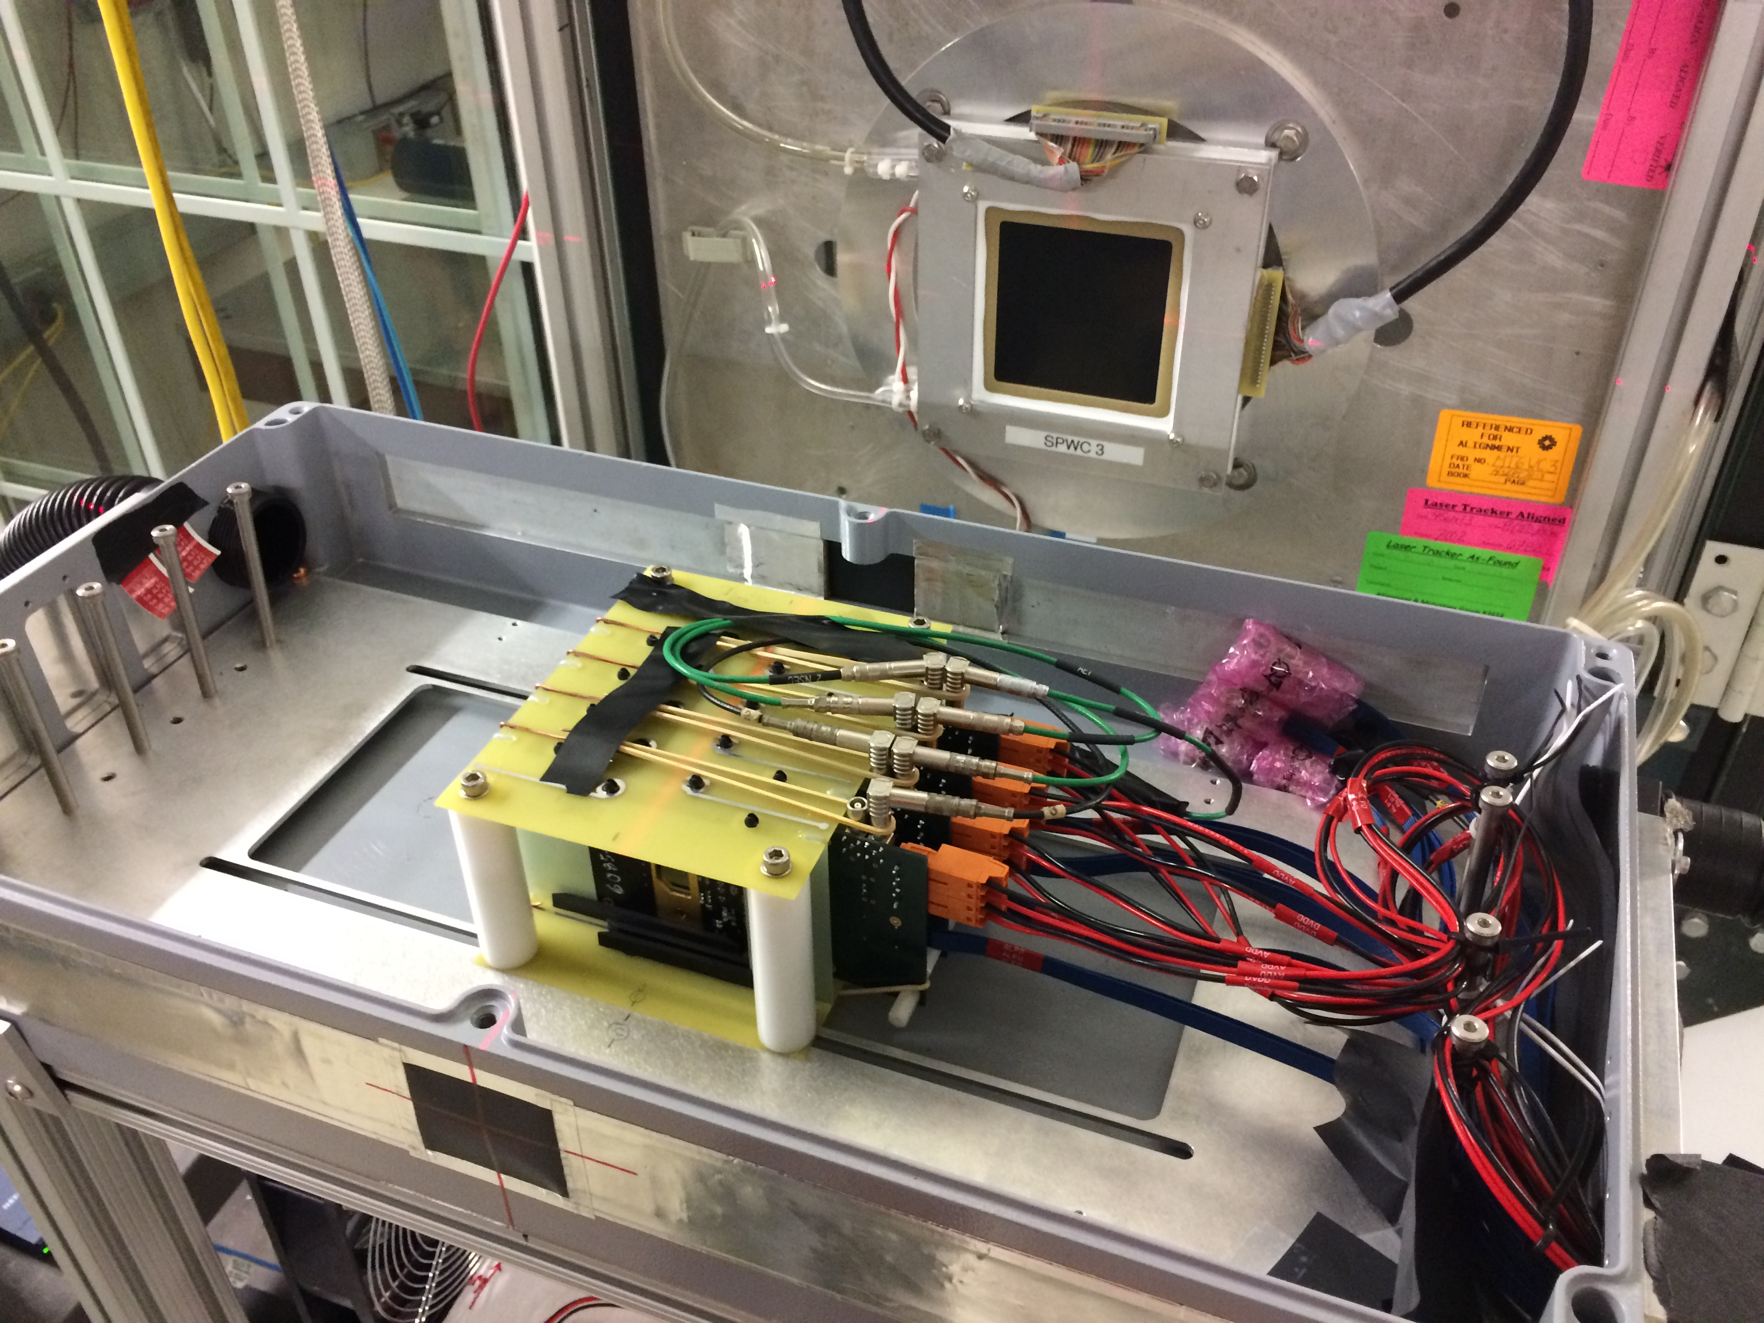
LDRD Scientific & Technical Goals
Develop a next generation QGP physics program with heavy quark jets at RHIC with full detector and physics simulation and modeling
New theoretical study of QGP tomography with b-jets
Carry out key detector R&D to demonstrate the open heavy flavor physics capability in the sPHENIX with MVTX
Develop a proposal to DOE to build a state-of-the-art MAPS-based Vertex Detector for the sPHENIX
4-ALPIDE Telescope;
5m long SamTec cables
MVTX proposal submitted & approved by DOE and BNL in 2018!

Slide 9
LDRD Project Scope and Status
Established at the beginning of this project feasibility review 1/2017
Minimal goals
  Develop a MVTX prototype telescope with 2-4 early prototype ALPIDE sensors/staves with ALICE readout units, complete sPHENIX DAQ integration
  Complete R&D on mechanical conceptual design, sPHENIX system integration
  Develop b-jet tagging algorithms for p+p and Au+Au
  DOE MIE proposal submitted to fund the full detector construction
  Complete b-jet theory for precision tomography of QGP with sPHENIX
Stretch goals
  Develop a full 4-production-stave MAPS telescope, test beam run with integrated sPHENIX DAQ
  DOE MIE proposal approved for the full detector construction

Slide 10
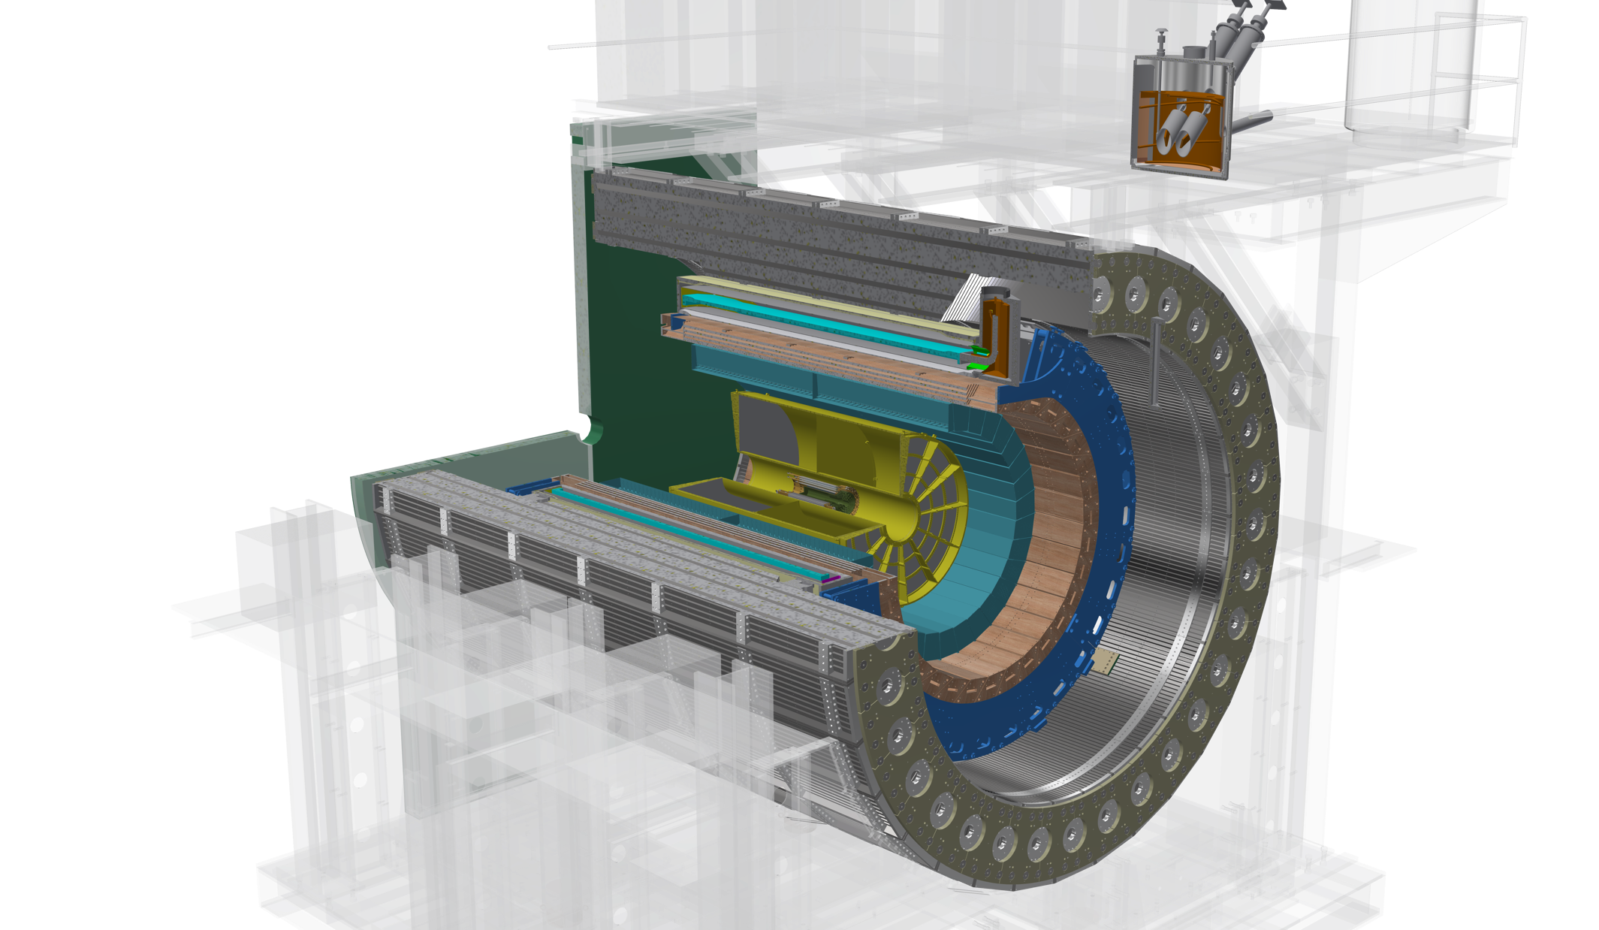
The sPHENIX Detector Design Today
Outer HCal
SC Magnet
Inner HCal
EMCal
TPC
INTT
MVTX
Φ ~ 5m
15 kHz trigger
>10 GB/s data
Notes:
15kHz matched to collision rate.

Slide 11


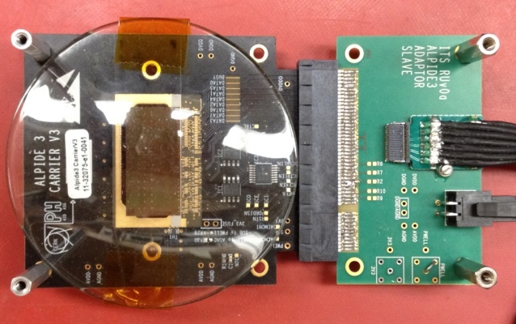
Monolithic Active Pixel Sensors (MAPS)
The Next-Generation, State-of-the-Art Pixel Tracker
Advantages of ALICE PIxel DEtector (ALPIDE) sensor:
Very fine pitch (27μm x 29μm), for superb spatial resolution
High efficiency (>99%) and low noise (<10⁻⁶), for excellent tracking
Time resolution, as low as ~5 μs, for less pileup
Ultra-thin/low mass, 50μm (~0.3% X₀), for less multiple scatterings
0.5M channels with on-pixel digitization, for zero-suppression and fast readout
Low power dissipation, 40mW/cm², for minimal service materials
An ideal detector for QGP physics!
Flexible Printed Circuit(FPC)
9 Chips
Cold plate
A 9-chip MAPS stave, 1.5cm x 27cm
ALPIDE design
ALPIDE sensor:
1.5cm x 3.0cm, 0.5M channels
50 μm
~28 μm

Slide 12
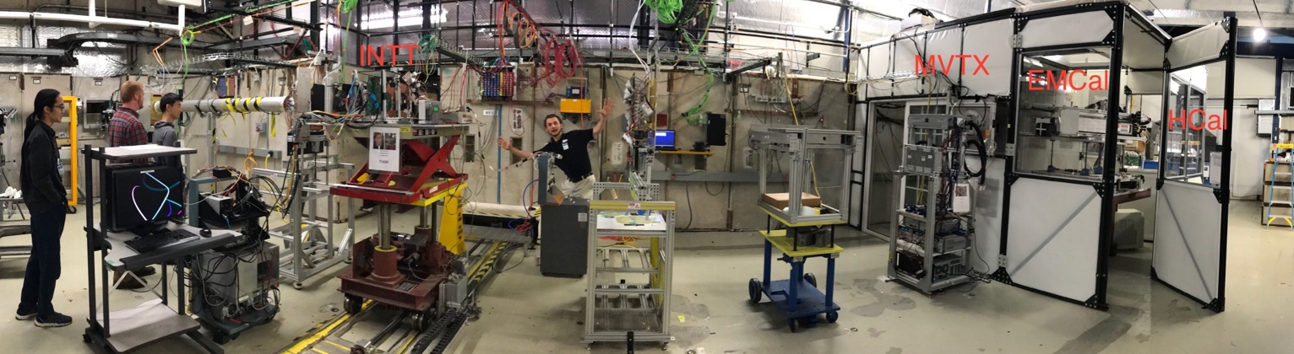
MVTX R&D Success: 2018 Fermilab Test Beam Highlights
Sho’s talk
INTT
MVTX EMCal HCal
Demonstrated full high-speed readout chain at Fermilab test beam in Feb - Mar 2018
Sensors + RU + FELIX + RCDAQ/sPHENIX
Track spatial
resolution: ~5 um
120 GeV protons
4-hit track
High hit efficiency: > 99.5%
4-MAPS telescope

Slide 13
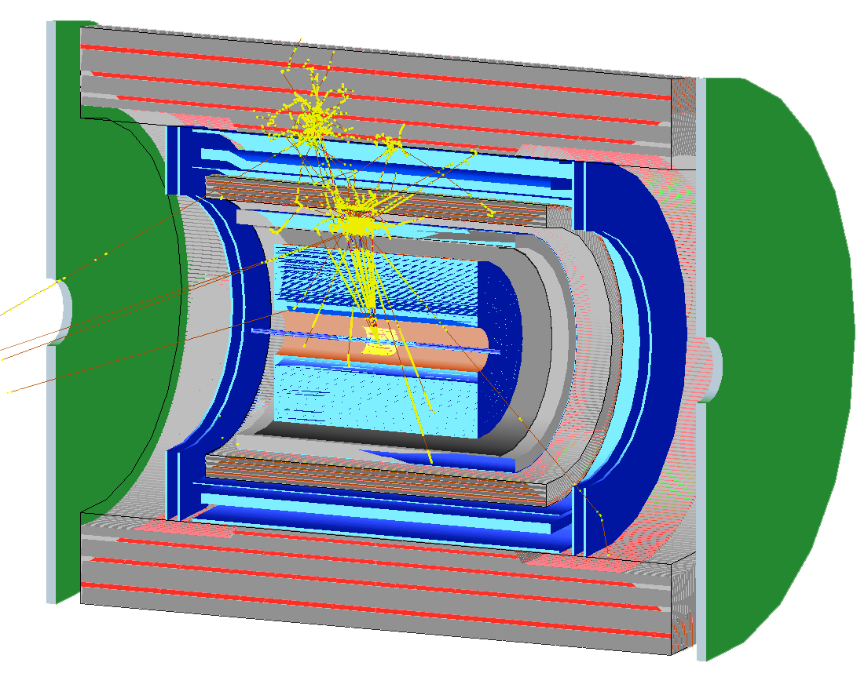
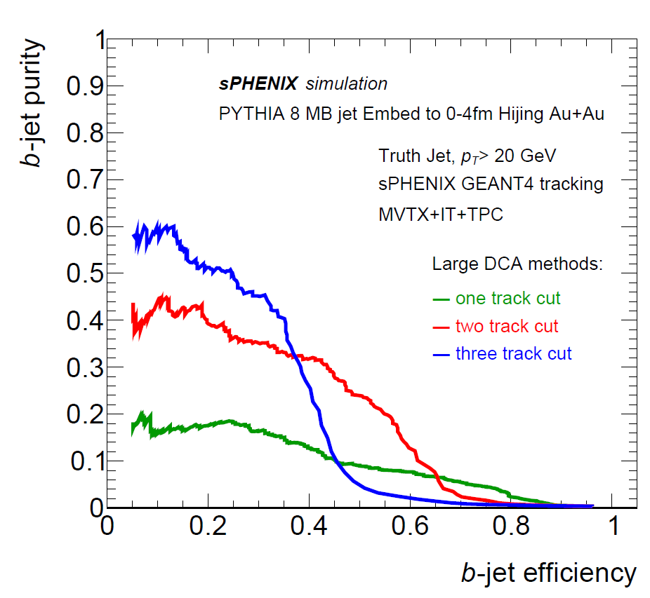
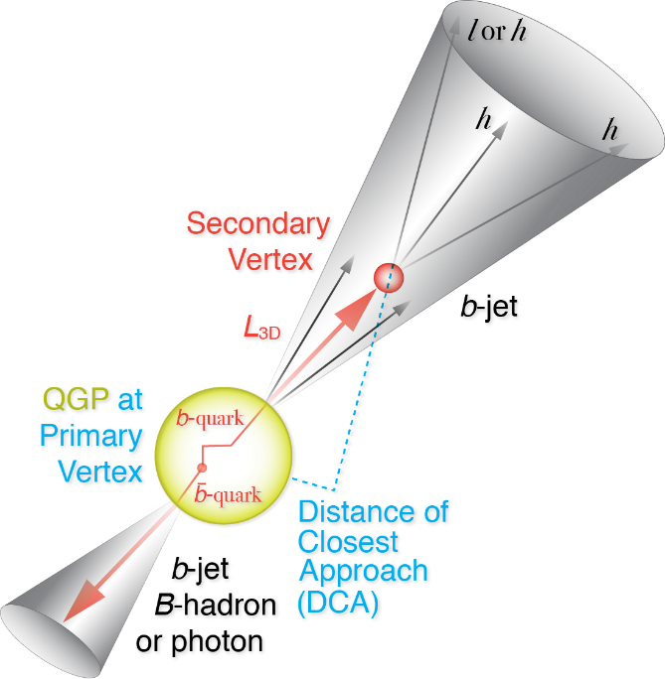
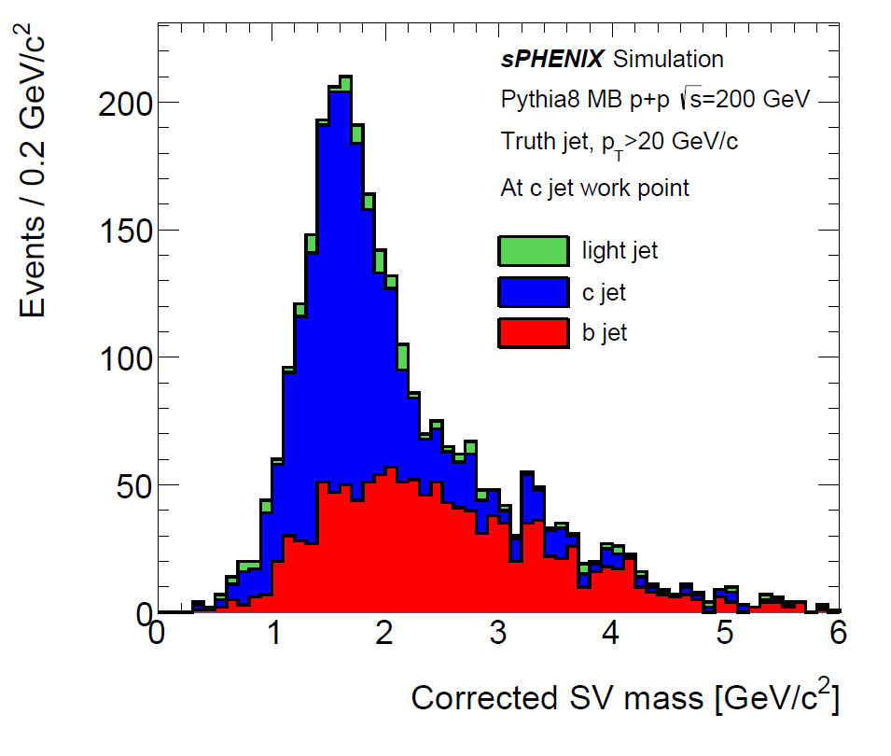
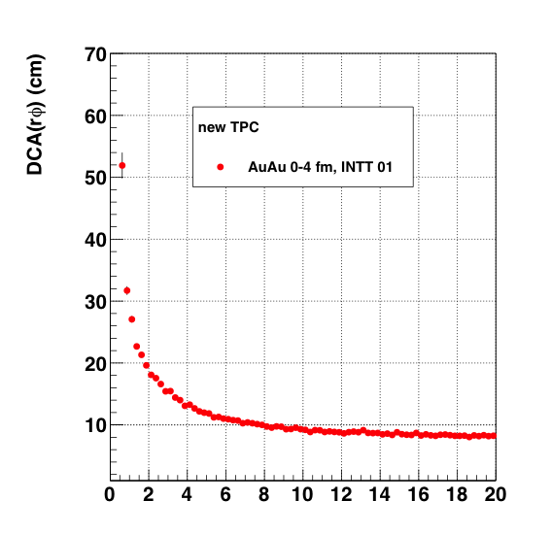
Full GEANT Detector and B Physics Simulations
B-Tagging:
Large DCA tracks
Invariant mass

Slide 14
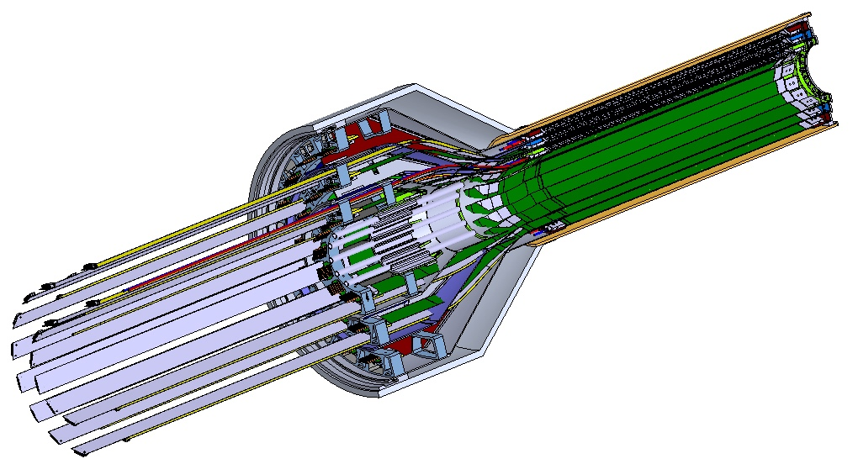
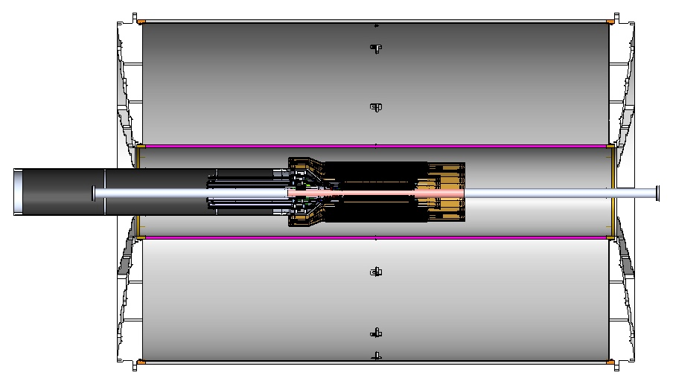
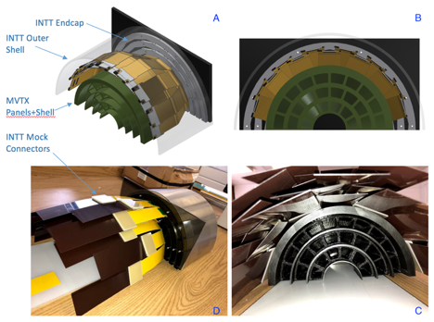
Mechanical System – Completed Conceptual Design
a new MVTX stave design with 40cm extended power FPC
Walt and Sho’s talks
Service Barrel
TPC
INTT
3D model and mockup
MVTX
PP-2:
Signal and power cables
PP-1b:
power cables
PP-1a:
short signal cables
12/7/18

Slide 15
Addressing Recommendations from last Appraisal
“Recommendation 1: Testing should be carried out with the 10m cables. The project recognizes the issue of cable lengths with the readout system, and we encourage the team to identify the maximum length that can be used (7, 9, 11 m) to ensure that unforeseen integration issues in sPHENIX do not create obstacles to their use. This is likely the highest risk in the detector development part.
- R&D in progress, don’t expect major issues (Sho’s talk)
Recommendation 2: The project had reached many milestones ahead of schedule and is proposing several enhanced goals. We advise the group to prioritize these to maximize the impact on the field (particular for theory).
- Pursuing stretch goal of 4-stave telescope, beam test planned for May 2019; (Sho’s talk)
- New theoretical development (Ivan’s talk)
Recommendation 3: In regard to the transition, we advise that the LDRD leadership explore ways to keep the knowledge within the group in order to make the MVTX sPHENIX project successful. The expertise also needs to be maintained for the ~5 year execution of the experiment, although possibly at a reduced level.
- Need support from management to retain talents in the group;
- New hires of two postdocs – one ITS expert, one highspeed electronics expert; staff training for MVTX;
Recommendation 4: It would be interesting to incorporate dynamical screening effects into these calculations, in addition to Debye screening effects.
- New theoretical development; (Ivan’s talk)

Slide 16
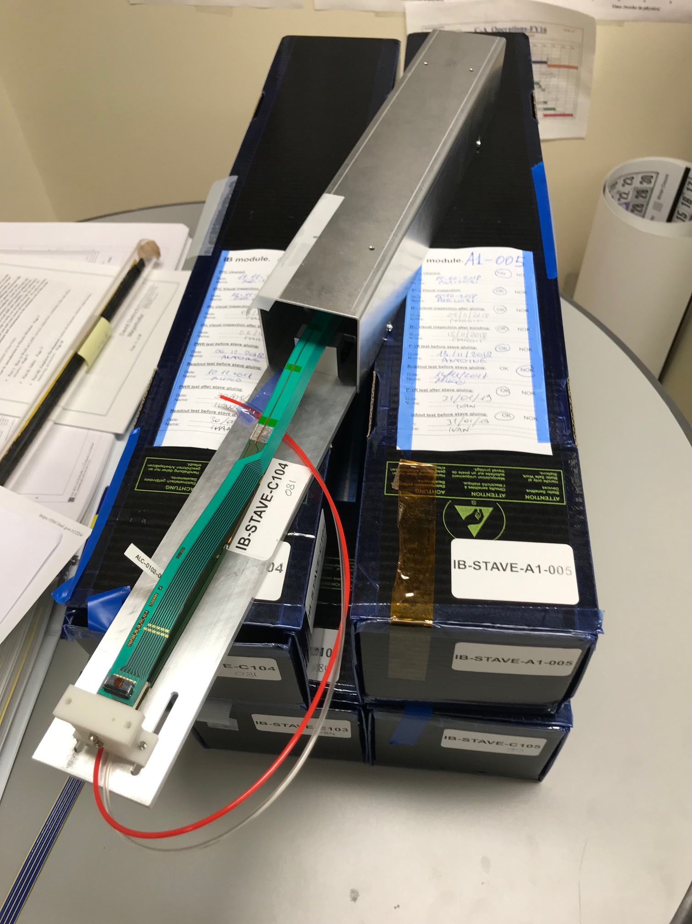
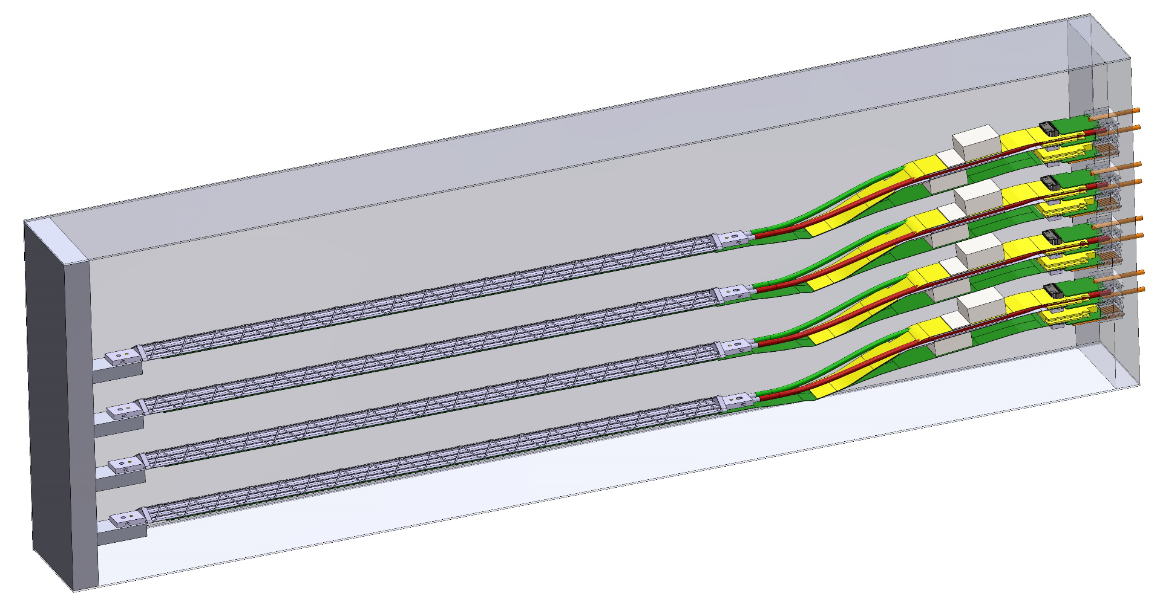
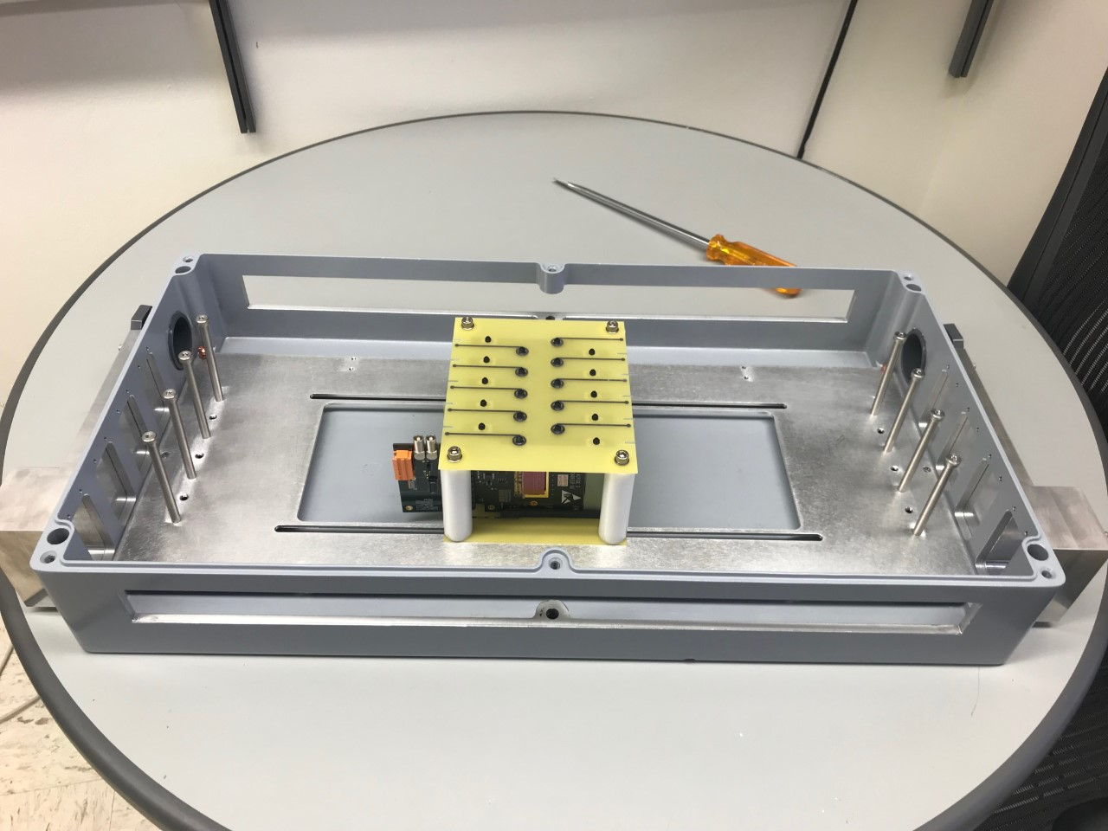
Detector R&D Tasks for FY19
Sho’s talk
MVTX prototype telescope beam test at Fermilab
  Staves with “final” electronics and cables
  Test beam planned for May, with sPHENIX INTT
SamTec cables
  AWG30, ~10m cables
ALPIDE sensor characterization and optimization
  Readout and trigger optimization for sPHENIX
  Laser system setup in preparation
4-stave Telescope
4 taves @LANL

Slide 17
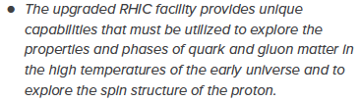

Mission Impact
NSAC Long Range Plan 2015
This project directly contributes to the LANL NPAC (Nuclear, Particle, Astrophysics and Cosmology) and DOE Nuclear Physics program, expand the leadership of LANL at national & international level:
High impact on national big science program
  sPHENIX and EIC
Define the directions for LANL basic science and applied programs
  Long-term DOE NP program
  New hires - Xuan, Sho, Yasser, Cameron (P-25), Alex(COMPA), also in theory groups
  Other LANL hires - Mike(XCP), Darren(XTD)
  DOE Early Carrier Award, Cesar
  Application to LANL applied program, safeguard and space program etc.
New proposals being developed
  for EIC based on MAPS technology
  X-ray imaging with MAPS
Recommendation #1 (RHIC):
Recommendation #3 (EIC):
The highest priority in this 2015 Plan is to capitalize on the investments made.
LDRD
sPHENIX
EIC
2015
2020
2025
2030

Slide 18
Transition into DOE sPHENIX MVTX Program
Cesar’s talk
MVTX approved by DOE and BNL, funded through RHIC Operation
  DOE provides $1.4M to produce 84 staves and 60 RUs through US-ALICE, addon to the ALICE mass production
  MVTX system design and construction in progress, additional ~$5M from DOE
As a result of this LDRD, we expect to have:
  Long term DOE NP support for sPHENIX
  Long term DOE support for theoretical effort
In the remaining ~7 months of this project, we will actively work with the sPHENIX MVTX group to make smooth transition:
  The full MVTX detector design and construction
  Ready for day-1 physics in 2023

Slide 19
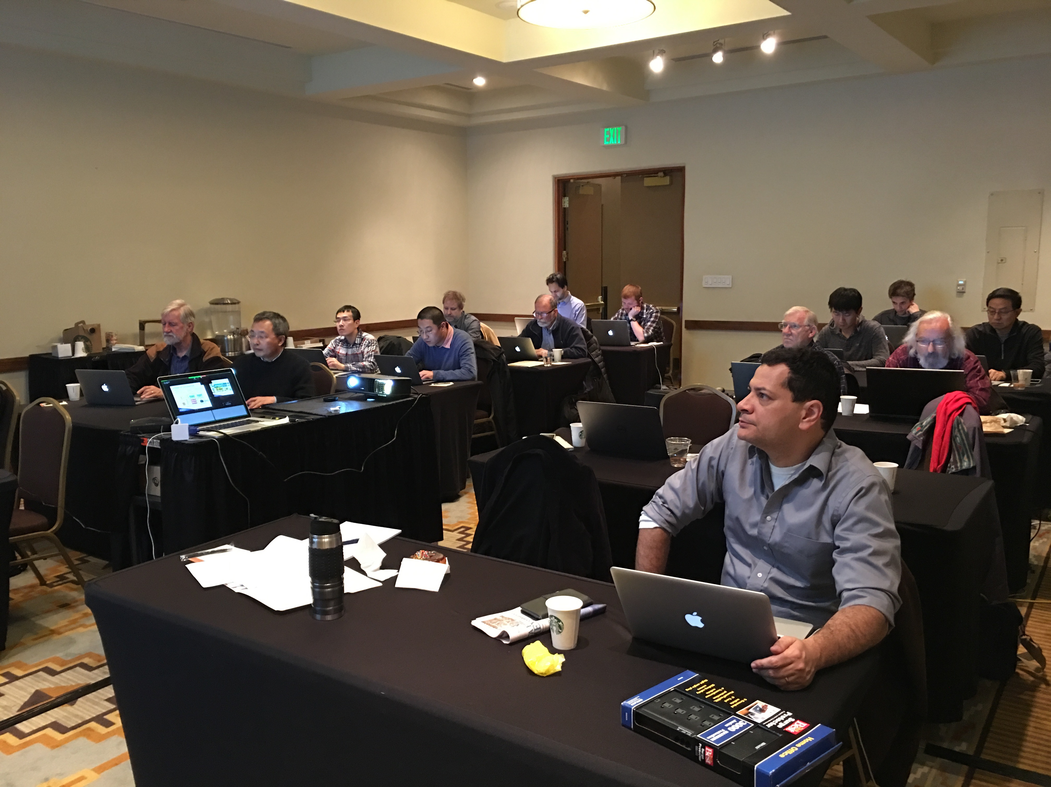
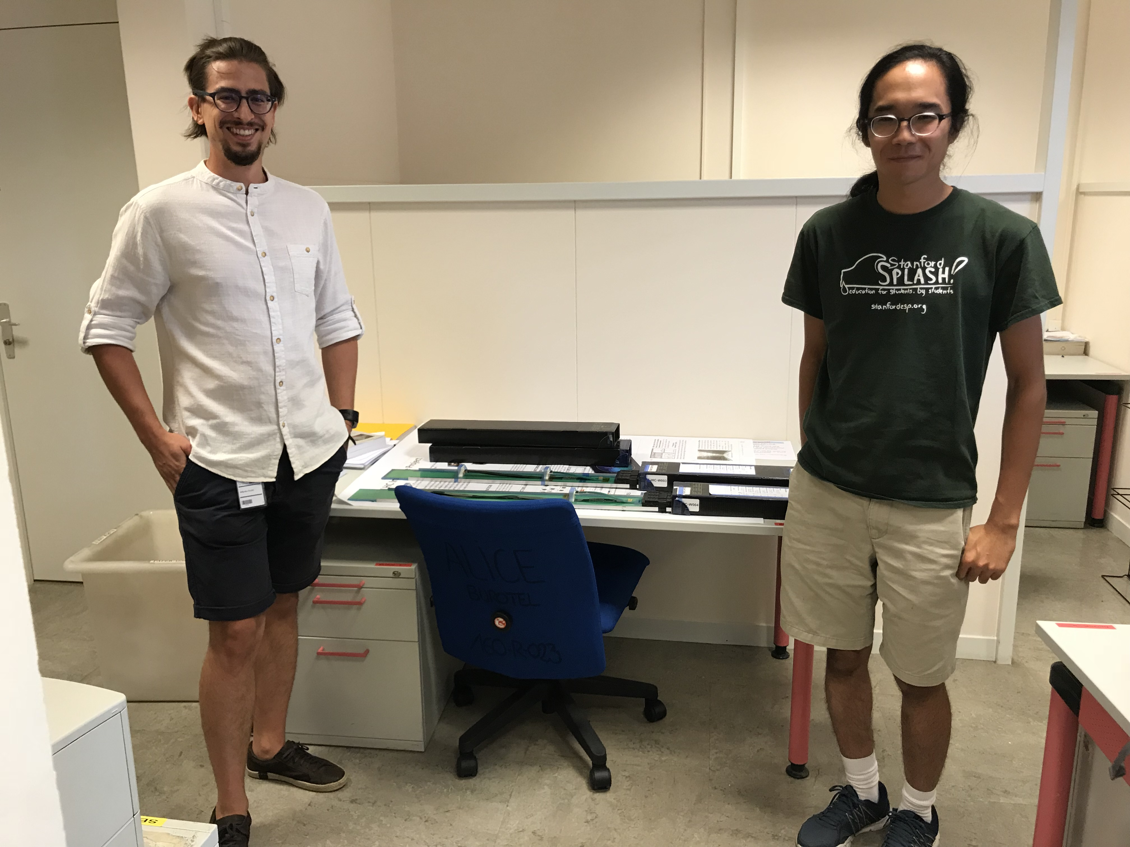
Major Activity Highlights
FY2019
MVTX/INTT mechanical integration @BNL, 10/2019
4 staves produced @CERN, 1/2019
4-stave TB in May 19
Transition into sPHENIX MVTX construction project
Full system test, summer 2019
MVTX workshop, project update @FSU 12/2018
MVTX workshop & mech integ meeting @LBNL, 2/2019
sPHENIX MVTX production tick-off meeting @Taiwan, 3/2019
Stave & RU production readiness review, 11/2018
MVTX plan with ALD@BNL, 11/2019
FY2018
MVTX/HF workshop@LBNL, 11/2017
UT-Austin, Readout meeting, 2/2018
sPHENIX meeting @China, 4/2018
BNL MVTX Director’s Review, 7/2018
Full proposal submitted 2/2018
MVTX proposal writing workfest @SantaFe, 12/2017
sPHENIX colla. Meeting @Santa Fe, 12/2017
Telescope TB @Fermilab,2-3/2018
Telescope chip production @CERN, 2/2018
Meeting with ALD @BNL, 3/2018
MVTX workshop @MIT, 4/2018
Jo’s LANL visit, readout meeting, 8/2018
PWR extension FPC work @CERN, 9/2018
01/2017
MVTX workfest @Santa Fe
FY2017
MOU with CERN 12/2016
MVTX readout workfest @UT-Austin, 4/2017
MVTX workshop @LBNL, MVTX group formed, 1/2017
Test bench @LANL
MVTX preproposal submitted to DOE, BNL, 2/2017
MVTX Cost&Schedule Review @BNL, 6/2017
MVTX workfest @SantaFe, 1/2017
BNL visit for FELIX readout, 4/2017
BNL FELIX card, 6/2017
12/2018
MVTX Planning @FSU
09/2018
MVTX PWR FPC @CERN

Slide 20
Summary
Established the 3rd science pillar for the sPHENIX, the next generation DOE flagship heavy ion program; a new open heavy flavor physics program with MVTX upgrade approved by DOE and funded through BNL
New theoretical tools developed for QGP study, for RHIC and LHC
Met all LDRD milestones, some ahead of time
Broad impacts on NP and other programs
In transition into DOE supported sPHENIX program
On track to meet all goals for FY19

Slide 21
Thank You!

Slide 22
MVTX Schedules and Milestones (11/2018)
Dave’s talk
sPHENIX: CD1/3a PD2/3
Installation
1st collisions
CY-2018 | 2019 | 2020 | 2021 | 2022 | 2023
MVTX
Stave & RU
production
FELIX
production
Detector mechanics design & production, global interface to sPHENIX
End Wheels
CYSS
Global integration
/interface design?
Service barrel
design & production
Ready for beam;
sPHENIX day-1 run
Barrel Assembly & Testing @LBNL
Install half barrels
@sPHENIX IR
Half barrel #1
Power system
production
Half barrel #2
Half barrels
arrive @BNL
design & procure
interface to
sPHENIX rails
Design & procure
sPHENIX rails
MVTX installation & commissioning @BNL
RU, FELIX, PS, cables etc.

Slide 23
sPHENIX MVTX Group: Institution Roles
Major institutions lead key tasks
(New) Lehigh University: Simulations and electronics/cable test

Slide 24


Open Charm & Beauty Production
Hadron | Abundance | cτ (μm)
D⁰ | 61% | 123
D⁺ | 24% | 312
D_{s} | 8% | 150
Λ_{c} | 6% | 60
B⁺ | 40% | 491
B⁰ | 40% | 455
B_{s} | 10% | 453
Λ_{b} | 10% | 435
b-tagged jet and cor.
p_{T}>15 GeV
60%
0.5%
p_{T}<15 GeV
Exploring and more

