Slide 1
MVTX Mechanics Update, sPHENIX LDRD review,
Walter Sondheim
Los Alamos National Laboratory
January 24th, 2019

Slide 2
What’s new since MVTX review at BNL 11/19/2018
The model for the MVTX has the following changes;
  The power pig-tails have been shortened to have an overall length of 40.0 cm from the end of the sensors on a stave
  The power extension cables for the inner layer have now been rerouted to be with in the current envelope for that layer’s shell.
  Ongoing discussion concerning the Samtec signal cable extension continues along with interconnection concerns at various patch panels
  Assembly fixtures, CMM work, FEA work, service barrel concepts, support from the sPHENIX inner HCAL support ring – along with the rest of sPHEINX tracking detectors?
  Update on MVTX cable routing to racks

Slide 3
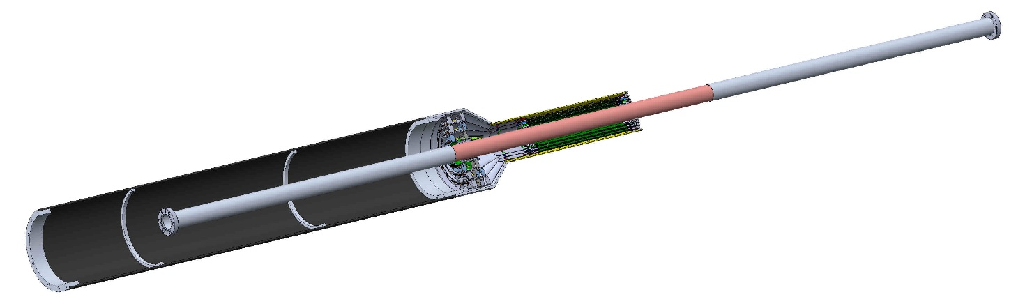
MVTX with sPHENIX beampipe, 11-19-2018
Overall length of sPHENIX beampipe, flange to flange 2,565.90 mm, beryllium center section length 800 mm.
Negotiations ongoing at BNL’s CAD division over making modifications to this beampipe assembly – moving end flanges further out from the IP by an additional 1.0 meters on each end.
This will allow for installation of INTT and MVTX detectors.

Slide 4
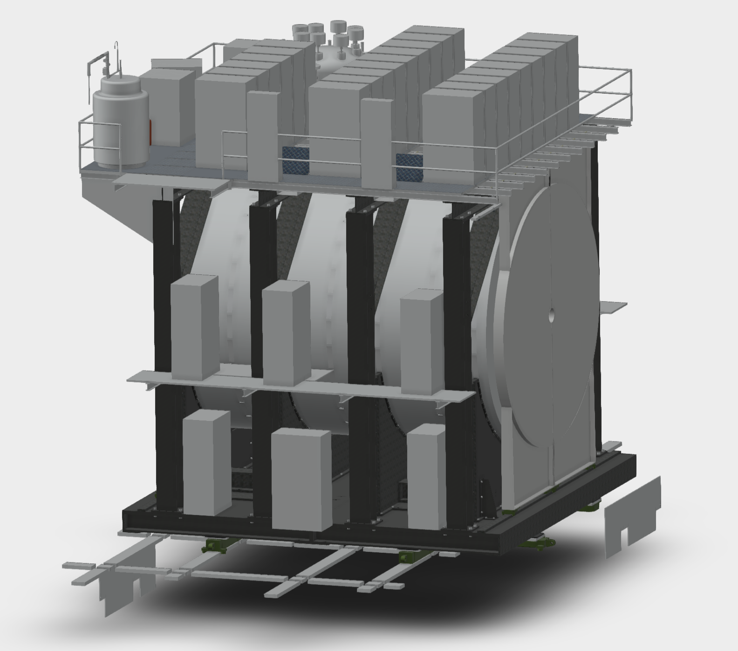
sPHENIX Racks
MBD
TPC
3B9
3C9
Rack Name | Subsystem
2E2 | HCAL
2W2 | HCAL
1E1 | EMCAL Digi
1E3 | EMCAL Digi
1W1 | EMCAL Digi
1W3 | EMCAL Digi
3A1 | EMCAL Digi
3A6 | EMCAL Digi
3C1 | EMCAL Digi
3C9 | EMCAL Digi
3A3 | EMCAL Control/Bias
3A4 | EMCAL Control/Bias
3C3 | EMCAL Control/Bias
3C7 | EMCAL Control/Bias
3A3 | TPC
3A4 | TPC
3C2 | TPC
3C8 | TPC
2W1 | INTT
2W3 | INTT
2E1 | MVTX
2E3 | MVTX
3B5 | MBD
EMCAL
3A5
3A6
3B7
3B8
3C7
3C8
3A3
3A4
3B5
3B6
3C5
3C6
3A1
3A2
3B3
3B4
3C3
3C4
3B1
3B2
3C1
3C2
West Arm Racks
2W1 2W2 2W3
1W1 1W2 1W3
MVTX
2E1
2E2
North
HCAL
2E3
EMCAL
1E1
1E3
1E2
(PATCH)
Cables have 6” clearance to get out of detector at door
Still need to decide on gas panels

Slide 5
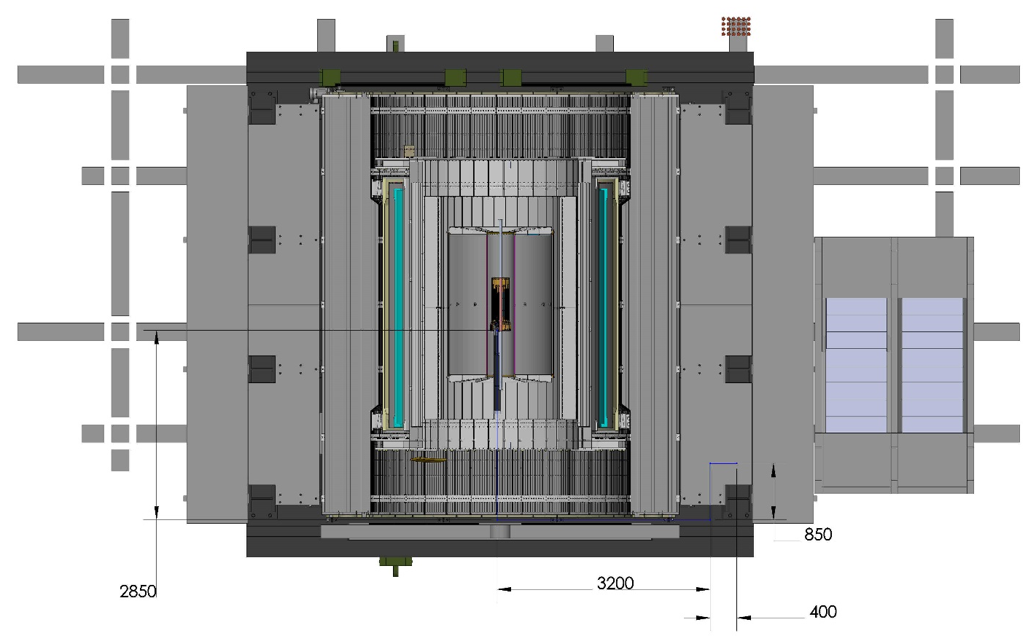
MXTX possible cable routing in sPHENIX
Possible location for the two MVTX racks, from previous slide
Estimated 2D plane cable length 7.3 meters

Slide 6
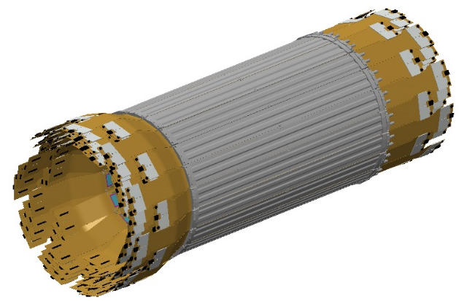
Mechanics & Cooling
Changes to the MVTX CAD model to allow for it’s integration with the current (10-17-2018) model for the INTT and the sPHENIX beam-pipe;
  End of INTT where MVTX
  detector fits
  Increase radial dimension for each of the three tracking layers such that a minimum of 2.0 mm stay clear area from the beam-pipe
  Reduce the conical section’s radial dimension, at the ends of each detector layer to fit with in the envelope for the INTT

Slide 7
Mechanics & Cooling
  Modify each of the interconnection patch panels for each layer to be compatible with the smaller radius on the conical shells;
    Allow for power cables from each stave to “pass-through” the patch panels in each layer, reducing their overall radial dimension
    Extend the length of the analog and digital power cables 400.0 mm each
  Incorporate these changes into the outer shell, bringing the connecting flange to mate with a service barrel to the interior of the half cylinder

Slide 8
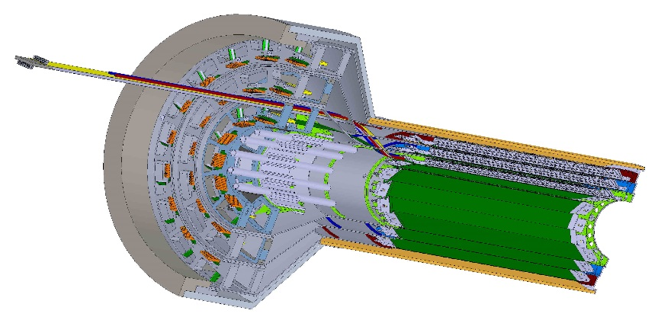
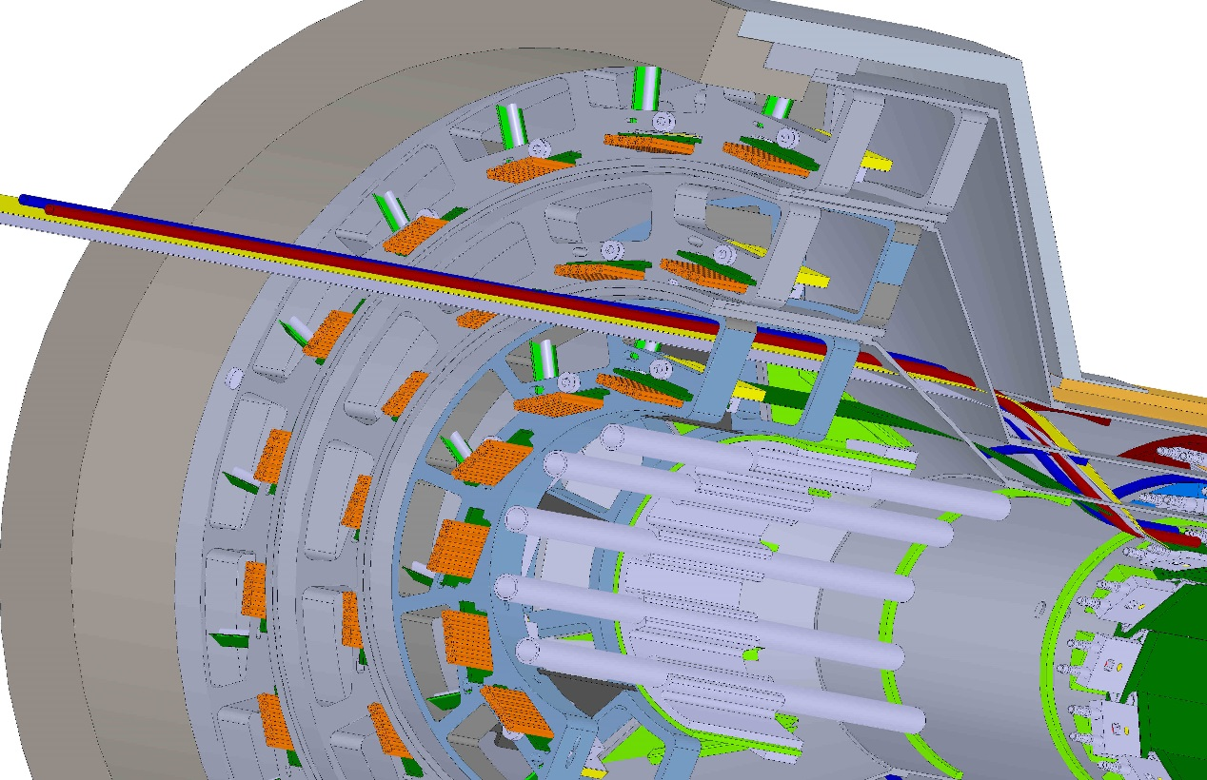
MVTX CAD model modification to patch-panels:
Layer 0 with one ext. power cable & cooling lines
Patch panels are in pairs per layer, inner one is structural for supporting outer shell, outer one serves as signal cable interface – 3D printed

Slide 9
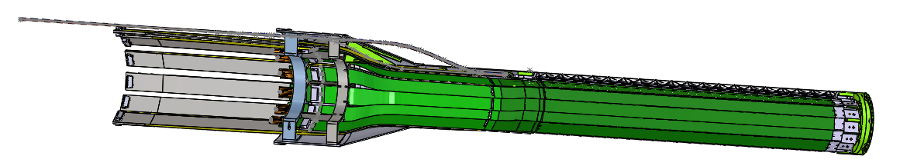
MVTX inner layer CAD model to do list;
163.0mm from patch –panel 1A to end of power cable extensions
Reroute cooling lines
Update signal cable patch panel
  How will the signal cable extension be held in the patch panel
Update fins between the two patch panels
Include fin supports from pass-through patch panel to conical shell
Verify indexing fiducials are included for mounting in assembly jigs

Slide 10
ALICE inner tracker assembly jigs:

Slide 11
ALICE jig assembly steps;

Slide 12
Modification to MVTX sensor layers;
Modified radial position of sensors in all three layers to give a radial clearance of ~ 2.0 mm from the sPHENIX beam-pipe. Closest radial distance is from surface mount components to beampipe = 2.025 mm. Each layer moved out radially by 1.25 mm.

Slide 13
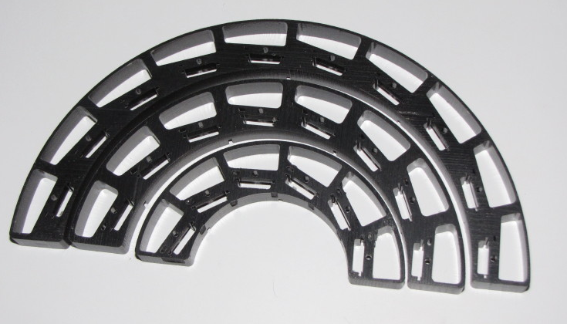
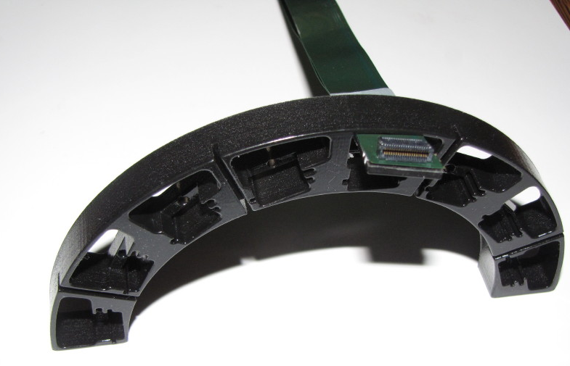
Modification to patch-panel & pass –through panel
Modified patch-panel inner & outer radius;
Layer 0, 29 & 50 mm
Layer 1, 53 & 73.5 mm
Layer 2, 76 & 96.5 mm
View showing extension power cables passing through panel cut-out
Original patch-panel outer radius:
Layer 0, 56.5 mm
Layer 1, 86.5 mm
Layer 2, 116.5 mm

Slide 14
ALICE inner layers in assembly jig;
Layer 0:
Patch-panel 3D printer
Pass-through panel, anodized aluminum
Layer 1:
Both layer shown in their assembly jig, note how pass-through panel serves as structural support for conical shell

Slide 15
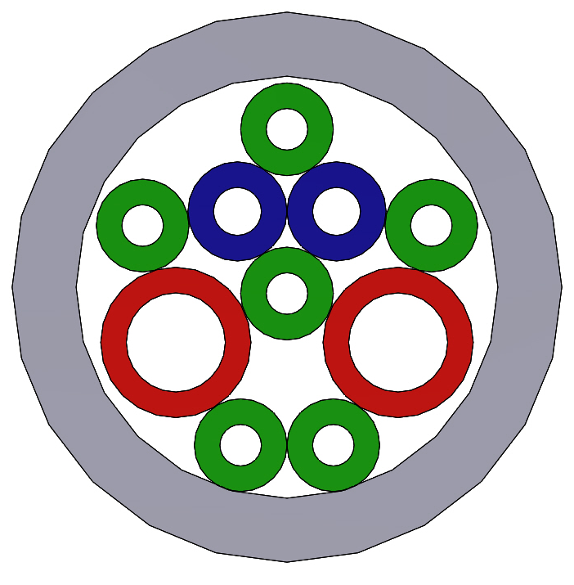
MVTX power cable bundle cross-section
OD 8.6mm, sheath 1.0mm thick
Analog Power, OD 1.55m,sheath .4 mm thick, 2X
A shield will be incorporated
Digital Power, OD 2.35 mm, sheath .4 mm thick, 2X
Grounds, bias, slow controls OD 1.45 mm, sheath .4mm thick, 6X

Slide 16
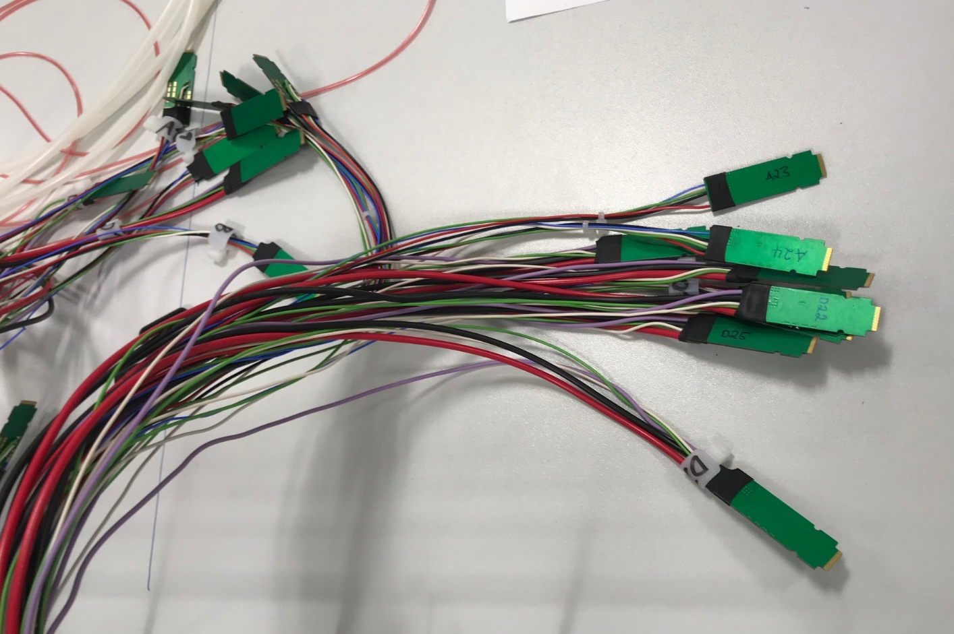
MVTX power cable bundle unsheathed
From previous slide, two of these adapter/connectors are for one stave. See next picture -

Slide 17
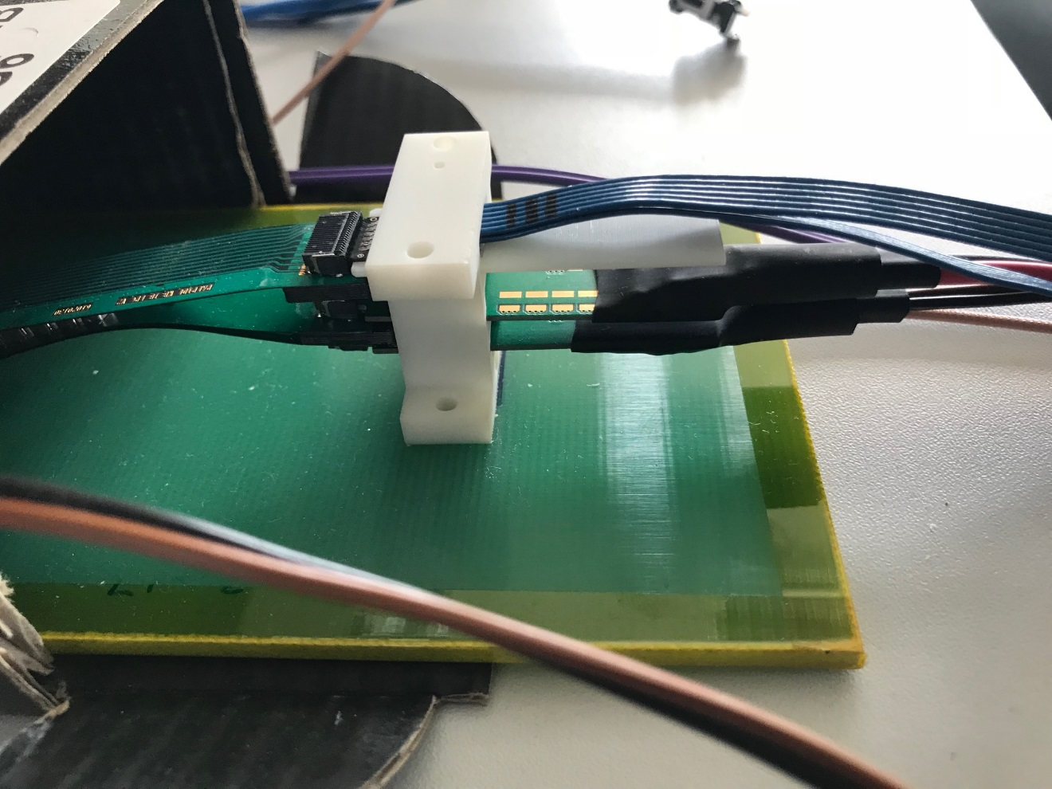
MVTX signal (Samtec) and power cables
Samtec-blue signal cable, non-halogen free.
Two power cables; analog and
digital stacked as if they were in a patch-panel.
Note lose power cable bundles in this picture from testing at CERN.
Could this be a connection similar to what will be needed at patch-panel 1B?

Slide 19
MVTX plus service barrel estimated weight;
MVTX detector; 2 X 1100 gms = 2200 gms = 5 pounds
1200 mm service barrel; 2 X 3644 gms = 7288 gms = 16.08 pounds
Extension cables, water cooling lines, air cooling lines, patch panels/services supports – yet to be designed
What is the balance point for the MXTX detector plus service barrel?

Slide 20
MVTX grounding scheme;

Slide 21
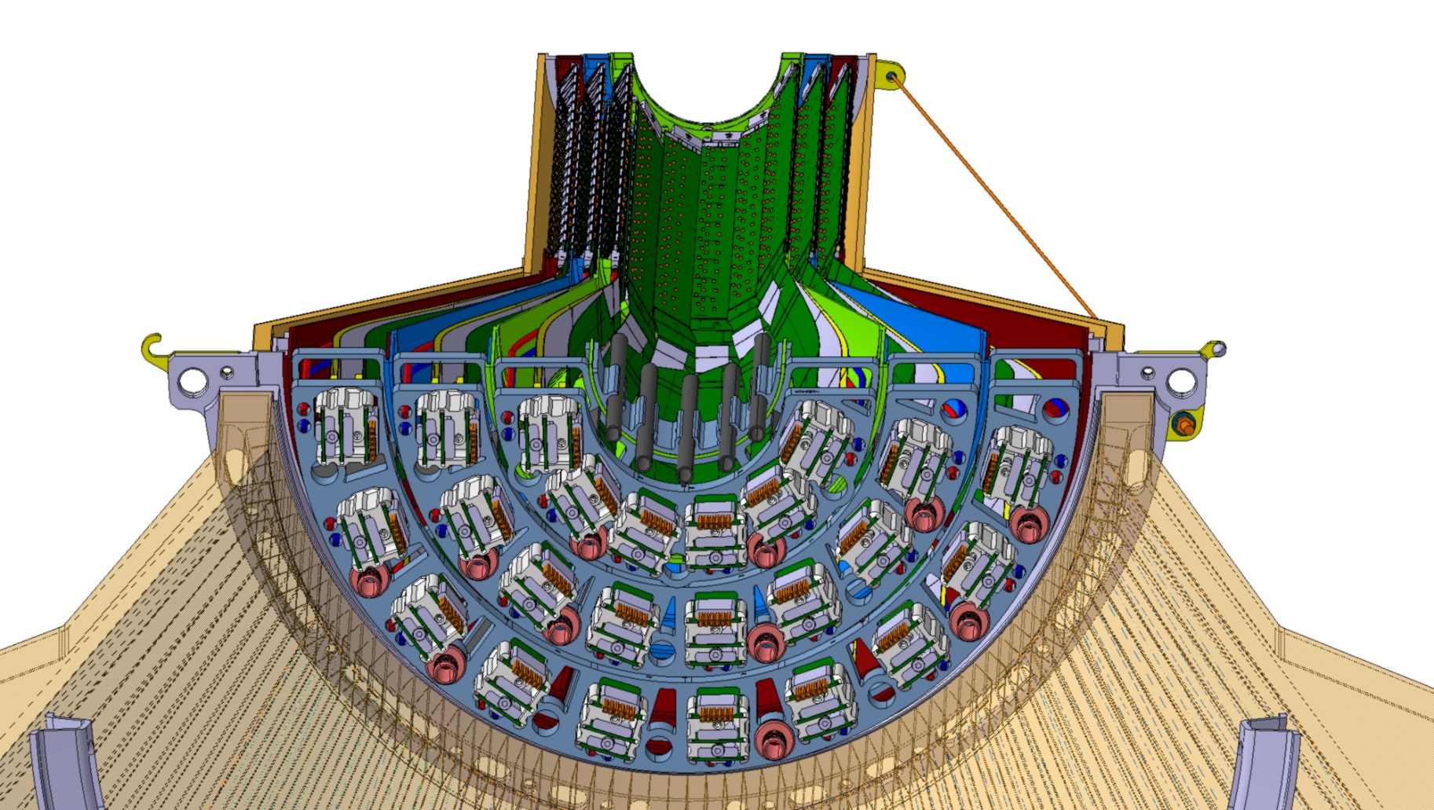
ALICE inner tracker end-on view:
NOTE: 15 dry air cooling lines:
5 + 2in inner layer
4 layer 1
5 layer 2

Slide 22
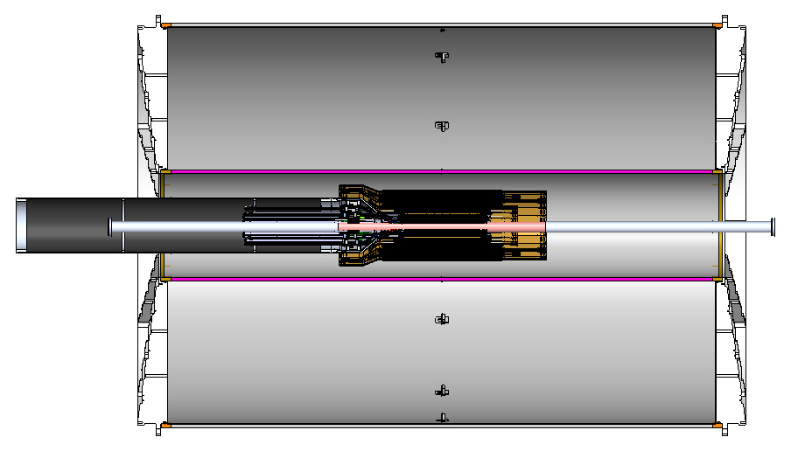
TPC-INTT-MVTX detectors, section view 11-19-2018
1200 mm service tube may not be long enough to locate second cable patch panel where service tube will be supported from, inner HCAL, inner tube for the INTT -

Slide 23
New two layer INTT configuration 1-15-2019

Slide 24
sPHENIX tracking acceptance into TPC

Slide 25
Using rail system for installation;

Slide 26
Proposed tasks:
Continue work on CAD model with MIT engineers and designers;
  Details for layers
    Detailing composite and non-composite pieces
    Verify layers integrate with each other as well as outer shell/service barrel
  Update jigs for assembly of layers
  Service barrel and patch panel 2
  sPHENIX beam-pipe support
    How far to move Conflat flange in Z at end of Aluminum section
Integration and detector support

