Slide 1
Probing Quark-Gluon Plasma with Bottom Quark Jets at sPHENIX
20170073DR
Ming Liu for the
sPHENIX LDRD Team
02/14/2019

Slide 2
Agenda for Today
Introduction 8:00-8:10AM LDRD office
Project overview and achievements 8:10 – 8:30AM Ming Liu (P-25)
Experimental highlights and plan 8:30 – 9:00AM
  Sensor and readout (10+5’) Sho Uemura (P-25)
  Mechanical system (10+5’) Walt Sondheim (P-25)
Theoretical highlights and plan 9:00 – 9:30AM
  Overview of theory (15+5’) Ivan Vitev (T-2)
  Simulations highlights (7+3’) Boram Yoon (CCS-7)
Transition plan 9:30-9:50AM Cesar da Silva (P-25)
Committee meeting 9:50 – 10:30AM

Slide 3
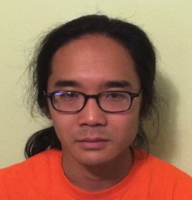
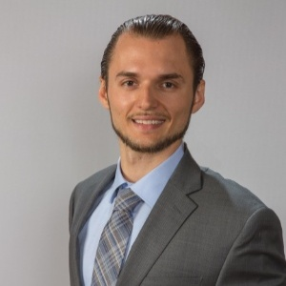








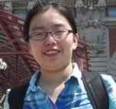
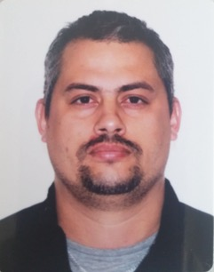

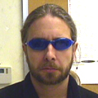
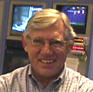
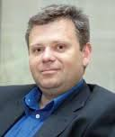
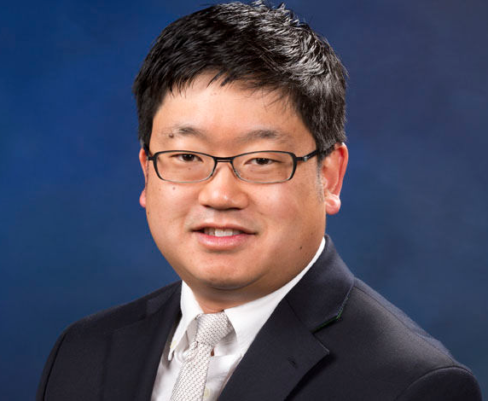
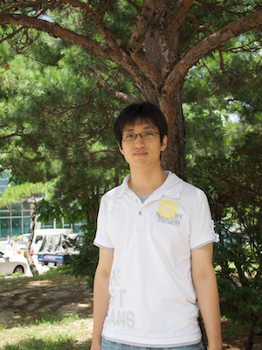


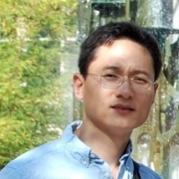

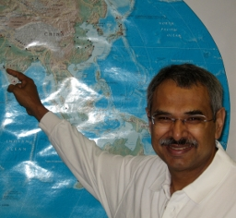


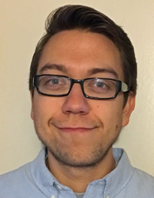
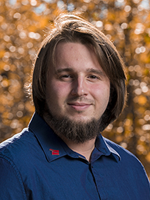
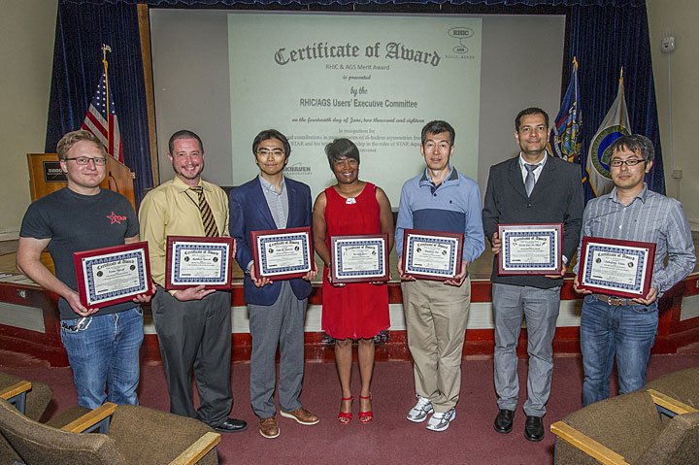
Introduction – The LDRD Team and Effort
Experimental group
  P-25, AOT
  Detector readout and mechanical support R&D
  Detector modeling and simulations
  Physics simulations
Theoretical group
  T-2, T-5, CCS-7
  Physics modeling & simulations
Budget: 1.6M/Year, FY17-19
  1/3 on experimental T&E
  1/3 on theoretical T&E
  1/3 on Hardware & M&S

Slide 4
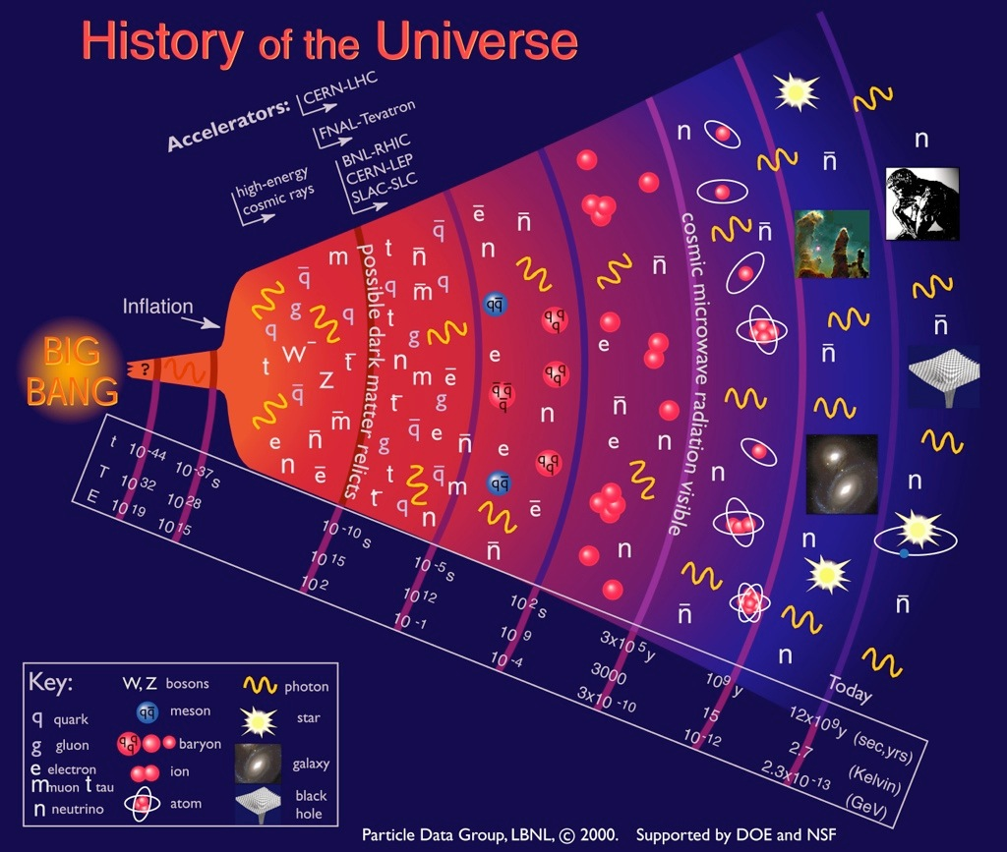
Quark-Gluon
Plasma (QGP)
Earliest stage of the universe that can be explored in detail in the laboratory

Slide 5

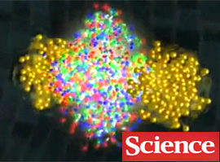
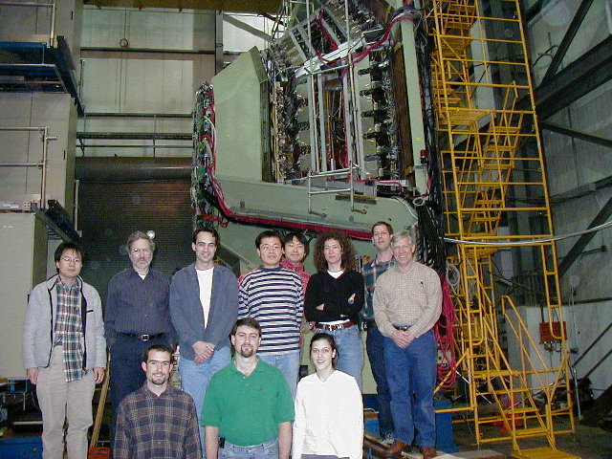
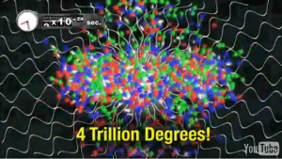
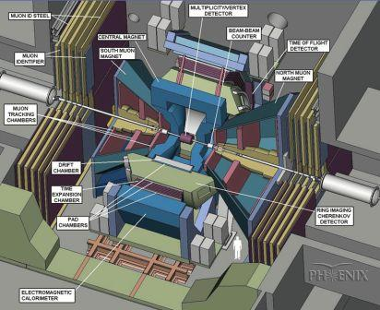
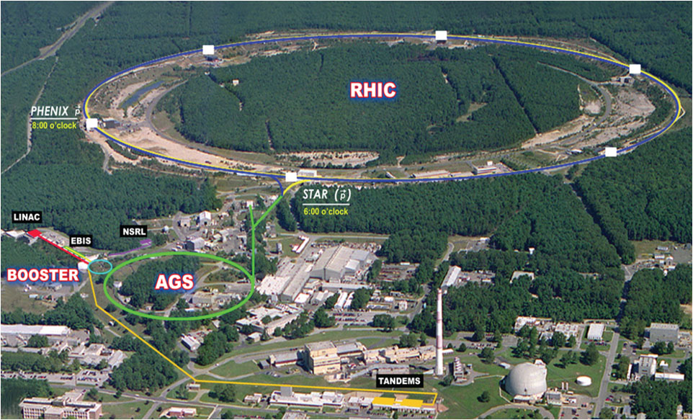
Discovery of QGP at the Relativistic Heavy Ion Collider
QGP created in Au+Au collisions @RHIC
Strongly coupled near perfect liquid!
LANL’s major roles @PHENIX experiment
  Muon Spectrometers (1990’s - 2016)
  Multiplicity vertex detector (1990s - 2004)
  Forward vertex detector upgrade (2007 - 2016)
QGP discovery announced in 2004 by 4 RHIC experiments, PHENIX, STAR, BRAHMS, PHOBOS
Confirmed later at LHC
PHENIX:
Mission completed in 2016
Upgrade path – sPHENIX @RHIC
Circa Year 2001
FVTX
LANL led
muon tracker
PHOBOS
BRAHMS

Slide 6
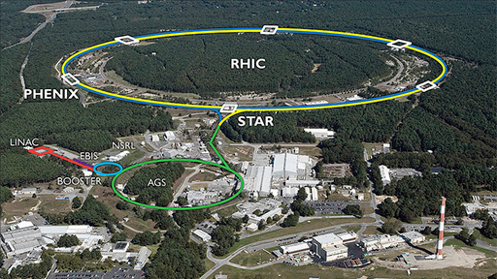

Bring Big Science to LANL – sPHENIX at RHIC
LANL’s NP program:
PHENIX: 1990s – 2016
sPHENIX: 2016 – 2027+
Electron Ion Collider: Next frontier
sPHENIX – the next US NP flagship heavy ion physics program, to study “the inner workings of QGP” (DOE/NP LRP2015)
  Granted CD0 9/2016; CD1 8/2018; PD2/3 scheduled 5/2019
  Construction 2019 – 2022; Physics runs: 5+ years
This LDRD allows LANL to take a leadership role in sPHENIX and be a key player in the Heavy Ion physics frontier
  Innovation: develop a new open heavy flavor physics program, identified as the 3rd Science Pillar of the sPHENIX experiment
  Bring new state of the art technical capability to LANL applied program, also future EIC program

Slide 7
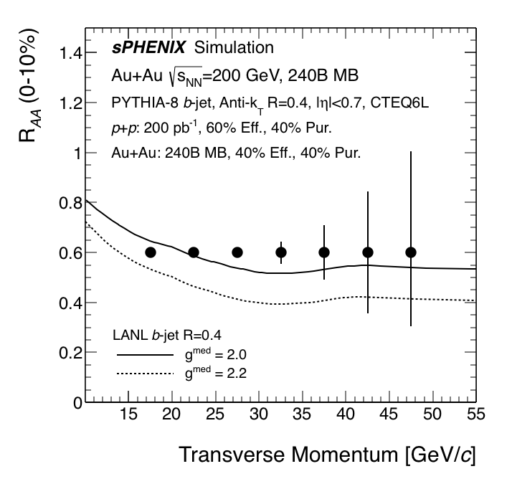
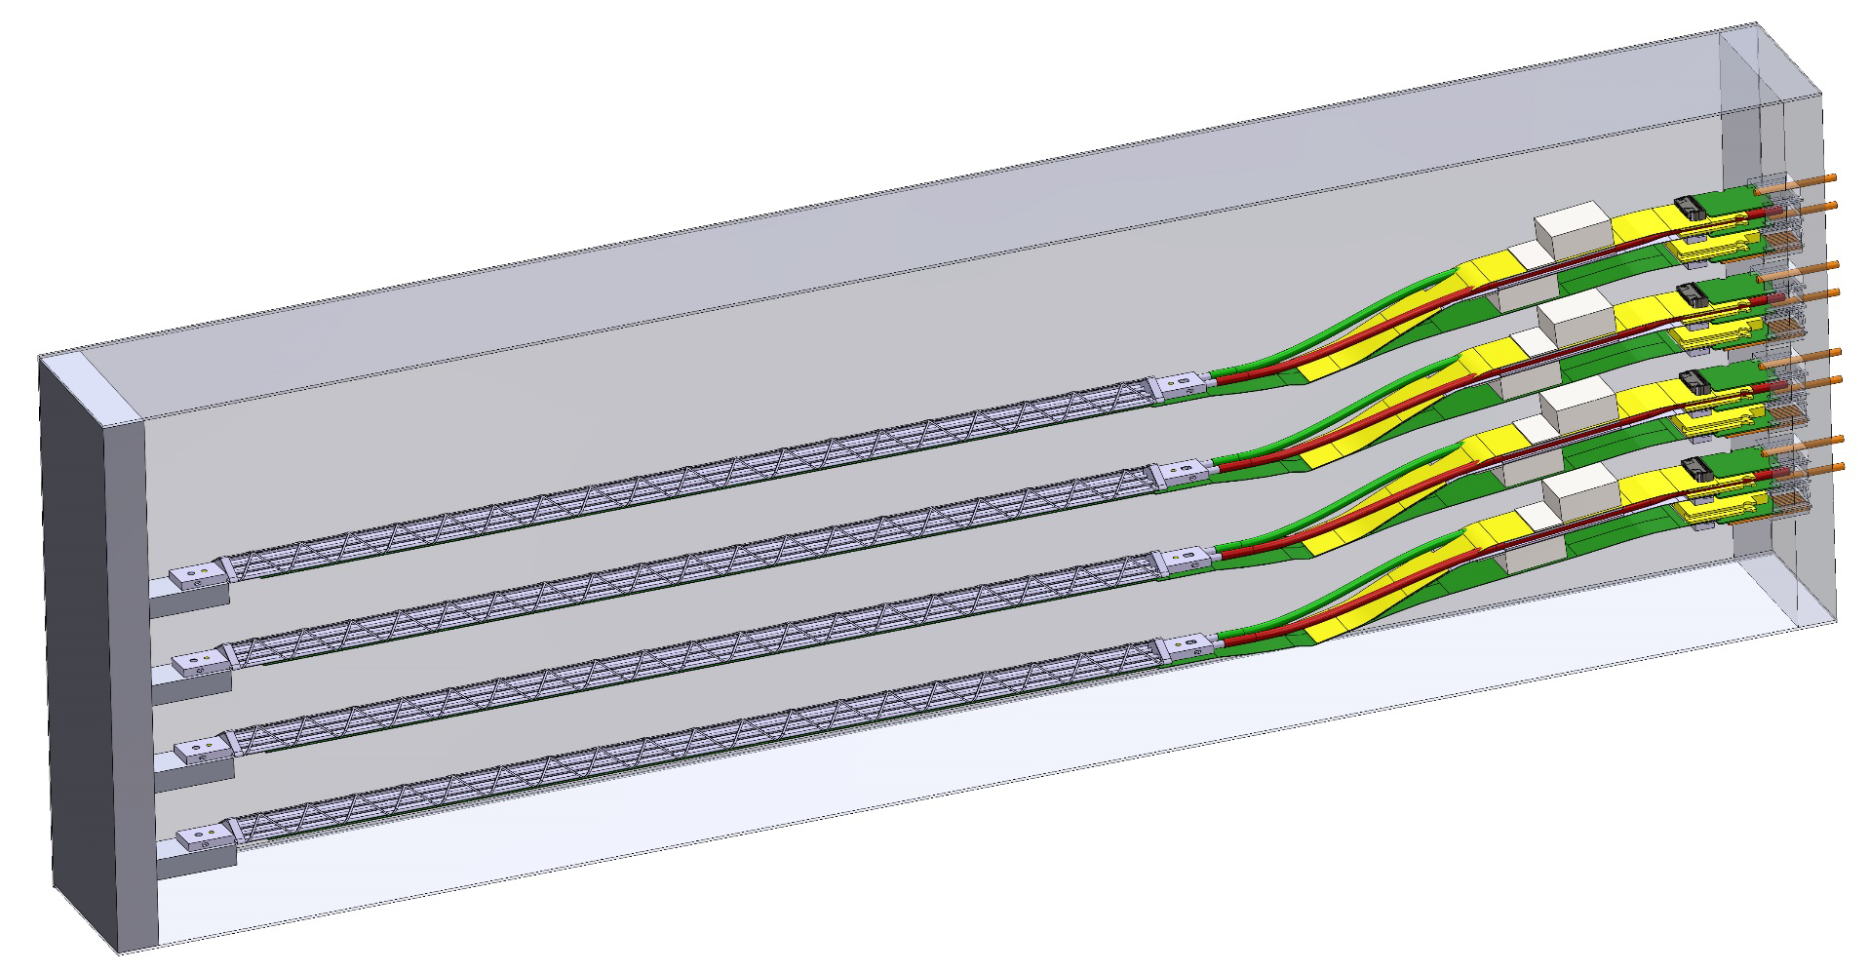
LDRD Scientific & Technical Goals
Develop a next generation QGP physics program with heavy quark jets at RHIC with full detector and physics simulation and modeling
New theoretical study of QGP tomography with b-jets
Carry out key detector R&D to demonstrate the open heavy flavor physics capability in the sPHENIX with MVTX
Develop a proposal to DOE to build a state-of-the-art MAPS-based Vertex Detector for the sPHENIX
MVTX Telescope
Proposal submitted 2018

Slide 8
LDRD Project Scope and Status
Established at the beginning of this project feasibility review 1/2017
Minimal scope
  Develop a MVTX prototype telescope with 2-4 early prototype ALPIDE sensors/staves with ALICE readout units, complete sPHENIX DAQ integration
  Complete R&D on mechanical conceptual design, sPHENIX system integration
  Develop b-jet tagging algorithms for p+p and Au+Au
  DOE MIE proposal submitted to fund the full detector construction
  Complete b-jet theory for precision tomography of QGP with sPHENIX
Stretched scope
  Develop a full 4-production-staves MAPS telescope, test beam run with integrated sPHENIX DAQ
  DOE MIE proposal approved for the full detector construction

Slide 9
sPHENIX Detector Design Today

Slide 10
LDRD Highlights
MVTX Sensors, Readout and Control System Developed
Sho’s Talk
Demonstrated full high-speed readout chain at Fermilab test beam in March 2018
  Sensors + RU + FELIX + RCDAQ/sPHENIX

Slide 11
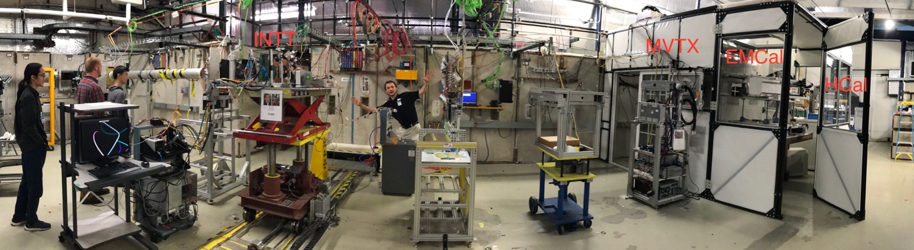
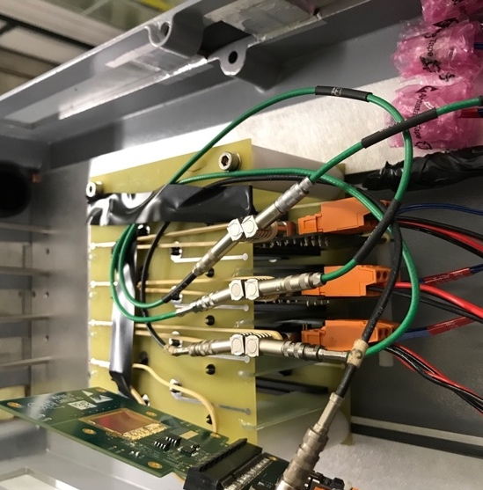
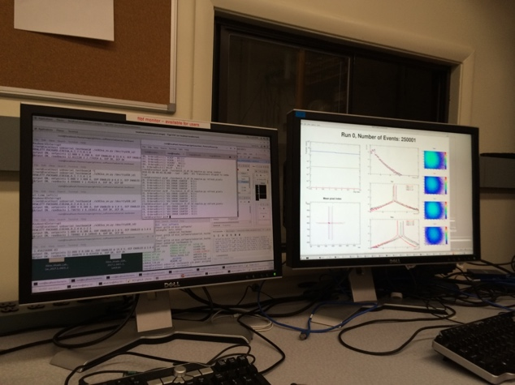
MVTX R&D Success: 2018 Fermilab Test Beam Highlights
INTT
MVTX EMCal HCal
FY2018 Fermilab Test beam facility, with other sPHENIX subsystems. Alex, Sanghoon, Darren, Sho, photographed by Ming
Track spatial resolution: ~5 um
High hit efficiency: > 99.5%
4-sensor MVTX
telescope
Online Control
& Monitoring

Slide 12
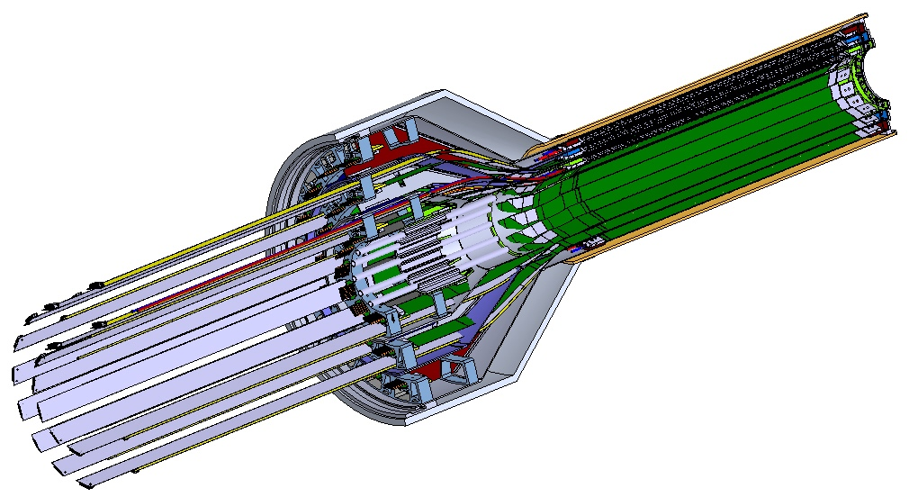
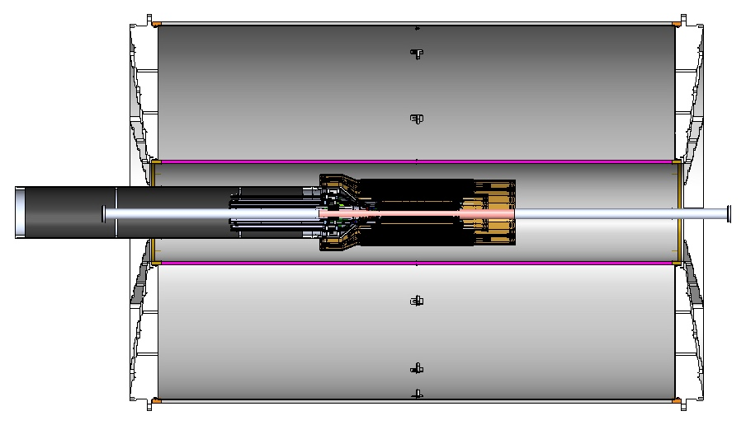
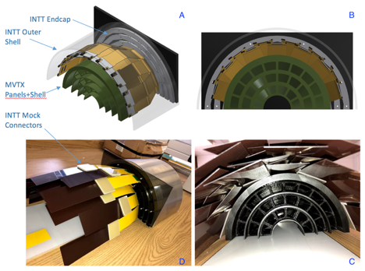
Mechanical System – Completed Conceptual Design
a new MVTX stave design with 40cm extended power FPC
Walt and Sho’s talks
Service Barrel
TPC
INTT
3D model and mockup
MVTX
PP-2:
Signal and power cables
PP-1b:
power cables
PP-1a:
short signal cables
12/7/18

Slide 13
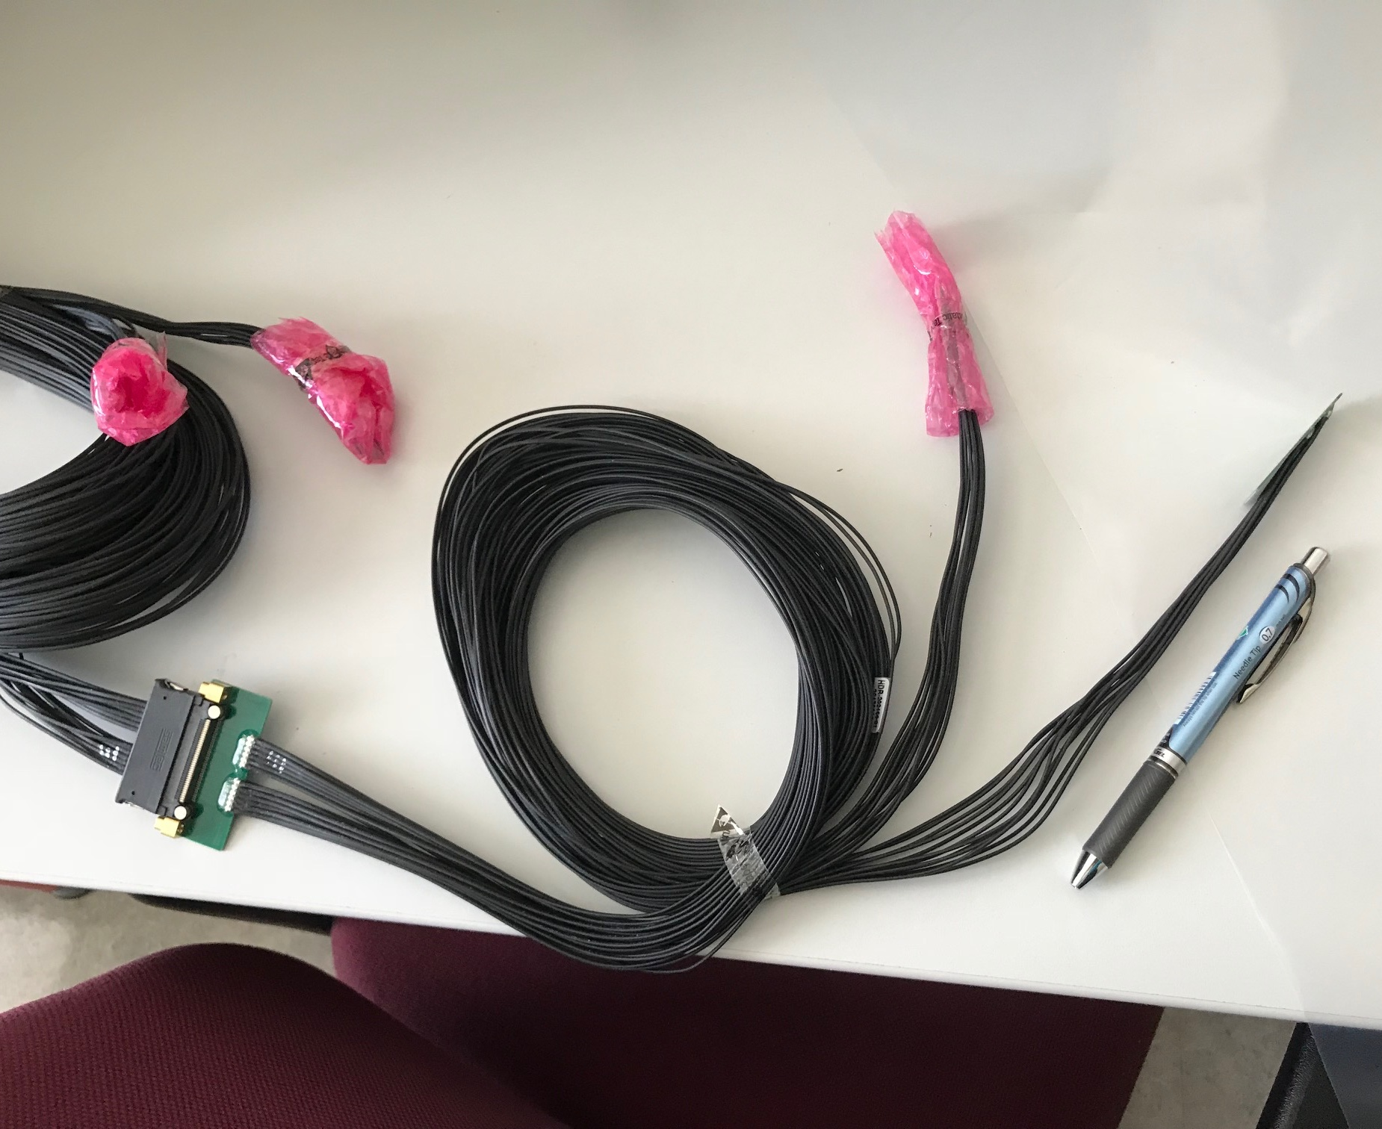
MVTX Readout and Power Cable Rout
Sho & Walt’s talks
ALICE ITS/IB readout cables: ~8m
Cable-B: 6.8m
Cable-A: 1.2m
PWR
RU
PU
sPHENIX MVTX: 7.9+m
  Cable-A: 1.4 m
  Cable-B: 6.5+ m
  Power cable:4.7+ m
On-going R&D for ~10m
BNL has approved “non-halogen free” cables for sPHENIX

Slide 14
Address Recommendations from last Appraisal
“Recommendation 1: Testing should be carried out with the 10m cables. The project recognizes the issue of cable lengths with the readout system, and we encourage the team to identify the maximum length that can be used (7, 9, 11 m) to ensure that unforeseen integration issues in sPHENIX do not create obstacles to their use. This is likely the highest risk in the detector development part.
- R&D in progress, don’t expect major issues, SamTec blue cables for sPHENIX; (Sho)
Recommendation 2: The project had reached many milestones ahead of schedule and is proposing several enhanced goals. We advise the group to prioritize these to maximize the impact on the field (particular for theory).
- Pursuing stretched goal of 4-stave telescope, beam test planned for May 2019; (Sho)
- New theoretical development (Ivan)
Recommendation 3: In regard to the transition, we advise that the LDRD leadership explore ways to keep the knowledge within the group in order to make the MVTX sPHENIX project successful. The expertise also needs to be maintained for the ~5 year execution of the experiment, although possibly at a reduced level.
- Need more help from management to retain talents in the group;
- New hires of two postdocs – one ITS expert, one highspeed electronics expert; staff training for MVTX;
Recommendation 4: It would be interesting to incorporate dynamical screening effects into these calculations, in addition to Debye screening effects.
- New theoretical development; (Ivan)

Slide 15
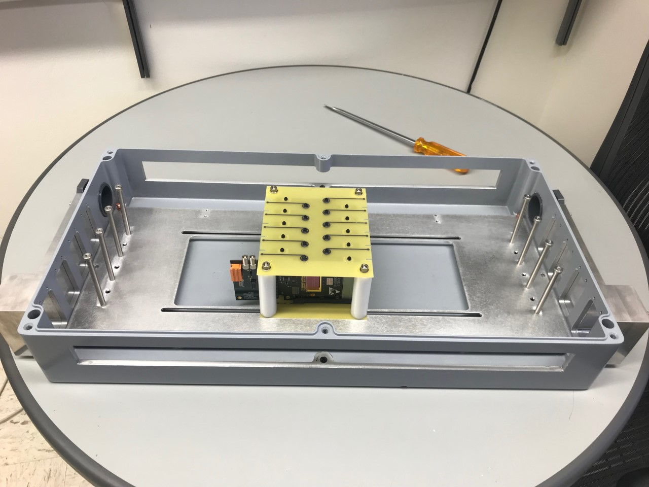
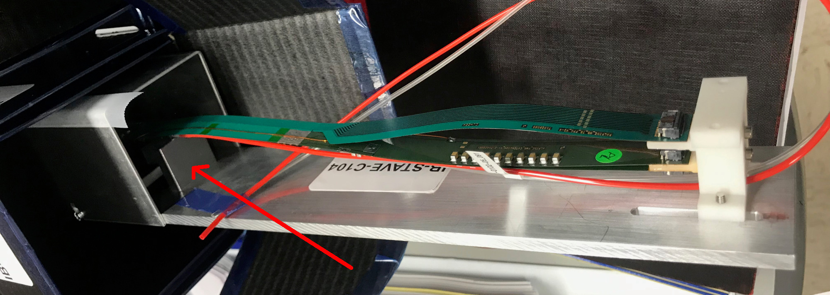
Detector R&D Tasks for FY19
MVTX prototype telescope beam test at Fermilab
  Full readout chain with staves
  Cooling, tracking etc.
  Test beam planned for May, with sPHENIX INTT
SamTec cables
  AWG30, ~10m blue cables
ALPIDE sensor characterization and optimization
  Readout and trigger optimization for sPHENIX
  Laser system setup in preparation
4-stave Telescope
Final staves @LANL

Slide 16
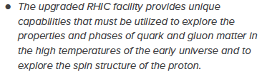

Mission Impact
NSAC Long Range Plan 2015
This project directly contributes to the LANL NPAC (Nuclear, Particle, Astrophysics and Cosmology) and DOE Nuclear Physics program, expand the leadership of LANL at national & international level:
High impact on national big science program
  sPHENIX and EIC
Define the directions for LANL basic science and applied programs
  Long-term DOE NP program
  New hires - Xuan, Sho, Yasser, Cameron (P-25), Alex(COMPA), also in theory groups
  Other LANL hires - Mike(XCP), Darren(XTD)
  DOE Early Carrier Award, Cesar
  Application to LANL applied program, safeguard and space program etc.
New proposals being developed
  for EIC based on MAPS technology
  X-ray imaging with MAPS
Recommendation #1 (RHIC):
Recommendation #3 (EIC):
The highest priority in this 2015 Plan is to capitalize on the investments made.
LDRD
sPHENIX
EIC
2015
2020
2025
2030

Slide 17
Transition into DOE sPHENIX MVTX Program
Cesar’s talk
MVTX approved by DOE and BNL, funded through RHIC Operation
  DOE provides $1.4M to produce 84 staves and 60 RUs through US-ALICE, addon to the ALICE mass production
  MVTX system design and construction in progress, ~$5M
As a result of this LDRD, we expect to have:
  Long term DOE NP support on sPHENIX heavy ion heavy flavor physics program
  Long term DOE support for theoretical effort
In the remaining ~7 months of this project, we will actively work with the sPHENIX MVTX group to make smooth transition:
  The full MVTX detector design and construction
  Ready for day-1 physics in 2023

Slide 18
Summary
Established the 3rd science pillar for sPHENIX, new open heavy flavor physics program with MVTX upgrade, approved by DOE and funded through BNL
New theoretical tools developed for QGP study, for RHIC and LHC
Met all LDRD milestones, some ahead of time
Broad impacts on NP and other programs
In transition into DOE supported sPHENIX program
On track to meet all goals for FY19

Slide 19
Backup slides

Slide 20
sPHENIX Status and Plan
MVTX funded
by DOE

Slide 21
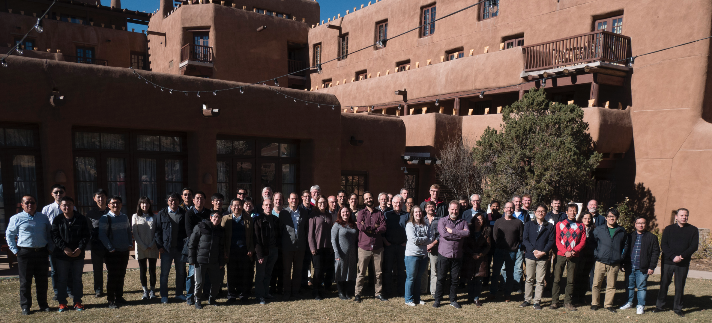
sPHENIX Collaboaration Meeting at Santa Fe, 12/2017

Slide 22
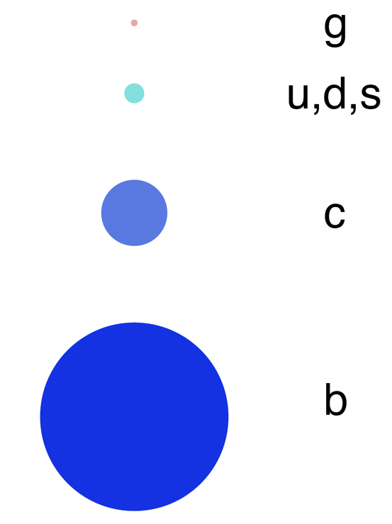
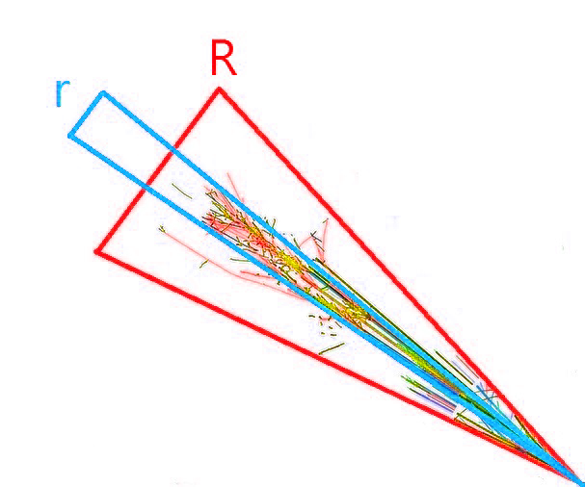
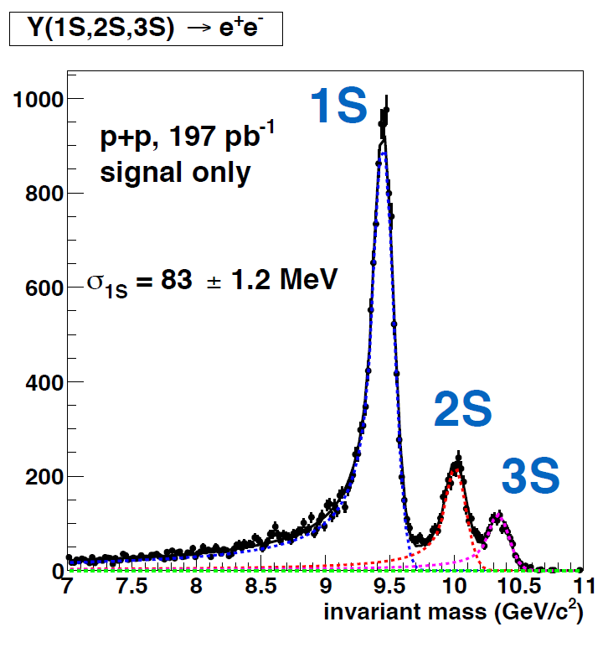
Three Science Pillars for sPHENIX
Jet cor. & substructure
Upsilon spectroscopy
Size of the probe
Parton energy loss & cor.
mass dependent
ϒ(3s)-0.78fm
ϒ(2s) – 0.56fm
ϒ(1s) – 0.28fm

Slide 23
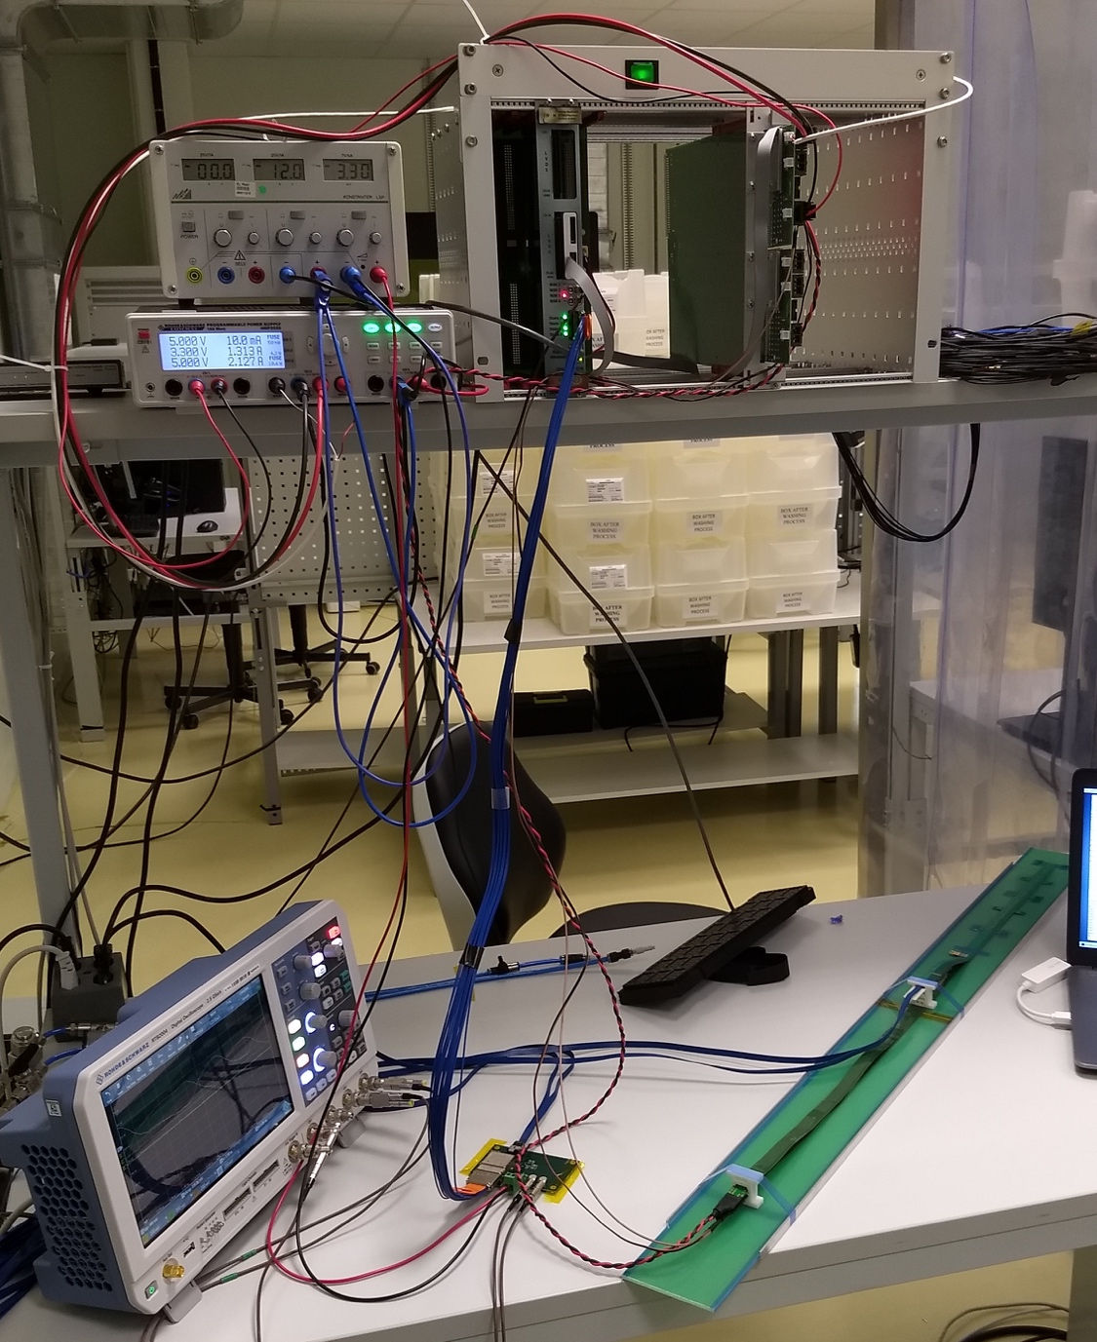
Confirmed HIC with Extended 40(60)cm Power FPC
Sho’s talk
Built and tested two HICs at CERN in 9/2018
  No change in sensor performance (noise, threshold) observed, as expected;
Followed identical ALICE IB
QA test procedure at CERN,
with a 8m SamTec cable!
Extended power FPC designed and built at LANL

Slide 24
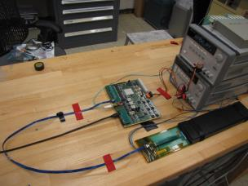
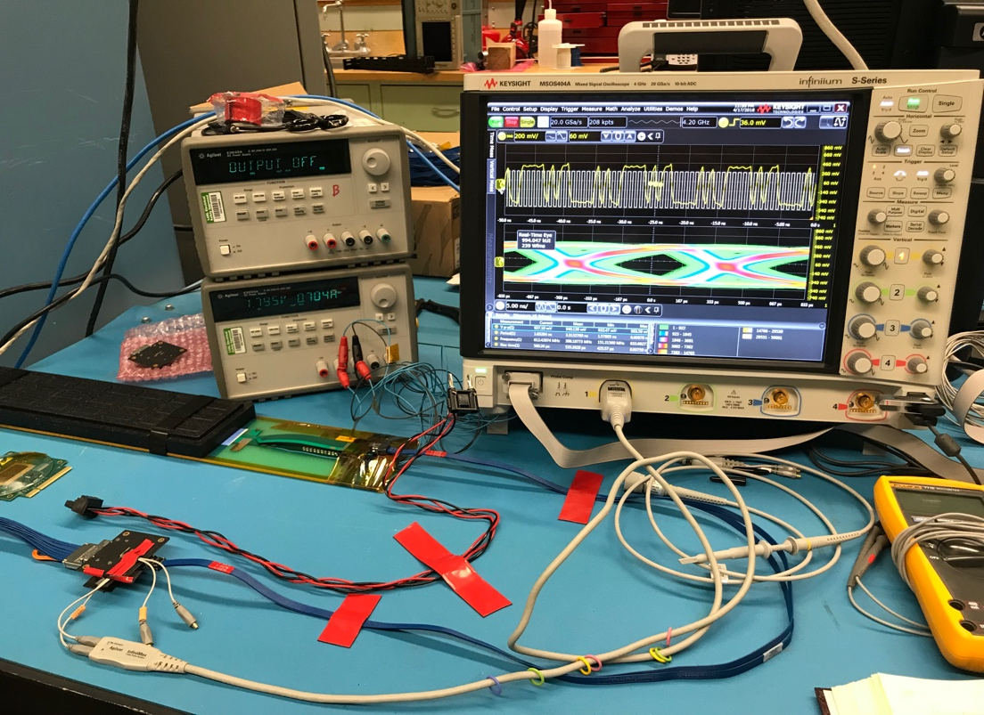
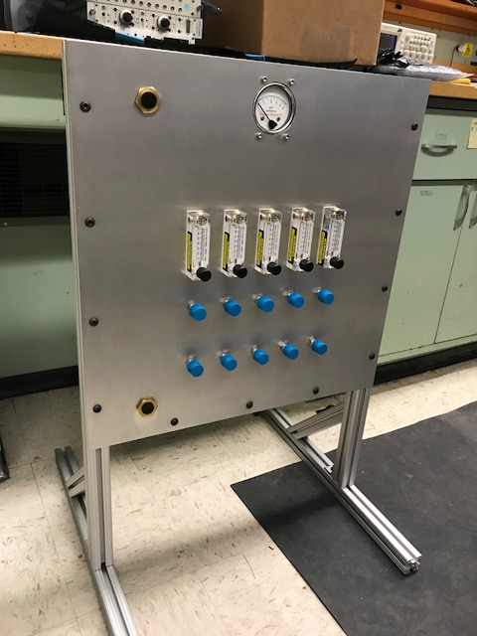
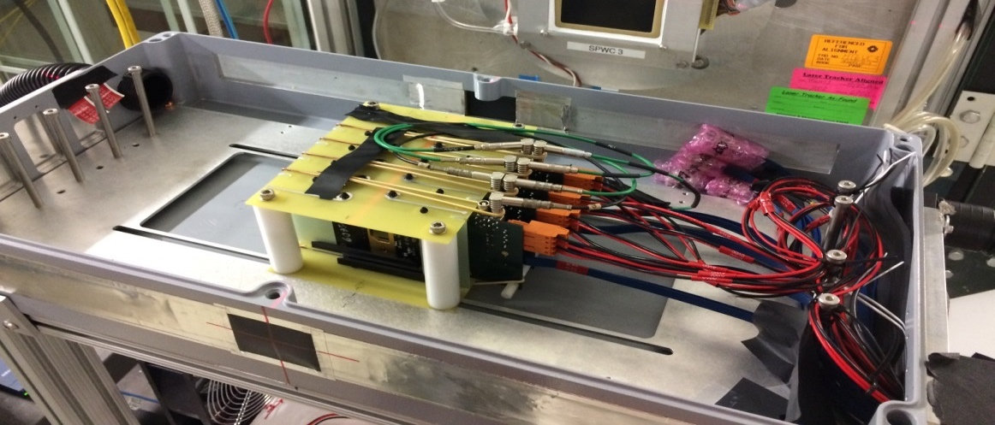
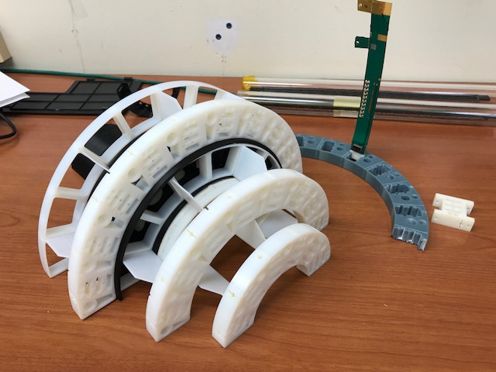
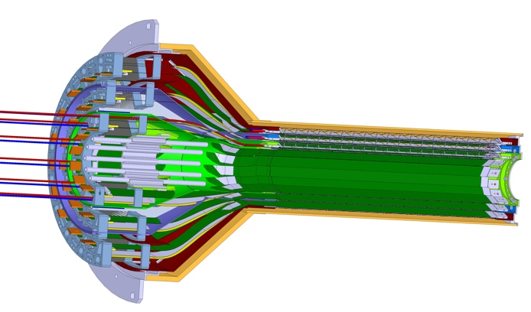
LANL LDRD Activity Highlights
Signal integrity & cables
MAPS evaluation
Readout integration
4-sensor telescope
Test beam at Fermilab
Mechanical & cooling
Readout R&D
RU
Cooling system
prototype
stave
4-ALPIDE Telescope;
5m-long SamTec cables
Service cone R&D
Sensor source test
FPC power extension R&D

Slide 25
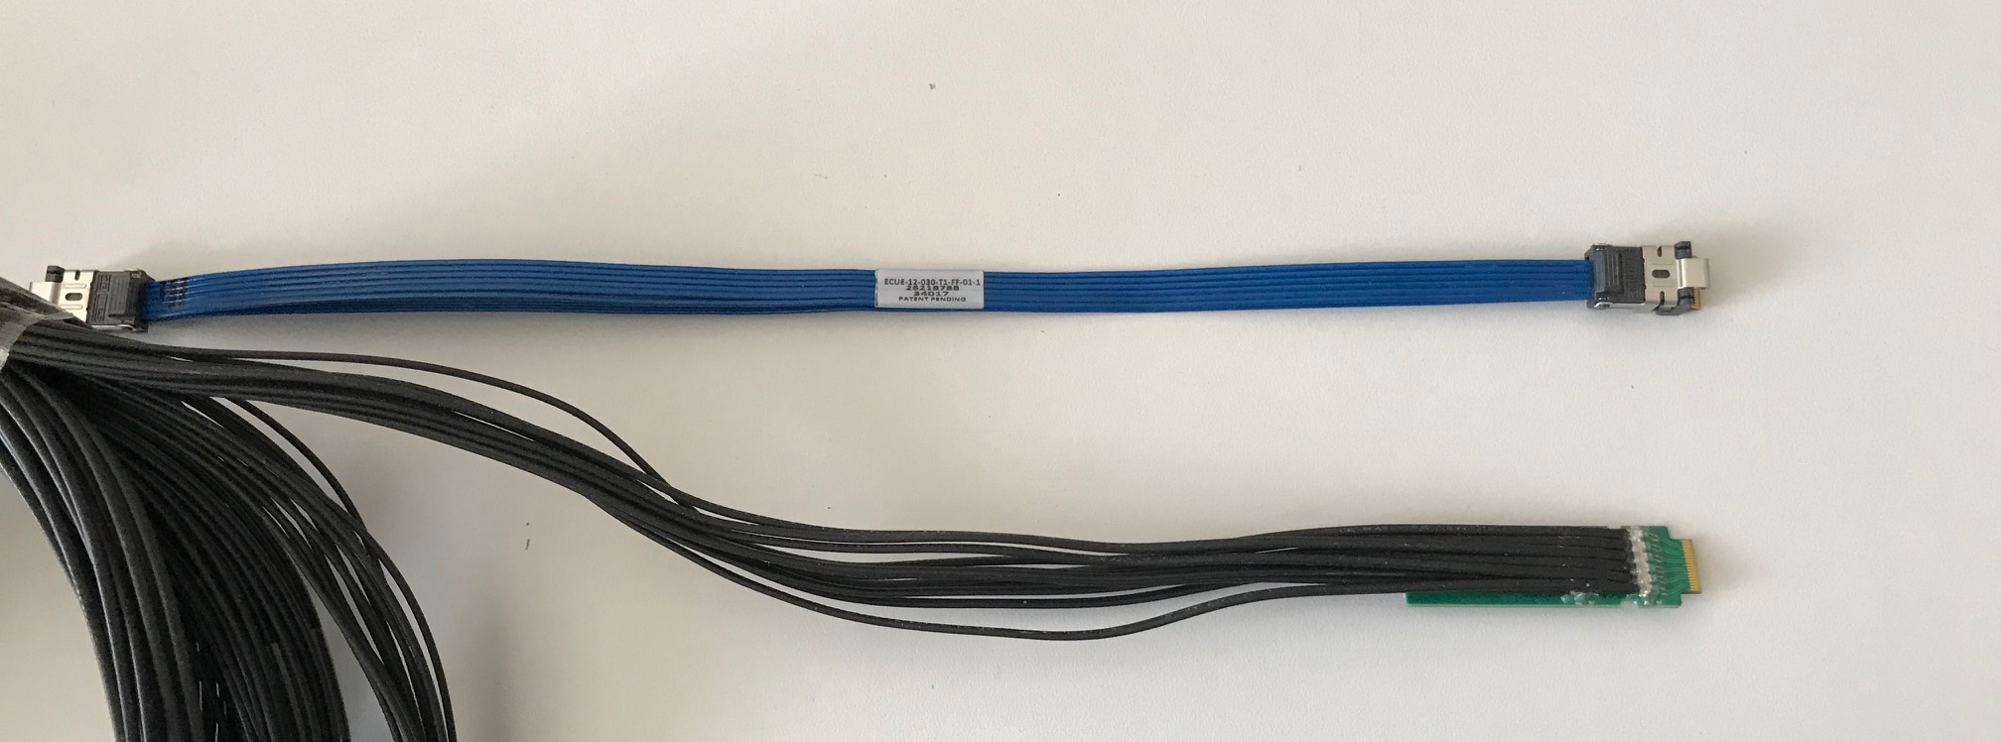
Address July MVTX Review Recommendations
https://docs.google.com/document/d/1vsm_G7ZLgqv-kBZqK0jF69T_Nx2Uwk0Zxv86jRVxybw/edit?usp=sharing
Stave and RU procurement readiness review
Completed sensor/HIC/stave evaluations at CERN
  Built and tested two HICs with 40cm and 60cm long power FPC
    Confirmed sensor performance same as the ALICE default configuration
  Sensors irradiated up to 2.7MRad, no issues (updated 9/18/2018).
Addressed all recommendations on stave/sensor R&D
Cost are set for staves/RU, UTK has started procurement paperwork
  Technical specs document completed for production, BNL/DOE agreed
  RU, Staves, sPHENIX production starts ~January 2019, expect to last ~12 months
MVTX/INTT mechanical integration
  Mechanical design being updated and 3-D mockup demonstrated
  Inner tracking task force completed evaluation, preferred INTT-layers ~2
Cables
  BNL approved the use of SamTec blue cables
    Electrically better & mechanically compact
    ALICE confirmed signal performance with 8m long readout cables. For MVTX, 10m very likely works (30AWG/sPHENIX vs 32AWG/ALICE), to be confirmed by on-going R&D
  Samples ordered for system integration mockup and test
Christof’s talk

