Slide 1
Probing Quark-Gluon Plasma with Bottom Quark Jets at sPHENIX
20170073DR
Ming Liu for the
sPHENIX LDRD Team
02/14/2019

Slide 2
Agenda for Today
Introduction 8:00-8:10AM LDRD office
Project overview and achievements 8:10 – 8:30AM Ming Liu (P-25)
Experimental highlights and plan 8:30 – 9:00AM
  Sensor and readout (10+5’) Sho Uemura (P-25)
  Mechanical system (10+5’) Walt Sondheim (P-25)
Theoretical highlights and plan 9:00 – 9:30AM
  Overview of theory (15+5’) Ivan Vitev (T-2)
  Simulations highlights (7+3’) Boram Yoon (CCS-7)
Transition plan 9:30-9:50AM Cesar da Silva (P-25)
Committee meeting 9:50 – 10:30AM

Slide 3
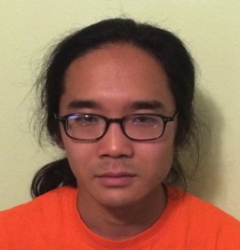
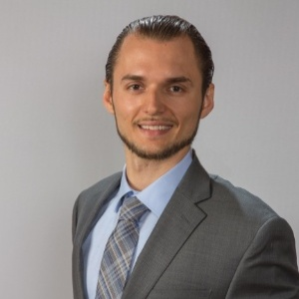


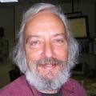





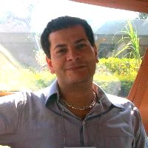
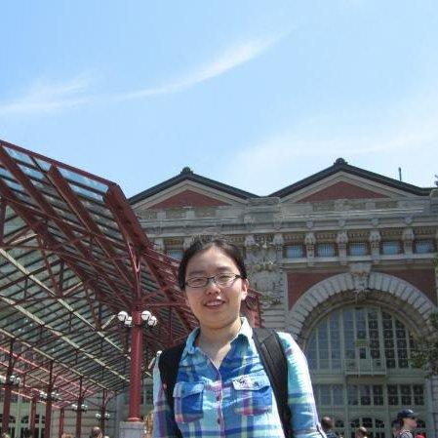
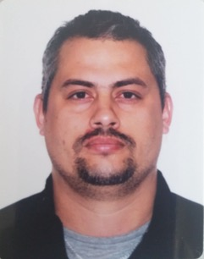

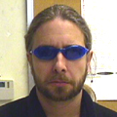
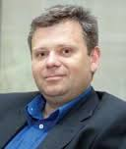
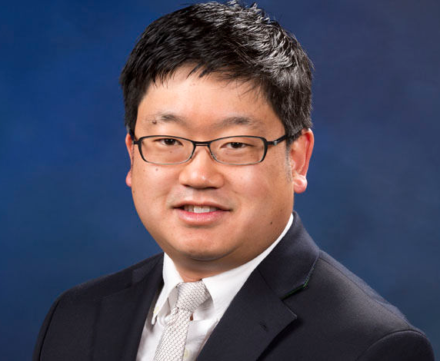
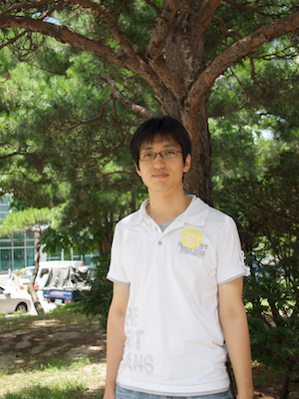
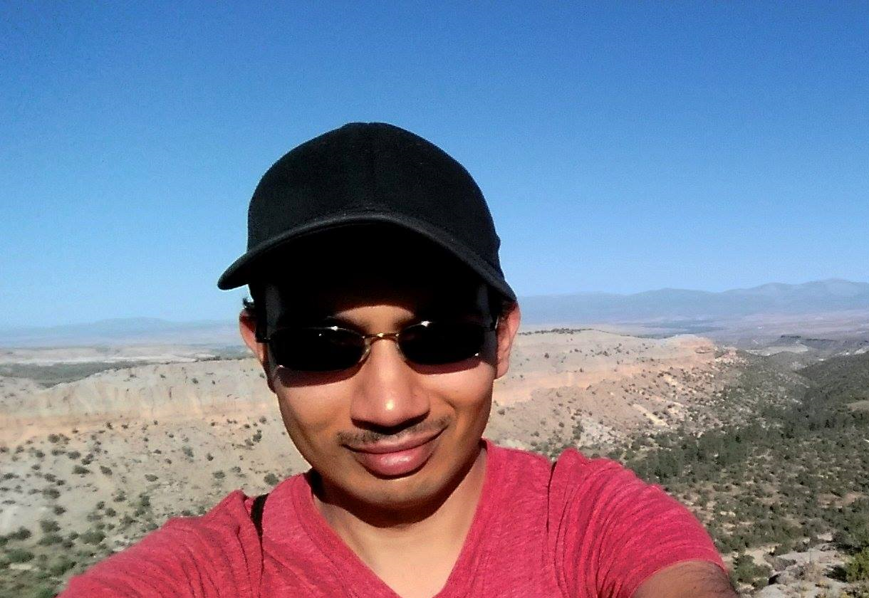
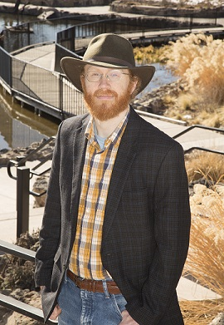
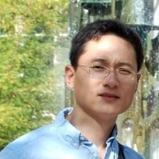
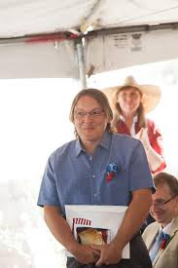
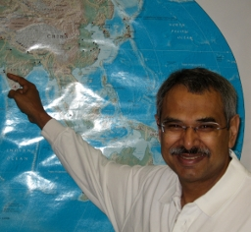
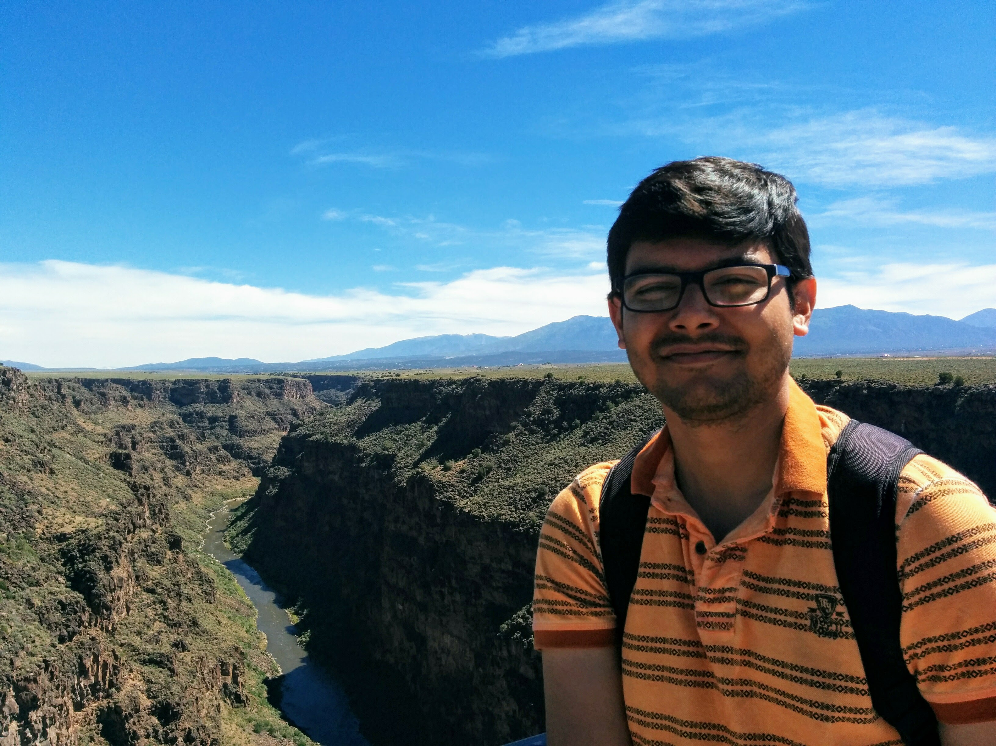
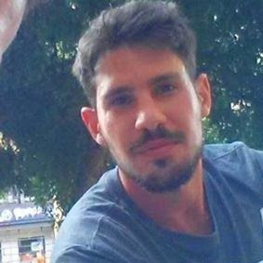
Introduction – The LDRD Team and Effort
Experimental group
  P-25, AOT
  Detector readout and mechanical support R&D
  Detector modeling and simulations
  Physics simulations
Theoretical group
  T-2, T-5, CCS-7
  Physics modeling & simulations
Budget: 1.6M/Year, FY17-19
  1/3 on experimental T&E
  1/3 on theoretical T&E
  1/3 on Hardware & M&S

Slide 4
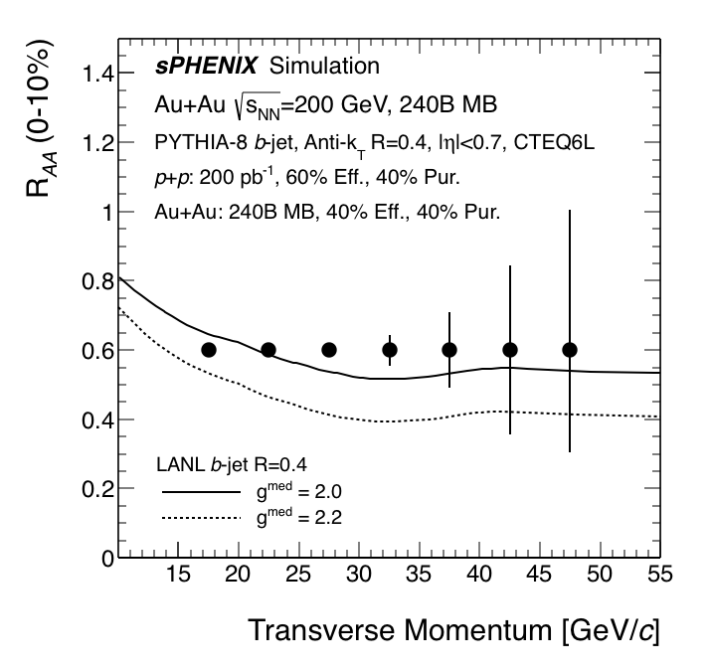
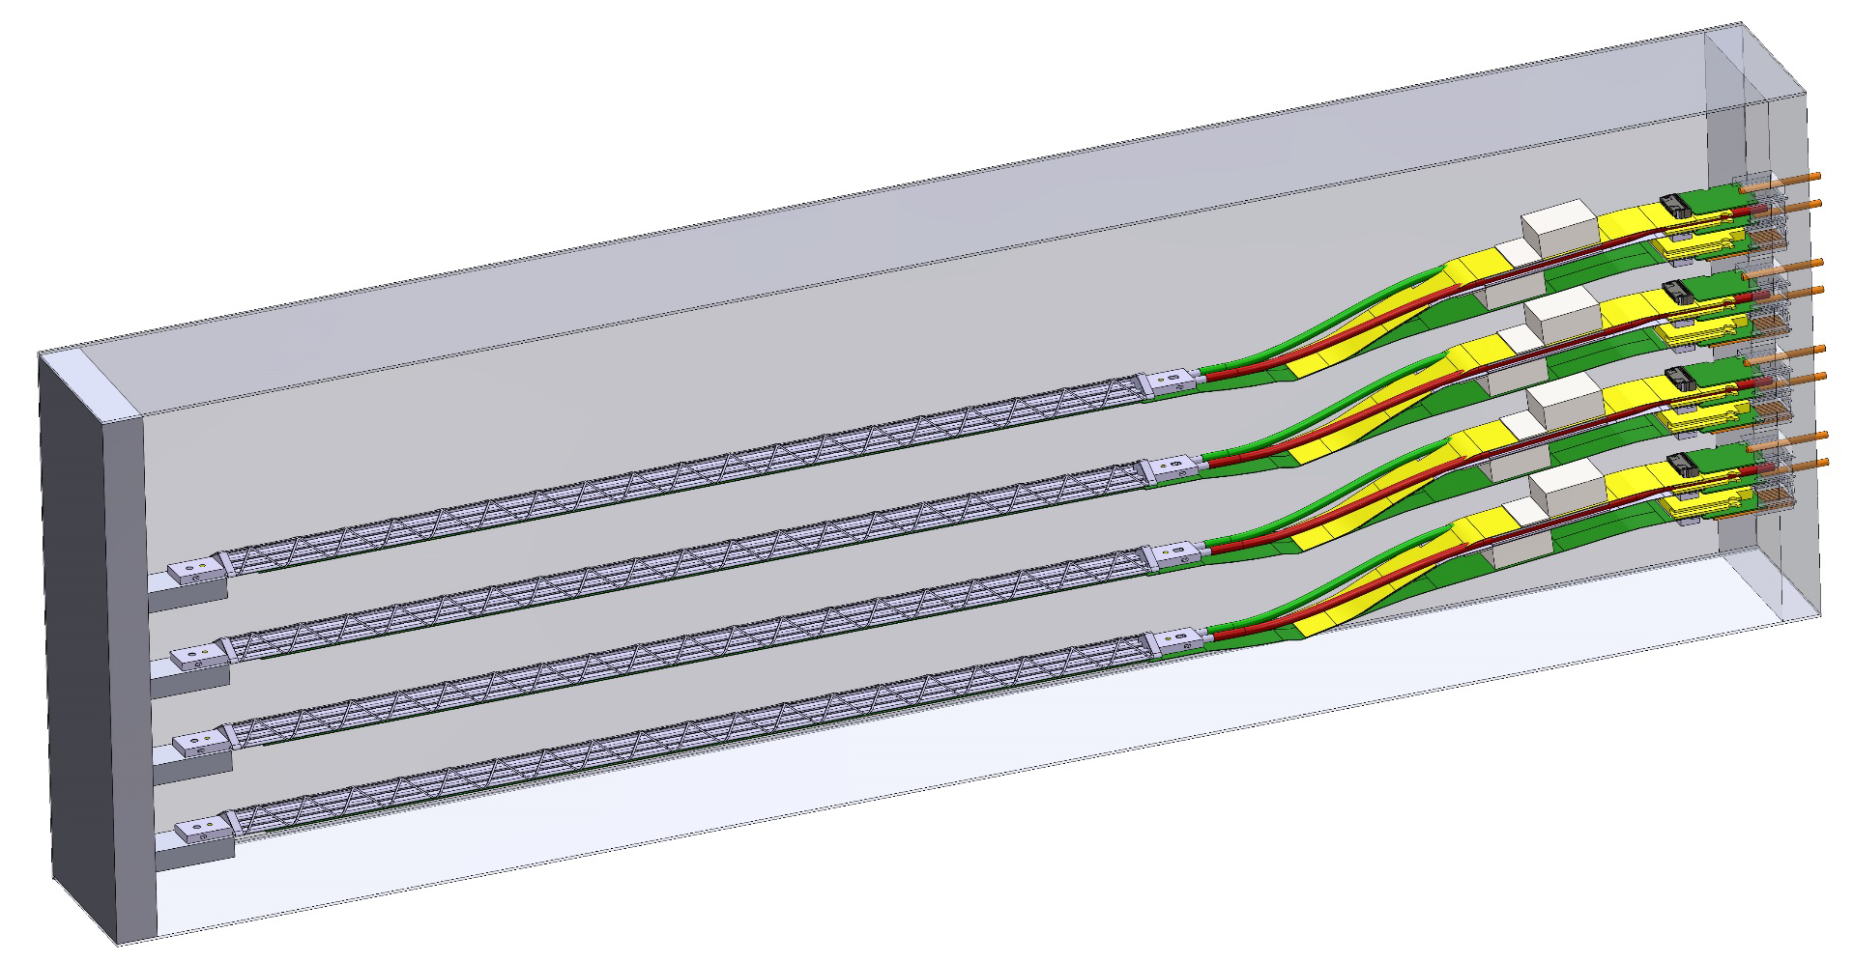
LDRD Scientific & Technical Goals
Develop a next generation QGP physics program with heavy quark jets at RHIC with full detector and physics simulation and modeling
New theoretical study of QGP tomography with b-jets
Carry out key detector R&D to demonstrate the open heavy flavor physics capability in the sPHENIX with MVTX
Develop a proposal to DOE to build a state-of-the-art MAPS-based Vertex Detector for the sPHENIX
MVTX Telescope

Slide 5
LDRD Project Scope and Status
Established at the beginning of this project feasibility review 1/2017
Minimal scope
  Develop a MVTX prototype telescope with 2-4 early prototype ALPIDE sensors/staves with ALICE readout units, complete sPHENIX DAQ integration
  Complete R&D on mechanical conceptual design, sPHENIX system integration
  Develop b-jet tagging algorithms for p+p and Au+Au
  DOE MIE proposal submitted to fund the full detector construction
  Complete b-jet theory for precision tomography of QGP with sPHENIX
Desired scope
  Develop a full 4-production-staves MAPS telescope, test beam run with integrated sPHENIX DAQ
  DOE MIE proposal approved for the full detector construction

Slide 6
LDRD Highlights
MVTX Sensors, Readout and Control System Developed
Sho’s Talk
Demonstrated full high-speed readout chain at Fermilab test beam
  4 Sensors + RU(v1.0) + FELIX(v1.5) + RCDAQ/sPHENIX
Confirmed modified stave design for sPHENIX
Completed preliminary conceptual mechanical system integration in sPHENIX

Slide 7
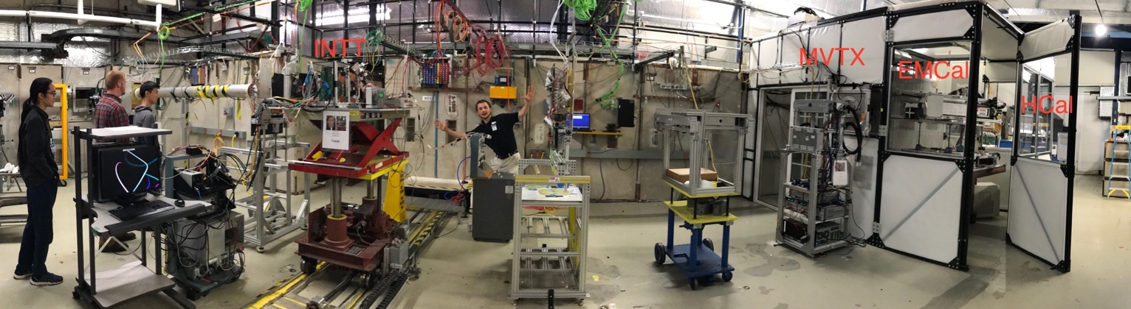
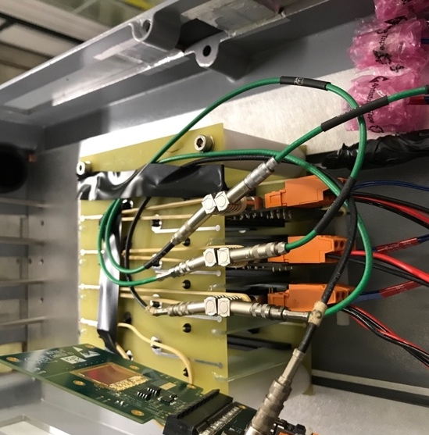
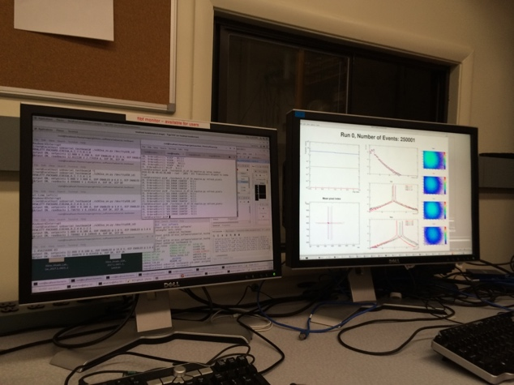
MVTX R&D: Fermilab Test Beam Results from 2018
INTT
MVTX EMCal HCal
FY2018 FermiLab Test beam, with other sPHENIX detector subsystems
Spatial Resolution:
< 5 um
Hit Efficiency:
> 99.5%
Contorl & online
monitoring
4-sensor telescope

Slide 8
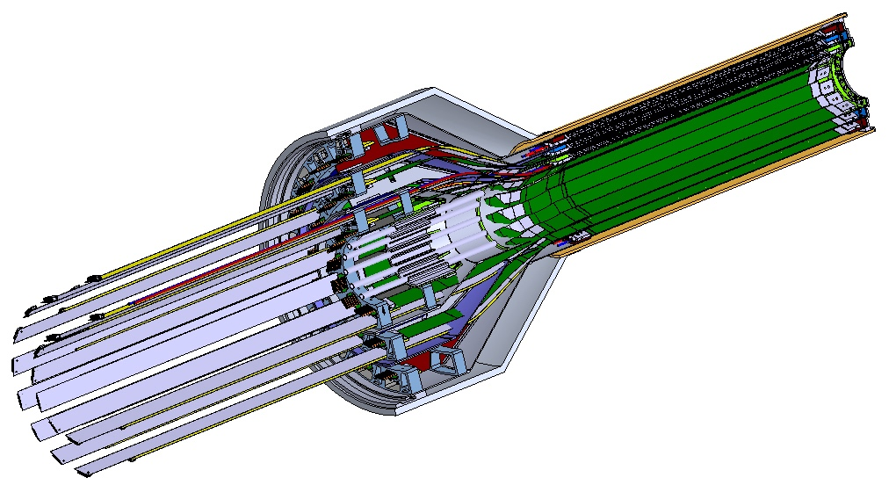
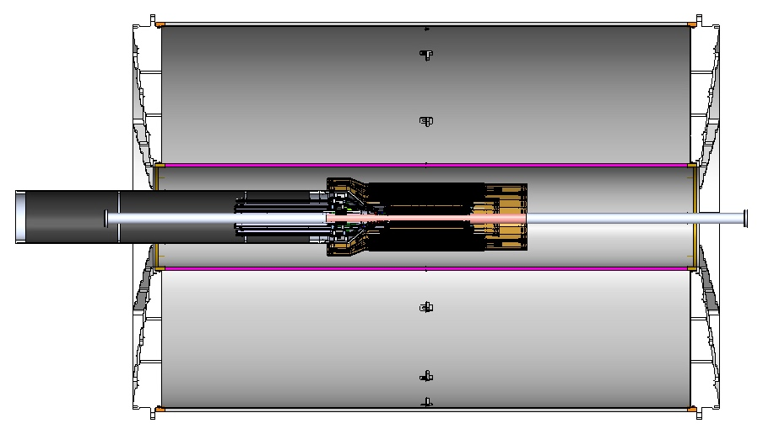
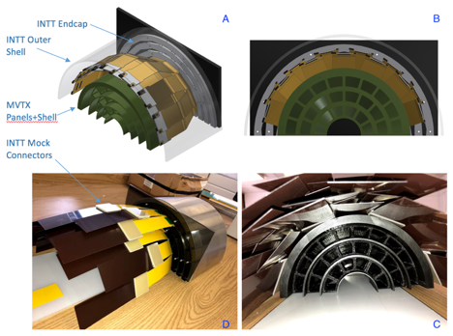
Mechanical System Integration – Stave Modification
a new MVTX stave design with 40cm extended power FPC
Walt’s talk
Service Barrel
TPC
INTT
3D model and mockup
MVTX
PP-2:
Signal and power cables
PP-1b:
power cables
PP-1a:
short signal cables
12/7/18

Slide 9
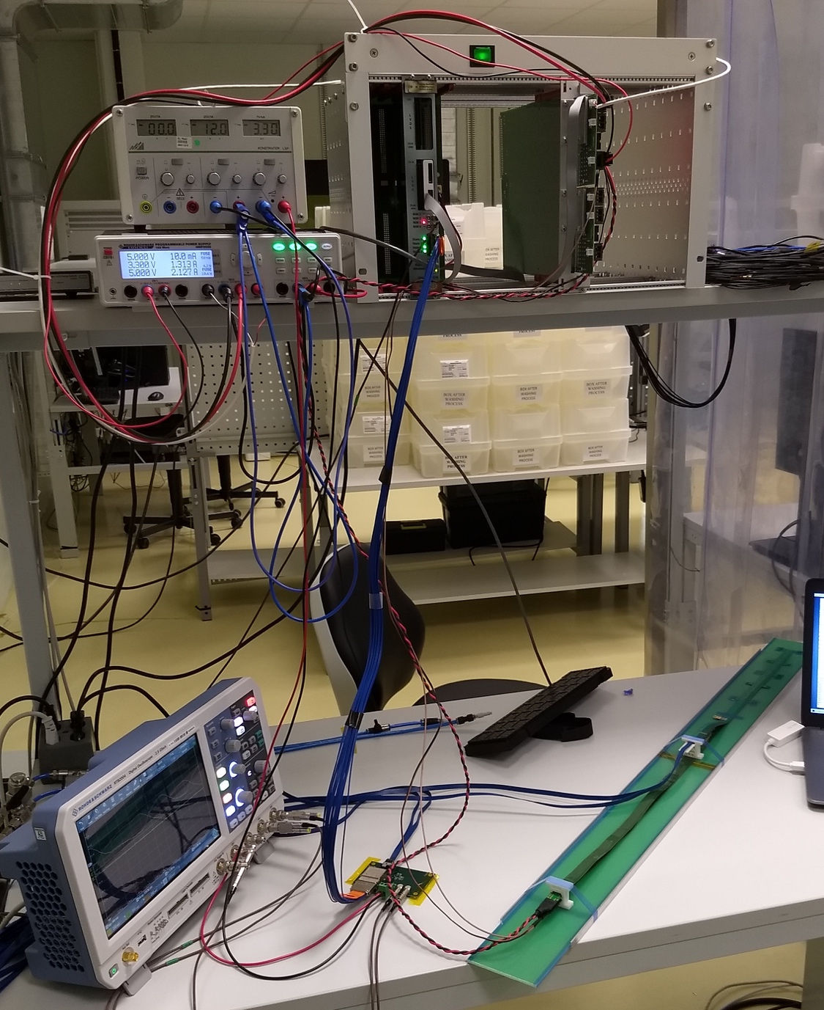
Confirmed HIC with Extended 40(60)cm Power FPC
Sho’s talk
Built and tested two HICs at CERN in 9/2018
  No change in sensor performance (noise, threshold) observed, as expected;
Followed identical ALICE IB
QA test procedure at CERN,
with a 8m SamTec cable!
Extended power FPC designed and built at LANL

Slide 10
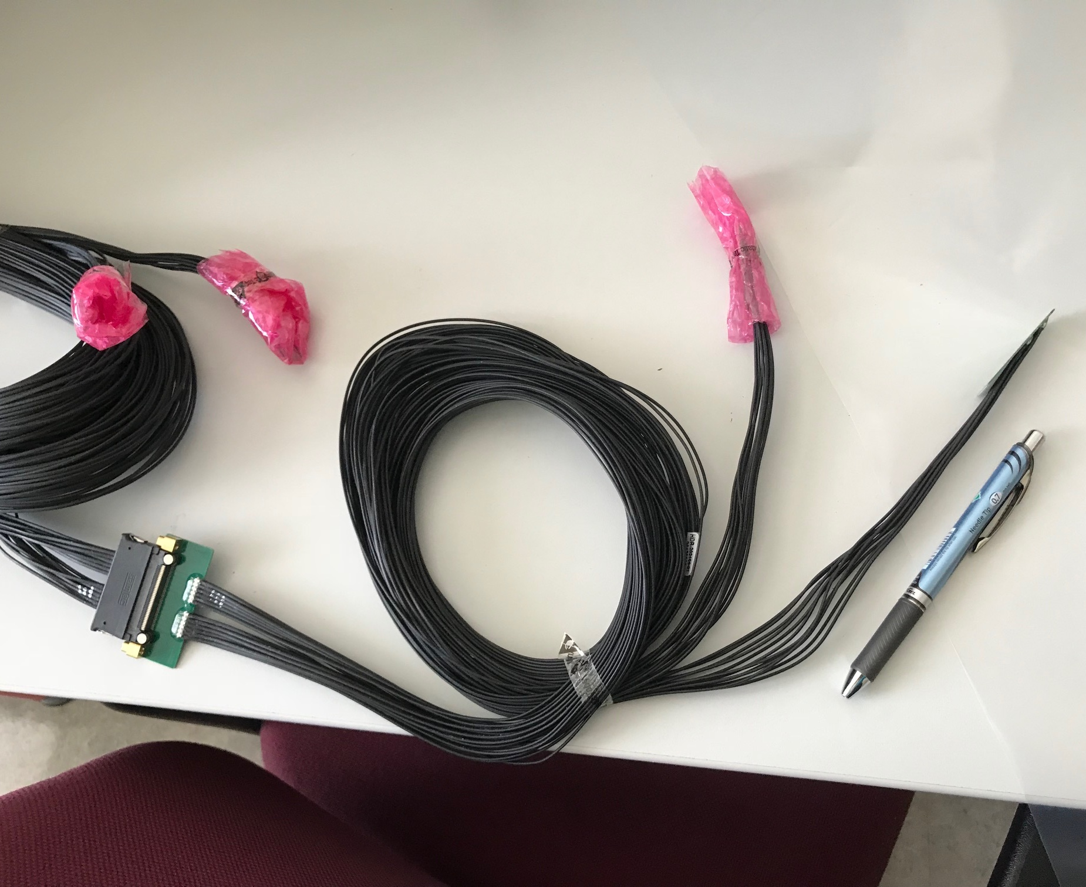
MVTX Readout and Power Cable Rout
Sho & Walt’s talks
ALICE ITS/IB readout cables: 8m
Cable-B: 6.8m
Cable-A: 1.2m
PWR
RU
PU
sPHENIX MVTX: 7.9+m
  Cable-A: 1.4 m
  Cable-B: 6.5+ m
  Power cable:4.7+ m
On-going R&D for ~10m (AWG30 vs 32)
BNL has approved “SamTec blue cables” (non-halogen free) for sPHENIX

Slide 11
Addressed Recommendations from last Appraisal
“Recommendation 1: Testing should be carried out with the 10m cables. The project recognizes the issue of cable lengths with the readout system, and we encourage the team to identify the maximum length that can be used (7, 9, 11 m) to ensure that unforeseen integration issues in sPHENIX do not create obstacles to their use. This is likely the highest risk in the detector development part.
- ALICE now uses 8m cables(AWG32), and sPHENIX plans to use ~10m with AWG30, 20+% better in attenuation, R&D in progress; obtained BNL approval to use SamTec blue cables for sPHENIX.
Recommendation 2: The project had reached many milestones ahead of schedule and is proposing several enhanced goals. We advise the group to prioritize these to maximize the impact on the field (particular for theory).
- Pursuing extended goal of 4-satve telescope, beam test planned for May 2019; New observables and calculations
Recommendation 3: In regard to the transition, we advise that the LDRD leadership explore ways to keep the knowledge within the group in order to make the MVTX sPHENIX project successful. The expertise also needs to be maintained for the ~5 year execution of the experiment, although possibly at a reduced level.
- New hires of two postdocs – one ITS expert, one HS electronics expert; staff training for MVTX; collaboration with MIT/Bates engineers; Try to keep the talents in the group.
Recommendation 4: It would be interesting to incorporate dynamical screening effects into these calculations, in addition to Debye screening effects.
- New theoretical models being developed

Slide 12
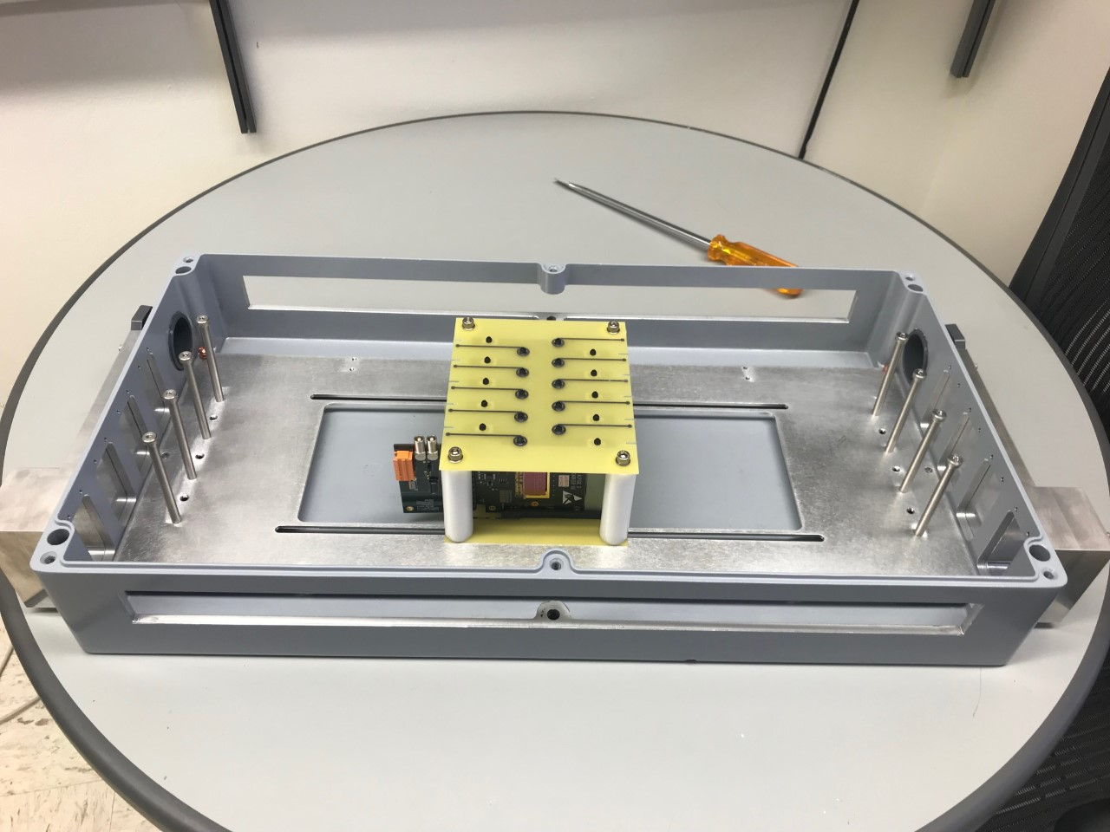
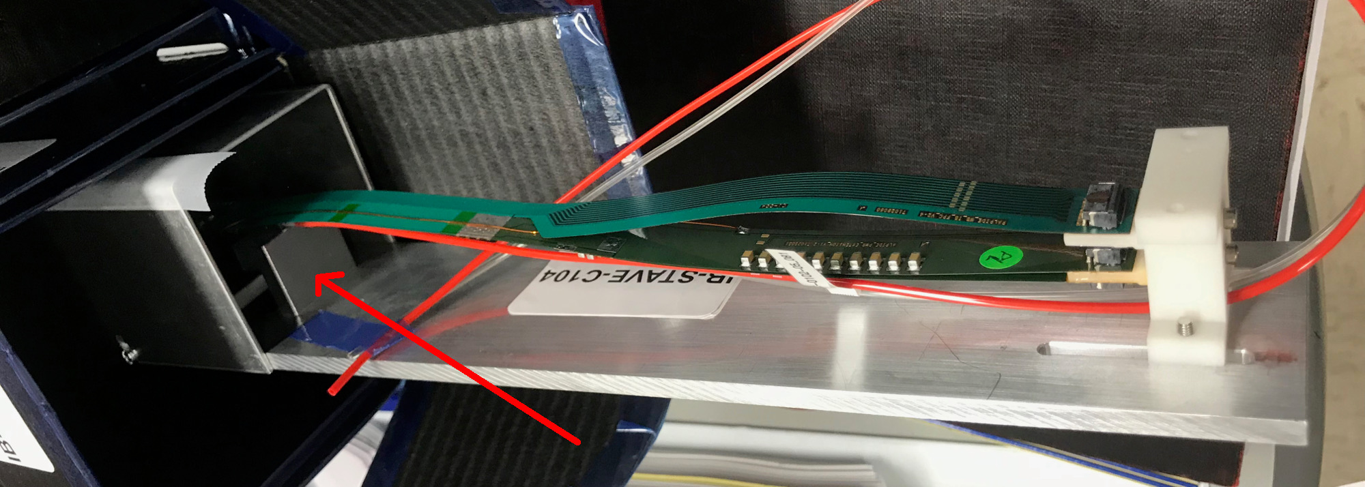
Detector R&D Tasks for FY19
MVTX prototype telescope final beam test at Fermilab
  Build a 4-stave telescope
    4 staves + 2 RUs + 1 FELIX + sPHENIX/RCDAQ + cables. & connectors
  Demonstrate full readout chain with staves
    multi-chip multi-stave readout
    multi-RU link to FELIX
  Demonstrate tracking capability for staves
    spatial resolution, efficiency
    high trigger rate (15kHz) and high event multiplicity
    detector alignment and offline tracking
  Test beam planned for May, with sPHENIX INTT
SamTech cable test
  8,10m SamTec blue cables, AWG30
ALPIDE sensor characterization and optimization
  Readout and trigger optimization for sPHENIX
  Laser system in preparation
4-stave Telescope
Final staves @LANL

Slide 13
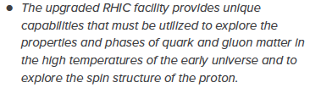

Mission Impact
This project directly contributes to the LANL NPAC (Nuclear, Particle, Astrophysics and Cosmology) and DOE Nuclear Physics program, expand the leadership of LANL at national & international level:
Defines the directions for LANL basic science and applied programs
  Long-term DOE NP support on sPHENIX
  New staff & postdoc hires - Xuan, Sho, Alex, Yasser, Cameron (P-25), also in theory groups
  Promotions- Mike(XCP), Cesar, Darren(XTD)
  New proposal being developed for EIC based on R&D on MAPS
Applied program at LANL
  X-ray imaging with MAPS techonology
  New proposals developed based on R&D from this LDRD project
NSAC Long Range Plan 2015
Recommendation #1 (RHIC):
Recommendation #3 (EIC):
The highest priority in this 2015 Plan is to capitalize on the investments made.
LDRD
sPHENIX
EIC
2015
2020
2025
2030

Slide 14
Transition into DOE sPHENIX MVTX Program
MVTX approved by DOE and BNL, fund through RHIC Operation
  Producing 84 staves and 60 RUs through US-ALICE, addon to the ALICE mass production, ~$1.4M
  MVTX system design and production in progress, ~$5M
The transition plan details are being worked out and evolving, as a result of this LDRD, we expect to have:
  Long term DOE NP support on sPHENIX heavy ion heavy flavor physics program with MVTX
  Long term DOE support for theoretical effort
In the remaining ~7 months of this project, we will actively work within the MVTX group to make smooth transition into sPHENIX project
  Complete the MVTX detector in time
  Ready for day-1 physics in 2023

Slide 15
sPHENIX Detector

Slide 16
sPHENIX Status and Plan

Slide 17
Summary
Established a new open heavy flavor physics program with MVTX upgrade for the sPHENIX, approved by DOE and funded through BNL
New theoretical development for QGP study
Met all LDRD milestones, some ahead of time
Broad impacts on NP and other programs
Developed a new sPHENIX program for LANL, bring in new fund
In transition into DOE supported sPHENIX program
On track to meet our extended goals for FY19

Slide 18
Backup slides

Slide 19
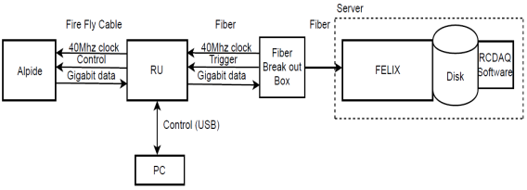
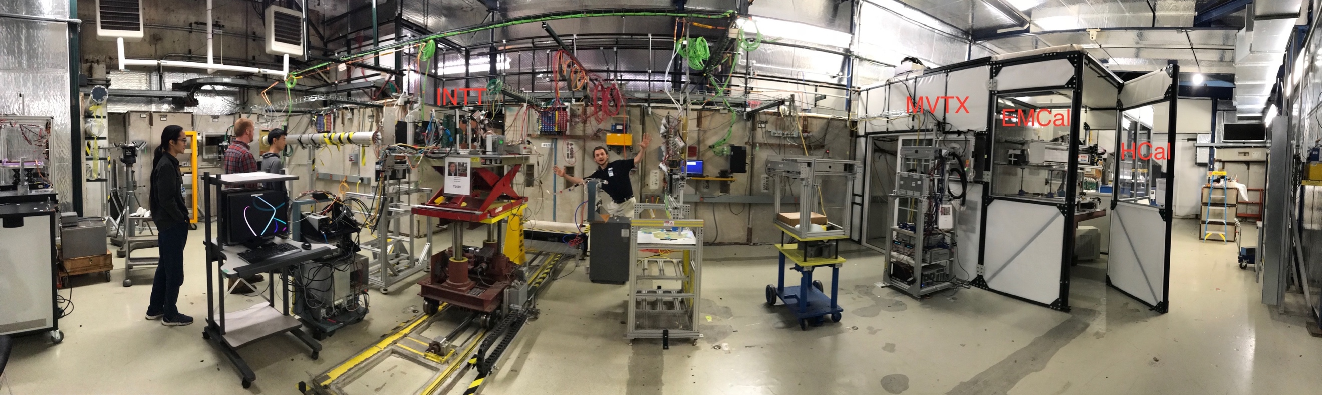
MVTX Full Readout Chain Demonstrated (3/2018)
4-MAPS
telescope
Tracking spatial resolution
achieved: <5 um
Fermilab Test Beam: Feb-Mar, 2018
120 GeV proton
beam
4-hit track
4-MAPS telescope

Slide 20
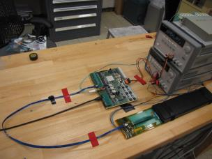
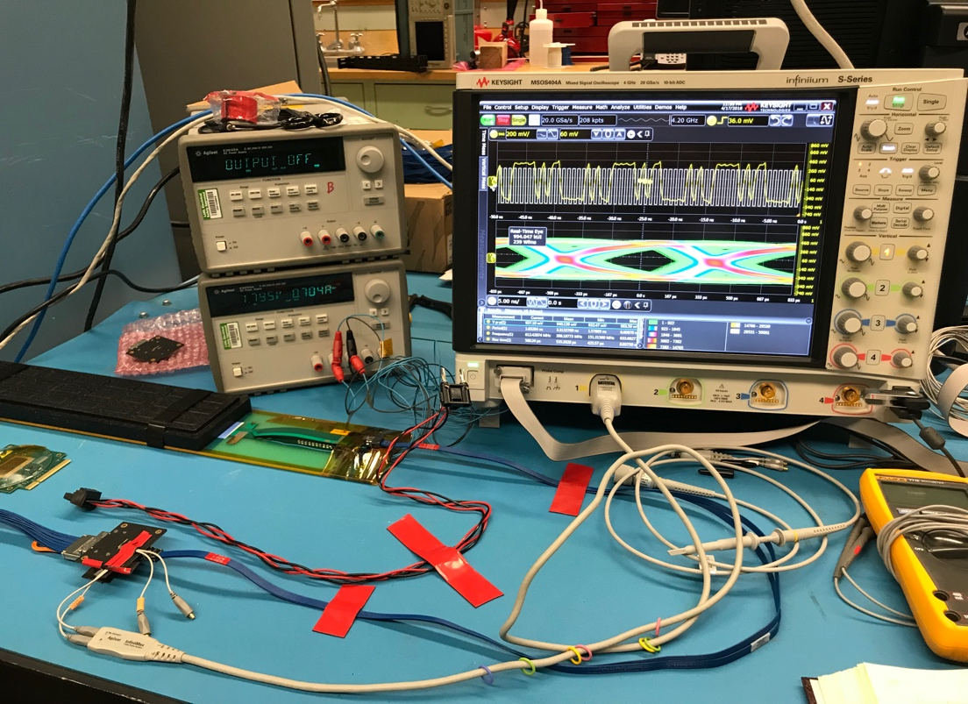
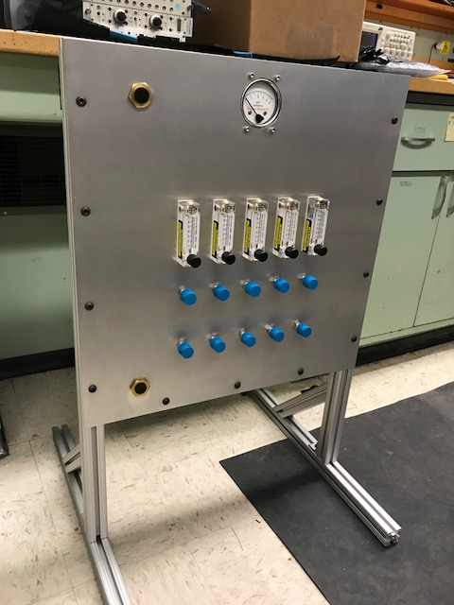
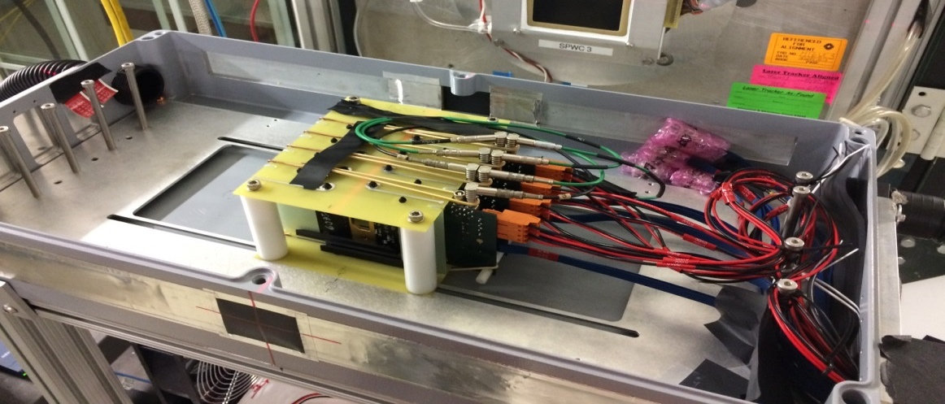
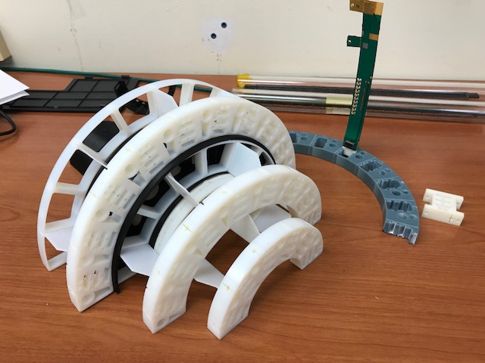
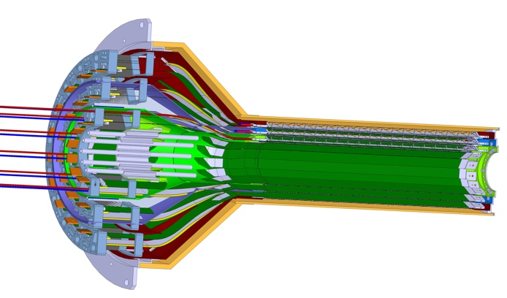
LANL LDRD Activity Highlights
MAPS evaluation
Readout integration
4-sensor telescope
Test beam at Fermilab
Mechanical & cooling
Readout R&D
Signal integrity & cables
RU
Cooling system
prototype
stave
4-ALPIDE Telescope;
5m-long SamTec cables
Service cone R&D
Sensor source test
FPC power extension R&D

Slide 21
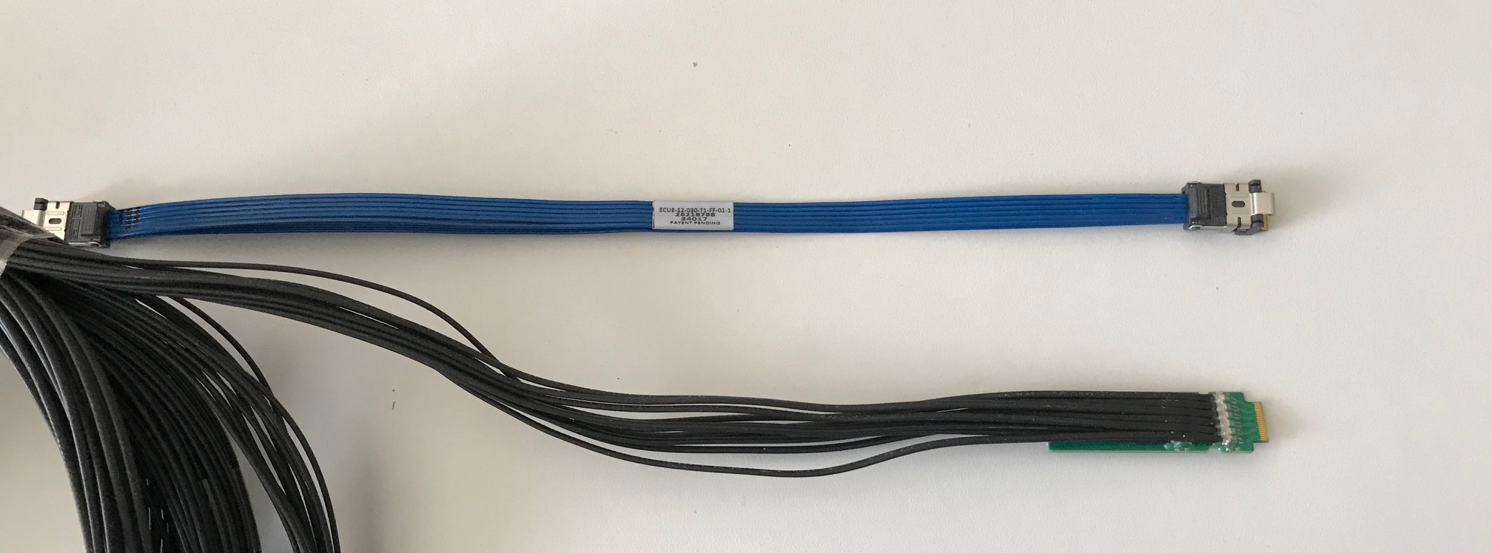
Address July MVTX Review Recommendations
https://docs.google.com/document/d/1vsm_G7ZLgqv-kBZqK0jF69T_Nx2Uwk0Zxv86jRVxybw/edit?usp=sharing
Stave and RU procurement readiness review
Completed sensor/HIC/stave evaluations at CERN
  Built and tested two HICs with 40cm and 60cm long power FPC
    Confirmed sensor performance same as the ALICE default configuration
  Sensors irradiated up to 2.7MRad, no issues (updated 9/18/2018).
Addressed all recommendations on stave/sensor R&D
Cost are set for staves/RU, UTK has started procurement paperwork
  Technical specs document completed for production, BNL/DOE agreed
  RU, Staves, sPHENIX production starts ~January 2019, expect to last ~12 months
MVTX/INTT mechanical integration
  Mechanical design being updated and 3-D mockup demonstrated
  Inner tracking task force completed evaluation, preferred INTT-layers ~2
Cables
  BNL approved the use of SamTec blue cables
    Electrically better & mechanically compact
    ALICE confirmed signal performance with 8m long readout cables. For MVTX, 10m very likely works (30AWG/sPHENIX vs 32AWG/ALICE), to be confirmed by on-going R&D
  Samples ordered for system integration mockup and test
Christof’s talk

