Slide 1
Plan for Today

Slide 2

sPHENIX LDRD Overview
Ming Liu (PI)
P-25
Thanks for the strong support from LDRD Office and LANL Program Management
UNCLASSIFIED

Slide 3
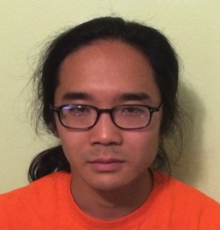
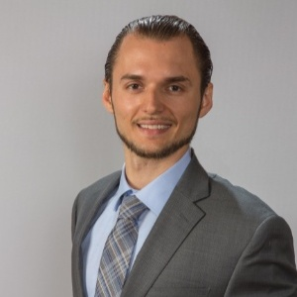





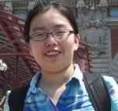





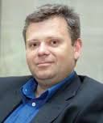
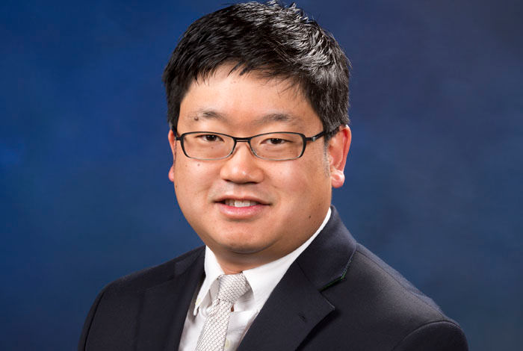
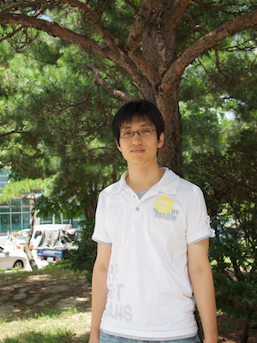
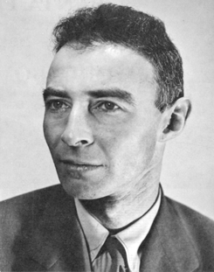
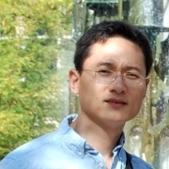

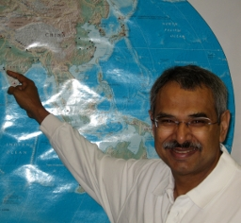

The LDRD Team
Experimental group
  P-25, AOT
  Detector readout and mechanical support R&D
  Detector modeling and simulations
  Physics simulations
Theoretical group
  T-2, T-5, CCS-7
  Physics modeling & simulations
Budget: 1.6M/Year, FY17-19
  1/3 on experimental T&E
  1/3 on theoretical T&E
  1/3 on Hardware & M&S

Slide 4
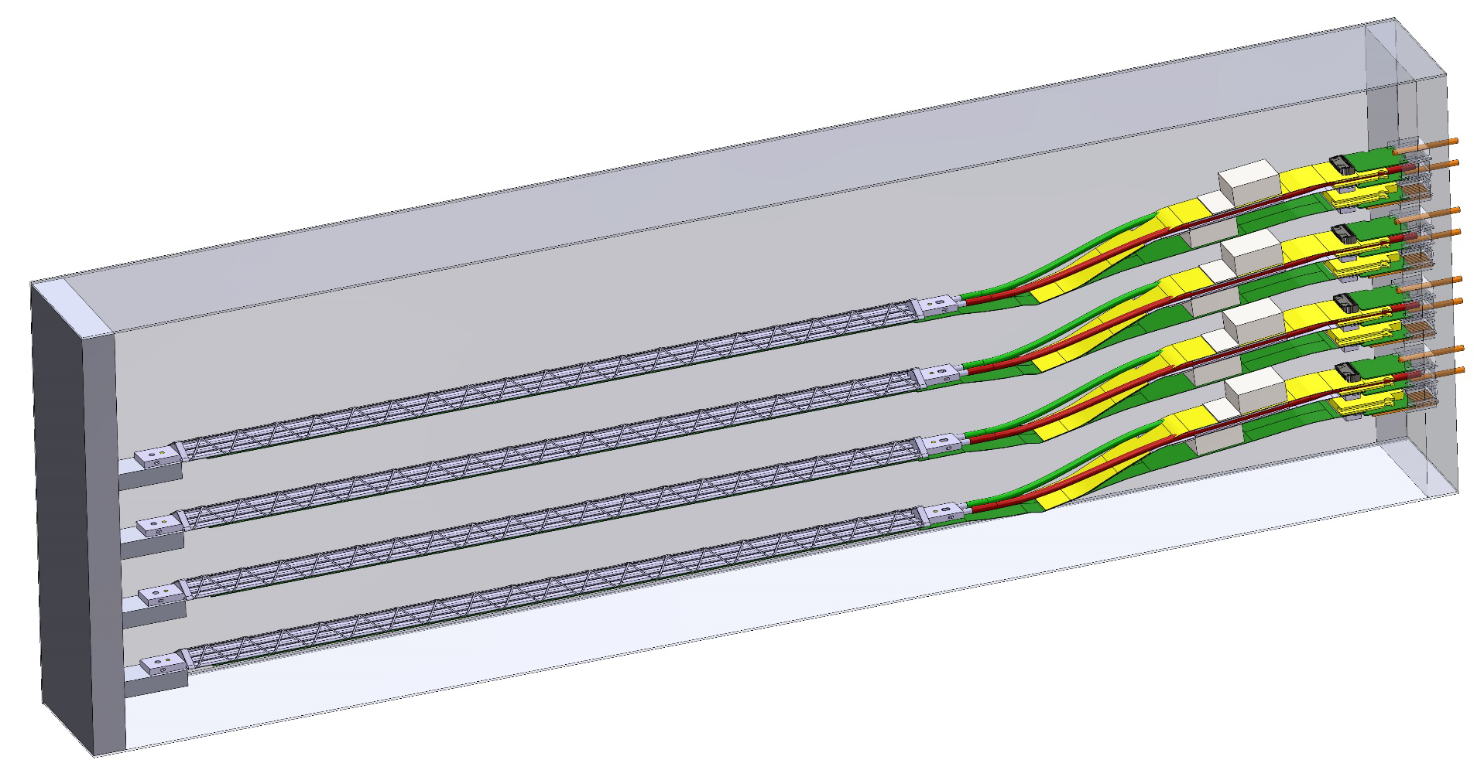

Outline
LDRD scientific goals
Project scope, status and plan
Mission impacts
Transition Plan
Telescope

Slide 5
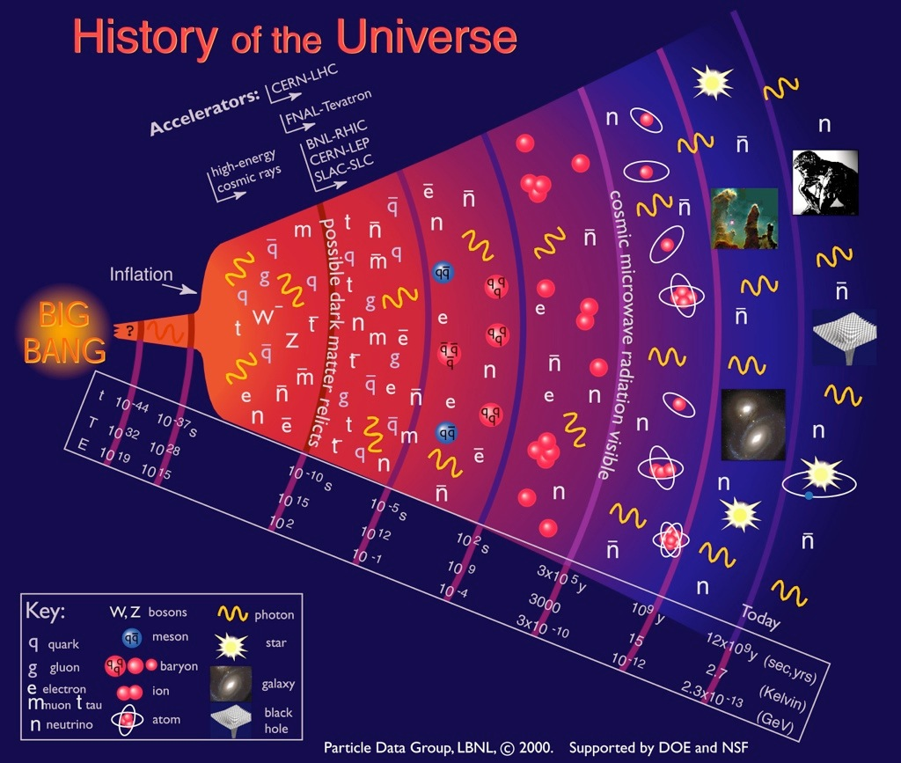
Quark-Gluon
Plasma (QGP)
Earliest stage of the universe that can be explored in detail in the laboratory

Slide 6


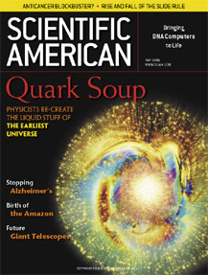
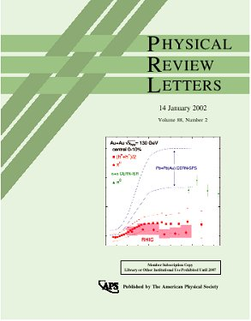

QGP Discovery
QGP discovery announced in 2004 by RHIC experiments, confirmed later at LHC
PHENIX mission completed in 2016
Upgrade path – sPHENIX @RHIC
Unambiguous evidence for phase transition from ordinary nuclear matter to QGP (T_{QGP}~175 MeV, ~10¹² degrees)
Fundamental discovery: QGP is not a weakly interacting gas of quarks and gluons, but rather a strongly coupled near-perfect liquid!
Exhibits strong collective behavior, has huge stopping power for color-charged particles (quarks, gluons – the fundamental constituents)
Big Question for Science: From what microscopic structure
do these properties emerge?→Requires new observables!

Slide 7
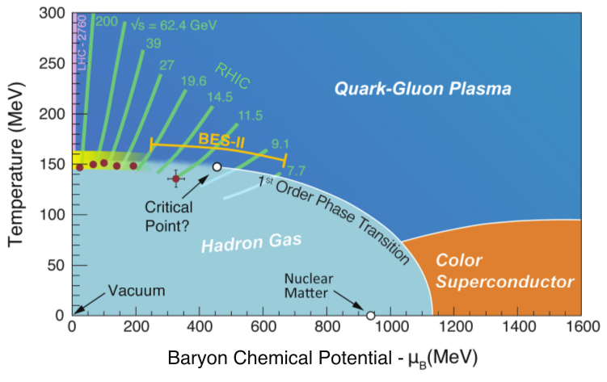
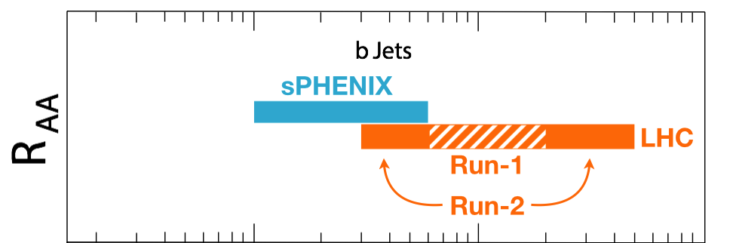
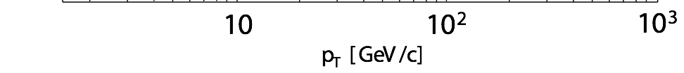
Bring Big Science to LANL
sPHENIX – the next US NP flagship heavy ion physics program, to study the inner workings of QGP
  Granted CD0 9/2016; CD1 scheduled 5/2018
This LDRD will allows LANL to take a leadership role in sPHENIX and a key player in the Heavy Ion physics frontier
  Innovation: develop a new open heavy flavor physics program, identified as the 3rd Science Pillar of the sPHENIX experiment
  Bring new state of the art technical capability (MAPS) to LANL applied program, also future EIC physics program
Jets
Upsilons
Heavy quarks
Complement & extend current and future RHIC and LHC QGP programs

Slide 8


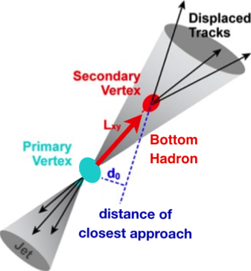
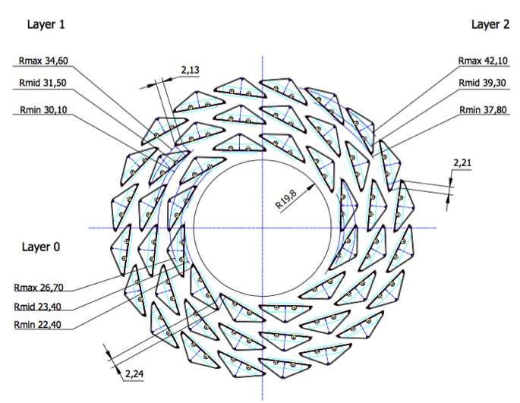
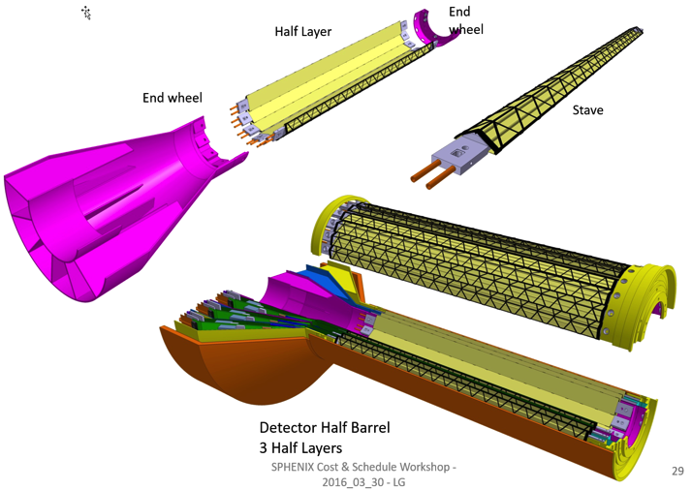
LANL Proposed Monolithic-Active-Pixel-Sensor-based Vertex Detector (MVTX)
2023+
ALICE ITS Upgrade (2021+);
Inner Tracker System
Key integration tasks:
Readout
Mechanics
sPHENIX Inner Tracking
“Adopt” ALICE/ITS
Mini. risk,
Max. physics

Slide 9
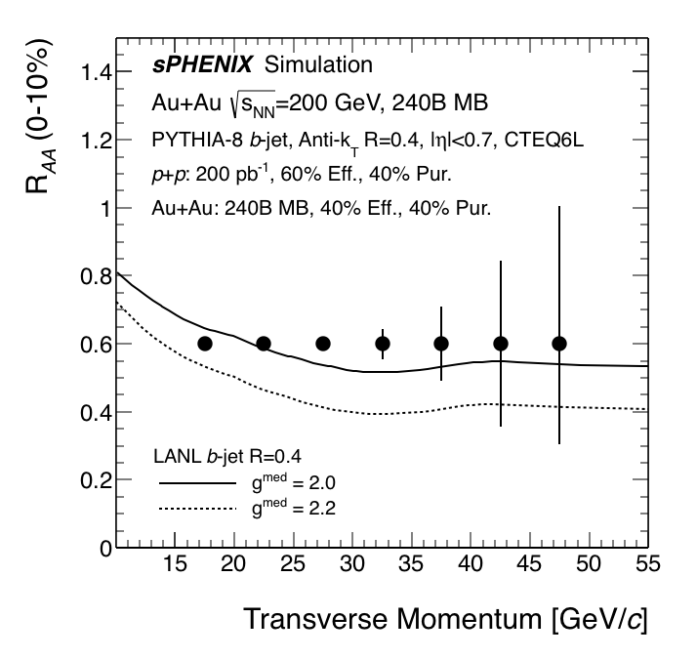
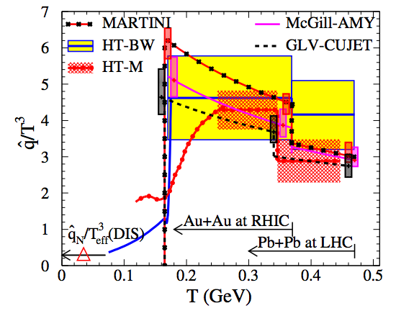
LDRD Scientific Goals
Develop a next generation QGP physics program with heavy quark jets at RHIC with full detector and physics simulation and modeling
Carry out key detector R&D to demonstrate the open heavy flavor physics capability in the sPHENIX with MVTX
Develop a proposal to DOE to build a state-of-the-art MAPS-based Vertex Detector for the sPHENIX
New theoretical study of QGP tomography with b-jets

Slide 10
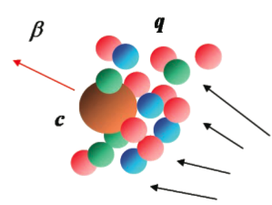
Physics with MVTX
Ivan and Darren’s talks
“B jet modification”
Heavy quarks – unique probe of QGP
  Study mass dependence
    Jet quenching & energy loss
    Flow – interaction with medium
  Access QGP properties
    Temperature, density, coupling, transport coefficients, viscosity etc.
“B meson and b-jet flow”
m_{u} m_{d}
m_{s}
Λ_{QCD}
m_{c}
m_{b}
MeV
1
10
10²
T_{c}
T_{QGP}
10³
10⁴

Slide 11
LDRD Project Scope
Established at the beginning of this project feasibility review 1/2017
Minimal scope
  Develop a MVTX prototype telescope with 2-4 early prototype ALPIDE sensors/staves with ALICE readout units, complete sPHENIX DAQ integration
  Complete R&D on mechanical conceptual design, sPHENIX system integration
  Develop b-jet tagging algorithms for p+p and Au+Au
  DOE MIE proposal submitted to fund the full detector construction
  Complete b-jet theory for precision tomography of QGP with sPHENIX
Desired scope
  Develop a full 4-production-staves MAPS telescope, test beam run with integrated sPHENIX DAQ
  DOE MIE proposal approved for the full detector construction

Slide 12
LDRD Timeline: Experiment
Milestones achieved
MOU with ALICE
B-tagging in p+p and Au+Au
BNL Director’s Review, recom’ed to proceed w/ full proposal
Talks by Darren, Xuan,
Alex, Sho, Walt, Cesar
Full readout chain demonstrated
Mechanical conceptual design
Collaboration formed and full MVTX proposal submitted
On track to succeed!

Slide 13
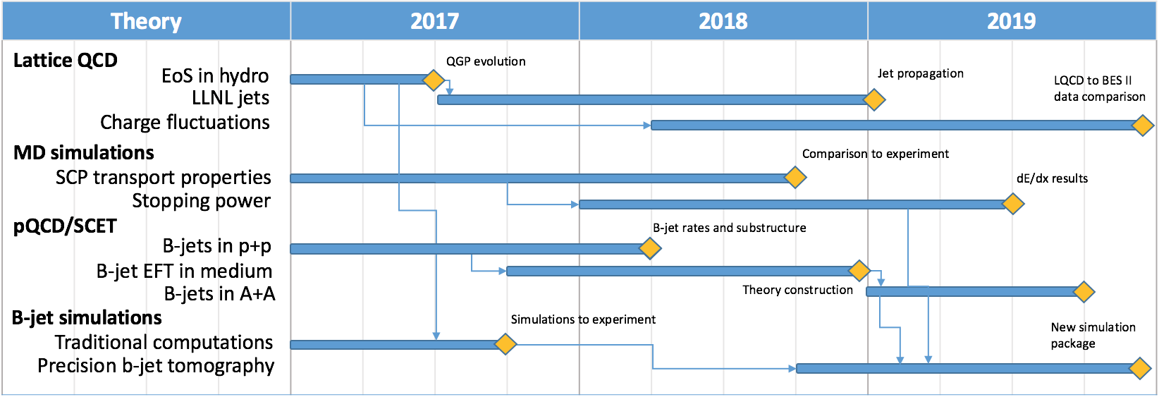
LDRD Scope: Theory
Ivan’s talk
Significant progress
  New calculations and new observables
  Some tasks completed ahead of time
Today

Slide 14


ALICE Pixel Detector (ALPIDE)
The 2nd generation state of the art MAPS technology
ALPIDE:
  Very fine pitch (28x28 μm)
  High hit efficiency (>99%) and low noise (<10⁻⁶)
  Fast response, ~5μS
  Ultra-thin/low mass, 50μm (~0.3% X₀)
  On-pixel digitization, low power dissipation
  Sensor chip: 1.5cm x 3.0cm, 0.5M pixels (512x1024)
A 9-chip stave
FPC
9 Chips
Cooling plate
An ideal detector for QGP b-jet physics!
50 μm
28 μm

Slide 15
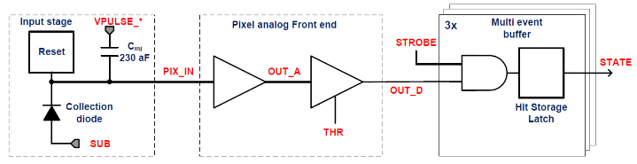
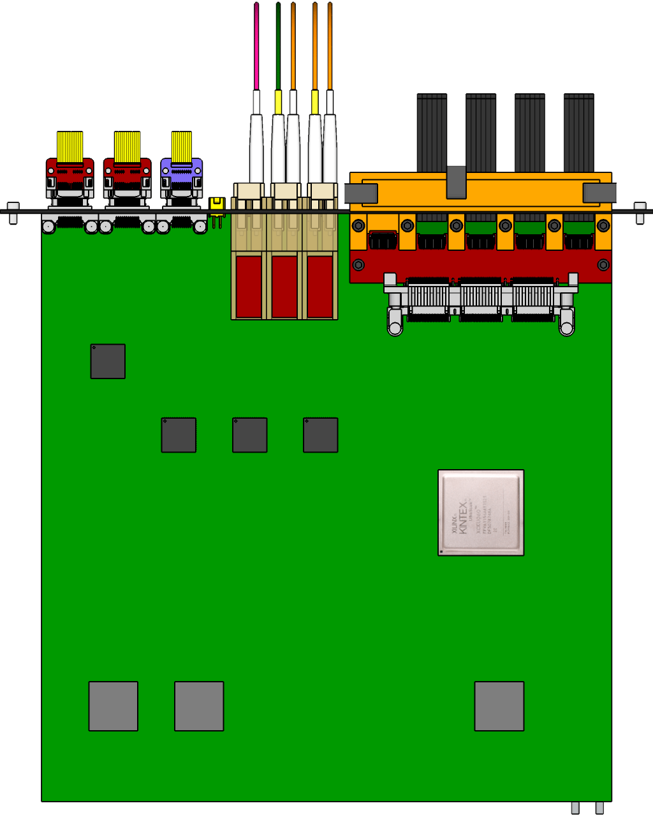

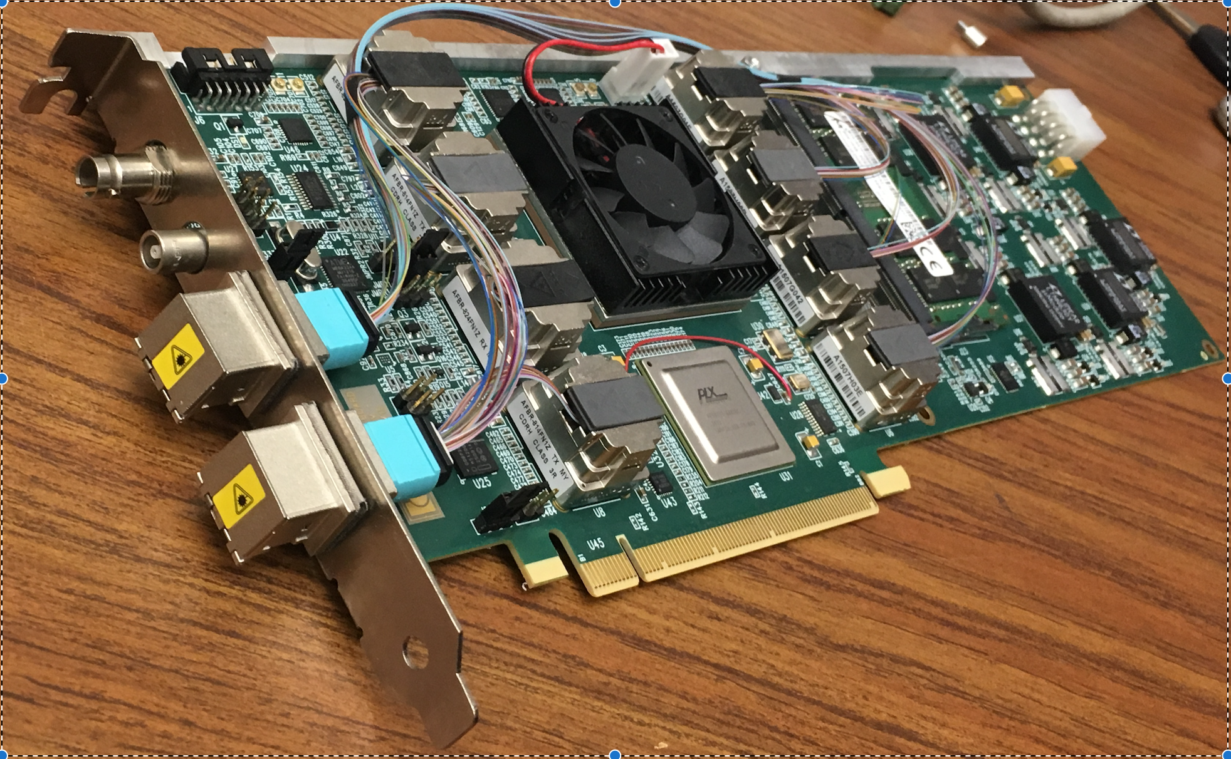
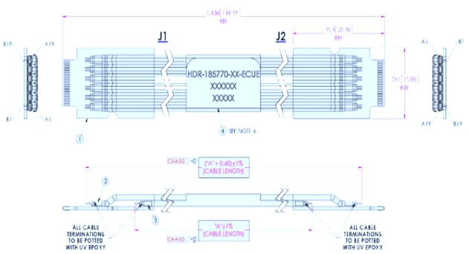

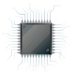
MVTX Sensors, Readout and Control
Alex and Xuan’s talks
ALPIDE pixel circuit
sPHENIX GL-1 & GTM
CAN bus
DCS
5~10 m
Readout Unit
Trigger & Clock
GBT Optical Links
9-sensor Stave
9 Data (1.2Gbps)
1 Clock, 1 Control/Trigger
Control
Data (9.6 Gb/s max)
Trigger
Samtec Twinax “FireFly”
FELIX
FPC
Power
ALPIDE Sensors
Power
RCDAQ
Linux
Filtering
Capacitors
regulators
Power supplies
Cold Plate
Regulated Power
Power Board
Demonstrated full high-speed readout chain
  1 Stave + RU(v1.0) + FELIX(v1.5) + RCDAQ/sPHENIX
ALPIDE and Power Unit control and monitor being evaluated

Slide 16
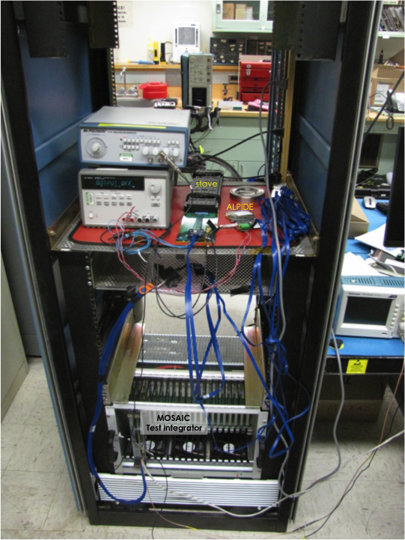
ALPIDE Characterization & Optimization
MOSAIC test bench
  Allows high-speed readout of ALPIDE chip, 1.2Gbps
  Scan sensor response parameters – work in progress
Laser testing system in preparation
  Laser pulses to inject MIP-level signal to each pixel
  Scan full parameter space to optimize the operation point for sPHENIX
Xuan’s talk
9-chip stave
1-chip sensor
MOSAIC Test Bench
Laser Driver
Laser
X-Y-Z station
sensor
location

Slide 17
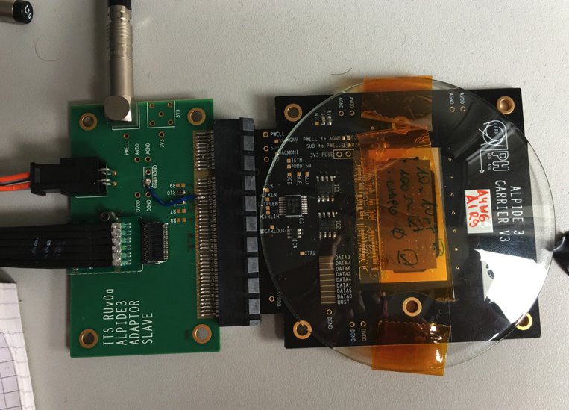
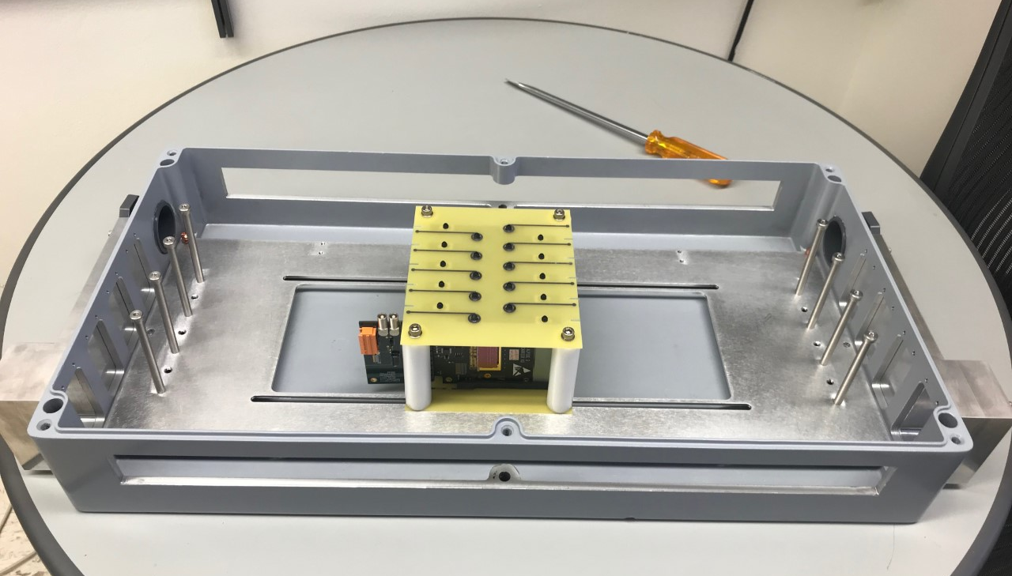
MVTX Prototype Telescope Under Development
Sho’s talk
Goal: A 4-stave telescope
  Sensor response and cluster size, MC tuning
  Hit spatial resolution
  Tracking and offline reconstruction
  Full readout chain
  Cooling and mechanical stability
A preliminary beam test at Fermilab
  Multi-layer ALIPDE chips
  Study sensor response to beam,
  Tune MC simulations
  Scheduled for March 2018
Cosmic test later 2018
  Tracking and offline reconstruction
  Benchmark MC response
4-Stave telescope
Single-chip sensor (or 9-chip stave)

Slide 18
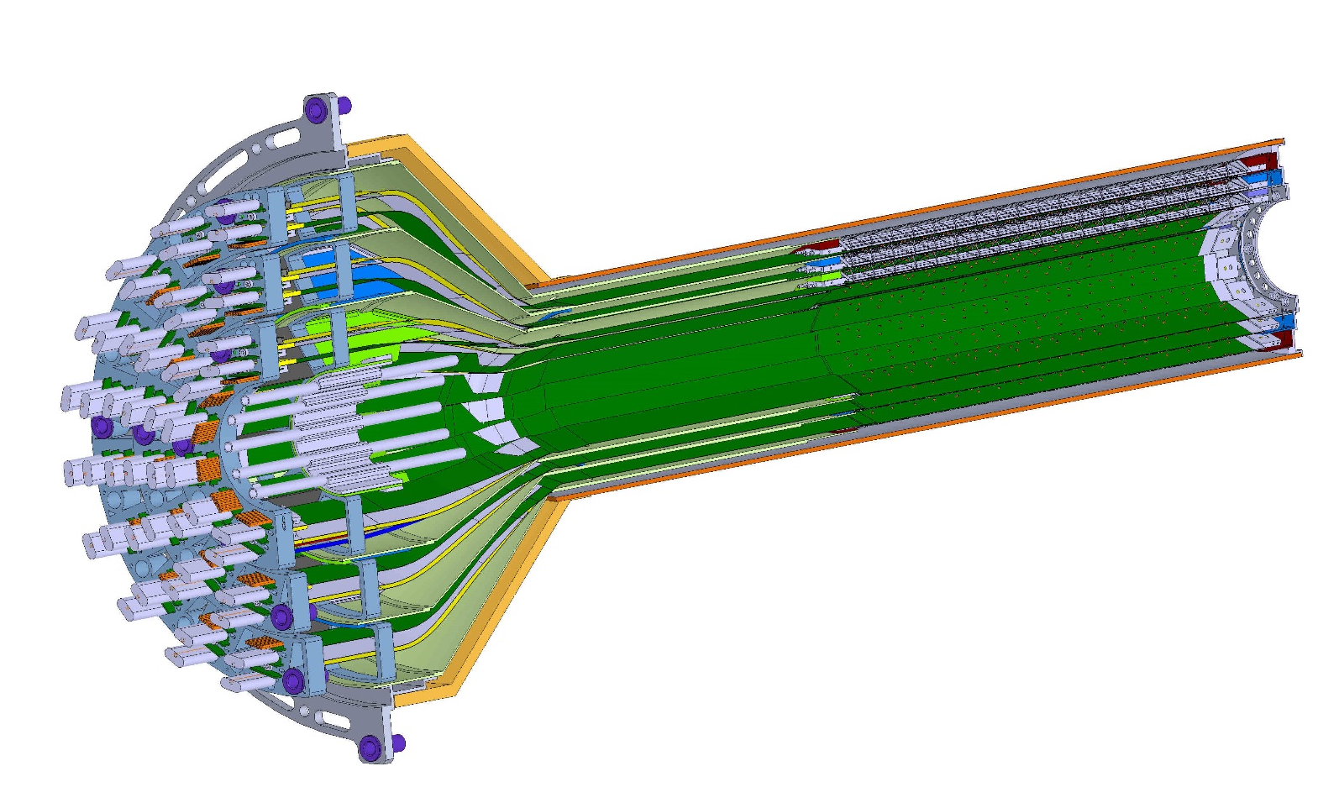
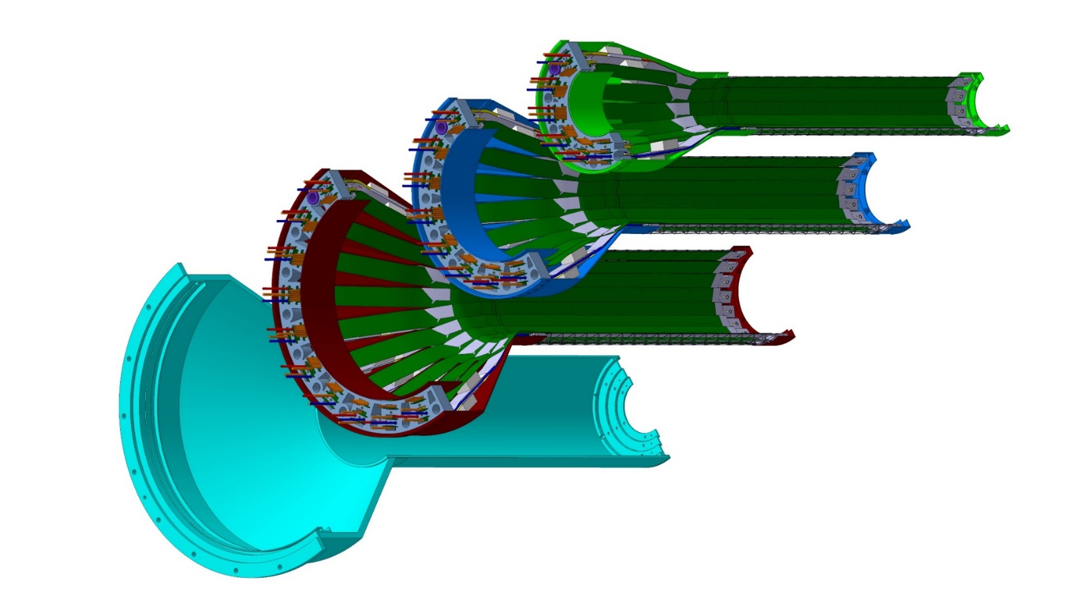
MVTX Detector Conceptual Design
Walt’s talk
Half detector assembly,
beam view
27cm
Layer 0
Layer 1
Layer 2
IB CYSS

Slide 19
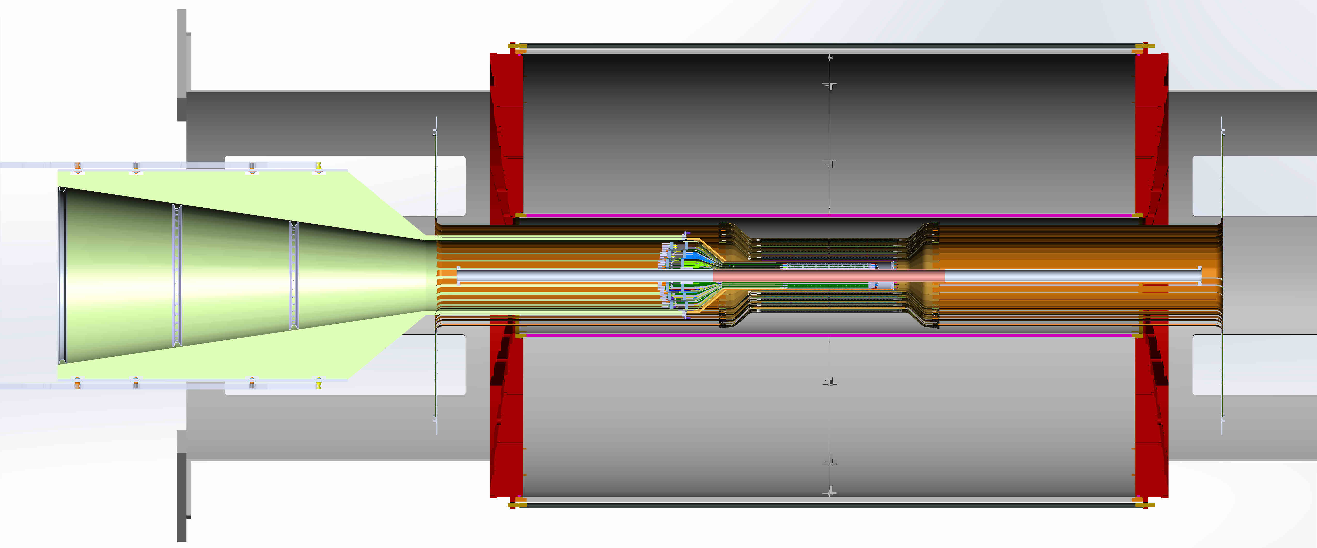
sPHENIX Mechanical System Integration
Walt’s talk
A conceptual design of MVTX mechanical system completed
TPC
INTT
MVTX
Xx cm

Slide 20
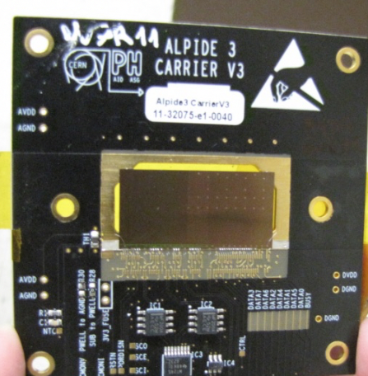
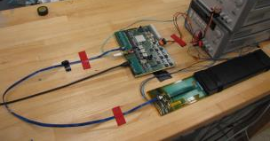
Procurements in FY17-18
Single chip
Sensors
  1 single chip with slow readout DAQ boards
  5 single chip sensors with high-speed readout adaptor
    10 more to be produced locally
  1 9-chip stave module
    5 more to come in FY18
Readout Units
  1 RU v1.0
    5 RU v1.x to come in FY18
FELIX back end
  1 FELIX v1.5
  2 FELIX v2.0 to be available in FY18
Linux DAQ server
  1 Linux in operation
Power system
  1 32-chan power distribution boards
  CEAN rad-hard power modules and server
  CEAN rad-hard bulk power supply will be available in FY18
Telescope mechanical support
  1 box made
Cooling system
  Cooler tested
  Negative-pressure system in design
FELIX
RU
9-chip
stave

Slide 21
FY18 Milestones
In progress:
  To construct a 4-stave MVTX prototype telescope and take cosmic ray data
  To complete readout and control integration with the final electronics and cables (RUv.1x and FELIXv2.0)
Achieved:
  Completed initial mechanical system integration and layout
  Completed and benchmarked b-jet tagging for pp and AuAu
  Completed and submit MVTX full proposal to BNL ALD

Slide 22
Major Technical Challenges and Risks from previous Feasibility Review Addressed
Project Risks with timely procurements of R&D items from CERN
  Availability of ALICE sensors
    A “Plan-B” was developed to us 3~4 single chip MAPS sensors for the initial telescope R&D in a simple mechanical/cooling enclosure in order to test the electronics readout chain of multi-chips.
  Availability of ALICE readout electrons
    A prototype Readout Unit (RU) with Xilinx evaluation board KC705 was developed before the arrival of RUv1.0
    In the difficulty of obtaining Common Readout Unit (CRU), an alternative path was developed to use ATLAS FELIX board and demonstrated it meets/excceeds the sPHENIX DAQ requirements.
  Removed the initial cost and schedule uncertainty of custom-designed readout option! (rec,#1)
Test beam and full proposal
  Given the success of full readout chain with RU and FELIX in advance, we have determined that a test beam is not required for the full proposal submission. However, a test beam is required before the full production of sPHENIX readout electronics.
  Given our advanced progress in readout and telescope design, we are preparing for an early test beam at Fermilab in March 2018 to study sensor response and readout characterization.
Add more milestones to MIE proposal development
  We have 3 implicit milestones: 1) to build a collaboration and submit a pre-proposal by the end of the first year FY17; 2) to have science and technical reviews in the 2nd year and complete a full proposal by the end of FY18; 3) to have the full proposal reviewed and approved by DOE by the end of FY19.
  We have already achieved the 1st milestone in Feb 2017 and the 2nd milestones in Jan 2018. The MVTX detector collaboration is formed and growing, a preproposal was submitted to DOE in Feb 2017 and a full proposal to BNL ALD in January 2018. LANL LDRD team is working with the MVTX detector collaboration, sPHENIX and BNL management to realize the full program.
Setup simulation milestones for the MIE proposal
  Through close collaboration with MVTX group, a full sPHENIX tracking simulation package has been developed and used for realistic b-jet tagging study for the MVTX proposal.
Bullet6s
Add item pics

Slide 23
Major Tasks to Complete the Project
ALPIDE sensor characterization and optimization
  Readout and trigger optimization for sPHENIX
  Laser system in preparation
Full readout and control integration in sPHENIX
  Full readout with RHIC clock and trigger
    RUv1.x and FELIXv2.0 and firmware
    Electronics production/procurements in process
    sPHENIX DAQ system development in progress
MVTX mechanical system integration in sPHENIX
  Barrel section extension R&D
    Signal extension and long SamTec cables
  Mechanical system integration
MVTX prototype telescope final beam test at Fermilab
  Demonstrate tracking capability, spatial resolution
  High trigger rate (15kHz) and high event multiplicity
By 2018
By 2019
Mark
Prokop
(AOT)
By 2019
By 2019

Slide 24
LDRD and sPHENIX Schedules
LDRD: 10/2016 – 9/2019
sPHENIX(proposed)
  CD-0 9/2016; CD-1, 5/2018
  Construction: 2018 – 2022
  Physics runs: 2023 – 2027+
MVTX (proposed)
  cons

Slide 25
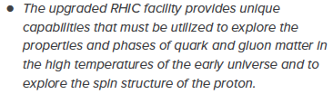

Mission Impact
NSAC Long Range Plan 2015
This project directly contributes to the LANL NPAC (Nuclear, Particle, Astrophysics and Cosmology) and DOE Nuclear Physics program, expand the leadership of LANL at national/international level:
High impact on big science at international level
  Current and future physics programs at RHIC, LHC, EIC
Define the directions for LANL basic science and applied programs
  Expect to have long-term DOE NP Baseline support as a result of this LDRD
  New staff & postdoc hirings - Xuan, Sho(P-25), Darren(XTD/P-25)
  Promotions- Mike(XCP), Cesar
  New proposals developed based on R&D from this LDRD project
Applied programs at LANL
  For X-ray imaging which leads to new detecting method developments and could benefit the future MaRIE project. a new LDRD proposals under preparation.
  Initiated a new feasibility study to develop a new neutron detection capability at LANL for applied programs, a new LDRD proposals under preparation.
  Future deve of fast MAPS
Recommendation #1 (RHIC):
Recommendation #3 (EIC):
The highest priority in this 2015 Plan is to capitalize on the investments made.
LDRD
sPHENIX
EIC
2015
2020
2025
2030

Slide 26
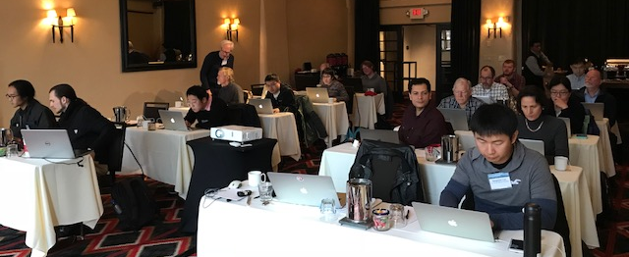
MVTX Full Proposal Development
MVTX detector collaboration formed, 1/2017
  International collaboration of 22 institutions, and counting
  Bi-weekly detector R&D and physics simulation meetings
  Weekly project development meetings, project leaders from LANL, BNL, MIT and LBNL
A pre-proposal completed and submitted to DOE in Feb. 2017
  Initial feedback from DOE, positive, compelling science
  Asked all future discussion and submission done through BNL
BNL Directors review, July 2017
  Very successful, positive feedback
  Recommended to proceed with a full proposal
Organized several workshops dedicated to detector R&D and to physics program development
  MVTX physics and detector design, 1/2017, LBNL
  Readout electronics R&D, 4/2017, UT-Austin
  Cost & schedule workfest, 6/2017, BNL
  MVTX and Heavy Flavor physics, 12/2017, Santa Fe
A full MVTX proposal completed and submitted to BNL ALD 1/2018
  66 pages … cover page
We are ~1 year ahead of plan
Preproposal submitted
Full proposal submitted

Slide 27
Transition Plan
Cesar’s talk
The transition plan details are still being worked out and evolving; as a result of this LDRD, we expect to have:
  Long term DOE NP support on sPHENIX heavy ion heavy flavor physics program
  Long term DOE support on theory
MVTX funding news (received by MVTX group on 1/19/2018)
  From email by BNL Associate Laboratory Director (ALD) Dr. Berndt Mueller:
    DOE “very much appreciate and encourage efforts to secure such contributions, but unfortunately in our present outlook, we do not foresee at this time that we would be able to identify new DOE funding for the purpose of implementing the MVTX”
MVTX group is working closely with sPHENIX and BNL management to seek alternative path to fund the full MVTX detector.
  Several options being explored within the sPHENIX collaboration
In the remaining 20 months of this project, we will actively pursue alternative funding sources to secure the construction of MVTX detector in time.

Slide 28
Summary
Developed a new physics program and MVTX proposal for sPHENIX
Met all milestones, some ahead of time
Designed and tested full readout system
Developed mechanical conceptual design
A MVTX prototype telescope being constructed, in preparation for beam test
New theoretical development
Broad impact on NP and other programs
On track to meet our goals for FY18 and FY19

Slide 29
backup

Slide 30
ALPIDE Timing & Trigger
ALPIDE Operation in sPHENIX
Use Alex’s slide
Well fits sPHENIX/RHIC environment, 10MHz beam crossing (LHC 40MHz)
v
PIX_IN
v
OUT_A
~5-6 μs
t_{f}~= 10 ns
OUT_D
Latched hit
ΔV=Q/C
threshold
t_{r}> 100 μs
~5-6 μs
STROBE
t
t
signal
Shaping, duration & threshold
sPHENIX trigger latency: ~4 μs

Slide 31
MVTX Cost and Schedule
Total budget: 6.5M
  Production
  Assembly
  Integration
About 9 months schedule float
Major Items | Cost w/ 35% Cont. ($M) | Schedule
Staves (WBS 1.5.3.1) | 1.3 | 8/2018-5/2019
Readout & Controls (WBS 1.5.2) | 1.3 | 1/2019-6/2019
Mechanics & Detector Assembly (WBS 1.5.3) | 1.8 | 2019-2022, TBO
Integration (WBS 1.5.4) | 1.0 | 2021-2022, TBO
Project Management | 1.0 | 8/2018-1/2023

Slide 32
Transition Plan
Project: 20170073DR
Title: Probing Quark-Gluon Plasma with Bottom Quark Jets at sPHENIX
Initial “Transition Plan”:
Experiment: At the end of this DR project we will have secured a major role for LANL in the development, construction, and utilization of the sPHENIX detector. Our transition model to DOE funding is based upon our previously successful PHENIX FVTX at BNL and the E906 muon identifier at Fermilab, both of which began as LANL LDRD projects. These two projects were subsequently adopted by the DOE Nuclear Physics program, who provided full detector funding and support for the LANL-led physics programs. This past record demonstrates that the current team has abundant program development experience for managing this kind of transition. After this DR project, we will work closely with LANL’s Nuclear Physics program office, the sPHENIX collaboration, and our DOE Nuclear Physics program managers to construct and install the full inner tracker. The potential total return on this proposed LDRD investment is large, above 6:1. For example, the DOE currently provides about $3M per year to LANL for physics work related to our FVTX detector and has done so for about 7 years. The FVTX physics program will likely end within a few years. Without a major new role at sPHENIX, our DOE longterm support is at risk.
Theory: This project will place LANL at the forefront of b-jet physics calculations for both RHIC and LHC collision energies under a common theoretical framework. This will ensure that, after the completion of the DR, the utilization of the next generation of experiments is fully maximized and will provide additional insight into the heavy ion LHC experiments currently underway. Previous successful theoretical LDRD projects have allowed LANL to secure significant DOE early career award funding ($1M/yr for 5 yrs) and we expect to receive long-term DOE baseline support as a result of this LDRD effort. Funding sources for the theoretical efforts include DOE’s Nuclear Physics, High Energy Physics and Fusion Energy Science program offices.

Slide 33
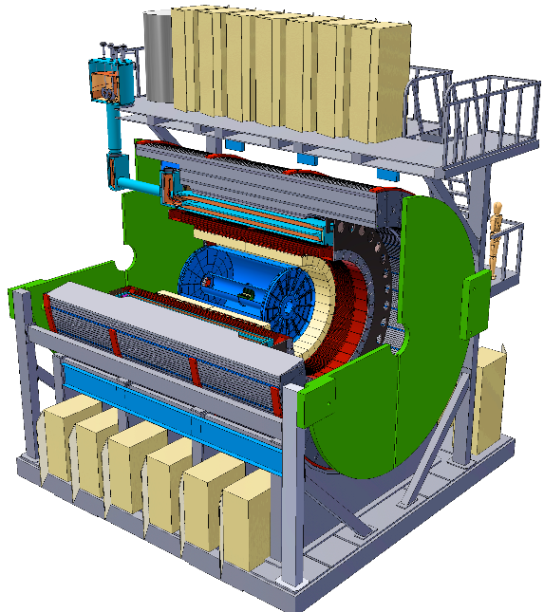
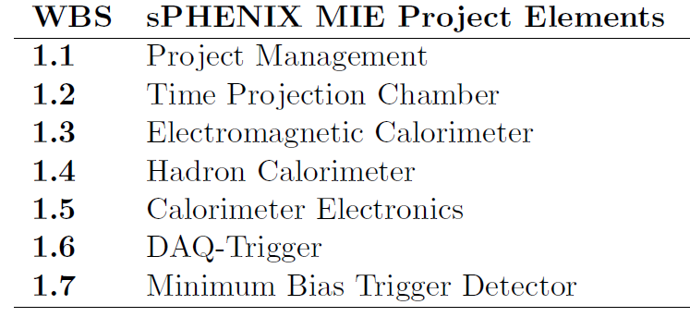
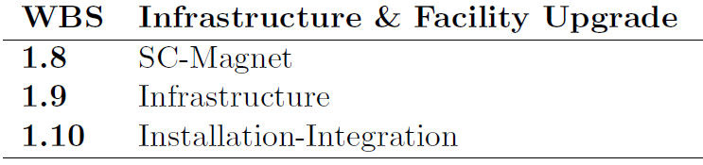
MVTX:MAPS-based Vertex Detector
A separate upgrade project for the baseline sPHENIX: Jet + B-tagging
Baseline
Parallel Activities
MAPS-based Vertex Detector (MVTX)
Intermediate Silicon Strip Tracker (INTT)
Upgrades

Slide 34
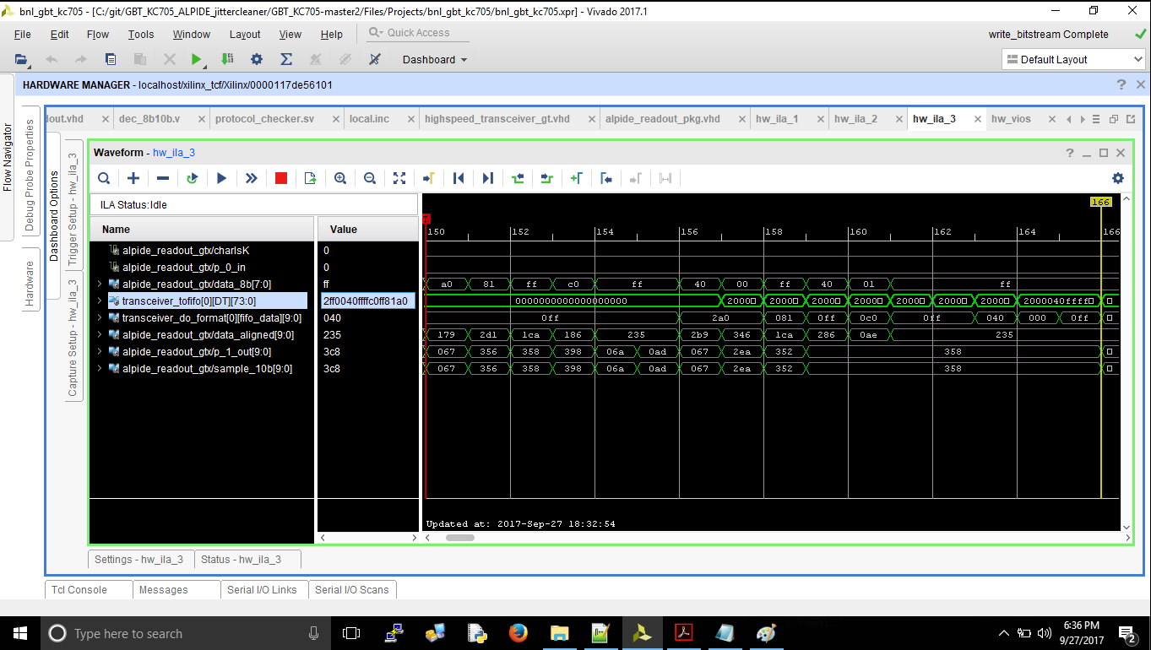
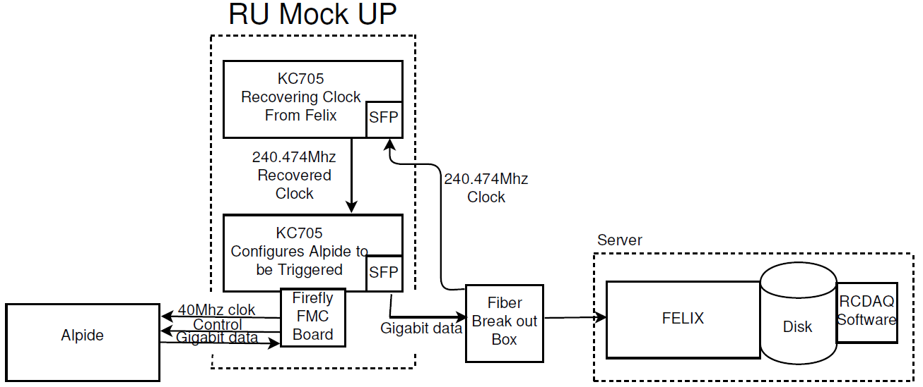
ALPIDE R&D at LANL
Power unit test
ALPIDE/Stave evaluation test bench
LV/HV controls
DAQ integration

Slide 35
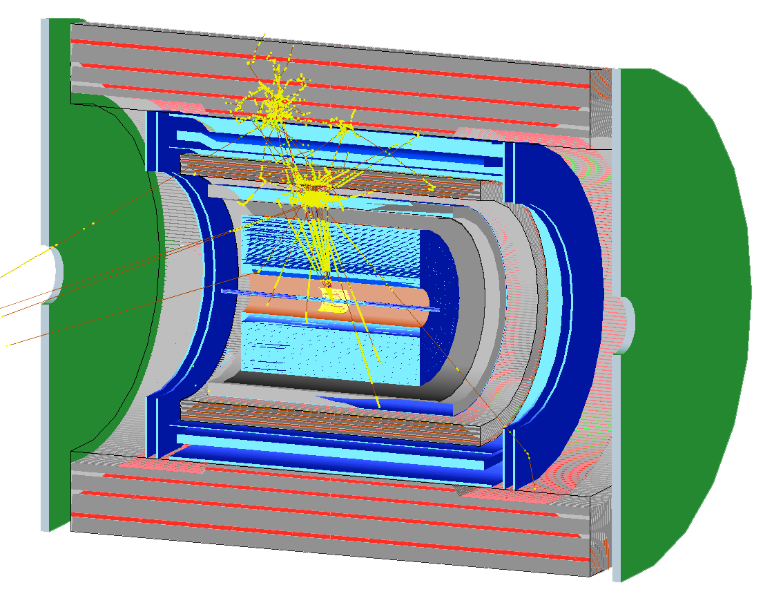
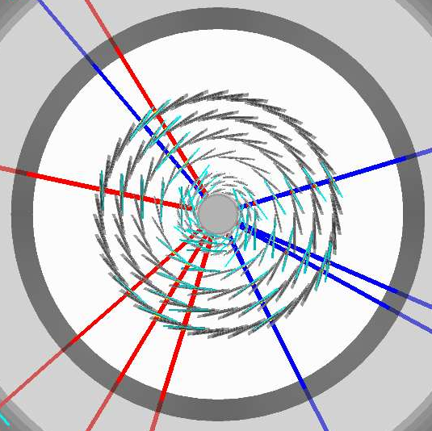
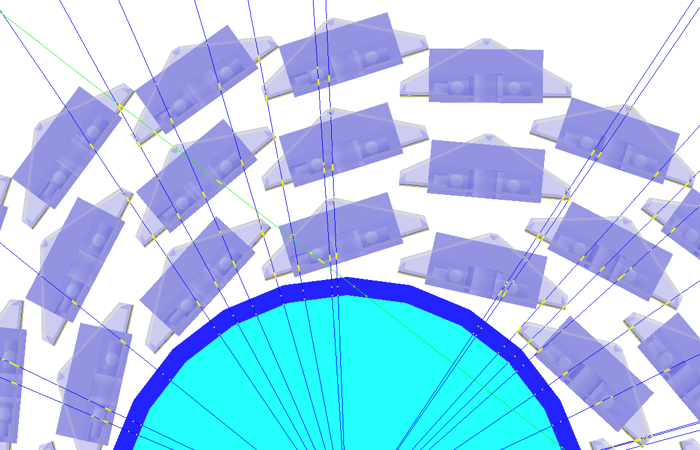
Simulation for b-jet and B-meson
sPHENIX Geant4 display of p_{T}=30 GeV/c B⁺-hadron
Design to Simulation
MVTX and INTT _
_ MVTX Ladders modeled in details
MVTX sensors

Slide 36
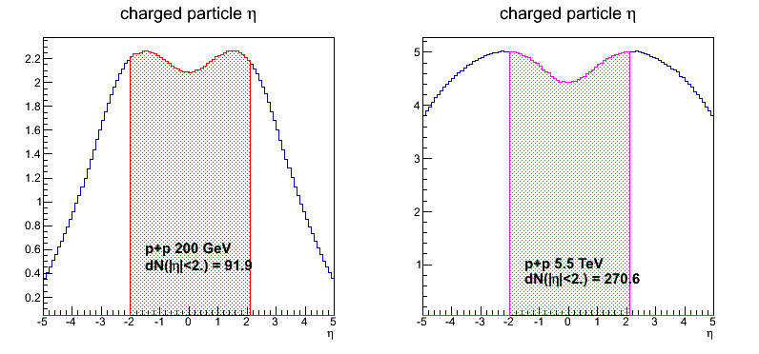
sPHENIX vs ALICE Specifications
 | ALICE (Run3) | sPHENIX
Pb+Pb / Au+Au | 100 kHz (50kHz) | 200 kHz
p+p | 400 kHz (200kHz) | 13 MHz
Trigger | 50 kHz | 15 kHz
Event size, dN/dη: sPHENIX = 1/3 ALICE (pp), 1/5 ALICE(AA)
sPHENIX
ALICE

Slide 37
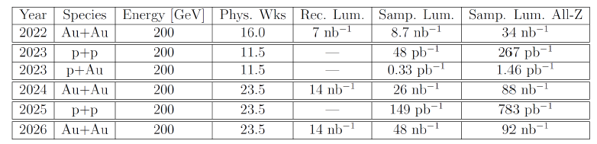
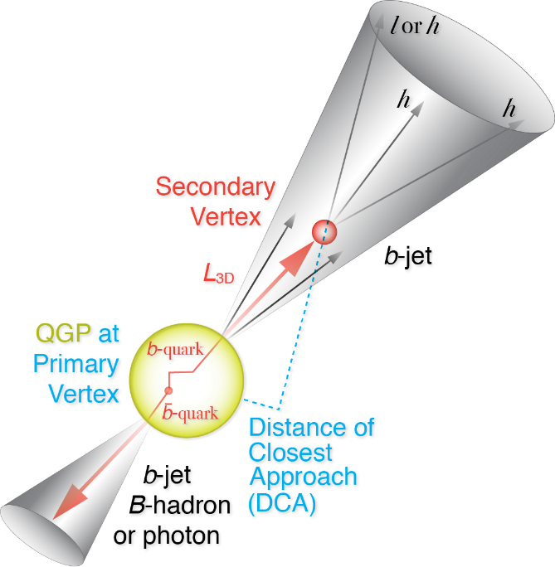
RHIC Multi-Year Plan: sPHENIX 2022-2026+
Evolving
B hadrons/pT<15GeV: O(1M)
b-jets/pT>15GeV: O(100K)
Precision 2nd vertexing for B-tagging:
  Tracking resolution better than 50um @pT=1GeV
  High multiplicity HI collisions
  Low multiplicity but high rate p+p collisions
  High efficiency and high purity

Slide 38
BNL sPHENIX Control Envelope Drawing
Z location of the inner hcal is at 2175,0mm

Slide 39
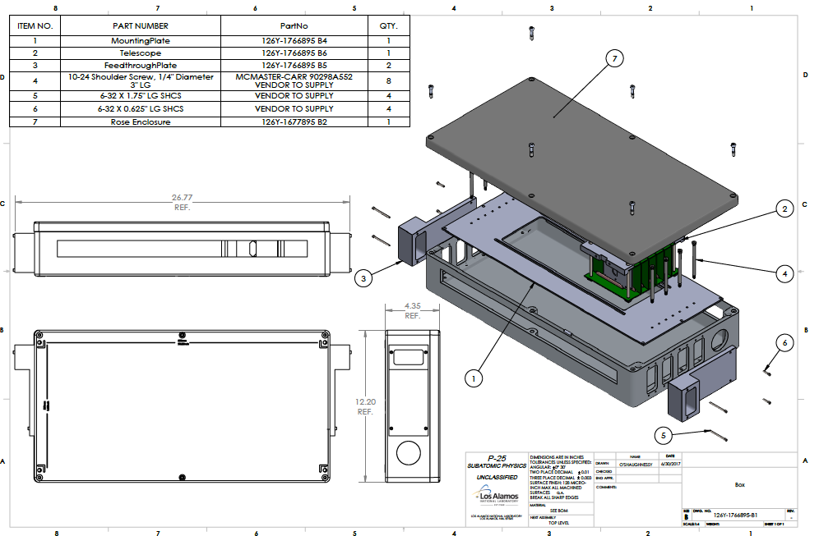
Telescope Enclosure
Telescope Mechanical box designed
  Design sent to UT-Austin for quote
  4 MAPS sensors
  4 staves

Slide 40
A Road Map
Excellent strategic Alignment
NSAC Long Range Plan
At the heart of the recently released LANL NP strategy, by Rej, Wilburn, Carlson, 2016
Our projects are pipelines for talent to applied LANL missions
Recommendation #1 (RHIC):
Recommendation #3 (EIC):
The highest priority in this 2015 Plan is to capitalize on the investments made.
LDRD
sPHENIX
EIC
2015
2020
2025
2030

Slide 41
LDRD Key Tasks/Milestones
7/17
10/17
10/18
10/19
Today
RUv1.0/FELIX1.5 Integration
40MHz, 7/17-12/17
More detailed task schedules
on MS Project
cosmic telescope
LDRD
RUv1.x/FELIX2.0, 10MHz,
10/17 – 6/18
MVTX Design Review 7/2018
System test, cosmic & source
6/18 - 1/19
Test Beam, tracking performance
analysis, physics sim, NIM paper etc.
1/19 – 9/19
MVTX: 2018 – 2021
Stave Production, procure FPGA, GBT etc.
8/18-4/19
BNL Director Review
7/10-11, 2017
Electronics Production
1/19-6/19

Slide 42
LDRD Scope: Experimental
Milestones achieved
MOU with ALICE
B-tagging in p+p and Au+Au
BNL Director’s Review, recom’ed to proceed w/ full proposal
Talks by Darren, Xuan,
Alex, Sho, Walt, Cesar
Full readout chain demonstrated
Mechanical conceptual design
Collaboration formed and full MVTX proposal submitted
On track to succeed!
Today

Slide 43
Leadership Roles
sPHENIX MVTX Upgrade project:
L2 manager: Ming Liu
Mechanical integration: Walt Sondheim
L3 managers:
Cesar da Silva, Stave production
Mark Prokop, Readout electronics

Slide 44




System Power Overview
Power – Baseline architecture using LDO regulators
Based on ALICE/ITS-IB system
High speed logic and
Stave
Control lines
Power Board Requirements:
Module Efficency > 99%
Noise rate < 10⁻⁶
Radiation Tolerant
Control Interface to FEE
Overcurrent protection
Remote current readout
Remote voltage readout
Remote voltage setting
FPC (Bus for signal, control, power, bias, decoupling caps)
PT100 from cooling loop
PT100 to DSS
Bias daisy chain
I2C control
CANbus
Breakout Boards
32 reg
Hardware Features:
Power board includes 2 independent sections:
8 Analog power regulators
8 Digital power regulators
8 Bias regulators
Controls
Diagnostics
x8
switch
reg
reg
reg
reg
reg
reg
V adjust
reg
V, I mon/buffer
CAEN
bias
CAEN
power
V, I mon/buffer
RDO
interface
Isolated bias section
Overcurrent
detection
PT100 interface
Overcurrent
reset
Overcurrent
threshold
Power Board
Power in

Slide 46
MVTX Major Cost Items
Major Items | Cost w/ 35%Cont. ($M) | Schedule
Staves (WBS 1.5.3.1) | 1.3 | 8/2018-5/2019
Readout & Controls (WBS 1.5.2) | 1.3 | 1/2019-6/2019
Mechanics & Detector Assembly (WBS 1.5.3) | 1.8 | 2019-2022, TBO
Integration (WBS 1.5.4) | 1.0 | 2021-2022, TBO
Project Management | 1.0 | 8/2018-1/2023

