Slide 1
Plan for Today

Slide 2

sPHENIX LDRD Overview
Ming Liu
P-25
UNCLASSIFIED

Slide 3
The LDRD Team
Experimental group
  P-25, AOT
  Detector readout and mechanical support R&D
  Detector modeling and simulations
  Physics simulations
Theoretical group
  T2, T5, CNS
  Physics modeling & simulations
Budget allocation: 1.6M/Year, FY17-19
  Expr.: 1/3 on T&E, 1/3 on Hardware & M&S
  Theo.: 1/3 on T&E

Slide 4
Outline
LDRD scientific goals
  (Leadership)
Project scope, status and plan
  (quality & execution)
  R&D highlights (quality)
  Cost, schedule, procurement and risk management
Mission impacts
  (Relevance & Leadership)
  LANL mission
Transition Plan
  (Leadership)

Slide 5
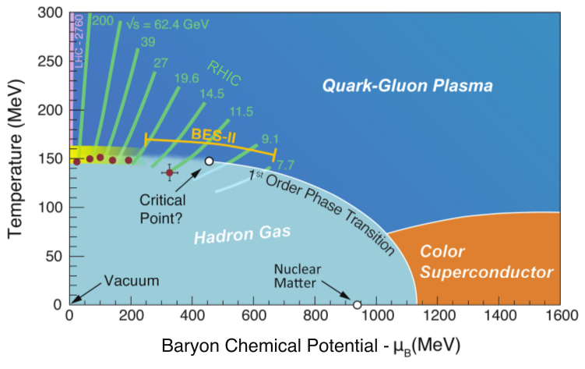
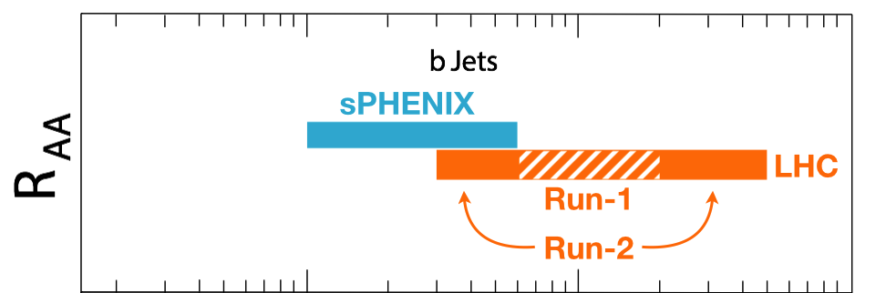
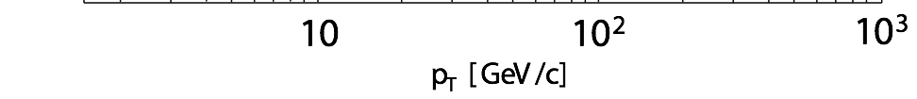
Bring Big Science to LANL
sPHENIX – the next US NP flagship heavy ion physics program, to study the inner workings of QGP
  Granted CD0 9/2016
  CD1 review scheduled 5/2018
This LDRD will allows LANL to take a leadership role in sPHENIX and a key player in the HI physics frontier
  Innovation: develop a new open heavy flavor physics program, identified as the 3rd Science Pillar of the sPHENIX experiment
  Bring new state of the art technical capability (MAPS) to LANL applied program, also future EIC physics program
-Jets
-Upsilons
-Heavy quarks
Complement & extend current and future RHIC and LHC QGP programs

Slide 6


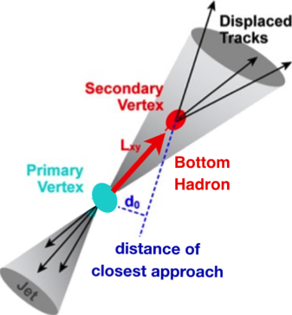
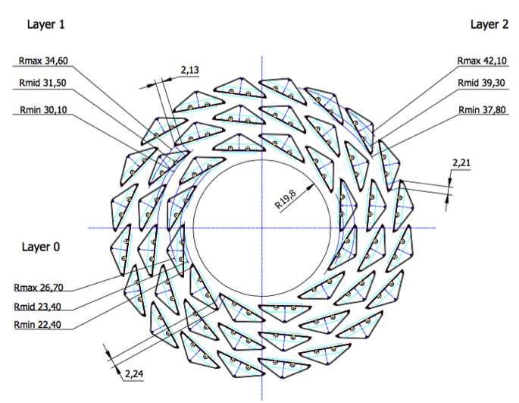
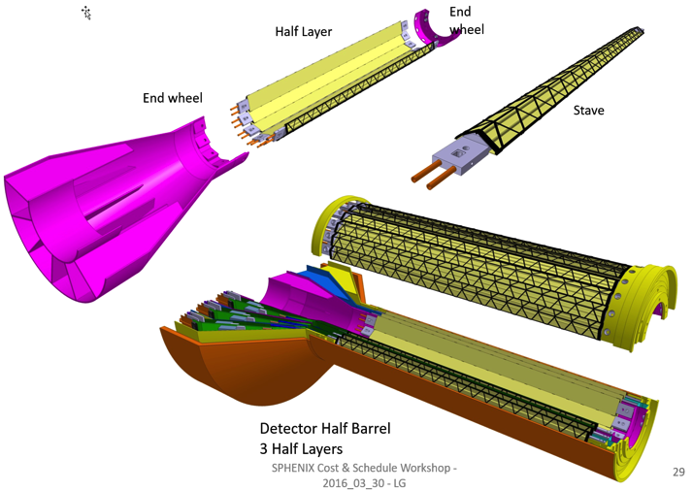
LANL Proposed Monolithic-Active-Pixel-Sensor-based Vertex Detector (MVTX)
2023+
ALICE ITS Upgrade (2021+);
Inner Tracker System
sPHENIX Inner Tracking
“Adopt” ALICE/ITS
Mini. risk,
Max. physics

Slide 7
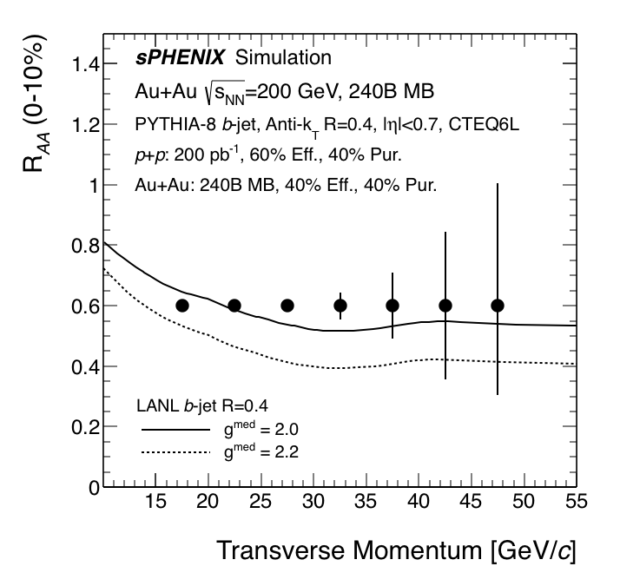
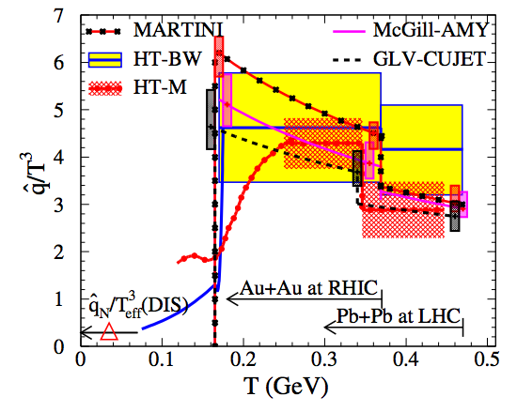
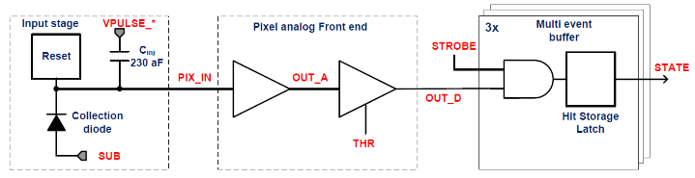
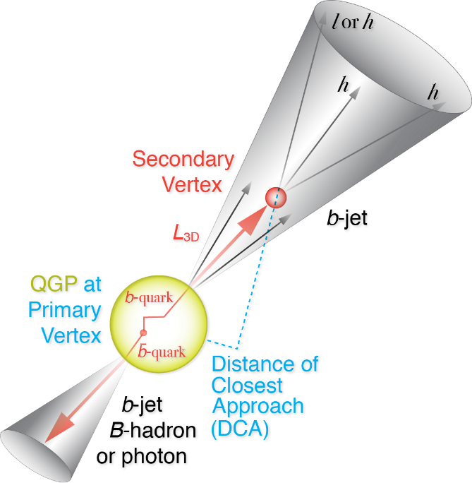
LDRD Scientific Goals
Develop a next generation QGP physics program with heavy quark jets at RHIC with full detector and physics simulation and modeling
Carry out key detector R&D to demonstrate the open heavy flavor physics capability in the sPHENIX with MVTX
Develop a proposal to DOE to build a state-of-the-art MAPS-based Vertex Detector for the sPHENIX

Slide 8
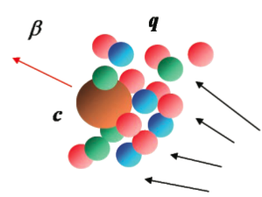
Physics with MVTX
Ivan and Darren’s talks
Heavy quarks – unique probe of QGP
  Study mass dependence
    Jet quenching & energy loss
    Flow – interaction with medium
  Access QGP properties
“B jet quenching”
“B flow”
m_{u} m_{d}
m_{s}
Λ_{QCD}
m_{c}
m_{b}
MeV
1
10
10²
T_{c}
T_{QGP}
10³
10⁴

Slide 9
LDRD Project Scope and Plan (1/2017)
Minimal scope
  Develop a MVTX prototype telescope with 2-4 early prototype sensors/staves with ALICE readout units, complete sPHENIX DAQ integration
  Complete R&D on mechanical conceptual design, sPHENIX system integration
  Develop b-jet tagging algorithms for p+p and Au+Au
  DOE MIE proposal submitted to fund the full detector construction
  Complete b-jet modeling & computations
Desired scope
  Develop a full 4-production-staves MAPS telescope, test beam run with integrated sPHENIX DAQ
  DOE MIE proposal approved for the full detector construction

Slide 10
LDRD Scope: Experimental
Milestones achieved:
MOU with ALICE
Full readout chain
Mechanical conceptual design
B-tagging in p+p and Au+Au
BNL Director’s Review, recom’ed to proceed w/ full proposal
Collaboration formed and proposal submitted
Talks by Darren, Xuan,
Alex, Sho, Walt, Cesar
On track to succeed!
Today

Slide 11
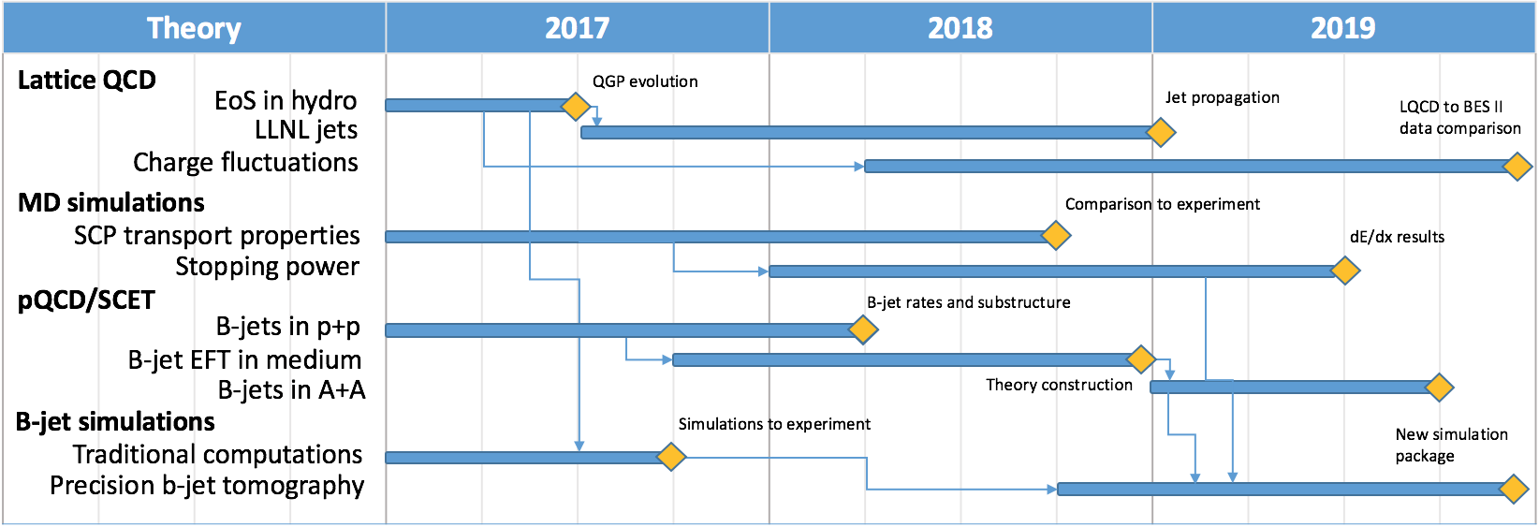
LDRD Scope: Theoretical
Ivan’s talk
Great progress
  New calculations and new observables
Today

Slide 12


Monolithic Active Pixel Sensor (MAPS)
ALPIDE: ALice PIxel Detector
  The 2nd generation state of the art MAPS technology
  Very fine pitch (28x28 μm)
  High hit efficiency (>99%) and low noise (<10⁻⁶)
  Fast response, ~5μS
  Ultra-thin/low mass, 50μm (~0.3% X₀)
  On-pixel digitization, low power dissipation
  Sensor chip: 1.5cm x 3.0cm, 0.5M pixels (512x1024)
A 9-chip stave
FPC
9 Chips
Cooling plate
An ideal detector for QGP b-jet physics!
50 μm
28 μm

Slide 13
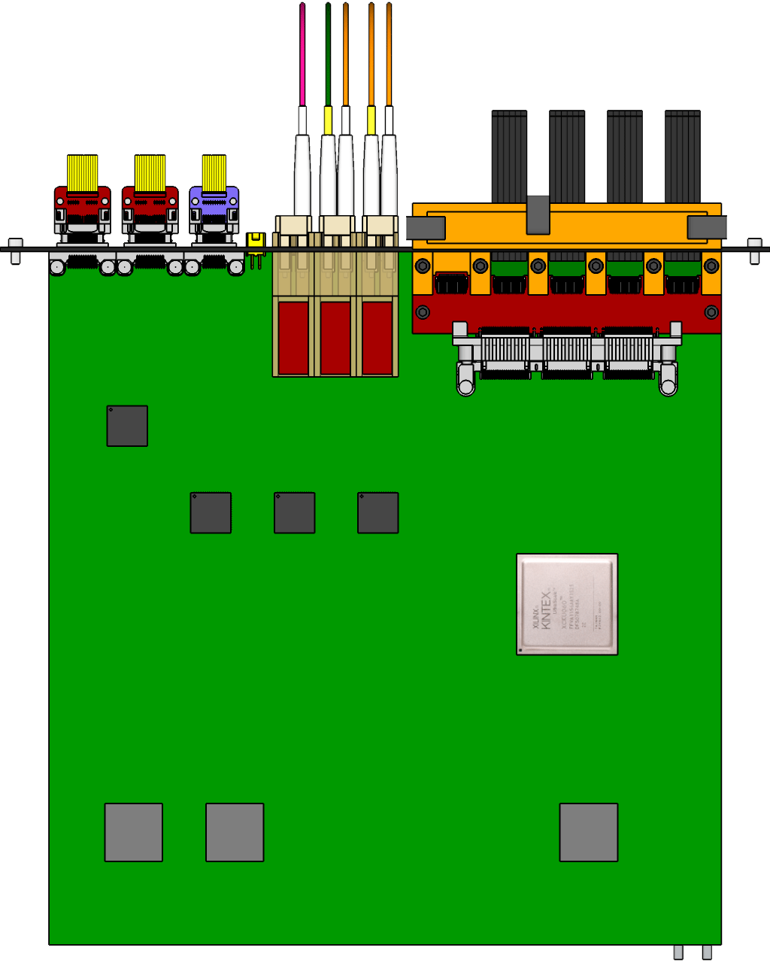

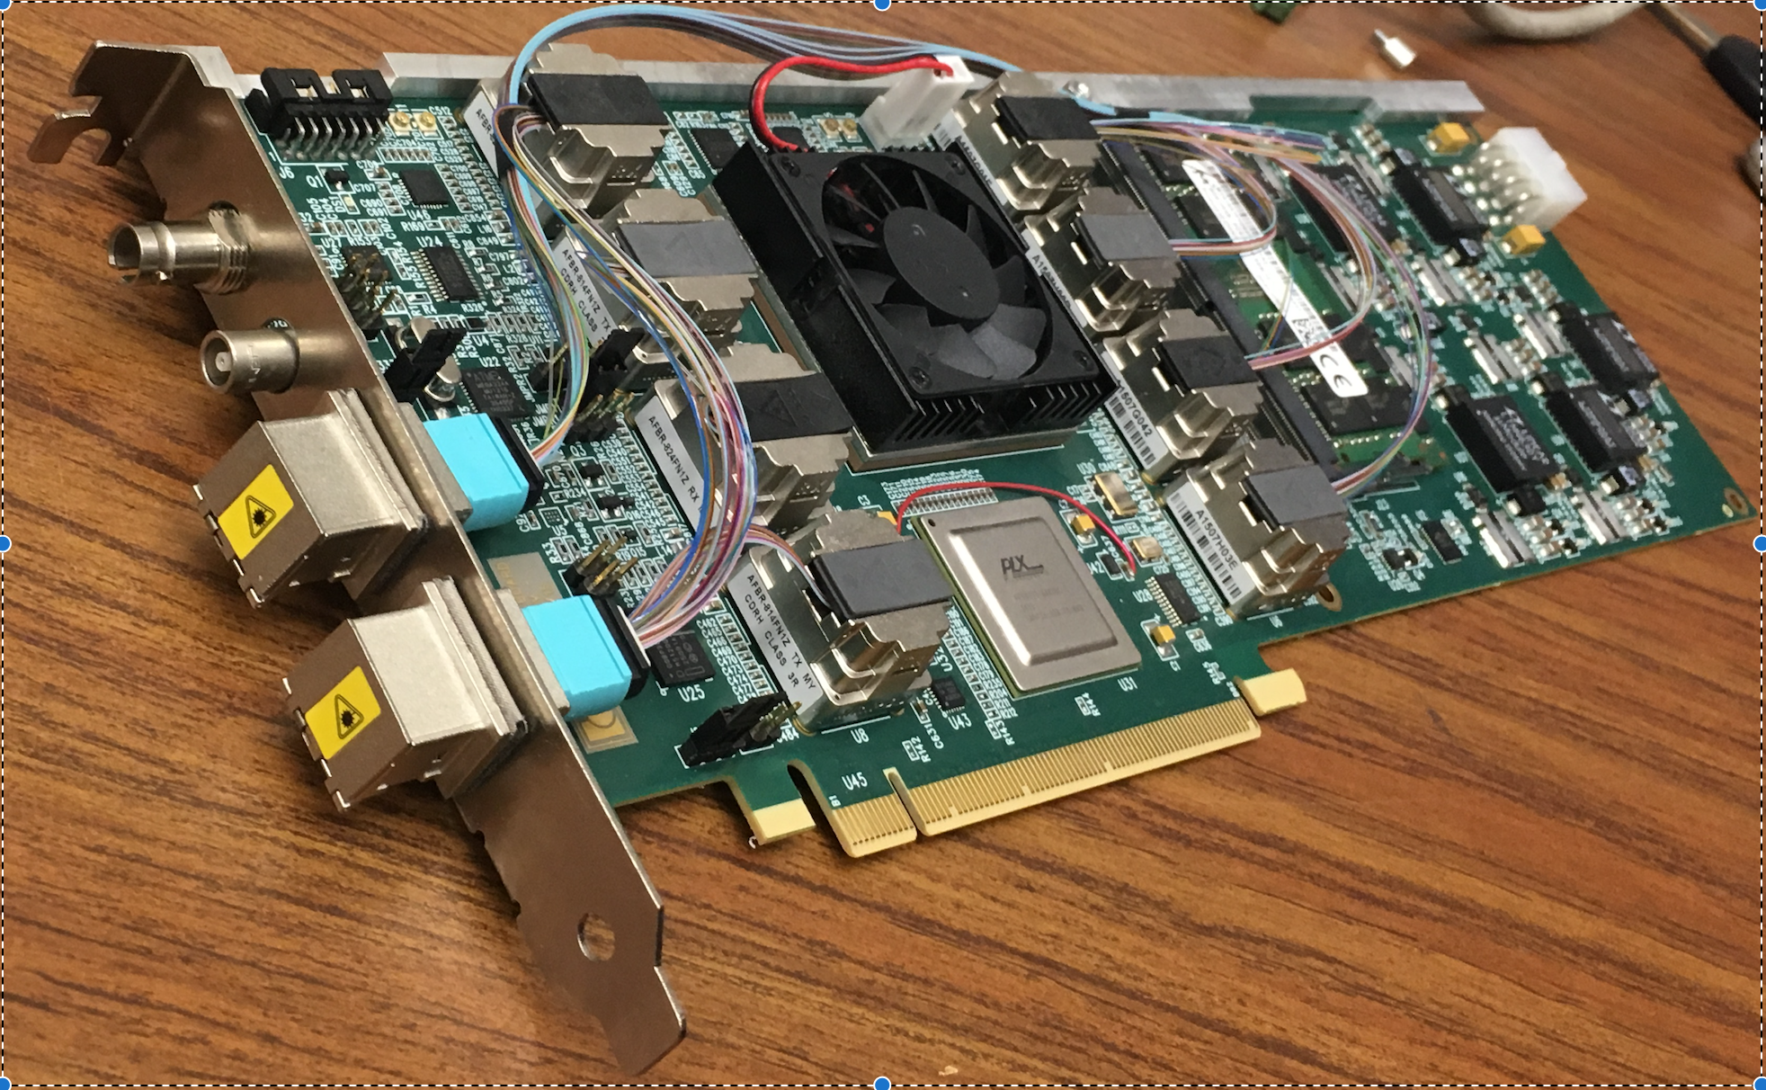
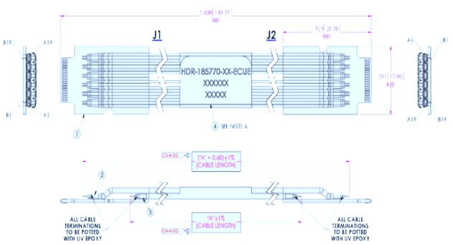

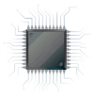
MVTX Sensors, Readout and Control
Alex and Xuan’s talks
ALPIDE pixel circuit
sPHENIX GL-1 & GTM
CAN bus
DCS
5~10 m
Readout Unit
Trigger & Clock
GBT Optical Links
9-sensor Stave
9 Data (1.2Gbps)
1 Clock, 1 Control/Trigger
Control
Data (9.6 Gb/s max)
Trigger
Samtec Twinax “FireFly”
FELIX
FPC
Power
ALPIDE Sensors
Power
RCDAQ
Linux
Filtering
Capacitors
regulators
Power supplies
Cold Plate
Regulated Power
Power Board
Established the full high-speed readout chain: Stave + RU(v1.0) + FELIX(v1.5) + RCDAQ/sPHENIX
  ALPIDE configuration through RU via USB control
  FELIX distribute clock and trigger to ALPIDE through RU, triggered at sPHENIX max rate of 15kHz
  RU receives 1.2Gbps signal from ALIPDE and sends the data to FELIX over fiber using GBT link; 8 RU’s emulated using 1 fiber per RU on FELIX
  FELIX packs the data and store them on disk which are readout using sPHENIX RCDAQ
ALPIDE and Power Unit control and monitor being tested with MOSAIC

Slide 14
ALPIDE Timing & Trigger
ALPIDE Operation
Well fits sPHENIX/RHIC environment, 10MHz beam crossing (LHC 40MHz)
v
PIX_IN
v
OUT_A
~5-6 μs
t_{f}~= 10 ns
OUT_D
ΔV=Q/C
threshold
t_{r}> 100 μs
~5-6 μs
STROBE
t
t
sPHENIX trigger latency: ~4 μs

Slide 15
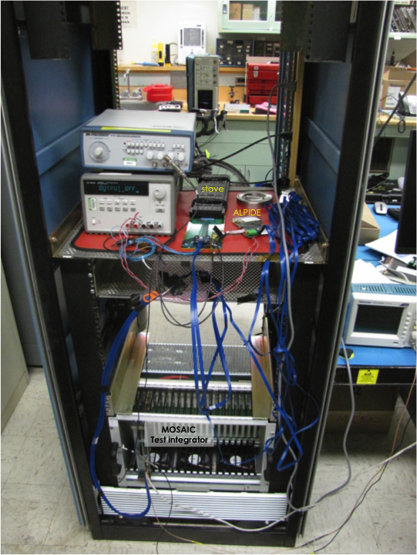
ALPIDE Characterization & Optimization
Xuan’s talk
MOSAIC test bench
  High-speed readout of ALPIDE chip, 1.2Gbps
  Scan sensor response parameters
    Threshold, shaping time, strobe length, trigger delay etc
    Initial evaluation with cosmic rays and external source
Laser testing system in preparation
  Laser pulses to inject MIP-level signal to each pixel
    Focused laser spot, ~10um
    Tunable pulse, ~5ns
    Repetition rate, up to 1MHz
  Scan full parameter space to optimize the operation point for sPHENIX
9-chip stave
1-chip sensor
MOSAIC Test Bench
Laser Driver
Laser
X-Y-Z station
sensor
location

Slide 16
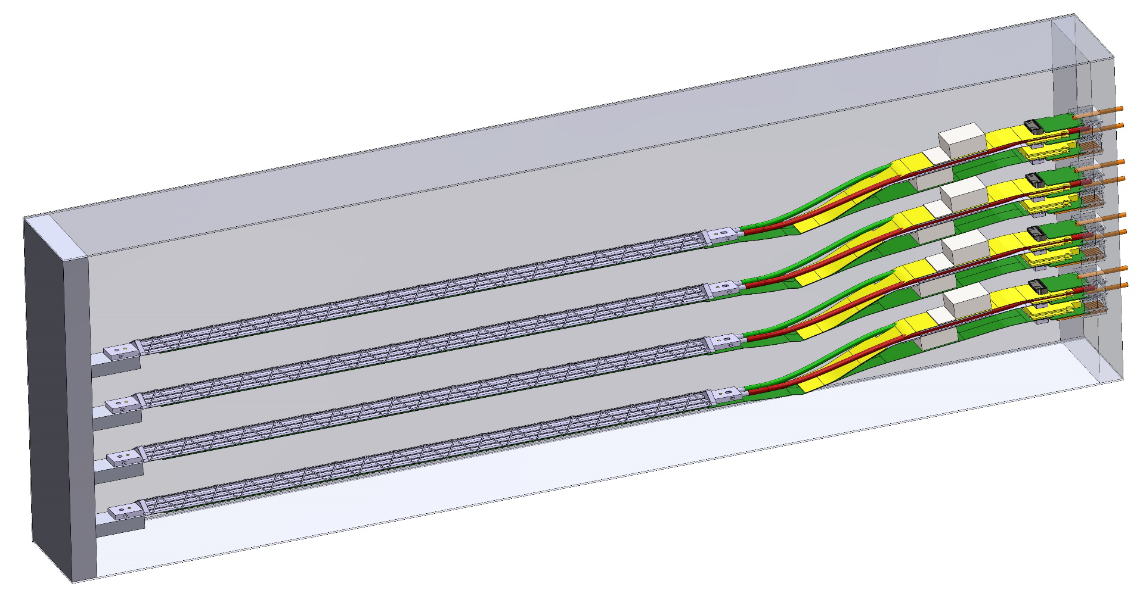
MVTX Prototype Telescope
Sho’s talk
A 4-stave telescope
  Sensor response and cluster size, MC tuning
  Hit spatial resolution
  Tracking and offline reconstruction
  Full readout chain
  Cooling and mechanical stability
Cosmic test: summer 2018
  Full readout chain, 4 staves/chips + 4 RUs + 1 FELIX +RCDAQ/sPHENIX
  Tracking and offline reconstruction
  Benchmark MC hit and cluster distributions
A preliminary beam test at Fermilab
  3-layer ALIPDE chips
  Parasitic with sPHENIX beam test
  Study sensor response to beam, to tune MC simulations
  Scheduled for March 2018

Slide 17
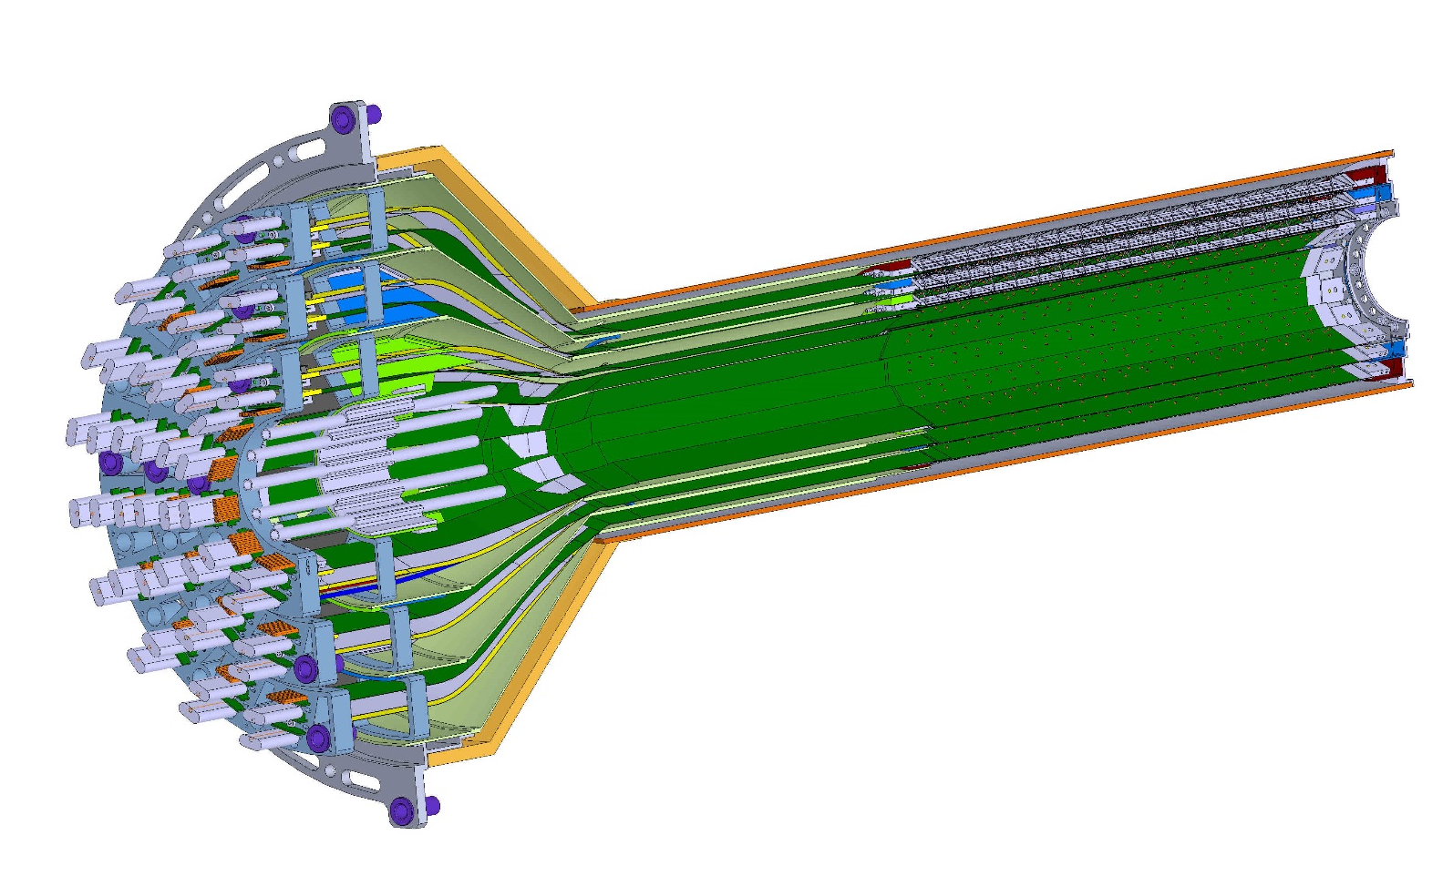
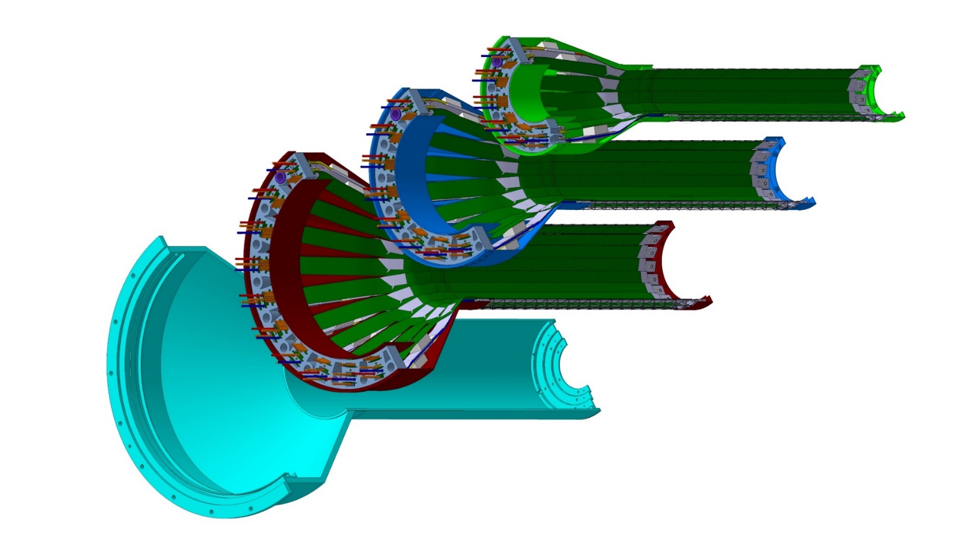
MVTX Detectors
Walt’s talk
Half detector assembly
beam view
27cm
Layer 0
Layer 1
Layer 2
IB CYSS

Slide 18
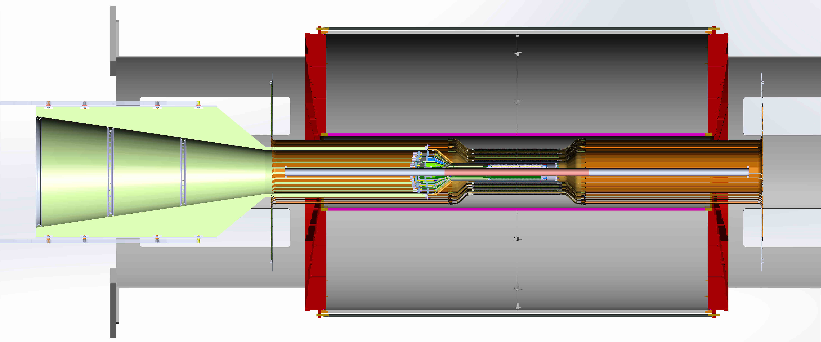
Mechanical System Integration
Walt’s talk
To fit within the sPHENIX
A conceptual design of MVTX mechanical system
TPC
INTT
MVTX

Slide 19
Procurements
Sensors
  1 single chip with slow readout DAQ boards
  5 single chip sensors with high-speed readout adaptor
    10 more to be produced locally
  1 9-chip stave module
    5 more to come in FY18
Readout Units
  1 RU v1.0
    5 RU v1.x to come in FY18
FELIX back end
  1 FELIX v1.5
  2 FELIX v2.0 to be available in FY18
Linux DAQ server
  1 Linux in operation
Power system
  1 32-chan power distribution boards
  CEAN rad-hard power modules and server
  CEAN rad-hard bulk power supply will be available in FY18
Telescope mechanical support
  1 box made
Cooling system
  Cooler tested
  Negative-pressure system in design
FY-18 Procurements plan:
5 staves
5 single chip sensors
5 RUs
2 FELIXv2.0
CAEN bulk PS
Signal extension cables
Stave and carbon structures
Miscellaneous small test equipment and cables

Slide 20
FY18 Milestones
Complete a 4-stave MVTX prototype telescope and cosmic ray test
Complete readout and control integration
Complete initial mechanical system integration and layout
Complete and benchmark b-jet tagging for pp and AuAu
Complete and submit MVTX full proposal to BNL ALD

Slide 21
Major Technical Challenges and Risks Addressed
Project Risks with timely procurements of R&D items from CERN
  Availability of ALICE sensors
    A “Plan-B” was developed to us 3~4 single chip MAPS sensors for the initial telescope R&D in a simple mechanical/cooling enclosure in order to test the electronics readout chain of multi-chips.
  Availability of ALICE readout electrons
    A prototype Readout Unit (RU) with Xilinx evaluation board KC705 was developed before the arrival of RUv1.0
    In the difficulty of obtaining Common Readout Unit (CRU), an alternative path was developed to use ATLAS FELIX board and demonstrated it meets/excceeds the sPHENIX DAQ requirements.
  Removed the initial cost and schedule uncertainty of custom-designed readout option! (rec,#1)
Test beam and full proposal
  Given the success of full readout chain with RU and FELIX in advance, we have determined that a test beam is not required for the full proposal submission. However, a test beam is required before the full production of sPHENIX readout electronics.
  Given our advanced progress in readout and telescope design, we are preparing for an early test beam at Fermilab in March 2018 to study sensor response and readout characterization.
Add more milestones to MIE proposal development
  We have 3 implicit milestones: 1) to build a collaboration and submit a pre-proposal by the end of the first year FY17; 2) to have science and technical reviews in the 2nd year and complete a full proposal by the end of FY18; 3) to have the full proposal reviewed and approved by DOE by the end of FY19.
  We have already achieved the 1st milestone in Feb 2017 and the 2nd milestones in Jan 2018. The MVTX detector collaboration is formed and growing, a preproposal was submitted to DOE in Feb 2017 and a full proposal to BNL ALD in January 2018. LANL LDRD team is working with the MVTX detector collaboration, sPHENIX and BNL management to realize the full program.
Setup simulation milestones for the MIE proposal
  Through close collaboration with MVTX group, a full sPHENIX tracking simulation package has been developed and used for realistic b-jet tagging study for the MVTX proposal.

Slide 22
Remaining Major Tasks and Challenges
ALPIDE sensor characterization and optimization
  Readout and trigger optimization for sPHENIX
Full readout and control in sPHENIX
  Full readout with RHIC clock and trigger
    RUv1.x and FELIXv2.0
  Long SamTec cable R&D
    Meet sPHENIX mechanical integration requirement
MVTX and INTT integration
  Barrel readout extension cable R&D
  Mechanical system integration
Final test beam at Fermilab with full MVTX prototype telescope
  Demonstrate tracking capability, spatial resolution
  High trigger rate (15kHz) at high multiplicity

Slide 23
Broad Impacts
Broad applications with the current MVTX detector design to maintain the leadership of LANL in nuclear physics fields:
High impact on big science at international level
  Current and future physics programs at RHIC, LHC, EIC
  EIC - the DOE highest priority next generation NP facility.
Define the directions for LANL basic science and applied programs
  Expect to have long-term DOE Baseline support on sPHENIX as a result of this LDRD effort
  New staff hiring, promotions
  New proposals developed based on this R&D from this LDRD project
Applied programs at LANL
  For X-ray imaging which leads to new detecting method developments and could benefit the future MaRIE project. a new LDRD proposals under preparation.
  Initiated a new feasibility study to develop a new neutron detection capability at LANL for applied programs, a new LDRD proposals under preparation.

Slide 24
MVTX Full Proposal Development
MVTX detector collaboration formed, 1/2017
  International collaboration of 17 institutions, and counting
  Bi-weekly detector R&D and physics simulation meetings
  Weekly project development meetings, project leaders from LANL, BNL, MIT and LBNL
A pre-proposal completed and submitted to DOE in Feb. 2017
  Initial feedback from DOE, positive, compelling science
  Asked all future discussion and submission done through BNL
BNL Directors review, July 2017
  Very successful, positive feedback
  Recommended to proceed with a full proposal
Organized several workshops dedicated to detector R&D and to physics program development
  MVTX physics and detector design, 1/2017, LBNL
  Readout electronics R&D, 4/2017, UT-Austin
  Cost & schedule workfest, 6/2017, BNL
  MVTX and Heavy Flavor physics, 12/2017, Santa Fe
A full MVTX proposal completed and submitted to BNL ALD 1/2018

Slide 25
Transition Plan
Cesar’s talk
The transition plan details are still being worked out and evolving; as a result of this LDRD, we expect to have:
  Long term DOE NP support on sPHENIX heavy ion heavy flavor physics program
  Long term DOE support on theory
MVTX funding news (received by MVTX group on 1/19/2018)
  From email by BNL Associate Laboratory Director (ALD) Dr. Berndt Mueller:
    “Tim Hallman (DOE NP Director) assured me that [DOE] appreciate the compelling science this instrument [MVTX] could enable and why it is considered very important to the sPHENIX experiment by the collaboration”
    [Hallman] “informed me given their present budget outlook, whatever is accomplished for sPHENIX will have to be achieved in the context of flat base funding for RHIC and /or foreign contributions”
    DOE “very much appreciate and encourage efforts to secure such contributions, but unfortunately in our present outlook, we do not foresee at this time that we would be able to identify new DOE funding for the purpose of implementing the MVTX”
  BNL ALD commented that guidance is informed by flat-flat budget outlook for the rest of the decade
  ALD commented that this can be viewed as implicit DOE approval of a “no-cost extension” of the baseline scope to include MVTX
MVTX group is working closely with sPHENIX and BNL management to seek alternative path to fund the full MVTX detector.
  Several options being explored within the sPHENIX collaboration

Slide 26
Summary
Identified the readout path, full readout chain demonstrated with near final electronics
  Eliminated major technical, schedule and budget uncertainties in the readout electronics design
Mechanical conceptual design developed
B-jet tagging algorithms developed for both p+p and Au+Au at the top RHIC energy
Formed MVTX collaboration, developed a much expanded new heavy flavor physics program for the sPHENIX experiment at RHIC
MVTX full proposal completed and submitted to BNL ALD
  Working with sPHENIX, BNL and DOE to identify funding
A MVTX prototype telescope being constructed, in preparation for beam test at Fermilab in near future
Addressed most of the LDRD technical, schedule and budget uncertainties identified at the beginning of this project
On track to meet all milestones in FY18.

Slide 27
backup

Slide 28
Transition Plan
Project: 20170073DR
Title: Probing Quark-Gluon Plasma with Bottom Quark Jets at sPHENIX
Initial “Transition Plan”:
Experiment: At the end of this DR project we will have secured a major role for LANL in the development, construction, and utilization of the sPHENIX detector. Our transition model to DOE funding is based upon our previously successful PHENIX FVTX at BNL and the E906 muon identifier at Fermilab, both of which began as LANL LDRD projects. These two projects were subsequently adopted by the DOE Nuclear Physics program, who provided full detector funding and support for the LANL-led physics programs. This past record demonstrates that the current team has abundant program development experience for managing this kind of transition. After this DR project, we will work closely with LANL’s Nuclear Physics program office, the sPHENIX collaboration, and our DOE Nuclear Physics program managers to construct and install the full inner tracker. The potential total return on this proposed LDRD investment is large, above 6:1. For example, the DOE currently provides about $3M per year to LANL for physics work related to our FVTX detector and has done so for about 7 years. The FVTX physics program will likely end within a few years. Without a major new role at sPHENIX, our DOE longterm support is at risk.
Theory: This project will place LANL at the forefront of b-jet physics calculations for both RHIC and LHC collision energies under a common theoretical framework. This will ensure that, after the completion of the DR, the utilization of the next generation of experiments is fully maximized and will provide additional insight into the heavy ion LHC experiments currently underway. Previous successful theoretical LDRD projects have allowed LANL to secure significant DOE early career award funding ($1M/yr for 5 yrs) and we expect to receive long-term DOE baseline support as a result of this LDRD effort. Funding sources for the theoretical efforts include DOE’s Nuclear Physics, High Energy Physics and Fusion Energy Science program offices.

Slide 29
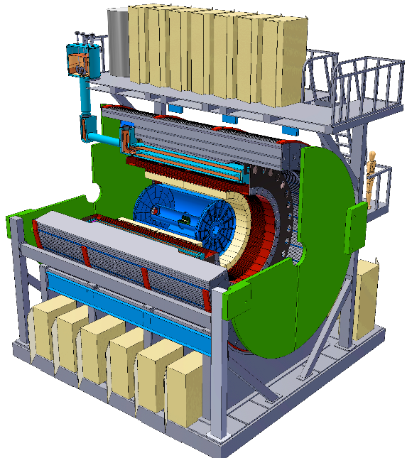
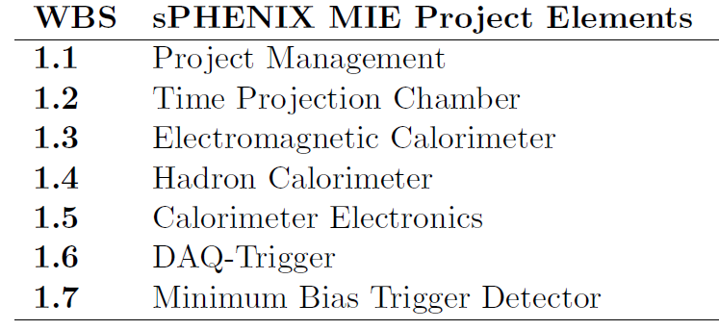
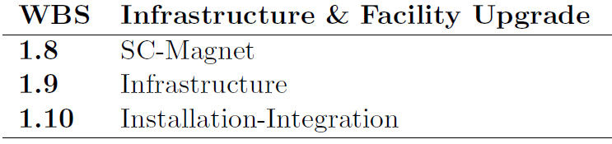
MVTX:MAPS-based Vertex Detector
A separate upgrade project for the baseline sPHENIX: Jet + B-tagging
Baseline
Parallel Activities
MAPS-based Vertex Detector (MVTX)
Intermediate Silicon Strip Tracker (INTT)
Upgrades

Slide 30
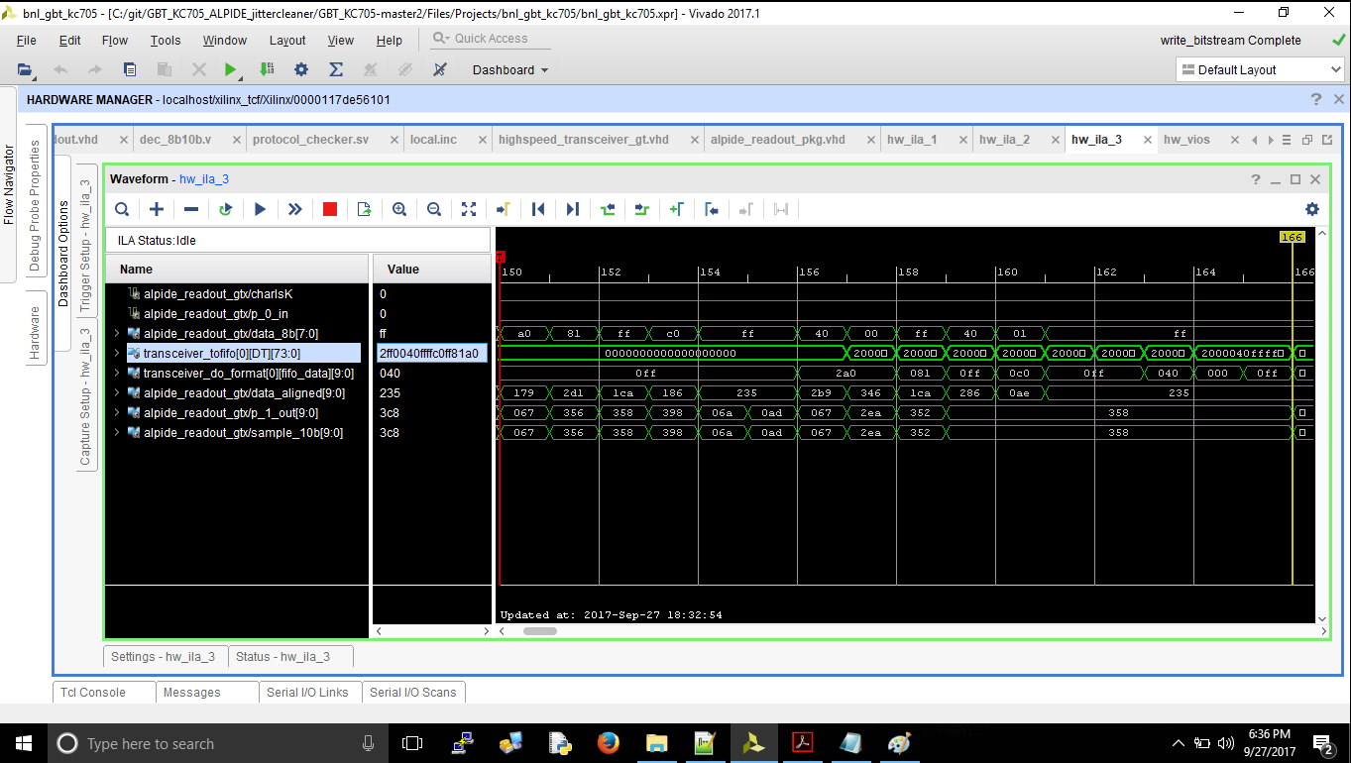
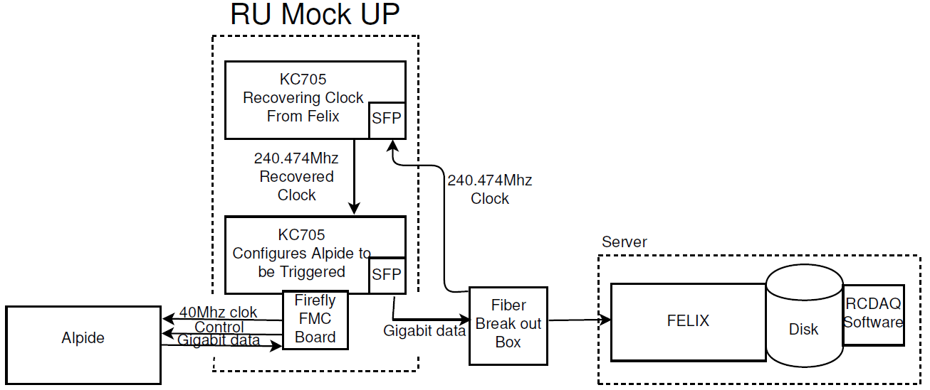
ALPIDE R&D at LANL
Power unit test
ALPIDE/Stave evaluation test bench
LV/HV controls
DAQ integration

Slide 31
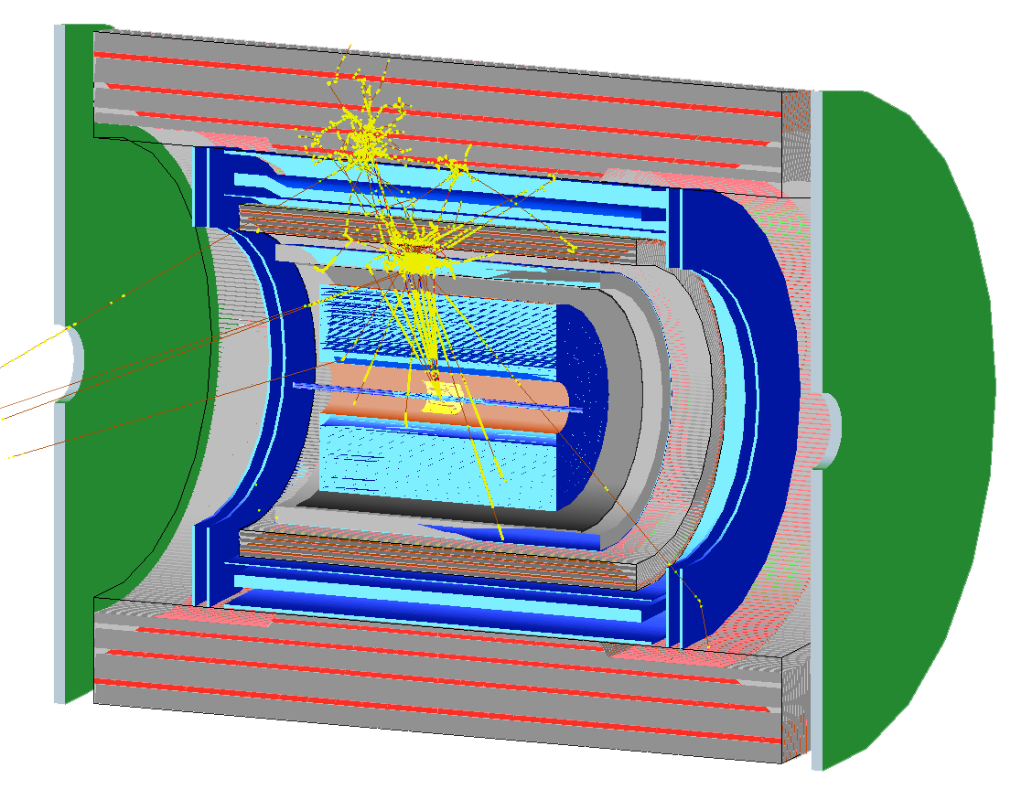
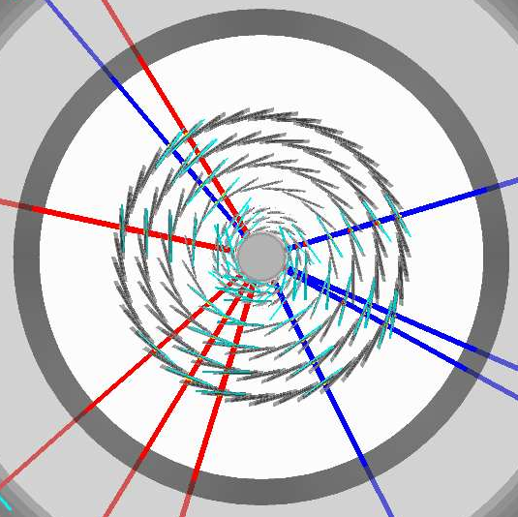
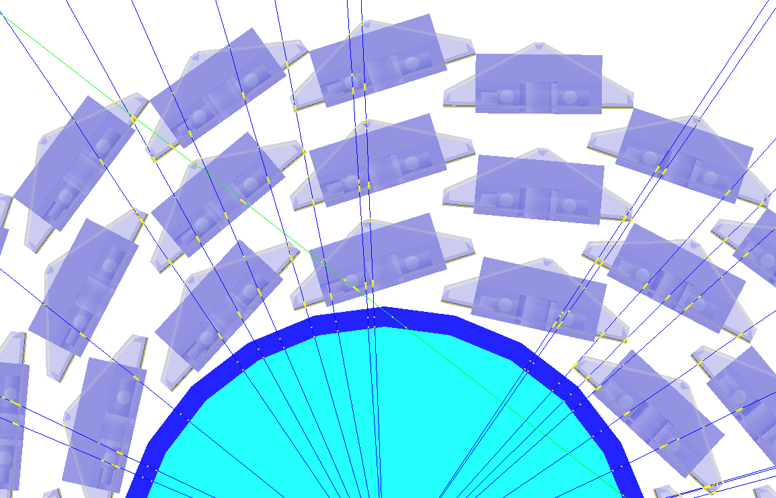
Simulation for b-jet and B-meson
sPHENIX Geant4 display of p_{T}=30 GeV/c B⁺-hadron
Design to Simulation
MVTX and INTT _
_ MVTX Ladders modeled in details
MVTX sensors

Slide 32
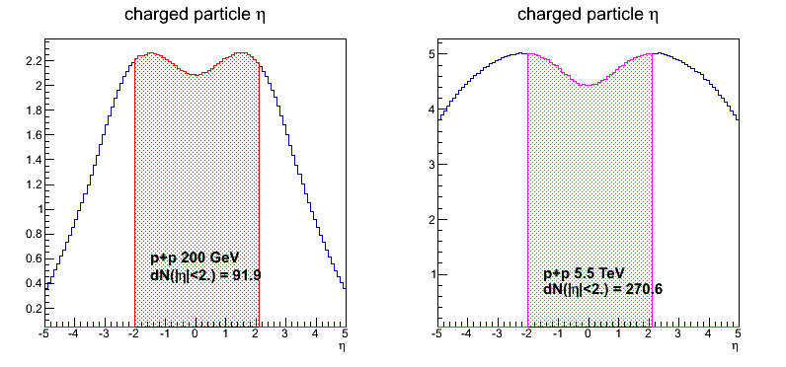
sPHENIX vs ALICE Specifications
 | ALICE (Run3) | sPHENIX
Pb+Pb / Au+Au | 100 kHz (50kHz) | 200 kHz
p+p | 400 kHz (200kHz) | 13 MHz
Trigger | 50 kHz | 15 kHz
Event size, dN/dη: sPHENIX = 1/3 ALICE (pp), 1/5 ALICE(AA)
sPHENIX
ALICE

Slide 33
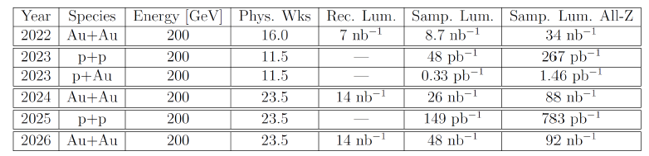
RHIC Multi-Year Plan: sPHENIX 2022-2026+
Evolving
B hadrons/pT<15GeV: O(1M)
b-jets/pT>15GeV: O(100K)
Precision 2nd vertexing for B-tagging:
  Tracking resolution better than 50um @pT=1GeV
  High multiplicity HI collisions
  Low multiplicity but high rate p+p collisions
  High efficiency and high purity

Slide 34
BNL sPHENIX Control Envelope Drawing
Z location of the inner hcal is at 2175,0mm

