Slide 1
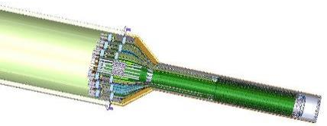

sPHENIX LDRD Review
MVTX mechanical conceptual design
Walter Sondheim
P-25
UNCLASSIFIED

Slide 2
sPHENIX experiment - MVTX Detector:
MVTX mechanical conceptual design:
Personnel involved:
Walter Sondheim, P-25,
  mechanical and integration engineering
Christopher O’Shaughnessy, P-25,
  mechanical engineer, physicist,
    Focusing on MVTX telescope and cooling
Hubert Van Hecke, P-25,
  Physicist,
    Prototype construction
David Lee, P-25,
  Physicist,
    “Project” file management
UNCLASSIFIED

Slide 3
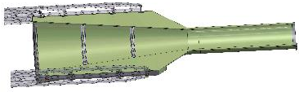
Outline:
MVTX mechanical components:
  Stave
    Cabling pig-tail
  Half-barrel (3 layer) assembly
  Service barrel
  Support cylinder

Slide 4
MVTX tracker stave:
Stave assembly consists of:
  One layer with 9 MAPS chips
  One thermally conductive carbon cold plate – space frame
  One carbon filament truss structure
  One flexible printed circuit (FPC) that is wire-bonded to the MAPS chips
  Bonded assembly
UNCLASSIFIED

Slide 5
MVTX stave cooling:
Coolant: negative pressure single phase H₂O
Pixel chip operational temperature < 30⁰ C
Pixel chip max temperature non-uniformity < 5⁰ C
Pixel chip (Alpide) power dissipation < 41 mW/cm²
Total power dissipation: 184.5 mW/chip X 9 chips per stave X 48 staves in the MVTX assembly = 79.7 Watts
Full length cold plate assembly 290 mm, mass 1.7 gms.
Full stave assembly, chips, FPC, cold plate mass 15.1 gms.
MXTX inner tracker stave cooling and support plate:
UNCLASSIFIED

Slide 6
MVTX stave radiation length:
UNCLASSIFIED

Slide 7
Half Barrel Service Interconnect:
MVTX Services and Cabling and Cooling lines:
Pig-tail
Interconnect patch-panel:
Signal cables, AC & DC power,
Cooling
Stave assy:
Carbon composite outer shell
Prototype Pig-tail layers:
Signal - Firefly coax
AC
DC and bias
Layer 0
Layer 1
Layer 2
Layer 0
Layer 1
Layer 2
Cooling: negative pressure water, plus dry air (nitrogen) flow
UNCLASSIFIED

Slide 8
Composite technology demonstrated:
Carbon composite production pieces:
These composite prototype parts made at CERN, similar to ones needed for MVTX detector:
UNCLASSIFIED

Slide 9
MVTX layer assembly steps:
MVTX layer assembly steps, using fixtures and dummy staves:
Using “dummy staves” to secure positioning
Replace “dummy staves” with production staves
Precision assembly fixture used to hold “end wheels” for placement of staves to required accuracy. Initial use of “dummy staves” maintains the overall required positioning.
Stave “pig-tails” mounted in patch panel
UNCLASSIFIED

Slide 10
sPHENIX MVTX Detector:
MVTX cabling configuration:
UNCLASSIFIED

Slide 11
MVTX composite service barrel:
Interface rollers mate to guide slots in support cylinder:
Overall length = 2161.73 mm
Radius = 319.2 mm
UNCLASSIFIED

Slide 12
Possible MVTX installation cylinder:
Rail guides for upper half assembly
Eccentric:
Adjustable roller +/- 1.0 mm, by steps of .25 mm
In sPHENIX we will not use a “service cone, rail system” anywhere near the size of that planned for the ALICE detector (shown here), but we will integrate their concept.
UNCLASSIFIED

Slide 13
sPHENIX experiment CAD model:
sPHENIX experimenter
5,200 mm
7,000 mm
7,000 mm

Slide 14
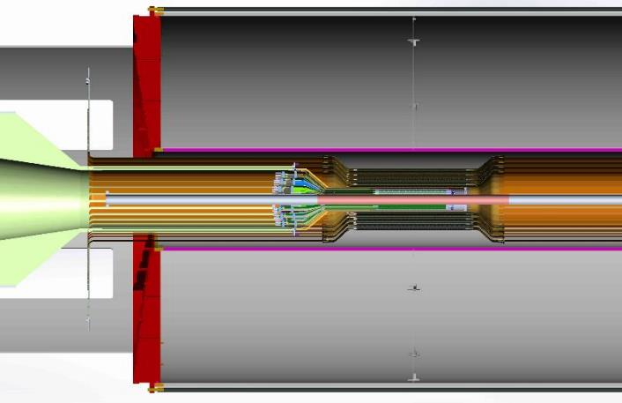
MILESTONE: MVTX mechanical system conceptual
design completed:
INTT extension cables, 1,200 mm length, to read-out boards
TPC
MVTX flex extension cable 180.0 mm
INTT stave length 480.0 mm
MVTX stave length 280.0 mm
UNCLASSIFIED

Slide 15
Milestones & integration issues:
Milestones continued:
  Modified model to be compatible with sPHENIX tracking detectors and beam-pipe, installation plan
The current design for the INTT detector does not have a support structure or additional services, power & cooling.
There is interference between the INTT extension cables and the conical region of the MVTX (“Z” locations)
Because of the different radial dimensions between the beam-pipe in ALICE and the beam-pipe in sPHENIX, each of the three MVTX layers needs to be moved outward in radius by .75 mm.
  This translation will still allow each layer to be hermetic
Continuation of integration issues will be taking place with all of the sPHENIX tracking detector systems: TPC, INTT & MVTX by the formation of a sPHENIX tracking integration task force.
UNCLASSIFIED

Slide 16
sPHENIX MAPS Detector:
Back-up:
UNCLASSIFIED

