Slide 1

Theory:
Introduction and perturbative QCD
Ivan Vitev (co-PI)
T-2
UNCLASSIFIED

Slide 2
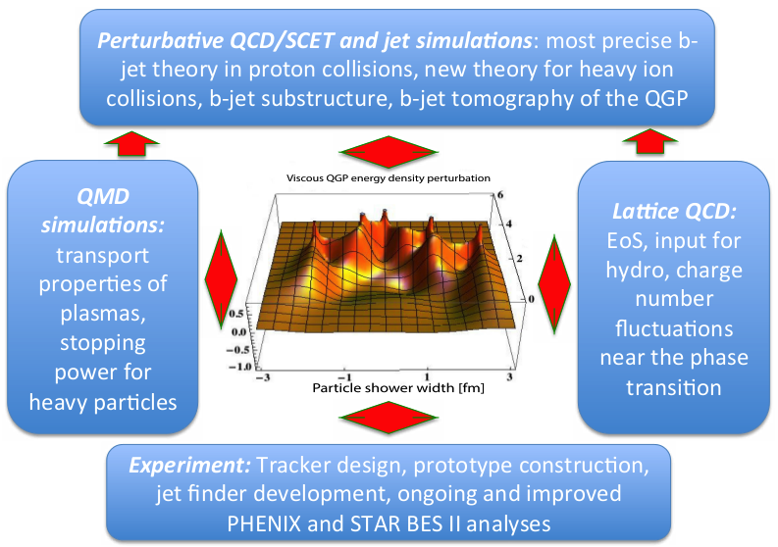
The Quark-Gluon Plasma
and Bottom Quark Jets
  pQCD: b-jets and heavy flavor, energy loss and b-jet substructure in the QGP
  SCET: b-jets in p+p, energy correlators, resummation
  MD: Transport properties of SCPs. Stopping power for heavy fermions
  LQCD: EOS in fluctuating hydro, simulations of jet propagation
Integrated effort:
T-2, T-5 and CCS-7 groups in close collaboration with experiment
Staff: J. Daligault, R. Gupta, Z. Kang, C. Lee, I. Vitev, B. Yoon
PD: H. Li, F. Ringer, M. Sievert, V. Vaidya Students: S. Aronson, D Bernstein, B. Odegard, J. Reiten, P. Shrivastava
Theory deliverable: package for precision b-jet tomography at sPHENIX and predictions for experiment

Slide 3
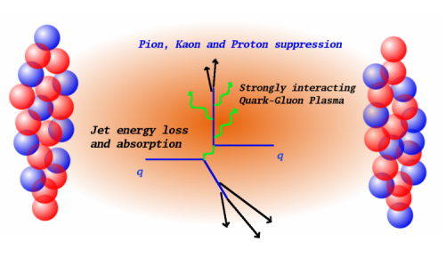
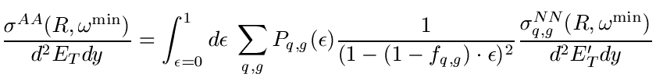
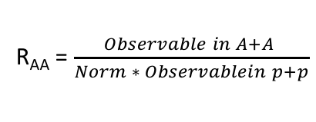
Traditional Energy Loss and B-jet
Suppression Simulations for sPHENIX
Provide b-jet suppression magnitude input: assess exp. sensitivity to QGP properties
Jets present
unique challenges
R
R_{AA} = $\frac{Observable in A+A }{Norm ∗ Observablein p+p}$
Theory uncertainties cancel in the ratio
Inclusive b-jet suppression
I. Vitev et al. (2018)
Provided results to sPHENIX for the full DOE proposal. Constraints on the coupling “g” between the jet and the medium better than 10%, transport coefficients ~ 30%

Slide 4

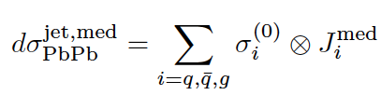
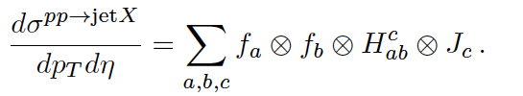
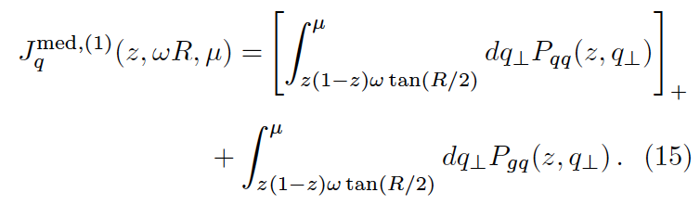
Evaluating the In-medium Jet Function
and Heavy Ion Phenomenology
Beyond traditional energy loss: incorporate the technology of higher order calculations and resummation from HEP
Inclusive jet cross sections can be formulated in terms of semi-inclusive jet functions J(z,ωR,μ)
Demonstrated that J(z,ωR,μ) is related to the Altarelli-Parisi splitting functions (parton showers)
Inclusive jet suppression
Central collisions
Z. Kang et al . PLB (2017)
Transverse momentum

Slide 5


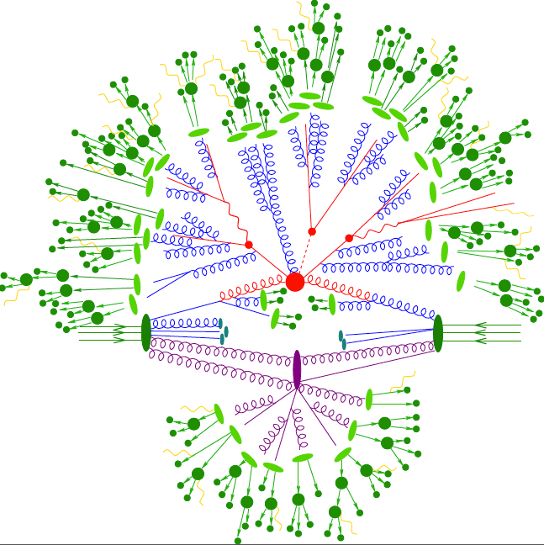
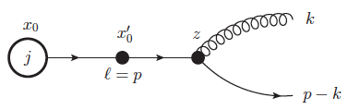


Effective Theory of Heavy Quark
Propagation in Nuclear Matter
Formulated a new effective theory SCET_{M,G} – for massive quarks & Glauber gluon interactions
With the field scaling in the covariant gauge for the Glauber field there is no room for interplay with mass in the LO Lagrangian
Result: SCET_{M,G} =SCET_{M} ✕ SCET_{G}
Splitting functions
x
1 - x
$$Q→Qg$$
$$Q→gQ$$
$$g→QQ$$
$$g→gg$$
Precise understanding of the mass dependence.
Z. Kang et al . JHEP (2017)

Slide 6
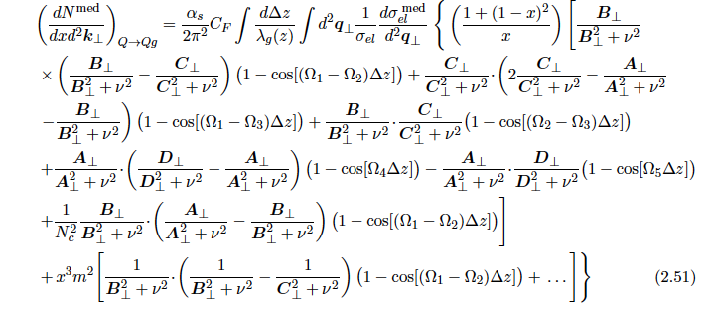



QCD In-medium Splitting Functions
Performed the First NLO heavy flavor calculation in HIC
Full in-medium splitting functions
Gives an improved description of open heavy flavor suppression from radiative processed down to lower p_{T}
Kinematic variables
See talk by B. Yoon on the evaluation
of the splitting functions
Z. Kang et al . JHEP (2017)

Slide 7


Groomed Soft Dropped Jet Distributions in SCET_{G}
Substructure of jets: the longitudinal and transverse momentum distribution of particles within jets, jets within jets
Groomed jet distribution using “soft drop”
Demonstrated the great utility of these new distributions:
Probe the early time dynamics / splitting when the jet forms in the QGP
p_{T2}
r_{g} = ΔR₁₂
p_{T1}
Y. T. Chien et al. PRL (2017)
z_{g =}
They are calculable from first principles and directly related to the splitting functions
Jet splitting function modification
Subjet momentum fraction z_{g}

Slide 8
Inverting the Mass Hierarchy of Jet Quenching Effects
B-jet substructure in heavy ion collisions:
Discovered a new way to constrain mass effects in parton showers
At RHIC jet energies, we predict a unique reversal of the mass hierarchy effects on jet splitting
Sudakov resummation: accounts for multiple branchings
H. Li et al . (2018)
See talk by C. Lee on other substructure observables

Slide 9
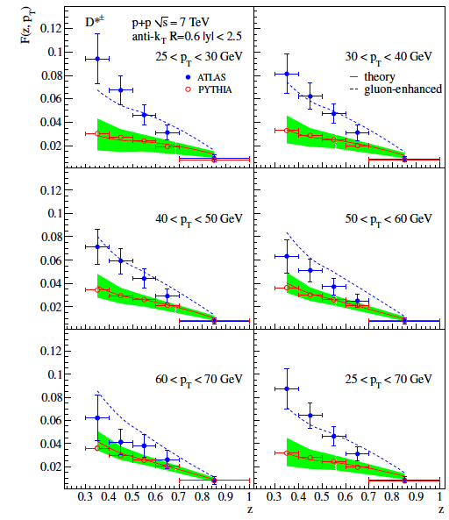
New Constraints on Gluon
Fragmentation in Heavy Mesons
Milestones met: achievements beyond the original research scope
Clearly the gluon contribution to heavy flavor is very important for reactions with nuclei
D* meson distribution
Momentum fraction
Performed global refit of fragmentation functions to world’s data including semi-inclusive annihilation, inclusive hadron production and hadrons in jets
Excellent χ²/DOF ~ 1

Slide 10
Final Results for D* Fragmentation Functions
Fit at NLO in Mellin space
Significant enhancement of the gluon fragmentation component to HF at small and intermediate z
Important implications for heavy flavor suppression in the QGP: larger color charge = larger suppression
Obtained much improved description of D* in jets
D. Anderle et al. PRD (2017)

Slide 11

Theory Timetable and Future pQCD Work
Future work:
Main focus: the new simulation package milestone, combining all theory advances
Specific tasks: b-jet quenching from semi-inclusive jet functions, incorporation of HF splitting functions in a hydrodynamic background, collisional E-loss; extend several calculations down to RHIC energies
New opportunities: di b-jet correlations, c-jets, soft-Glauber interactions
See talk by J. Daligault on transport properties and stopping power of SCPs

Slide 12
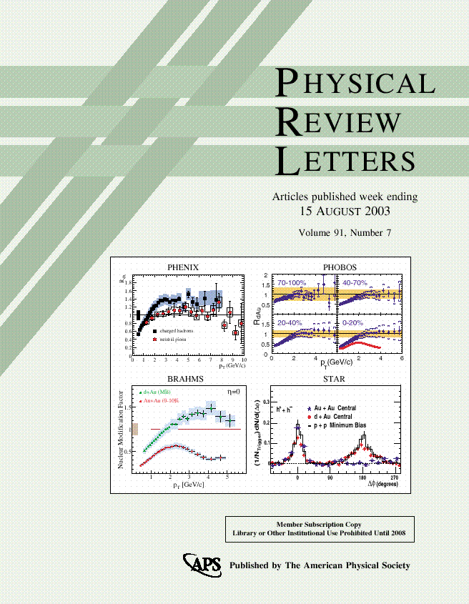


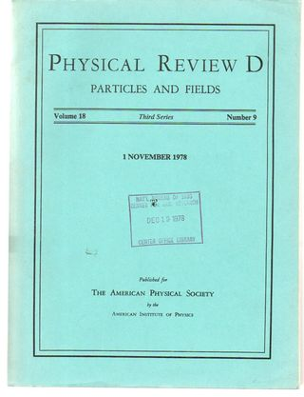

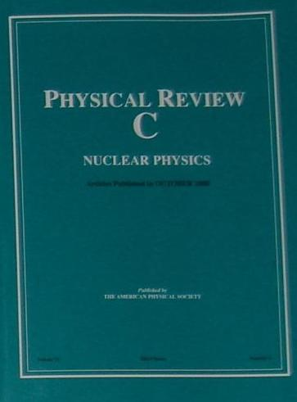
Summary of pQCD Accomplishments
Publications – 9 refereed publications in the leading journals in the field (including 3 letters), 1 more near completion. 4 refereed conference proceedings
- Y. Chien, I. Vitev, Physical Review Letters 119: 112301 (2017)
- Z. Kang, F. Ringer, and I. Vitev, Journal of
High Energy Physics. 1703: 146 (2017)
- Z. Kang, F. Ringer, and I. Vitev, Physics Letters
B. 769: 242-248 (2017)
- D. Anderle, T. Kaufmann, M. Strattman,
F. Ringer, I. Vitev, Physical Review D 96 034028 (2017) …
Talks – given 16 talks and seminars, many invited, including plenary
- I. Vitev, “Jets in SCET”, Precision spectroscopy of the QGP with jets and heavy flavor, INT,
Seattle, WA, 2017
- F. Ringer, “Inclusive jets and their substructure in SCET”, Jets@LHC, Bangalore, India, 2017
- H. Li, “Inverting the mass hierarchy of jet quenching effects with b-jet substructure
sPHENIX Collaboration Workshop, Santa Fe, NM 2017 …
Summary - Work is well on track, we have met all milestones (some considerably ahead of time). This allowed us to seize the opportunity to expand the originally proposed scope and impact, better understand heavy flavor fragmentation and work on collisional energy loss / b-jet correlations

Slide 13


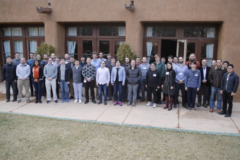

The Broader Impact of pQCD/SCET Theory
Follow on projects / grants: NSF three year award $60K/y, “Perturbative QCD Study for Jet and Heavy Flavor Production”. August 2017 – August 2020
Conferences: Co-organized conferences related to jet and heavy flavor physics– Santa Fe Jets and Heavy Flavor workshop, 2017, 2018. UCLA jet physics workshop 2017. Selected to host 2019 International Symposium on Multiparticle Dynamics in Santa Fe, NM (in competition with Scotland)
Personnel
F. Ringer to LBNL, now on UIUC shortlist; H. Xing to ANL/Northwestern, standing Assistant Professorship offer from Southern China Normal U.; D. Kang to Fudan U., professor; M. Sievert was a finalist at NMSU, to Rutgers U.; H. Li joined us from Monash U. Australia; Consult with D. Neill, Feynman to staff.

