Slide 1

sPHENIX LDRD Readout System Review
Alex Tkatchev
P-25
UNCLASSIFIED

Slide 2
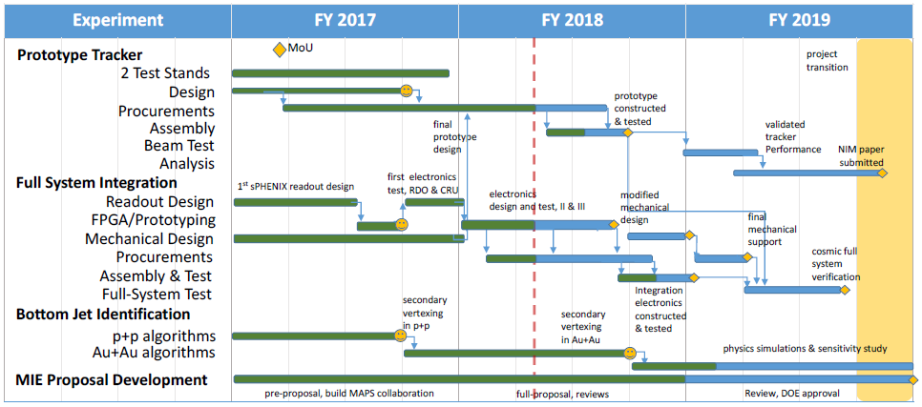

Schedule
Notes:
Me

Slide 3
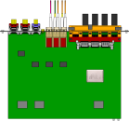

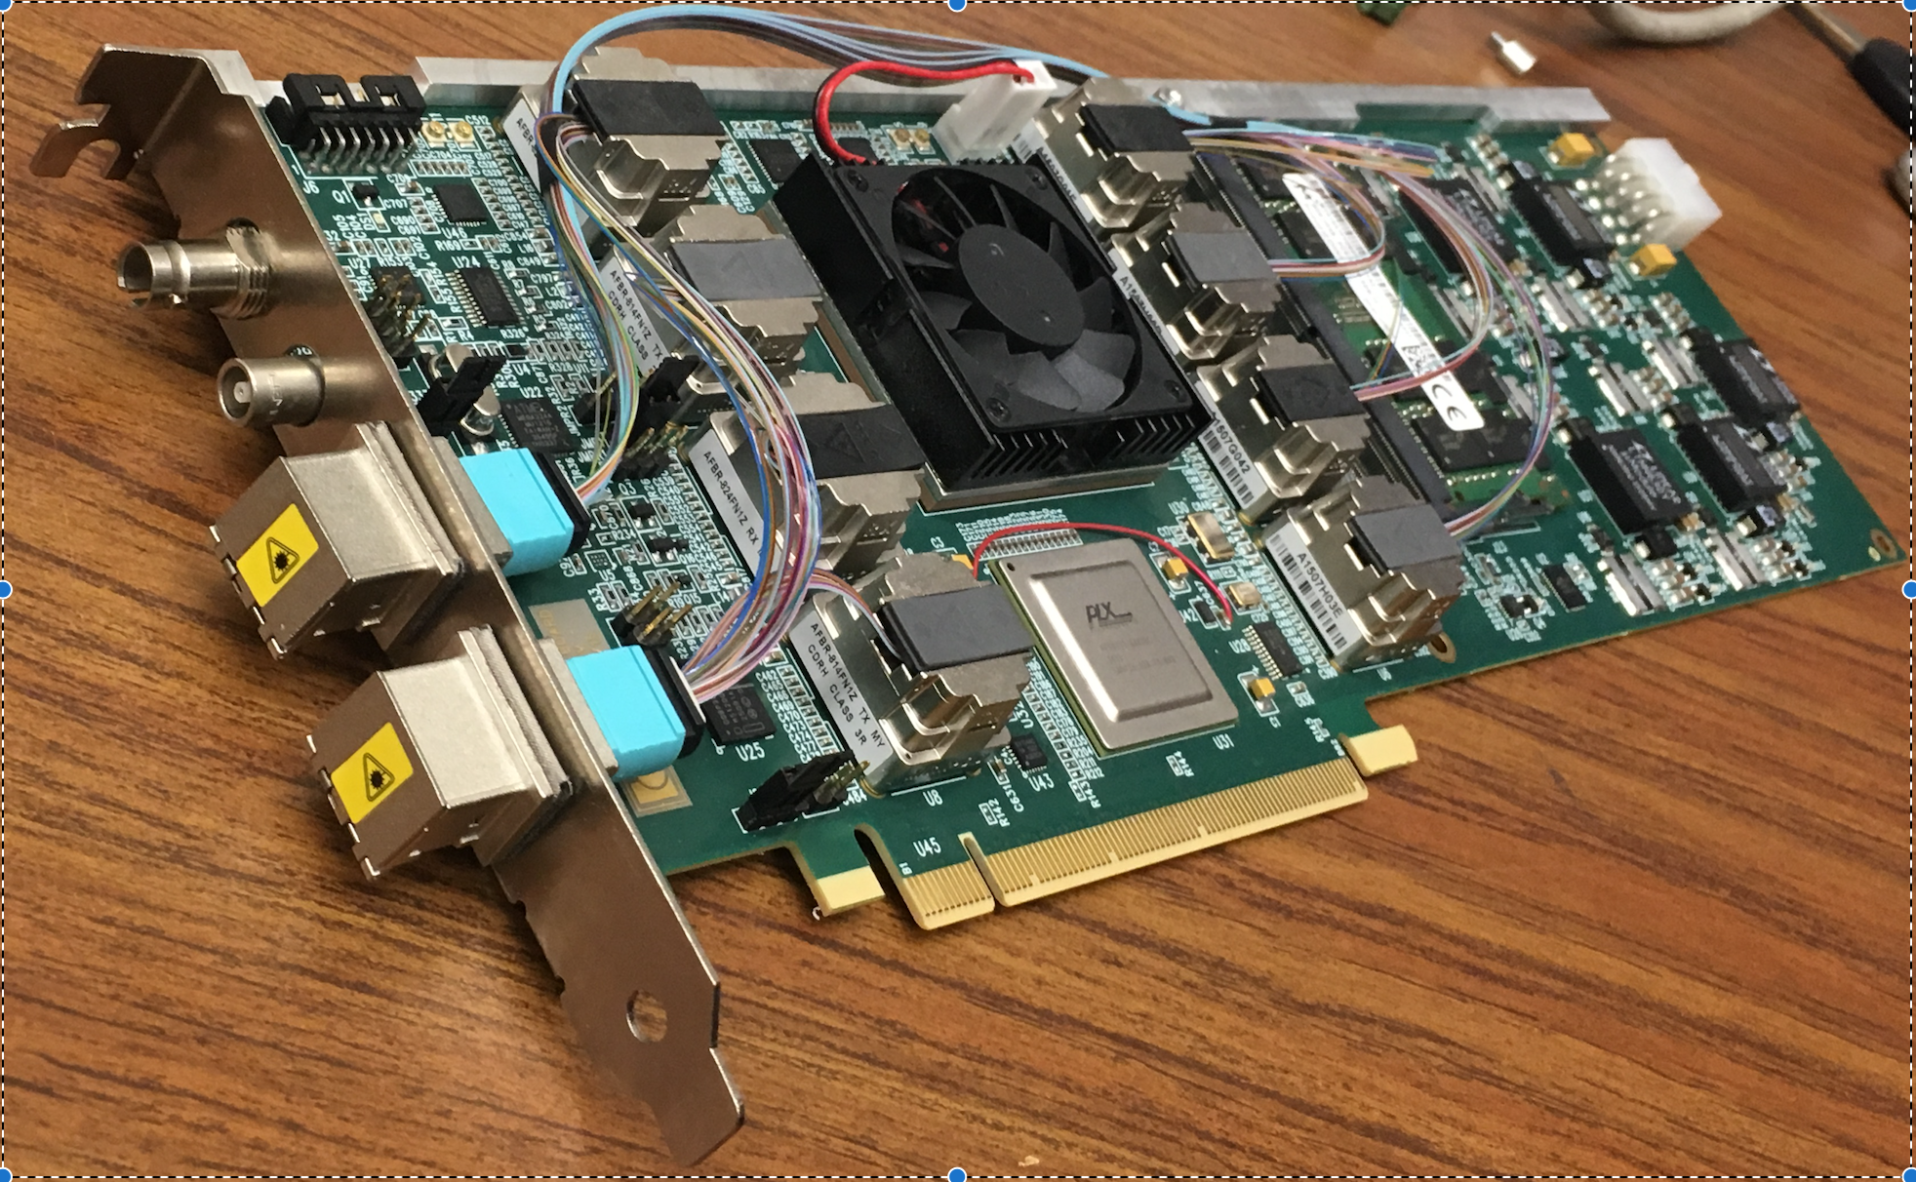
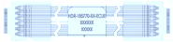
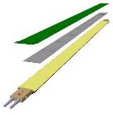

MVTX Electronics Overview
CAN bus
DCS
5-10 m
Trigger & Clock
Readout Unit
Front End
GBT Optical Links
9-sensor Stave
9 Data (1.2Gbps)
1 Clock, 1 Control/Trigger
Control
Data (9.6 Gb/s max)
Trigger
Samtec Twinax “FireFly”
FELIX
Back End
FPC
Power
Alpide Sensors
Power
Filtering Capacitors
regulators
Power supplies
Cold Plate
Regulated Power
Power Board
Interaction Region
Experimental Hall
Counting House
MVTX Detector Electronics consists of three parts
Sensor-Stave (9 ALPIDE chips) | Front End-Readout Unit | Back End-FELIX

Slide 4
Sensor
CAN bus
DCS
5-10 m
Trigger & Clock
Readout Unit
Front End
GBT Optical Links
9-sensor Stave
9 Data (1.2Gbps)
1 Clock, 1 Control/Trigger
Control
Data (9.6 Gb/s max)
Trigger
Samtec Twinax “FireFly”
FELIX
Back End
FPC
Power
Alpide Sensors
Power
Filtering Capacitors
regulators
Power supplies
Cold Plate
Regulated Power
Power Board
Interaction Region
Experimental Hall
Counting House
MVTX Detector Electronics consists of three parts
Sensor-Stave (9 ALPIDE chips) | Front End-Readout Unit | Back End-FELIX

Slide 5
Stave
Stave– 9 chips, common clock and control, independent data lines
Clock
Control+Trigger
Chip1
Chip2
Chip3
Chip4
Chip5
Chip6
Chip7
Chip8
Chip9
1024 pixel columns
Serial Outputs (1.200 Gbps)
State Of the Art:
In pixel:
Amplification
Discrimination
3 hit storage registers (MEB)
AMP
COMP
THR
512 pixel rows
Readout (zero suppression)
ALPIDE Architecture Highlights
Multi-event buffering capability reduces Readout Unit data throughput requirements
Digital data output
Integrated test and masking
Data output rate at 1.2 Gb/s, 0.6Gb/s, or 0.4Gb/s
Readout (zero suppression)
Readout (zero suppression)
Readout (zero suppression)
Bias, Readout, Control

Slide 6
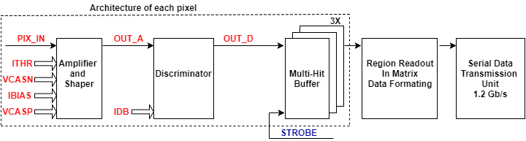
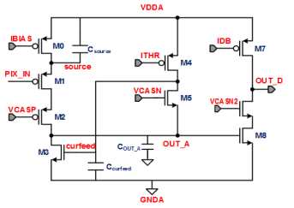
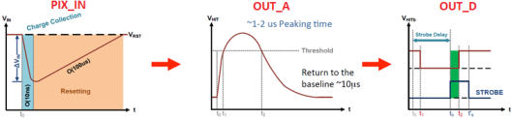
ALPIDE Characterization
Main bias parameters:
IBIAS first stage bias current
VCASN, ITHR define OUT_A baseline voltage level
ITHR defines return to baseline
IDB second stage threshold
OUT_D
OUT_D
delay
STROBE
delay
STROBE
STROBE Latches Data into the Multi Hit Buffer

Slide 7
MVTX Overview Readout Unit
CAN bus
DCS
5-10 m
Trigger & Clock
Readout Unit
Front End
GBT Optical Links
9-sensor Stave
9 Data (1.2Gbps)
1 Clock, 1 Control/Trigger
Control
Data (9.6 Gb/s max)
Trigger
Samtec Twinax “FireFly”
FELIX
Back End
FPC
Power
Alpide Sensors
Power supplies
Filtering Capacitors
regulators
Power
Cold Plate
Regulated Power
Power Board
Experimental Hall
Front End-Readout Unit
Data readout from Stave
Stave status and power control
Control and monitoring to/from the sensors
Trigger & busy management
Data building and transmission through the rad-hard Giga Bit Transceivers
7

Slide 8
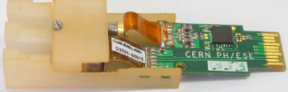
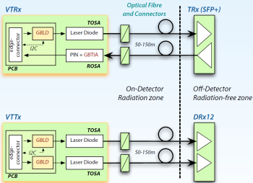
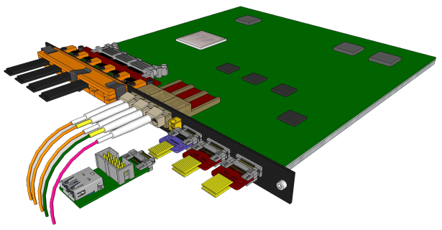

Readout Unit
State Of the Art:
Xilinx Kintex Ultrascale FPGA
ProAsic FPGA (Manage Radiation Upsets)
GBT ASIC (Rad. Tolerant Giga Bit Transceiver)
  VTRx: Transciver up & down link
  VTTx: Double Transmitter 2 * up link:
Samtec firefly copper twinax cable interface
  9 independent 1.2Gb/s data streams
  1 40MHz Clock
  1 Control Line
Transition Board
Samtec Firefly cable
VTTx
VTRx
VTRx sm
Power Boards link
2 uplink (data) to FELIX
1 uplinks (data/CTRL) to FELIX
1 downlink (CTRL) from FELIX
CAN bus
1 trigger downlink directly
to ensure low latency
Diagnostic / busy IO
Notes:
Bla foo this is a test

Slide 9
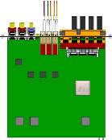
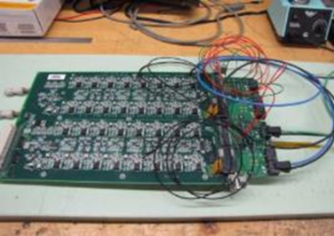
System Power Overview
High speed logic and
Readout Unit
Stave
Control lines
FPC (Bus for signal, control, power, bias, decoupling caps)
PT100 from cooling loop
PT100
Bias daisy chain
I2C control
CANbus
Breakout Boards
Power Board Requirements:
LDO regulator architecture
Control Interface to Readout Unit
Efficiency > 99%
Noise rate < 10⁻⁶
Radiation Tolerant
Overcurrent protection
Remote current readout
Remote voltage readout
Remote voltage setting
x8
switch
reg
reg
reg
32 reg
reg
reg
reg
V adjust
reg
V, I mon/buffer
CAEN
bias
CAEN
power
V, I mon/buffer
Isolated bias section
Overcurrent
detection
PT100 interface
Overcurrent
reset
Overcurrent
threshold
Power in

Slide 10
MVTX Overview FELIX
CAN bus
DCS
5-10 m
Trigger & Clock
Readout Unit
Front End
GBT Optical Links
9-sensor Stave
9 Data (1.2Gbps)
1 Clock, 1 Control/Trigger
Control
Data (9.6 Gb/s max)
Trigger
Samtec Twinax “FireFly”
FELIX Back End
FPC
Power
Alpide Sensors
Power supplies
Filtering Capacitors
regulators
Power
Cold Plate
Regulated Power
Power Board
Counting House
Back End-FELIX:
Data readout from 8 Readout Units
Slow Control and Monitoring to/from sensors
Trigger and Timing systems interface
Data aggregation and sub-event packaging
Data transmission through the PCIe to Server CPU

Slide 11
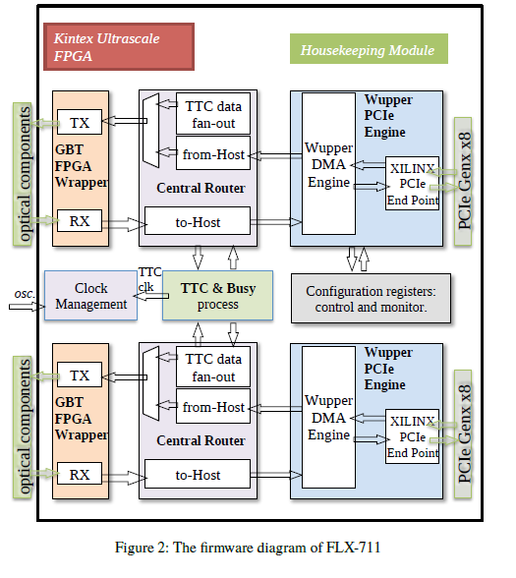
FELIX
State Of the Art:
Xilinx Kintex Ultrascale FPGA
48 bi-directional GBT links
16 lane Gen3 PCIe
Performance Summary:
PCIe Tx > 100 Gb/s
FEE Rx < 80 Gb/s

Slide 12
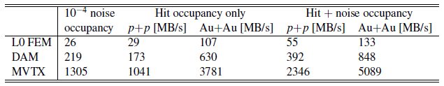
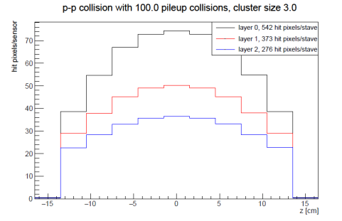
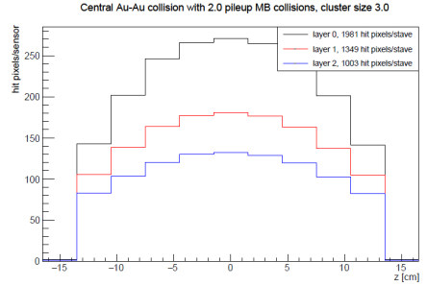
Data Rate Requirements
Readout Units 3 GBTX @ 0.4 GB/s = 1.2 GB/s >133MB/s
GBTx: 3.2-4.48Gb/s, 0.4 GB/s
FELIX (48 input on FELIX, twice the number needed to support 8 RUs (3 links))
2x 8-lane PCIe Gen 3 @ 7880 MB/s = 15760 MB/s > 848 MB/s

Slide 13






MVTX Readout Electronics
Hardware
  48 ALPIDE Staves (~200M Channels)
  48 Front End Electronics (RUv1)
  6 Back End Electronics (FELIX v2.x)
  6 EBDC server
  3 Power Boards+ Supplies
  48 Stave to RU cables
  144 Fiber optic cables (3 fibers x 48 FEE)
Spares at ~20%

Slide 14
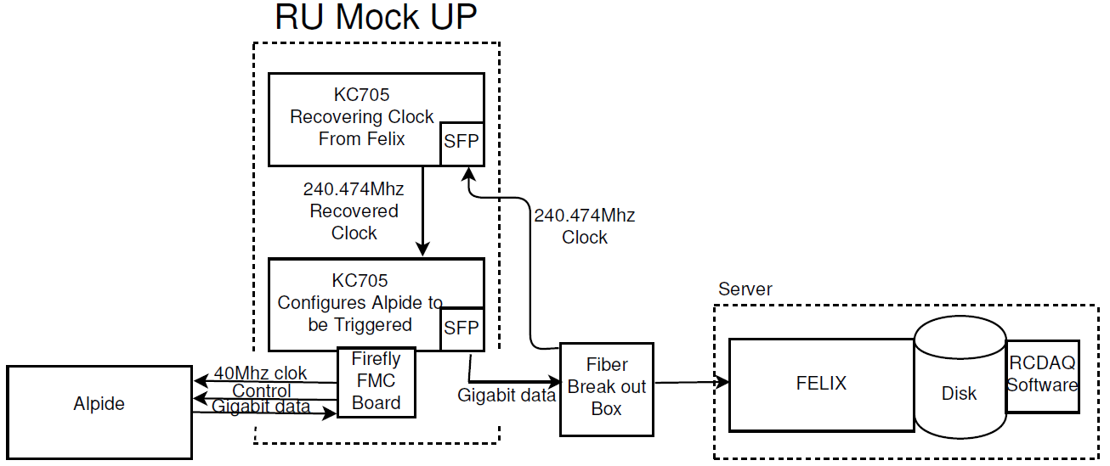
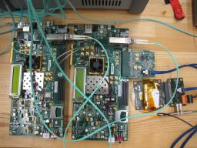
R&D Accomplishments
Accelerated Development:
Mitigated Readout Unit
arrival delay
While RU (Readout Unit) was not available:
Designed system to emulate RU on Xilinx Development Kits
  ALPIDE triggered and read out at 15kHz, 448 hits
  Developed prototype RCDAQ plugin
  FELIX packs and places ALPIDE data on disk
  Emulated 8 RU’s using 1 fiber link per RU on FELIX, 15kHz

Slide 15
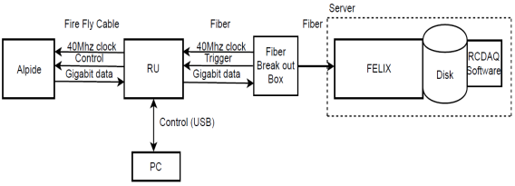
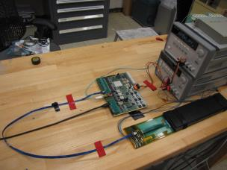
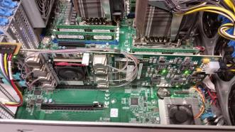
MVTX Full Chain
Stave
Readout
Unit
FELIX
Demonstrated Full MVTX Chain Readout
Once the Readout Unit arrived, successfully configured, triggered and readout Stave:
  Readout Unit configures Stave using USB interface
  FELIX distributes clock to Readout Unit
  Readout Unit distributes clock to the Stave
  Stave is triggered, sends data at 1.2Gb/s
  Configured GBT link to recover clock from FELIX
  Readout Unit receives the data and sends the data to FELIX over fiber using GBT link
  FELIX packs data, stores it on disk using RCDAQ
Readout Unit + Stave
Server + FELIX

Slide 16
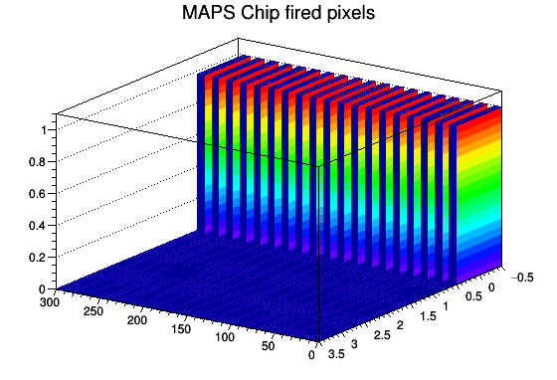
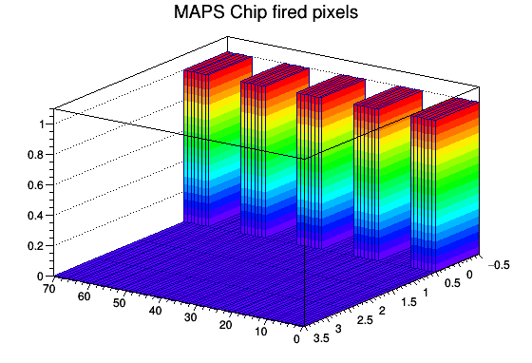
RCDAQ
RCDAQ = sPHENIX DAQ
  Our accomplishments of integrating FELIX with RCDAQ prove that MVTX should tie into sPHENIX day one.
  Plots generated by RCDAQ show pulsed Pixels readout by Readout Unit and FELIX
Full MVTX Readout Chain integrated with sPHENIX DAQ

Slide 17
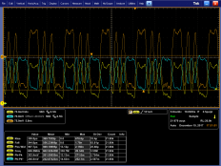
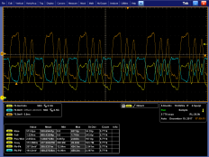
MVTX Stave-RU Extension
5-10 m
9 Data (1.2Gbps)
1 Clock, 1 Control/Trigger
Samtec Twinax “FireFly” cable
5 Meter
7 Meter
Flex Cable Manufacturer Identified
Signal Integrity of the longer Stave-RU interconnect cable for the MVTX mechanical configuration including overall length and necessary data output rate is under evaluation
  Confirmed Default ALPIDE Data Transmission Settings are not suitable for cable lengths over 5m
  2 electronics options
    Increase ALPIDE Drive Strength
    Increase ALPIDE Preemphasis

Slide 18
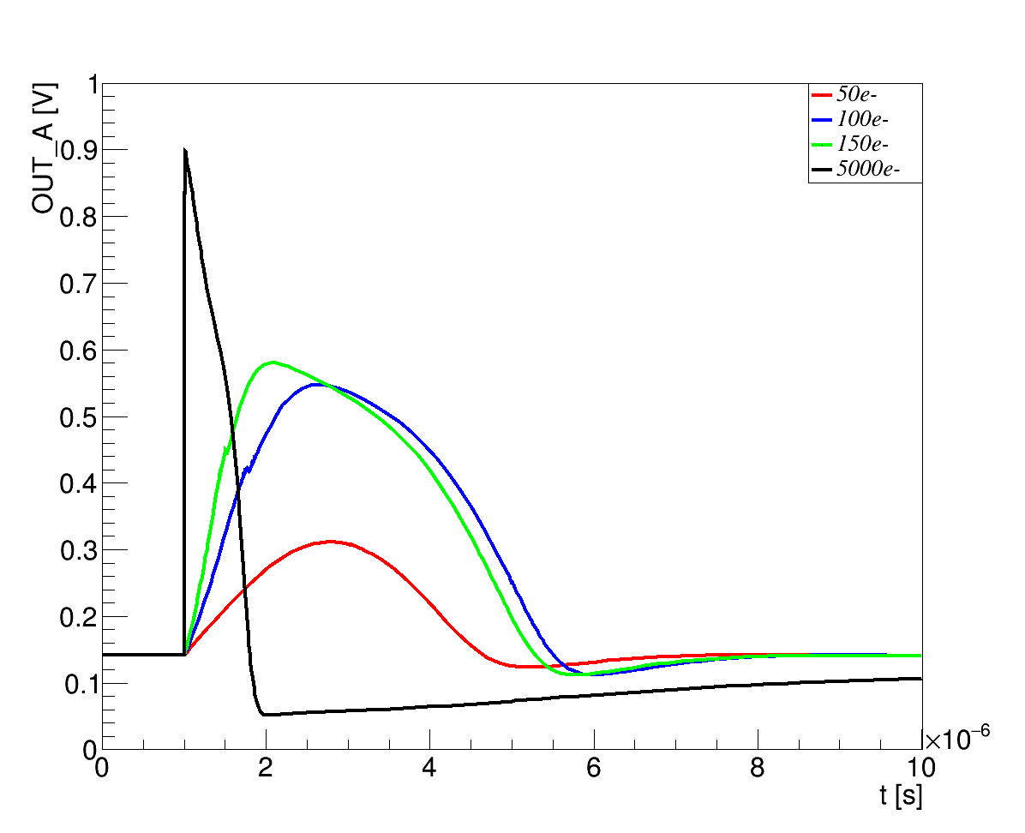
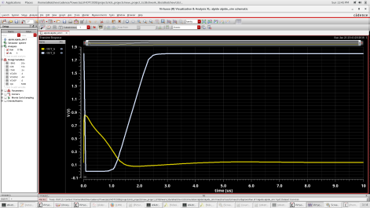
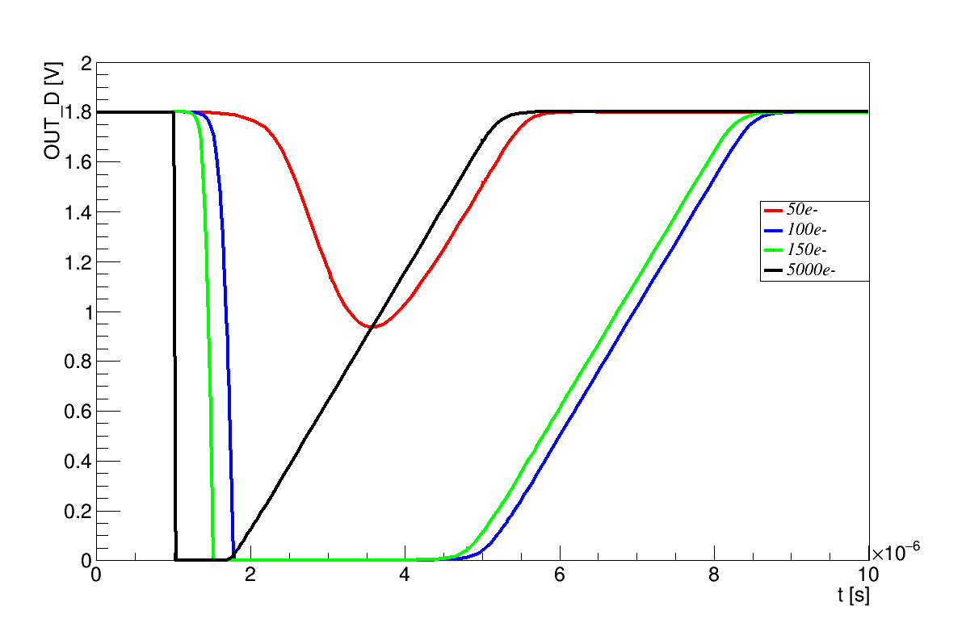
ALPIDE Simulations
< OUT_A >
Input charge
Clipping point
( OUT_A - curfeed > Vth M6)
Threshold of second stage
( IDB = I_{M8} )
Charge Threshold
OUT_A base line
< OUT_D >
Input charge
Need to Adapt ALPIDE Bias Parameters for use in MVTX
Obtained evaluation license for Mentor Graphics Virtuoso
Obtained technology files from Tower Jazz
Understood the effects of each Bias and Threshold Parameter on the output

Slide 19
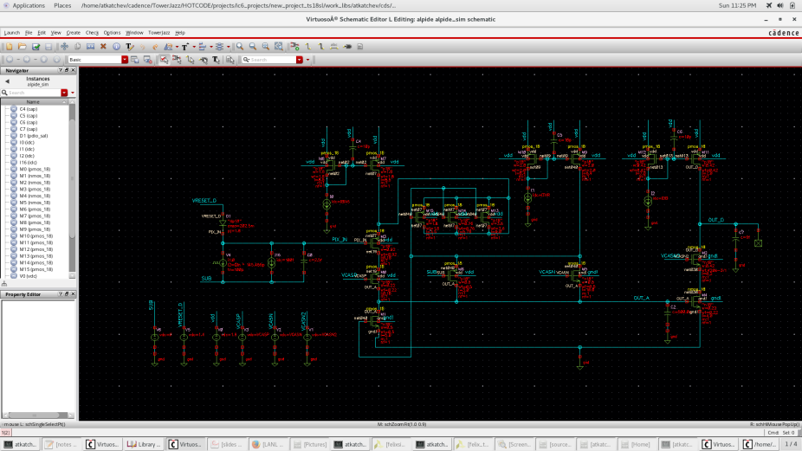
ALPIDE Sim. Schematic

Slide 20
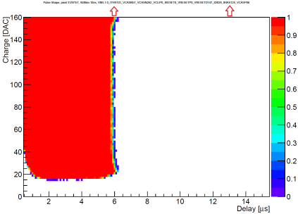
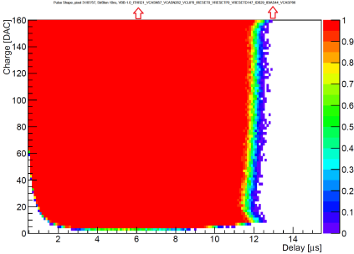
Simulation Confirmation
ITHR: Double
IBIAS: Double
OUT_D
OUT_D
ITHR: Half
IBIAS: apprx. Half
delay
STROBE
delay
STROBE
Pulse Shape Measurement with Charge Injection
  Pulse Shape is measured by moving the timing of the (small) trigger window with respect to the injection time (“strobe delay”)
  Values extracted from 2D-measurement vs charge and trigger timing:
    Time over threshold, maximum pulse length, time walk
Creates a baseline for laser test stand efforts

Slide 21


Risk Mitigation
Risks:
Previous LDRD Review
Custom Electronics concerns
CRU FELIX finalization
BNL Directors Review
MVTX readout scheme integration into sPHENIX DAQ
Achievements
Successfully demonstrated full readout chain:
  STAVE->Readout Unit->FELIX
  Successfully integrated readout chain with RCDAQ (sPHENIX DAQ)
  Validated FELIX and Readout Unit performance for MVTX
    System triggered at 15Khz
    emulating 8 RU’s on FELIX
  Power System at LANL
Reduced cost of LDRD Contingencies

Slide 22

Future Deliverables
ALPIDE Characterization & Cluster Size Finalization
ALPIDE Triggered & Continuous Modes
Remote Readout Unit programming (over fiber)
Readout Unit Radiation Upset (Scrubbing) Firmware
FELIX programming (over PCIe)
FELIX firmware revisions to adapt MVTX detector specs.
RCDAQ (sPHENIX DAQ) finalization
Signal Integrity evaluation of the longer Stave-RU interconnect for MVTX
System Optimization & Documentation
Most tasks are well underway

