Slide 1

sPHENIX LDRD Review
ALPIDE Introduction and Test Stand
Xuan Li
P-25
Outline
ALPIDE chip introduction
LDRD test bench setup
LDRD test bench achievements
Summary and Plans
UNCLASSIFIED

Slide 2
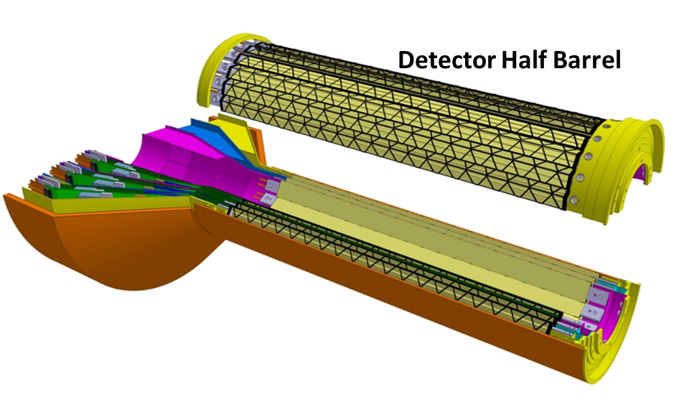
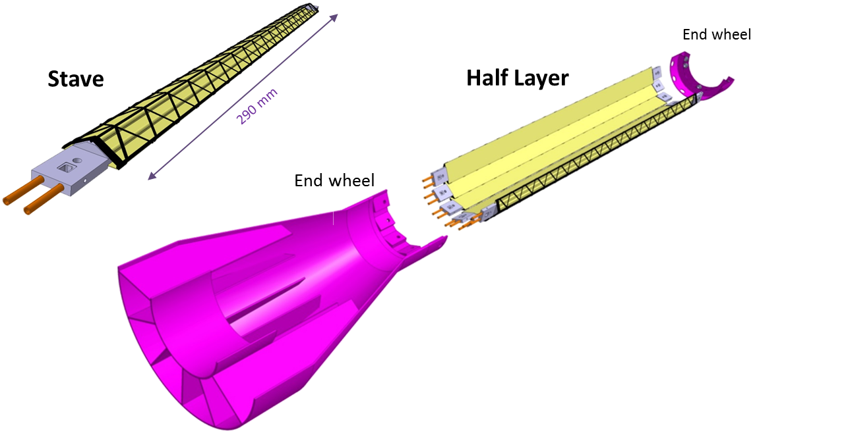
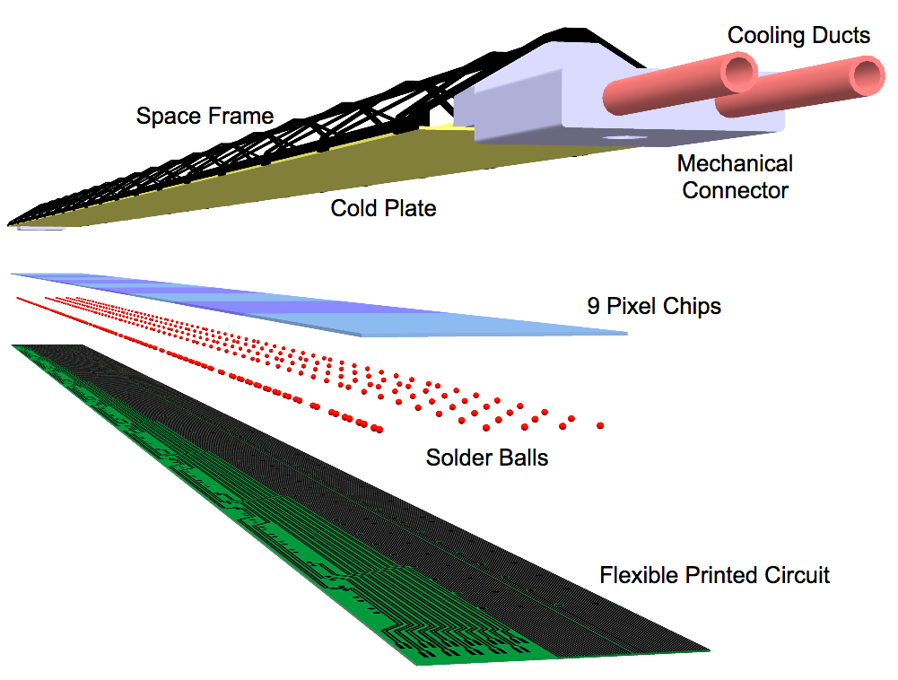
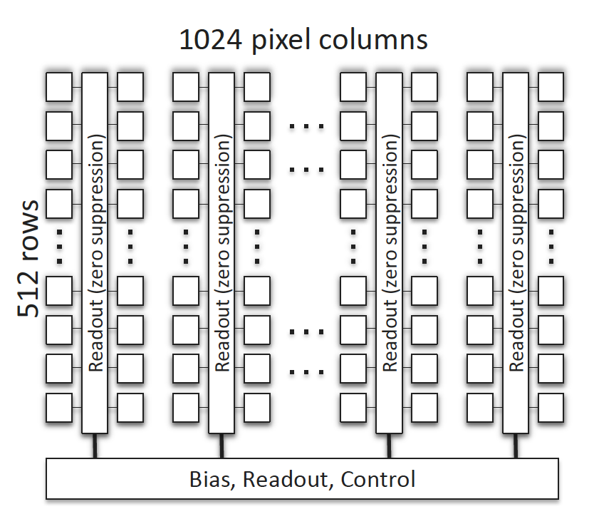
The MVTX Basic Unit: ALPIDE sensor
ALPIDE chip Introduction:
The 3-layer MVTX consists of 48 staves and each stave contains 9 ALPIDE chips.
Stave
Scheme of ALPIDE (524288 channels)
1.5cm
3cm

Slide 3
MVTX Performance Requirements
The heavy flavor program at sPHENIX led by the MVTX requires good vertex resolution and high efficiency.
w/ perfect acceptance
no pile up
w/ perfect acceptance
no pile up
Can MVTX meet these requirements in real data?
  Small dead channel fraction →High efficiency.
  High signal/noise ratio → Low background.

Slide 4
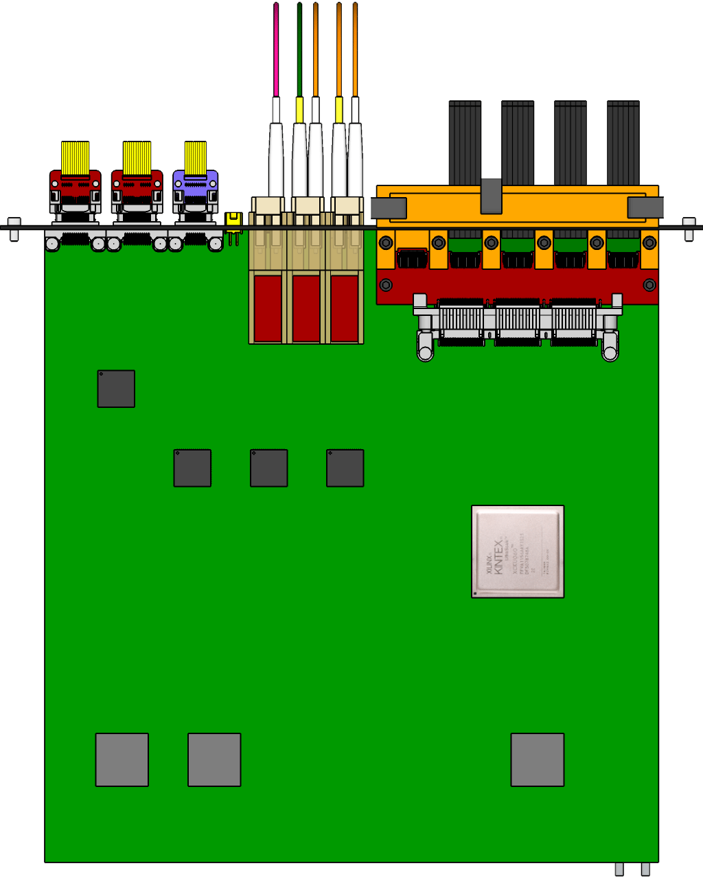
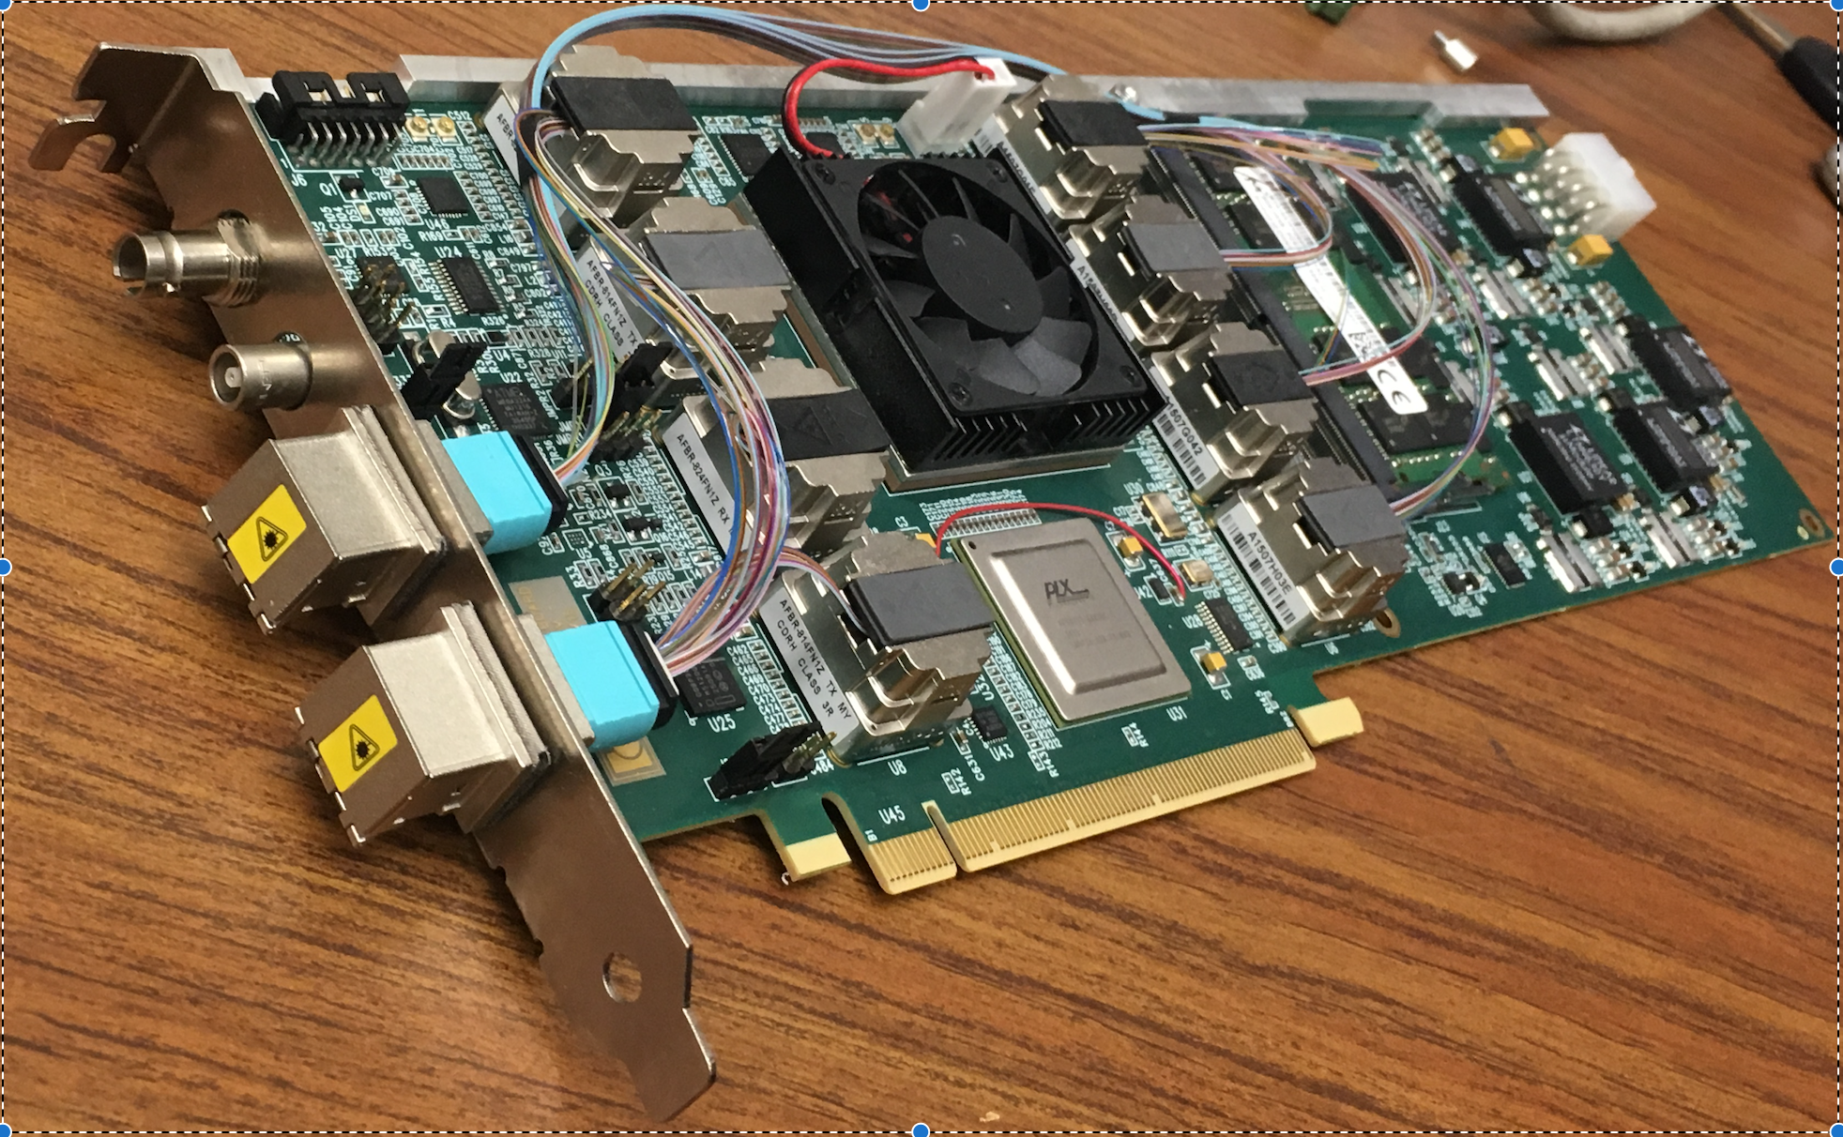

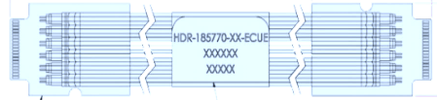

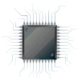
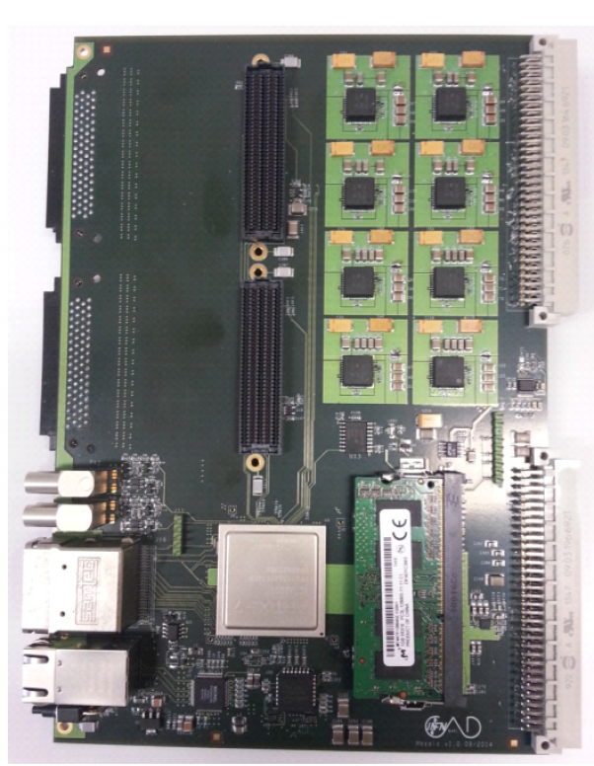
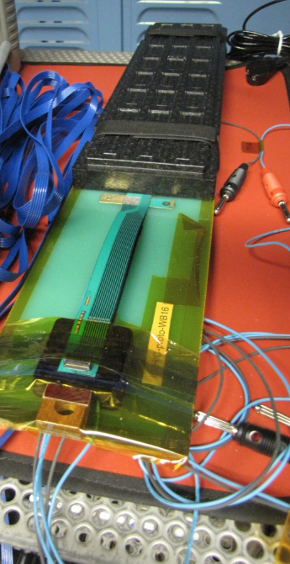
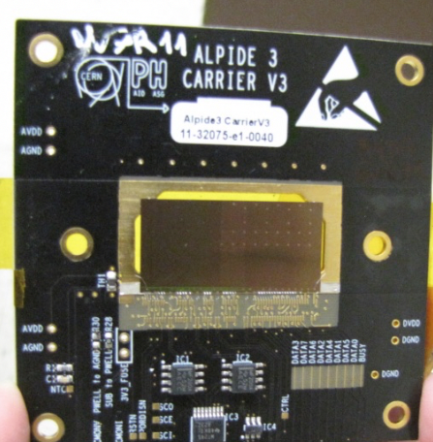
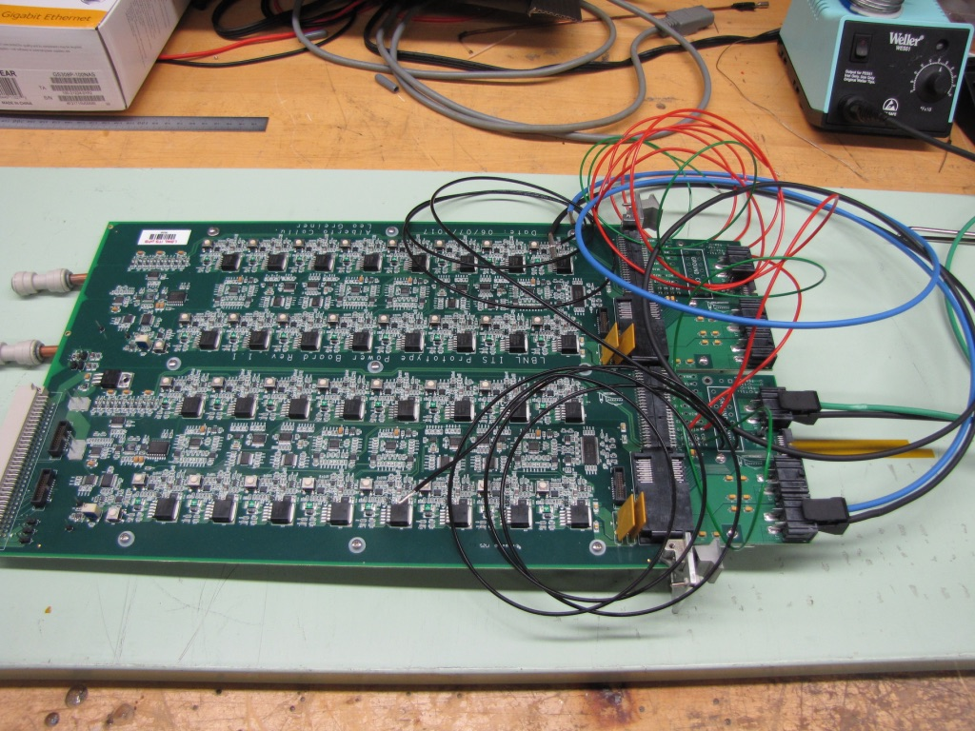
LDRD Test Bench Components
5 m
Readout Unit
Optical Links
FELIX
9 Sensor Stave
9 Data (1.2Gbps)
1 Clock, 1 Control/Trigger
Control
Data (9.6 Gb/s max)
Trigger
Samtec Twinax “FireFly”
FPC
Power
Alpide Sensors
RCDAQ
Filtering Capacitors
regulators
Power Board
Cold Plate
Regulated Power
Purchased one stave and 5 individual ALPIDE chips.
Test bench
readout module:
MOSAIC
Purchased 1 Power Board

Slide 5
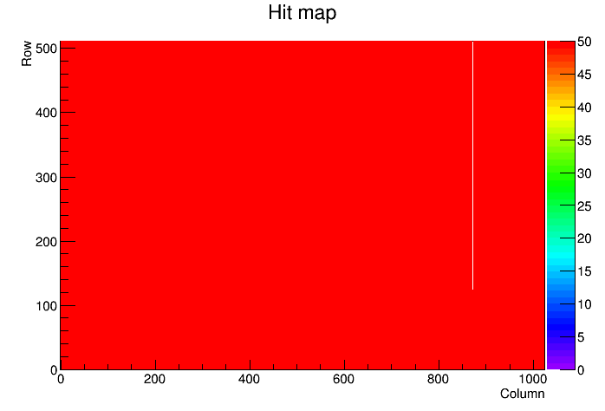
ALPIDE Characterization: Good Active Area
Measure the dead areas for efficiency evaluation.
Test with internal pulse generator:
  Scanned available chips and stave at LANL through digital scan to verify the good channel fraction: the active pixel fraction is >>99%.
  Similar results with different readout speed.
ALPIDE chip test example
No. of 0 hits
777
Cold channel
1
Hot channel
0
Bad fraction
0.15%

Slide 6
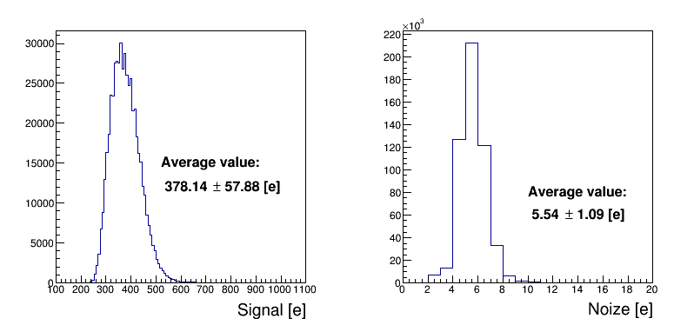
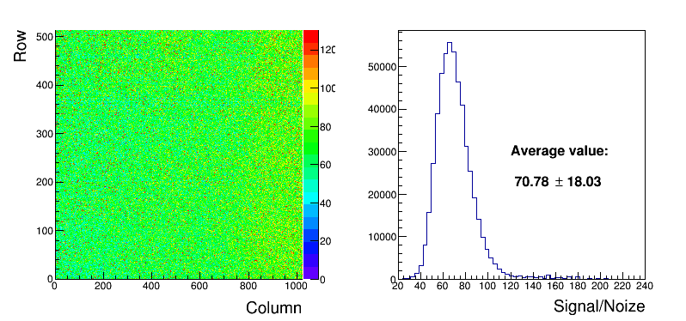
ALPIDE Characterization: Low Noise (I)
Charge injection with internal pulse generator:
  Scanned available chips and stave at LANL through threshold scan: signal/noise based on charge injection study is > 60. Comparable with CERN test (~60).
Proves the background contribution is low!
Chip test with internal trigger
Signal scan per chip
Noise scan per chip
MIP~1000 e⁻
Noise scan per chip
Signal/Noise ratio scan
Signal/Noise uniformity
Signal/Noise scan per chip

Slide 7
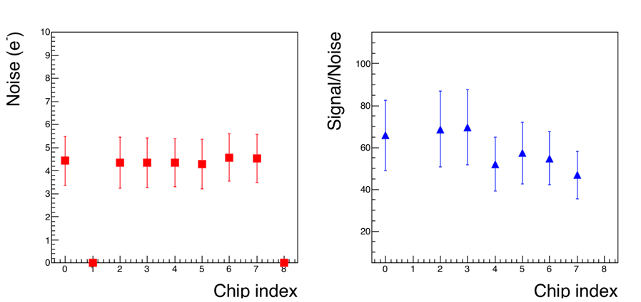
ALPIDE Characterization: Low Noise (II)
Charge injection with internal pulse generator:
  Scanned available chips and stave at LANL through threshold scan: signal/noise based on charge injection study is around 60. Comparable with CERN test (~60).
Stave test with internal trigger:
Simultaneous readout of all chips.
Noise
Signal/Noise
Inactive chips due to
communication failure.

Slide 8
ALIPIDE Performance Evaluation Configuration
Study the ALPIDE performance with real particles.
Tests in triggered mode with default delay at 2μs:
  External trigger with cosmic ray muons (rate: ~0.1HZ).
  External trigger with ⁹⁰Sr beta decay electrons (rate: ~1Hz).
Scintillator 1
Scintillator 2
Cosmic ray setup
Muon average
energy 2GeV
μ⁻
ALPIDE chip
Scintillator 1
Scintillator 2
e⁻
⁹⁰Sr setup
Electron maximum
energy 2MeV
Sr⁹⁰
ALPIDE chip

Slide 9
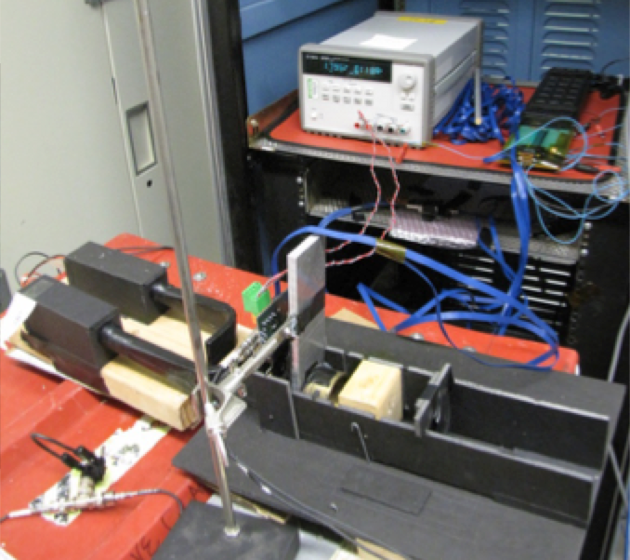
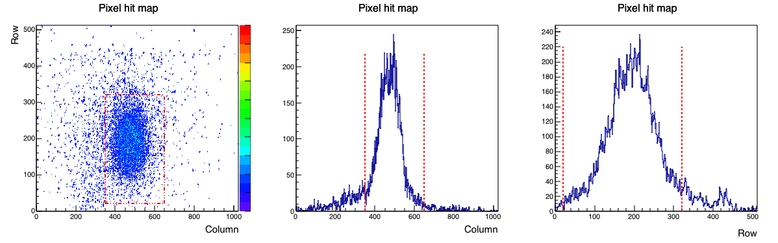
Test Achievements: verify trigger timing and signal detection
Time in trigger and observe physical signal.
For example: ⁹⁰Sr source test.
Collimator
ALPIDE chip
ALPIDE
chip
Row 0
Scintillators
Row 511
Collimator
⁹⁰Sr source
Pixel hit 2D map
Profile along column
Profile along Row
Row
Column
Column
Row
Clear collimator structure seen in the ALPIDE chip.

Slide 10
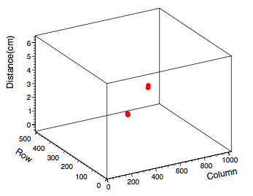
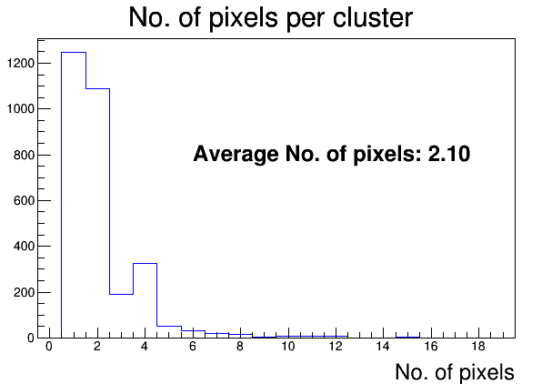
Test Achievements: good hit resolution
Initial look at tracking with two layers of ALPIDE chips.
Test stands
μ⁻
Event Display
Scintillator 1
Found clusters that belong to a cosmic ray muon track.
MAPS chip
Scintillator 2
Characterize the cluster size: related to the hit resolution.
Comparable with ⁹⁰Sr source test results and DESY beam test (cluster size < 3 pixels).
Average cluster size (2 pixels) indicate the hit resolution < 10μm → Meets requirements.
Cosmic ray
Linear scale

Slide 11
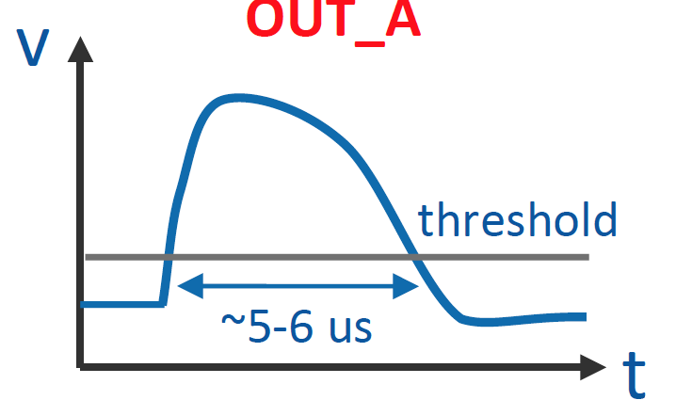
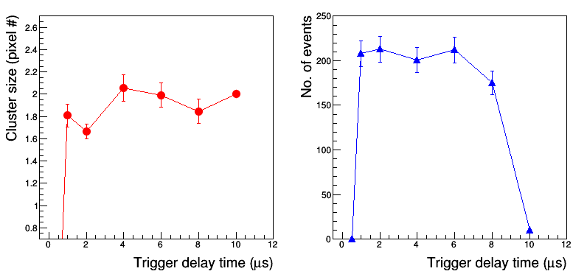
Under study: Trigger delay latency
Can the MVTX adapt to the sPHENIX trigger scheme with default trigger delay at 4-5 μs?
The default ALPIDE trigger delay is 2μs.
Need to tune the pulse shaping and trigger delay.
Analog IN
Digital IN
Duration:5-10μs
Trigger
Trig Delay
After lowering the threshold to optimize the pulse shaping time:
No significant performance differences with trigger delay from 2μs to 6μs.

Slide 12
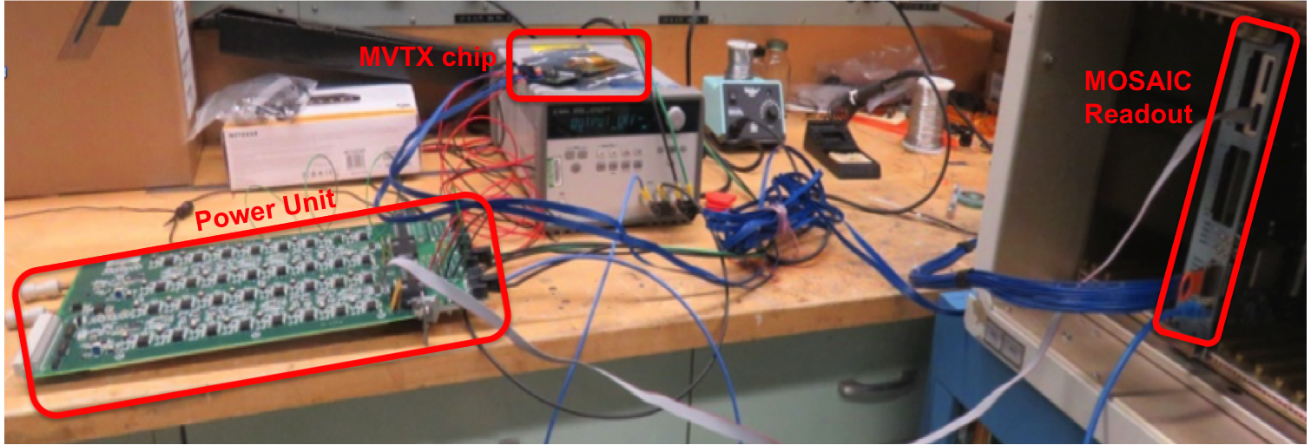
Integration: Power Board Test
5 m
Readout Unit
9 Data (1.2Gbps)
1 Clock, 1 Control/Trigger
Optical Links
FELIX
9 Sensor Stave
Control
Data (9.6 Gb/s max)
Trigger
Samtec Twinax “FireFly”
FPC
Power
Alpide Sensors
RCDAQ
Filtering Capacitors
regulators
Power Board
Cold Plate
Regulated Power
MOSAIC GUI for PB
Successfully operating the ALPIDE using the Power Board prototype!

Slide 13
Summary
Initial results achieved from the LDRD test bench:
  >>99% good channels on chip → High efficiency.
  MIP/Noise ≥ 200 → Low background.
  Hit resolution from cosmic ray or ⁹⁰Sr beta decayed electrons < 10μm → Meets the MVTX requirements.
  Proof of principle study proves the feasibility to adapt the MVTX to the sPHENIX trigger scheme.
  Successful test of the Power Board prototype as part of the MVTX electronics.

Slide 14
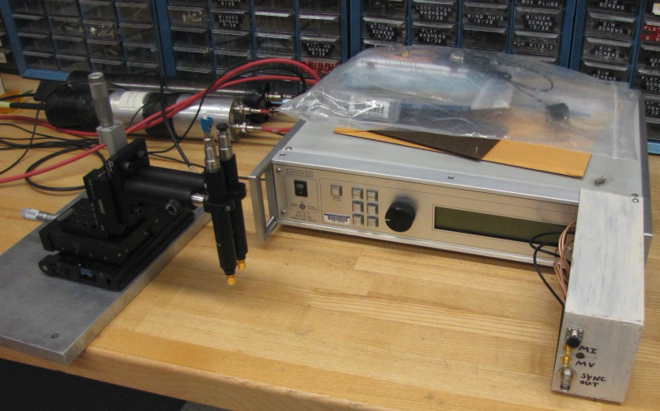
Plans
Set up the laser test bench to study the efficiency, noise rate, trigger delay time, threshold, pulse shaping, etc.
Laser generator:
Duty cycle: < MHz
Focus area: < 10μm²
X-Y scan table
Set up the telescope containing multiple layers of ALPIDE chips (staves) to study the track resolution, efficiency, etc, from cosmic ray and source tests.
Telescope for cosmic/source test
μ⁻
scintillator
ALPIDE
chips
scintillator
Complete optimizing the ALPIDE performance with the RU+FELIX+PB full readout chain this summer.

Slide 15
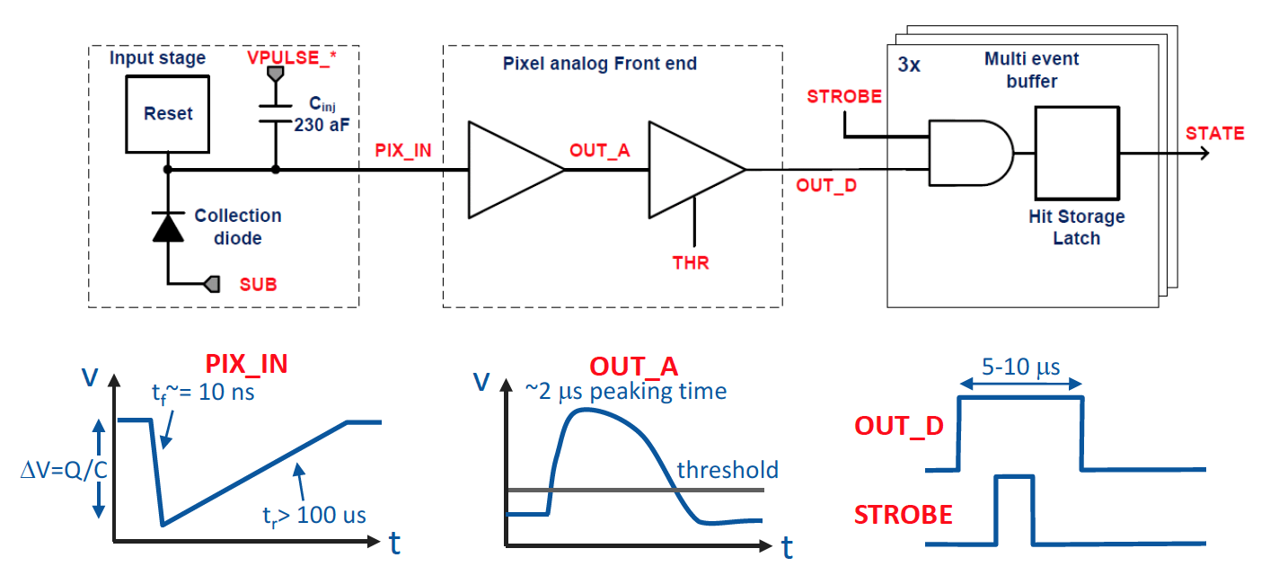
Backup
ALPIDE pixel block diagram.

Slide 16
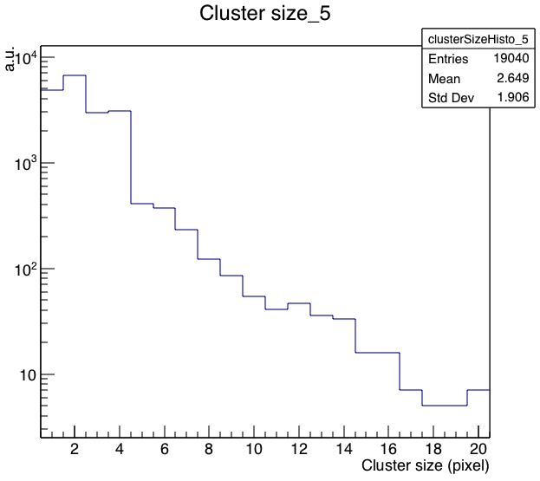
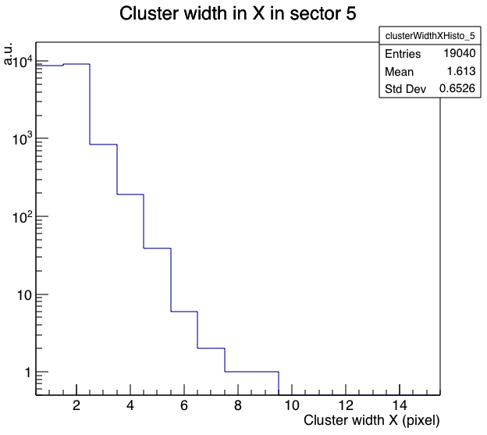
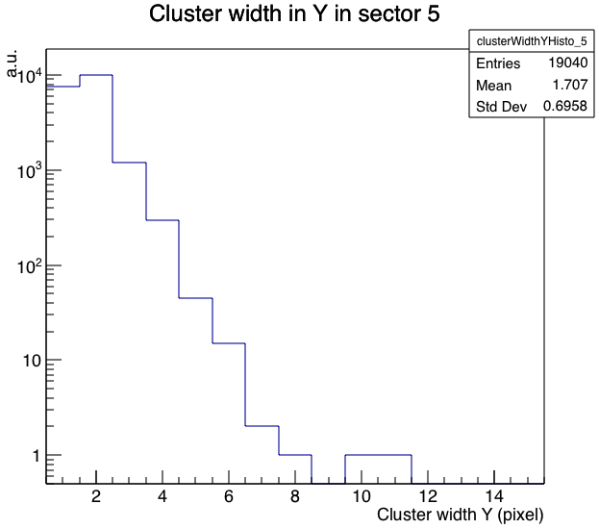
Backup
Cluster evaluation by the CERN team from 450 MeV e- beam test.
Cluster Size
Cluster Profile along X
Cluster Profile along Y
Even particle energies are different, similar results are achieved between the test bench studies with cosmic ray or ⁹⁰Sr beta decayed electrons.

Slide 17
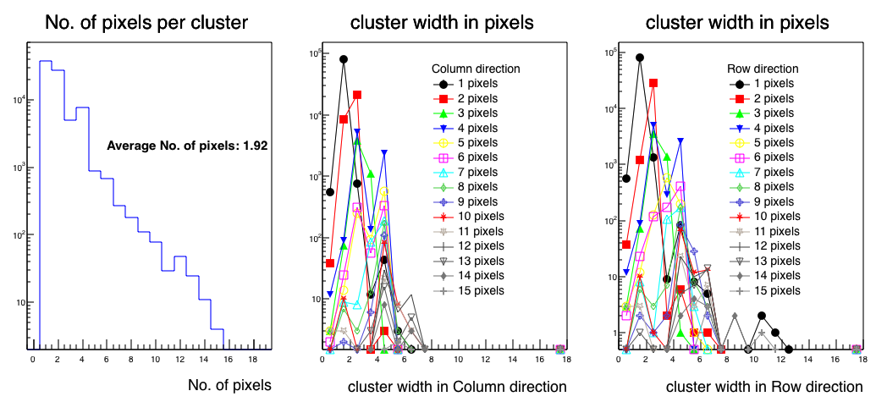
Achievements: cluster determination
Cluster size determined from ⁹⁰Sr beta decayed electrons.
The average cluster size determined from ⁹⁰Sr source is comparable with cosmic ray test.

