Slide 1
sPHENIX LDRD Review:
Physics & Detector
Simulations
Darren McGlinchey
XTD-PRI / P-25
UNCLASSIFIED

Slide 2
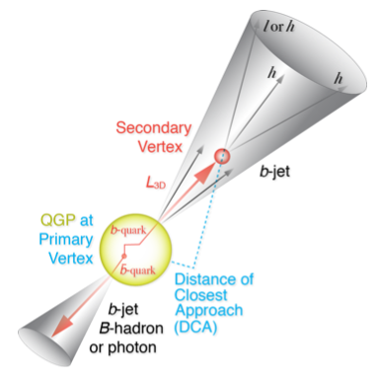
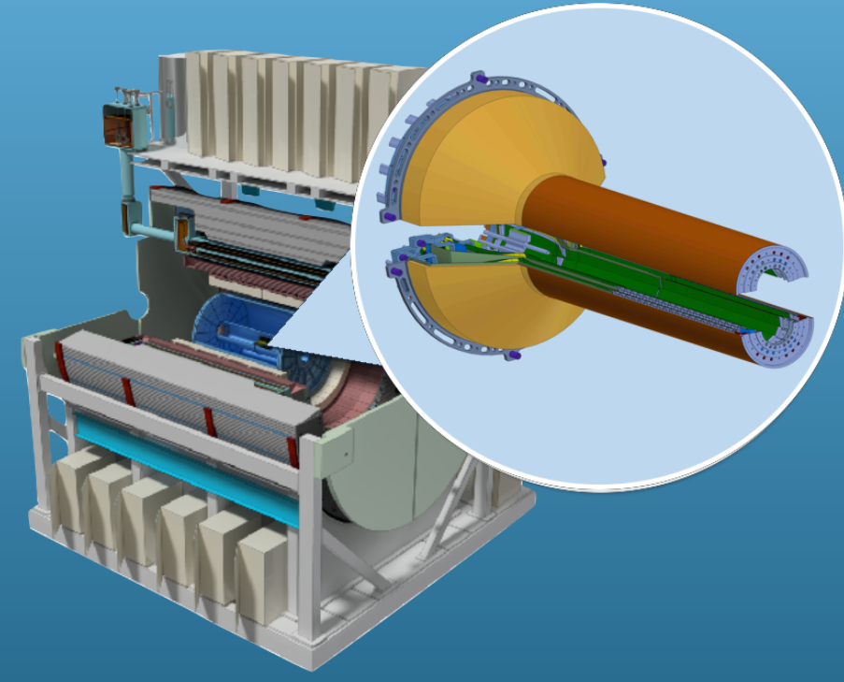
Physics Reminder
Physics Goal:
Study the properties of the Quark Gluon Plasma (QGP)
Experimental Observable:
Jets originating from bottom quarks (b-jets)
Bottom quarks are heavy (4.2 GeV)
Produced in initial collision, not QGP
Well controlled in pQCD
Provide access to fundamental transport properties
Detected using the long lifetime of bottom quark hadrons
Need excellent jet detection capabilities – sPHENIX!
Need high precision tracking and vertex determination – MVTX!
… B-mesons are another important observable, but won’t be discussed here
D. McGlinchey - Physics & Detector Simulations

Slide 3
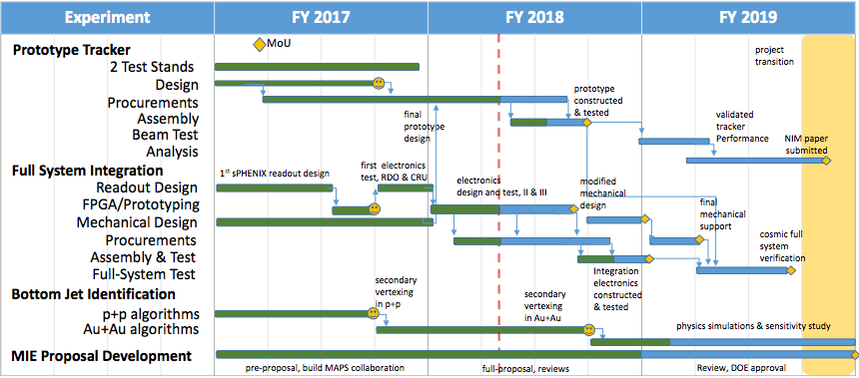
Overview
LDRD Deliverable:
Develop the software framework necessary for validation of the sPHENIX MAPS-based Vertex Detector (MVTX) design.
Manpower:
Sanghoon Lim (postdoc), Darren McGlinchey (postdoc), Xuan Li (staff)
D. McGlinchey - Physics & Detector Simulations

Slide 4
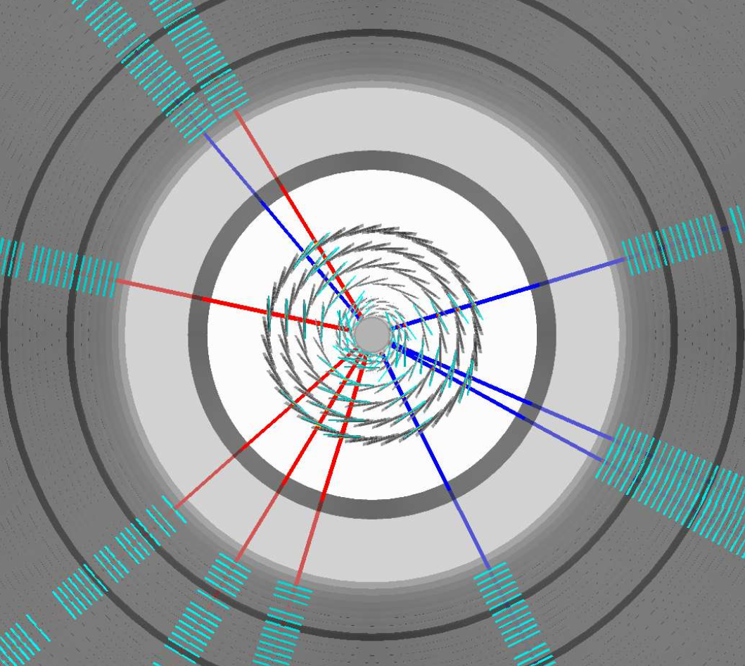
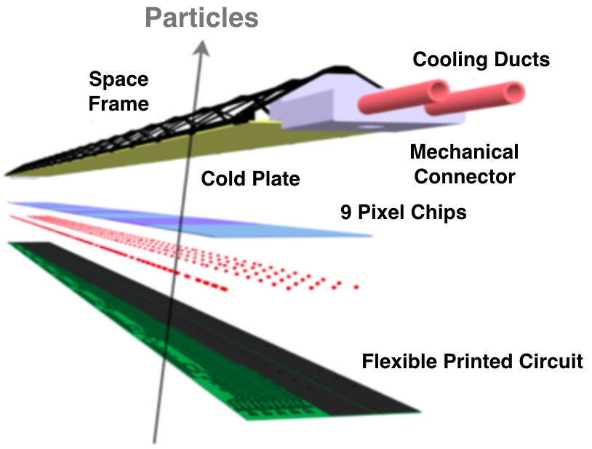
sPHENIX Tracking Overview
TPC
INTT
3 layer MAPS Vertex Detector (MVTX):
R = 2.3, 3.2, 3.9 cm
Thickness: 50 μm (0.3% X₀) per layer
Cell dimension: 28 μm x 28 μm
Using realistic detector geometry
4 layer Intermediate Silicon Strip Tracker (INTT):
R = 6, 8, 10, 12 cm
Using realistic detector geometry
40 layer Time Projection Chamber (TPC):
R = 20 (40) — 80 cm
Progress highlight:
Detailed stave geometry imported and used in all tracking studies
MVTX
D. McGlinchey - Physics & Detector Simulations

Slide 5
sPHENIX Tracking Performance (I)
Tracking performance:
Simulations of pions embedded in central Au+Au collisions (HIJING)
100% detector efficiency, no event pile-up
Hough transform for pattern recognition
Kalman-filter (GenFit) for track propagation and fitting
Single track efficiency ~95%
D. McGlinchey - Physics & Detector Simulations

Slide 6
sPHENIX Tracking Performance (II)
Performance requirement
Tracking performance:
Simulations of pions embedded in central Au+Au collisions (HIJING)
100% detector efficiency, no event pile-up
Significant improvement in Distance of Closest Approach (DCA) resolution with MVTX
DCA(rϕ) resolution < 20 μm for p_{T} > 1 GeV (target of < 50 μm for p_{T} > 1 GeV)
DCA(z) resolution < 20 μm for p_{T} > 1 GeV (target of < 50 μm for p_{T} > 1 GeV)
D. McGlinchey - Physics & Detector Simulations

Slide 7
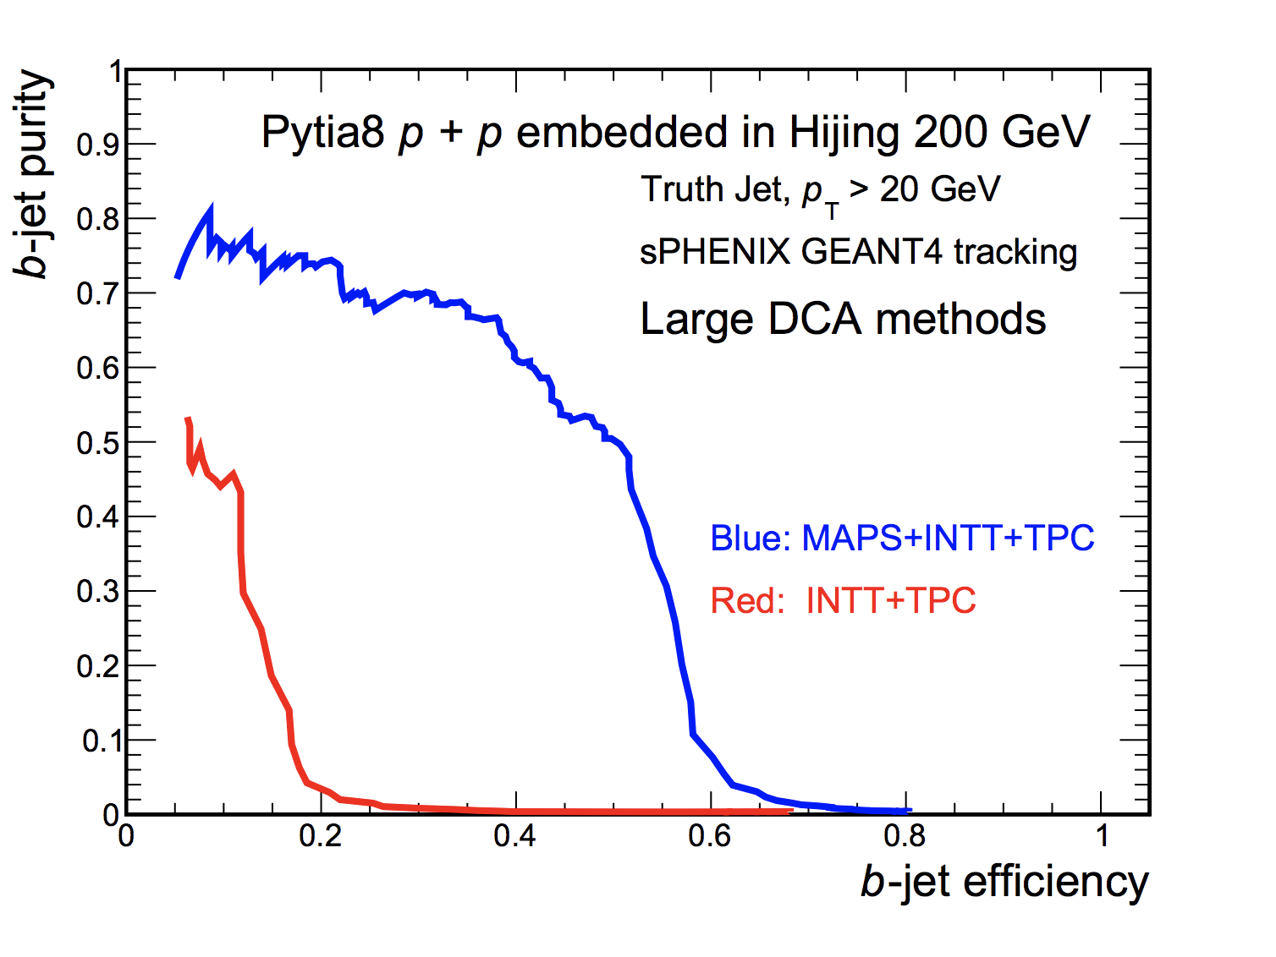
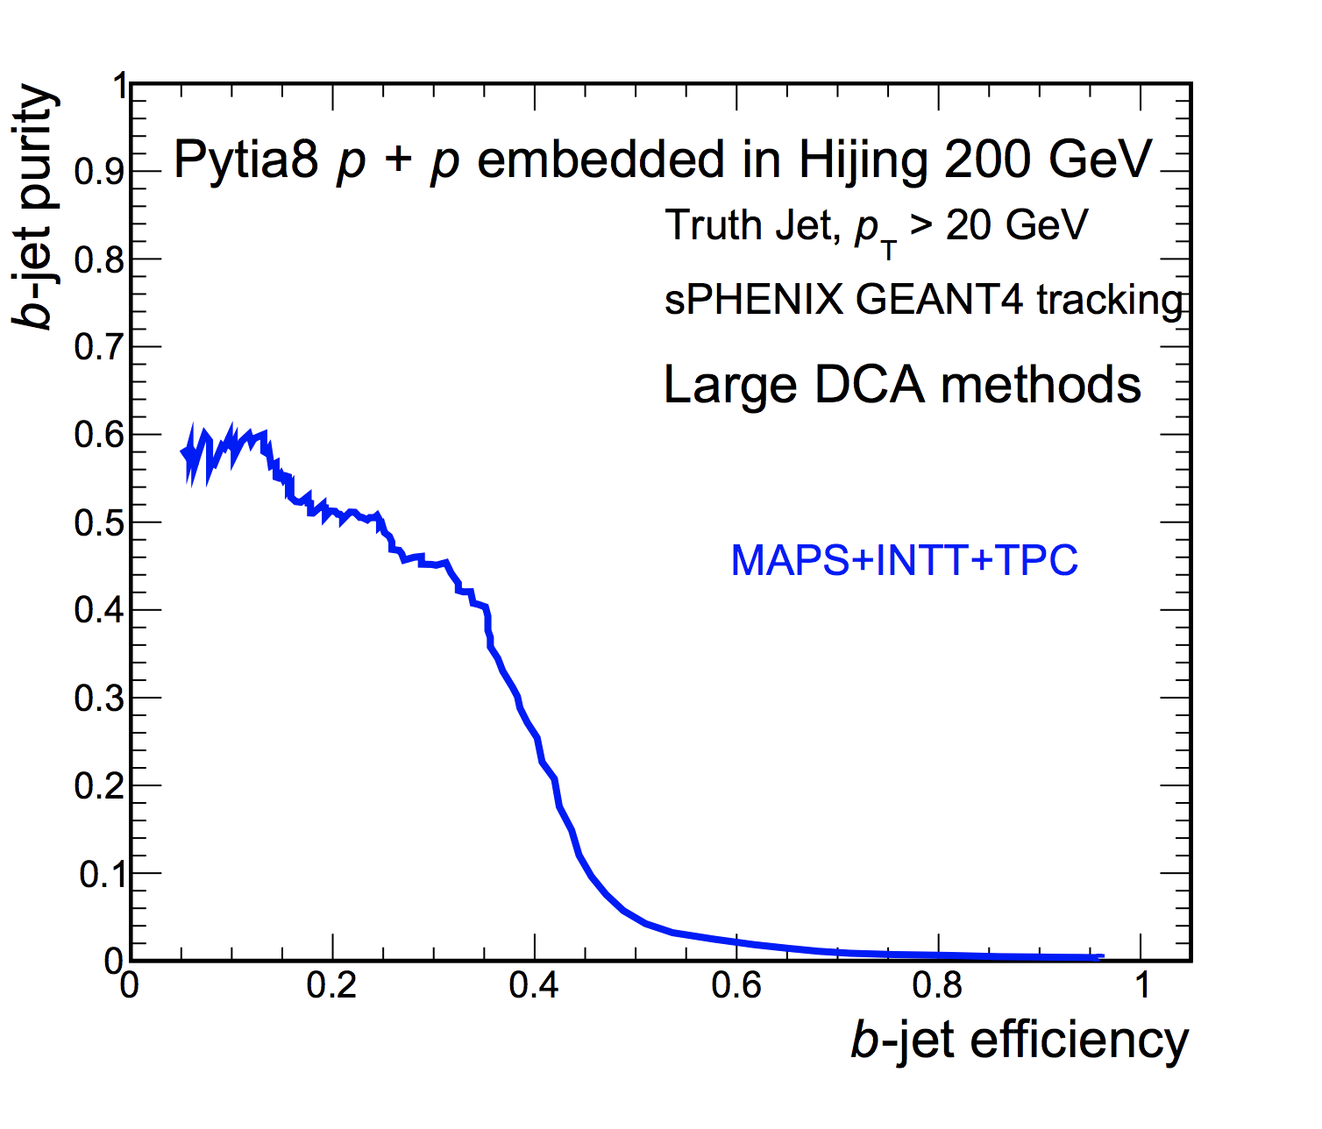
b-jet Tagging: Algorithm I
Au+Au
p+p
w/ MVTX
Working point
Algorithm I:
Utilize Distance of Closest Approach (DCA)
Count the number of tracks in the jet with DCA larger than your cut
Full Geant-4 simulation of p+p (pythia 8) and central Au+Au (Hijing) + reconstruction & tracking software
No pile-up included (under development)
Progress highlight:
Algorithm successfully tested in p+p and Au+Au collisions!
D. McGlinchey - Physics & Detector Simulations

Slide 8
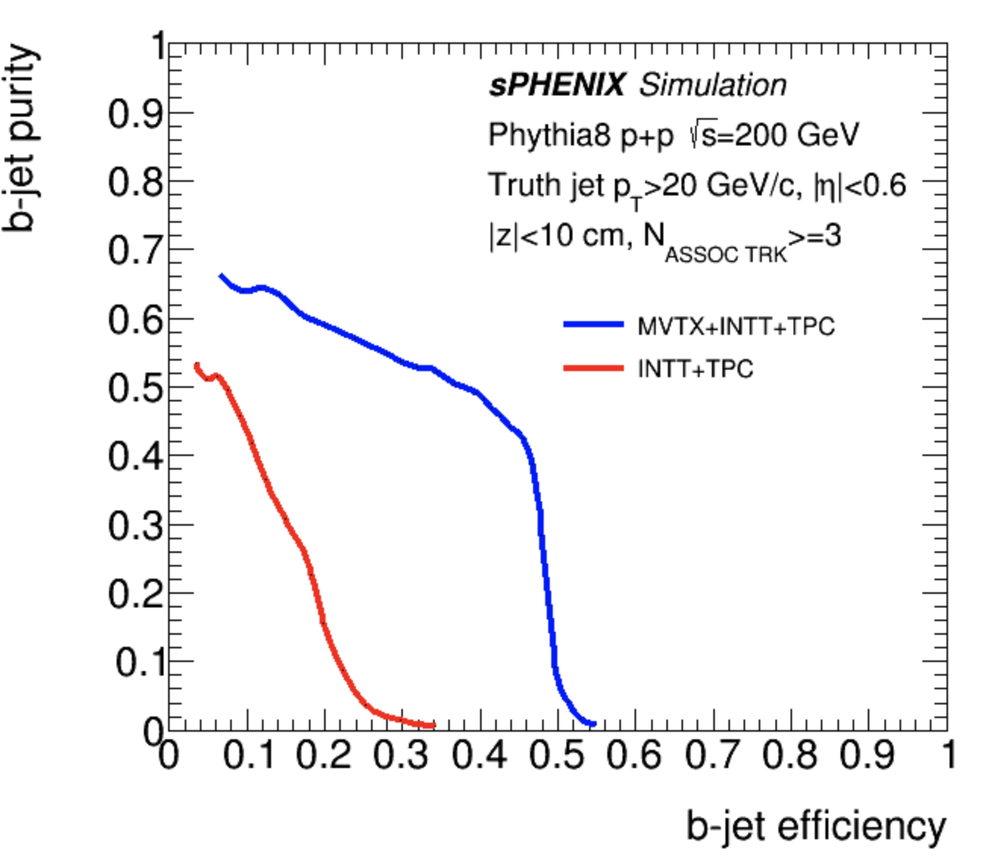
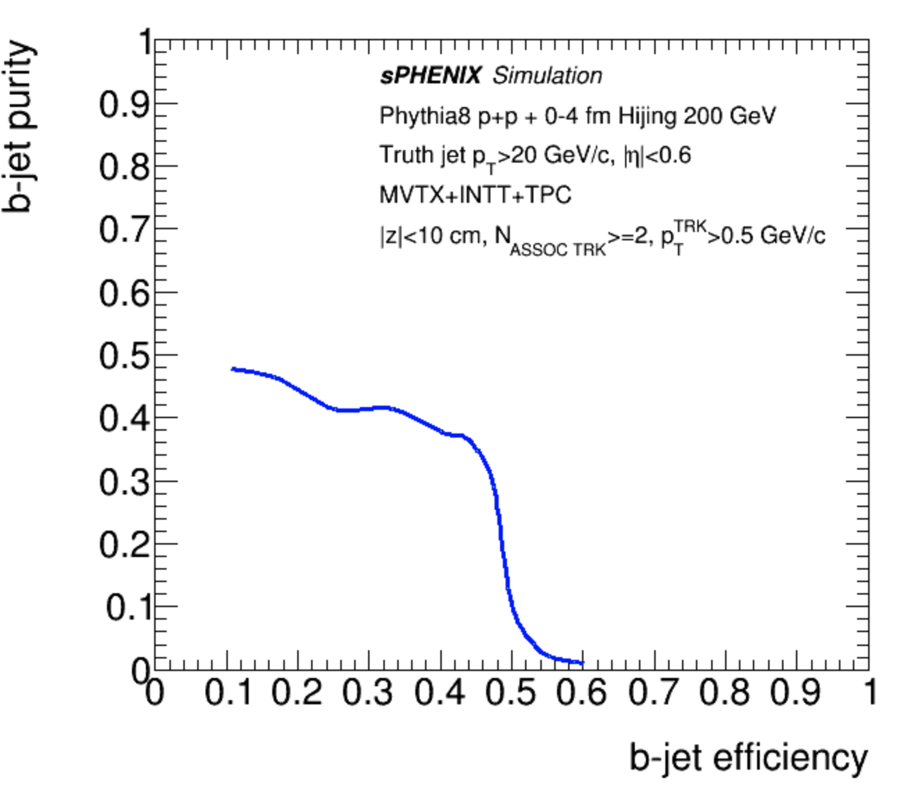
b-jet Tagging: Algorithm II
p+p
Au+Au
w/ MVTX
Algorithm II:
Utilize Secondary Vertex reconstruction
Reconstruct secondary vertex & require ≥ 2 tracks associated with it
Full Geant-4 simulation of p+p (pythia 8) and Au+Au (Hijing) + reconstruction & tracking software
No pile-up included (under development)
Progress highlight:
Algorithm successfully tested in p+p and Au+Au collisions!
D. McGlinchey - Physics & Detector Simulations

Slide 9
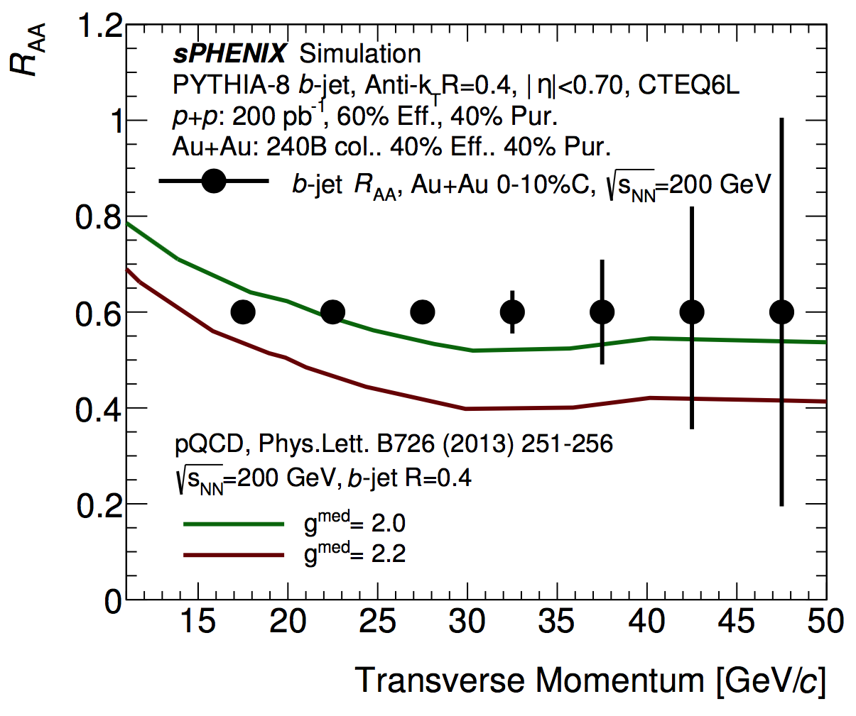
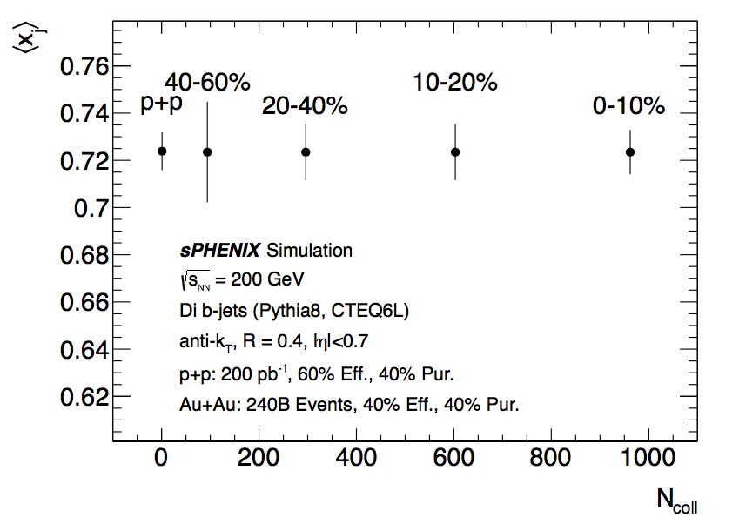
b-jet: Physics Projections
Performance projections included in MVTX proposal submitted to DOE
Di b-jets
Progress highlight:
Full physics projections included in proposal!
D. McGlinchey - Physics & Detector Simulations

Slide 10
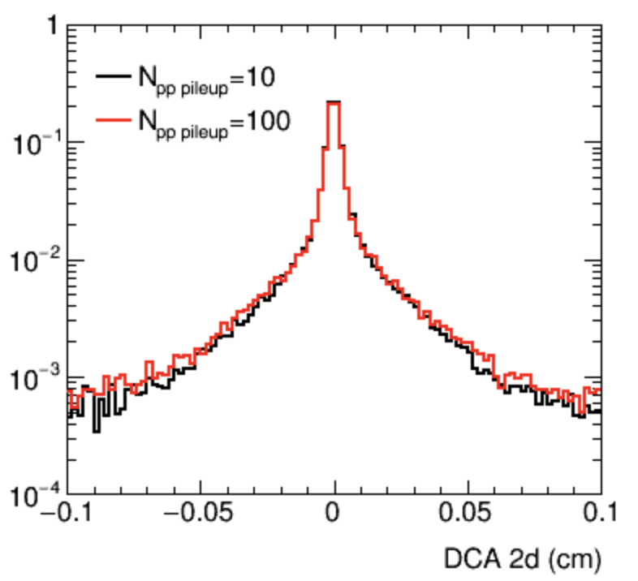
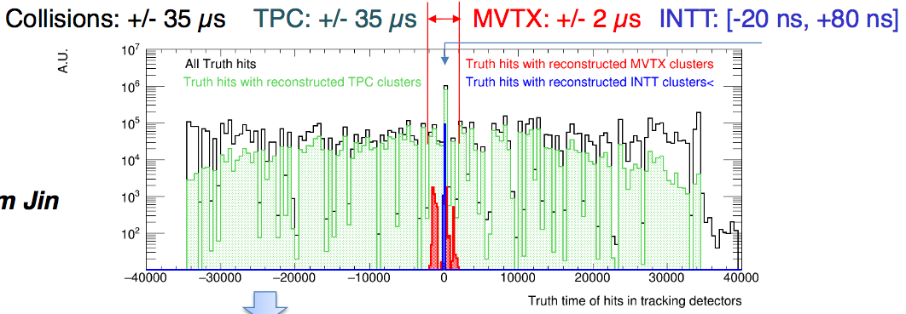
Improving Realism: Event pile-up
Detector | Integration window [μs] | p+p [13 MHz] | Au+Au [200 kHz]
MVTX | [-5.0, +5.0] | 130 (<<1% occ) | 2 (<<1% occ)
INTT | [-0.02,+0.08] | 1 | 1
TPC | [-35, +35] | 910 | 14 (~35% occ)
Event pile-up:
With high luminosity, expect multiple collisions per trigger due to integration times
Largest effect in the Time Projection Chamber (TPC)
Now have a full framework to test this in simulations (as of ~Nov 2017)
Working on improving tracking algorithms to mitigate effect
Goal for 2018:
Test pile-up effect on b-jet performance
D. McGlinchey - Physics & Detector Simulations

Slide 11
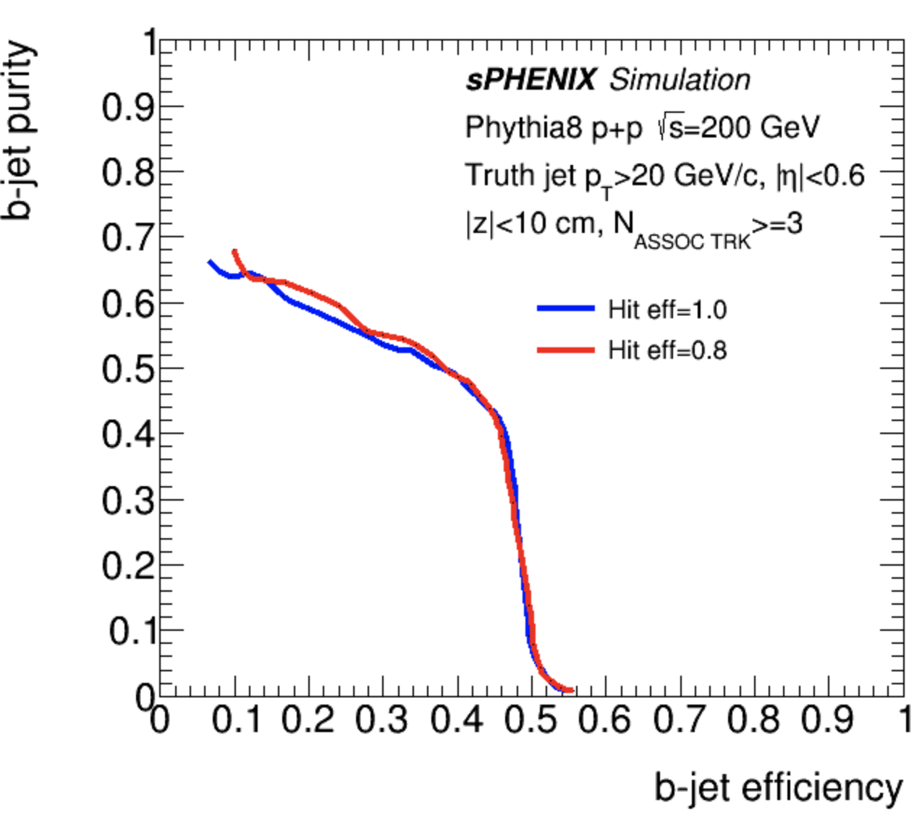
Improving Realism:
Detector efficiency & alignment
Detector efficiency:
Current efficiency studies test effect of random hit inefficiency
80% hit (channel) efficiency → little degradation in b-jet tagging efficiency & purity
Need to test effect of dead chips & ladders on b-jet performance
Goal for 2018:
Provide framework for detailed eff studies
Detector alignment:
Currently assume perfect detector alignment
Detector misalignment can worsen DCA resolution
Add ability to mis-align detector between simulation & reconstruction stages
Develop method for aligning the detector in real data
The group has significant experience from PHENIX silicon detectors
Goal for 2019:
Provide sPHENIX MVTX alignment procedure
D. McGlinchey - Physics & Detector Simulations

Slide 12
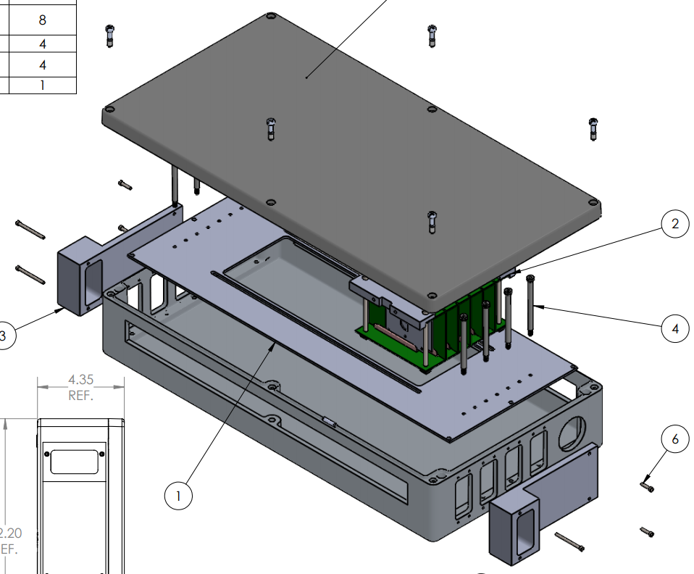
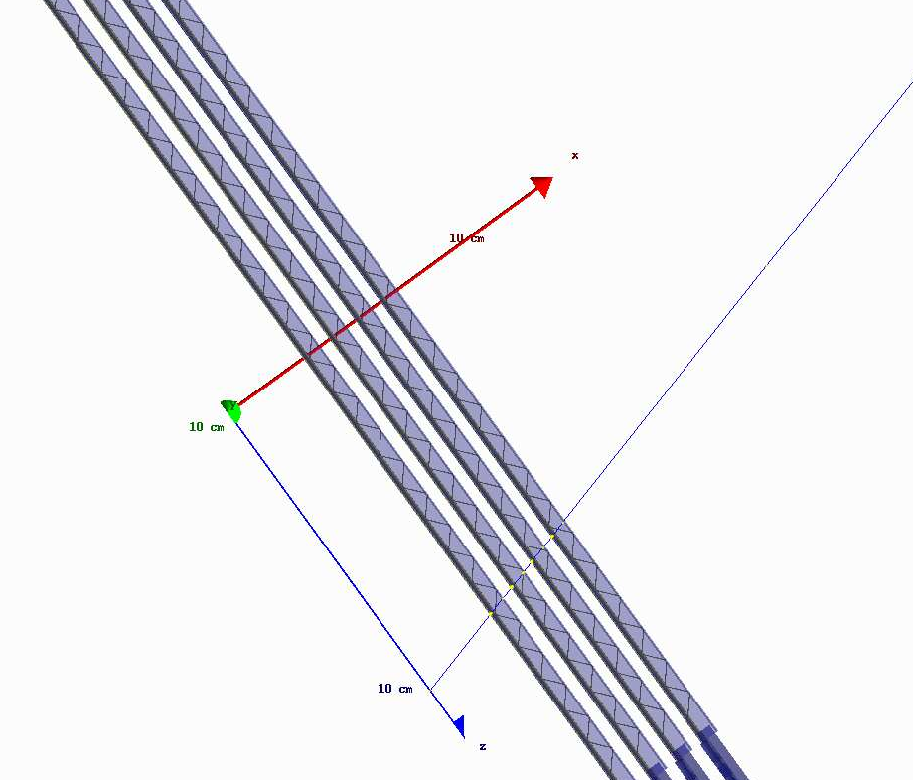
MVTX Prototype
MVTX Prototype:
Key deliverable of LDRD is 4 stave (or chip) telescope for cosmic ray & beam test studies
Discussed in detail later by Sho Uemura
Software & simulation goals:
Use the same software for simulation & data reconstruction
Validate charge sharing in simulations
Test alignment procedure
Goal for 2018:
Validate charge sharing in simulations using real data
D. McGlinchey - Physics & Detector Simulations

Slide 13
Summary
Deliverable:
Develop the software framework necessary for validation of the MVTX design.
Progress:
Simulations now include realistic detector geometry
B-jet tagging performance studied in both p+p and Au+Au using two methods
p+p: 60% efficiency, 40% purity
Au+Au: 40% efficiency, 40% purity
(assumes 100% detector efficiency and no event pile-up)
Provided physics projections for b-jet R_{AA} in MVTX proposal
We also have physics projections for other observables, b-jets highilighted here.
Goals for 2018-2019:
[2018] Test pile-up effect on b-jet performance
[2018] Make detailed efficiency studies
[2018] Validate charge sharing in simulations using MVTX prototype data
[2019] Provide sPHENIX MVTX alignment software and procedure (tested on MVTX prototype data)
D. McGlinchey - Physics & Detector Simulations

Slide 14
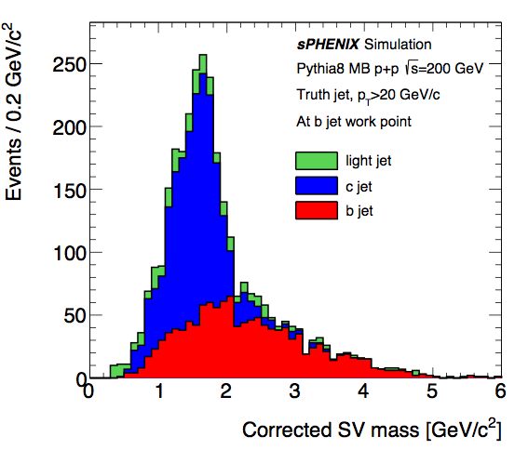
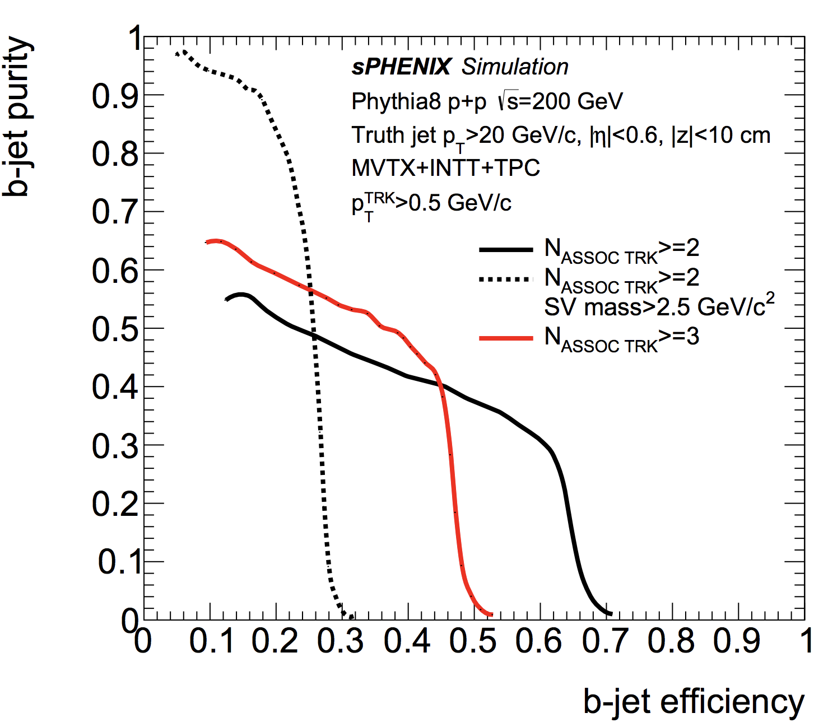
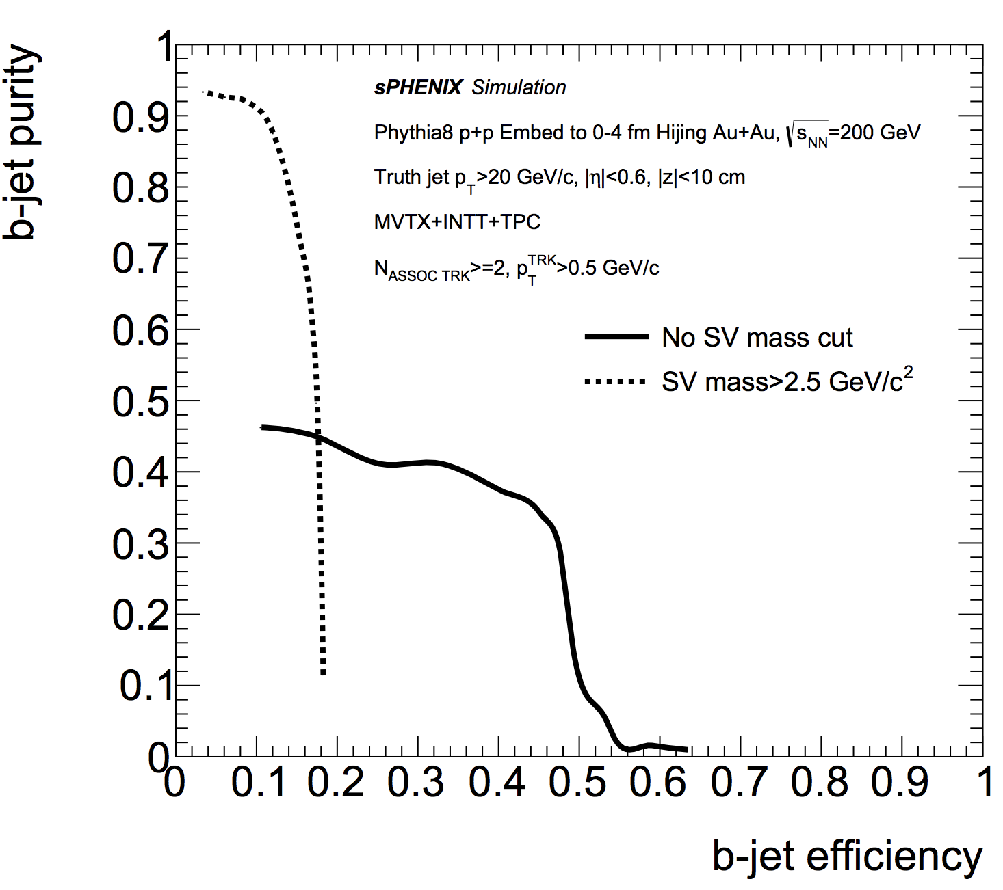
Backup: SV Mass
Using the secondary vertex mass:
The corrected secondary vertex mass can help distinguish between light-, c-, and b-jets
Adding a cut on the SV mass can drastically increase b-jet purity at the expense of efficiency
D. McGlinchey - Physics & Detector Simulations

Slide 15
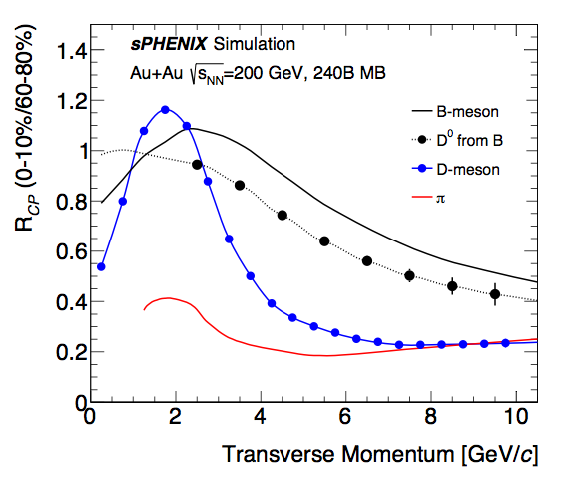
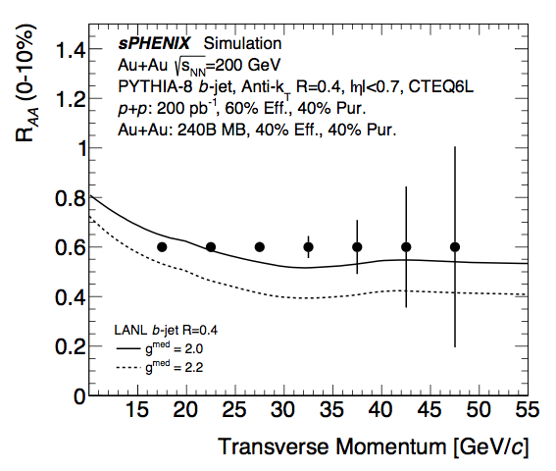
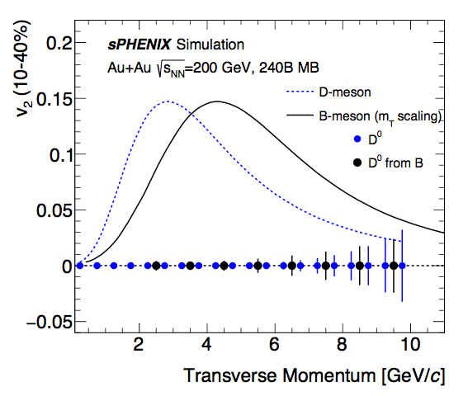
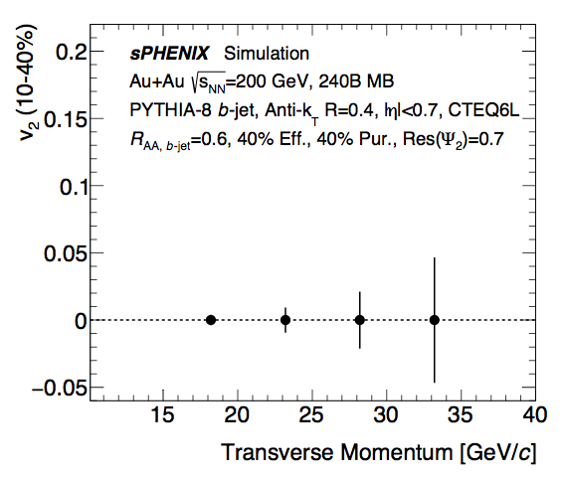
Backup: MVTX Projections
D. McGlinchey - Physics & Detector Simulations

