Slide 1

Molecular Dynamics Simulations
Jérôme Daligault
Applied Math. and Plasma Theory, T-5
UNCLASSIFIED

Slide 2
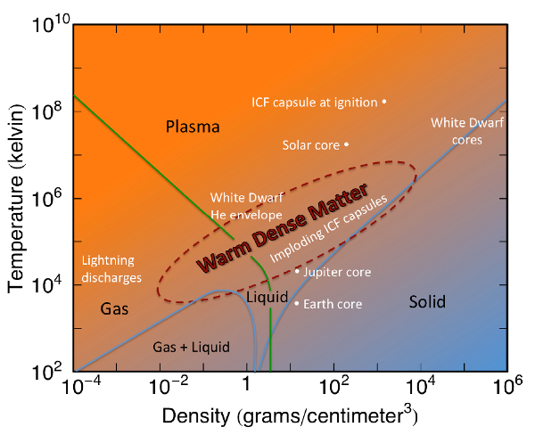
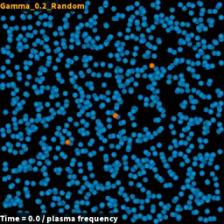
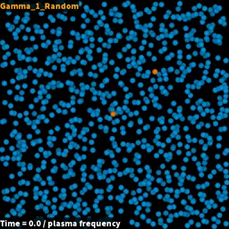
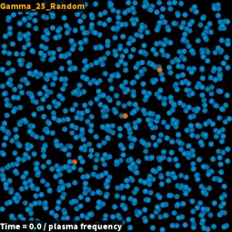
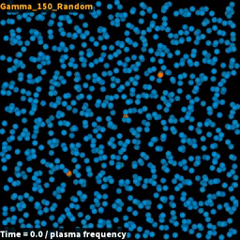
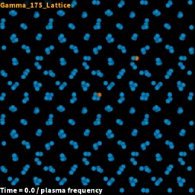

Objectives
Explore the potentially fruitful analogies between Quark-Gluon Plasmas and Warm Dense Matter to provide physical insights and theoretical guidance on the effects of strong coupling on b-jet stopping power phenomenology
Coulomb coupling strength
How does strong coupling affect the stopping power of plasmas ?
$$S=−\frac{dE(V)}{dx}$$
QGP
breakdown of
traditional plasma theory
minimum of viscosity
onset of liquid-like behavior
1st order
liquid-solid transition
Gas-like
Liquid-like
Crystal
UNCLASSIFIED

Slide 3
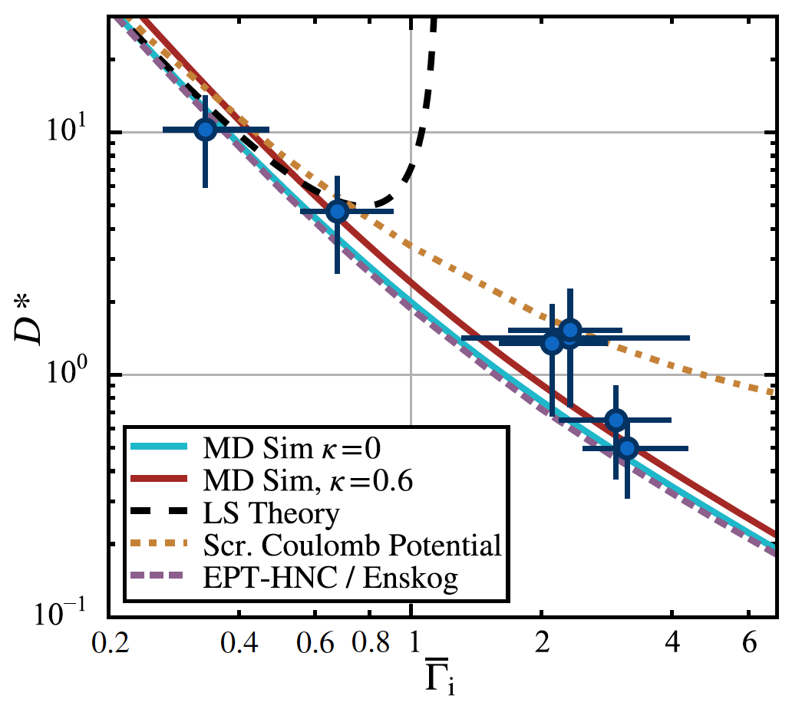







Methods: molecular dynamics
Classical
Molecular Dynamics
+
PBC
Diffusion coefficient
Viscosity coefficient
$$Γ_{QGP}$$
$$Γ$$
Strickler, Daligault et al., PRX (2016)
$$0.1$$
$$1$$
$$10$$
$$100$$
1st milestone met
UNCLASSIFIED

Slide 4

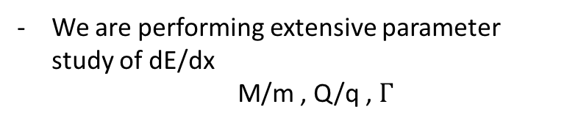



Methods: molecular dynamics of dE/dx
Classical
Molecular Dynamics
$$(1≤i≤N)$$
+
PBC
M/m$=1000$
We developed an MD code to perform dE/dx
Q/q$=1$
We determined viscosity coefficient and
location of viscosity minimum
We are performing extensive parameter study of dE/dx
M/m , Q/q , $Γ$
$$tω_{p}$$
UNCLASSIFIED

Slide 5







Effect of strong coupling on dE/dx
M/m$=10$
M/m$=1$
$$Γ=1$$
Q/q$=1$
$$V/{\text{v}}_{thermal}$$
$$V/{\text{v}}_{thermal}$$
Classic plasma theory
mean field theory :
$$Γ≪1$$
m/M$≪1$
We are developing a theory
binary collisions including strong coupling effects
renormalized binary scattering
cross section
dynamical dielectric effects neglected
UNCLASSIFIED

Slide 6








Strong coupling vs non-linear effects
Weak coupling theory breaks down for $Γ>0.1$
but strong coupling effects arise together with non-linear effects
Dimensionless
Hamiltonian
projectile
projectile - plasma
plasma
$$Γ=0.05$$
$$Γ=1.$$
MD simulations
$$\frac{Q}{q}Γ=.5$$
$$\frac{Q}{q}Γ=10$$
non-linearity + coupling effects
PIC simulations
non-linearity only
$$\frac{m}{M}={10}^{−3}$$
0
1
2
3
4
5
6
7
8
9
$$V/{\text{v}}_{th}$$
$$V/{\text{v}}_{th}$$
2nd milestone well underway
UNCLASSIFIED

Slide 7

Summary
- Performed simulations to understand how strong coupling effects affect transport properties and stopping power of plasmas
1st milestone met, 2nd well underway
- We will now work with DR team members (I. Vitev) to figure out what these findings tell us about QGP’s
- Work done in collaboration with 2017 summer student David Bernstein, Univ. of Iowa. David has started a PhD on this topic
- Publications: Phys. Rev. E 96, 043202 (2017) 95, 013206 (2017)
- Manuscript on dE/dx in preparation
- Talks: 2017 APS-DPP (contr.) 2017 White Dwarfs Physics Wkp (invited) Charged Particle Transport Wkp (invited)
UNCLASSIFIED

Slide 9
Hydrodynamic Simulation and
Splitting Function Calculation
Boram Yoon
CCS-7
UNCLASSIFIED

Slide 10


Hydrodynamic Simulation
Relativistic viscous hydrodynamics for b-jets
  Reliable description of the QGP required to
  understand b-jet production in heavy-ion collisions
  Hydrodynamic medium
  → b-jet splitting functions and propagation
Hydrodynamic simulation
  Relativistic viscous hydrodynamics
  describes soft particle production
  in RHIC & LHC
  State-of-the-art hydrodynamics
  including viscosity and density fluctuations
  Inputs: Initial condition & Equation of State (EOS)
y
z
x
UNCLASSIFIED

Slide 11
Hydrodynamic Simulation with
iEBE-VISHNU Code Package
iEBE-VISHNU package
  Hydro + hadron cascade simulator for relativistic heavy-ion collisions
  Developed by Chun Shen (2016)
UNCLASSIFIED

Slide 12
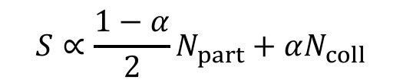
Hydrodynamic Simulation with
iEBE-VISHNU Code Package
Initial Condition Generation
  MC-Glauber model using SuperMC
  includes fluctuation
$$S∝\frac{1−α}{2}N_{part}+αN_{coll}$$
UNCLASSIFIED

Slide 13
Hydrodynamic Simulation with
iEBE-VISHNU Code Package
Hydrodynamic Simulation
  Solving second-order Israel-Stewart equation in (2+1)-dimension
UNCLASSIFIED

Slide 14
Hydrodynamic Simulation with
iEBE-VISHNU Code Package
Freeze-out and Particle Sampling
  Fast Cooper-Frye using iS & iSS, hadron cascade using UrQMD
UNCLASSIFIED

Slide 15
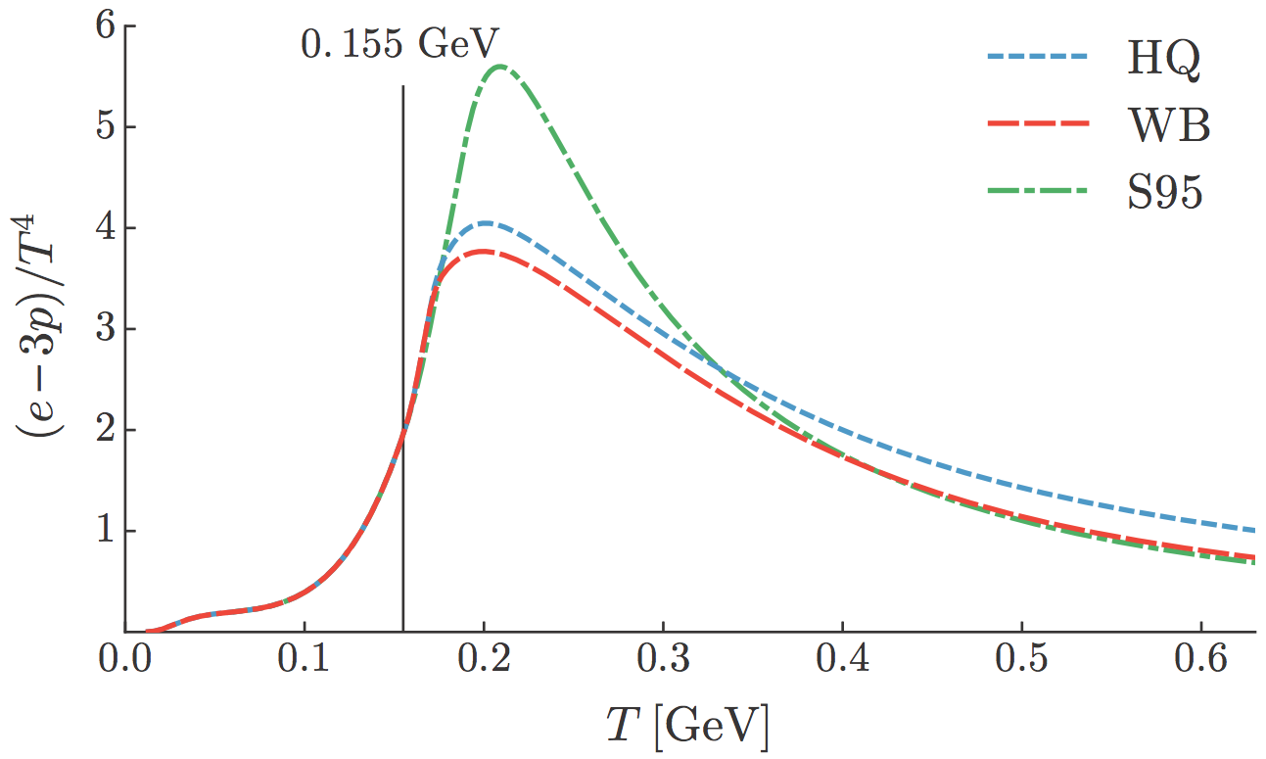
EOS from HotQCD Collaboration
Inclusion of HotQCD EOS in simulation
  Replaced
  older s95p-v1 (2010) parameterization by newer HotQCD (2014) collaboration results
  20% difference found in spectra and flow coefficients (s95p-v1 vs HotQCD)
Moreland & Soltz, 2016
PHENIX 2004
Milestone met: Hydrodynamic simulation with HotQCD EOS
UNCLASSIFIED

Slide 16
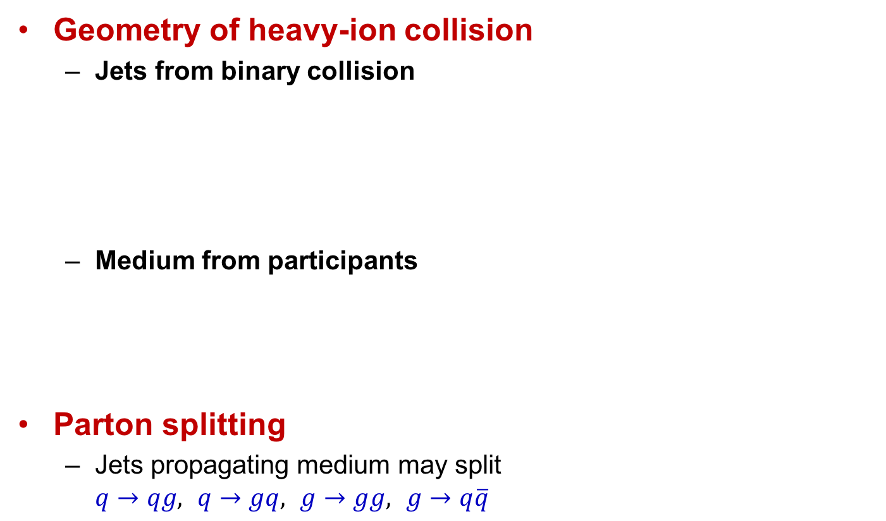
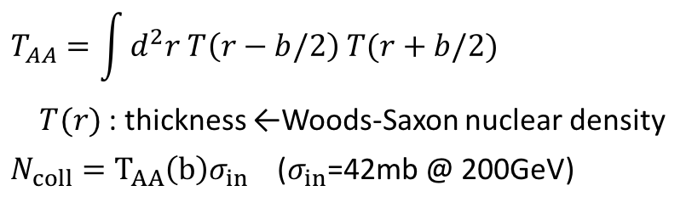
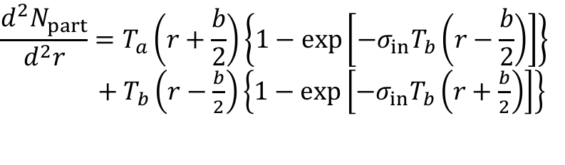
Splitting Function Calculation
Heavy-quark splitting functions are evaluated in the hydrodynamic medium
Geometry of heavy-ion collision
  Jets from binary collision
  Medium from participants
Parton splitting
  Jets propagating medium may split
  $q→qg,$ $q→gq,$ $g→gg,$ $g→q\overline{q}$
$$T_{AA}=\int{d^{2}r T\left(r−b/2\right) T(r+b/2)}$$
$T(r)$: thickness ←Woods-Saxon nuclear density
$N_{coll}=T_{AA}\left(b\right)σ_{in}$ ($σ_{in}$=42mb @ 200GeV)
$$\frac{d^{2}N_{part}}{d^{2}r}=T_{a}\left(r+\frac{b}{2}\right)\left\{1−\exp\left[−σ_{in}T_{b}\left(r−\frac{b}{2}\right)\right]\right\}$$
$+ T_{b}\left(r−\frac{b}{2}\right)\left\{1−\exp\left[−σ_{in}T_{b}\left(r+\frac{b}{2}\right)\right]\right\}$
UNCLASSIFIED

Slide 17
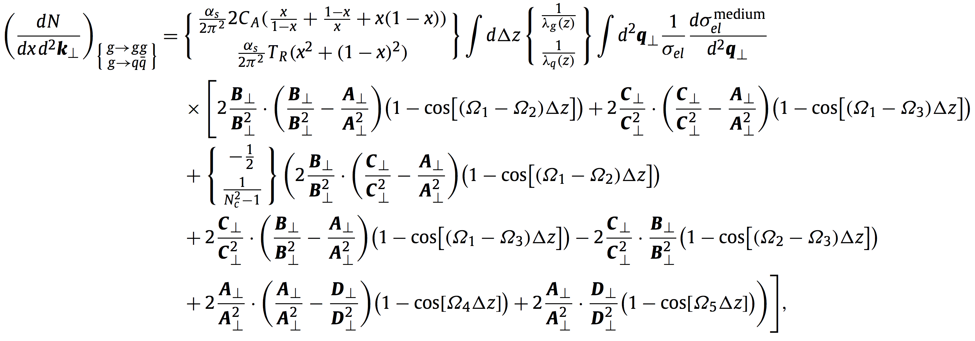
Splitting Function Calculation
Medium-induced parton splitting kernels are
calculated (JHEP 2017) and coded up by Ivan Vitev
Use a simple model for QGP medium background
Take 3 days on a 32 Core Xeon node for a parameter set
  Need to be repeated for various couplings, energies, centralities, …
UNCLASSIFIED

Slide 18
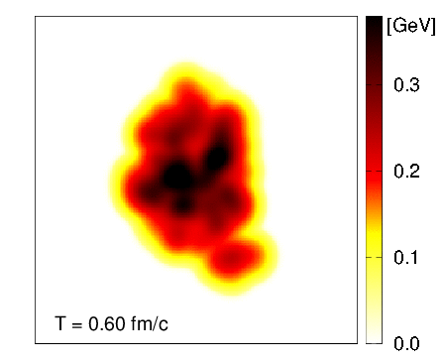
Splitting Function Calculation with realistic QGP medium
Major accomplishment in lattice QCD and simulation part
Improved QGP medium
Simple Bjorken model → hydrodynamic simulation w/ full transverse expansion
Splitting
Momentum Fraction
Large difference found in the splitting functions on model vs hydro simulation QGP medium
Code takes 6 times more time
Evolution of medium temperature in Au+Au
UNCLASSIFIED

Slide 19
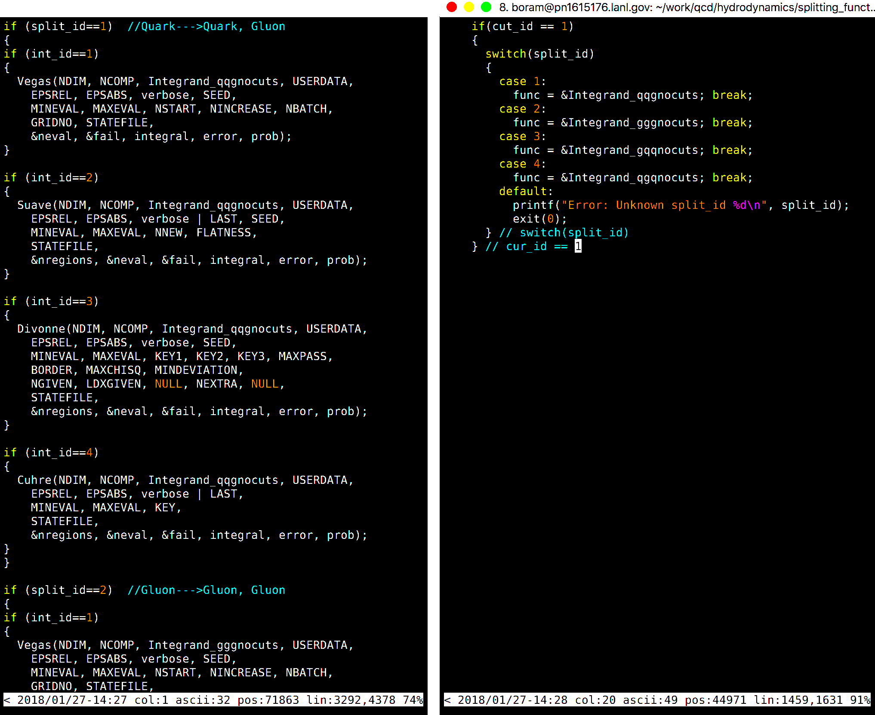
Splitting Function Code Optimization
Refactoring
  Original code has complicated
  structure that restricts extensions,
  and many redundant replications
  Only GNU compiler can compile
  it due to the nested functions
  Code is restructured (in C++) and
  shortened (24K → 8K lines)
  Arithmetic calculations are optimized to be more efficient
  20x speed improvement accomplished
Effective incorporation of simulated QGP medium
  Reduced overhead for calling QGP medium grid function
  2x speed improvement accomplished
UNCLASSIFIED

Slide 20
Splitting Function Code Optimization
Efficient on-node parallelization
  Original code uses parallelization
  supported by Cuba numerical
  integration library (pthread)
  Scales terribly
  Problem can be embarrassingly
  parallelizable by distributing
  integrations for different
  energy/momenta for different cores
  New parallelization shows much better scaling
  10x speed improvement accomplished
Overall improvement: 18 days → 1 hour
  Precise splitting probability on variety of simulation parameters
  Easy to read, and easy to extend code base
Preparing for a paper for di-b-jet in LHC and RHIC (2018)
Milestone met: Jet propagation into fluctuating hydro medium
UNCLASSIFIED

Slide 21
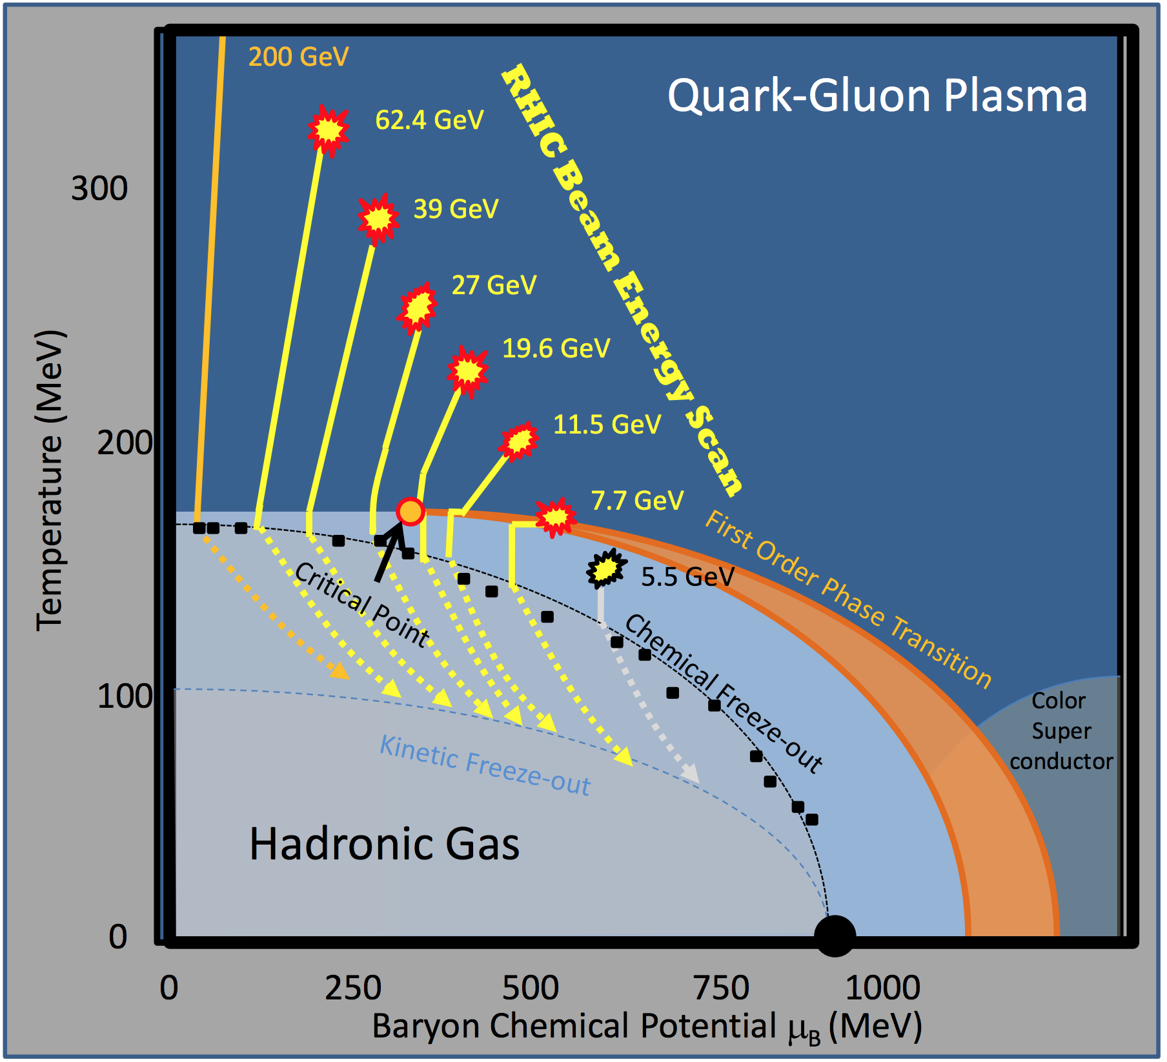
Summary
Hydrodynamic simulation
  Improved Equation of State (EOS)
Heavy quark splitting function calculation
  Realistic QGP background generated by the hydrodynamic simulation
  Optimized code for practical evaluation
  on various simulation parameters
  Paper in preparation
FY18-19 plan
  Complete splitting function calculations
  Beam energy scan to address jet quenching at low center of mass energies
PHENIX 2004
UNCLASSIFIED

