Slide 1

Molecular Dynamics Simulations
Jérôme Daligault
Applied Math. and Plasma Theory, T-5
UNCLASSIFIED

Slide 2
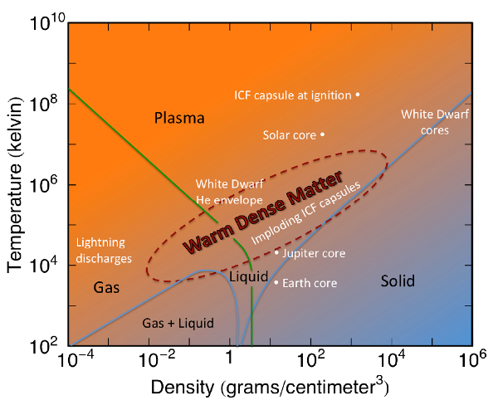
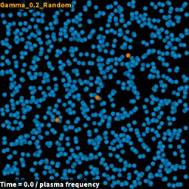
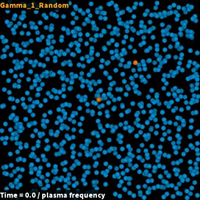
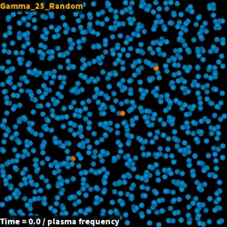
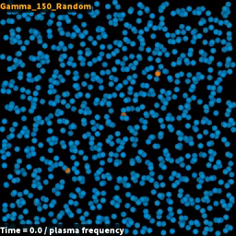
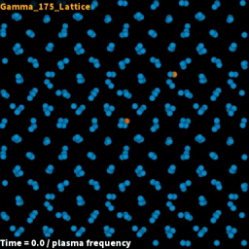

Objectives
Explore the potentially fruitful analogies between Quark-Gluon Plasmas and Warm Dense Matter to provide physical insights and theoretical guidance on the effects of strong coupling on b-jet stopping power phenomenology
Coulomb coupling strength
How does strong coupling affect the stopping power of plasmas ?
$$S=−\frac{dE(V)}{dx}$$
QGP
breakdown of
traditional plasma theory
minimum of viscosity
onset of liquid-like behavior
1st order
liquid-solid transition
Gas-like
Liquid-like
Crystal
UNCLASSIFIED

Slide 3
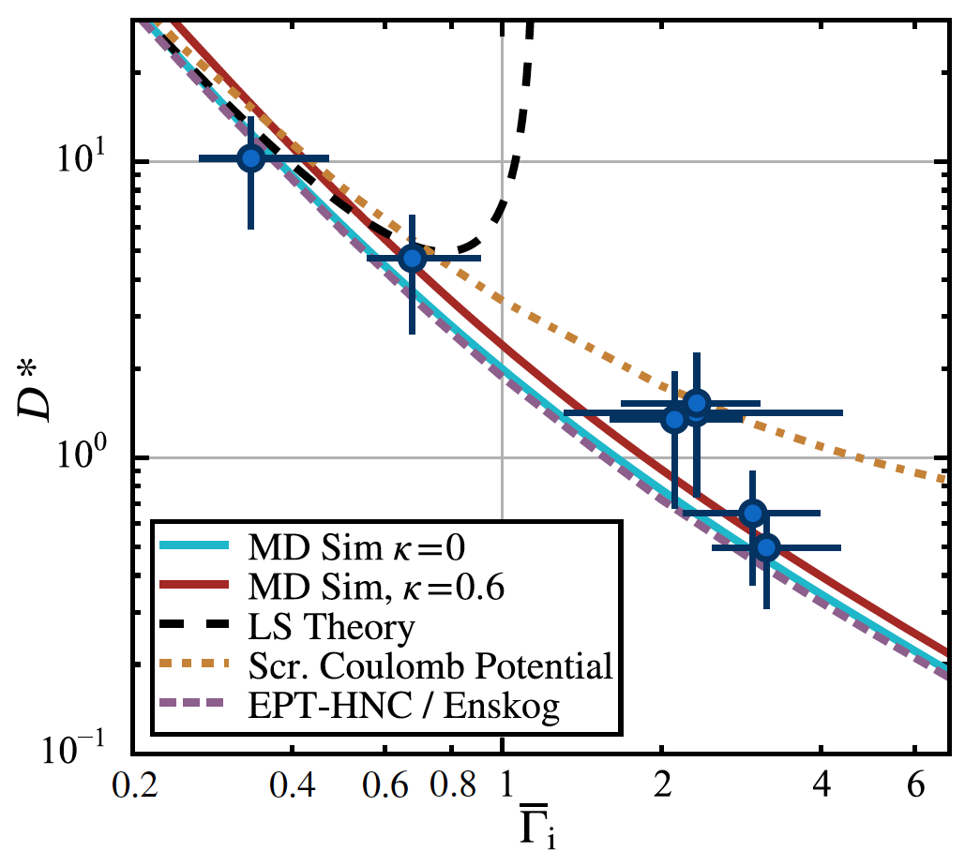







Methods: molecular dynamics
Classical
Molecular Dynamics
+
PBC
Diffusion coefficient
Viscosity coefficient
$$Γ_{QGP}$$
$$Γ$$
Strickler, Daligault et al., PRX (2016)
$$0.1$$
$$1$$
$$10$$
$$100$$
1st milestone met
UNCLASSIFIED

Slide 4

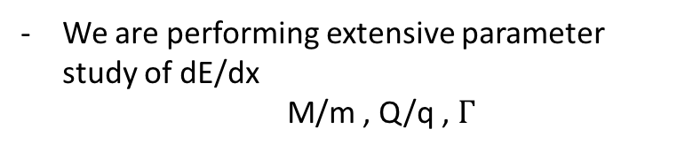



Methods: molecular dynamics of dE/dx
Classical
Molecular Dynamics
$$(1≤i≤N)$$
+
PBC
M/m$=1000$
We developed an MD code to perform dE/dx
Q/q$=1$
We determined viscosity coefficient and
location of viscosity minimum
We are performing extensive parameter study of dE/dx
M/m , Q/q , $Γ$
$$tω_{p}$$
UNCLASSIFIED

Slide 5







Effect of strong coupling on dE/dx
M/m$=10$
M/m$=1$
$$Γ=1$$
Q/q$=1$
$$V/{\text{v}}_{thermal}$$
$$V/{\text{v}}_{thermal}$$
Classic plasma theory
mean field theory :
$$Γ≪1$$
m/M$≪1$
We are developing a theory
binary collisions including strong coupling effects
renormalized binary scattering
cross section
dynamical dielectric effects neglected
UNCLASSIFIED

Slide 6








Strong coupling vs non-linear effects
Weak coupling theory breaks down for $Γ>0.1$
but strong coupling effects arise together with non-linear effects
Dimensionless
Hamiltonian
projectile
projectile - plasma
plasma
$$Γ=0.05$$
$$Γ=1.$$
MD simulations
$$\frac{Q}{q}Γ=.5$$
$$\frac{Q}{q}Γ=10$$
non-linearity + coupling effects
PIC simulations
non-linearity only
$$\frac{m}{M}={10}^{−3}$$
0
1
2
3
4
5
6
7
8
9
$$V/{\text{v}}_{th}$$
$$V/{\text{v}}_{th}$$
2nd milestone well underway
UNCLASSIFIED

Slide 7

Summary
- Performed simulations to understand how strong coupling effects affect transport properties and stopping power of plasmas
1st milestone met, 2nd well underway
- We will now work with DR team members (I. Vitev) to figure out what these findings tell us about QGP’s
- Work done in collaboration with 2017 summer student David Bernstein, Univ. of Iowa. David has started a PhD on this topic
- Publications: Phys. Rev. E 96, 043202 (2017) 95, 013206 (2017)
- Manuscript on dE/dx in preparation
- Talks: 2017 APS-DPP (contr.) 2017 White Dwarfs Physics Wkp (invited) Charged Particle Transport Wkp (invited)
UNCLASSIFIED

