Slide 1

sPHENIX LDRD Review
MVTX mechanical conceptual design
Walter Sondheim
P-25
UNCLASSIFIED

Slide 2
Outline:
Main mechanical components:
  Stave
    Cabling pig-tail
  Half-barrel (3 layer) assembly
  Half-barrel outer shell, including service patch panel in conical region
  Service barrel
  Support cylinder
  sPHENIX CAD model
Integration to sPHENIX tracking system

Slide 3
ALICE & MVTX tracker stave:
UNCLASSIFIED

Slide 4
ALICE & MVTX stave structure:
MVTX stave support/cold plate geometry:
UNCLASSIFIED

Slide 5
ALICE & MVTX stave cooling:
Now < 41 mW/cm²
Full stave assembly mass 15.1 gms
MXTX inner tracker stave cooling and support plate:
UNCLASSIFIED

Slide 6
Tracker Stave Pigtail:
Three layers: signal lines (FPC) 2X twisted pair, digital power, analog power
UNCLASSIFIED

Slide 7
Half Barrel Three Layer Assy:
Both in the case of ALICE and sPHENIX, the silcon inner tracker is split in two halves since the beryllium beam-pipe will already be installed. The total mass of this assembly 2,200 gms
UNCLASSIFIED

Slide 8
Half Barrel Service Interconnect:
Total power: on detector 119.55 watts
power cables 34.0 watts
Pig-tail
Stave assy:
Layer 0
Layer 1
Layer 2
Layer 0
Layer 1
Layer 2
Cooling: negative pressure water, plus dry air (nitrogen) flow
UNCLASSIFIED

Slide 9
Inner Barrel Assembly Steps:
UNCLASSIFIED

Slide 10
ALICE Half Barrel Assembly:
Stave fixed end
Radiation length of MVTX Assembly 0.3% X₀/layer
UNCLASSIFIED

Slide 11
ALICE ITS Service Barrel:
UNCLASSIFIED

Slide 12
MVTX Service Barrel:
Overall length 2161.73 mm
UNCLASSIFIED

Slide 13
MVTX Service Barrel:
Interface rollers to slots in support cylinder
UNCLASSIFIED

Slide 14
ALICE ITS Support Cylinder:
Rail guides for upper half assembly
Eccentric:
Adjustable roller +/- 1.0 mm, by steps of .25 mm
In sPHENIX we will not use a “service cone, rail system” anywhere near the size of that planned for the ALICE detector (shown here), but we will use their concept.
UNCLASSIFIED

Slide 15
sPHENIX Tracking Detectors:
sPHENIX TPC inner bore 400.0 mm
UNCLASSIFIED

Slide 16
sPHENIX Overall CAD Model:
UNCLASSIFIED

Slide 17
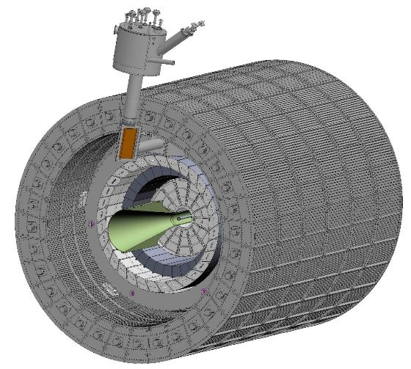
sPHENIX CAD Model, Detectors:
Outer Hcal
BABAR magnet coil
Inner Hcal
EM Cal
MVTX Service Cone
TPC
UNCLASSIFIED

Slide 18
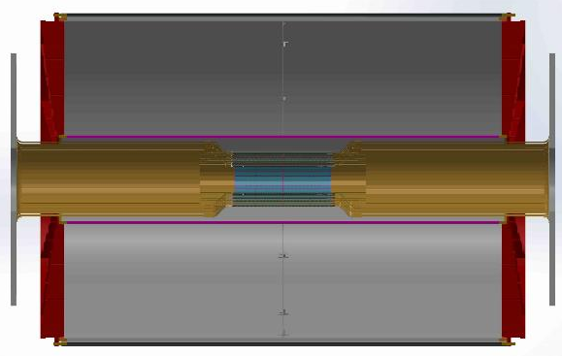
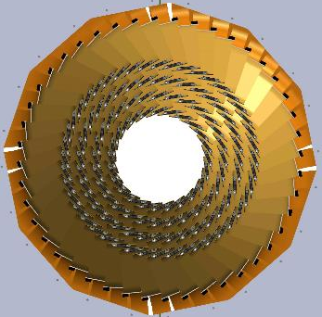
sPHENIX INTT TPC CAD model:
INTT updated CAD model, 4 layers silicon strip detectors with extension cables
INTT
INTT extension cables
TPC
Cross-section view of INTT, four layers of silicon ladders
INTT readout electronics, FVTX ROC boards
TPC & INTT CAD model, section view
UNCLASSIFIED

Slide 19
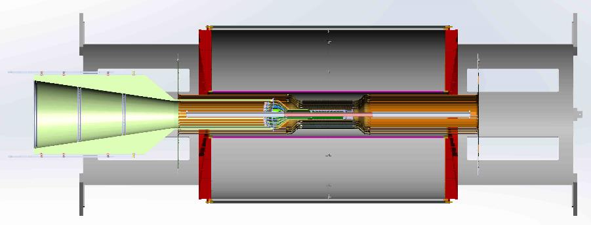
sPHENIX INTT, TPC, MVTX CAD model:
TPC support structure tied to the inner HCal
INTT with 1.2 meter extension cables running out both ends of TPC to electronics
MVTX with 18.0 cm extension cables on staves, interconnect conical region and service barrel,
Needed to have adequate clearance from INTT ladders
sPHENIX beryllium beam-pipe
UNCLASSIFIED

Slide 20
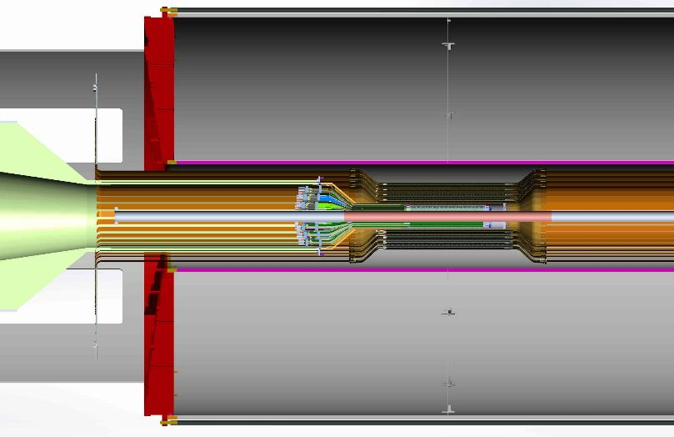
sPHENIX Tracking detectors, detail:
MVTX flex extension cable 180.0 mm
INTT stave length 480.0 mm
MVTX stave length 280.0 mm
UNCLASSIFIED

Slide 21
sPHENIX Tracking detector issues:
The current design for the INTT detector does not have a support structure or additional services shown like cooling.
There is interference between the INTT extension cables and the conical region of the MVTX (“Z” locations)
  A possible solution would be locating the conical region of the MVTX at the “Z” location of the INTT readout-electronics disk, this would be an additional 1200.0 mm
Because of the different radial dimensions between the beam-pipe in ALICE and the beam-pipe in sPHENIX, eack of the three MVTX layers need to be moved outward in radius by .75 mm.
  This translation will still allow each layer to be hermetic
A meeting will take place at BNL to discus tracking detector integration issues on Friday January 26th.
UNCLASSIFIED

Slide 22
sPHENIX MAPS Detector:
UNCLASSIFIED

