Slide 1
sPHENIX LDRD Review
ALPIDE Introduction and Test Stand
Xuan Li
P-25
Outline
ALPIDE chip introduction
LDRD test bench setup
Test bench achievements
Plans
UNCLASSIFIED

Slide 2
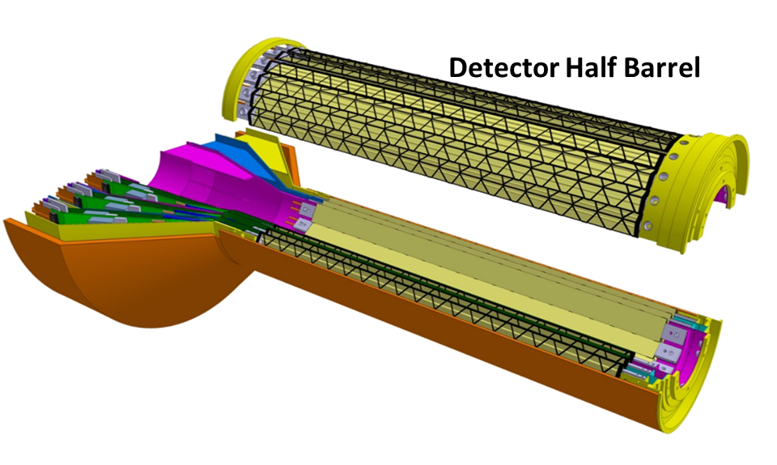
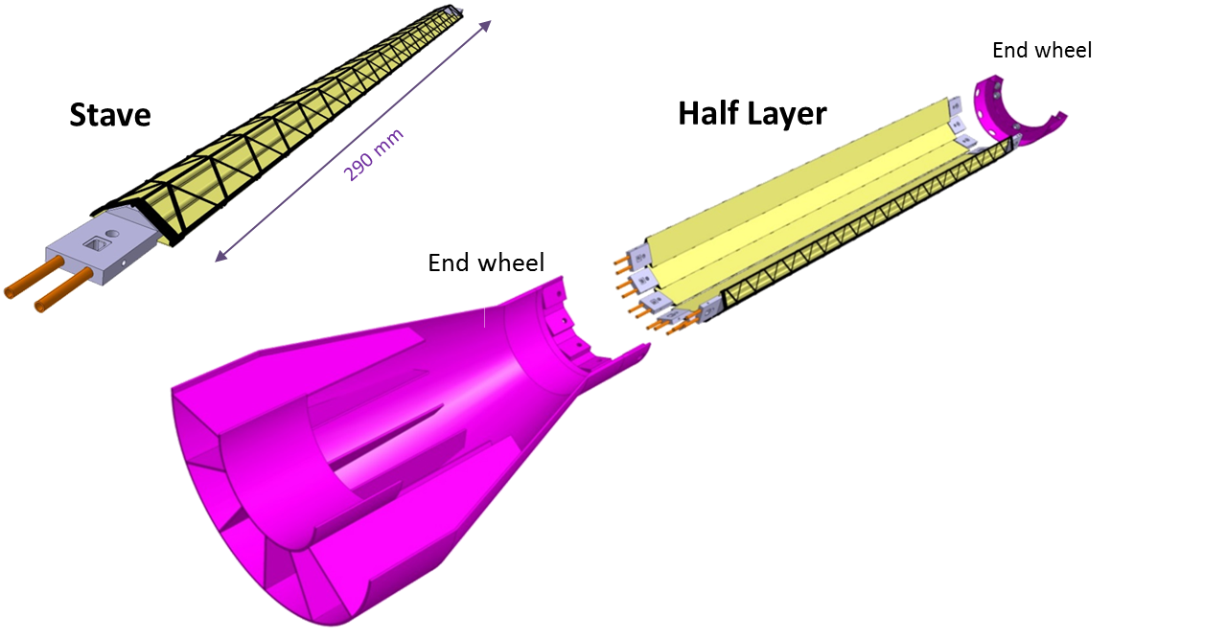
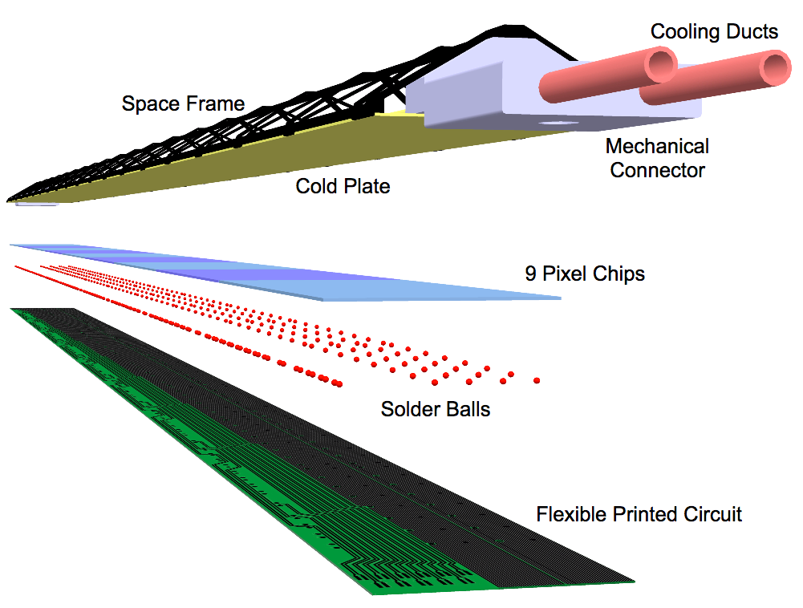
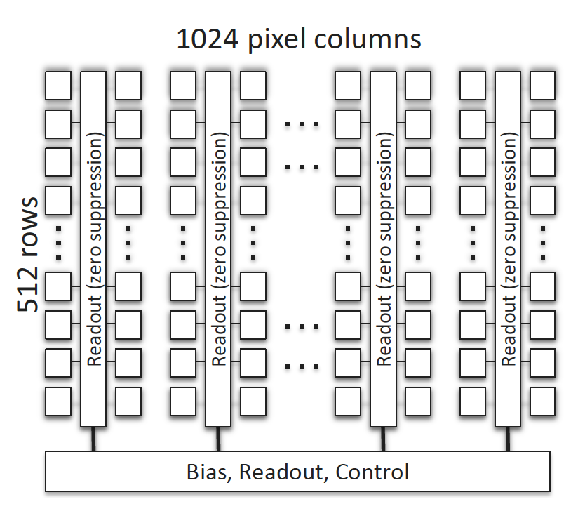
The MVTX Basic Unit: ALPIDE chip
ALPIDE chip Introduction:
The 3 layer MVTX consists of 48 staves and each stave contains 9 ALIPDE chips.
Stave
ALPIDE chip scheme
1.5cm
3cm

Slide 3
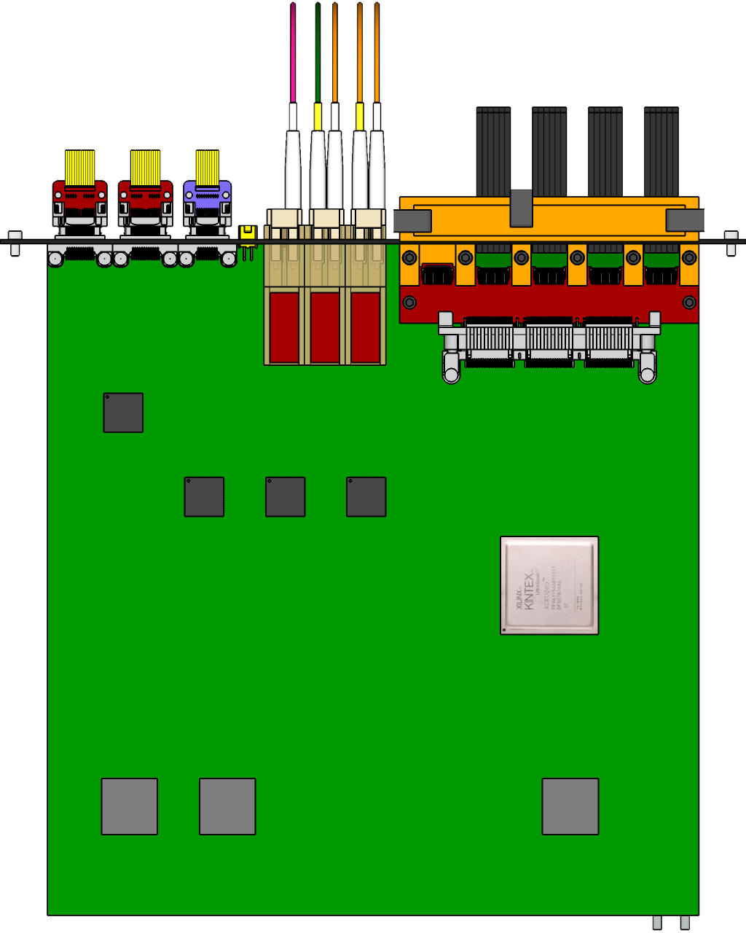
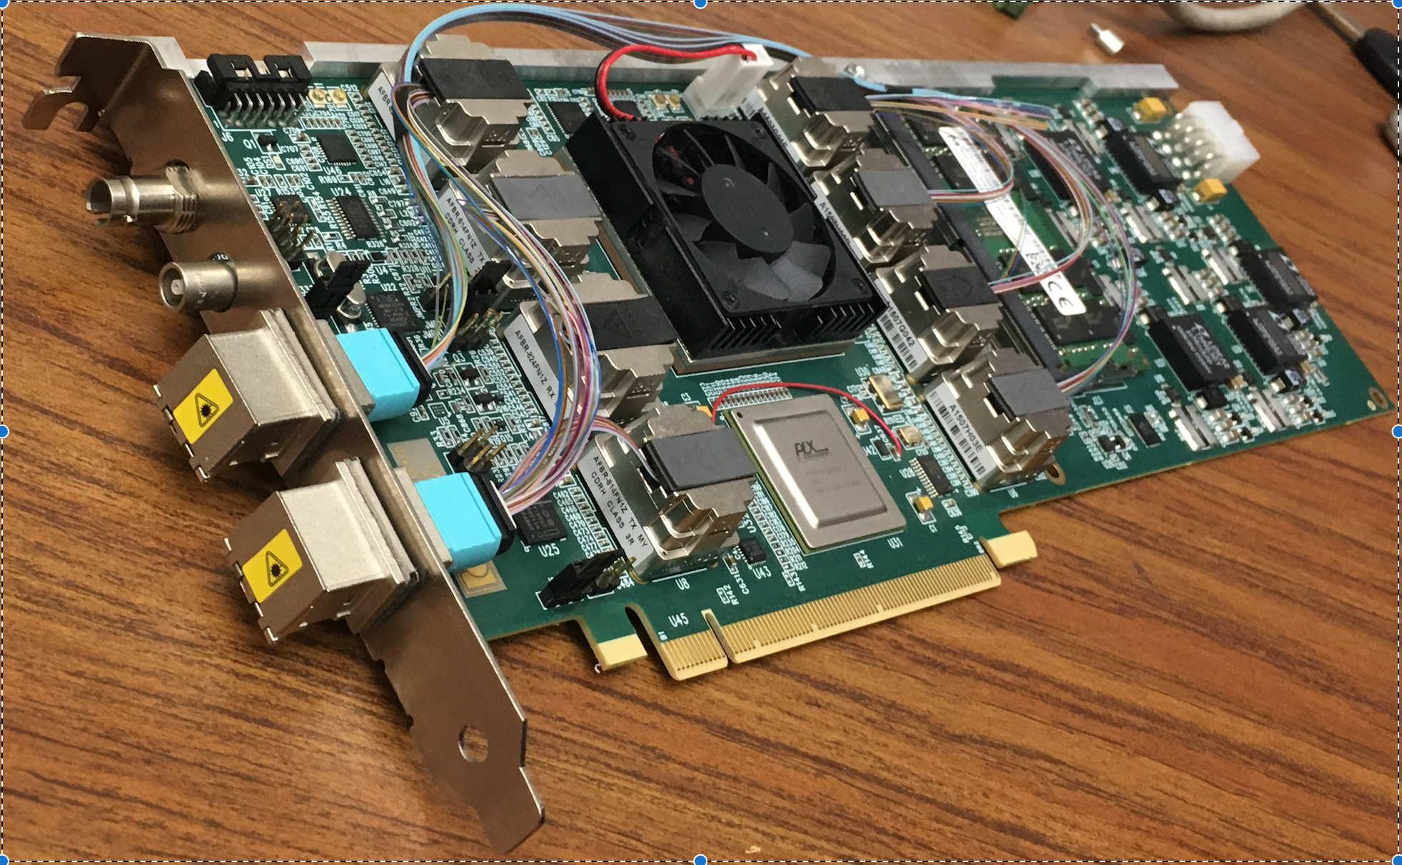
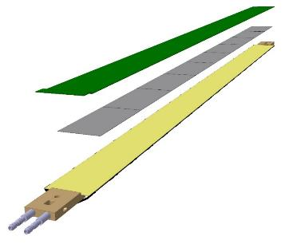
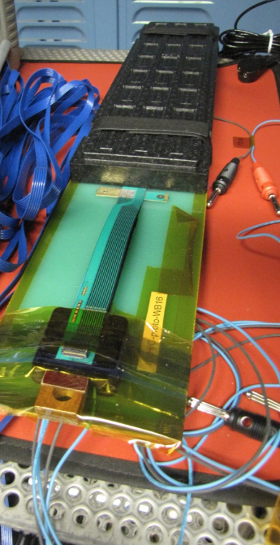
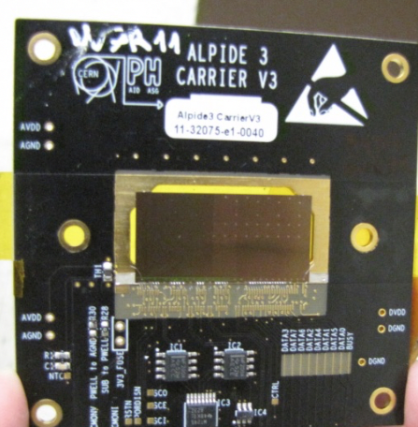
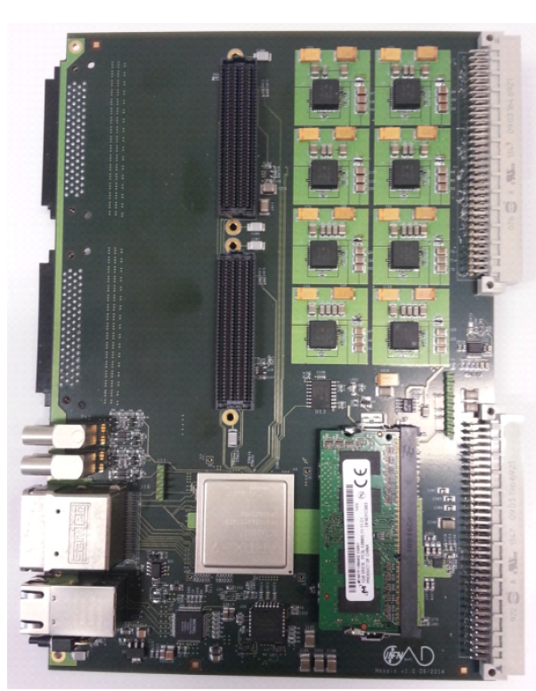
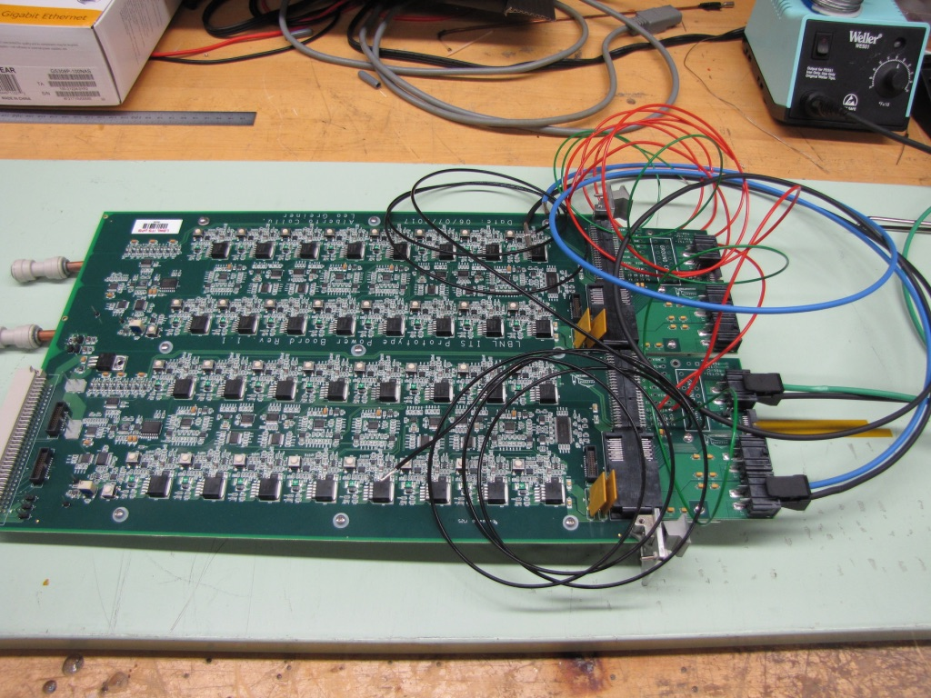
Test bench Components
5 m
Readout Unit
Optical Links
FELIX
9 Sensor Stave
9 Data (1.2Gbps)
1 Clock, 1 Control/Trigger
Control
Data (9.6 Gb/s max)
Trigger
Samtec Twinax “FireFly”
FPC
Power
Alpide Sensors
RCDAQ
Filtering Capacitors
regulators
Power Board
Cold Plate
Regulated Power
Purchased one stave and 5 individual ALPIDE chips.
Test bench
readout module:
MOSAIC
Purchased 1 Power Board

Slide 4
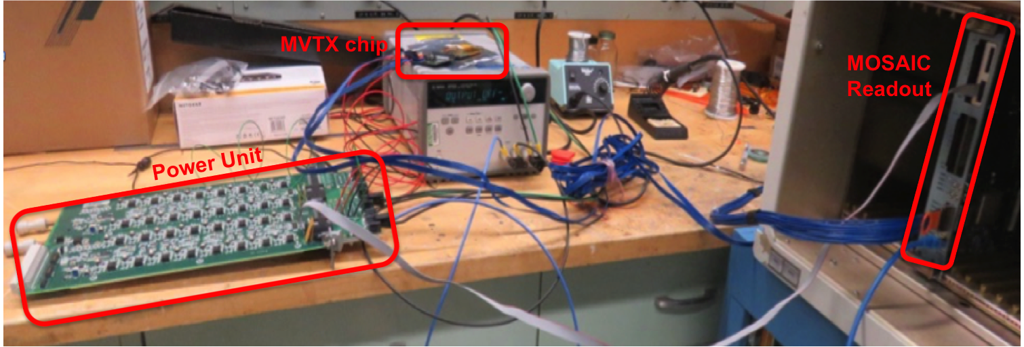
Power Board Integration Test
5 m
Readout Unit
Optical Links
FELIX
9 Sensor Stave
9 Data (1.2Gbps)
1 Clock, 1 Control/Trigger
Control
Data (9.6 Gb/s max)
Trigger
Samtec Twinax “FireFly”
FPC
Power
Alpide Sensors
RCDAQ
Filtering Capacitors
regulators
Power Board
Cold Plate
Regulated Power
Successful integration of Power Board + ALPIDE chip + MOSAIC!

Slide 5
ALIPIDE Chip Evaluation Test Configuration
Test in triggered mode with default delay at 2μs:
Internal trigger with pulse generator (rate:2MHz).
External trigger with cosmic ray muons (rate: ~0.1HZ).
External trigger with ⁹⁰Sr beta decayed electrons (rate: ~1Hz).
Scintillator 1
Scintillator 2
μ⁻
Cosmic ray setup
5mm
MAPS chip
5mm
Scintillator 1
Scintillator 2
e⁻
Sr⁹⁰
⁹⁰Sr setup
5mm
3cm
5mm
5mm
MAPS chip

Slide 6
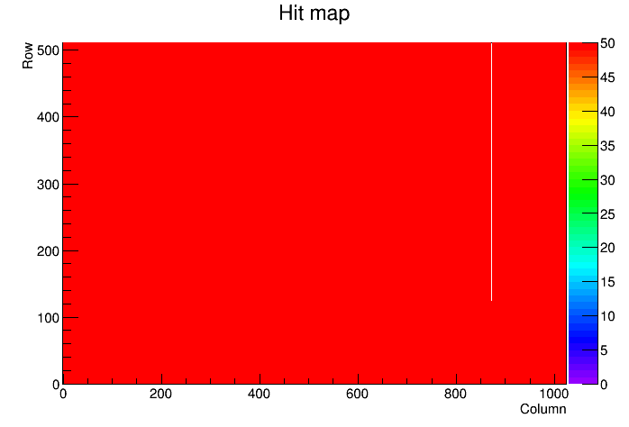
Achievements: Bad Channel
Internal trigger configuration with pulse generator:
Scanned available chips and stave at LANL through digital scan to verify the dead channel fraction: the bad channel fraction is <1%.
Similar results with different readout speed.
ALPIDE chip test example
No. of 0 hits
777
Cold channel
1
Hot channel
0
Bad fraction
0.15%

Slide 7
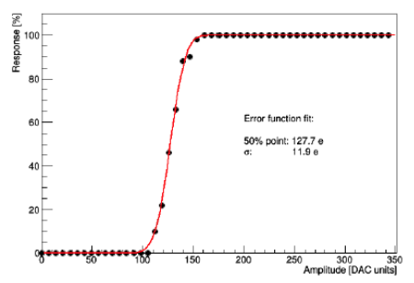
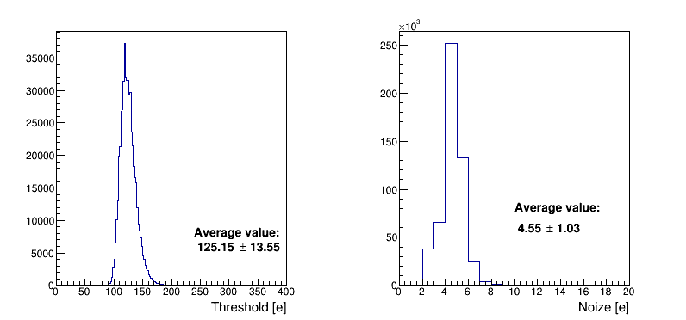
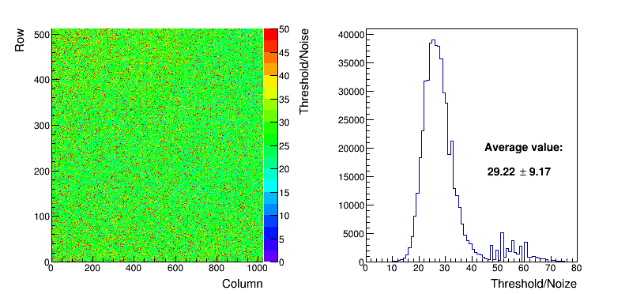
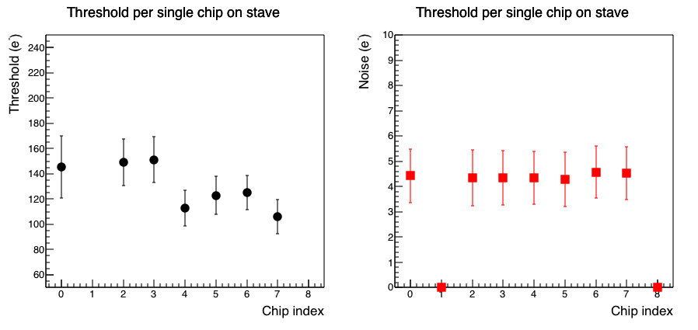
Achievements: Signal/Noise
Internal trigger configuration with pulse generator:
Scanned available chips and stave at LANL through threshold scan: signal/noise based on charge injection study is around 60. Comparable with CERN test.
MIP~1000 e⁻
Analog charge
Threshold and Noise scan per chip
Threshold/Noise ratio scan
Erf function fit: Threshold is at the 50% point.
Active chips on stave
Data
0
1
2
3
4
5
6
7
8
Power
control

Slide 8
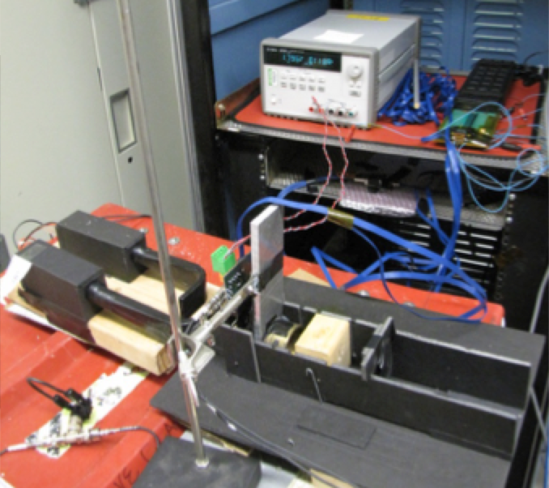
Achievements: Timing in External Trigger
⁹⁰Sr beta decayed electron with energy <2MeV.
Trigger rate: 1Hz. One cluster per triggered event.
Collimator
ALPIDE chip
ALPIDE
chip
Row 0
Scintillators
Row 511
Collimator
⁹⁰Sr source
Pixel hit 2D map
Profile along column
Profile along column
Clear collimator structure seen in the ALPIDE chip.

Slide 9
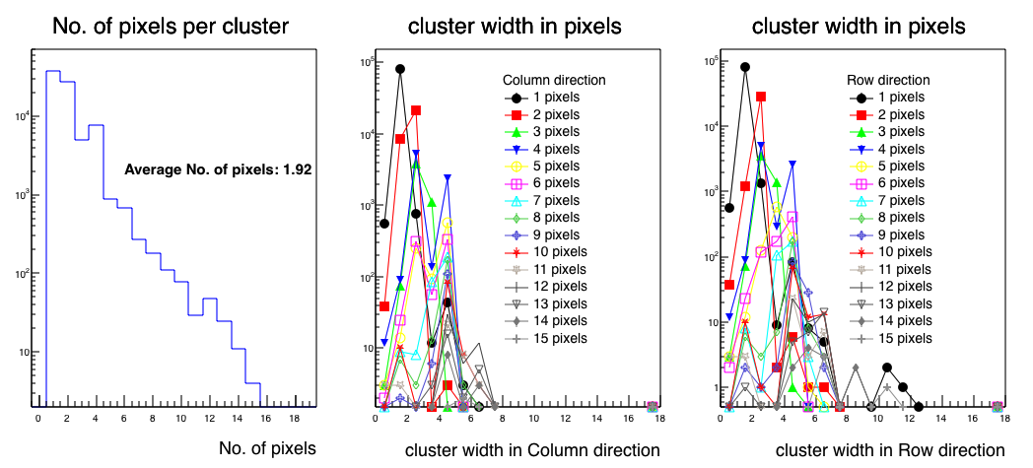
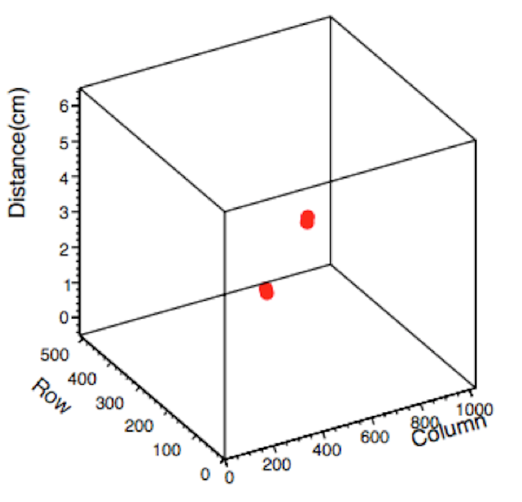
Achievements: cluster size
Cluster size determined from ⁹⁰Sr beta decayed electrons.
The average cluster size determined from ⁹⁰Sr source is comparable with cosmic ray test.
Initial look of tracking with two layers of ALPIDE chips.
Test stands
Event Display
μ⁻
Scintillator 1
Clear cosmic ray muon track found.
MAPS chip
Scintillator 2

Slide 10
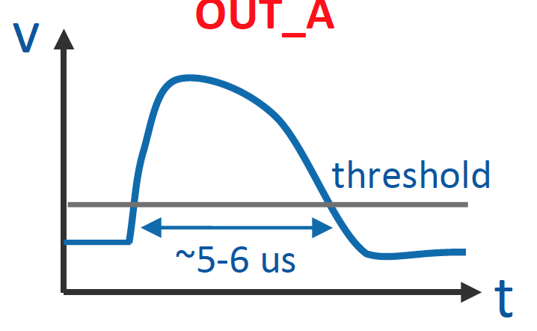
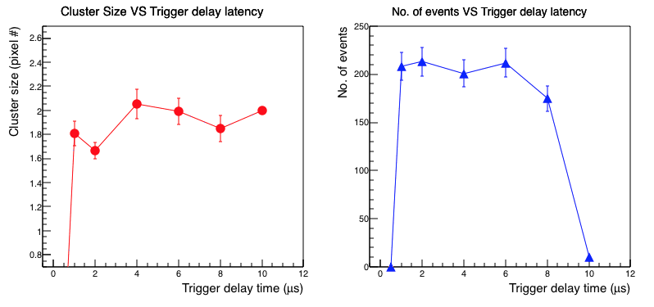
Under study: Trigger delay latency
Analog IN
The default trigger delay of the ALPIDE chip is 2μs.
Digital IN
Trigger
Trig Delay
Whether the MVTX can adapt the sPHENIX trigger scheme with default trigger delay at 4.5 μs?
Tune the threshold and take cosmic ray data within the same time periods.
Initial look with tuned threshold, no significant differences of performance for trigger delay from 2μs to 6μs.

Slide 11
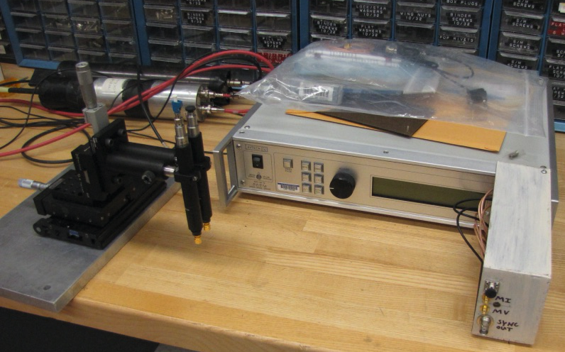
Plans
Set up the laser test bench to study the efficiency, noise rate, trigger delay time, optimize the gain, pulse shaping and etc.
Will purchase 10 more ALPIDE dices and build chips at LANL to build the telescope for the cosmic ray, source tests.
Study the ALPIDE performance with the RU+FELIX full readout chain.
Telescope for cosmic and
source test
μ⁻
scintillator
ALPIDE
chip
X-Y scan table
Laser generator:
Duty cycle: < MHz
Focus area: < 10μm²

Slide 12
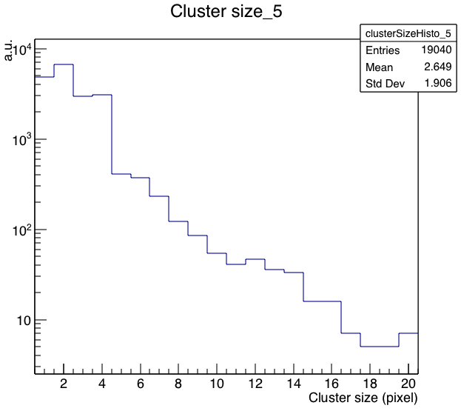
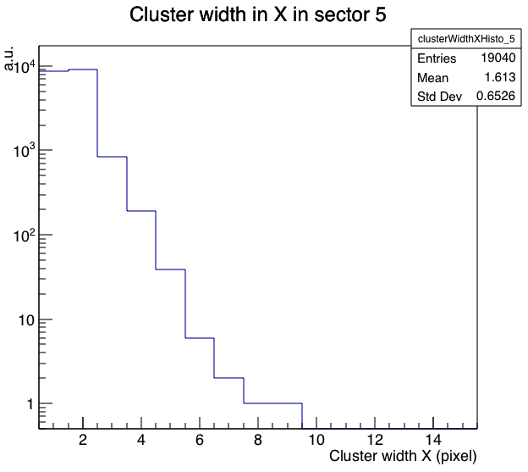
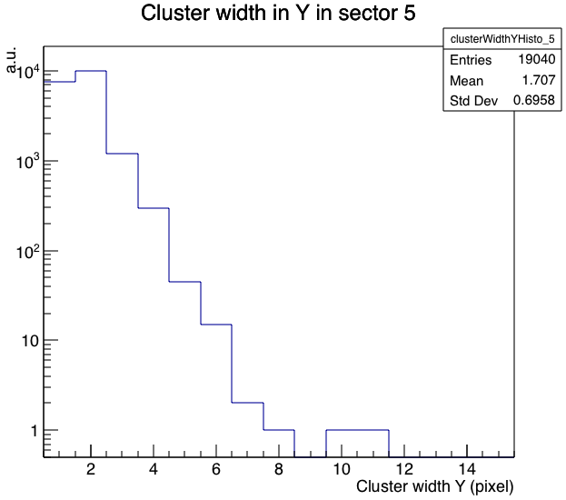
Backup
Cluster evaluation by the CERN team from 450 MeV e- beam test.
Cluster Size
Cluster Profile along X
Cluster Profile along Y
Even particle energies are different, similar results are achieved between the test bench studies with cosmic ray or ⁹⁰Sr beta decayed electrons.

