Slide 1
Transition Plan
Project: 20170073DR
Title: Probing Quark-Gluon Plasma with Bottom Quark Jets at sPHENIX
Initial “Transition Plan”:
Experiment: At the end of this DR project we will have secured a major role for LANL in the development, construction, and utilization of the sPHENIX detector. Our transition model to DOE funding is based upon our previously successful PHENIX FVTX at BNL and the E906 muon identifier at Fermilab, both of which began as LANL LDRD projects. These two projects were subsequently adopted by the DOE Nuclear Physics program, who provided full detector funding and support for the LANL-led physics programs. This past record demonstrates that the current team has abundant program development experience for managing this kind of transition. After this DR project, we will work closely with LANL’s Nuclear Physics program office, the sPHENIX collaboration, and our DOE Nuclear Physics program managers to construct and install the full inner tracker. The potential total return on this proposed LDRD investment is large, above 6:1. For example, the DOE currently provides about $3M per year to LANL for physics work related to our FVTX detector and has done so for about 7 years. The FVTX physics program will likely end within a few years. Without a major new role at sPHENIX, our DOE longterm support is at risk.
Theory: This project will place LANL at the forefront of b-jet physics calculations for both RHIC and LHC collision energies under a common theoretical framework. This will ensure that, after the completion of the DR, the utilization of the next generation of experiments is fully maximized and will provide additional insight into the heavy ion LHC experiments currently underway. Previous successful theoretical LDRD projects have allowed LANL to secure significant DOE early career award funding ($1M/yr for 5 yrs) and we expect to receive long-term DOE baseline support as a result of this LDRD effort. Funding sources for the theoretical efforts include DOE’s Nuclear Physics, High Energy Physics and Fusion Energy Science program offices.

Slide 2
LDRD Project Overview
Ming Liu, P-25
December 5th, 2016
LDRD Goals
  Develop a new QGP physics program with heavy flavor b-jet measurements in sPHENIX at RHIC
  Carry out key detector R&D and develop a new MIE proposal to DOE to build a state-of-the-art MAPS-based high precision vertex detector to support the b-jet physics program in sPHENIX
Project Scope, Plan and Milestones
  Experimental tasks
  Theoretical tasks
Cost, Schedule, Procurement and Risk Management
Organization
sPHENIX/MAPS Project Web page:
https://p25ext.lanl.gov/maps/

Slide 3
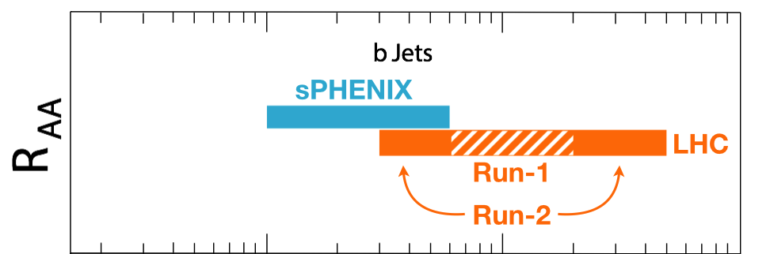
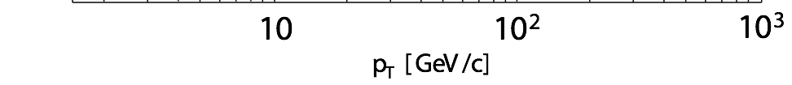
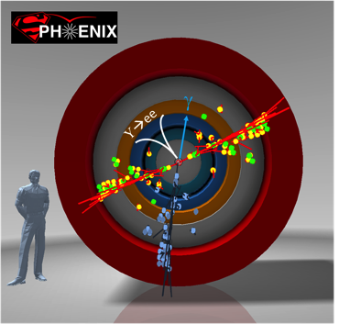
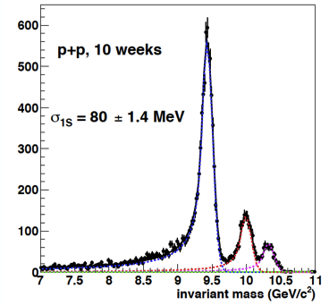
Goal: Big Science to LANL
sPHENIX is the next US NP flagship project in heavy ion physics, to study the properties of Quark-Gluon-Plasma (QGP); recently granted CD-0 (9/2016)
This LDRD will allow LANL to take a leadership role in sPHENIX
  Proposed innovation : develop a new b-jet physics program as a Major Pillar of the sPHENIX Program; novel Monolithic-Active-Pixel-Sensor (MAPS) based precision tracking; b-jet identification and theory
  Bring new state of the art technical capability (MAPS) to LANL applied program, also future EIC program
Cannot be done at the LHC for lack of low pT reach and huge backgrounds
sPHENIX Three Physics Pillars
Jets
Upsilons
B-Jets ← this LDRD

Slide 4


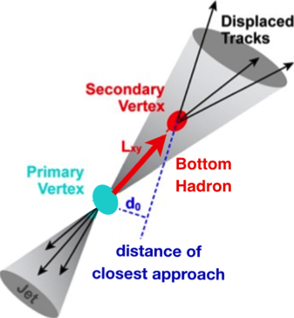
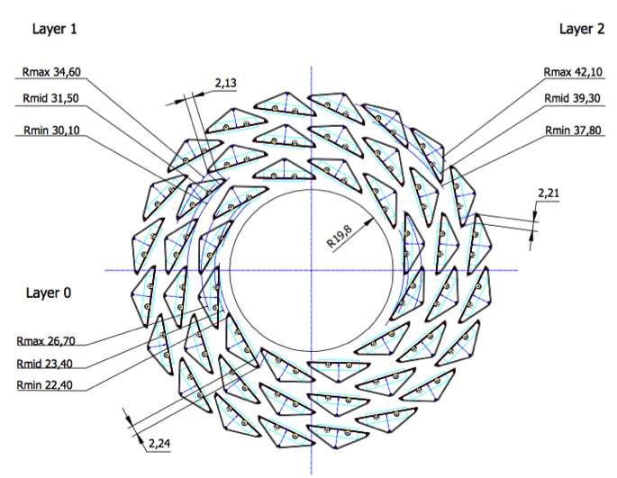
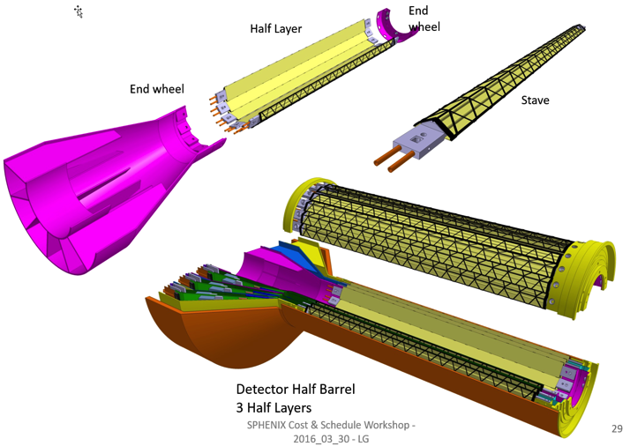
LANL Proposed sPHENIX MAPS Inner Tracker
2022+
ALICE ITS Upgrade (2021+);
Inner Tracker System
Key integration issues:
- Readout
- Mechanics
sPHENIX Inner Tracking
“Adopt” ALICE/ITS
Mini. risk,
Max. physics

Slide 5
LDRD Project Scope and Plan
Minimal scope
  Develop a MAPS telescope with 2-4 early prototype staves with ALICE readout, sPHENIX DAQ integration
  Complete R&D on Mechanics conceptual design, sPHENIX mechanical system integration
  Develop b-jet tagging algorithms
  DOE MIE proposal submitted to fund the full detector construction
Desired scope
  Develop a full 4-production-staves MAPS telescope, test beam run with integrated sPHENIX DAQ
  DOE MIE proposal approved for the full detector construction

Slide 6
LDRD Experimental Key Tasks and Schedules
Closely tied to ALICE R&D and Production Schedule

Slide 7
Possible sPHENIX Project Scenario
Operating* Funds
Construction
& PED
Funds
Operating Funds
Initiation
Definition
Execution
Closeout
Conceptual Design
Preliminary and Final Design
Construction
*
Assumption:
3 Months CR
Will receive 1/12 per month during CR
Critical
Decisions
CD-0
Approved Mission Need
9/2016
CD-1
Approve Alternative Selection
and Cost
Range
CD-2
Approve Performance Baseline (PB)
Installation
CD-4
Approve
Start of Operations or Project Completion
CD-3
Approve Start of Construction or Execution
Request/Receive
Construction Funds
CY
2016
2017
2018
2019
2020
2021
2022
2023
Operating Funds are used for conceptual design between CD-0 and CD-1. Operating funds may also be used prior to CD-4 for R&D, NEPA, D&D, ES&H, transition, startup, and training costs. Non-federal funds from other sources that are considered capital funds and are included in the “Total line item cost” as OPC.
Good Practice—For the first year that TEC is requested, ensure that OPC is also requested for that year. The OPC will allow the project to continue in a long CR until TEC is available and new starts are allowed.
MIE funds are more flexible than Line Items. Moving OPC to TEC or vice versa is much easier than for Line-Item reprogramming since MIE funds are “batched.”
New Start is defined as the first use/appropriation of any TEC funds (including TEC PED) for both line items and MIEs project.
7

Slide 8

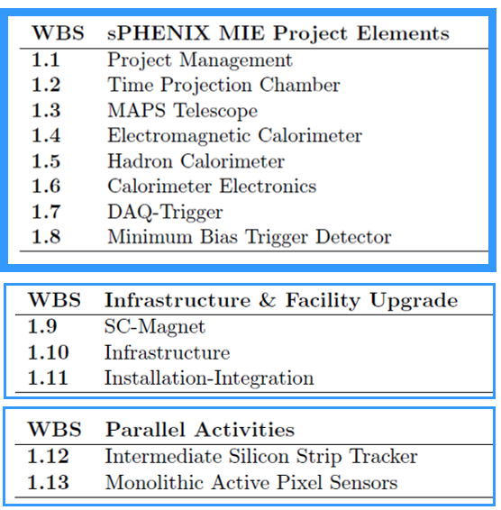
Scope of sPHENIX MIE
The MIE scope will be tracked with EVMS and reported to DOE
The Infrastructure and Facility upgrade will be managed by the Project team. Likely reported to NPP/BNL. Could require EVMS
The Ops labor supporting the MIE will also be managed by the Project team and reported to NPP.
MAPS and INTT are treated like deliverables and tracked with milestones

Slide 9
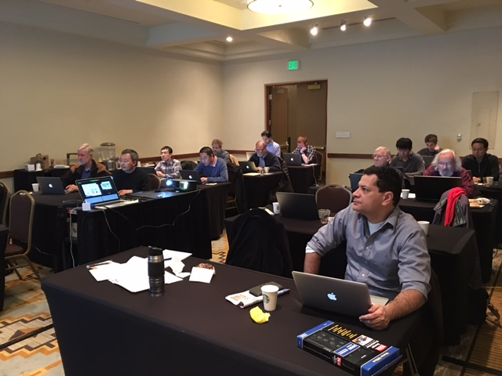
sPHENIX/MAPS LDRD Updates
Feasibility review, December 5th , 2016
  Waiting for feedback
Electronics and readout and mechanics
  Readout units: 10 V0 boards to be produced, 5 for LANL R&D
  2 High-speed readout test bench (MOSAIC boards): ordered and to be fabricated soon
  5 production version MAPS chips: ordered and fabricated (expected ~December),
  Altera evaluation boards ordered for CRU FPGA work, will be available soon
  Alternative Comm. RU being explored, ATLAS/FELIX boards @BNL/ATLAS
  Workshop @UT-Austin in March on readout
Simulations
  Multi-collision pileup effects studied
  Realistic geometry being tested
  2nd vertexing in p+p and Au+Au
MIE proposal development
  MIE writing workfest @Santa Fe, Jan 5-7, 2017
  Major tasks and lead institutes identified
  Key physics plots identified and being updated
  LBNL workshop to finalize the proposal, Jan 24-25
  DOE Feb. budget meeting
  Continue building collaboration, new institutions joined the effort
Good progress in Theory
Project is on track
  MIE writing workfest @Santa Fe, Jan 5-7, 2017

Slide 10
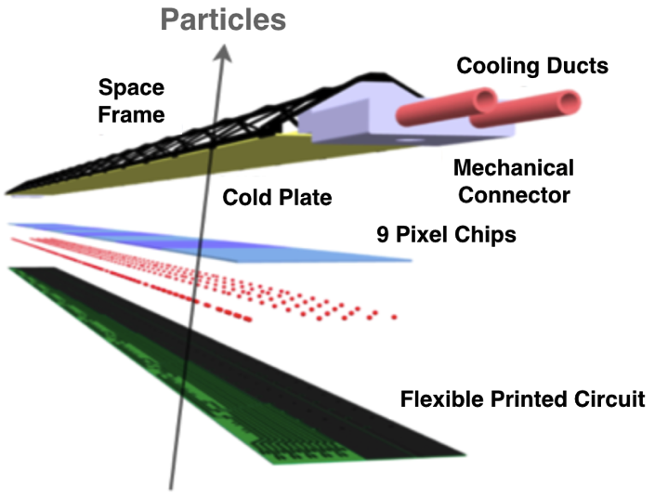

MAPS: a State of the Art Tracker
Advantages of MAPS:
  Very fine pitch (28x28 μm)
  High efficiency (>99%) and low noise (<10⁻⁶)
  High speed, 2~4 μS
  Ultra-thin/low mass, 50μm (~0.3% X₀)
  On-pixel digitization, low power dissipation
  15+ years of R&D at CERN for ALICE upgrade
An ideal detector for QGP b-jet physics!
A 9-chip MAPS stave
50 μm
28 μm

Slide 11
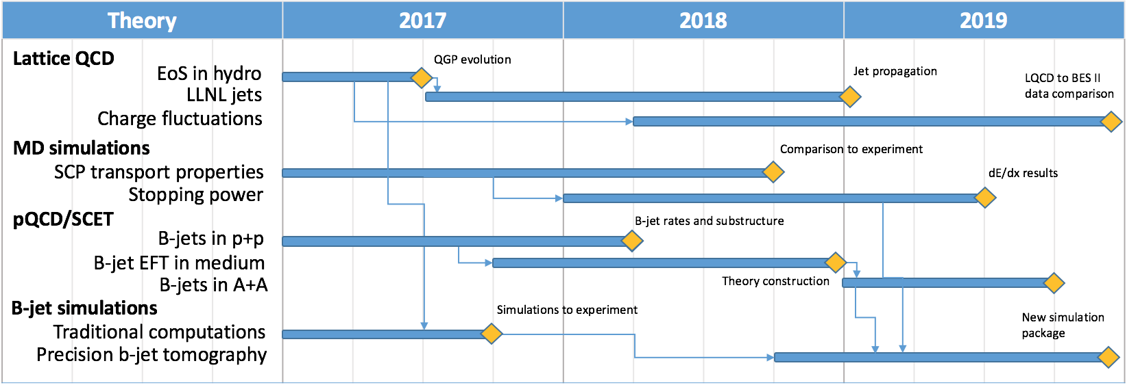
Theory: Tasks and Schedules

Slide 12
Theory Transition Details
The Transition Plan details is still being worked out. The transition is 2 ¾ years away
We can certainly can use some of the experience of LANL managers. What were the transition steps taken 3 year prior to the end of the last successful project you led?
Theory: This project will place LANL at the forefront of b-jet physics calculations for both RHIC and LHC collision energies under a common theoretical framework. This will ensure that, after the completion of the DR, the utilization of the next generation of experiments is fully maximized and will provide additional insight into the heavy ion LHC experiments currently underway. Previous successful theoretical LDRD projects have allowed LANL to secure significant DOE early career award funding ($1M/yr for 5 yrs) and we expect to receive long-term DOE baseline support as a result of this LDRD effort. Funding sources for the theoretical efforts include DOE’s Nuclear Physics, High Energy Physics and Fusion Energy Science program offices.

Slide 13
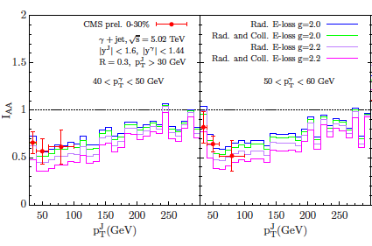
Perturbative QCD and SCET
Two Early career awards in this area:
Vitev $500k/y ending this year
Lee $500k/y ending FY19
Theory: NP program manager J. Carlson
We expect to receive long-term DOE
Baseline support as a result of this
LDRD effort.
Extended jet studies at LHC
Jet and heavy flavor physics at
RHIC sPHENIX
Future EIC program
Observe the lepton

Slide 14
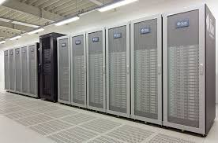
Lattice QCD and Plasma Physics
Lattice QCD needs to work with DOE to increase HEP funding.
Apply for computing time
Theory: R. Gupta is HEP program manager.
Computing: USQCD at LANL, LLNL, ORNL, BNL, Jlab, Fermilab, …
Seek OFES DOE funding
Theory: FES funding D. Rej.
Predict transport properties of materials (carbon, aluminum) relevant to temperatures and densities accessible in current and future experiments LCLS.
Stopping power measurements at NIF and OMEGA are becoming available.

