Slide 1
Feasibility Review
12/5(Mon), 1:00-3:30PM
4 weeks from now, minus holidays!
Focus on experimental aspects
  Theory part is not required
Goal/Schedule/Milestone/Budget/Negotiation
  “This process will clarify the minimum and desired project goals.”
Hiring
  Staff (0.5FTE), in progress, job ad in AD
  Postdoc (1FTE)
    0.5 FTE (Sho) – “hired”, strong physics and electronics and silicon detectors
    0.5FTE (Darren) – plan to hire, strong physics and software analysis
Reviewers
  Dr. John P. Sullivan, ISR-1 GL
  Prof. Bernd Burrow of Temple Univ.
  One from PD-O (Andy Saunders, Richard Van de Water?)
Budget? – it seems we got the full fund!
  Oct – April: feasibility study, $225K allocated
  April – Mar 4th year, full LDRD $$ for 3 years

Slide 2
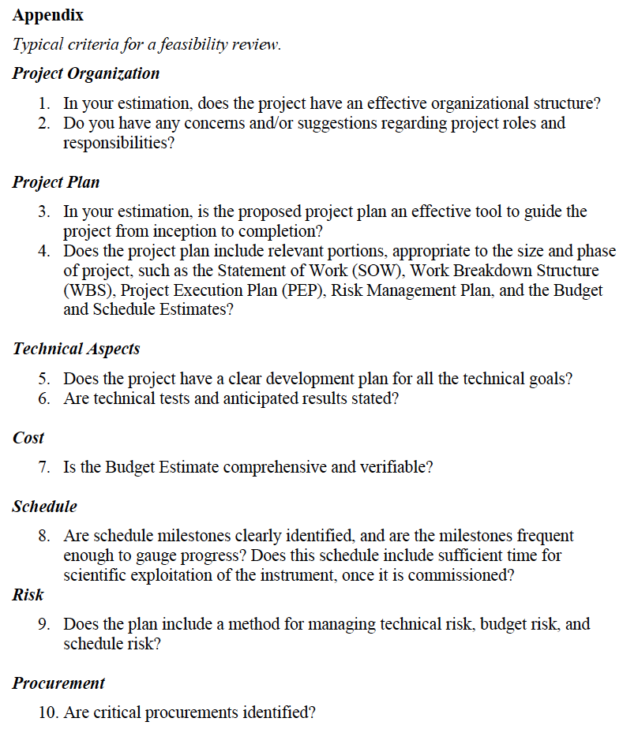
Experimental group
  Lead persons on major tasks
Theory group
Experimental MS Project:
Tasks & resources, WBS etc.
Milestones
Theory:
- Milestones
- Milestones
MoU with CERN, by mid Decemebr
Local R&D
MS Project:
Tasks & resources, WBS etc.
Milestones
Risk mitigation:
Technical, early R&D
Budget, MoU, early R&D
Schedule, collaboration with
ALICE/ITS R&D,

Slide 3
Presentations: ~2.5Hrs
Overview – 15+5’ Ming 1:00-1:20PM
  Project Org, scope and plan, collaborations, CD0
Theory Status – 15+5’ Ivan 1:20-1:40
Experimental technical aspects (I)
  Simulation/Algo progress - 10+5 Sanghoon/Mike 1:40-1:55
  Electronics readout – 20+5 Pat/Mike 1:55-2:20
  Mechanical R&D – 20+5 Walt/Hubert 2:20-2:45
Experimental Cost, Schedule, Risk
and Procurements (II) – 20+10’ Cesar/Ming 2:45-3:15
  MoU and ALICE/ITS Associate Membership
  R&D cost and schedule
  CERN procurement and MoU
Summary - 5’ Ming 3:15-3:20
Committee discussion 3:20-3:45PM
Closeout 3:45
Draft slides ready by 11/21(Mon)
Rehearsal practice on 11/28(Mon) 1:00-3:00

Slide 4
LDRD MS Project

Slide 5
Experimental Task Assignments
10/20/2016
sPHENIX readout and trigger requirements (DCM2, JSEB etc) – Mike and Ming
MAPS CRU readout - Mark, Ming, Pat
  Physical parameters (PCIex4)
  Data format
  Electrical signal, lack of busy etc
  sPHENIX trigger/busy inputs and clock
Detailed specs/understanding of MAPS/ALIPED-3(4 ~ final) test card – Pat, Cesar and Andi, Alex
BNL specifies cabling/material electrical and fire safety etc – Walt, Hubert, Eric…
Radiation enviroenment, damage, occupancy, SEU; Configuration and Operation, programing and initializatio etc – Mark, Xuan
Power needs:
  (LANL LDRD) Hubert and Ming;
  (BNL sPHENIX) Hubert, Eric
  Staves, readout control etc. (A, V)
Mechanics – Walt, Hubert, Jin
  Structure, cooling, alignment, assembly and integration
Integration into sPHENIX – Walt, Eric
Test stands setup and operation
  Single chip readout – Mike, Pat
  Staves and cosmic ray - Xuan Cesar
  Mockup, electrical, readout, power – Sanghoon, Hubert, Walt
FPGA firmware – Andi, Mark, Cesar, Ming and Pat
  VHDL, Verilog
Software – Sanghoon and Andi
  Slow controls, electronics
  Test software, root-based
Beam test – Ming and team
  LANL, FNAL, rad damage at LANSCE
Web page – Hubert, Pat
  R+W access
  Tree structure
  https://p25ext.lanl.gov/maps/

Slide 6
MAPS Project Status
sPHENIX/MAPS discussion at MIT
  Oct. 27, 28, 2016
  Physics and Bates
  All senior leaders + managers attended
Identified MIT’s interest and responsibility
  Major tasks to lead – Mechanical integration
  MIT Physics and Bates Engineering Group
  Resource and timeline
    Engineers and Techs
    Students and postdocs
A separate MIE proposal for MAPS
  Feasibility, start communication with DOE
  Develop a plan to identify tasks, resources and timeline
  Have a pre-proposal soon, first draft/outline by Dec 15
    First full doc by Jan 2017, to be ready for discussions with DOE
  Timeline of MIE
    Submitted and reviewed in FY17, establish DOE “mission need”
    Federal budget request by DOE in Feb 2018,
    Fund available FY20 for construction
  Advanced fund in mid 2018 to produce MAPS chips and staves following ALICE/ITS production at CERN

Slide 7
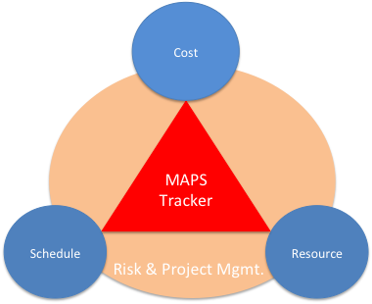
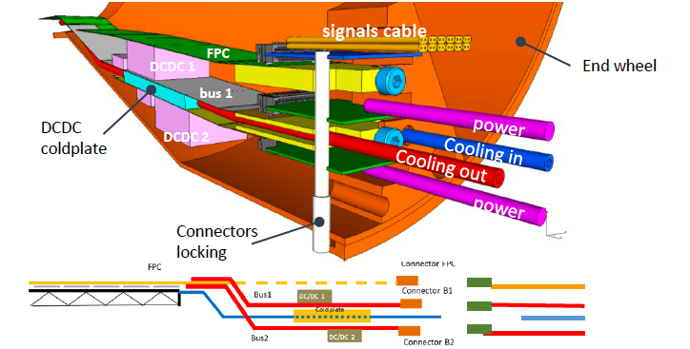
sPHENIX MAPS Inner Tracker

Slide 8
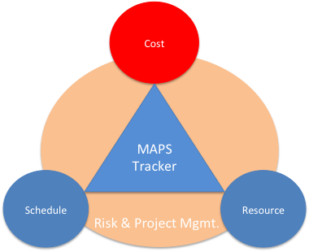
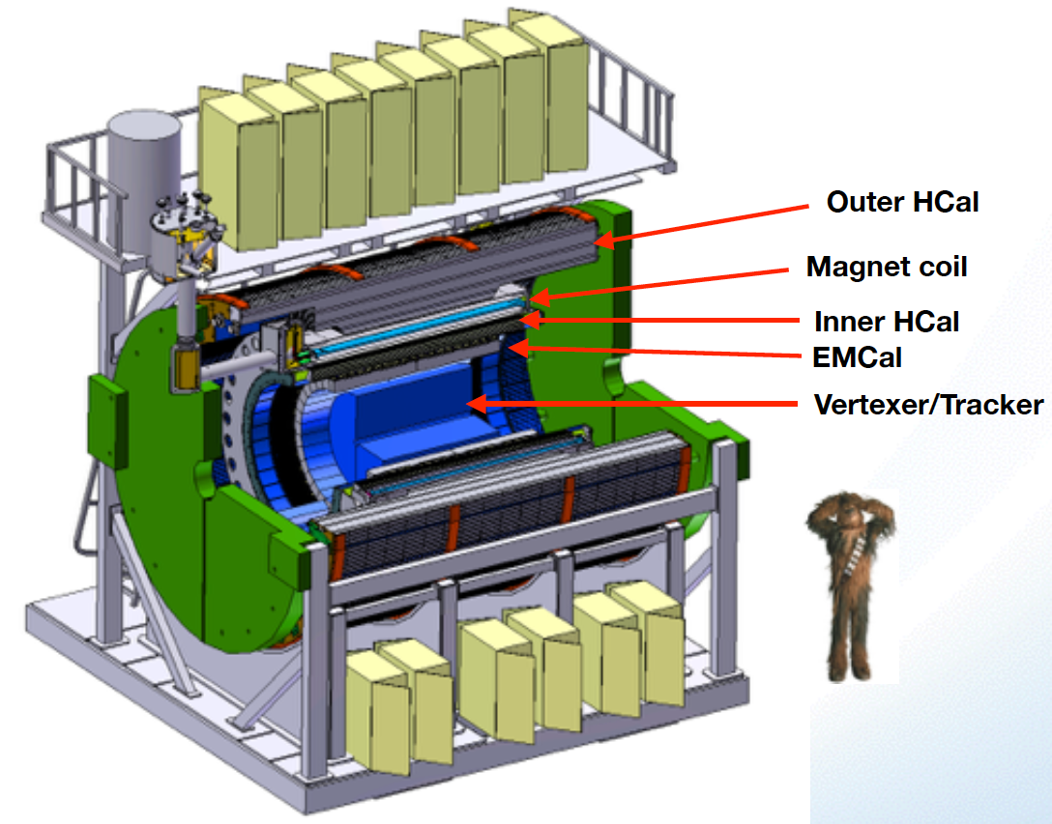
Project Task and Timeline
FY2016
FY2017
FY2018
FY2019
FY2020
FY2021
CD-0
11/1
CD-1
11/1
CD-2/3
8/1
Ready for
Beam
6/1
Readout R&D
Mech. design
@LANL/ALICE
A schedule driven project!
Key R&D
Mech. Integr.
& Prototype
@MIT/BNL
Production
MAPS Prod. & QA
@ALICE
Stave Prod.&Test @CERN;
FEM Prod. @US
Det. Assembly & Test
@BNL
Det. Install.
@BNL
+2%
+50%
“MoU” w/ ALICE: ~12/2016
To produce staves, frames and FEMs

Slide 9
Meeting Summary: 10/20/2016
We agreed to have a bi-weekly meeting on Thursday 1:00 – 2:00PM (~2:30 if needed) to discuss experimental progress
A joint Exp+The meeting once a month on Thursday 1:00-3:00PM
Assigned experimental tasks and responsibilities (next slide)

Slide 10
A MIE Proposal
A MAPS detector subgroup to identify and work on
  Tasks, Resources and Responsibilities for each institution
  Agreement on each institution’s interest and available resource
  Start joint R&D on critical tasks
    LDRD, associate members and other R&D fund etc
Pre-proposal writing?
  Identify required resources ($$ and manpower) and timeline
  Intended contributions from all institutions
  Electronics and readout – LANL
  Mechanic system and integration – MIT
  Ancillary and other systems – other collaborators
  A draft by January 2017? Discussions with DOE during Feb budget meeting
More communications with DOE
  Based on updated resource loaded Cost and Schedule from pre-proposal
  Then decide on next step
    either go forward or not, work out a plan with DOE
  Get more support from ALD & DOE on CERN-SPHENIX agreement etc.

Slide 11
DOE MIE Process and Challenges
Contact for new scientific proposals
  Associate Director for NP (Tim), who will then identify point of contact for the project
    Jehanne Gillo
For a project with Total Estimated Cost(TEC) < $10M
  no CD process needed: good news
  The 3-layer MAPS inner tracker fit this scope
For a project with TPC > $2M
  “includes all engineering and fabrication costs, needs to be identified individually in the federal budget as Major Item of Equipment(MIE)” - concern over timeline
  If submitted and reviewed and DOE “mission need” approved in FY17
    the earliest date to receive fund is FY20, Oct. 2019.
  Federal budget prepared 2-year in advance
  DOE budget request to Congress ~Feb 2018
  It is hard to have a complete proposal submitted, reviewed and approved for “DOE mission need” and have this MIE included in the Feb. 2017 DOE budget request (~3 months from now)
    while we are still waiting for (CD0 and) CD1 approval from DOE
  http://science.energy.gov/np/facilities/project-development/
Challenges to match ALICE/ITS production schedules
  Early fund (~$1M) needed summer 2018 to continue ALICE/ITS production line for sPHENIX MAPS staves
My Conclusion
The normal MIE process may not match current ALICE/ITS and sPHENIX installation and run schedules, need to work closely with DOE how to proceed
Some minimum fund (~$1M) must be secured for the MAPS stave production at CERN following the completion of ALICE/ITS project, such as $$ from RHIC operation savings or foreign contributions etc.
Other considerations:
  Can we defend the “BNL base line TPC only” tracking system for the sPHENIX physics program, with separate MAPS MIE?
  If MAPS delayed, with TPC only, it won’t be able to do tracking

