Slide 1
MAPS LDRD
Experimental Cost, Schedule, Risk and Procurements
Cesar da Silva , Ming Liu

Slide 2
Charge
Project Organization
    Project Plan
    Technical Aspects
    Cost
    Schedule
    Risk
    Critical Procurements

Slide 3
Project Organization
Co-PIs
Mike McCumber
Ivan Vitev
Advisor
Melynda Brooks
Program Manager for
LANL NP programs
Joe Carlson
Project Manager
Ming Liu (LANL)
Test Stand
WBS 3.2, 3.3
Hubert van Hecke
Stave Production
WBS 3.4
Ming Liu
Readout
Electronics
WBS 3.5
Pat McGaughey
Mechanics
WBS 3.9
Walt Sondheim
Theoretical
Effort
Ivan Vitev
Software
WBS 3.13
Sanghoon Lim
Procurement
Procurement
Review
Structure Design
for prototype
pQCD
Simulation
Setup
Assembly
at CERN
Firmware
Programming
Final detector
design
Lattice/Hydro
Offline
Tests
Tests
Molecular
Dynamic
Simulation
B-jet tagging

Slide 4
Initial Assignments
sPHENIX readout and trigger requirements (DCM2, JSEB etc) – Mike and Ming
MAPS CRU readout - Mark, Ming, Pat
  Physical parameters (PCIex4)
  Data format
  Electrical signal, lack of busy etc
  sPHENIX trigger/busy inputs and clock
Detailed specs/understanding of MAPS/ALIPED-3(4 ~ final) test card – Pat, Cesar and Andi
BNL specifies cabling/material electrical and fire safety etc – Walt, Hubert, Eric…
Radiation enviroenment, damage, occupancy, SEU; Configuration and Operation, programing and initializatio etc – Mark, Xuan
Power needs:
  (LANL LDRD) Hubert and Ming;
  (BNL sPHENIX) Hubert, Eric
  Staves, readout control etc. (A, V)
Mechanics – Walt, Hubert, Jin
  Structure, cooling, alignment, assembly and integration
Integration into sPHENIX – Walt, Eric
Test stands setup and operation
  Single chip readout – Mike, Pat
  Staves and cosmic ray - Xuan Cesar
  Mockup, electrical, readout, power – Sanghoon, Hubert, Walt
FPGA firmware – Andi, Mark, Cesar, Ming and Pat
  VHDL, Verilog
Software – Sanghoon and Andi
  Slow controls, electronics
  Test software, root-based
Beam test – Ming and team
  LANL, FNAL, rad damage at LANSCE
Web page – Hubert, Pat
  R+W access
  Tree structure
  https://p25ext.lanl.gov/maps/

Slide 5
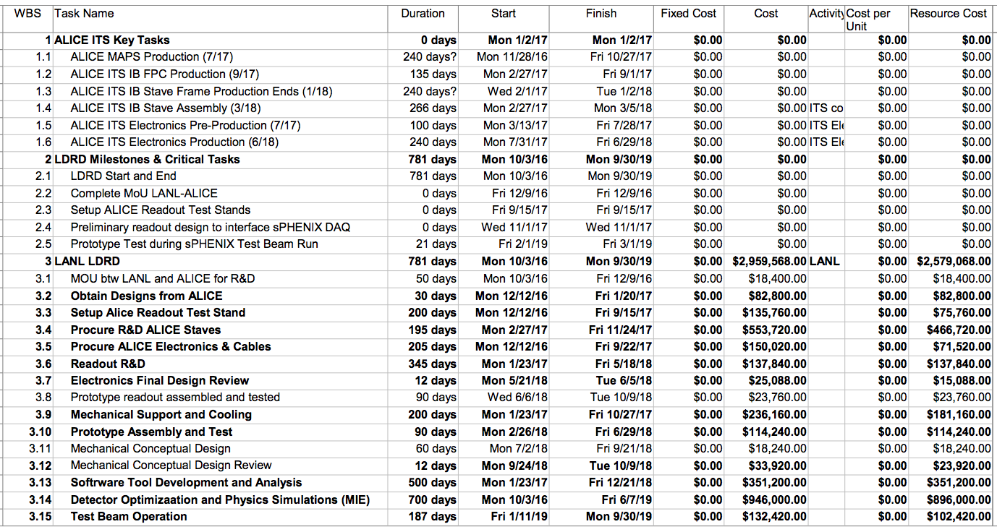
Project Management
Work Breakdown Structure

Slide 6
Costs
WBS | Task | T&E | M&S | RISK
3.1 | MOU btw LANL and ALICE | 19K |  | Low
3.2 | Obtain design from ALICE | 83K |  | Low
3.3 | Setup Alice Readout Test Stand | 10K | 100K | Low
3.4 | Procure ALICE staves | 260K | 290K | Medium
3.5 | Procure ALICE electronics & cables | 110K | 180K | Medium
3.6 | Readout R&D | 140K
3.8 | Prototype Readout Assembled | 24K
3.9 | Mechanical Support and Cooling | 130K | 110K | Low
3.10 | Prototype Assembly and Test | 55K | 55K | Low
3.13 | Software (FPGA, online, controls) | 350K |  | Low
3.14 | Detector optimization and physics simulations (MIE) | 850K | 50K | Low
3.15 | Test beam operations | 50K | 80K | Low
20% contingencies applied. Except electronics with 40% contingency.
Estimates based on ALICE ITS procurements and recent FVTX experience.

Slide 7
Schedule
MAPS sensors by mid 2018
  2 test stands by August 2018
    4 fully assembled staves for system test, by the end of 2018
Preliminary mechanical design by Nov 2018

Slide 8
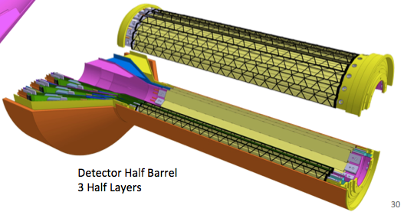
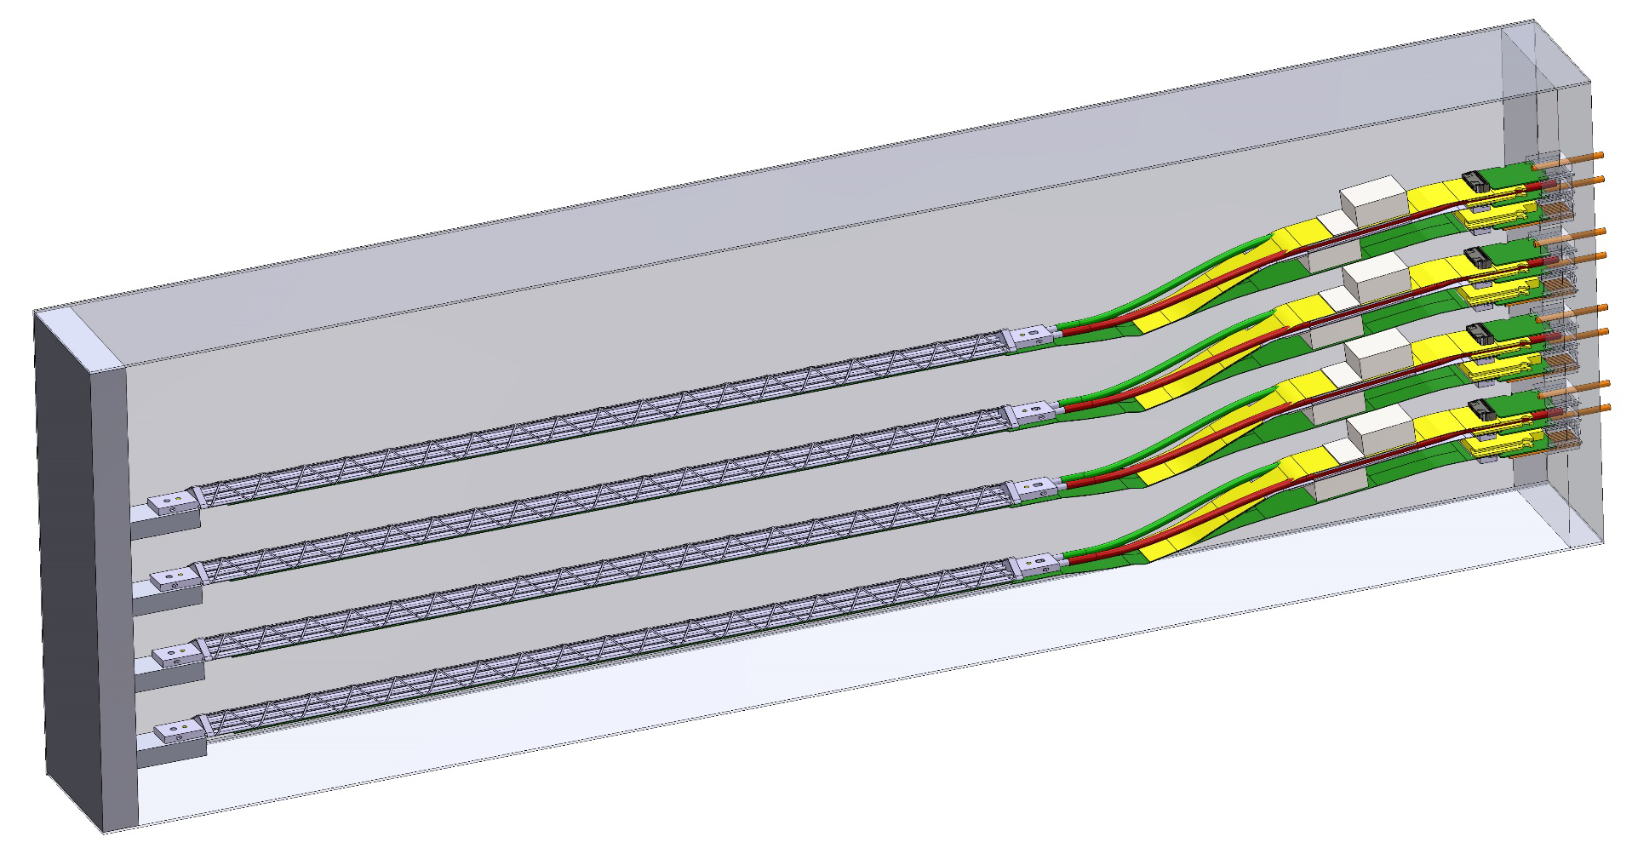
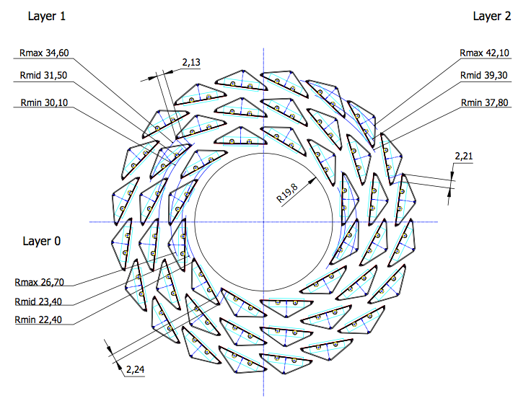
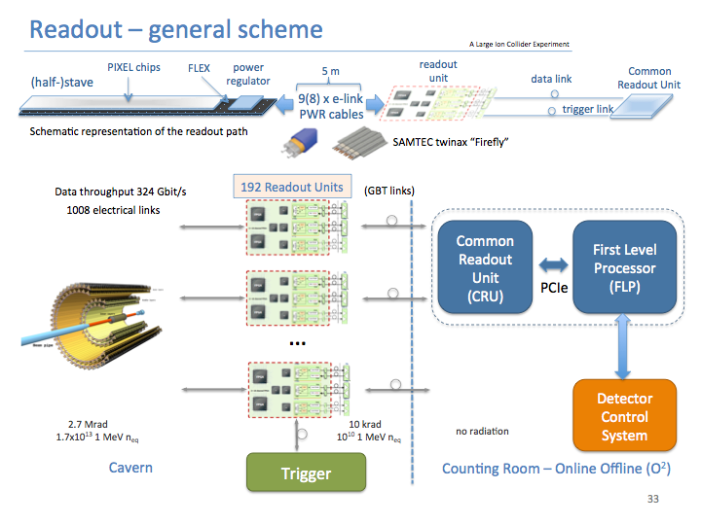
Technical Goals
DOE MAPS PROJECT GOAL
LDRD GOAL
4-staves prototype
Readout firmware

Slide 9
LDRD MAPS Electronics Goal
Plan A:
reprogram
ALICE readout path
Obtain 4 staves from CERN, get readout board and common readout unit chain working at LANL
rewrite the FPGA code to wrap the data with the sPHENIX formatting
test it with sPHENIX readout system
Plan B: design a readout interface board to convert ALICE data format into sPHENIX standard

Slide 10
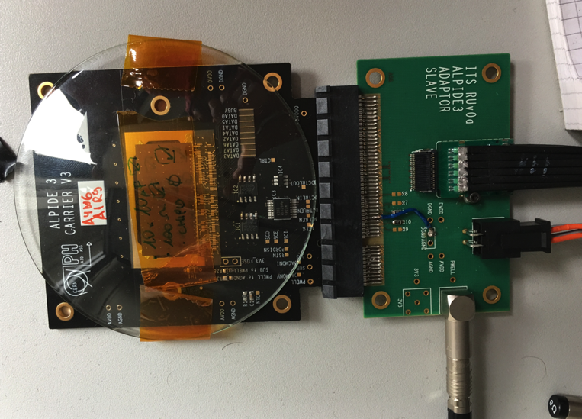
Risk I: ALICE Staves Procurement
ALICE stave production officially ends on March 2018
The chance to postpone the end of ALICE production is configured a medium risk for the LDRD deliverables
Mitigation:
                develop and test the readout with a 5-layer single chip MAPS telescope
                ALPIDE chips with fast readout already available
                Readout system may be ready by the time the 4 staves are available
Single-chip MAPS with fast readout

Slide 11
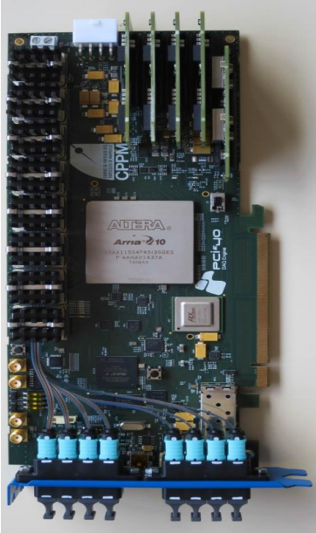
Risk II: Readout Electronics
Common Readout Unity (CRU) development for the sPHENIX trigger, busy and data format requirements
There is a medium risk that we may need to develop our own readout board
Mitigation:
A pre-final version of the CRU has been used by ALICE
A CRU board or the design file (Gerber file) can already be obtained for our single-chip MAPS telescope for tests and FPGA programming
Possibility to deal with data formatting in computers trough regular software
PCie40

Slide 12
Summary
Tasks, organization and schedule of the work established
ALICE ITS previous work and our experience with FVTX will help in the accomplishment of this project
Two major risks and mitigations identified

