Slide 1
sPHENIX/MVTX LDRD Status & Plan
—specifications for all items in the readout chain
—purpose, goals for any beam tests
—engineering estimates for mechanical and electrical development work that needs to be done
—more detailed specifications of milestones that will be guiding the work over the next 2+ years
—Priority lists of what needs to be completed before the full DOE MAPS review
—Spend-plan for the remainder of this year and the following year.
More directions for people involved in both LDRD and MAPS project?

Slide 2
Goals of Test Beams and Cosmic Tests
Evaluate tracking performance with test beam @Fermilab
  Resolution vs momentum, P= (1, 2, 5) 10, 20, 40 … GeV
  Efficiency vs momentum, adjusting “bending angle”
  Rate dependence, shaping time, high rate ~1MHz (?), pile-up, latch-up etc. (radiation test done at CERN)
    Test beam rate ~ 100kHz, 5x10^5 per spill
  Stress test of “event multiplicity”, put a converter
  Test trigger latency, rate dependence
  Test alignment algorithms
  MVTX + (INTT, TPC) + (EMCal + Hcal +), be part of sPHENIX test beam (~ Jan/Feb 2019)
Test sPHENIX DAQ integration @Fermilab
  MVTX + EMCal + Hcal + (TPC)
  MVTX data format and suppression
  Slow controls and monitoring, I, V, T … (already packed in RU)
Cosmic Ray Test, ~Jan 2018
  Check GEANT MC detector response simulation, cluster size
  Test stave mechanical stability, cooling
  Continuous operation, stability
  Stave spacing = same as MVTX, ~1cm

Slide 3
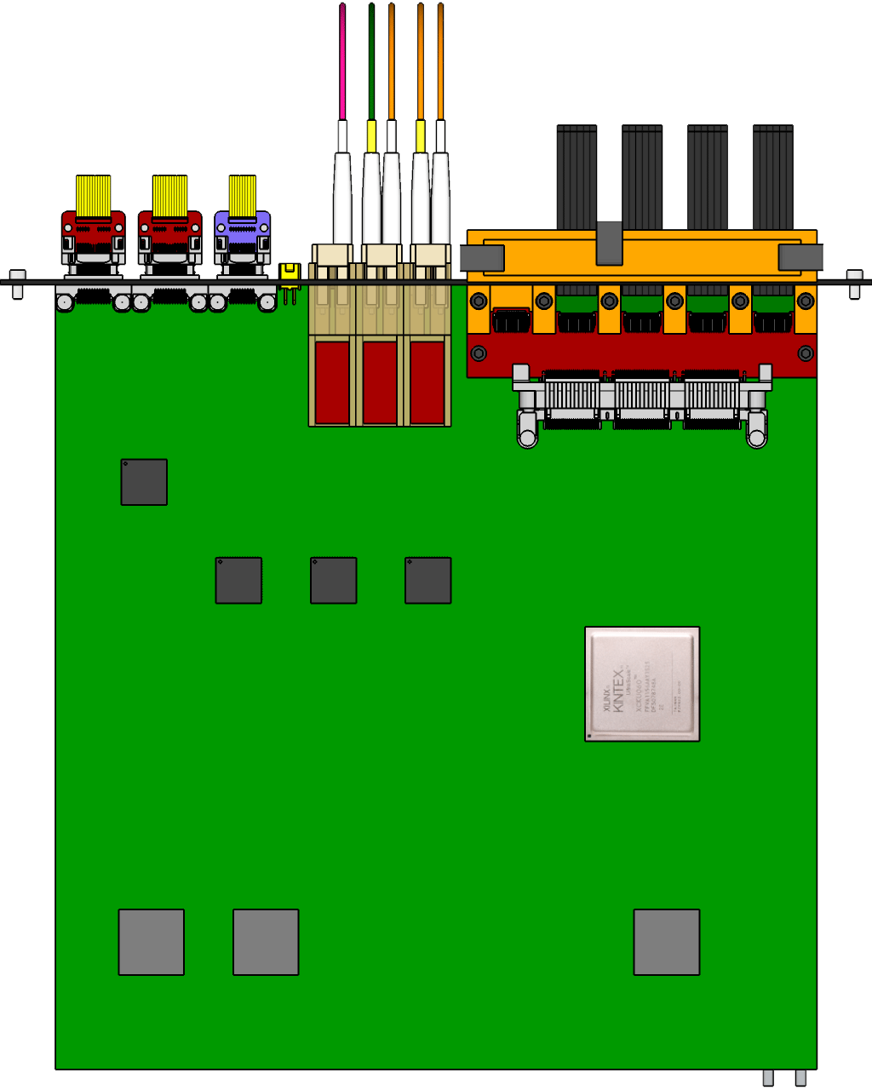

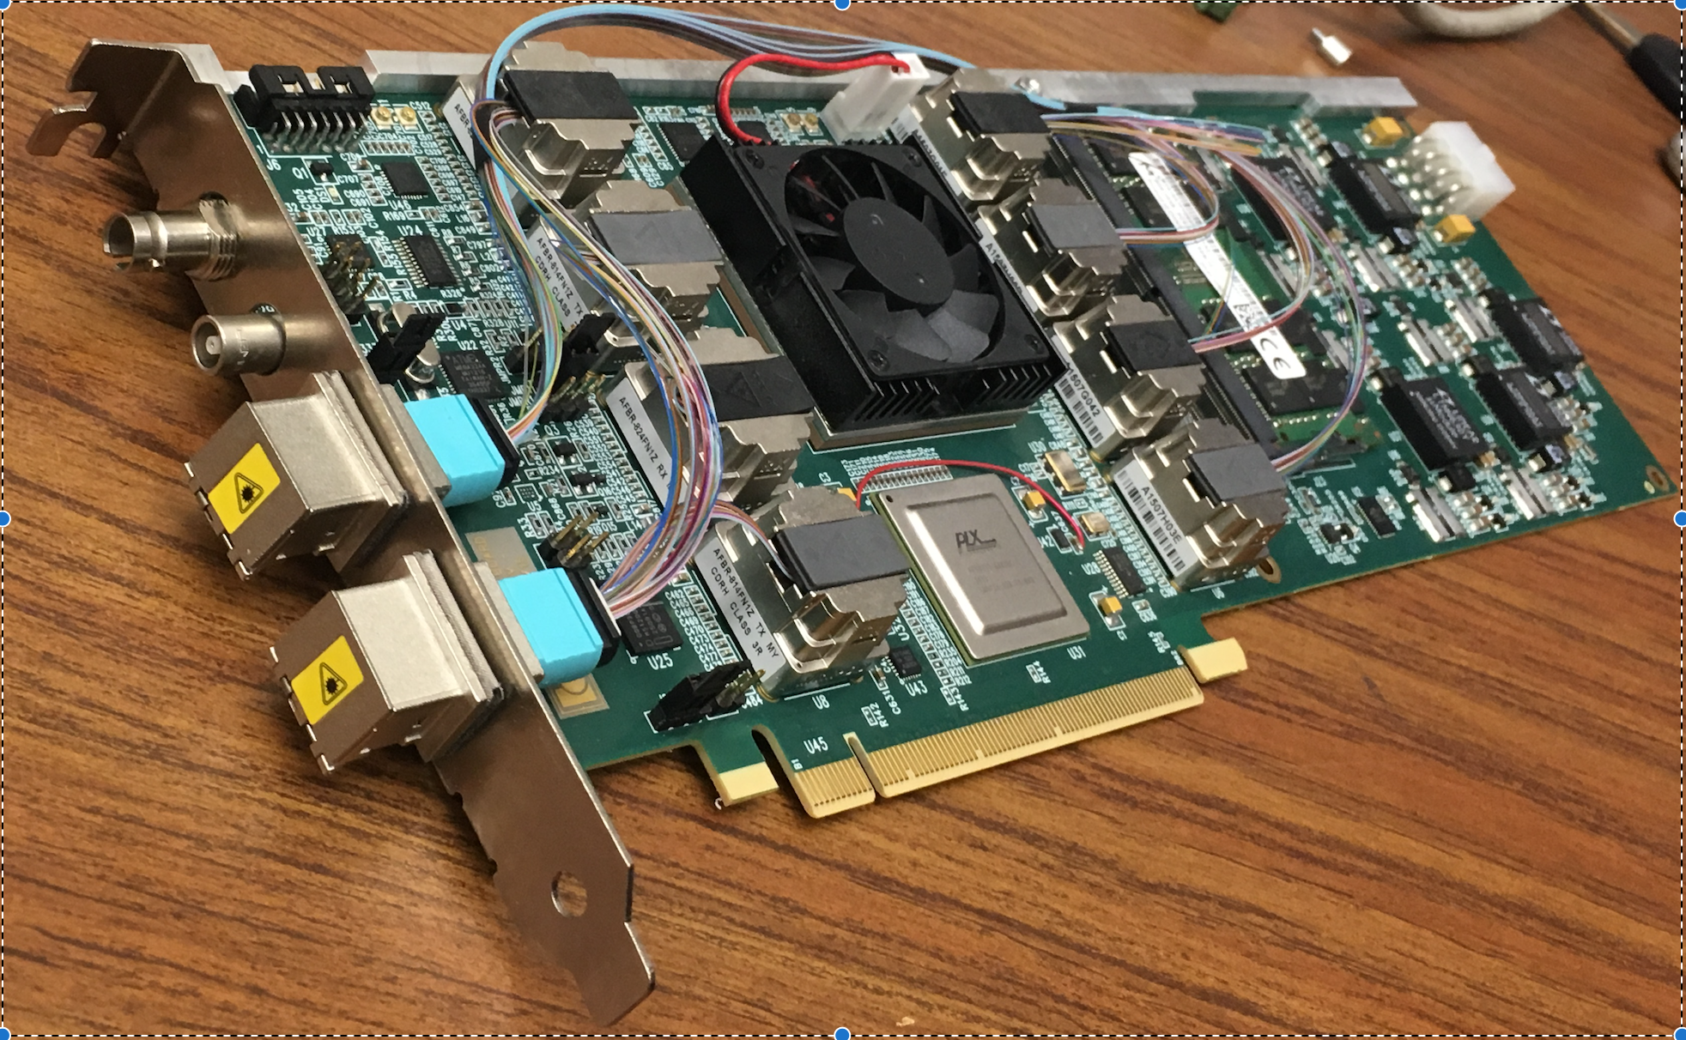
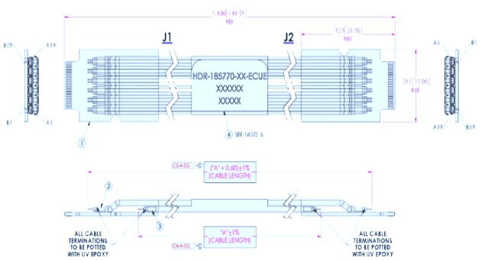

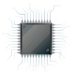
MVTX Readout Electronics
sPHENIX GL-1 & GTM
RUv1.0: ~08/2017
Stave: 06/2017
CAN bus
DCS
5-10 m
Trigger & Clock
Front End Electronics
GBT Optical Links
9-sensor Stave
9 Data (1.2Gbps)
1 Clock, 1 Control/Trigger
Control
Data (9.6 Gb/s max)
Trigger
Samtec Twinax “FireFly”
Back End Electronics
FPC
Power
Alpide Sensors
Power
FELIXv1.5:
6/2017
Filtering Capacitors
regulators
Power supplies
Cold Plate
Regulated Power
Power Board
Interaction Region
Experimental Hall
Counting House
PS: ~08/2017
CAEN PS: 07/2017

Slide 4
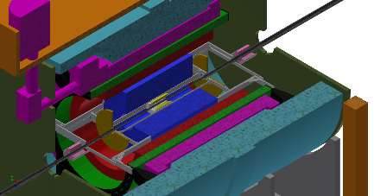
MVTX Data Flow
FEE
BEE
EBDC
10+ Gigabit
Crossbar
Switch
Buffer Box
DCM
DCM
/
8
DCM
FEE
Buffer Box
DCM
BEE
EBDC
DCM
/
8
DCM
FEE
Buffer Box
DCM
BEE
EBDC
DCM
/
8
DCM
FEE
Buffer Box
To RCF/
HPSS
DCM
EBDC
DCM
/
8
BEE
DCM
MVTX
FEE
Buffer Box
DCM
DCM
BEE
EBDC
DCM
/
8
FEE
Buffer Box
DCM
DCM
BEE
EBDC
DCM
/
8
Buffer Box
Data Concentration
FEE x 48
Buffer Box
BEE: Back End Electronics (FELIX)
EBDC: Event Buffering Data Compressor
FEE: Front End Electronics (RU)
FELIX+ sPHENIX Server Integration:
~ 8-10, 2019, sPHENIX/DAQ, RCDAQ

Slide 5
LDRD – MVTX Key Tasks/Milestones
7/17
10/17
10/18
10/19
Today
RUv1.0/FELIX1.5 Integration
40MHz, 7/17-12/17
More detailed task schedules
on MS Project
Full cosmic test
LDRD
RUv1.x/FELIX2.0, 10MHz,
10/17 – 6/18
MVTX Design Review 7/2018
System test, cosmic & source
6/18 - 1/19
Test Beam, tracking performance
analysis, physics sim, NIM paper etc.
1/19 – 9/19
MVTX: 2018 – 2021
Stave Production, procure FPGA, GBT etc.
8/18-4/19
BNL Director Review
7/10-11, 2017
Electronics Production
1/19-6/19

Slide 6
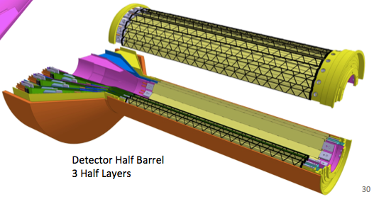
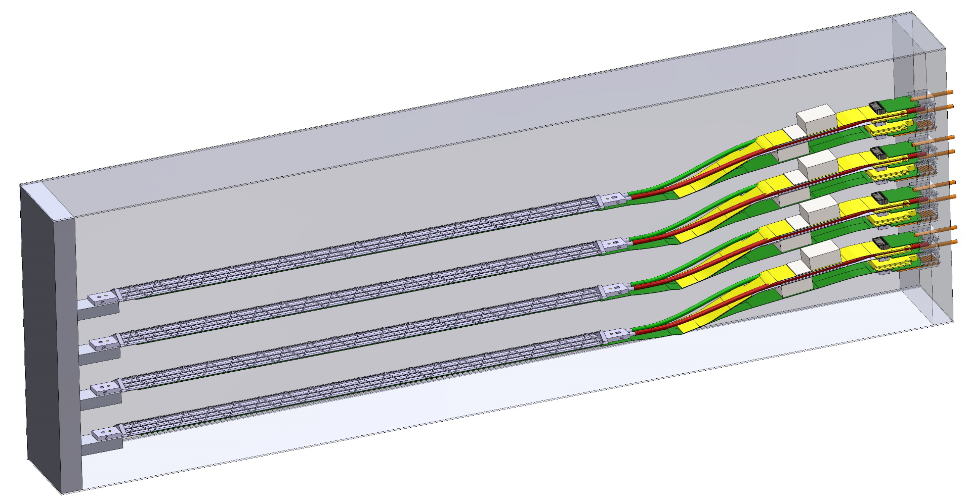
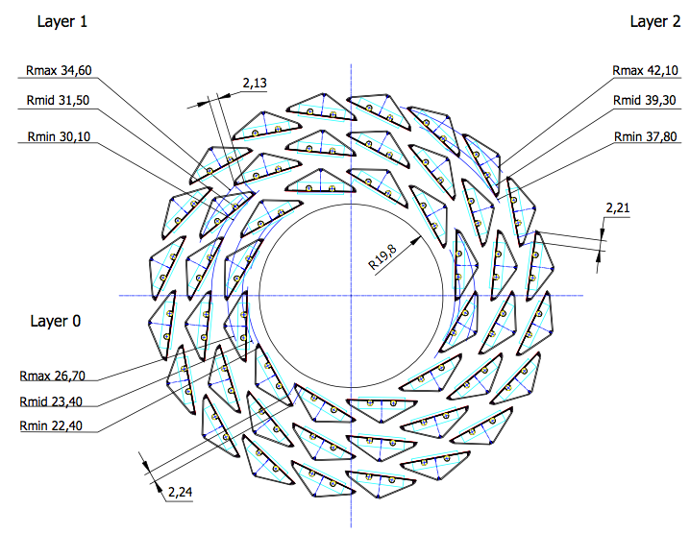
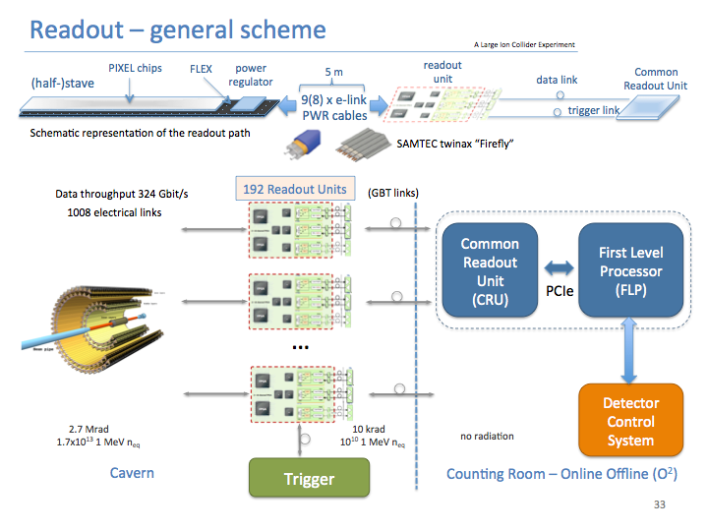
Technical Goals
LDRD GOAL
DOE MAPS PROJECT GOAL
4-staves prototype
Readout firmware

Slide 7
Engineering Estimate
Readout Electronics – 1.2 FTE Engineer 1 year
  RU integration, w/ UT-Austin, ALICE
  FELIX integration, w/ BNL/ATLAS, sPHENIX DAQ
  PS control integration, w/ LBNL, ALICE
  Based on inputs from experts (Alex, Mark, Martin et al)
Mechanical work – 0.2 FTE
  Telescope mechanical structure: 0.2FTE, 1 year
    A Box with air cooling for the 4-satve telescope
    Cooling system test
  Conceptual design of mechanical system: 0.2 FTE, 1 year
  Based on inputs from Chris and Walt
More detailed task schedules
on MS Project

Slide 8
LDRD Priority List
Readout integration
  1 stave + RU + FELIXv1.5 @40MHz, by 12/2017
  1 stave + RU + FELIXv2.0 @10MHz, by 6/2018
Readout chain validation
  Test system using evaluation boards, FELIX /GBT
MVTX Conical extension
  Test 20cm FirFly extension cable/ALICE flexible cable, by 12/2017
  MVTX/INTT integration, conceptual design
B-tagging in AuAu
  B-hadron
  B-jet
  Theory inputs
More detailed task schedules
on MS Project

Slide 9
Experimental Tasks and Assignments
07/20/2017
Interface to sPHENIX – Sho, Cesar, Ming
  Data format, trigger etc.
  Online monitoring and analysis
Readout firmware - Alex T., Sho, Mark
  RU and FELIX firmware development & test – Alex, Mark, Sho, Kun
  FELIX and sPHENIX DAQ, offline code - Sho, Alex T., Ming
  Evaluation test boards – Andi, Kun, Mark
Detector Control System (DCS) – Sho, Sanghoon, Xuan, Pat
  Slow control and monitoring of sensor status
  PS control and monitor, offline code
Single chip/stave evaluation w/ MOSAIC – Xuan, Alex W. Elena, Andi
  Chip performance, noise, threshold, gain, timing etc
  Stave performance
  Data analysis
  Cosmic telescope - Xuan
FireFly cable test w/ MOSAIC - Xuan, Sho, Ming
  Extension cable test
Mechanical system: Chris, Walt, Hubert, a visiting student?
  Telescope frame
  Cooling
  sPHENIX integration conceptual design – Walt, Chris, Ming
Physics simulation : Sanghoon, Darren, Xuan, Alex W.
  Vertex finding
  B-reconstruction
  Full physics simulations
Stave production and test – Cesar, new hire? Collaborators
  Stave production
  Test staves, DAQ operation , Training
More detailed task schedules
on MS Project.
Lead person from each subtask
develop and defines the details,
goals, schedules, resource needs etc.,
with Ming and other experts

Slide 10
LDRD Budget for Major Items
FY-17,
  Scope, $38K
  4 staves, $11.5 x 4 = $46K
  5 RUv1.0, $7K x 5 =$35K
  Cooling system and design, $30K
  2 MOSAIC test stands, $8K
  Telescope mechanical box, $10K
  Electronics Engineer, $50K
FY18
  Electronics Engineering, $150K
  CERN Housing etc, $20K
  FELIX v2.0 cards, $12K x 2 = $24K
  FELIX final cards, $12K x 2 = $24K
  RU final, $7K x 5 = $35K
  PS final, $10K
  Cables, fibers and patch panels, $10K
  2 High Performance Linux Servers hosting 2 FELIX boards, $12K x 2 = $24K

Slide 11
Scope of the MVTX Project
MAPS Staves & Electronics
  Produce 68 ITS inner Barrel Staves
    No modification
  Readout Electronics R&D (LANL LDRD)
    Frontend: ALICE/ITS, RU
    Backend: ATLAS FELIX
    Modify/reprogram RU & FELIX for sPHENIX
  Production:
    Extend ALICE/ITS MAPS stave production
      WBS 1.5.3.1, LANL
      sPHENIX personnel help at CERN
    Reproduce additional ALICE/RU & ATLAS/FELIX
      WBS 1.5.2.1, UT-Austin
      WBS 1.5.2.2 , LANL
    Final assembly and test in US
      WBS 1.5.3, LBNL
  Ancillary systems, “adopt” ALICE system
    Power distribution, cables, crates, racks etc.,
      WBS 1.5.2.3, LBNL
    Slow control, safety and monitoring
Mechanics & Cooling
  Some changes to ALICE/ITS inner tracker mechanical structures, WBS 1.5.3
    End Wheels
    Cylindrical structure shells
    Detector half barrels
    Detector and Service half barrels
  Mechanical Integration, WBS 1.5.4
    Conceptual design by LANL LDRD
    Prototype by sPHENIX R&D, MIT/LANL
    Design integration frames
    Carbon frames etc., LBNL
    Installation tooling etc.
  Adopt ALICE cooling plant design
    Minor modification to fit sPHENIX
    Smaller heat load than ALICE ITS
  Metrology and Survey

Slide 12
Status, Plans and Issues
LANL- ALICE MoU
  Associate member of ALICE ITS Upgrade project
  Obtained ALICE readout test stand, MAPS sensors, staves and electronics for early R&D
  Obtained design files, electronics and mechanics
  Training sPHENIX personnel
High Level Agreement with ALICE – on going discussions
  Produce 68 staves for sPHENIX using ALICE/CERN facilities
Potential schedule/funding gap of stave production
  ITS/IB production: 7/2017 - 6/2018
  If funding significantly delayed, concerns over the availability of CERN facilities
  Risk Mitigation:
    Early training through LDRD effort, maintain activity at low level
    External foreign funding, CCNU Pixel Lab etc.
    Possible “mortgage” for sPHENIX production from ALICE/CERN with “Agreement”
sPHENIX readout and mechanical integration R&D
  Schedule risks due to unavailability of key R&D elements like staves and readout electronics
  MVTX/INTT integration
  Risk mitigation:
    Early joint R&D with ALICE as associate members
    Early R&D with prototype staves, RU and FELIX
    Early mechanical system integration R&D

Slide 13
Schedule
MAPS sensors by mid 2018
  2 test stands by August 2018
    4 fully assembled staves for system test, by the end of 2018
Preliminary mechanical design by Nov 2018

Slide 14
Costs
WBS | Task | T&E | M&S | RISK | Lead Person
3.1 | MOU btw LANL and ALICE | 19K |  | Low | Ming
3.2 | Obtain design from ALICE | 83K |  | Low | Ming
3.3 | Setup Alice Readout Test Stand | 10K | 100K | Low | Sho
3.4 | Procure ALICE staves | 260K | 290K | Low | Cesar
3.5 | Procure ALICE electronics & cables | 110K | 180K | Medium | Ming
3.6 | Electronic Final design Review | 15 K | 10K | Low | Mark
3.7 | Mechanical Support and Cooling | 130K | 110K | Low | Walt, Chris
3.8 | Mechanical Conceptual Design Review | 24K | 10K | Low | Walt, Chris
3.9 | Prototype assembly and test | 55K | 55K | Low | Cesar
3.10 | Software (FPGA, online, controls) | 350K |  | Low | Mark and new staff or post-doc
3.11 | Detector optimization and physics simulations | 850K | 50K | Low | Sanghoon, Xuan, Darren
3.12 | Test beam operations | 50K | 80K | Low | M. Durham
 | TOTAL | 1.8M | 885K
20% contingencies applied. Except electronics with 40% contingency.
Estimates based on ALICE ITS procurements and recent FVTX experience.

Slide 15
Initial Assignments, 10/2016
sPHENIX readout and trigger requirements (DCM2, JSEB etc) – Mike and Ming
MAPS CRU readout - Mark, Ming, Pat
  Physical parameters (PCIex4)
  Data format
  Electrical signal, lack of busy etc
  sPHENIX trigger/busy inputs and clock
Detailed specs/understanding of MAPS/ALIPED-3(4 ~ final) test card – Pat, Cesar and Andi
BNL specifies cabling/material electrical and fire safety etc – Walt, Hubert, Eric…
Radiation enviroenment, damage, occupancy, SEU; Configuration and Operation, programing and initializatio etc – Mark, Xuan
Power needs:
  (LANL LDRD) Hubert and Ming;
  (BNL sPHENIX) Hubert, Eric
  Staves, readout control etc. (A, V)
Mechanics – Walt, Hubert, Jin
  Structure, cooling, alignment, assembly and integration
Integration into sPHENIX – Walt, Eric
Test stands setup and operation
  Single chip readout – Mike, Pat
  Staves and cosmic ray - Xuan Cesar
  Mockup, electrical, readout, power – Sanghoon, Hubert, Walt
FPGA firmware – Andy, Mark, Cesar, Ming and Pat
  VHDL, Verilog
Software – Sanghoon and Andy
  Slow controls, electronics
  Test software, root-based
Beam test – Ming and team
  LANL, FNAL, rad damage at LANSCE
Web page – Hubert, Pat
  R+W access
  Tree structure
  https://p25ext.lanl.gov/maps/

Slide 16
MVTX BNL Director’s Review
July 10-11, 2017
Review went well
Received constructive comments; overall encouraging
Our understanding is that we will be able to forward report to the collaboration once we received it (~in a few weeks)
Discussed further process with ALD. ALD planning to discuss with DOE regarding proposal submission/update, once satisfatory answers to report received from MVTX group

