Slide 1
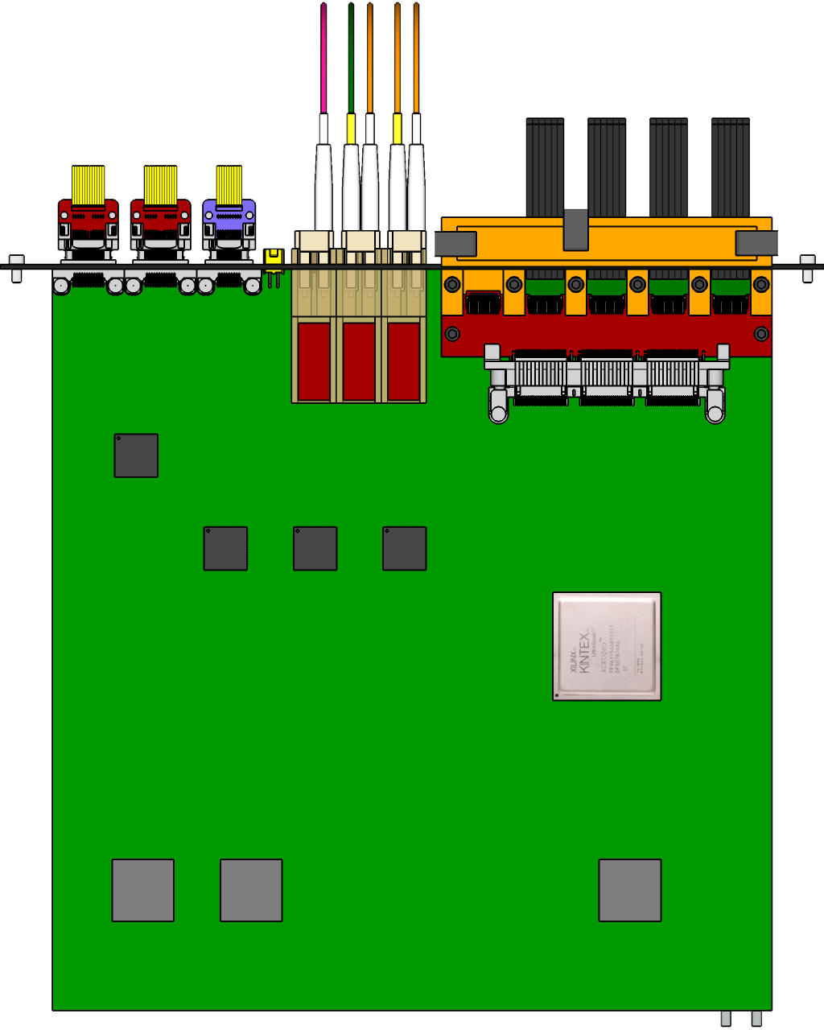
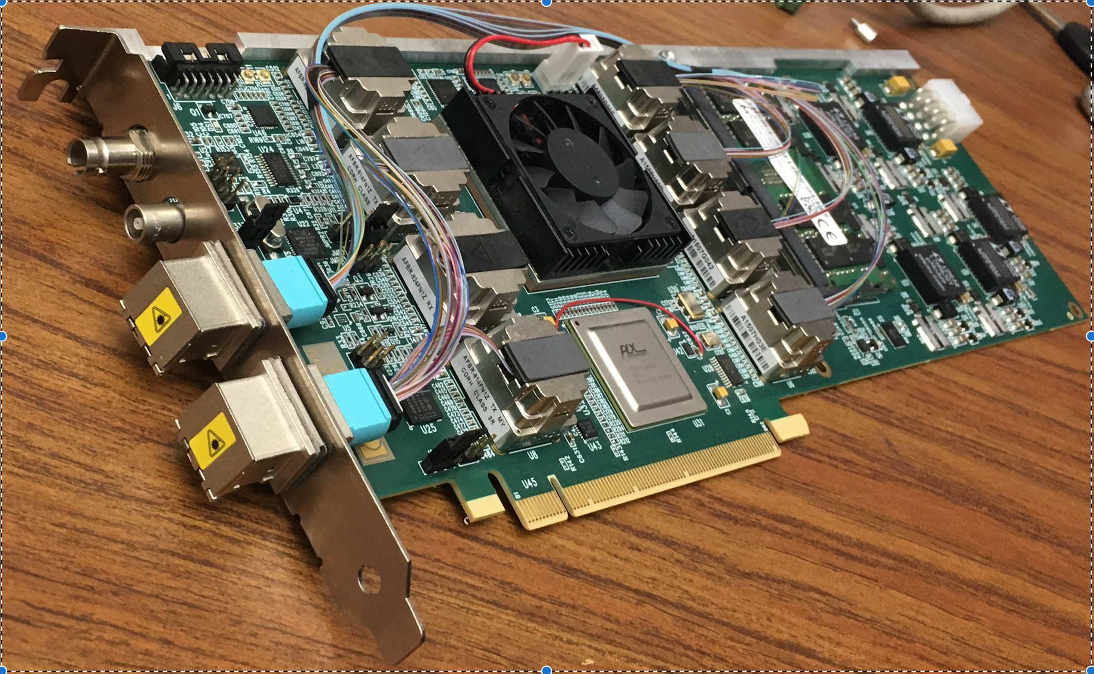
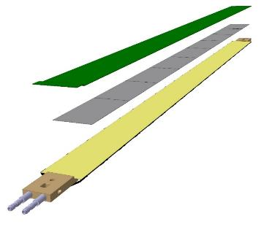
MVTX Readout and Control System
RUv1 prototype:
available: ~Aug/Sep.
sPHENIX GL-1 & GTM
Prototype stave:
Arrived: June
CAN bus
DCS
5 m
Trigger & Clock
Readout Unit
GBT Optical Links
9-sensor Stave
9 Data (1.2Gbps)
1 Clock, 1 Control/Trigger
Control
Data (9.6 Gb/s max)
Trigger
Samtec Twinax “FireFly”
FELIX (or CRU)
FPC
Power
Alpide Sensors
FELIX v1.5:
Arrived June
Power
Filtering Board
(Capacitors)
regulators
Power supplies
Cold Plate
Regulated Power
Power Board
Available:
~August

Slide 2
LDRD – MVTX Key Tasks/Milestones
7/17
10/17
10/18
10/19
Today
RUv1.0/FELIX1.5 Integration
40MHz, 7/17-12/17
LDRD
RUv1.x/FELIX2.0, 10MHz,
10/17 – 6/18
MVTX Design Review 7/6/2018
System test, cosmic & source
6/18 - 1/19
Test Beam, tracking performance
analysis, physics sim, NIM paper etc.
1/19 – 9/19
MVTX: 1/1/2018 – 1/1/2022
Stave Production, procure FPGA, GBT etc.
8/18-4/19
BNL Director Review
7/10-11, 2017
Electronics Production
1/19-8/19

Slide 3
Experimental Tasks and Assignments
Interface to sPHENIX – Sho, Cesar, Ming
Data format, trigger etc.
Online monitoring and analysis
Readout firmware - Alex T., Sho, Mark
RU and FELIX firmware development & test – Alex, Mark, Sho, Kun
FELIX and sPHENIX DAQ, offline code - Sho, Alex T., Ming
Evaluation test boards – Andi, Kun, Mark
Detector Control System (DCS) – Sho, Sanghoon, Xuan
Slow control and monitoring of sensor status
PS control and monitor, offline code
Single chip/stave evaluation w/ MOSAIC – Xuan, Alex W. Elena
Chip performance, noise, threshold, gain, timing etc
Stave performance
Data analysis
Cosmic telescope - Xuan
FireFly cable test w/ MOSAIC - Xuan, Ming
Extension cable test
Mechanical system: Chris, Walt, a visiting student?
Telescope frame
Cooling
sPHENIX integration conceptual design – Walt, Chris, Ming
Physics simulation : Sanghoon, Darren, Xuan, Alex W.
Vertex finding
B-reconstruction
Full physics simulations
Stave production and test – Cesar, new hire? Collaborators
Stave production
Test staves, DAQ operation

