Slide 1
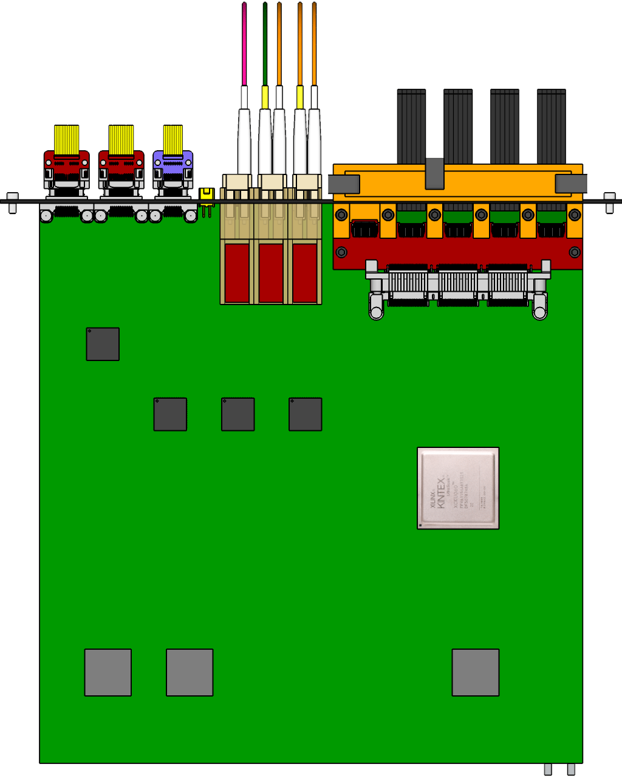

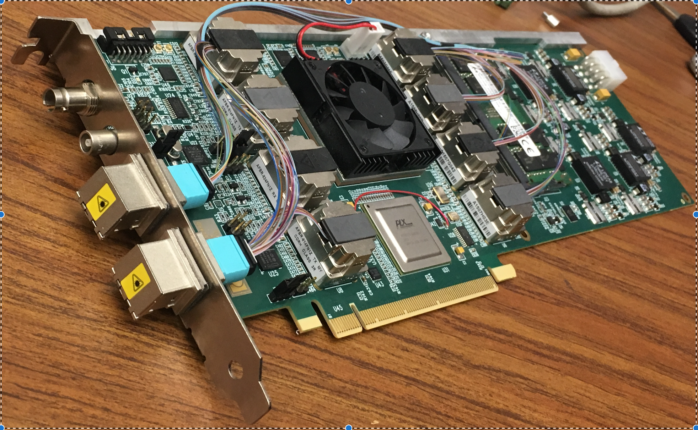
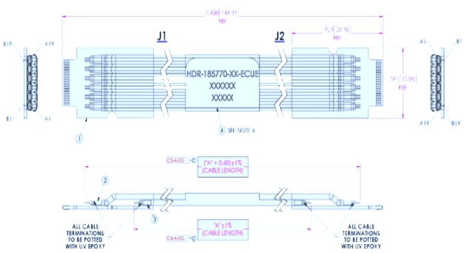

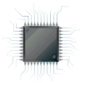
MVTX Readout and Control System
RUv1 prototype:
available: ~Aug/Sep.
sPHENIX GL-1 & GTM
Prototype stave:
Arrived: June
CAN bus
DCS
5 m
Trigger & Clock
Readout Unit
GBT Optical Links
9-sensor Stave
9 Data (1.2Gbps)
1 Clock, 1 Control/Trigger
Control
Data (9.6 Gb/s max)
Trigger
Samtec Twinax “FireFly”
FELIX (or CRU)
FPC
Power
Alpide Sensors
FELIX v1.5:
Arrived June
Power
Filtering Board
(Capacitors)
regulators
Power supplies
Cold Plate
Regulated Power
Power Board
Available:
~August

Slide 2
LDRD – MVTX Key Tasks/Milestones
7/17
10/17
10/18
10/19
Today
RUv1.0/FELIX1.5 Integration
40MHz, 7/17-12/17
LDRD
RUv1.x/FELIX2.0, 10MHz,
10/17 – 6/18
MVTX Design Review 7/6/2018
System test, cosmic & source
6/18 - 1/19
Test Beam, tracking performance
analysis, physics sim, NIM paper etc.
1/19 – 9/19
MVTX: 1/1/2018 – 1/1/2022
Stave Production, procure FPGA, GBT etc.
8/18-4/19
BNL Director Review
7/10-11, 2017
Electronics Production
1/19-8/19

Slide 3
Experimental Tasks and Assignments
Interface to sPHENIX – Sho, Cesar, Ming
  Data format, trigger etc.
  Mechanical system
Readout firmware - Alex T., Sho, Mark
  RU and FELIX, integration firmware development & test - Alex
  FELIX and sPHENIX DAQ, offline code - Sho, Alex
  Test boards – Andi, Mark
Detector Control System (DCS) – Sho, Sanghoon, Xuan
  Slow control and monitoring of sensor status
  PS control and monitor, offline code
Single chip/stave evaluation w/ MOSAIC – Xuan, Alex W. Elena
  Chip performance
  Stave performance
  Telescope
  Analysis
Mechanical system: Chris, Walt, a visiting student?
  Telescope frame
  Cooling
  sPHENIX Integration conceptual design
Physics simulation : Sanghoon, Darren, Xuan, Alex W.
  Vertex finding
  B-reconstruction
  Full physics simulations
Stave production and test – new hire? Collaborators
  Stave production
  Test staves, DAQ operation

Slide 4
LDRD & MVTX Readout Milestones
The schedules in LDRD and MVTX readout electronics schedules are out of sync. due to schedule slips in obtaining ALICE Stave/RU/CRU for R&D
  This impacts both LANL LDRD readout R&D milestones and MVTX production, the schedule of electronics in current project file is out of date
  The mechanic R&D is OK
At present, there is an overall delay in ALICE stave production, RU and CRU R&D, by about 3~6months
  Alice readout electronics PRR (production readyniess review): ~12/2017
  Electronics production & Test: Feb-Dec, 2018
  MVTX can produce RU and FELIX in US if we obtain key CERN items, such as GBT chipset, and high-cost FPGA with high discount (~50%) with ALICE RU production
With the above changes, I believe we have consistent schedules between LDRD and MVTX projects.

Slide 5
Update LDRD Readout R&D Schedule
Update line #41
  Obtain 5 RUv1, cost $7K x 5 = $35K
Update line #45
  Obtain 3 FELIX boards: 1 FELIX1.5 (in hand, 6/1027) and 2 FELIX2.0 (Jan. 2018)
  $12K x 3 = $36K
Firmware development line #58: delayed by ~2 months
  start from 8/1/2017 (was 6/6/17)
  Replace 1.4.7.1.4 (CRU Trig. Control etc) with “Initial RUv1.0 & FELIX1.5 Integration chain test”, 8/30-10/26, 40days
Milestone-1: first full readout chain test with RUv1+FELIX1.5, 40MHz, by Dec. 2017
  This will allow us to update readout in the MVTX proposal, demonstrate “proof of principle” of the readout design
Milestone-2: first full readout chain test with RUv1 + FELIX2.0, 10MHz RHIC clock, by 6/1/2018
  To be ready for the Electronics final design review 6/20-7/5, 2018
Milestone-3: MVTX final design review (7/6-23, 2018)
  Allow stave production @CERN, starting from 8/2018
  Allow advanced purchasing of high cost/long lead-time readout electronics items with ALICE readout production to get high discount (FPGA, GBT chipsets etc), 8/2018
Milestone-4: full system test with cosmic and source, line #111 (WBS1.4.13.1), 6/20/18-1/8/19
  Allow full production of RU and FELIX

Slide 6
Update MVTX Production Schedule
Line #124 (WBS 1.5.2.1)
  Add one line on purchase of FPGA and GBT chipset as part of ALICE RU production
    Cost ~50% of RU production
  Move the starting date of line #125 (WBS 1.5.2.1.1) from 7/6/2018 to 1/8/2019, but keep the end-date
    RU production delayed by ~6 months, 1/8/2018 – 8/15/19
    After the completion of readout system test with cosmic and source, 1/8/2019
  Same for FELIX production
    Line # 134, delayed by 6 months, starting from 1/8/2019, instead of 7/6/18, keep the same production time 4wks.
    Line #138 and following lines , all delayed accordingly by ~6months,
    cost: 11.5K x 8 = $92K

