Slide 1
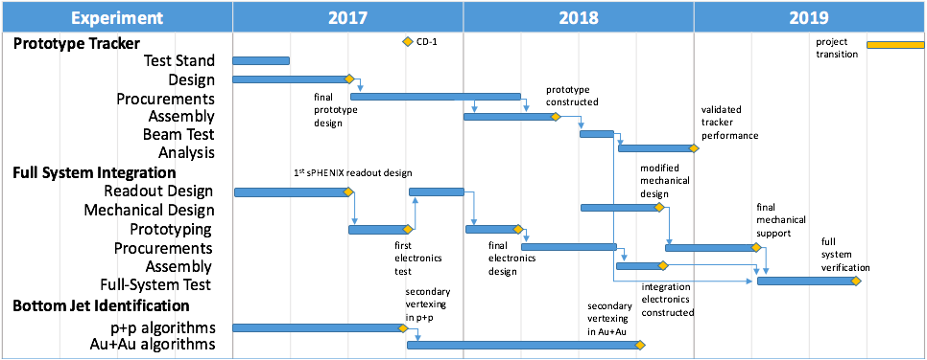
Experiment: Tasks and Schedules

Slide 2
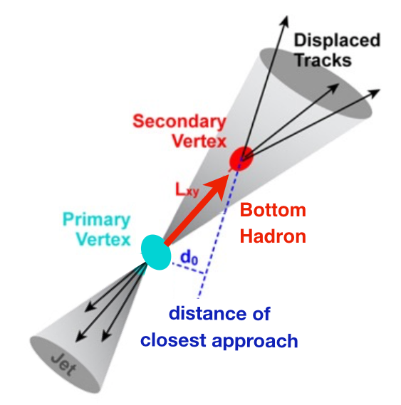
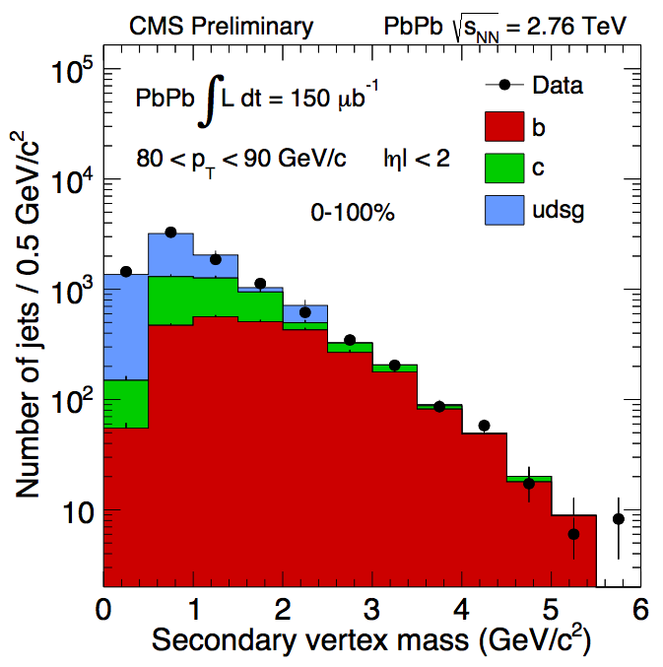
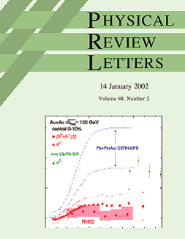
Experimental R&D Deliverables: Physics
LDRD Experimental Goal: Improved B-jet Identification in Heavy Ion Collisions
Secondary Vertexing
Track-Counting
Q3:
Q1:
LANL proposed tracker, a new b-jet identification with high efficiency and high purity is possible
Figure of merit is efficiency x purity. Greatly enhancing the b-jet physics program, x4 improvement in FOM
Analysis of existing PHENIX data using these techniques, as developed for our prototype tracker, will produce additional B hadron results at RHIC

Slide 3
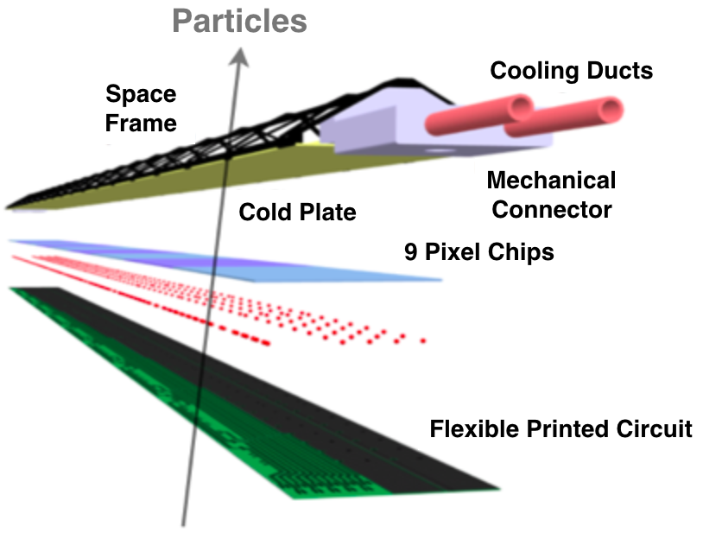


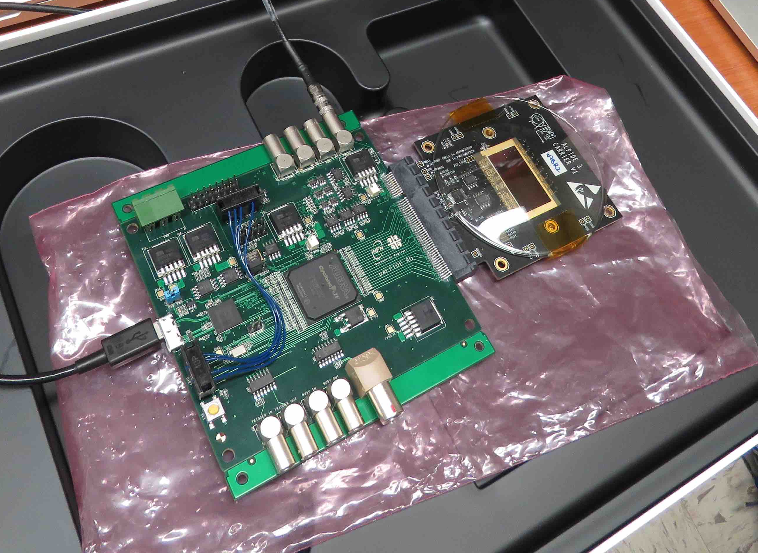

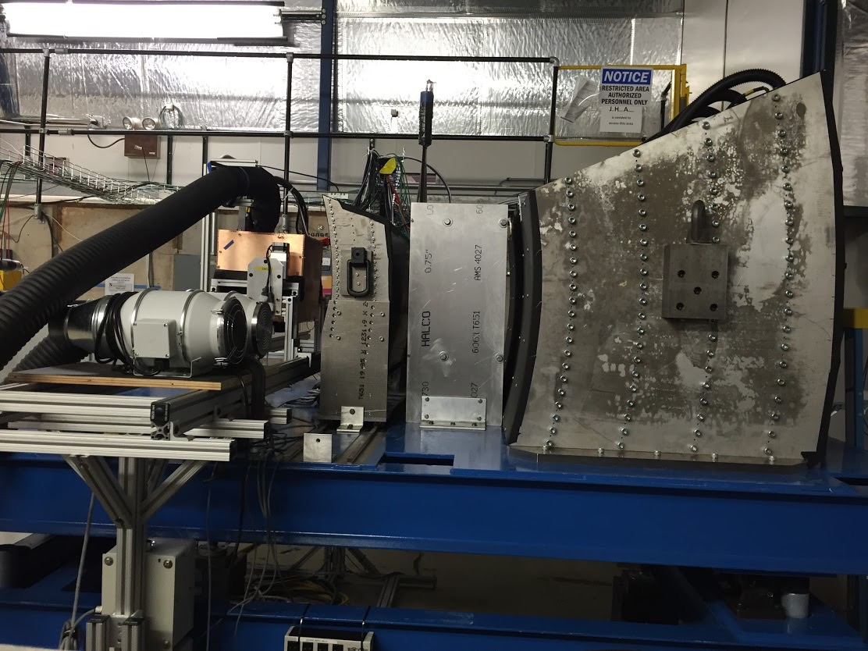
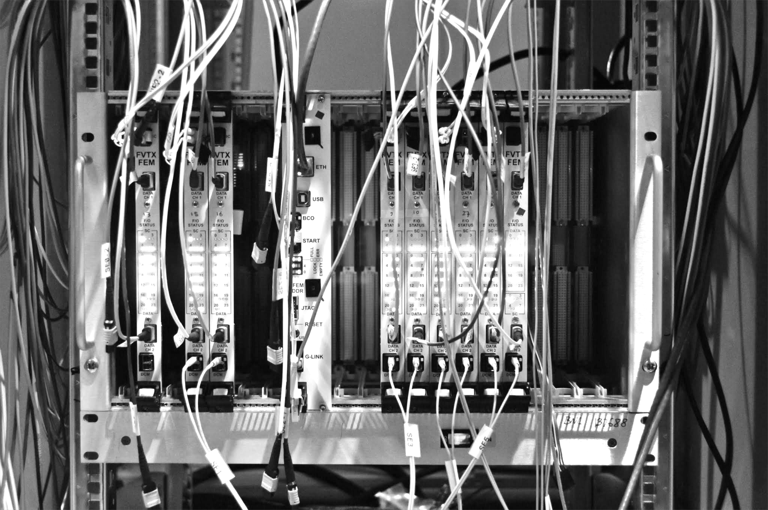
Experimental R&D Deliverables: Tracker
LDRD Experimental Goal: LANL built 4-stave prototype tracker at test beam with custom sPHENIX readout
1st MAPS prototype sensor being studied at TA-53
MAPS Stave
Construction
Annual FermiLab
Test Beam
Test prototype tracker
Validate tracking and reconstruction
Custom Front-End, intergrate into
sPHENIX EMCAL & HCAL Prototypes taken April 19, 2016
sPHENIX Readout (FVTX expertise)

Slide 4
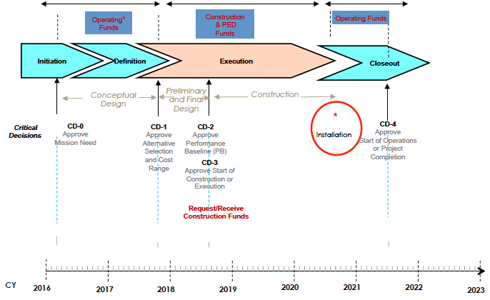
Tasks and Schedules: LDRD-sPHENIX
Possible sPHENIX Project Schedule
- Challenging experimental task
- Theory challenges
LDRD
ALICE MAPS Prod./Test complete
ALICE ITS complete
Q6:
Q8:
Detailed theory schedule matched to experimental timeline (simulations for design, comparison to
PHENIX data, validation of theoretical input, package for b-jet simulations )

Slide 5
“My” Effort in FY17
MoU between LANL-CERN/ALICE
  Associate membership
  Access resources from CERN
sPHENIX MAPS proposal
  build collaboration
Detector readout R&D
  Obtain test bench
  Obtain MAPS and readout cards
  Collaboration with ALICE/ITS
  Local readout R&D with Mark et al.
Build up MAPS expertise
  Work at ALICE/CERN for extended periods
  MAPS, staves assembly and testing etc.
Simulations
  Physics simulations and b-tagging algorithms

Slide 6
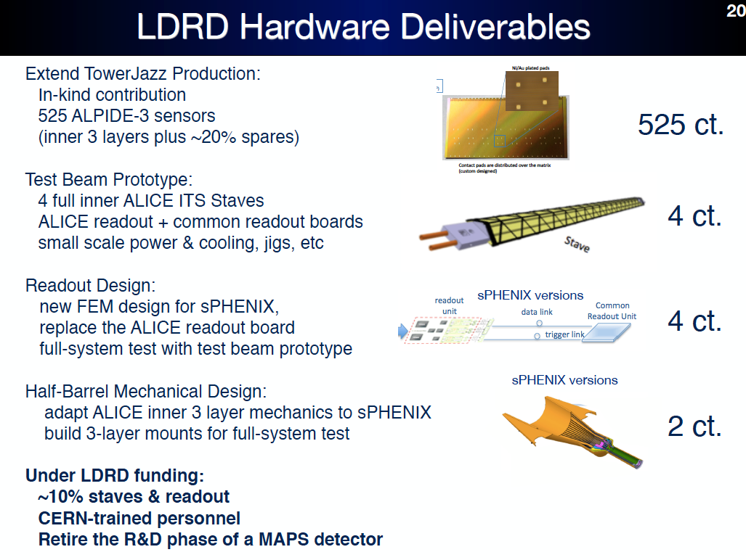

Slide 7
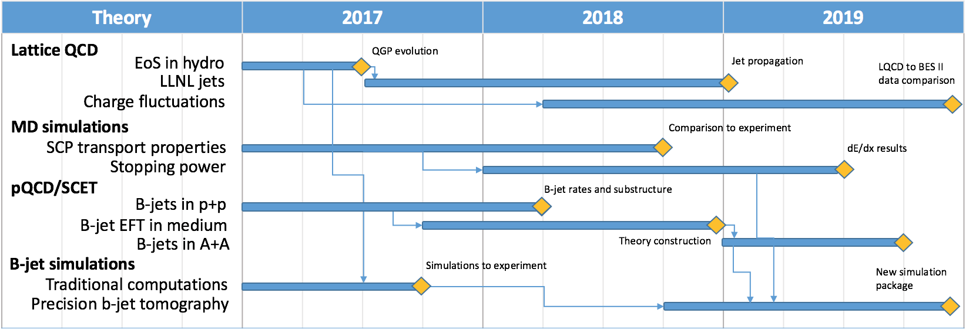
Theory: Tasks and Schedules

Slide 8
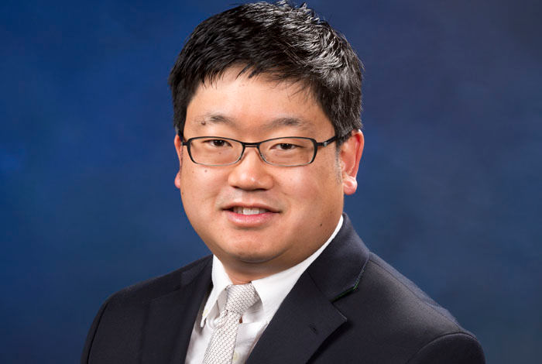
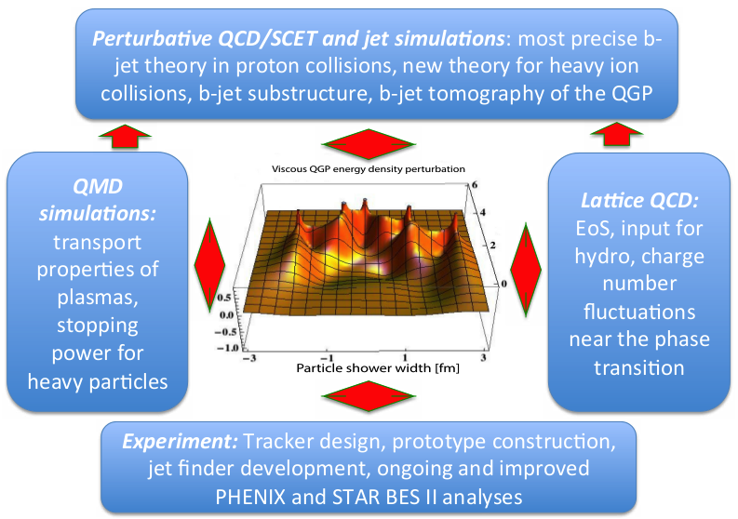
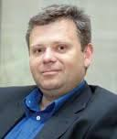
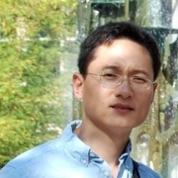
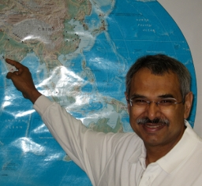

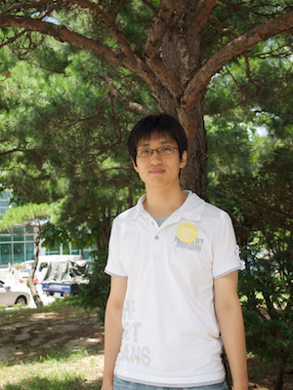
B-jet Theory Effort and Innovation
LDRD Theoretical Goal: develop the most accurate description of b-jet observables in heavy ion collisions; use b-jets as precision diagnostics of the QGP
  SCET, jets,
  resummation,
  p+p
  Energy loss,
  b-jets, HIC,
  tomography
  pQCD, b-jets
  heavy flavor,
  substructure
  Lattice QCD,
  EoS, charge
  fluctuations
  MD simulations,
  strongly-coupled
  plasmas
Key advancements in several intersecting areas of physics needed. Breakthrough only possible at LANL
  Lattice QCD,
  large-scale
  simulations

Slide 9
Meeting Summary: 10/20/2016
We agreed to have a bi-weekly meeting on Thursday 1:00 – 2:00PM (~2:30 if needed) to discuss experimental progress
Once a month a joint Exp+The meeting on Thursday 1:00-3:00PM
Assigned experimental tasks and responsibilities (next slide)

Slide 10
Experimental Task Assignments
sPHENIX readout and trigger requirements (DCM2, JSEB etc) – Mike and Ming
MAPS CRU readout - Mark, Ming, Pat
  Physical parameters (PCIex4)
  Data format
  Electrical signal, lack of busy etc
  sPHENIX trigger/busy inputs and clock
Detailed specs/understanding of MAPS/ALIPED-3(4 ~ final) test card – Pat, Cesar and Andy
BNL specifies cabling/material electrical and fire safety etc – Walt, Hubert, Eric…
Radiation enviroenment, damage, occupancy, SEU; Configuration and Operation, programing and initializatio etc – Mark, Xuan
Power needs:
  (LANL LDRD) Hubert and Ming;
  (BNL sPHENIX) Hubert, Eric
  Staves, readout control etc. (A, V)
Mechanics – Walt, Hubert, Jin
  Structure, cooling, alignment, assembly and integration
Integration into sPHENIX – Walt, Eric
Test stands setup and operation
  Single chip readout – Mike, Pat
  Staves and cosmic ray - Xuan Cesar
  Mockup, electrical, readout, power – Sanghoon, Hubert, Walt
FPGA firmware – Andy, Mark, Cesar, Ming and Pat
  VHDL, Verilog
Software – Sanghoon and Andy
  Slow controls, electronics
  Test software, root-based
Beam test – Ming and team
  LANL, FNAL, rad damage at LANSCE
Web page – Hubert, Pat
  R+W access
  Tree structure
  https://p25ext.lanl.gov/maps/

Slide 11
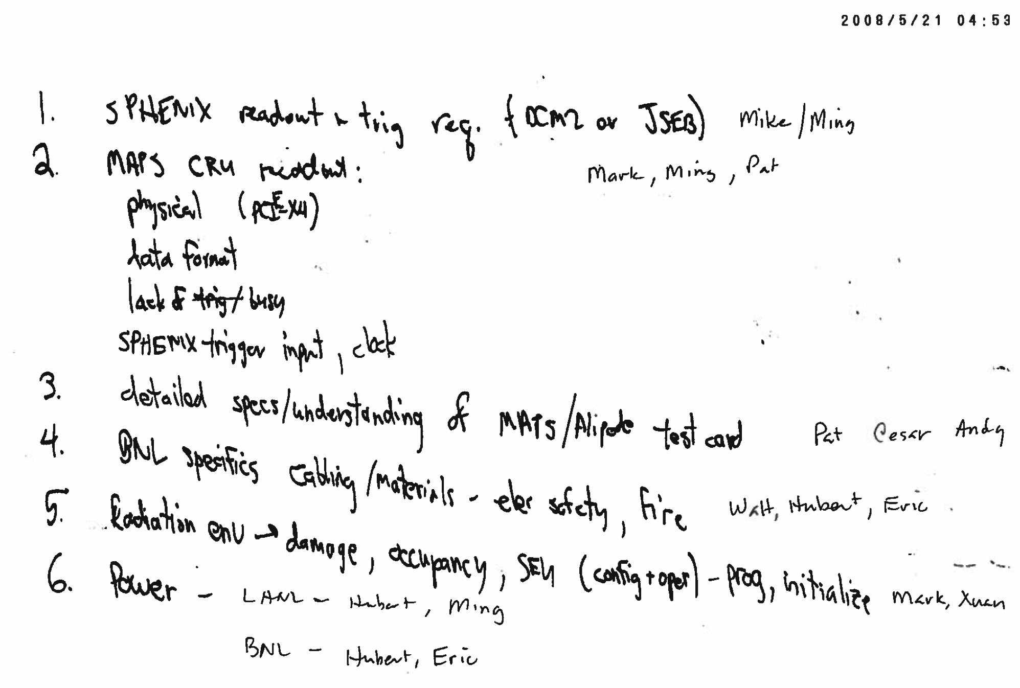
Summary of Experimental to-do list and assigned names

Slide 12
