Slide 1
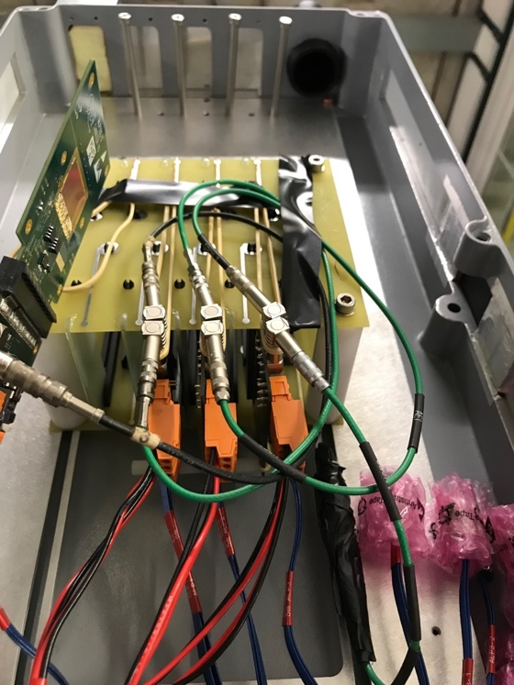
MVTX Test Beam at Fermilab
120 GeV
proton
Goals:
Test full readout chain
Evaluate ALIPDE sensor performance
Experimental setup
A 4-sensor telescope
Full readout chain: MAPS+RU+FELIX+RCDAQ
Parasitic with INTT run
Very productive & collaborative
4-sensor

Slide 2
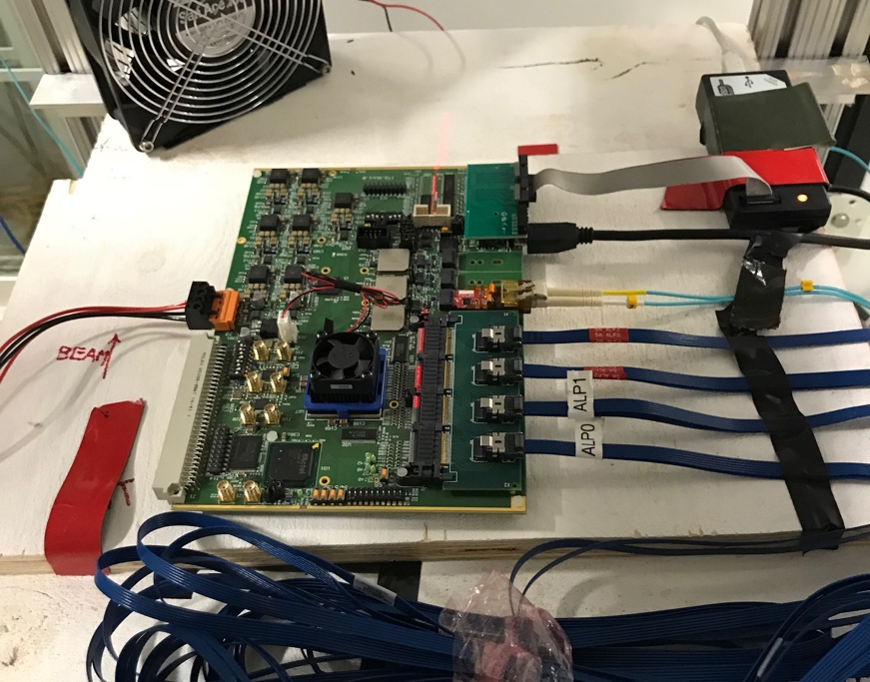
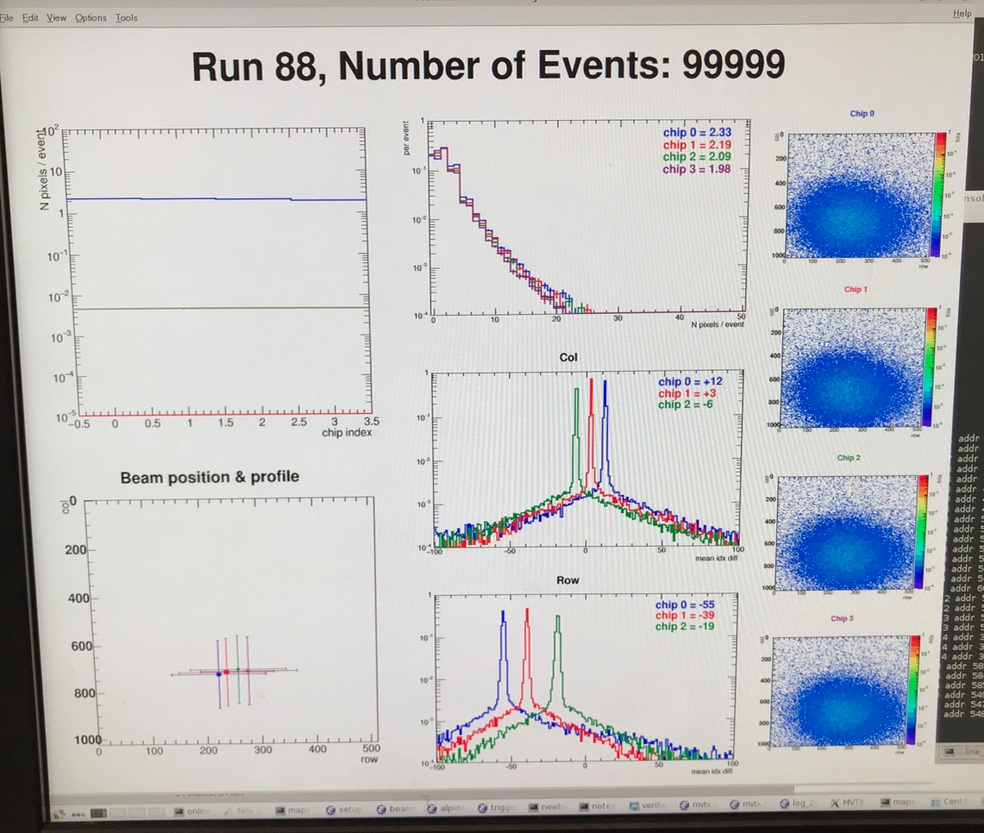
Achieved all goals and more!
RU
Tested a new readout scheme
4 sensors (~4 staves) per RU (ALICE 1 stave per RU)
Sensor performance evaluation
Cluster size
Threshold, signal shaping, trigger delay
System stress test
High multiplicity events created via lead bricks “shower”
With 5, 10, 20cm lead bricks
Software being developed
Online monitor
hit distribution, relative alignment etc.
Offline reconstruction, alignment etc.
Preliminary alignment, ~O(100um)
4 sensors
Connected
to one RU
hits
Hits/sensor

Slide 3
