Slide 1
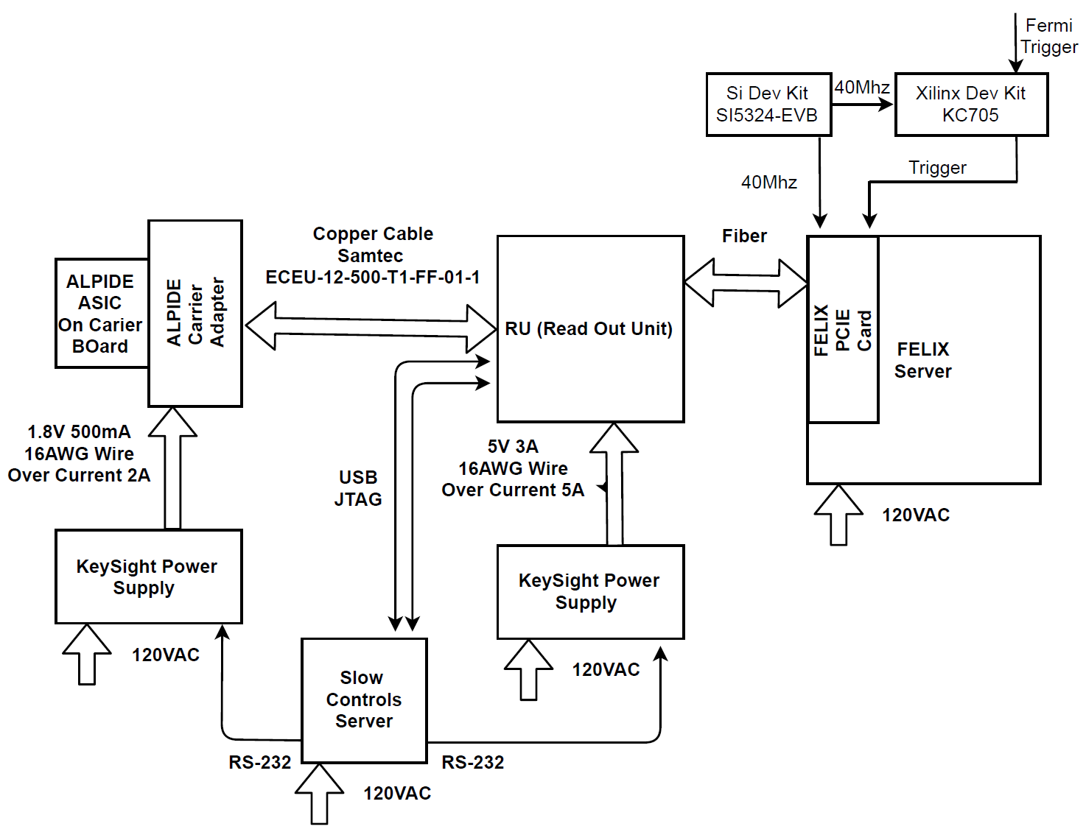
LHC 40MHz
mockup
LANL Fermilab Test Beam Setup 03/2018
4-ALPIDE Telescope + 4-SamTec cables + 1 RU + 1 FELIX(“CRU”)
4-ALPIDE Telescope
4 5m SamTec Cables, 1.2Gbps
CLK recovered from
FELIX through GBT link;
Trigger from FELIX
FELIX (“CRU”)

Slide 2
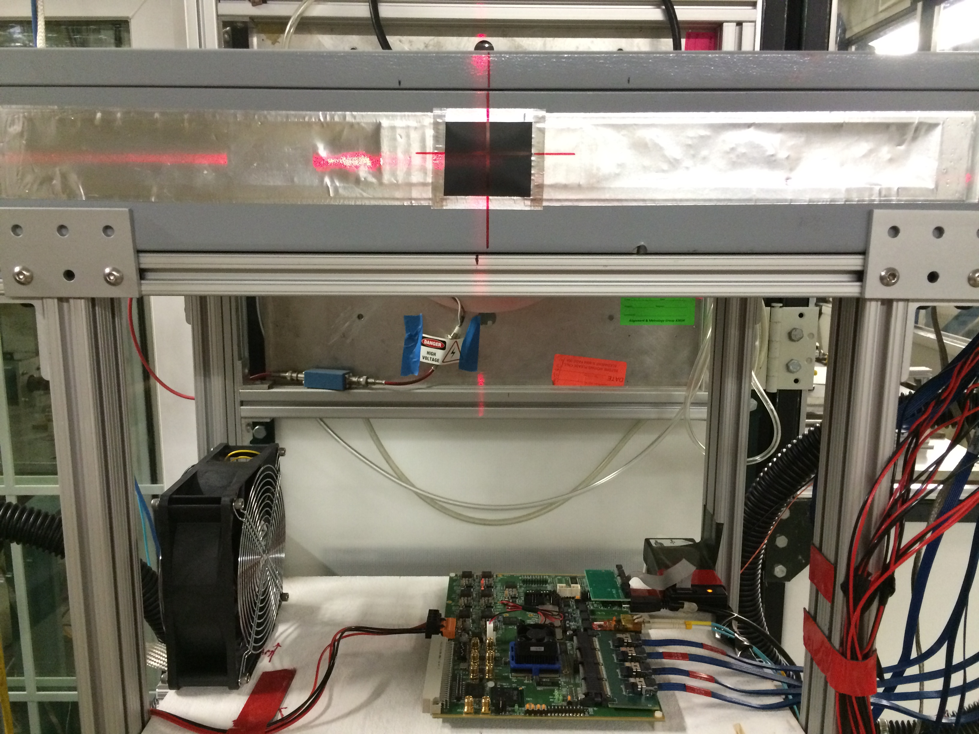
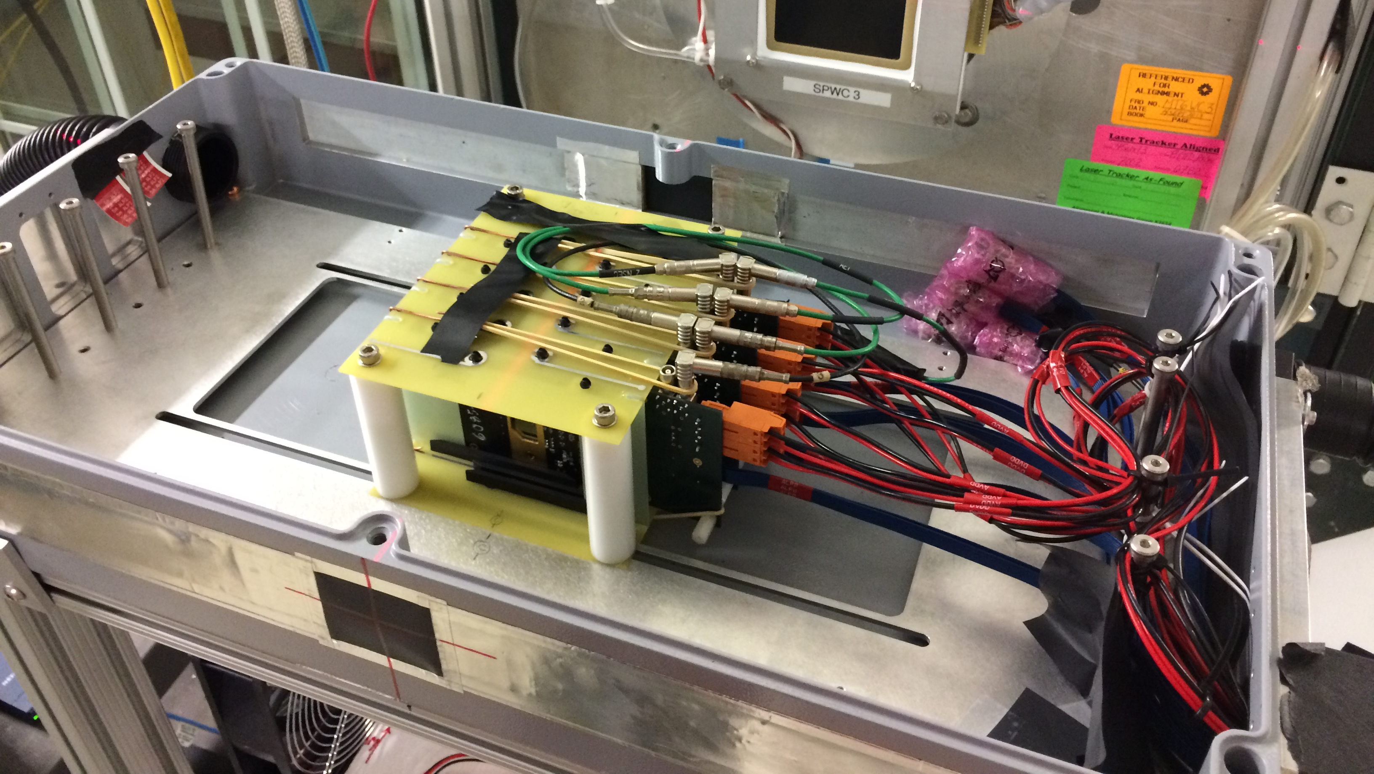
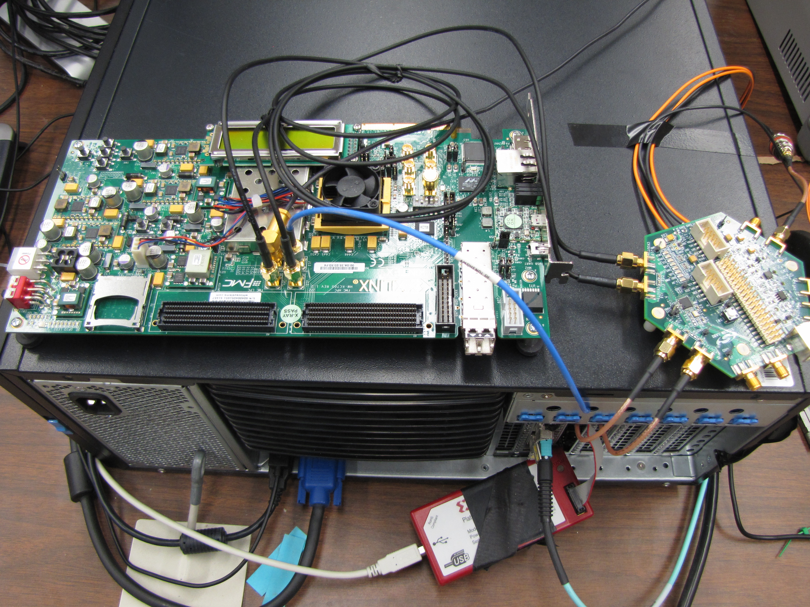
LANL 4-ALPIDE Telescope Setup at Fermilab: 03/2018
RU
4-ALPIDE Telescope;
5m long SamTec cables
Summary:
Successfully operated the full readout chain
at Fermilab test beam facility
Confirmed all communications links and data path
120GeV proton beam
Beam trigger rate ~7kHz
High ALPIDE occupancy runs, with 10cm lead bricks
Analysis confirmed telescope performance
FELIX(“CRU”) in Server
KC705
LHC 40MHz
Mockup

