Slide 1
Inner Tracker FPC, 04/03/2018

Slide 2
ITS/IB FPC, 50cm long; CERN can make upto 60cm long ones but need to be tested.
Caps, resistors, connectors, etc
Is there a CAD model that includes the surface mount components on the end of the FPC? Any other detail features -

Slide 3
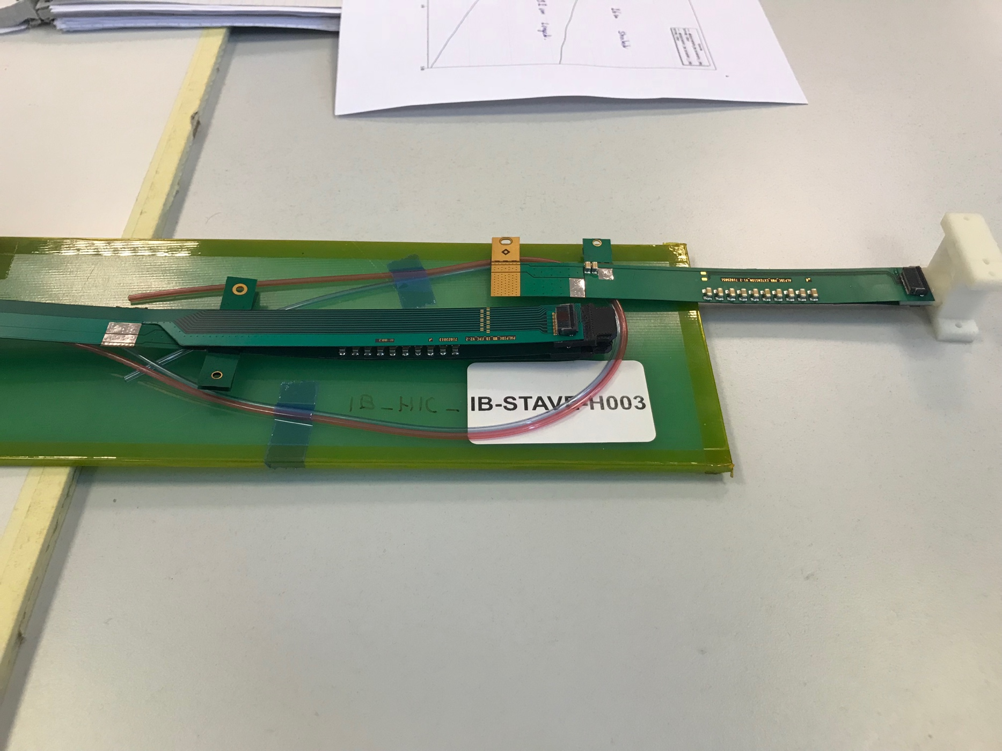
FPC R&D @CERN and LANL
Analogy and Digital Power
Extension
High-speed signal, 1.2Gbps
Try to extend high-speed portion of FPC
by 10cm @CERN, September 18
2) Try to extend AV and DV by 50+cm at LANL,
by summer 18

