Slide 1
MVTX Status
Camelia, Grazyna, Ming
03/18/2021
sPHENIX L2 Project Meeting

Slide 2
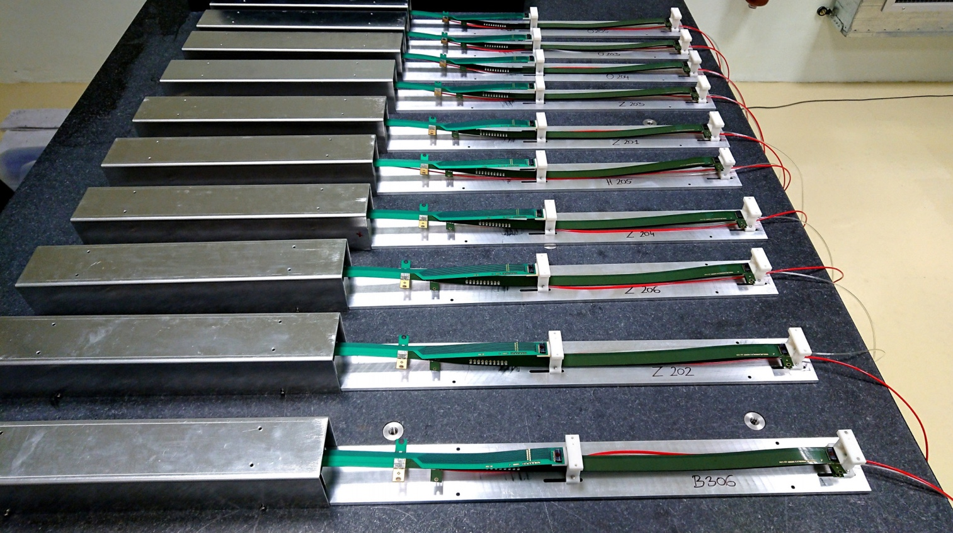
Stave Production Near Completion
Goal: 84 Gold/Silver Staves
Stave production meeting with CERN
@March 11, 2021
76 staves produced
  71 Gold → Full MVTX with Gold Staves (48)
  5 Silver
  6 more to complete the production
Next:
  Shipping and QA at LBNL
sPHENIX Staves
@CERN

Slide 3
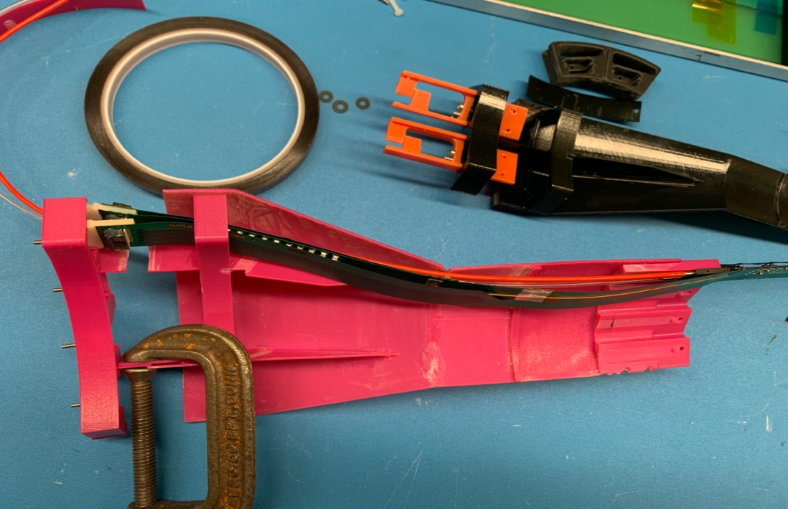
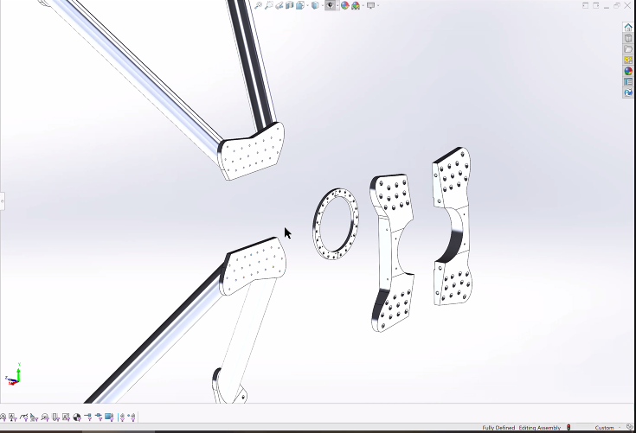
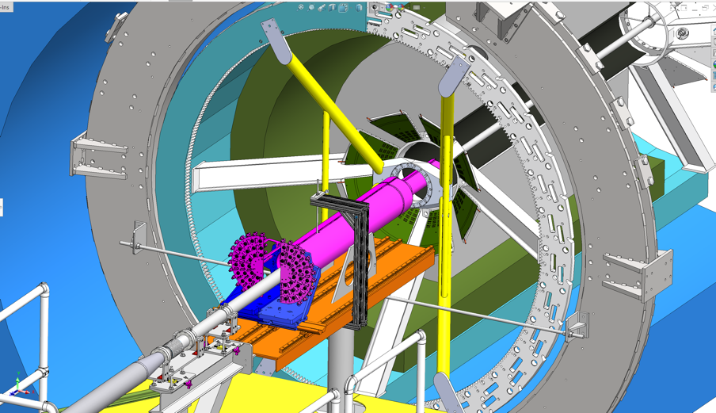
Mechanical System
@WorkShape
CFC production in good progress at WorkShape
  Spring-back issues being addressed
  Possible schedule delay 1~2 weeks?
3-D mockup to check PP-cable interferences
  Finalize assembly fixture layout
X-Wing and insertion system
  Design updated, ready for production
Cooling system design and test in progress
  Initial test @BNL
  Stave cooling, preliminary design available
  Electronics RU & PU cooling, later, by MIT/LANL
3D mockup @LANL
X-Wing,
New Design

Slide 4
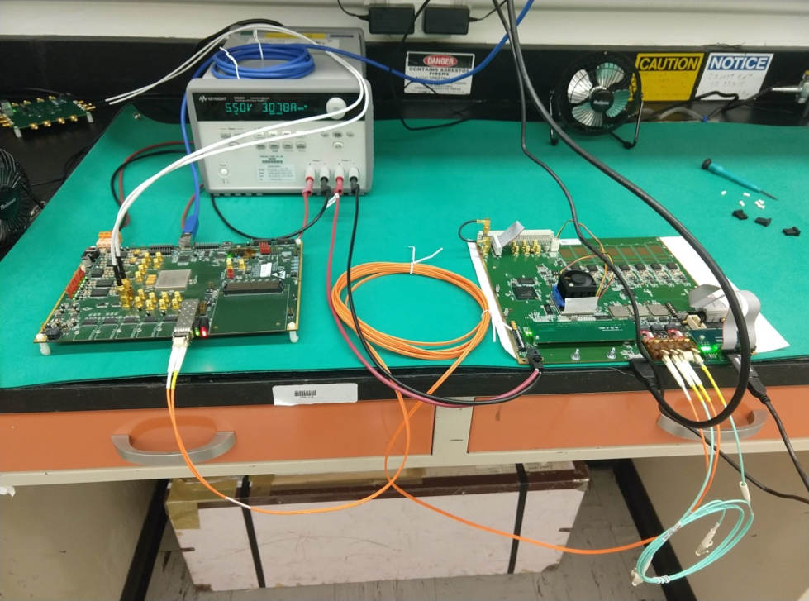
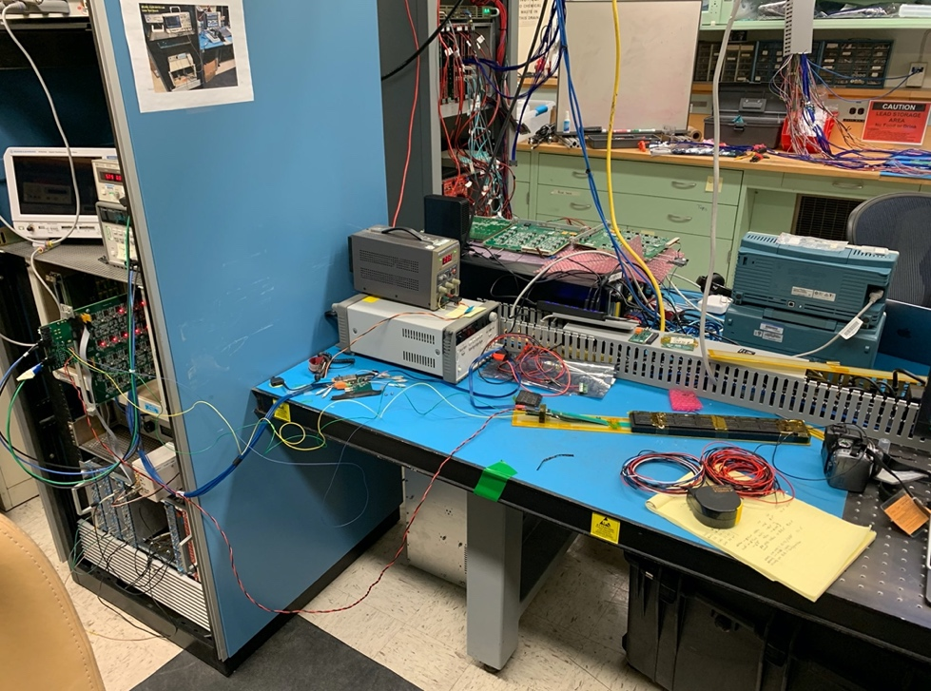
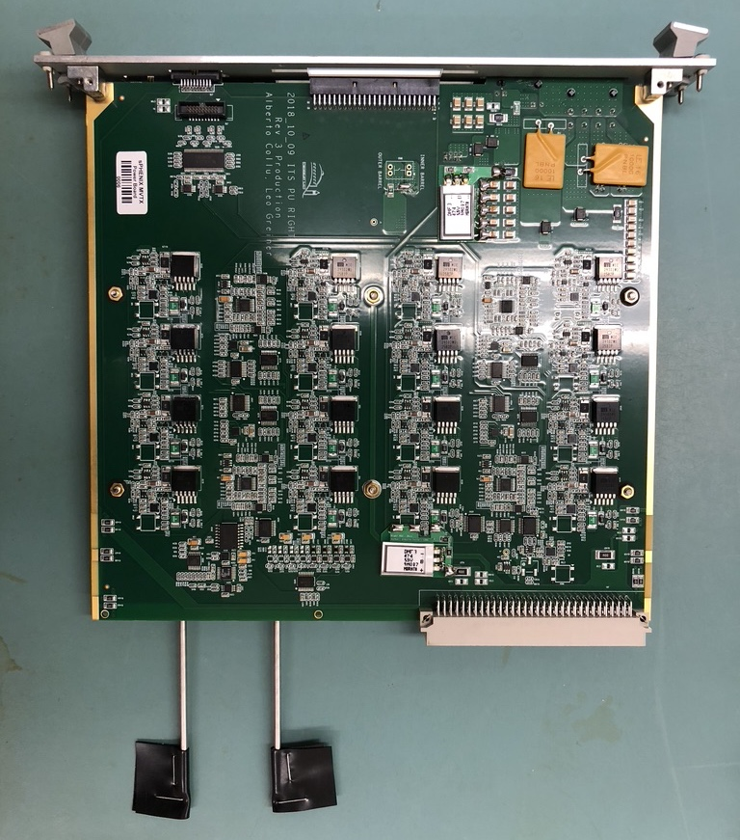
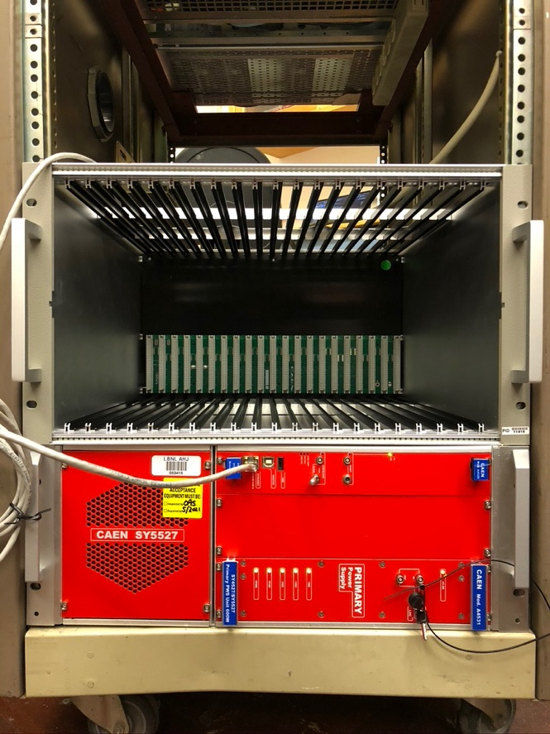
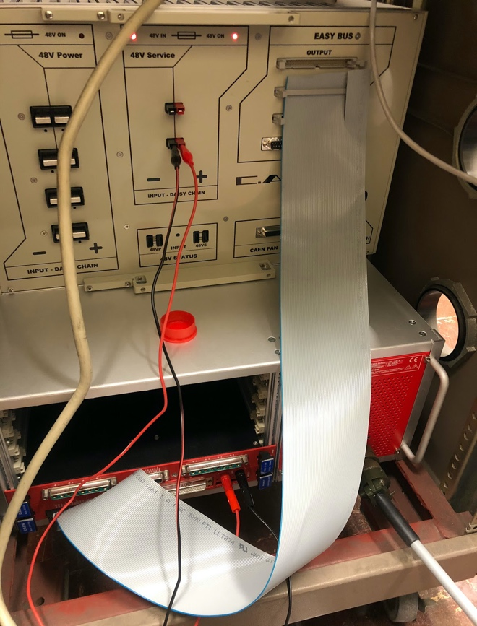
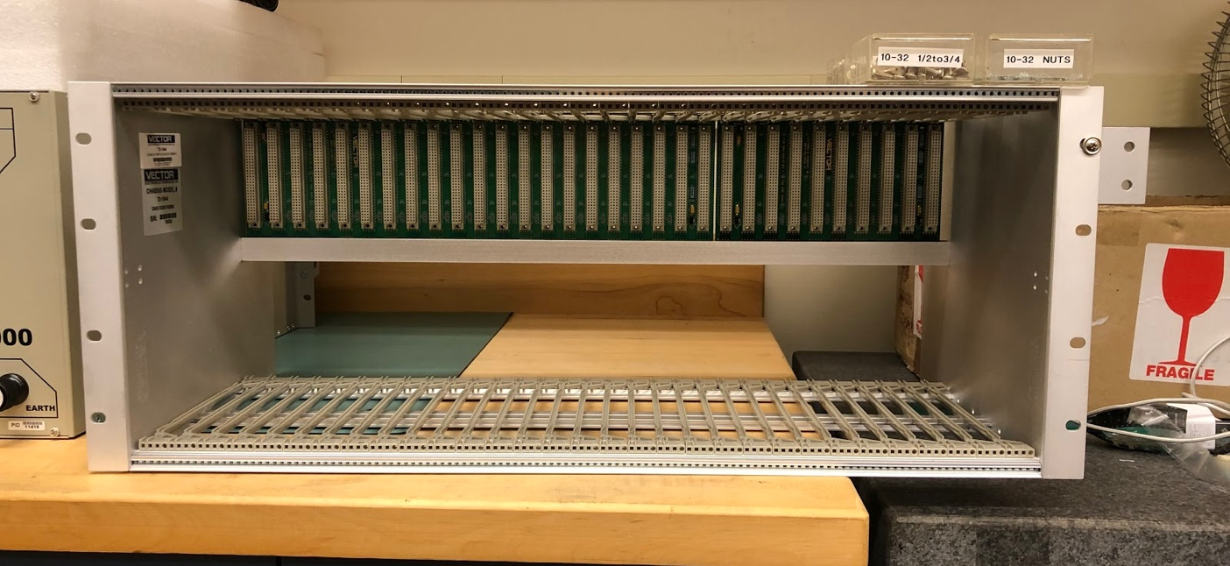
Electrical System
60 production RUs tested
30 production power boards tested and calibrated
  Power board I2C issues resolved, RU FW updated
CAEN power system
  Test setup at LBNL
Detector safety system design in progress
  Meetings with BNL last week
A new HIC tested at LANL – shipping QC
  Reproduced CERN results, noise level ~ 5e, Gold
  Confirm the shipping safety
Readout and control system integration
  mGTM development @BNL
    MVTX firmware
  AMD full readout test
    w/ new RU FW & Date Format
  Slow controls
  Power system, racks etc.
RUs tested @ORNL
HIC test @LANL
CAEN PS @LBNL
sPHENIX
Power Board
27” custom subrack for RU & PU

Slide 5
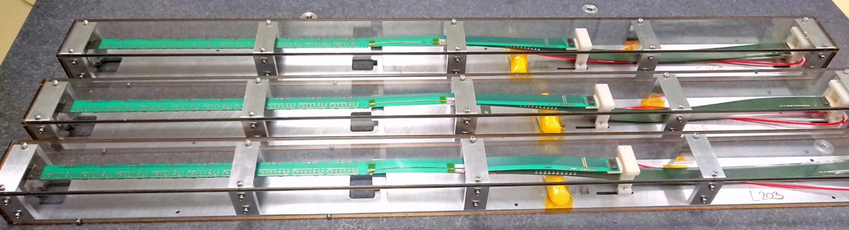
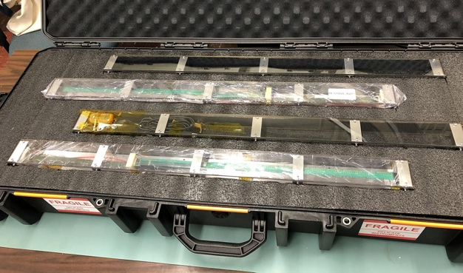
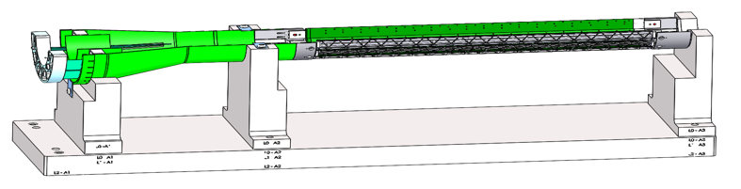
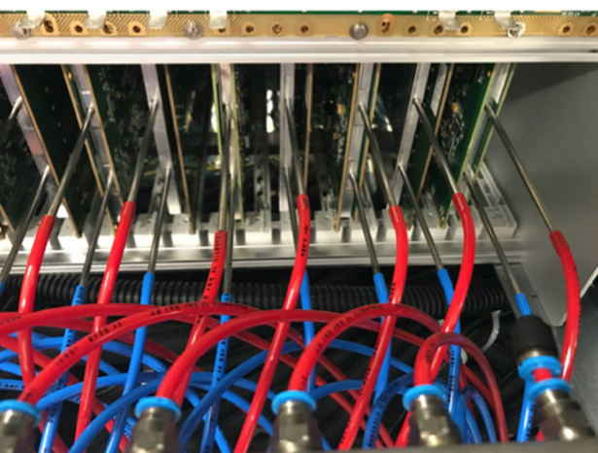
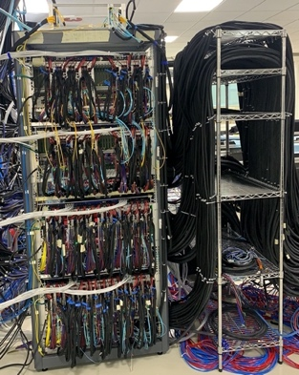
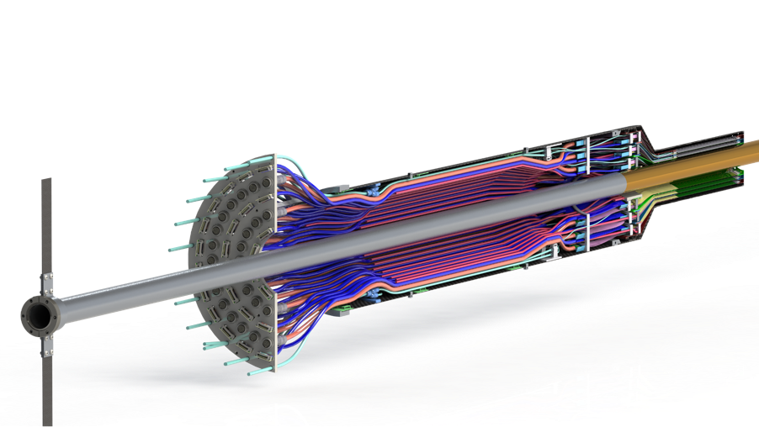
Near Term Plan
Staves @CERN
Stave shipping & QA
  Prepare for detector assembly
  sPHENIX QA DB
Mechanical structures
  Continue CFC production at WorkShape
    Produce low-cost “evil-twin” at the end of production
  Finished X-wing design, fabrication
    Build full mockup, w/ beam pipe @MIT
  Assembly fixture fabrication
    Pending PP1/PP2 finalization (3D mockup)
Readout and control integration
  AMD full chain readout
  mGTM
  Slow control
MVTX detector safety system
  Integrated into sPHENIX safety system
Power & Cooling systems
  Finalizing the design
  system tests and procurements
Experimental Safety Review
  power cables etc.
Budget update -> more engineering support in FY21
LBNL, in progress,
  extra ~$6K for clean tent safety system
MIT, in progress ->
  finish X-wing +insertion system, assembly fixtures,
  cooling system -> MIT + LANL
  extra evil MVTX (for insertion dry testing in BNL)
Test fit @LBNL: ~April, 2021
Detector assembly Review: ~May 2021
Racks + Cooling
(Shown ITS system)
Full test @LBNL
Stave readout
Cooling

Slide 6
backup

Slide 7
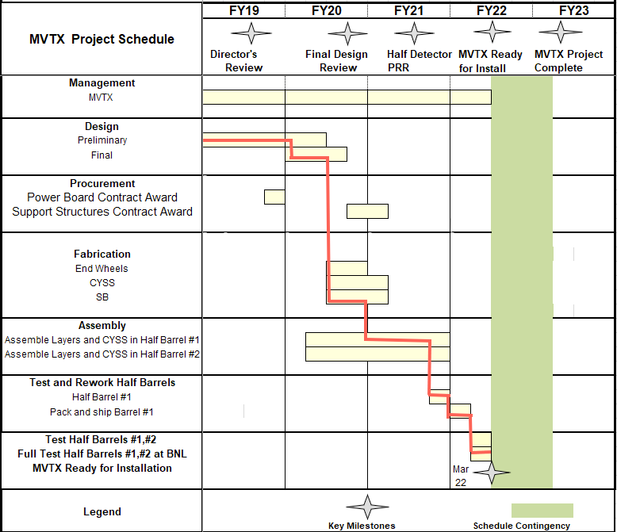

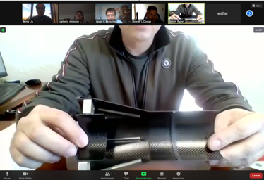
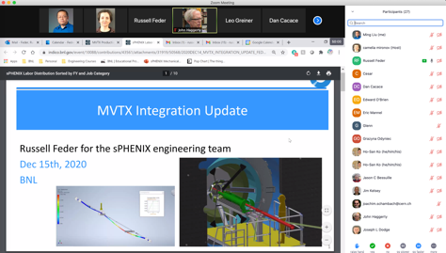

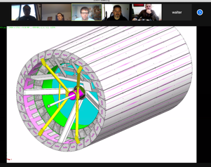
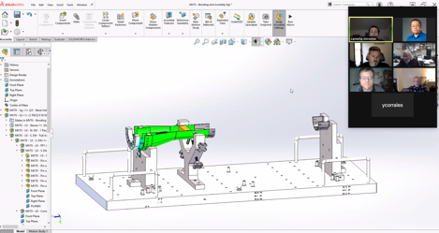
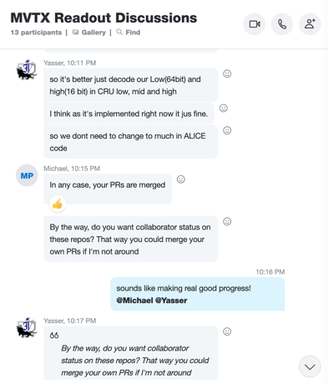

Status & Plan
Pre-COVID19 Schedule
Today
production started
Some delay in CFC production,
but still on track for completing
the assembly work in 2021
Assembly review
@LBNL
Readout, Control and Electrical System Integration
3 RUs sent to factory@UK for repair
FW/SW synced to latest ALICE/ATLAS code
Low-level slow control under testing
mGTM progress at BNL (40MHz/LHC)
Readout and service cables and power system
MVTX
installation
~9/2022

