Slide 1
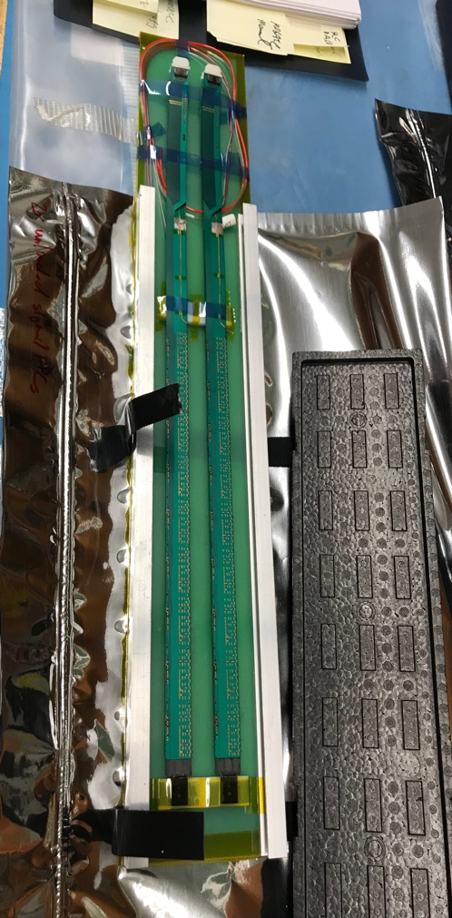
MVTX Upgrade Status: 09/02/2020
Detector mechanical design completed, vendor selection in progress
Received 3 bids, under review, will make decision soon
Within the estimated budget in the MVTX project
Readout system firmware and software updated
RU and FELIX firmware synced to the latest versions in ALICE and ATLAS
Implemented and tested slow control low-level interface to the readout system, user software underdevelopment
SC through FELIX
SC through CANBUS
Power board assembly and test in progress at LBNL
All hardware received
Readout board test in preparation at ORNL
Received RU and cooling plates
Stave production in good progress at CERN
Transport box designed and produced, shipping options under discussion
Recent reviews
MVTX (sPHENIX) AC/DC system reviewed
MVTX cooling system design discussed with BNL engineers, initial system test planned at BNL
On-going study of possible reuse of MVTX for EIC
Two production staves

Slide 2
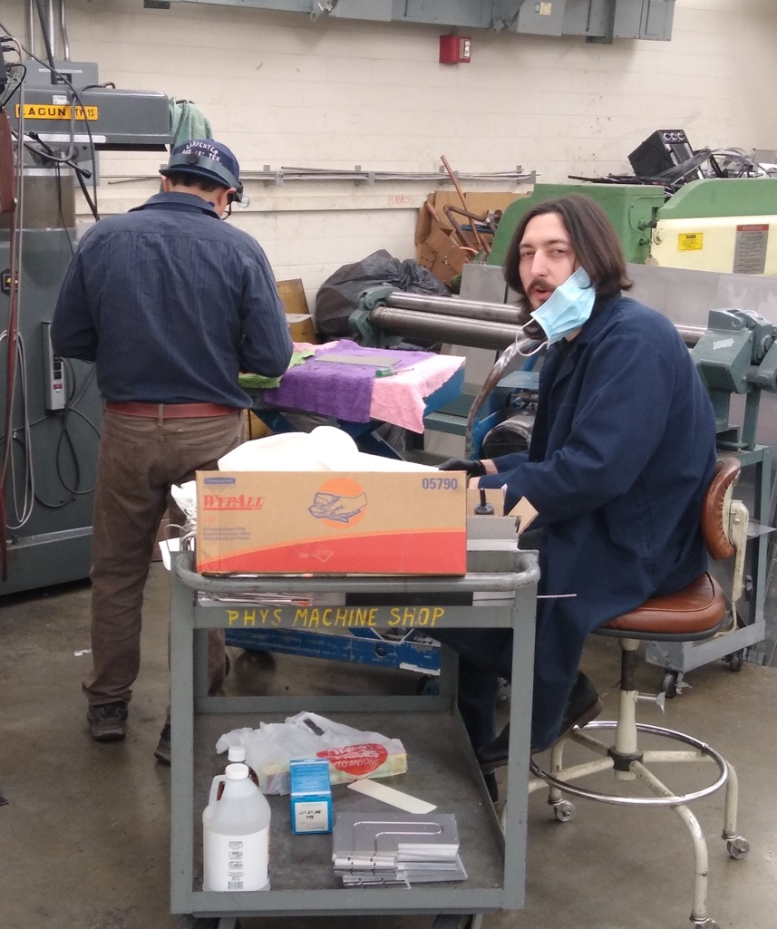
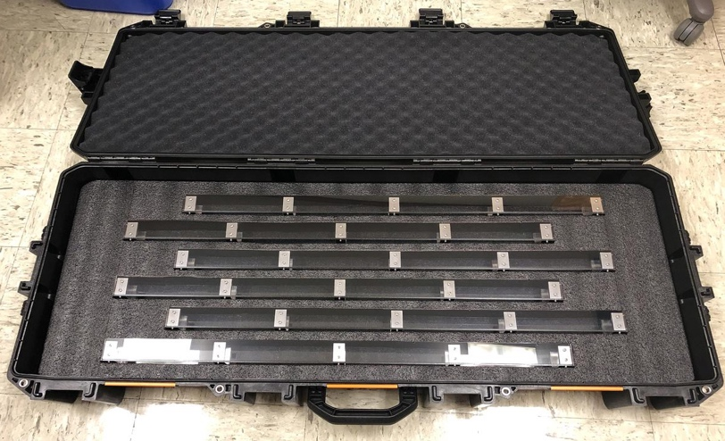
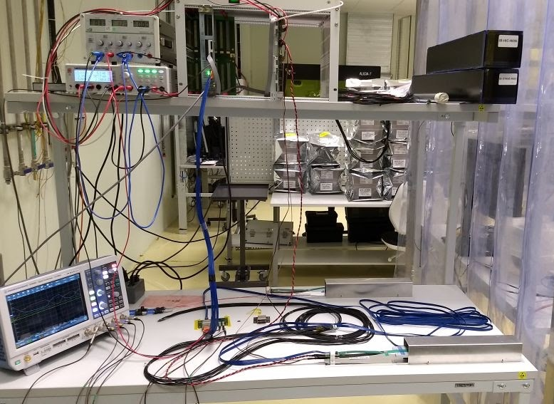
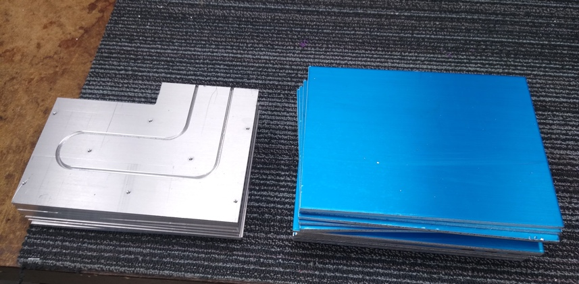
Hardware Progress
All 100 cooling plates for electronics produced at UT-A and LANL
Stave transportation case designed and fabricated at LBNL
Power board assembly and test in progress at LBNL
Readout Units and Cooling plates received at ORNL
RU test under preparation
Stave transportation case
@LBNL
Cooling plate production at UT-Austin Machine shop
Stave test station @ LBNL
RU and PU Cooling Plates @UT-A

Slide 3
 | STAVE-production summary table
IBSTAVE ID | HIC assembly | Ins. after glue | Bonding | Pull test (>=2 lifts + F <7g) | Ins. after bonding | HIC PWR test | Qualification test | Threshold cluster | HIC Matrix | HIC DTU | HIC+SF+C -> Stave | Stave PWR test | Stave test | STAVE metrology | Stave PWR test (long PWR extn.) | STAVE final test (PT100)
TOTAL | 48 | 48 | 46 |  | 46 | 46 | 36 |  |  |  | 26 | 26 | 26 | 25 | 22 | 19
A201 (326) | 1 | 1 | 1 | 1 | 1 | 1 | 1 | 1 | GOLD | OK | 1 | 1 | 1 | 1 | 1 | 1
A202* | 1 | 1 | 1 | 0 | 1 | 1 | 0 | ?? | PARTIAL | OK
A203 (144) | 1 | 1 | 1 | 0 | 1 | 1 | 1 | 0 | GOLD | OK | 1 | 1 | 1 | 1 | 1 | 1
A204 (158) | 1 | 1 | 1 | 1 | 1 | 1 | 1 | 0 | GOLD | OK | 1 | 1 | 1 | 1 | 1 | 1
A205 (167) | 1 | 1 | 1 | 4 | 1 | 1 | 1 | 0 | GOLD | CAN | 1 | 1 | 1 | 1 | 1 | 1
A206 (204) | 1 | 1 | 1 | 3 | 1 | 1 | 1 | 2 | GOLD | CAN | 1 | 1 | 1 | 1 | 1 | 1
B201 (352) | 1 | 1 | 1 | 0 | 1 | 1 | 1 | 0 | GOLD | CAN | 1 | 1 | 1 | 1 | 1 | 1
B202* | 1 | 1 | 1 | 0 | 1 | 1 | 0 |  | Broken
B203 (114) | 1 | 1 | 1 | 1 | 1 | 1 | 1 | 0 | GOLD | CAN | 1 | 1 | 1 | 1 | 1 | 1
B204 (116) | 1 | 1 | 1 | 0 | 1 | 1 | 1 | 1 | SILVER | CAN | 1 | 1 | 1 |  | 1
B205 (115) | 1 | 1 | 1 | 2 | 1 | 1 | 1 | 0 | GOLD | CAN | 1 | 1 | 1 | 1 | 1 | 1
B206 (295) | 1 | 1 | 1 | 2 | 1 | 1 | 1 | 0 | GOLD | CAN | 1 | 1 | 1 | 1 | 1 | 1
F201* | 1 | 1 | 1 | 1 | 1 | 1 | 0 | ?? | PARTIAL | OK
F202 (230) | 1 | 1 | 1 | 3 | 1 | 1 | 1 | 0 | GOLD | OK | 1 | 1 | 1 | 1 | 1 | 1
F204 | 1 | 1 | 1 | 5 | 1 | 1 | 1 | 2 | GOLD | CAN
G202 (234) | 1 | 1 | 1 | 0 | 1 | 1 | 1 | 1 | GOLD | OK | 1 | 1 | 1 | 1 | 1 | 1
G203 | 1 | 1 | 1 | 1 | 1 | 1 | 1 | 1 | GOLD | CAN
F203* | dummy
H202 (294) | 1 | 1 | 1 | 0 | 1 | 1 | 1 | 0 | GOLD | OK | 1 | 1 | 1 | 1 | 1 | 1
H203 (302) | 1 | 1 | 1 | 0 | 1 | 1 | 1 | 0 | GOLD | OK | 1 | 1 | 1 | 1 | 1 | 1
H204 (354) | 1 | 1 | 1 | 0 | 1 | 1 | 1 | 0 | GOLD | OK | 1 | 1 | 1 | 1 | 1 | 1
H206 | 1 | 1 | 1 | 0 | 1 | 1
E204 (110) | 1 | 1 | 1 | 0 | 1 | 1 | 1 | 1 | GOLD | CAN | 1 | 1 | 1 | 1 | 1 | 1
E201* | 1 | 1 | 1 | 0 | 1 | 1 | 0 | 3 | PARTIAL | CAN
E202 | 1 | 1 | 1 | 1 | 1 | 1 | 1 | 1 | GOLD | CAN (bad driver)
E206 (101) | 1 | 1 | 1 | 0 | 1 | 1 | 1 | 1 | GOLD | OK | 1 | 1 | 1 | 1 | 1 | 1
H205 | 1 | 1 | 1 | 0 | 1 | 1 | 1 | 1 | SILVER | OK
I202 (175) | 1 | 1 | 1 | 0 | 1 | 1 | 1 | 0 | GOLD | OK | 1 | 1 | 1 | 1 | 1 | 1
I203 (187) | 1 | 1 | 1 | 0 | 1 | 1 | 1 | 0 | GOLD | CAN | 1 | 1 | 1 | 1 | 1 | 1
I204* | 1 | 1 | 1 | 0 | 1 | 1 | 0 | 0 | PARTIAL | OK
I205 (266) | 1 | 1 | 1 | 0 | 1 | 1 | 1 | 0 | GOLD | OK | 1 | 1 | 1 | 1 | 1 | 1
J201* | 1 | 1 | 1 | 0 | 1 | 1 | 0 | ?? | PARTIAL | OK
J202 (207) | 1 | 1 | 1 | 0 | 1 | 1 | 1 | 0 | GOLD | CAN | 1 | 1 | 1 | 1
J203 (245) 345 right | 1 | 1 | 1 | 0 | 1 | 1 | 1 | 0 | GOLD | CAN | 1 | 1 | 1 | 1
J204 (252) | 1 | 1 | 1 | 0 | 1 | 1 | 1 | 0 | GOLD | OK | 1 | 1 | 1 | 1
J206 (260) | 1 | 1 | 1 | 0 | 1 | 1 | 1 | 0 | GOLD | OK | 1 | 1 | 1 | 1
K202 (122) | 1 | 1 | 1 | 0 | 1 | 1 | 1 | 1 | GOLD | OK | 1 | 1 | 1 | 1 | 1
K203 (125) | 1 | 1 | 1 | 0 | 1 | 1 | 1 | 0 | GOLD | OK | 1 | 1 | 1 | 1 | 1
K204 | 1 | 1 | 1 | 0 | 1 | 1 | 1 | 0 | GOLD | CAN
K205 | 1 | 1 | 1 | 0 | 1 | 1 | 1 | 1 | GOLD | CAN
K206 | 1 | 1 | 1 | 0 | 1 | 1
L202 | 1 | 1 | 1 | 0 | 1 | 1 | 1 | 0 | GOLD | CAN
L203 | 1 | 1 | 1 | 0 | 1 | 1 | 1 | 0 | GOLD | CAN
L204 | 1 | 1 | 1 | 0 | 1 | 1 | 1 | 0 | GOLD | CAN
L205 | 1 | 1 | 1 | 0 | 1 | 1 | 1 | 0 | GOLD | OK
J205 | 1 | 1 | 1 | 0 | 1 | 1 | 1 stuck pix in Chip6 unstable
I201 | 1 | 1 | 1 | 0 | 1 | 1 | 0 | 0 | PARTIAL | CAN
L206 | 1 | 1 | 0
L201 | 1 | 1
From Stave Production meeting with CERN 08/27/20202
19 golden staves ready for shipping;
2nd batch of metrology done for 6 STAVEs. Ready for final tests in next week or two
6 HICs ready to STAVE gluing.
Expectations:
- production rate ~10 staves/month
- CERN can hold ~40 staves for ~5 weeks;
- We need to get them to US soon.

Slide 4
COVID-19 Impacts on Schedule
Pre-COVID19 Schedule
Mechanical support design and production
~3 months delay in detector design and prototyping
FDR(7/2020) postponed to a later time this year(TBD)
Readout electronics production
Power boards, ~1 month delay, but no impact on other schedules
RU boards, ~2 months delay, but no impact on other schedules
FELIX board production under preparation
Readout cables, designed and tested, waiting for the final mechanical design to fix the length
Readout firmware and software
Minimal impact, all milestones achieved

Slide 5
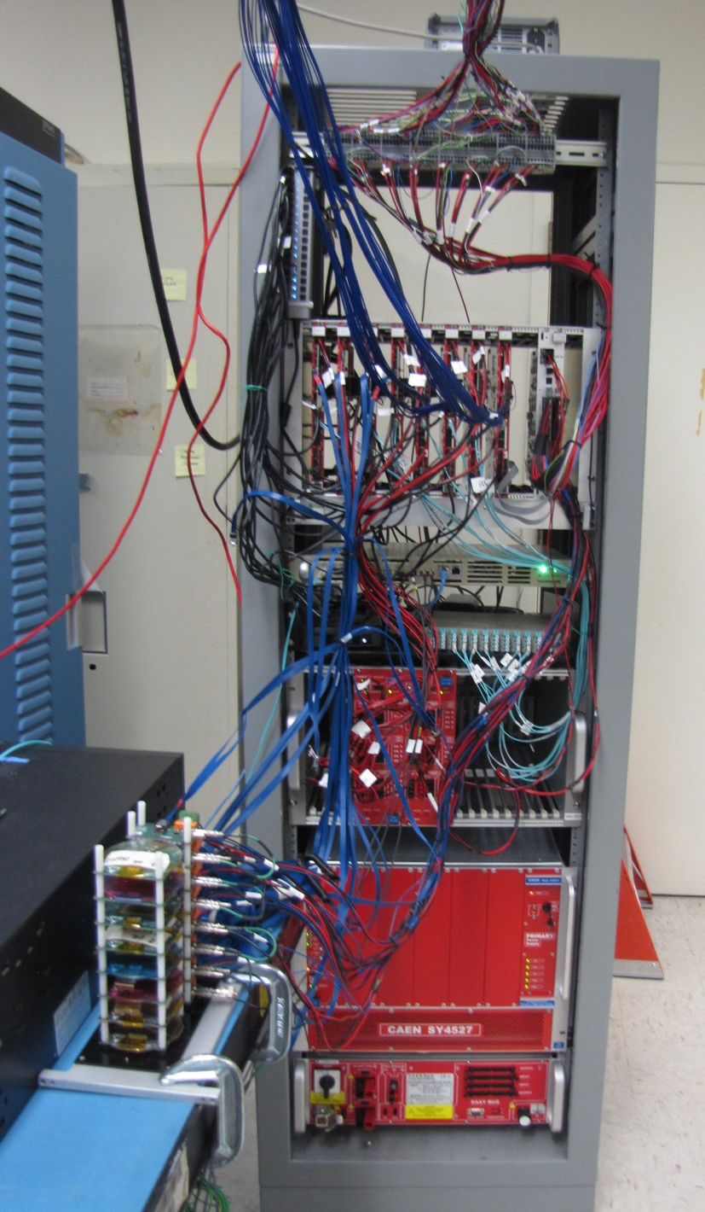
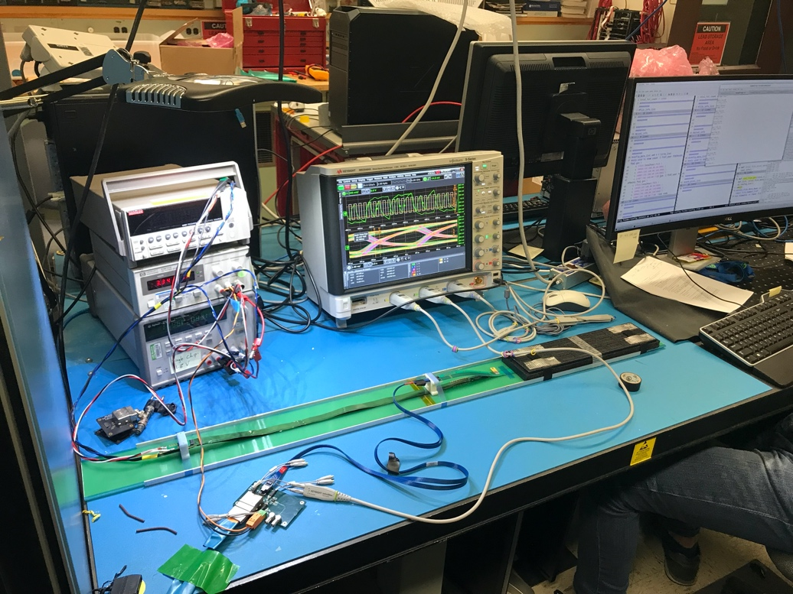
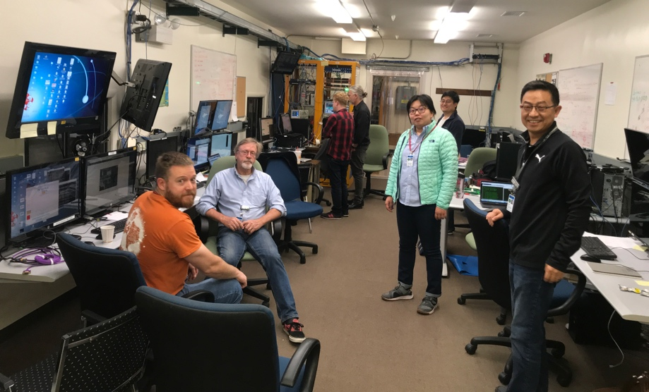
More good looking photos
8-chip/stave full readout &
control system @LANL
Add photos of people working on hardware, testing etc.
Testing production staves at LANL
Fermilab Test beam May 2019

