Slide 1
MVTX Status
Ming Liu
sPHENIX L2 Meeting
02/06/2020

Slide 2
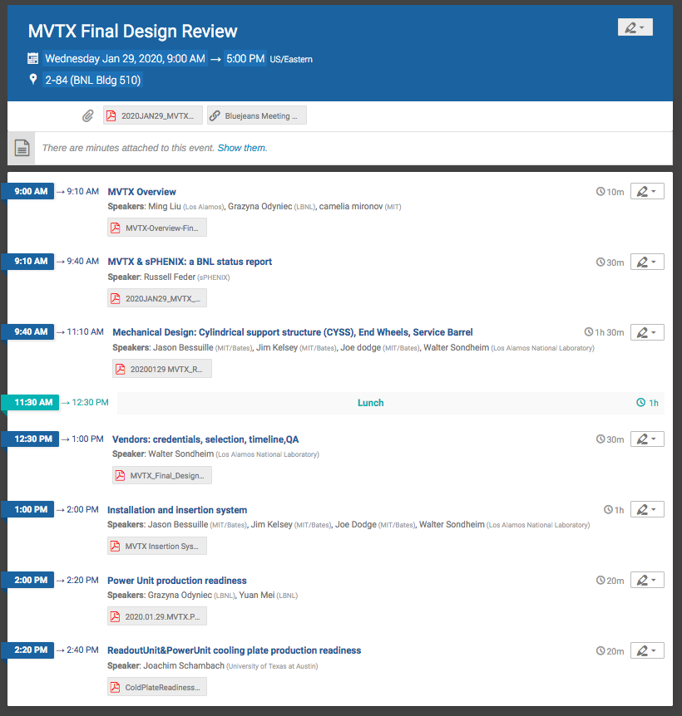
Progress and Status
Final Design Review 1/29/2020 at BNL
Reviewed:
Carbon structure design, test production and vendor selection
Installation & insertion
Power system production
Cooling plate production
Received positive report (Draft)
Follow up discussions among MVTX groups, carbon structure production in March 2020
Stave production at CERN
Next meeting, ~Feb. 13
On-going discussion about stave cooling tube replacement
Stave import paperwork in progress, LBNL/UTK/BNL
MVTX project fund being distributed
LANL, LBNL, MIT, UT-Austin

Slide 3
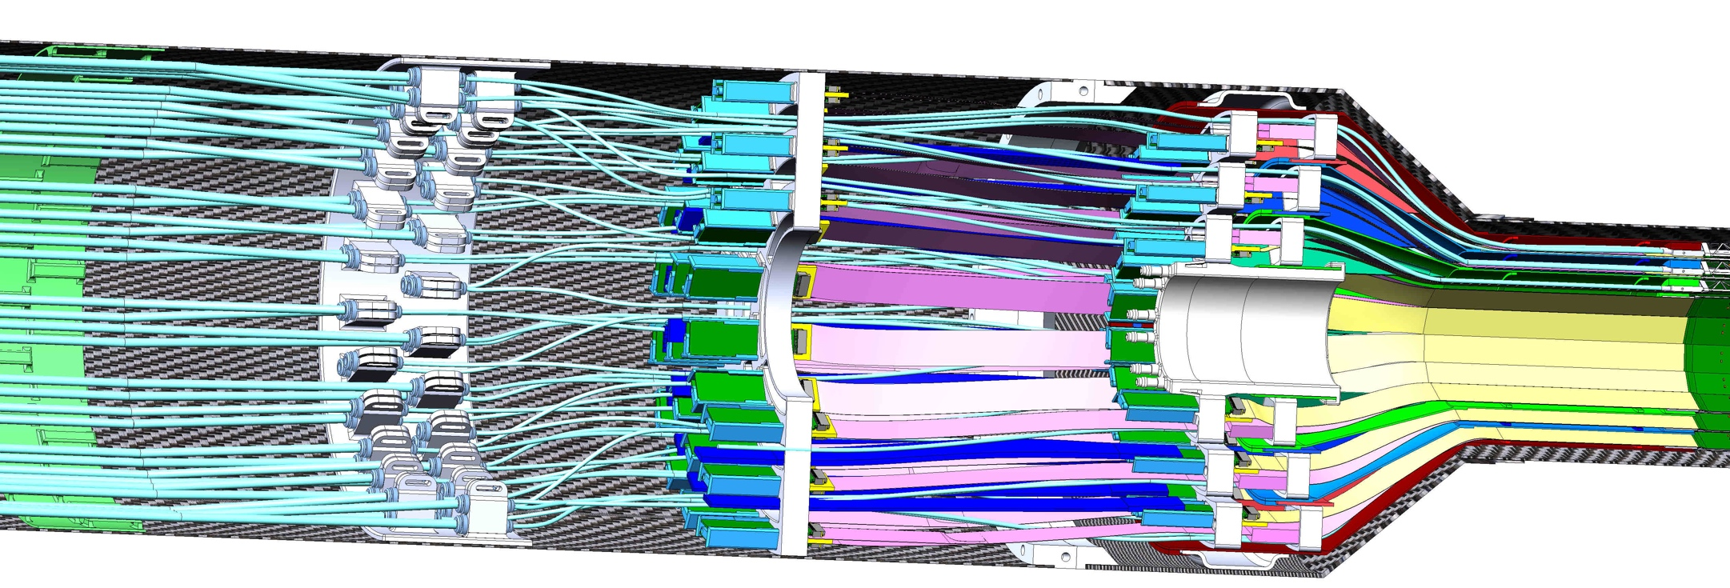
MVTX Stave Cooling Tube Extension Proposal, 02/04/2020
- The pre-built stave cooling tubes are 5~10cm short to fit the current MVTX service support design.
We propose to replace all the cooling tubing with 70cm ones (currently ~55cm)
CERN requests EU$10K to replace ~100 carbon frames
55cm tubes
(from ITS/IB design)
MVTX Stave on a transport plate
Cooling tubes
Signal connection
power connection
Proposed 70cm tubes
for MVTX

Slide 4
“Full Readout Chain” MVTX 8-stave Telescope Test Beam Run Planned: April – May at Fermilab
A complete readout chain 8-stave telescope of the MVTX detector
8-stave + 8-RU + 1-FELIX + 1GTM (mGTM?)
MVTX = 6 x (8-stave telescope)
RU firmware/software “synced” to a ITS recent version v0.5(11/2019),
FELIX firmware update next;
A new (derived from GTM) mGTM for MVTX to be developed by BNL
Provides 2x40.08MHz clock (synced to RHIC) for all FELIX/RU/ALPIDE
Same hardware, different firmware
All GTM mode-bit and header information available
Important for offline event alignment and cross check
JohnH, JoeM, JohnK, Ming at BNL, with Alex, Gerd, Yasser (remotely)

