Slide 1
MVTX Status Report
Ming Liu
LANL
1/9/2020
sPHENIX L2 Meeting

Slide 2
Budget Distribution
BNL has opened MVTX budget account
MVTX PMP has been approved and signed by BNL
Detailed budget for each institution done, 12/3/2019
Plan presented in July 2019 MVTX review
Paperwork submitted to BNL for fund transfer
SOW, detailed budget sheet and cover letter from each institute
LANL, LBNL, MIT, UT-A

Slide 3
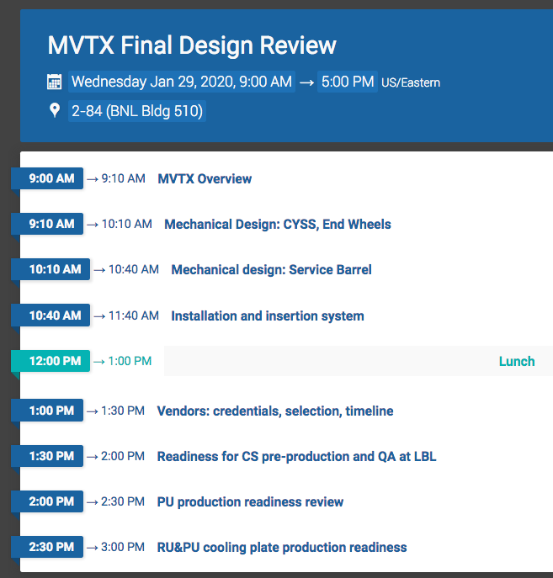
One-day MVTX Final Design Review Scheduled 1/29/2020 @BNL
Final review charge available tomorrow (Fri)
Focus on the mechanical design readiness for carbon structure production
Design
Pre-production
Vendor selection
Also production readiness
Power Units(PU)
Electronics RU and PU cooling plates
Draft agenda page: https://indico.bnl.gov/event/7165/

Slide 4
Stave Production at CERN
In good progress, on schedule
~10 HICs/month, used up all good chips in December
3 wafers delivered in mid December, 45 chips available now, expect 10 more chips
Next chips delivery expected in late January, 8 wafers,
~120 gold chips, good for 13 weeks of assembly, last wafers by April 2020
23 FPCs available for assembly
Plan
Resume HIC production in week 2 of 2020
Bond 4 HICs as soon as the bond lab available in January
1st set of 10~12 staves ready for shipping to LBNL in mid Feb
Are we ready? Shipping – a batch of ~10 staves or ~20?
Bi-weekly meeting with CERN
Last meeting, 12/19/2020
Next one, 1/16/2020

