Slide 1
MVXT Status and Plan
Camelia Mironov, Grazyna Odyniec, Ming Liu
sPHENIX L2 Meeting
11/05/2020

Slide 2
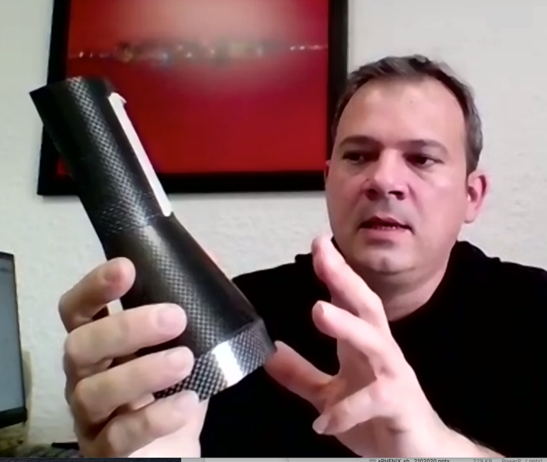
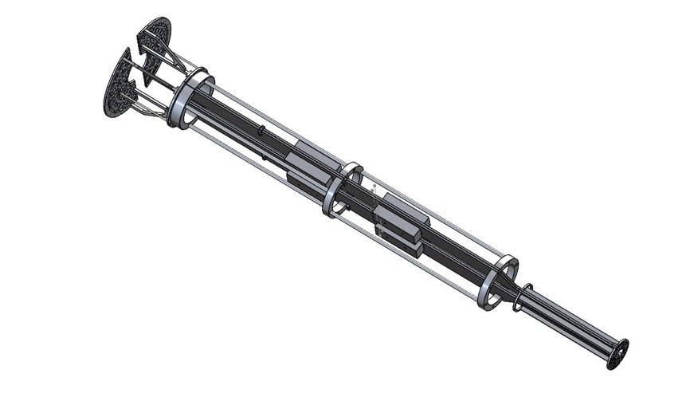
Project Status & Plan
Detector assemble fixture desiged and reviewed - MIT, LANL, LBNL
Mechanical system
  Carbon fiber production started at WorkShape (Fr.)
    1st test article by 11/2020, Layer-0 EW, in progress
    Complete full production in ~4/2021
    1st half detector available early, ~3/2021
  MVTX insertion mockup designed, MIT/LANL
  Detector assembly fixture designed and reviewed
Readout and control
  Readout Unit Test in progress at ORNL
  FELIX AMD server setup in progress at LANL
  Slow control, LLA (Low-Level Arbitration) interface in progress
  mGTM development - doc circulated
Stave production and transportation
  31+ Gold staves ready for shipping
  Transportation case tested
FY21 funding expected ~Jan 2021
  Early funding needed for ORNL and LANL, in progress
  Okey for MIT and LBNL for next a few months
ITS commissioning remote shift participation
  Good opportunity to help us for MVTX commissioning later
1st prototype L0 EW fabricated,
next version in progress
X-wing support structure,
submitted for quote/fab.
MVTX mockup ready
for production

Slide 3
Stave Transportation Test and Plan
Reproduced vibration/shocking during the LBNL->CERN transportation
Wire bond pull test before and after the “handling”
Electrical test - signal, noise level etc., no change observed
Shipping Plan: total 84 staves
1) 4 staves (1 Silver + 3 Gold/short pipe) for the first shipment
- higher risk, but better statistics for evaluation and checking
-- or 2 staves (1 Silver + 1 Gold)?
2) ~10 staves per trip, ~4 trips
Stave transportation case
Wire bonding pull test: good

Slide 4
Issues and Concerns
Pre-COVID19 Schedule
Schedule delay due to COVID-19
  Carbon structure production and test/QA
    3~4 months delay in detector design and prototyping
    FDR(7/2020) postponed to ~Dec. 15, 2020
  Start full production ~ Jan. 2021
    1st half CF(EW+CYSS+SB) available in ~March 2021
    2nd half CF available in April
Half-detector assembly at LBNL
  Test fitting ~March 2021
  Half-detector assembly review, ~7/2021
  Complete the 2nd Half-detector by 12/2021
  Lab access at LBNL, schedule etc.
Stave transportation plan changed
  Commercial option, first test shipping soon
  Minimal impact on assembly schedule
Tight schedule to meet the installation dates
Funding for FY21
  Need to use contingency reserve for engineering work
    MIT and LANL – design, mock-up, assembly fixtures
  Early funding for ORNL and LANL
Today
Assembly start

Slide 5
backup

Slide 6
Milestones in PMP, 12/2019
(targeted schedule + 2 months/contingency)
Now ~ 12/15/2020
CF structures:
- 1st half: 3/2021
- 2nd half: 4/2021
Assembly testing starts ~3/2021
Half-Detector assembly review, ~July 2021
On track … to meet the final completion milestones

Slide 7
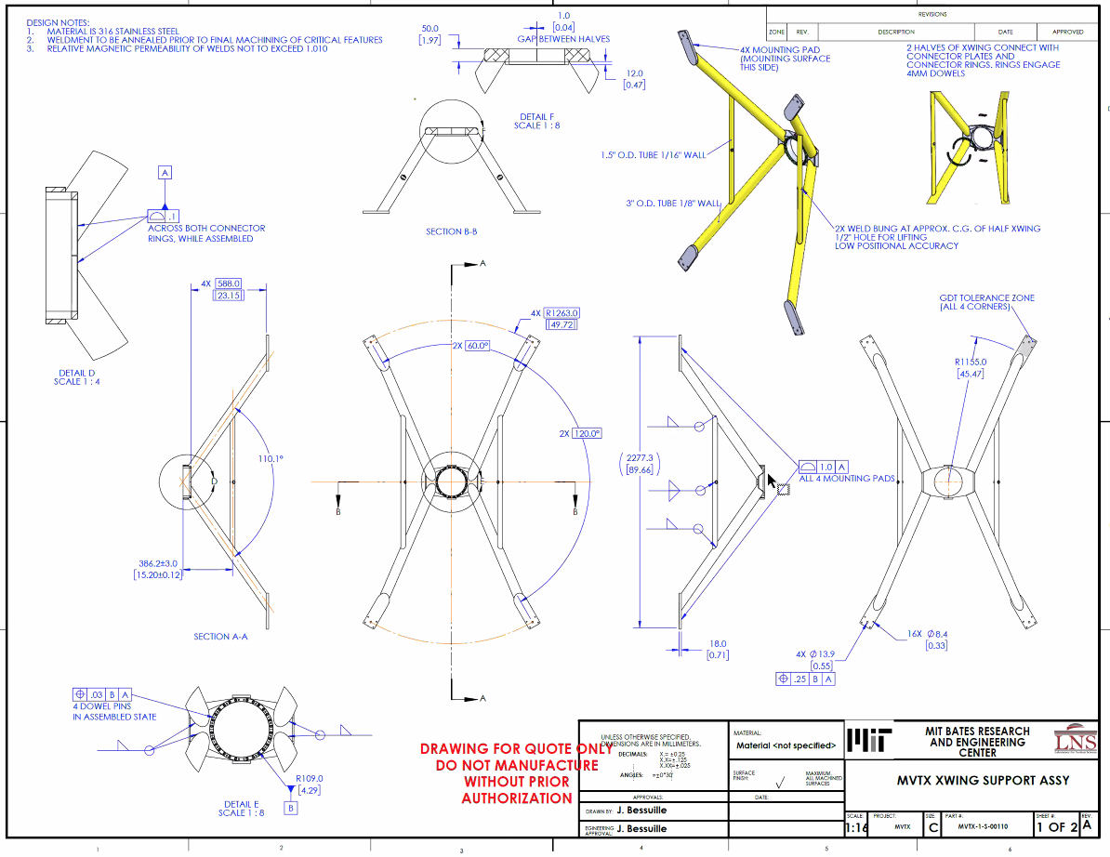
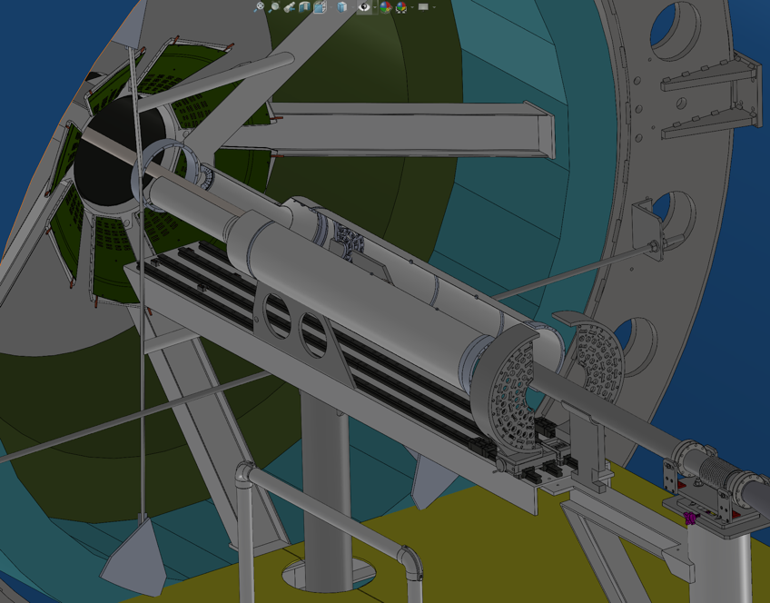
1-piece EW: to be replaced with Al,
to minimize “springb ack”

Slide 8
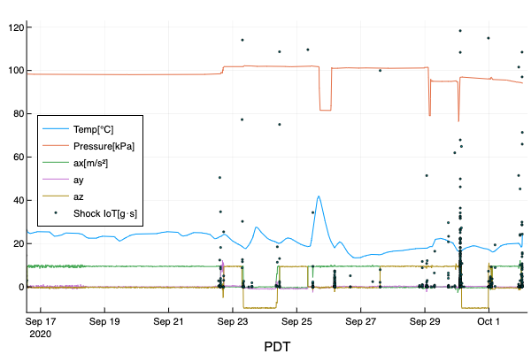
Transportation Case Test: LBNL -> CERN
Delivered |  | GENEVE CH | 10/01/2020 | 11:30
Arrived at Terminal 3rd Leg |  | GENEVA ES | 09/30/2020 | 11:35
Confirmed on Board 3rd Leg |  | MADRID ES | 09/30/2020 | 09:52
Arrived at Terminal 2nd Leg |  | GENEVA GB | 09/27/2020 | 14:00
Confirmed on Board 2nd Leg |  | LONDON HEATHROW GB | 09/27/2020 | 10:30
Arrived at Terminal |  | LONDON HEATHROW US | 09/26/2020 | 10:55
Confirmed on Board Carrier |  | SAN FRANCISCO, CA US | 09/25/2020 | 16:55
Booked with Carrier |  |  | 09/22/2020 | 15:50
Picked up |  | BERKELEY, CA US | 09/22/2020 | 15:11
Dispatched |  |  | 09/22/2020 | 14:42
Order Created |  |  | 09/22/2020 | 14:39

Slide 9
Stave Production at CERN
31 gold staves ready for shipping
Still some issues with assembly machine
  Waiting for new parts, this week
    IBS engineer can’t travel to CERN
  Resume HICs production next week
Evaluating transportation risks
  More tests at CERN this week
    Vibration/shocks
    Wire bond pull-test
  Temperature variation during transportation
New COVID-19 policy at CERN
  Reduce on-site work, from 10/26
Stave test/assembly @LBNL
  1st batch (~10 staves) in ~Nov/Dec.
  50 staves available ~Feb 2021
  To be ready for assembly work in ~3/2021

