Slide 1
MVTX Status and Plan
Camelia, Grazyna and Ming
09/24/2020
sPHENIX L2 Project Meeting

Slide 2
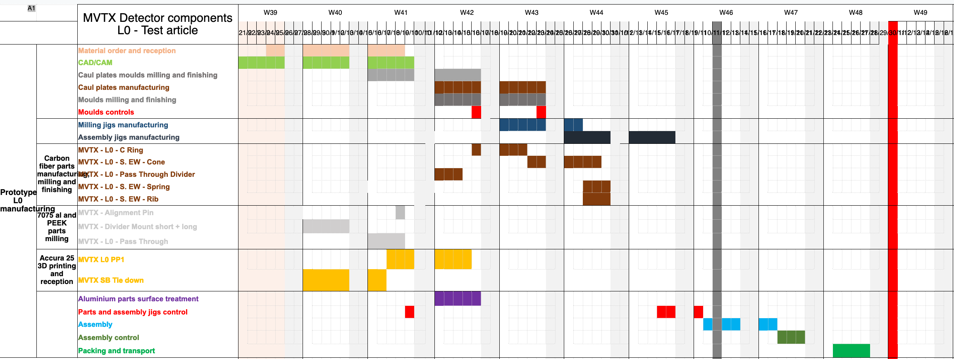
Project Status & Plan (I)
EW,
CYSS
Mechanical design and vendor selection
WorkShape (France) won the competition to fabricate the carbon structures
3 vendors responded, including LBNL and one commercial company in CA
Experience, cost and schedule - within MVTX projected budget
First test article (one layer of EndWheels) by the end of November this year
Setup FAB account at MIT, ready to make the first payment
30% of the first test article, ~EU$15K
CF Production Readiness Review planned
Early December, 2020
Full CF production complete ~April 2021 (15~17 weeks)
Cooling system designed, v2
Piping & Instrumentation Diagram sent to BNL this week for OK/discussion before purchases
Cooling plant tests at BNL to decide on the needed customization
Insertion system design and mockup in progress
Service Barrel
First test article schedule & milestones:
10 wks, already started 9/21/2020
MVTX insertion &
support system

Slide 3
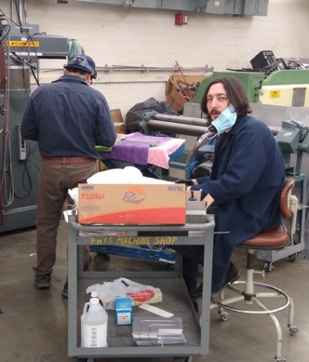
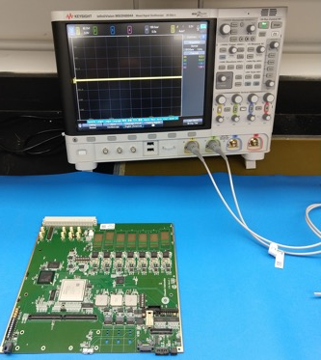
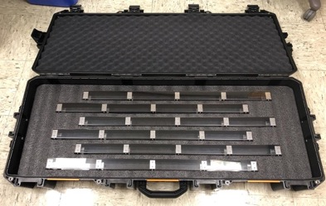
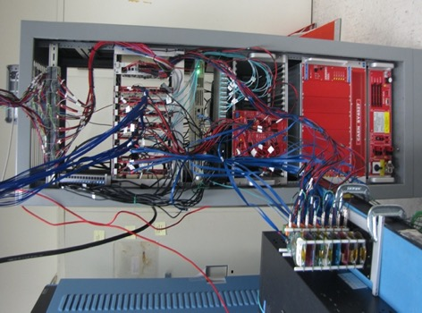
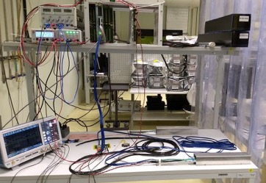
Project Status & Plan (II)
Readout and control electronics production
All 30 power boards assembled and tested at LBNL
60 RUs and cooling plates produced and arrived at ORNL for testing
Testbench setup in progress
All testing done by the end of November
RU and FELIX firmware/software updated
Full readout chain system test in progress
LANL – restart lab work, paperwork submitted for COVID-19 approval
ORNL - will receive one FELIX card soon from BNL
SamTec readout cable designed and tested 11.4m, final length TBD, pending final sPHENIX cable route layout plan
Stave production and transportation
Good progress at CERN, 25+ golden staves produced
>50% of MVTX (48 staves), finish all ~Jan/Feb 2021
Transportation case produced, stave QA test bench under preparation at LBNL
Cooling plate production at UT-Austin Machine shop
RU Test @ORNL
Stave transportation
case produced @LBNL
8-chip/stave full readout &
control system @LANL
Stave test station @ LBNL

Slide 4
 | STAVE-production summary table
IBSTAVE ID | HIC assembly | Ins. after glue | Bonding | Pull test (>=2 lifts + F <7g) | Ins. after bonding | HIC PWR test | Qualification test | Threshold cluster | HIC Matrix | HIC DTU | HIC+SF+C -> Stave | Stave PWR test | Stave test | STAVE metrology | Stave PWR test (long PWR extn.) | STAVE final test (PT100)
TOTAL | 53 | 53 | 50 |  | 50 | 49 | 40 |  |  |  | 32 | 32 | 32 | 25 | 26 | 25
A201 (326) | 1 | 1 | 1 | 1 | 1 | 1 | 1 | 1 | GOLD | OK | 1 | 1 | 1 | 1 | 1 | 1
A202* | 1 | 1 | 1 | 0 | 1 | 1 | 0 | ?? | PARTIAL | OK
A203 (144) | 1 | 1 | 1 | 0 | 1 | 1 | 1 | 0 | GOLD | OK | 1 | 1 | 1 | 1 | 1 | 1
A204 (158) | 1 | 1 | 1 | 1 | 1 | 1 | 1 | 0 | GOLD | OK | 1 | 1 | 1 | 1 | 1 | 1
A205 (167) | 1 | 1 | 1 | 4 | 1 | 1 | 1 | 0 | GOLD | CAN | 1 | 1 | 1 | 1 | 1 | 1
A206 (204) | 1 | 1 | 1 | 3 | 1 | 1 | 1 | 2 | GOLD | CAN | 1 | 1 | 1 | 1 | 1 | 1
B201 (352) | 1 | 1 | 1 | 0 | 1 | 1 | 1 | 0 | GOLD | CAN | 1 | 1 | 1 | 1 | 1 | 1
B202* | 1 | 1 | 1 | 0 | 1 | 1 | 0 |  | Broken
B203 (114) | 1 | 1 | 1 | 1 | 1 | 1 | 1 | 0 | GOLD | CAN | 1 | 1 | 1 | 1 | 1 | 1
B204 (116) | 1 | 1 | 1 | 0 | 1 | 1 | 1 | 1 | SILVER | CAN | 1 | 1 | 1 |  | 1
B205 (115) | 1 | 1 | 1 | 2 | 1 | 1 | 1 | 0 | GOLD | CAN | 1 | 1 | 1 | 1 | 1 | 1
B206 (295) | 1 | 1 | 1 | 2 | 1 | 1 | 1 | 0 | GOLD | CAN | 1 | 1 | 1 | 1 | 1 | 1
F201* | 1 | 1 | 1 | 1 | 1 | 1 | 0 | ?? | PARTIAL | OK
F202 (230) | 1 | 1 | 1 | 3 | 1 | 1 | 1 | 0 | GOLD | OK | 1 | 1 | 1 | 1 | 1 | 1
F204 | 1 | 1 | 1 | 5 | 1 | 1 | 1 | 2 | GOLD | CAN
G202 (234) | 1 | 1 | 1 | 0 | 1 | 1 | 1 | 1 | GOLD | OK | 1 | 1 | 1 | 1 | 1 | 1
G203 | 1 | 1 | 1 | 1 | 1 | 1 | 1 | 1 | GOLD | CAN
F203* | dummy
H202 (294) | 1 | 1 | 1 | 0 | 1 | 1 | 1 | 0 | GOLD | OK | 1 | 1 | 1 | 1 | 1 | 1
H203 (302) | 1 | 1 | 1 | 0 | 1 | 1 | 1 | 0 | GOLD | OK | 1 | 1 | 1 | 1 | 1 | 1
H204 (354) | 1 | 1 | 1 | 0 | 1 | 1 | 1 | 0 | GOLD | OK | 1 | 1 | 1 | 1 | 1 | 1
H206 | 1 | 1 | 1 | 0 | 1 | 1 | 1 | ?? | PARTIAL | OK
E204 (110) | 1 | 1 | 1 | 0 | 1 | 1 | 1 | 1 | GOLD | CAN | 1 | 1 | 1 | 1 | 1 | 1
E201* | 1 | 1 | 1 | 0 | 1 | 1 | 0 | 3 | PARTIAL | CAN
E202 | 1 | 1 | 1 | 1 | 1 | 1 | 1 | 1 | GOLD | CAN (bad driver)
E206 (101) | 1 | 1 | 1 | 0 | 1 | 1 | 1 | 1 | GOLD | OK | 1 | 1 | 1 | 1 | 1 | 1
H205 | 1 | 1 | 1 | 0 | 1 | 1 | 1 | 1 | SILVER | OK
I202 (175) | 1 | 1 | 1 | 0 | 1 | 1 | 1 | 0 | GOLD | OK | 1 | 1 | 1 | 1 | 1 | 1
I203 (187) | 1 | 1 | 1 | 0 | 1 | 1 | 1 | 0 | GOLD | CAN | 1 | 1 | 1 | 1 | 1 | 1
I204* | 1 | 1 | 1 | 0 | 1 | 1 | 0 | 0 | PARTIAL | OK
I205 (266) | 1 | 1 | 1 | 0 | 1 | 1 | 1 | 0 | GOLD | OK | 1 | 1 | 1 | 1 | 1 | 1
J201* | 1 | 1 | 1 | 0 | 1 | 1 | 0 | ?? | PARTIAL | OK
J202 (207) | 1 | 1 | 1 | 0 | 1 | 1 | 1 | 0 | GOLD | CAN | 1 | 1 | 1 | 1 | 1 | 1
J203 (245) 345 right | 1 | 1 | 1 | 0 | 1 | 1 | 1 | 0 | GOLD | CAN | 1 | 1 | 1 | 1 | 1 | 1
J204 (252) | 1 | 1 | 1 | 0 | 1 | 1 | 1 | 0 | GOLD | OK | 1 | 1 | 1 | 1 | 1 | 1
J206 (260) | 1 | 1 | 1 | 0 | 1 | 1 | 1 | 0 | GOLD | OK | 1 | 1 | 1 | 1 | 1 | 1
K202 (122) | 1 | 1 | 1 | 0 | 1 | 1 | 1 | 1 | GOLD | OK | 1 | 1 | 1 | 1 | 1 | 1
K203 (125) | 1 | 1 | 1 | 0 | 1 | 1 | 1 | 0 | GOLD | OK | 1 | 1 | 1 | 1 | 1 | 1
K204 (129) | 1 | 1 | 1 | 0 | 1 | 1 | 1 | 0 | GOLD | CAN | 1 | 1 | 1
K205 (128) | 1 | 1 | 1 | 0 | 1 | 1 | 1 | 1 | GOLD | CAN | 1 | 1 | 1
K206 | 1 | 1 | 1 | 0 | 1 | 1 | 1 | 0 | GOLD | CAN
L202 (130) | 1 | 1 | 1 | 0 | 1 | 1 | 1 | 0 | GOLD | CAN | 1 | 1 | 1
L203 (139) | 1 | 1 | 1 | 0 | 1 | 1 | 1 | 0 | GOLD | CAN | 1 | 1 | 1
L204 (127) | 1 | 1 | 1 | 0 | 1 | 1 | 1 | 0 | GOLD | CAN | 1 | 1 | 1
L205 (136) | 1 | 1 | 1 | 0 | 1 | 1 | 1 | 0 | GOLD | OK | 1 | 1 | 1
J205 | 1 | 1 | 1 | 0 | 1 | 1 | 0 | ?? | PARTIAL | CAN
I201 | 1 | 1 | 1 | 0 | 1 | 1 | 0 | 0 | PARTIAL | CAN
L206 | 1 | 1 | 0
L201 | 1 | 1 | 1 | 0 | 1 | 1 | 1 | 1 | GOLD | CAN
S201 | 1 | 1 | 1 | 0 | 1 | 1 | 1 | 0 | GOLD | CAN
S202 | 1 | 1 | 1 | 0 | 1 | 1
S203 | 1 | 1
S204 | 1 | 1 | 1 | 0 | 1
S205 | 1 | 1
Reported at 09/17/2020
Stave production meeting
- Next meeting in 3 weeks
25 golden staves ready for shipping;
2nd batch of 6 staves ready for metrology, and final tests in next week or two
Plan at CERN:
Continue ~10staves/month, finish 84 staves ~ Jan 2021;
minimal impact on detector assembly work at LBNL (CF schedule driven)
CERN can hold ~40 staves for
~5 weeks;
- We need to get them to US soon, working with CERN to test commercial transportation options

Slide 5
Issues and Concerns
Pre-COVID19 Schedule
Schedule delays due to COVID-19
Carbon structure production and test/QA
3~4 months delay in detector design and prototyping
FDR(7/2020) postponed to ~Dec. 2020
Detector assembly work
Lab access at LBNL, schedule etc.
Stave transportation plan changed
Commercial options
Minimal impact on assembly schedule
Tight schedule for the installation, May 2022
Funding for FY21
Need to use some contingency reserve for engineering work
MIT and LANL
ORNL – to support RU and other electronics test work
Previously assigned to UT-A, under Jo’s responsibility
Draft SOW ready for sPHENIX review
Today

