Slide 1
MVTX Status and Plan
Camelia, Grazyna and Ming
09/24/2020
sPHENIX L2 Project Meeting

Slide 2
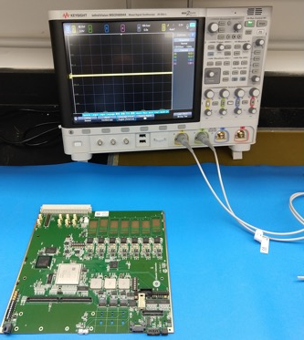
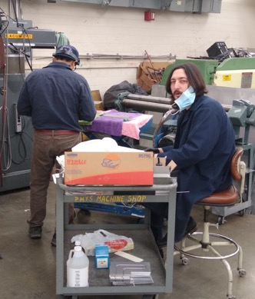
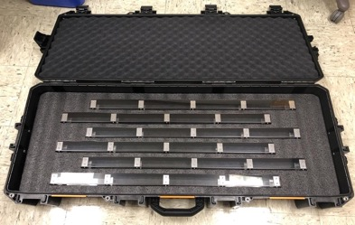
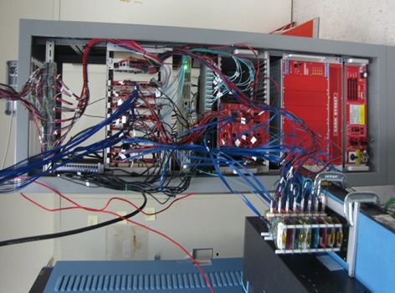
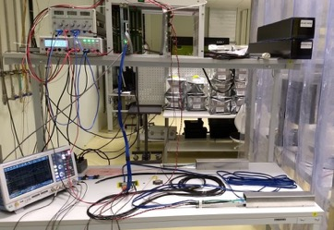
Project Status & Plan
Mechanical design and vendor selection
  WorkShape (France) won the competition to fabricate the carbon structures
    3 vendors responded, including LBNL and one commercial company in CA
    Experience, cost and schedule - within MVTX projected budget
    First test article (one layer of EndWheels) by the end of November this year
    Setup FAB account at MIT, ready to make the first payment (~30% of the first article, ~EU$15K)
  Production Readiness Review planned, ~early December, 2020
    Full production complete in April 2021 (15~17 weeks)
  Cooling system designed, v2
    Piping & Instru. Diagram sent to BNL this week for OK/discussion before purchases
    Cooling plant tests at BNL to decide on the needed customization
  Insertion system design and mockup in progress
Readout and control electronics production
  All 30 power boards assembled and tested at LBNL
  60 RUs and cooling plates produced and arrived at ORNL for testing
    Testbench setup in progress, all testing done by the end of November at ORNL
  RU and FELIX firmware/software updated
  Full readout chain system test
    LANL – restart lab work, paperwork submitted for COVID-19 approval
    ORNL - will receive one FELIX card soon from BNL
Stave production and transportation
  Good progress at CERN, 25+ produced (50% MVTX), complete ~Jan 2021
  Transport case produced, stave QA test bench under preparation at LBNL
RU Test @ORNL
Cooling plate production at UT-Austin Machine shop
Stave transportation
case produced @LBNL
8-chip/stave full readout &
control system @LANL
Stave test station @ LBNL

Slide 3
 | STAVE-production summary table
IBSTAVE ID | HIC assembly | Ins. after glue | Bonding | Pull test (>=2 lifts + F <7g) | Ins. after bonding | HIC PWR test | Qualification test | Threshold cluster | HIC Matrix | HIC DTU | HIC+SF+C -> Stave | Stave PWR test | Stave test | STAVE metrology | Stave PWR test (long PWR extn.) | STAVE final test (PT100)
TOTAL | 53 | 53 | 50 |  | 50 | 49 | 40 |  |  |  | 32 | 32 | 32 | 25 | 26 | 25
A201 (326) | 1 | 1 | 1 | 1 | 1 | 1 | 1 | 1 | GOLD | OK | 1 | 1 | 1 | 1 | 1 | 1
A202* | 1 | 1 | 1 | 0 | 1 | 1 | 0 | ?? | PARTIAL | OK
A203 (144) | 1 | 1 | 1 | 0 | 1 | 1 | 1 | 0 | GOLD | OK | 1 | 1 | 1 | 1 | 1 | 1
A204 (158) | 1 | 1 | 1 | 1 | 1 | 1 | 1 | 0 | GOLD | OK | 1 | 1 | 1 | 1 | 1 | 1
A205 (167) | 1 | 1 | 1 | 4 | 1 | 1 | 1 | 0 | GOLD | CAN | 1 | 1 | 1 | 1 | 1 | 1
A206 (204) | 1 | 1 | 1 | 3 | 1 | 1 | 1 | 2 | GOLD | CAN | 1 | 1 | 1 | 1 | 1 | 1
B201 (352) | 1 | 1 | 1 | 0 | 1 | 1 | 1 | 0 | GOLD | CAN | 1 | 1 | 1 | 1 | 1 | 1
B202* | 1 | 1 | 1 | 0 | 1 | 1 | 0 |  | Broken
B203 (114) | 1 | 1 | 1 | 1 | 1 | 1 | 1 | 0 | GOLD | CAN | 1 | 1 | 1 | 1 | 1 | 1
B204 (116) | 1 | 1 | 1 | 0 | 1 | 1 | 1 | 1 | SILVER | CAN | 1 | 1 | 1 |  | 1
B205 (115) | 1 | 1 | 1 | 2 | 1 | 1 | 1 | 0 | GOLD | CAN | 1 | 1 | 1 | 1 | 1 | 1
B206 (295) | 1 | 1 | 1 | 2 | 1 | 1 | 1 | 0 | GOLD | CAN | 1 | 1 | 1 | 1 | 1 | 1
F201* | 1 | 1 | 1 | 1 | 1 | 1 | 0 | ?? | PARTIAL | OK
F202 (230) | 1 | 1 | 1 | 3 | 1 | 1 | 1 | 0 | GOLD | OK | 1 | 1 | 1 | 1 | 1 | 1
F204 | 1 | 1 | 1 | 5 | 1 | 1 | 1 | 2 | GOLD | CAN
G202 (234) | 1 | 1 | 1 | 0 | 1 | 1 | 1 | 1 | GOLD | OK | 1 | 1 | 1 | 1 | 1 | 1
G203 | 1 | 1 | 1 | 1 | 1 | 1 | 1 | 1 | GOLD | CAN
F203* | dummy
H202 (294) | 1 | 1 | 1 | 0 | 1 | 1 | 1 | 0 | GOLD | OK | 1 | 1 | 1 | 1 | 1 | 1
H203 (302) | 1 | 1 | 1 | 0 | 1 | 1 | 1 | 0 | GOLD | OK | 1 | 1 | 1 | 1 | 1 | 1
H204 (354) | 1 | 1 | 1 | 0 | 1 | 1 | 1 | 0 | GOLD | OK | 1 | 1 | 1 | 1 | 1 | 1
H206 | 1 | 1 | 1 | 0 | 1 | 1 | 1 | ?? | PARTIAL | OK
E204 (110) | 1 | 1 | 1 | 0 | 1 | 1 | 1 | 1 | GOLD | CAN | 1 | 1 | 1 | 1 | 1 | 1
E201* | 1 | 1 | 1 | 0 | 1 | 1 | 0 | 3 | PARTIAL | CAN
E202 | 1 | 1 | 1 | 1 | 1 | 1 | 1 | 1 | GOLD | CAN (bad driver)
E206 (101) | 1 | 1 | 1 | 0 | 1 | 1 | 1 | 1 | GOLD | OK | 1 | 1 | 1 | 1 | 1 | 1
H205 | 1 | 1 | 1 | 0 | 1 | 1 | 1 | 1 | SILVER | OK
I202 (175) | 1 | 1 | 1 | 0 | 1 | 1 | 1 | 0 | GOLD | OK | 1 | 1 | 1 | 1 | 1 | 1
I203 (187) | 1 | 1 | 1 | 0 | 1 | 1 | 1 | 0 | GOLD | CAN | 1 | 1 | 1 | 1 | 1 | 1
I204* | 1 | 1 | 1 | 0 | 1 | 1 | 0 | 0 | PARTIAL | OK
I205 (266) | 1 | 1 | 1 | 0 | 1 | 1 | 1 | 0 | GOLD | OK | 1 | 1 | 1 | 1 | 1 | 1
J201* | 1 | 1 | 1 | 0 | 1 | 1 | 0 | ?? | PARTIAL | OK
J202 (207) | 1 | 1 | 1 | 0 | 1 | 1 | 1 | 0 | GOLD | CAN | 1 | 1 | 1 | 1 | 1 | 1
J203 (245) 345 right | 1 | 1 | 1 | 0 | 1 | 1 | 1 | 0 | GOLD | CAN | 1 | 1 | 1 | 1 | 1 | 1
J204 (252) | 1 | 1 | 1 | 0 | 1 | 1 | 1 | 0 | GOLD | OK | 1 | 1 | 1 | 1 | 1 | 1
J206 (260) | 1 | 1 | 1 | 0 | 1 | 1 | 1 | 0 | GOLD | OK | 1 | 1 | 1 | 1 | 1 | 1
K202 (122) | 1 | 1 | 1 | 0 | 1 | 1 | 1 | 1 | GOLD | OK | 1 | 1 | 1 | 1 | 1 | 1
K203 (125) | 1 | 1 | 1 | 0 | 1 | 1 | 1 | 0 | GOLD | OK | 1 | 1 | 1 | 1 | 1 | 1
K204 (129) | 1 | 1 | 1 | 0 | 1 | 1 | 1 | 0 | GOLD | CAN | 1 | 1 | 1
K205 (128) | 1 | 1 | 1 | 0 | 1 | 1 | 1 | 1 | GOLD | CAN | 1 | 1 | 1
K206 | 1 | 1 | 1 | 0 | 1 | 1 | 1 | 0 | GOLD | CAN
L202 (130) | 1 | 1 | 1 | 0 | 1 | 1 | 1 | 0 | GOLD | CAN | 1 | 1 | 1
L203 (139) | 1 | 1 | 1 | 0 | 1 | 1 | 1 | 0 | GOLD | CAN | 1 | 1 | 1
L204 (127) | 1 | 1 | 1 | 0 | 1 | 1 | 1 | 0 | GOLD | CAN | 1 | 1 | 1
L205 (136) | 1 | 1 | 1 | 0 | 1 | 1 | 1 | 0 | GOLD | OK | 1 | 1 | 1
J205 | 1 | 1 | 1 | 0 | 1 | 1 | 0 | ?? | PARTIAL | CAN
I201 | 1 | 1 | 1 | 0 | 1 | 1 | 0 | 0 | PARTIAL | CAN
L206 | 1 | 1 | 0
L201 | 1 | 1 | 1 | 0 | 1 | 1 | 1 | 1 | GOLD | CAN
S201 | 1 | 1 | 1 | 0 | 1 | 1 | 1 | 0 | GOLD | CAN
S202 | 1 | 1 | 1 | 0 | 1 | 1
S203 | 1 | 1
S204 | 1 | 1 | 1 | 0 | 1
S205 | 1 | 1
Reported at 09/17/2020
Stave production meeting
- Next meeting in 3 weeks
25 golden staves ready for shipping;
2nd batch of 6 staves ready for metrology, and final tests in next week or two
Plan at CERN:
- Continue ~10staves/month, finish 84 staves ~ Jan 2021; expect no impact on detector assembly work at LBNL
CERN can hold ~40 staves for ~5 weeks;
- We need to get them to US soon, working with CERN to test commercial transportation options

Slide 4
Issues and Concerns
Pre-COVID19 Schedule
Schedule delays due to COVID-19
  Carbon structure production and test/QA
    3~4 months delay in detector design and prototyping
    FDR(7/2020) postponed to ~Dec. 2020
  Detector assembly work
    Lab access at LBNL, schedule etc.
  Stave transportation plan change
    Commercial option, expect no impact on assembly
  Tight schedule for the installation, May 2022
Funding for FY21
  Need to use some contingency reserve for engineering work
    MIT and LANL
  ORNL – to support RU and other electronics test work
    Previously assigned to UT-A, under Jo’s responsibility
    Draft SOW ready for review
Today

