Slide 1
MVTX Status and Plan
Camelia, Grazyna and Ming
09/22/2020
sPHENIX L2 Project Meeting

Slide 2
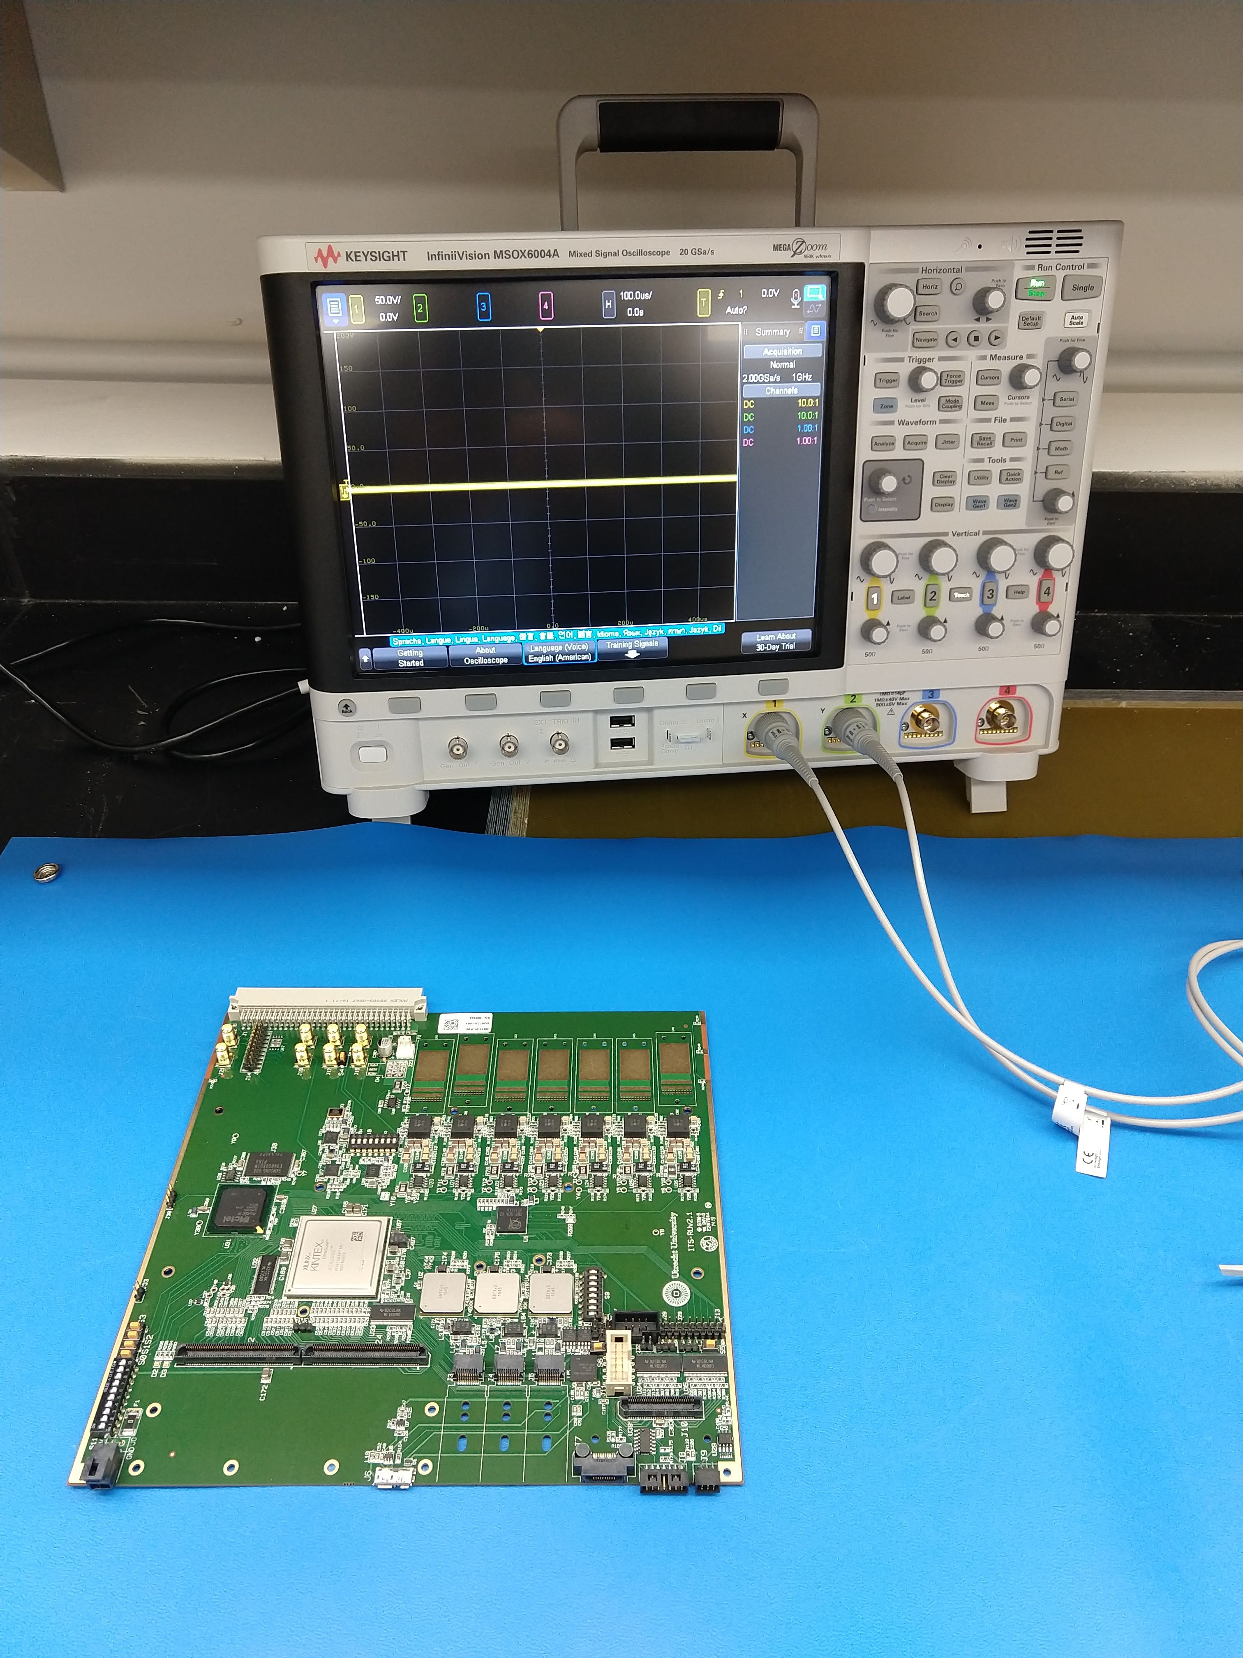
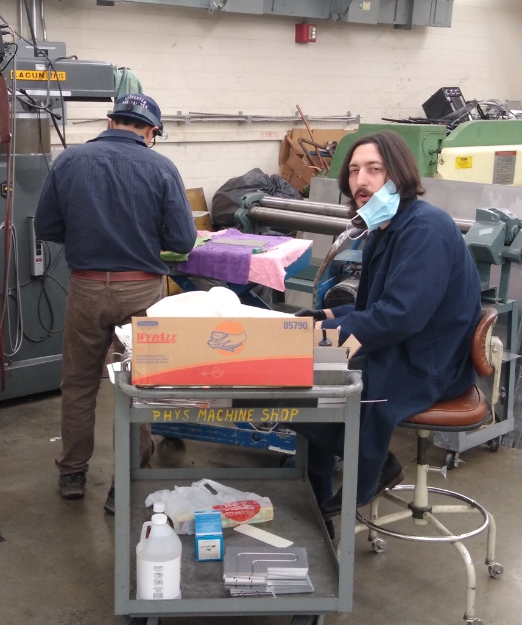
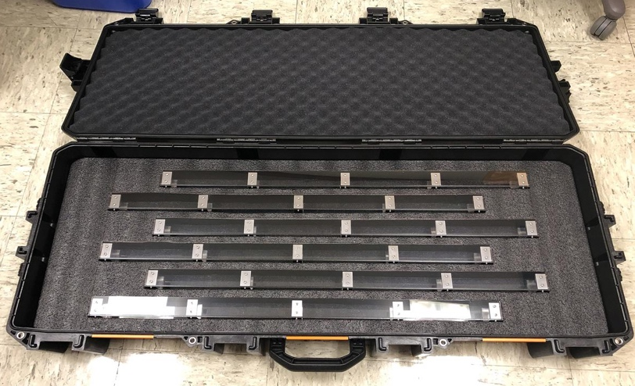
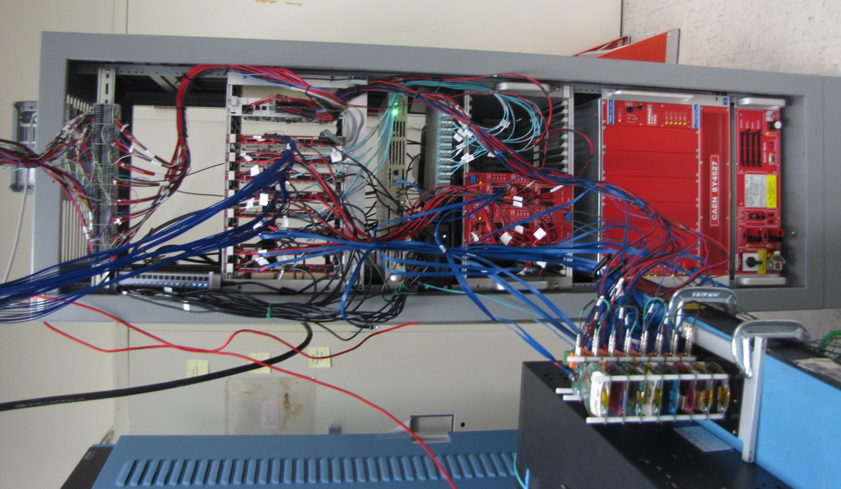
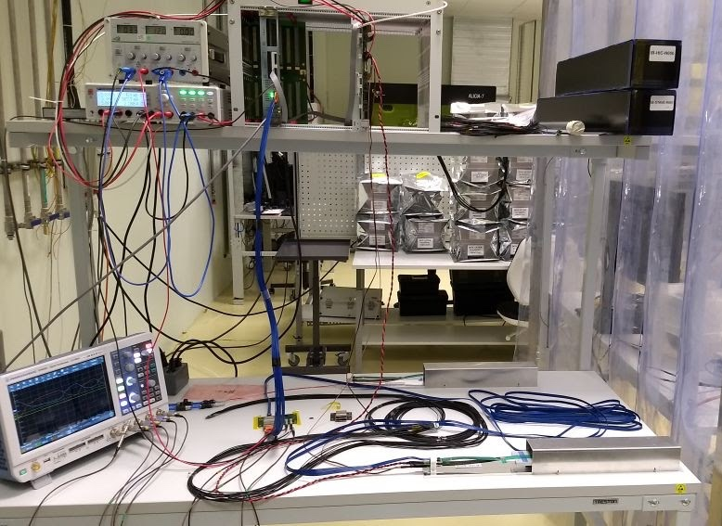
Project Status & Plan
Mechanical design and vendor selection
WorkShape won the competition to fabricate the carbon structures
3 vendors responded, including LBNL and one commercial company in CA
Experience, cost and schedule - within MVTX projected budget
First test article (one layer of EndWheels) by the end of November this year
Production Readiness Review planned, ~early December, 2020
Full production complete by April 2021 (15~17 weeks)
Cooling system designed, v2
Performance test at BNL planned
Insertion system design and mockup in progress
Readout and control electronics production
all 30 power boards assembled and tested at LBNL
60 RUs and cooling plates produced and arrived at ORNL for testing
Testbench setup in progress, all testing done by the end of November at ORNL
RU and FELIX firmware/software updated
Full readout chain system test
LANL – restart lab work, paperwork submitted for COVID-19 approval
ORNL - will receive one FELIX card soon from BNL
Stave production and transportation
Good progress at CERN, 25+ produced
Stave QA test bench under preparation at LBNL
RU @ORNL
Cooling plate production at UT-Austin Machine shop
Stave transportation
case produced @LBNL
8-chip/stave full readout &
control system @LANL
Stave test station @ LBNL

Slide 3
 | STAVE-production summary table
IBSTAVE ID | HIC assembly | Ins. after glue | Bonding | Pull test (>=2 lifts + F <7g) | Ins. after bonding | HIC PWR test | Qualification test | Threshold cluster | HIC Matrix | HIC DTU | HIC+SF+C -> Stave | Stave PWR test | Stave test | STAVE metrology | Stave PWR test (long PWR extn.) | STAVE final test (PT100)
TOTAL | 53 | 53 | 50 |  | 50 | 49 | 40 |  |  |  | 32 | 32 | 32 | 25 | 26 | 25
A201 (326) | 1 | 1 | 1 | 1 | 1 | 1 | 1 | 1 | GOLD | OK | 1 | 1 | 1 | 1 | 1 | 1
A202* | 1 | 1 | 1 | 0 | 1 | 1 | 0 | ?? | PARTIAL | OK
A203 (144) | 1 | 1 | 1 | 0 | 1 | 1 | 1 | 0 | GOLD | OK | 1 | 1 | 1 | 1 | 1 | 1
A204 (158) | 1 | 1 | 1 | 1 | 1 | 1 | 1 | 0 | GOLD | OK | 1 | 1 | 1 | 1 | 1 | 1
A205 (167) | 1 | 1 | 1 | 4 | 1 | 1 | 1 | 0 | GOLD | CAN | 1 | 1 | 1 | 1 | 1 | 1
A206 (204) | 1 | 1 | 1 | 3 | 1 | 1 | 1 | 2 | GOLD | CAN | 1 | 1 | 1 | 1 | 1 | 1
B201 (352) | 1 | 1 | 1 | 0 | 1 | 1 | 1 | 0 | GOLD | CAN | 1 | 1 | 1 | 1 | 1 | 1
B202* | 1 | 1 | 1 | 0 | 1 | 1 | 0 |  | Broken
B203 (114) | 1 | 1 | 1 | 1 | 1 | 1 | 1 | 0 | GOLD | CAN | 1 | 1 | 1 | 1 | 1 | 1
B204 (116) | 1 | 1 | 1 | 0 | 1 | 1 | 1 | 1 | SILVER | CAN | 1 | 1 | 1 |  | 1
B205 (115) | 1 | 1 | 1 | 2 | 1 | 1 | 1 | 0 | GOLD | CAN | 1 | 1 | 1 | 1 | 1 | 1
B206 (295) | 1 | 1 | 1 | 2 | 1 | 1 | 1 | 0 | GOLD | CAN | 1 | 1 | 1 | 1 | 1 | 1
F201* | 1 | 1 | 1 | 1 | 1 | 1 | 0 | ?? | PARTIAL | OK
F202 (230) | 1 | 1 | 1 | 3 | 1 | 1 | 1 | 0 | GOLD | OK | 1 | 1 | 1 | 1 | 1 | 1
F204 | 1 | 1 | 1 | 5 | 1 | 1 | 1 | 2 | GOLD | CAN
G202 (234) | 1 | 1 | 1 | 0 | 1 | 1 | 1 | 1 | GOLD | OK | 1 | 1 | 1 | 1 | 1 | 1
G203 | 1 | 1 | 1 | 1 | 1 | 1 | 1 | 1 | GOLD | CAN
F203* | dummy
H202 (294) | 1 | 1 | 1 | 0 | 1 | 1 | 1 | 0 | GOLD | OK | 1 | 1 | 1 | 1 | 1 | 1
H203 (302) | 1 | 1 | 1 | 0 | 1 | 1 | 1 | 0 | GOLD | OK | 1 | 1 | 1 | 1 | 1 | 1
H204 (354) | 1 | 1 | 1 | 0 | 1 | 1 | 1 | 0 | GOLD | OK | 1 | 1 | 1 | 1 | 1 | 1
H206 | 1 | 1 | 1 | 0 | 1 | 1 | 1 | ?? | PARTIAL | OK
E204 (110) | 1 | 1 | 1 | 0 | 1 | 1 | 1 | 1 | GOLD | CAN | 1 | 1 | 1 | 1 | 1 | 1
E201* | 1 | 1 | 1 | 0 | 1 | 1 | 0 | 3 | PARTIAL | CAN
E202 | 1 | 1 | 1 | 1 | 1 | 1 | 1 | 1 | GOLD | CAN (bad driver)
E206 (101) | 1 | 1 | 1 | 0 | 1 | 1 | 1 | 1 | GOLD | OK | 1 | 1 | 1 | 1 | 1 | 1
H205 | 1 | 1 | 1 | 0 | 1 | 1 | 1 | 1 | SILVER | OK
I202 (175) | 1 | 1 | 1 | 0 | 1 | 1 | 1 | 0 | GOLD | OK | 1 | 1 | 1 | 1 | 1 | 1
I203 (187) | 1 | 1 | 1 | 0 | 1 | 1 | 1 | 0 | GOLD | CAN | 1 | 1 | 1 | 1 | 1 | 1
I204* | 1 | 1 | 1 | 0 | 1 | 1 | 0 | 0 | PARTIAL | OK
I205 (266) | 1 | 1 | 1 | 0 | 1 | 1 | 1 | 0 | GOLD | OK | 1 | 1 | 1 | 1 | 1 | 1
J201* | 1 | 1 | 1 | 0 | 1 | 1 | 0 | ?? | PARTIAL | OK
J202 (207) | 1 | 1 | 1 | 0 | 1 | 1 | 1 | 0 | GOLD | CAN | 1 | 1 | 1 | 1 | 1 | 1
J203 (245) 345 right | 1 | 1 | 1 | 0 | 1 | 1 | 1 | 0 | GOLD | CAN | 1 | 1 | 1 | 1 | 1 | 1
J204 (252) | 1 | 1 | 1 | 0 | 1 | 1 | 1 | 0 | GOLD | OK | 1 | 1 | 1 | 1 | 1 | 1
J206 (260) | 1 | 1 | 1 | 0 | 1 | 1 | 1 | 0 | GOLD | OK | 1 | 1 | 1 | 1 | 1 | 1
K202 (122) | 1 | 1 | 1 | 0 | 1 | 1 | 1 | 1 | GOLD | OK | 1 | 1 | 1 | 1 | 1 | 1
K203 (125) | 1 | 1 | 1 | 0 | 1 | 1 | 1 | 0 | GOLD | OK | 1 | 1 | 1 | 1 | 1 | 1
K204 (129) | 1 | 1 | 1 | 0 | 1 | 1 | 1 | 0 | GOLD | CAN | 1 | 1 | 1
K205 (128) | 1 | 1 | 1 | 0 | 1 | 1 | 1 | 1 | GOLD | CAN | 1 | 1 | 1
K206 | 1 | 1 | 1 | 0 | 1 | 1 | 1 | 0 | GOLD | CAN
L202 (130) | 1 | 1 | 1 | 0 | 1 | 1 | 1 | 0 | GOLD | CAN | 1 | 1 | 1
L203 (139) | 1 | 1 | 1 | 0 | 1 | 1 | 1 | 0 | GOLD | CAN | 1 | 1 | 1
L204 (127) | 1 | 1 | 1 | 0 | 1 | 1 | 1 | 0 | GOLD | CAN | 1 | 1 | 1
L205 (136) | 1 | 1 | 1 | 0 | 1 | 1 | 1 | 0 | GOLD | OK | 1 | 1 | 1
J205 | 1 | 1 | 1 | 0 | 1 | 1 | 0 | ?? | PARTIAL | CAN
I201 | 1 | 1 | 1 | 0 | 1 | 1 | 0 | 0 | PARTIAL | CAN
L206 | 1 | 1 | 0
L201 | 1 | 1 | 1 | 0 | 1 | 1 | 1 | 1 | GOLD | CAN
S201 | 1 | 1 | 1 | 0 | 1 | 1 | 1 | 0 | GOLD | CAN
S202 | 1 | 1 | 1 | 0 | 1 | 1
S203 | 1 | 1
S204 | 1 | 1 | 1 | 0 | 1
S205 | 1 | 1
Reported at 09/17/2020
Stave production meeting
- Next meeting in 3 weeks
25 golden staves ready for shipping;
2nd batch of 6 staves ready for metrology, and final tests in next week or two
Plan at CERN:
- Continue ~10staves/month, finish 84 staves ~ Jan 2021; expect no impact on detector assembly work at LBNL
CERN can hold ~40 staves for ~5 weeks;
- We need to get them to US soon, working with CERN to test commercial transportation options

Slide 4
Issues and Concerns
Pre-COVID19 Schedule
Schedule delays due to COVID-19
Carbon structure production and test/QA
3~4 months delay in detector design and prototyping
FDR(7/2020) postponed to ~Dec. 2020
Detector assembly work
Lab access at LBNL, schedule etc.
Stave transportation plan change
Use commercial option
Funding for FY21
Need to use some contingency reserve for engineering work
MIT and LANL
ORNL – to support RU and other electronics test work
Previously assigned to UT-A, under Jo’s responsibility
Draft SOW ready for review

Slide 5
Backup slides

Slide 6
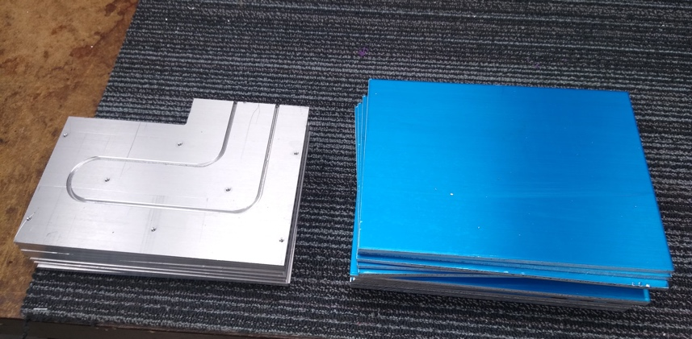
Hardware Progress
All 100 cooling plates for electronics produced at UT-A and LANL
Stave transportation case designed and fabricated at LBNL
Power board assembly and test completed at LBNL
Readout Units and Cooling plates received at ORNL
RU test under preparation
Stave transportation case
@LBNL
Cooling plate production at UT-Austin Machine shop
Stave test station @ LBNL
RU and PU Cooling Plates @UT-A

Slide 7
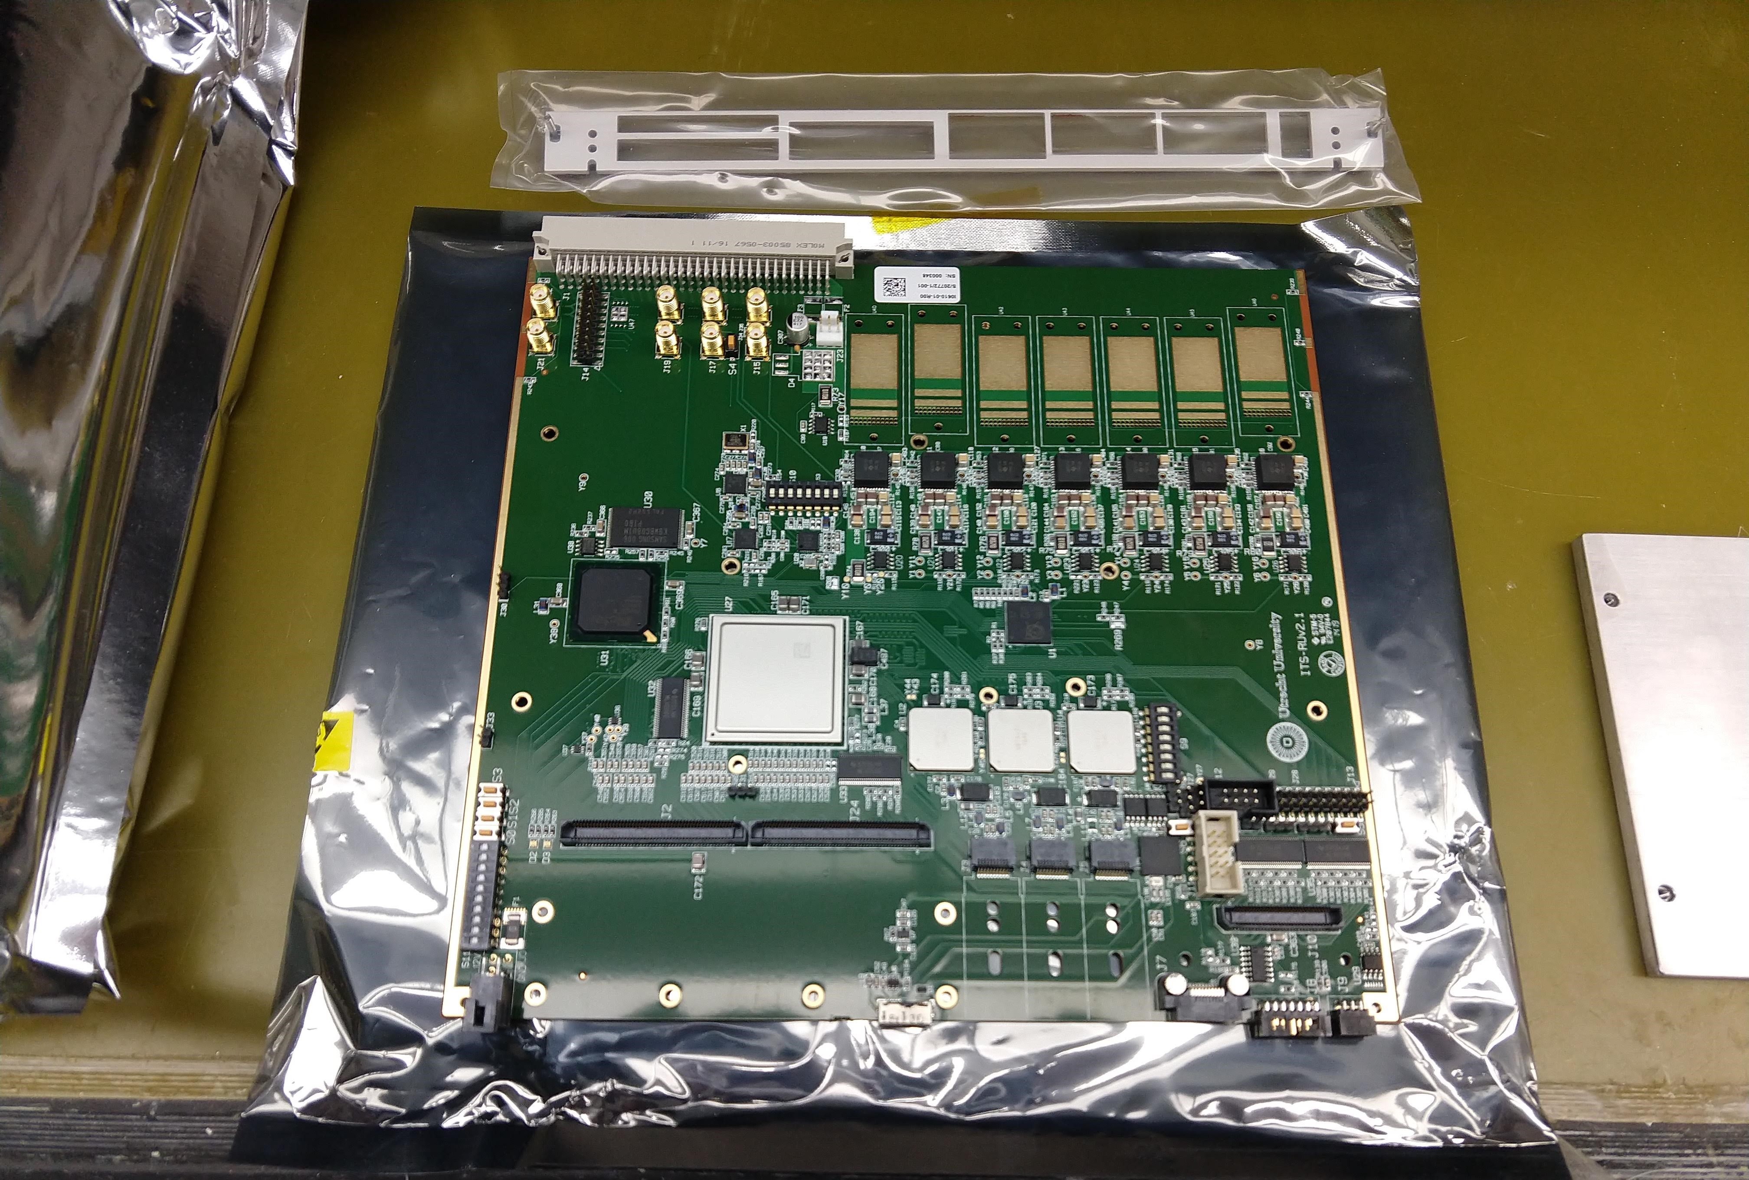
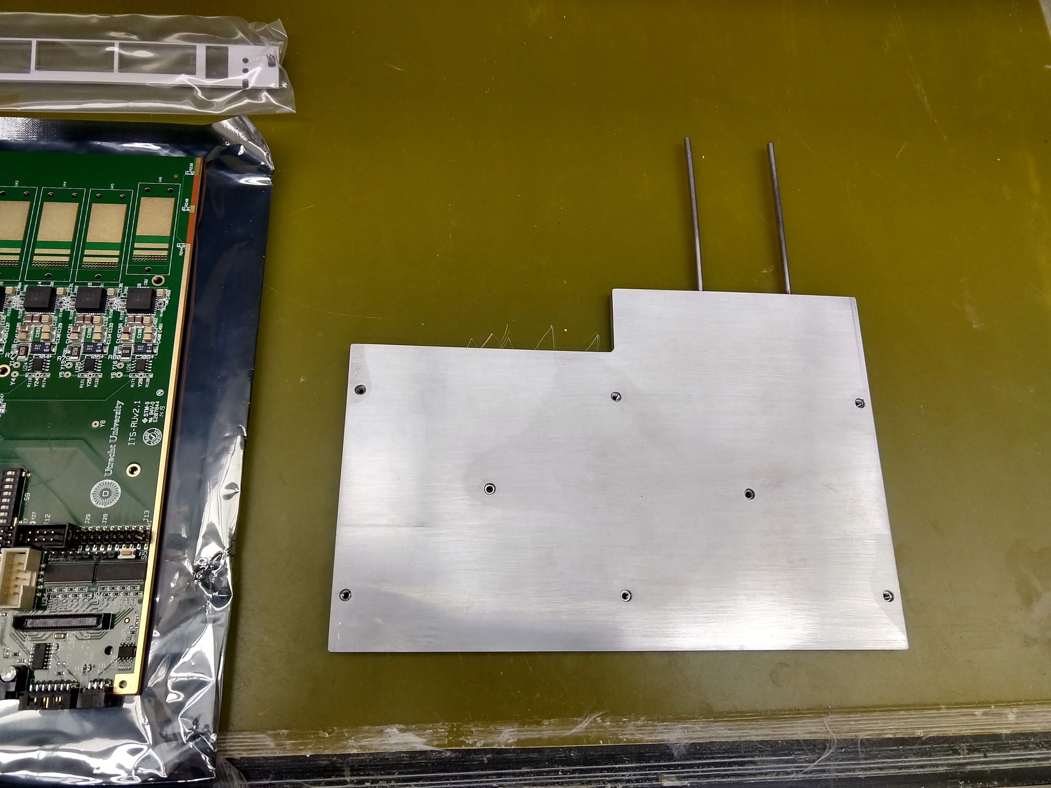
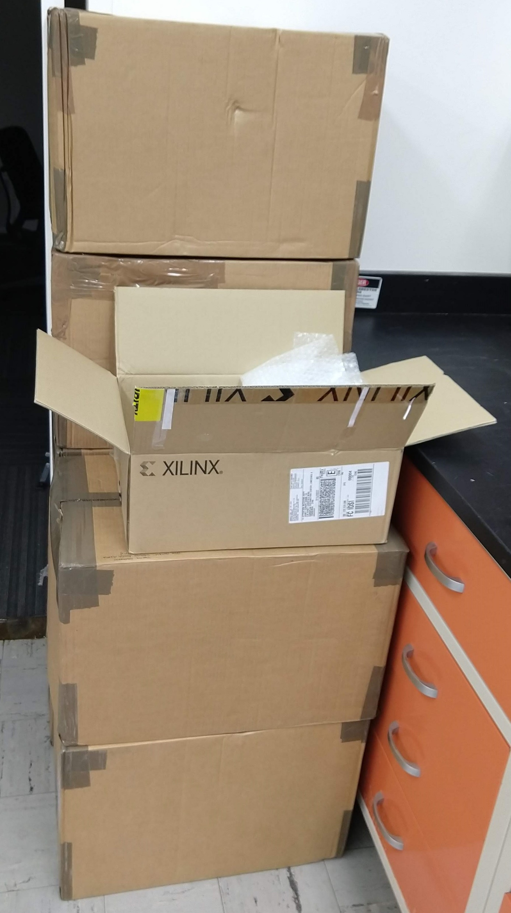
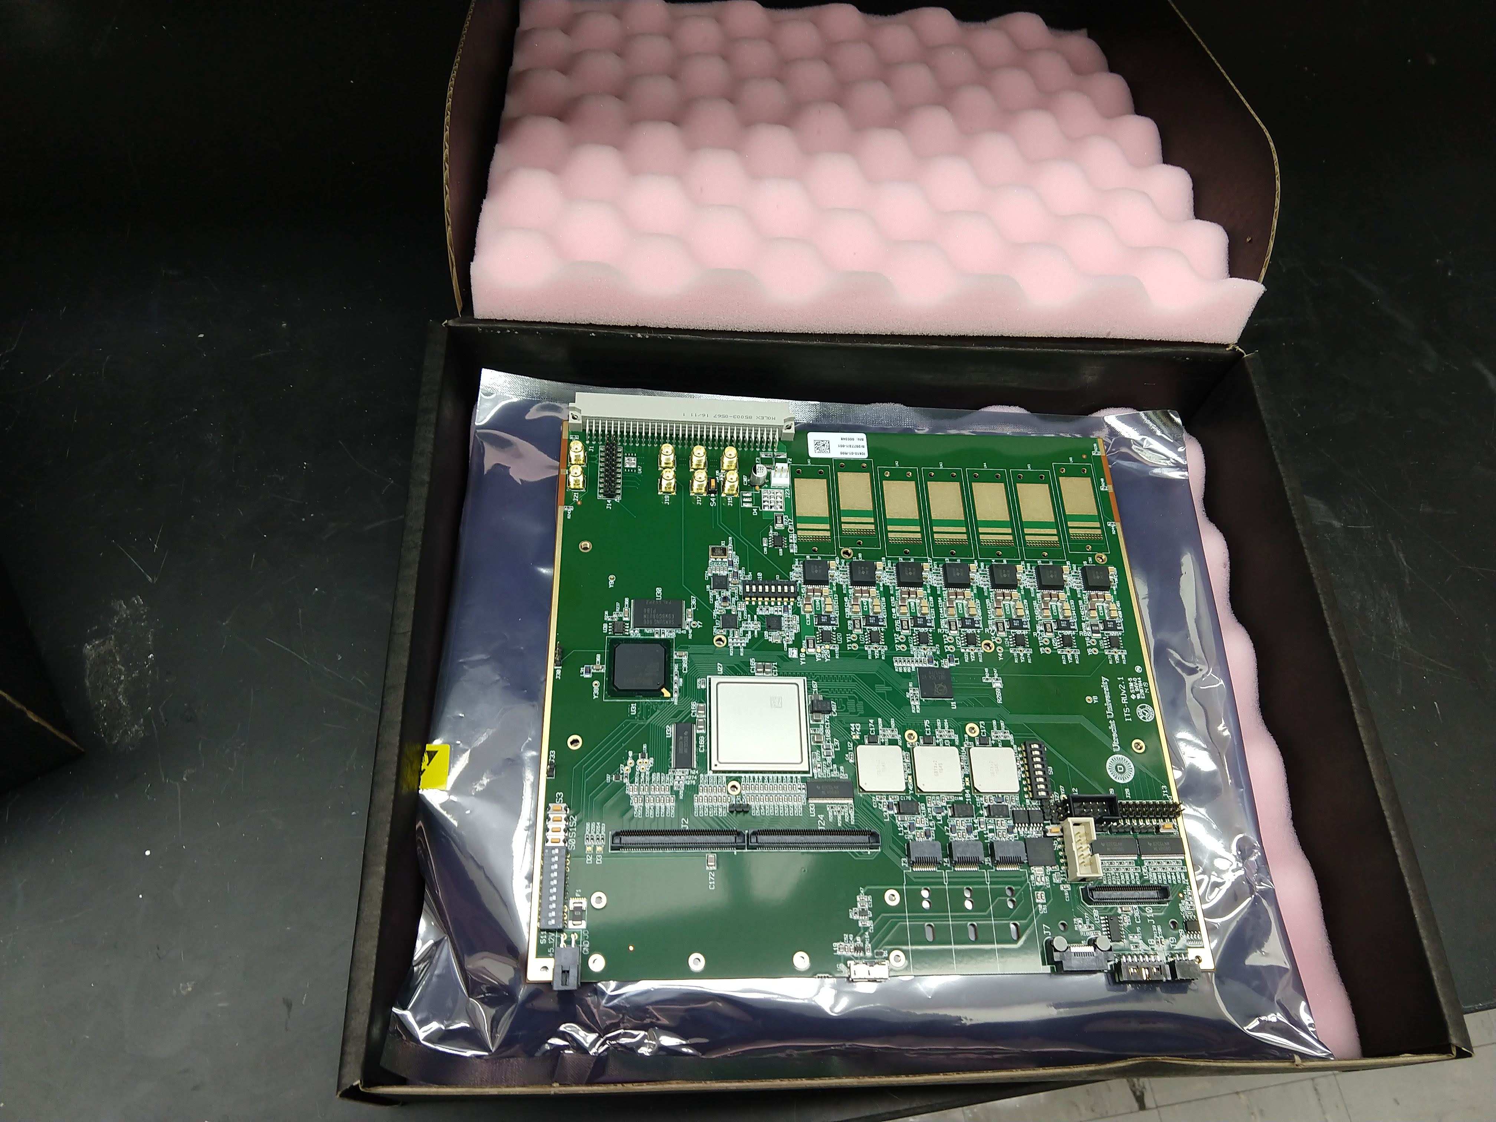
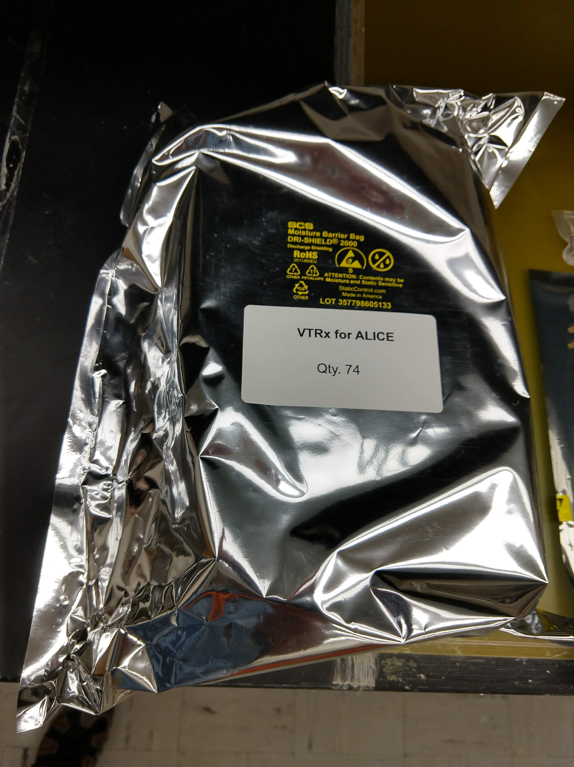
RUs and Cold Plates @ORNL
Cold Plates
Readout Units
60 RU plus VTRx/VTTx at ORNL
VTRx / VTTx

Slide 8
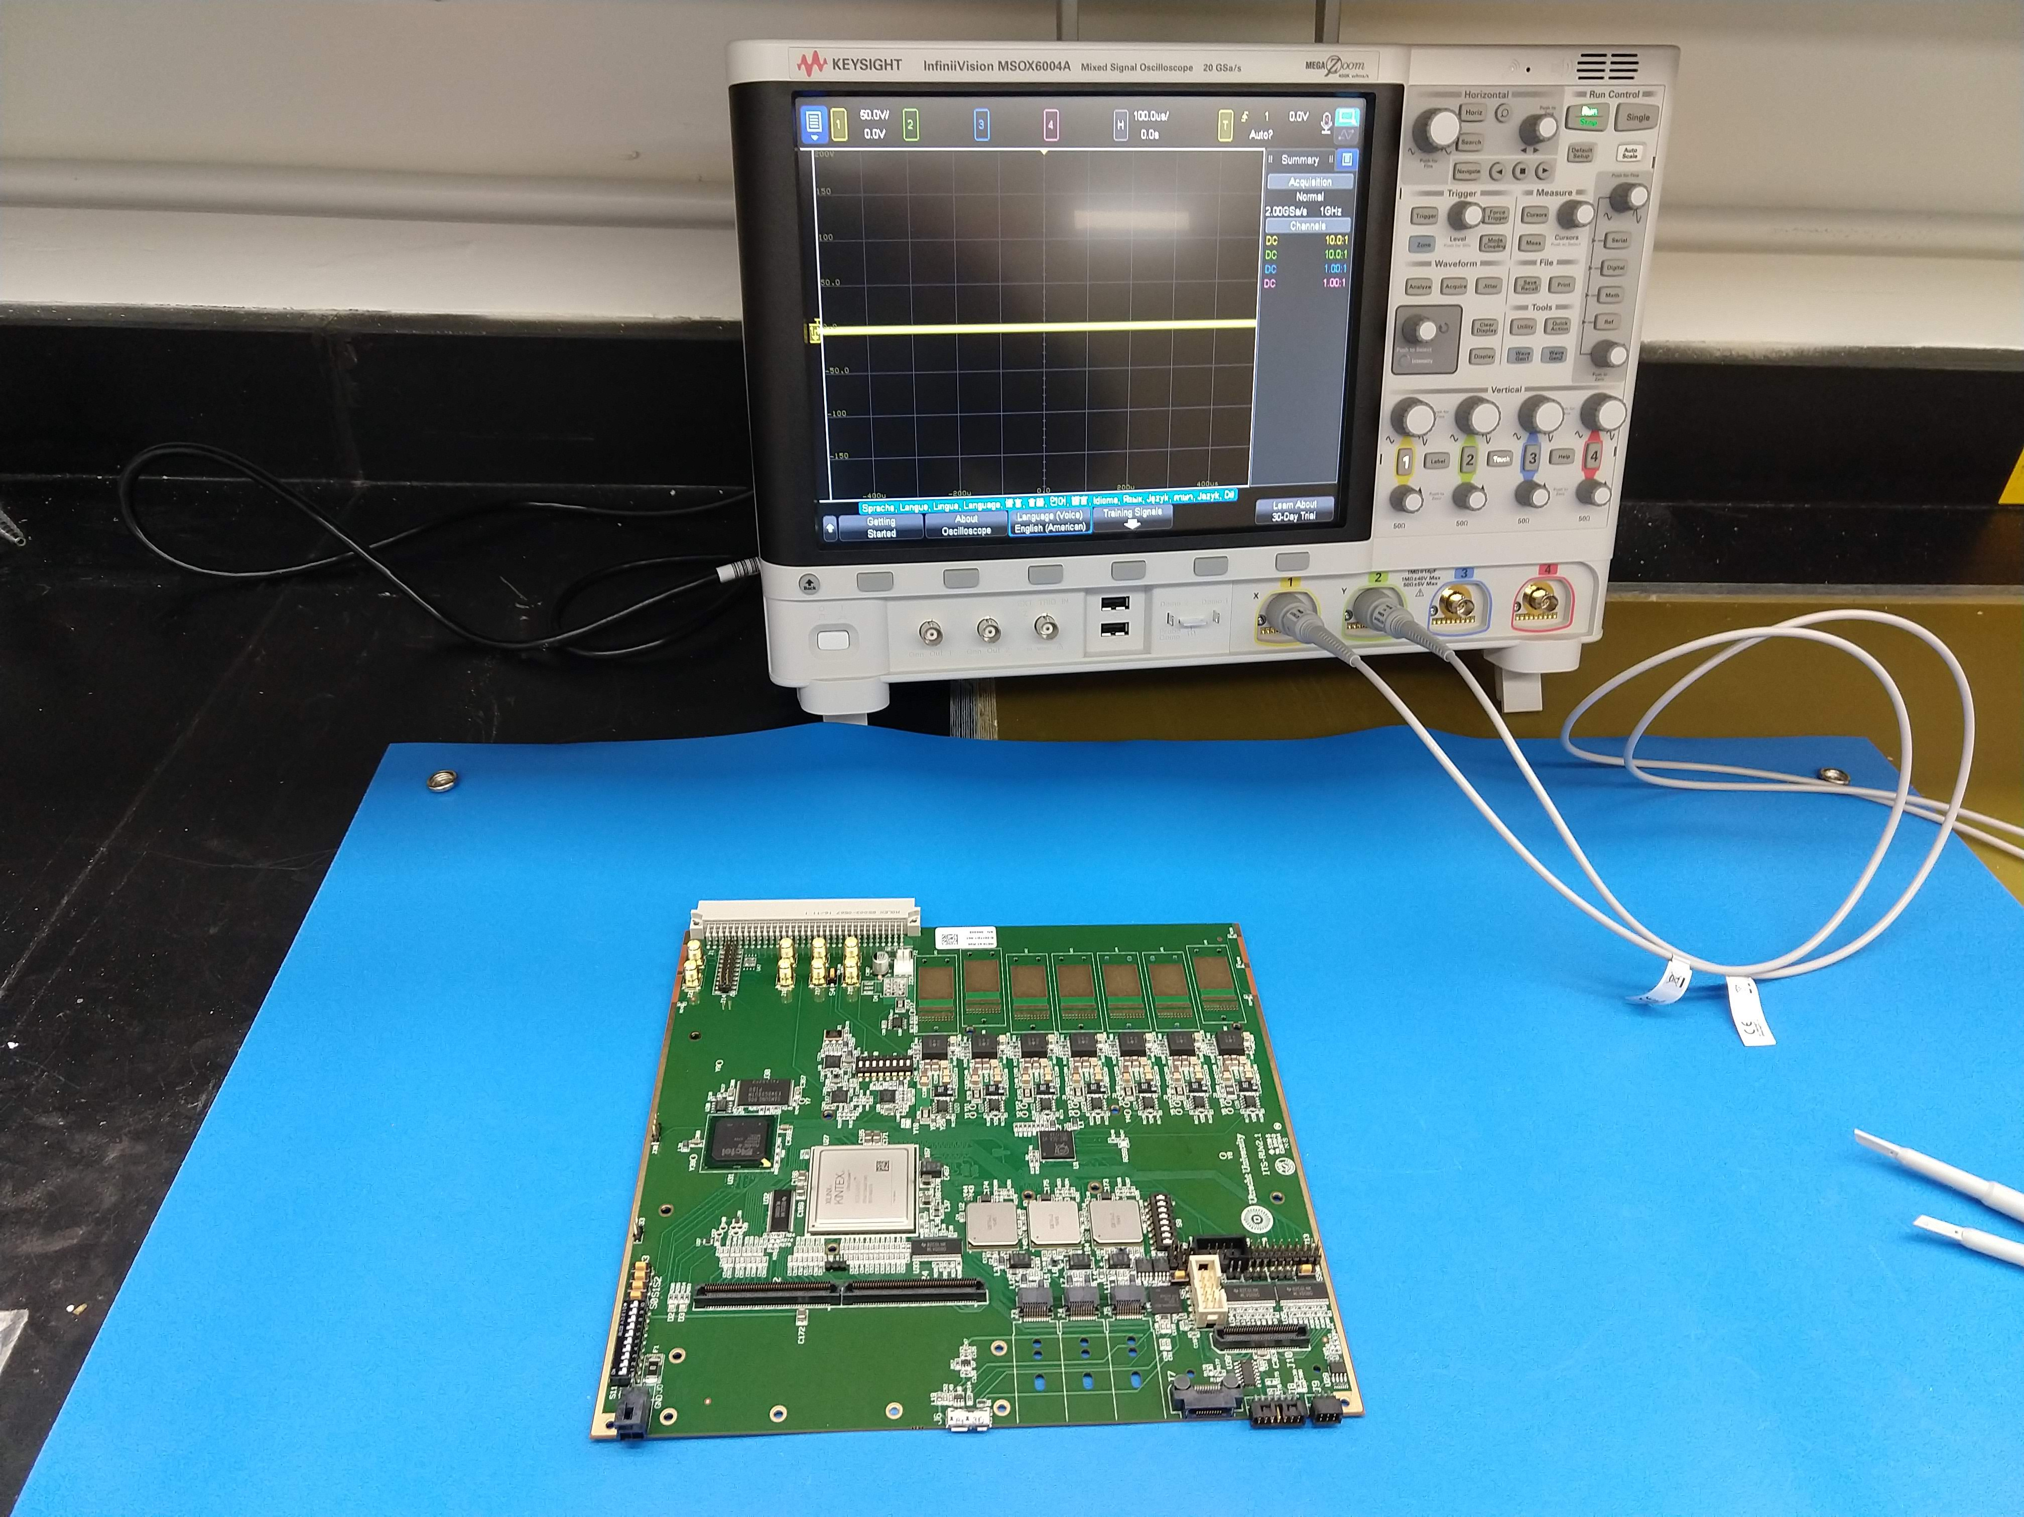

Slide 9
Testing Readiness at ORNL
Received so far:
30 cold plates (from UT)
Mechanical components (from UT)
Thermal Mats (from UT)
CANbus dongle
Various electrical components (resistors, FPGA fans, USB cables, …)
Tools
Scope
Multimeter
Power Supplies
Clock Generator
GBTx programmer
Ordered:
Workstation
FPGA programmers (Xilinx, ProAsic3)
40 additional cold plates (from UT)
Cables (CANbus, power, …)
Loan from Utrecht:
RUv0 with associated cables
Loopback PCBs
Loopback cables
Power Cables
Fiber patch cables

