Slide 1
MVTX Status WBS 3.2
Ming Liu
sPHENIX L2 Meeting
03/05/2020

Slide 2
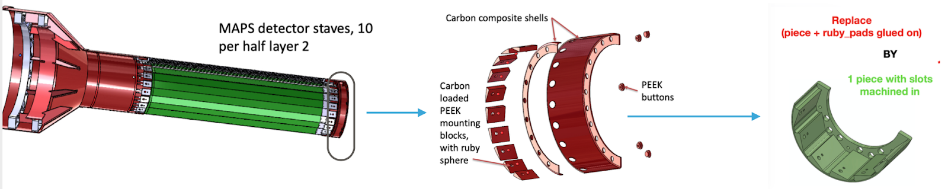
Finalizing MVTX Mechanical Design
Address recommendations from 1/29/2020 FDR
  Added rollers to maintain the correct gap between the detector and the beam-pipe,
  modified one of the patch panels (for an easier access to cooling lines),
  FEA analysis confirmed sagging is small
    attaching the two North end flanges together to further reduce the overall sag of the detector (by ~x2)
  Talking with others (LBL) to decide on a simplified (shorter) vendor selection procedure
  Weekly mechanical design meeting, MIT/LANL, LBNL
Investigating a simplification compared to the ITS design
  Analysis seemed promising, and price with vendors was checked (looks ok so far)
  Internal ‘review’ with CERN (ITS lead engineer) and LBNL engineers, this Friday, 11AM/BNL

Slide 3
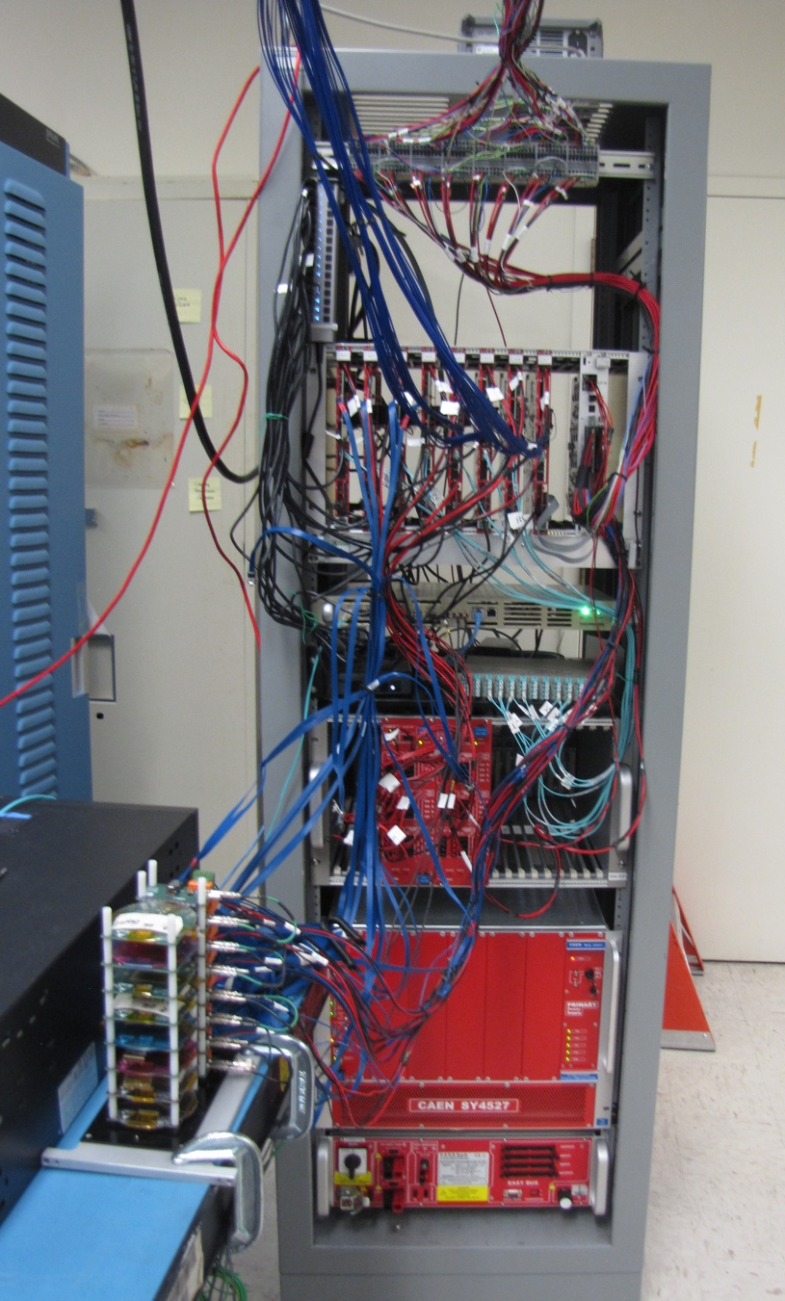
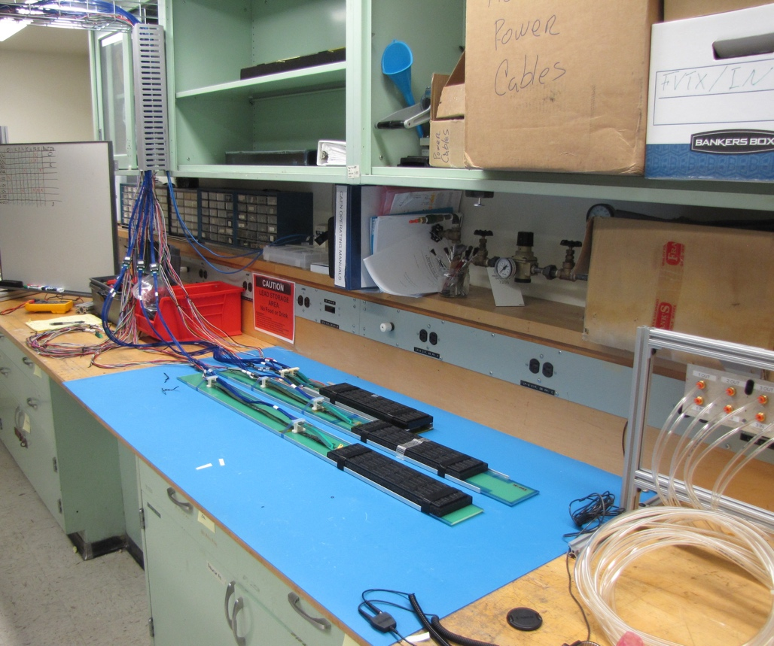
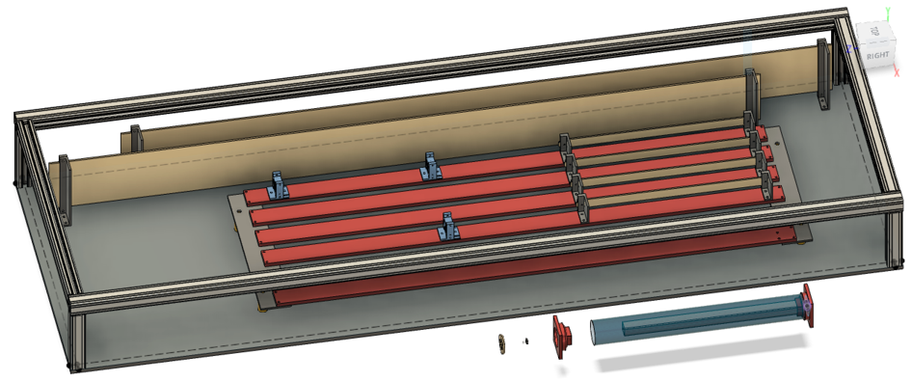
MVTX 8-Stave Telescope Setup
Successfully readout the system
  2-stave + 2-HIC + 4-SingleChip, (4 staves will arrive next week with Alex)
  8-RUs + 1-PU + 1-FELIX + 1-GTM + CAEN PS
  11m long “final” readout cable
  Telescope box designed
Weekly readout meeting
  Firmware & software
Test Beam @Fermilab, 4/22-5/4
8 RUs + PU
4 “final” cables
CAEN PS
MVTX Telescope Box
6-stave + 2-HIC
New cooling
panel for 8-stave
Trigger scope
2 Staves
8-SingleChips
2 HICs

Slide 4
Stave Production at CERN
Replacement of carbon frame cooling tubes starts next week, 3/9
HIC production in progress
  Issues with software upgrade last week
  Rolled back to older version, system is working now
Production meeting with CERN next Thursday,
  Cooling tube work
  HICs & Stave testing
  Shipping ~10 staves to LBNL, late March or early April
Cooling tubes:
55cm -> 70cm

